Slide 1
Doctoral Program Oral Examination – Deployable Hybrid Quantum–Classical Edge Intelligence for Sustainable IoT Security –
Sajib Kumar Mitra

Slide 2
Announcement content
Previous work experience and job responsibilities Research achievements (M.S. thesis, published papers, ongoing survey) Motivation for pursuing doctoral study Research plan

Slide 3
Work experience
B.Sc. in Computer Science & Engineering, University of Dhaka M.S. in Computer Science & Engineering, University of Dhaka (Thesis: efficient reversible logic & quantum circuit design) Joint Director (ICT), Bangladesh Bank (Large-scale secure ICT systems, software engineering, audit support) Full-time availability for funded 3–4 year doctoral study

Slide 4
Business content
ICT systems engineering & security R&D

Slide 5
Responsibilities
Secure ICT architecture and software engineering leadership Research on quantum computing, reversible logic, and IoT security analytics Cross-functional coordination for national-scale financial ICT systems

Slide 6
Research achievements
Research spans quantum computing, reversible logic, hybrid IoT security, and embedded AI—with publications in IEEE/ACM venues and an ongoing systematic IoT–Quantum AI survey (co-investigator).
 | academic journal | Study group Symposium | tournament | Registered Patent
Reversible / quantum logic design | — | IEEE conf. | 3+ | —
Quantum circuits & optimization | — | IEEE / ACM | 2+ | —
IoT–Quantum AI survey (ongoing) | Survey | — | 1 | —
Hybrid edge QML (doctoral target) | Target | IEEE IoT J., FGCS | — | —
total (selected) | 1 | 5+ | — | —
Past initiatives that seem highly compatible with current responsibilities
* Counts reflect selected IEEE/ACM and survey outputs.

Slide 7
[ Reference ] Ongoing survey — Quantum AI-powered IoT
( Survey manuscript )
- Pre-calculate the file identifier and hash value and store them within the boot image.
- After image deployment, the files are verified using hash values to prevent tampered bootables.
( PRISMA corpus n=57: 42 IoT + 15 enabling refs. )
- Users verify the code using a simple verification device.
- Detects screen spoofing without relying on a dedicated UI or confidential information.

Slide 8
[ Reference ] Past presentations (M.S. thesis, published papers)
( M.S. thesis, University of Dhaka )
• Published in IEEE and ACM conference proceedings
( Ongoing: IoT–Quantum AI survey with PRISMA corpus )
( IEEE / ACM conferences )
• Efficient reversible logic & quantum circuit optimization • Low-power arithmetic datapaths for embedded quantum-classical co-processors

Slide 9
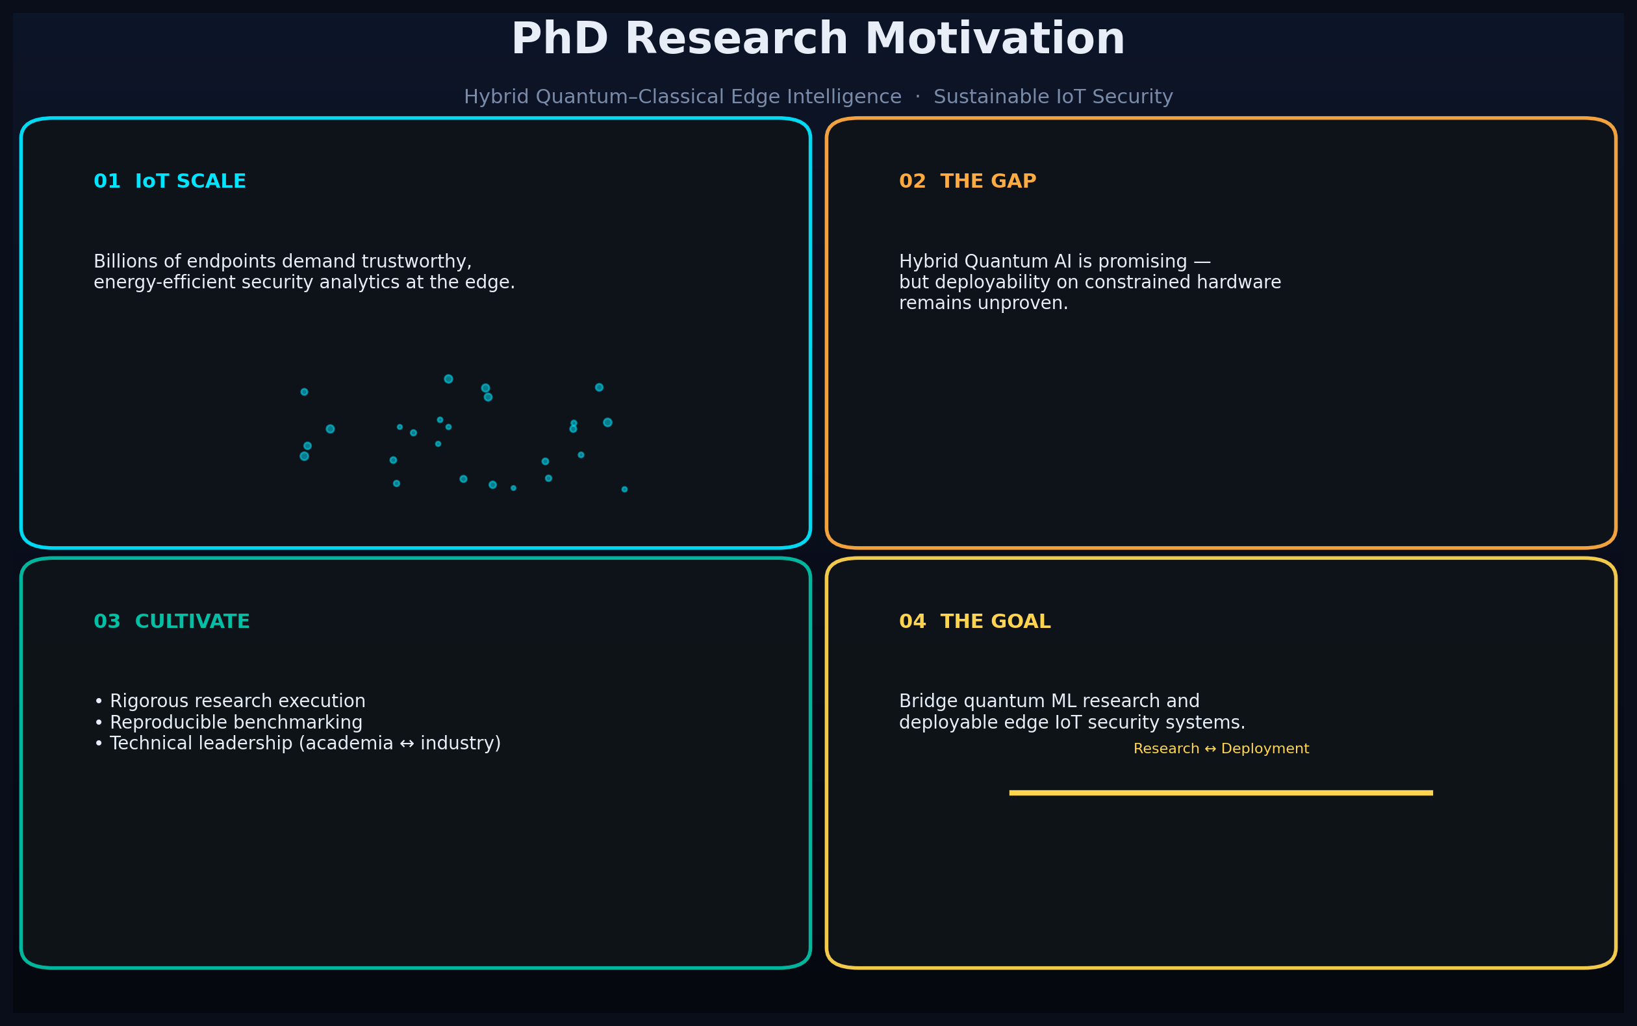
Motivation for pursuing higher education
To lead security & embedded-AI R&D at the intersection of quantum computing and IoT … Doctoral study will solidify expertise in deployable hybrid edge intelligence. Cultivation goals: • Research execution ability on hardware-aware QML pipelines • Technical leadership bridging academic research and national-scale ICT practice • Bridge academic survey insights and reproducible edge prototypes

Slide 10
Research plan
Deployable Hybrid Quantum–Classical Edge Intelligence for Sustainable IoT Security and Anomaly Detection

Slide 11
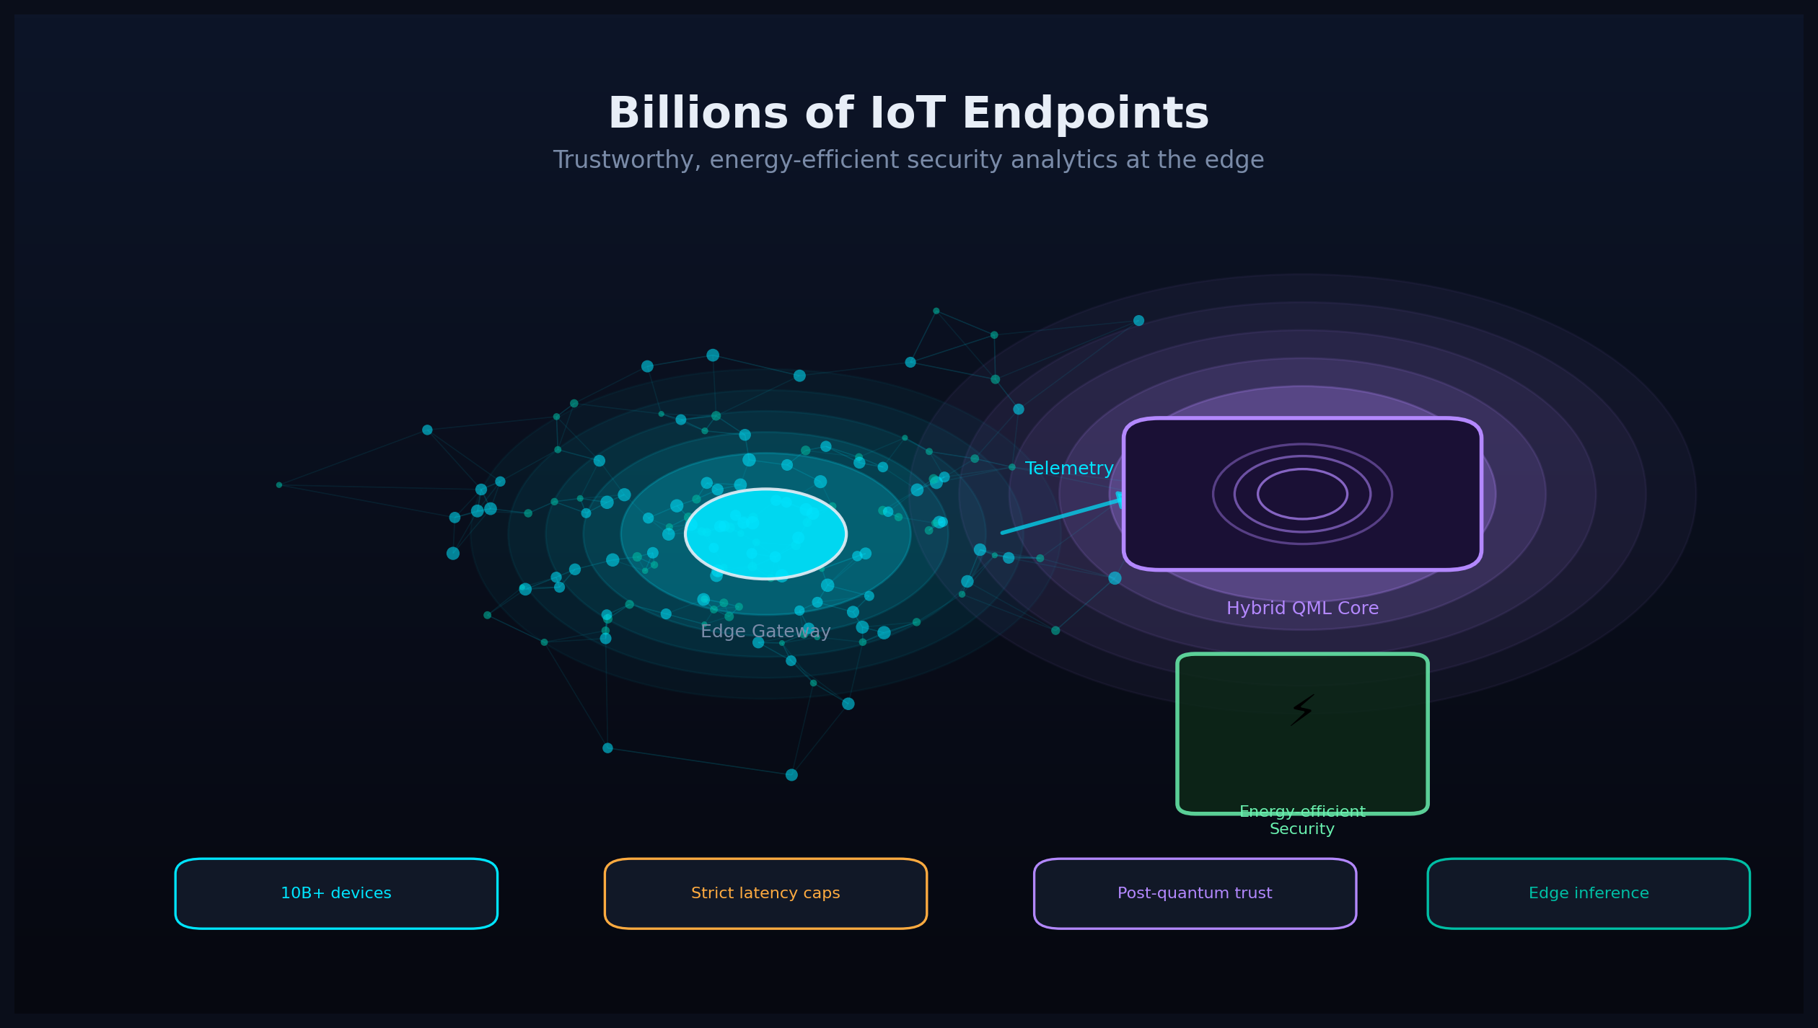












Background
IoT Trends
Quantum AI for IoT Security
Research Trends
Edge AI reduces backhaul and improves responsiveness; adversarial analytics motivate selective Quantum AI in hybrid pipelines.
Billions of IoT endpoints generate continuous telemetry under strict energy, latency, and trust constraints.
Sustainable IoT security analytics must co-design accuracy, circuit depth, and deployability.
TinyML
CPU
VQC / Q-kernel
PennyLane
...
Rapid QML progress for IoT
2020–2026
QML toolchains (PennyLane, Qiskit) enable hybrid quantum–classical learning pipelines.
...
IEEE / ACM IoT & QCE venues show accelerating hybrid QML research.
Hybrid Quantum–Classical Edge Intelligence targets train-on-cloud/simulator, infer-on-edge pipelines.

Slide 12


Research area
Hybrid QML (Edge Intelligence)
IoT Security (Anomaly Detection)
User
Service providers and data providers, etc.
Diverse
Attacker
Edge deployment paths remain the critical gap.
Attacker
Compressed VQC inference
Using hybrid QML pipelines on constrained edge hardware
Sensitive data
Sensor nodes
Streaming IoT features
Circuit depth, qubit budget, latency & energy caps
Edge gateway
FPGA accelerator
Benchmark harness
Cloud Service
(Azure, AWS, GCP…)
Hypervisor
OS
CPU
CPU
CPU
GPU​
Firmware
Sign
User
ARM IoT gateway
Zynq / Artix-class
Training phase (Qiskit / PennyLane)
CPU
Trains on simulator/cloud; deploys compressed inference on a single embedded platform.
Trusted
Qiskit, PennyLane, FPGA offload
Local anomaly scoring with compressed quantum–classical models
Edge platform operators

Slide 13
Research objectives and challenges
To deliver deployable hybrid edge intelligence, we address four research gaps in IoT QML:
User
Sensor nodes
Sign
Cloud
Service
Edge gateway
FPGA accelerator
verification
the purpose
Sign
correct answer
Gap 1
Doctoral aim: sustainable IoT anomaly detection under fixed power and latency budgets.
Gap 1: Cloud-centric training — VQCs sized for QPUs, not microcontroller/FPGA budgets.
Nurse
Nurse
Move OS
Move OS
Hypervisor
Hypervisor
Gaps 2–4
OS
OS
To deliver deployable hybrid edge intelligence, we address four research gaps in IoT QML:
Firmware
Firmware
RoT
CPU
GPU​
CPU
RoT
Zynq / Artix-class
ARM IoT gateway

Slide 14
Related research
Prior QML for IoT anomaly detection (Chowdhury et al., AIMLSystems 2025) → Competitive accuracy but substantial simulator-era overhead Projected quantum kernels for IoT (D'Amore et al., PICom 2024) → Cloud-centric; limited edge deployability evidence Candidate's four-paradigm IoT survey (Babu & Mitra) → PRISMA corpus n=57; unified benchmarks; TRL roadmap Embedded QML feasibility study (Dey & Raza, 2026) → Hybrid architectures promising; deployment evidence still sparse
Survey gap: Cloud-centric QML
RQ2–RQ3: Which compression strategies minimise resource use? Does FPGA offload improve joules-per-inference vs. ARM gateways?
Doctoral focus: Edge deployability
RQ1: Under fixed power P and latency T, can hybrid inference match classical edge accuracy within tolerance ε?

Slide 15

Approach
Design and implement a hardware-aware hybrid pipeline: simulator/cloud training, compressed edge inference, unified benchmarking.
IoT security analytics require co-design of ML models, quantum circuits, and embedded platforms.
Two-phase pipeline: train on simulator/cloud, compress, and infer on edge.
Qubit-depth constraints
Hybrid Edge QML
Empirical guidance on when hybrid Quantum AI outperforms classical edge AI.
Compression & export
F1 / AUC / Latency / Energy
FPGA offload
Benchmark harness
Remote Attestation
FPGA accelerator
Remote Attestation
Training phase (Qiskit / PennyLane)
Benchmark harness
• Public datasets • Power metering
Training phase (Qiskit / PennyLane)

Slide 16
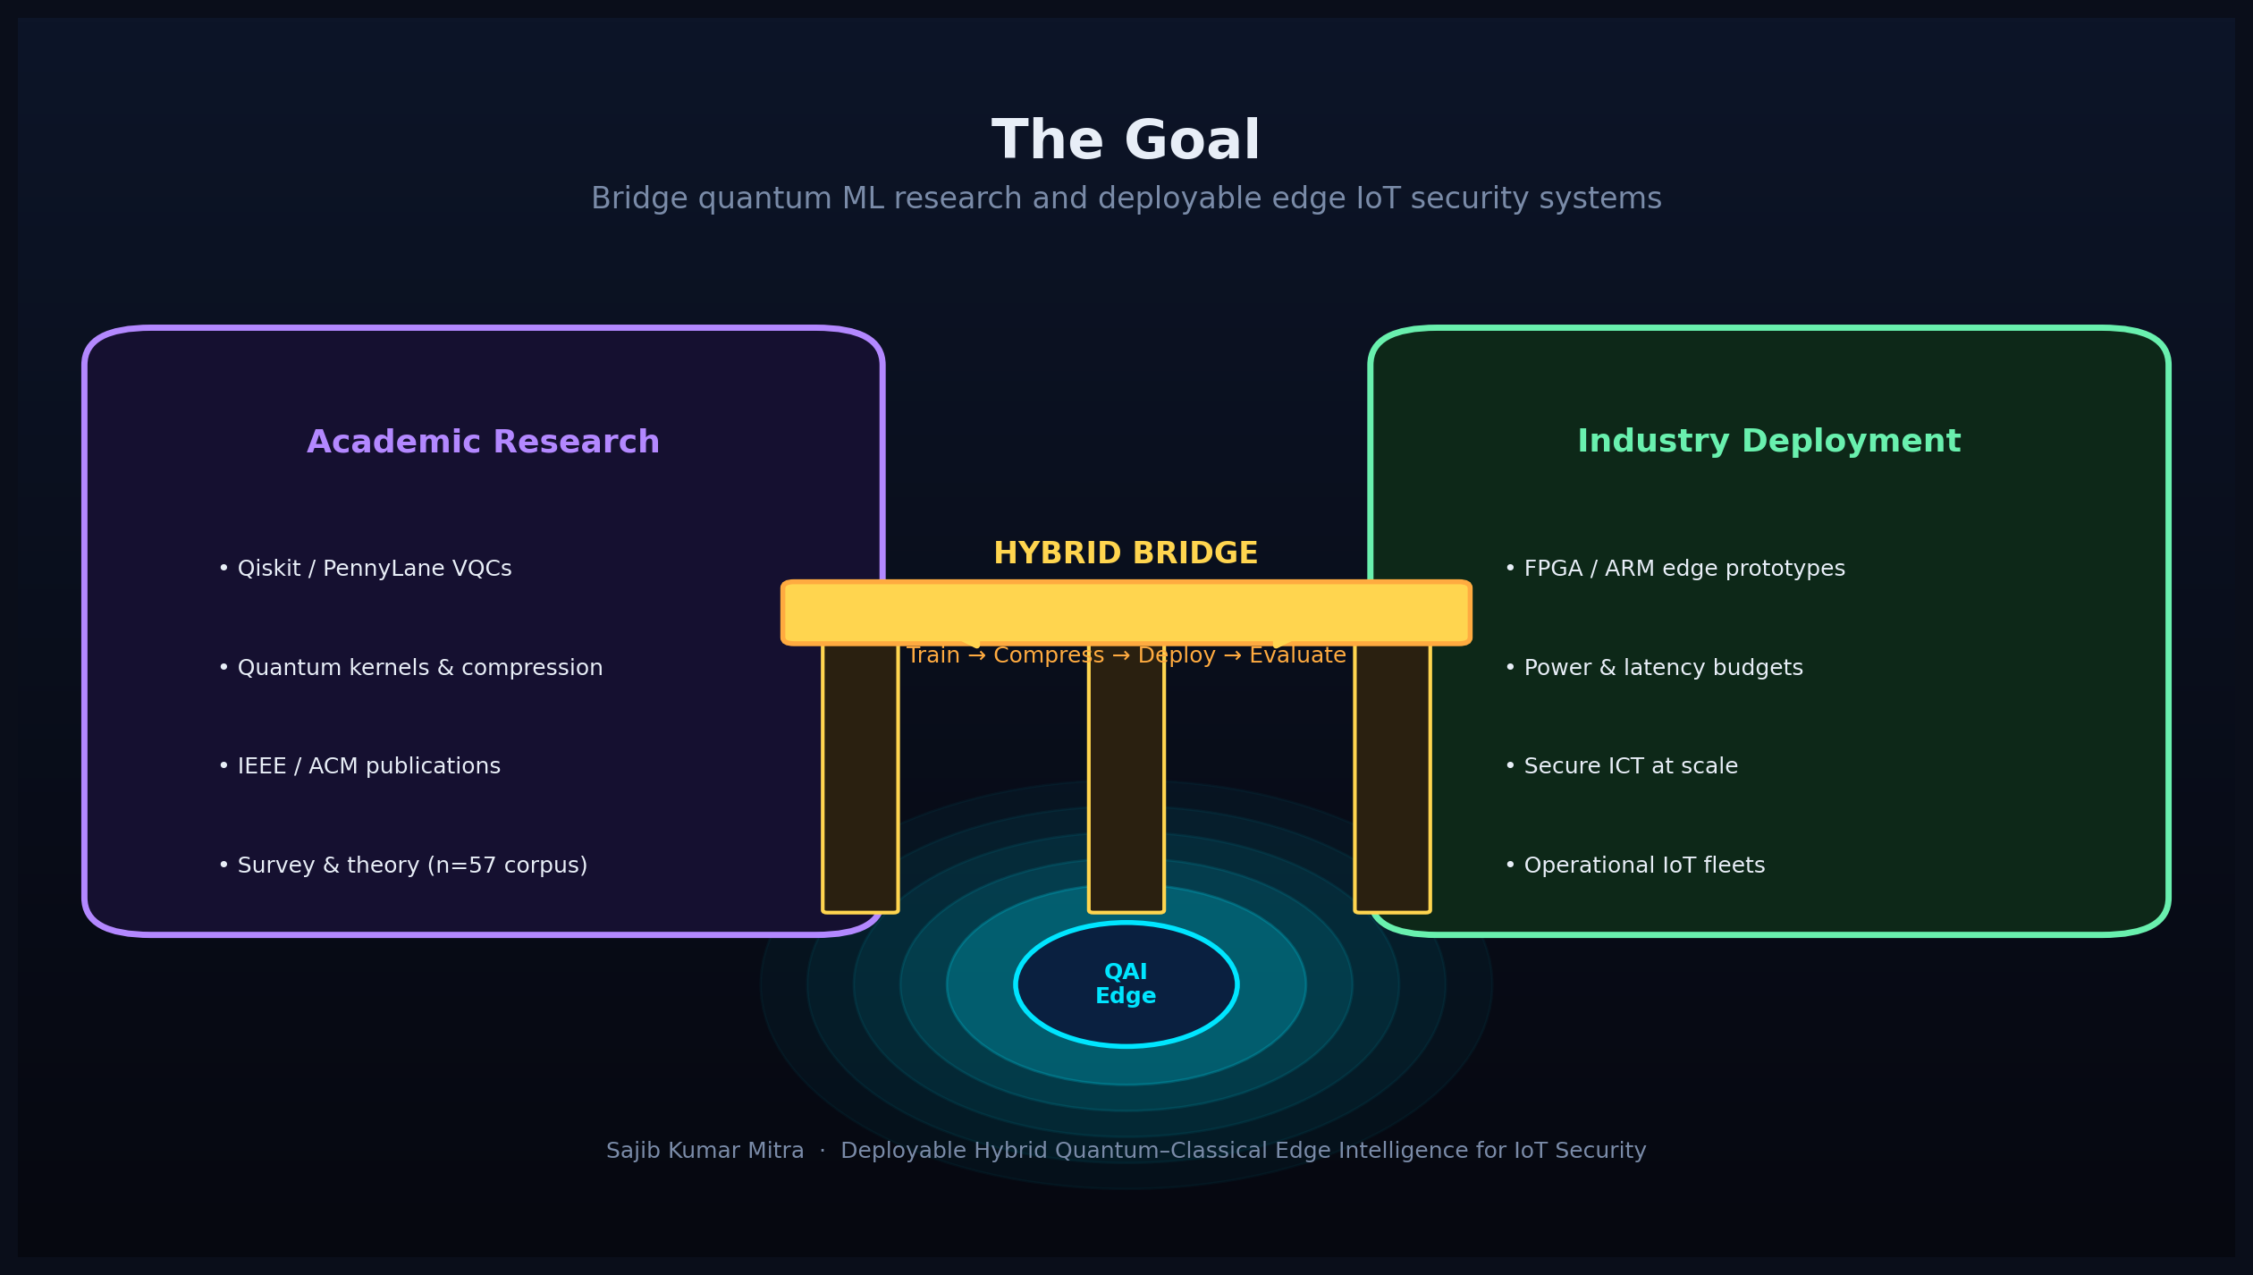
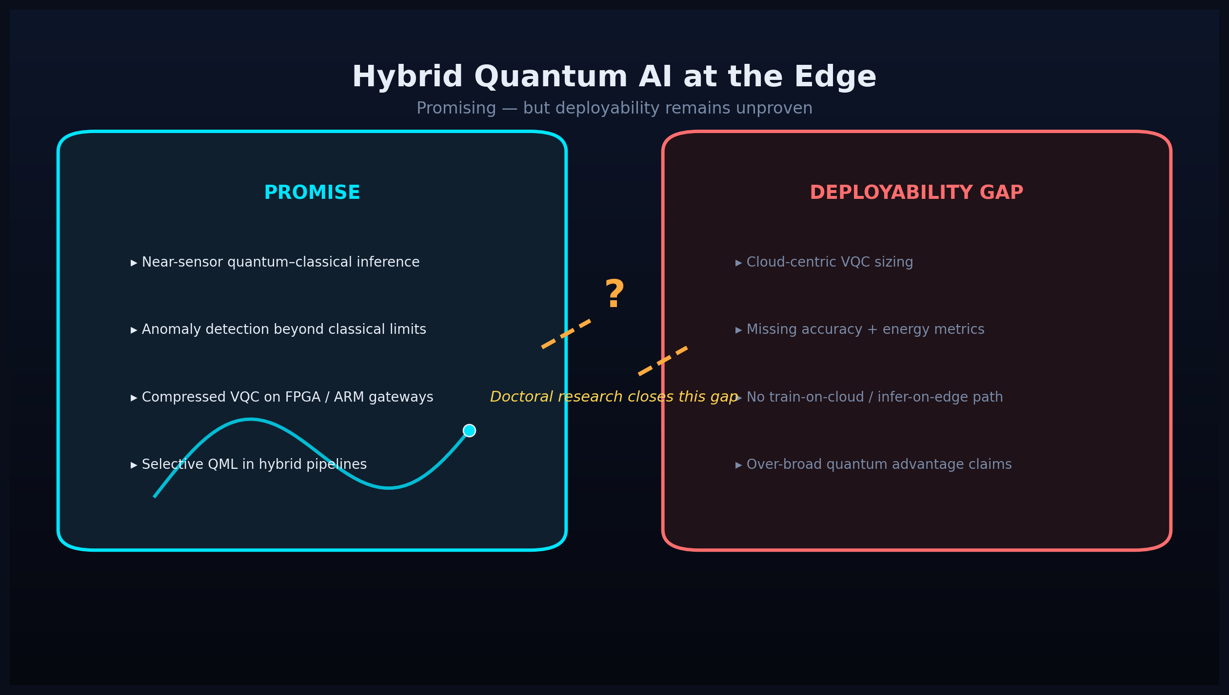
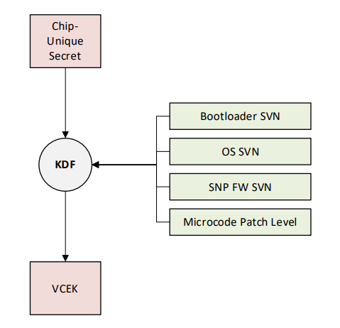
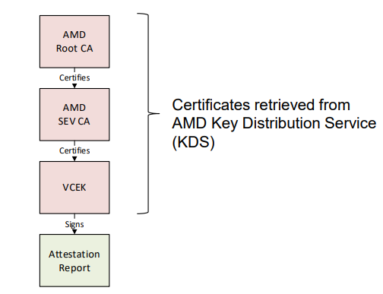
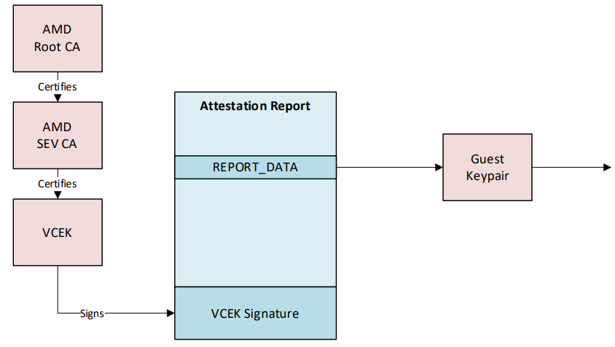
[ Reference ] Hybrid edge architecture (proposed)

Slide 17
A. Benchmark protocol & requirements (Year 1)
• PRISMA-inspired literature update; dataset selection (NSL-KDD, Edge-IIoTset, Bot-IoT) • Reproducible evaluation harness: accuracy, latency, algorithmic complexity, energy proxy • Classical edge baselines (lightweight CNN / autoencoder) under fixed budgets • Stakeholders: supervisor, FPGA lab, IoT testbed operators, open-source QML community
Stakeholders: supervisor, FPGA lab, IoT testbed operators, open-source QML community
Use cases: smart-building gateway IDS, industrial IoT anomaly detection, post-discharge RPM IoMT

Slide 18
B. Hybrid model development & hardware integration (Years 2–3)
• VQC / quantum-kernel design with noise-aware training and qubit-depth constraints • Compression strategies: depth reduction, angle encoding, quantum-inspired surrogates • FPGA SoC (Zynq/Artix) or ARM gateway integration; power & thermal measurement • Head-to-head evaluation vs. classical TinyML and cloud-hybrid QML (RQ1–RQ3)

Slide 19
Announcement plan (48 months)
Iterative loop: benchmark → hybrid model → FPGA prototype → thesis
 | 2024 |  | 2024 |  | 2025 |  |  |  | 2026 |  |  |  | 2027
 | First half |  | Second half |  | First half |  | Second half |  | First half |  | Second half |  | First half
dissertation writing
Task 1 the TEE usage environment.
Task 2 Advanced CC
Domestic Conference
Submission / Announcement
International conference
Preparation/Presentation
Preparing for/presenting at an international conference
journal submission/presentation
Iterative loop: benchmark → hybrid model → FPGA prototype → thesis
(Issues raised)
Distributed Attestation Proposal​
Attestation proposal for confidential information
Detailed feasibility assessment
and safety verification
Iterative loop: benchmark → hybrid model → FPGA prototype → thesis
A. Trust Model Consideration
B. RA improvement proposal
Evaluation/Verification
Evaluation/Verification
Systematization
A. Security Model Consideration
B. Proposal for RA extension
Evaluation/Verification
▲Start
Completion ( expected ) ▲

Slide 20
In conclusion (Aspirations)
Regarding hybrid Quantum AI for IoT security, I will co-design quantum circuits, classical ML, and embedded platforms under real energy and latency constraints. As a security researcher, I aim to deepen expertise in deployable edge intelligence and bridge academic research with national-scale ICT practice. Ultimate goal: provide trustworthy, energy-efficient IoT security analytics and contribute to a convenient and safe intelligent society.

Slide 21
Supplementary slides follow Survey highlights · Four paradigms · Benchmark alignment · TRL roadmap

Slide 22
[ Reference ] Survey workflow — PRISMA corpus
PRISMA-inspired reduction: 229 records → 42 IoT-focused studies (+ 15 enabling refs.) Multi-database search: OpenAlex, Scopus, PubMed, WoS Tools: PyBibX, bibliometrix, VOSviewer

Slide 23
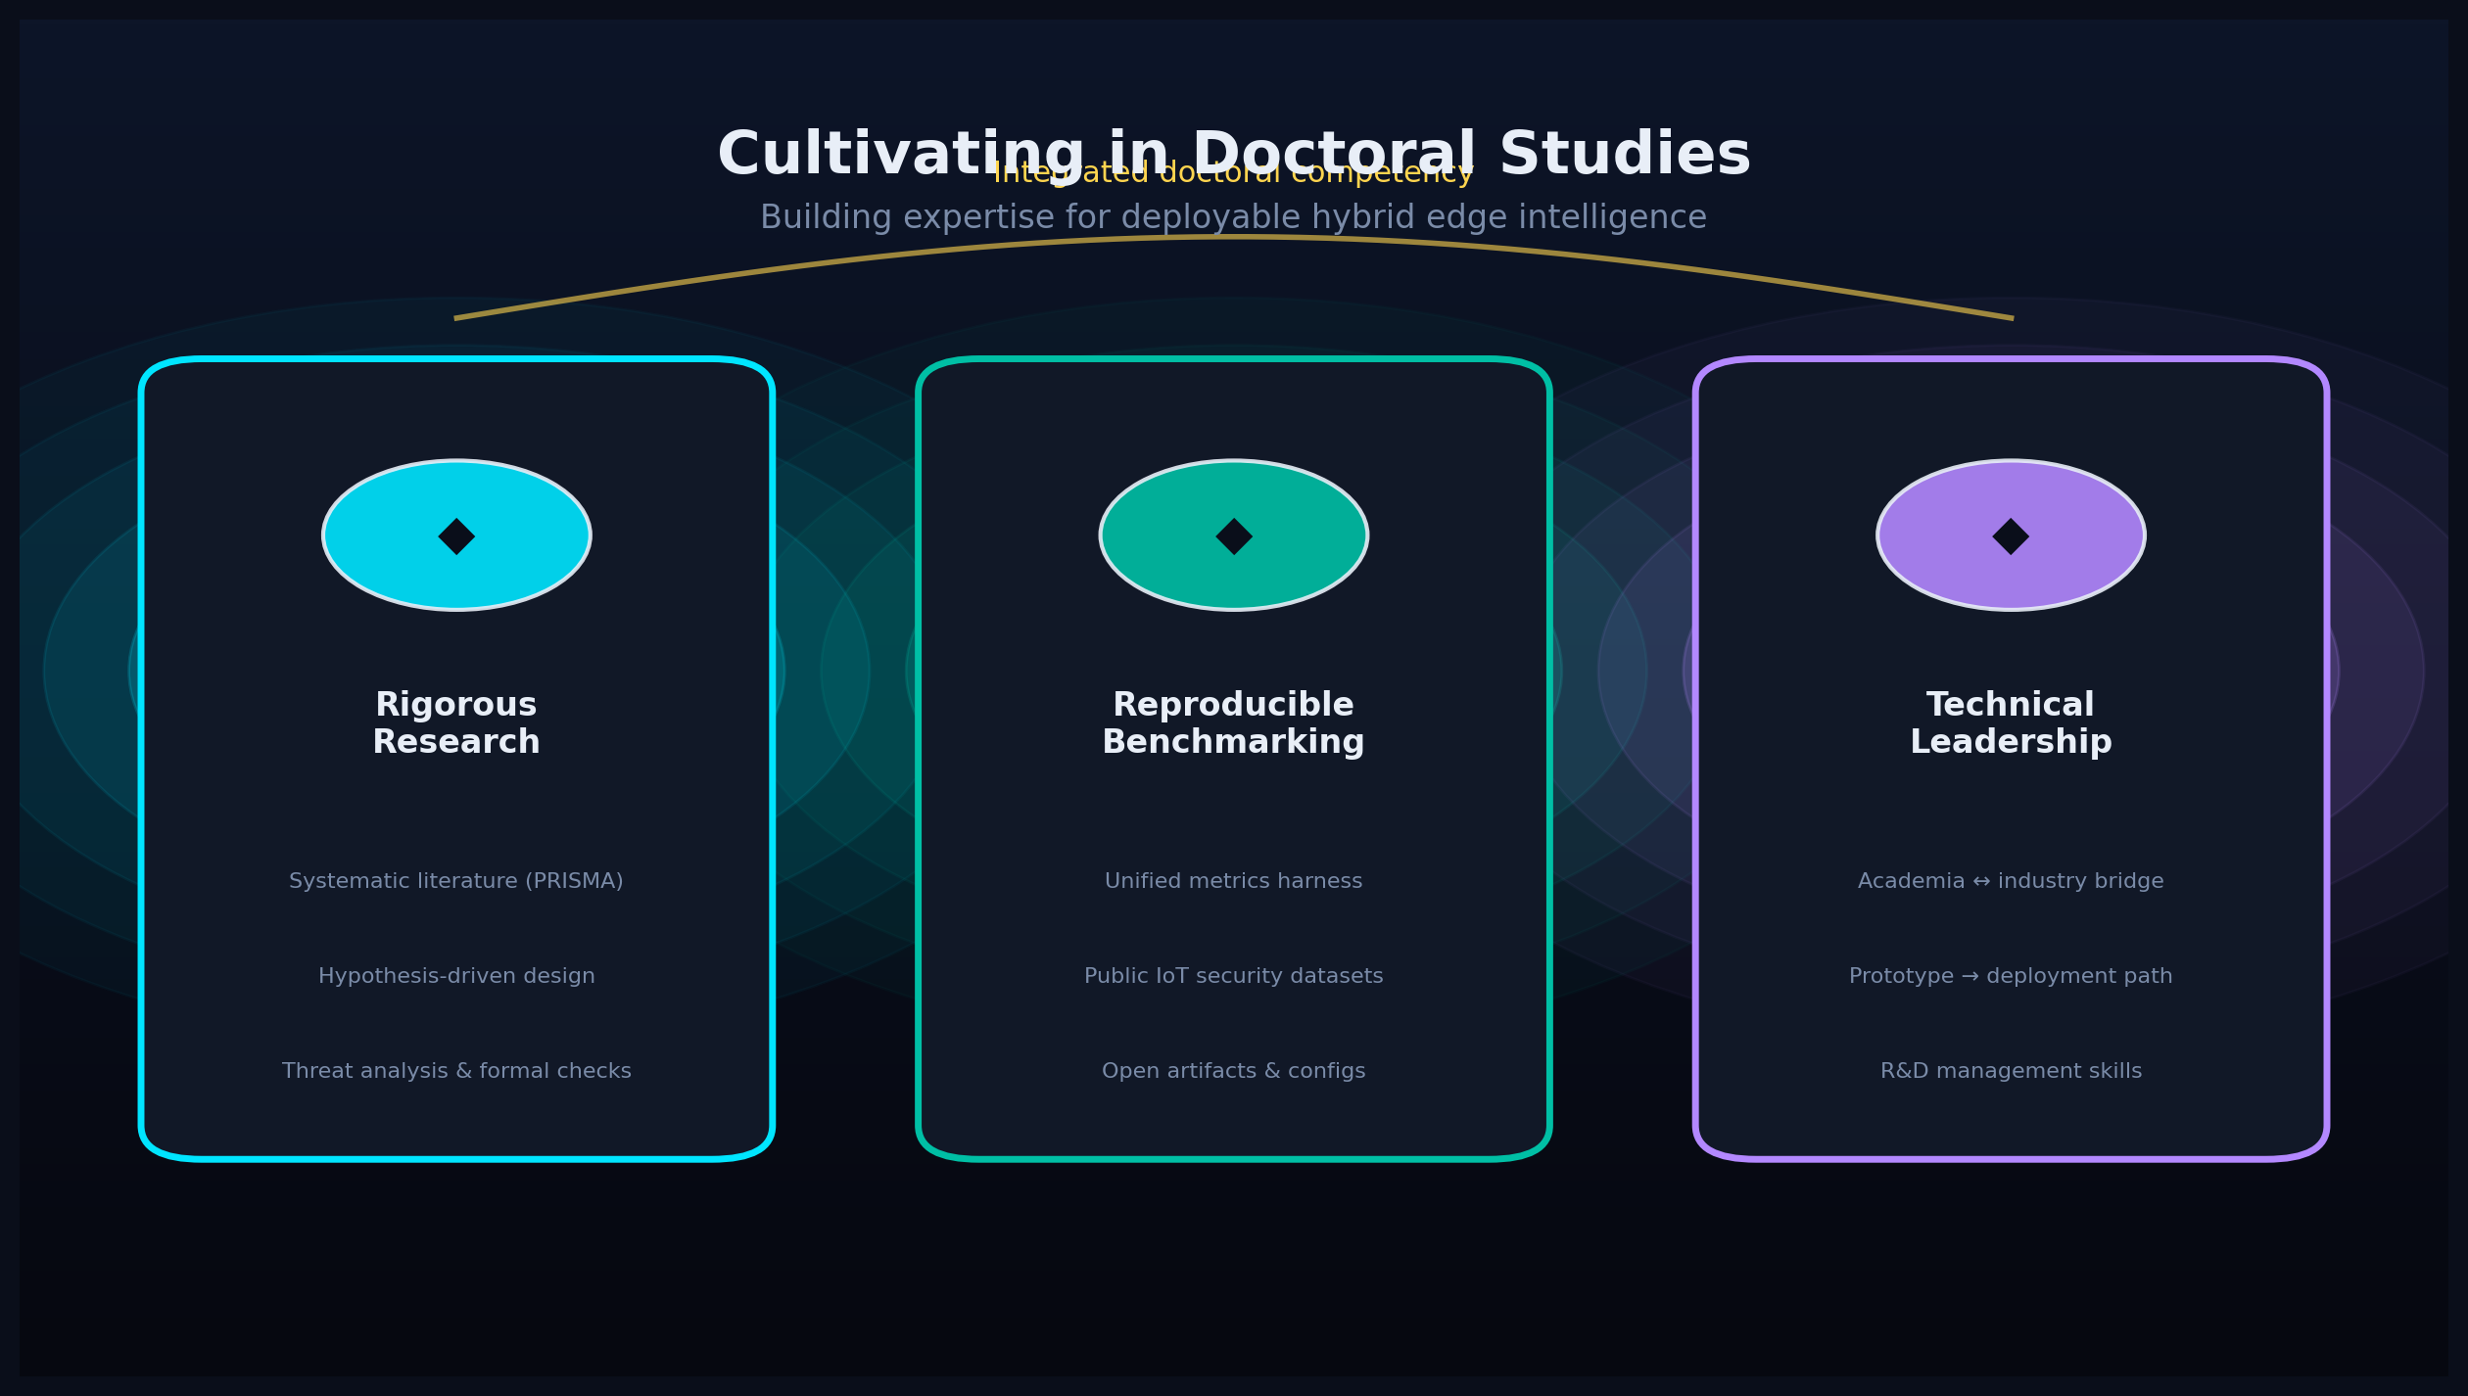
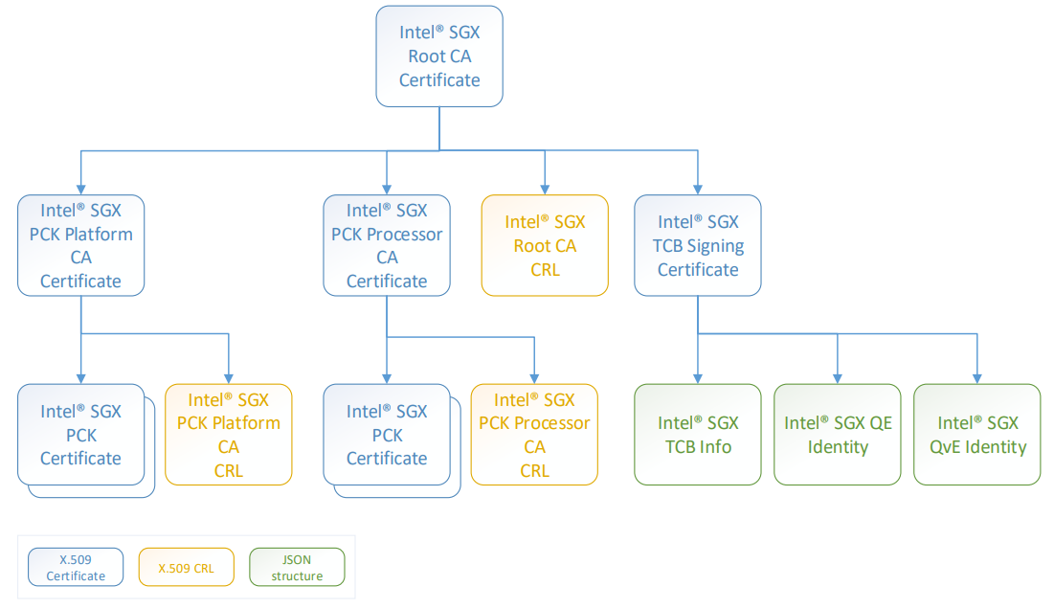
[ Reference ] Four-paradigm IoT taxonomy
Conventional IoT (C:17) | AI-based IoT (AI:15) Quantum-enhanced (Q:4) | Quantum AI IoT (QAI:6) Comparison functional J(𝒲) for paradigm selection under deployability constraints

Slide 24
[ Reference ] Case studies from current survey
Primary: Smart-building IoT security gateway (hybrid edge IDS) Secondary: Post-discharge RPM IoMT with innovative Hybrid Reference Architecture Policy-routed deployment paths α, β, γ for zero-trust hybrid edge

Slide 25
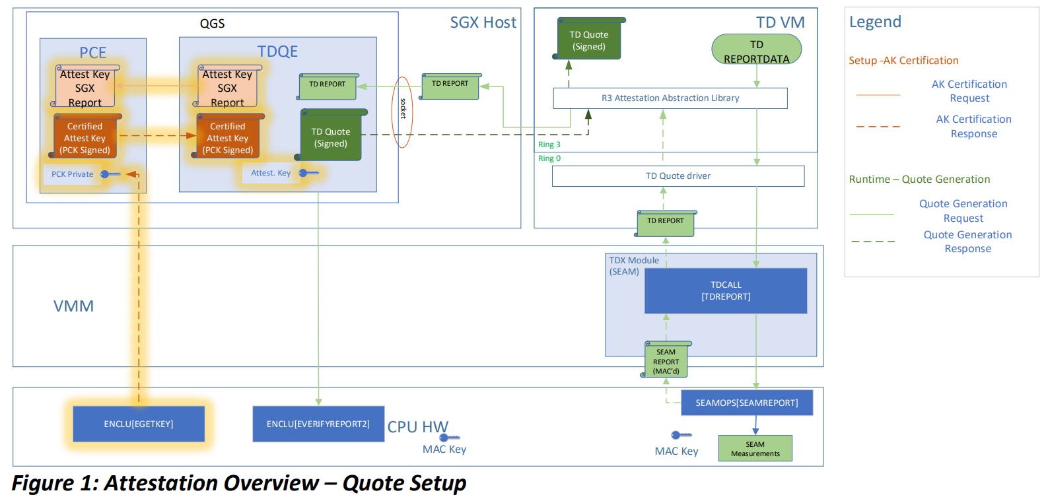
[ Reference ] Benchmark metrics alignment
Six-panel performance simulation: latency, complexity, resource proxies, F1/AUC Addresses documented gap—accuracy rarely reported jointly with circuit depth and energy Formal propositions: qubit budgets, shot-noise, latency decomposition, memory crossover

Slide 26
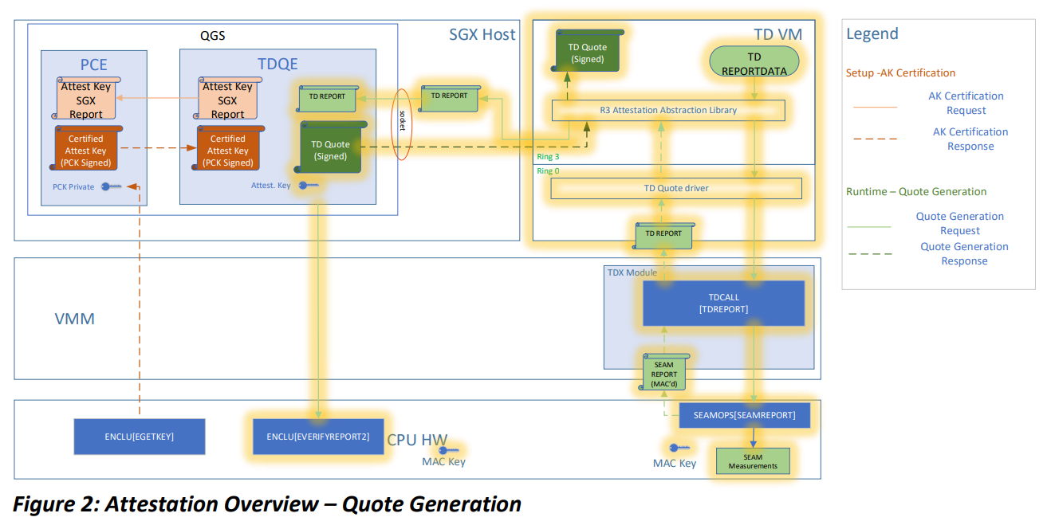
[ Reference ] Strategic importance of QAI IoT
Formalises hybrid necessity, Pareto improvement, and fleet-scale trade-offs TRL roadmap for quantum AI-based IoT fleets Near-sensor analytics and ultra-low-latency cyber–physical control

Slide 27
[ Reference ] Candidate publications (selected)
Reversible/quantum logic: IEEE conferences; IoT–Quantum AI survey (co-PI) Target PhD venues: IEEE IoT Journal, FGCS, Applied Soft Computing, IEEE Access Conferences: IEEE IoT, QCE, edge-AI venues

Slide 28
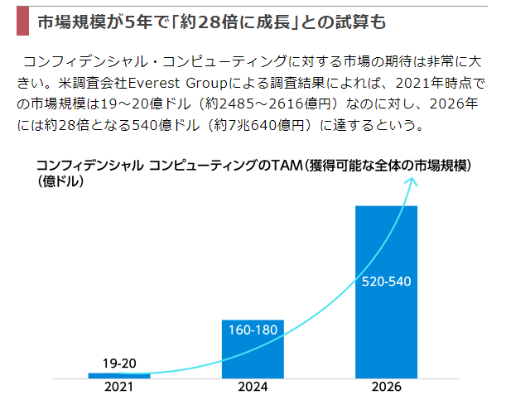
[ Reference ] QAI IoT technology readiness (TRL)
TRL 2–4 target for doctoral prototype: lab-validated hybrid edge inference Roadmap: simulator training → compressed export → FPGA/ARM deployment → fleet evaluation

Slide 29
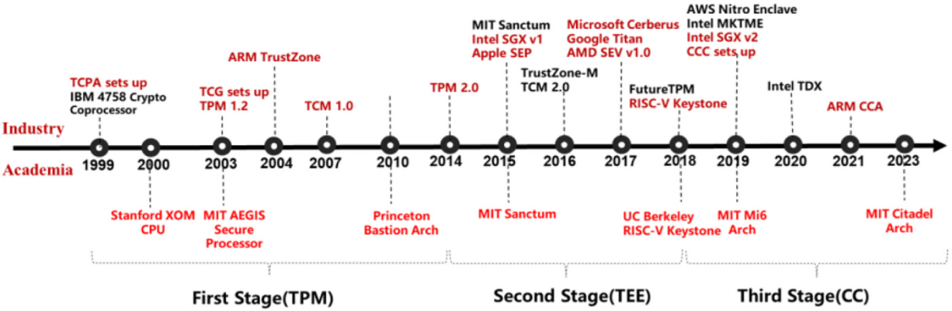
[ Reference ] Publication growth in QAI IoT (2016–2026)
Survey corpus shows accelerating publication growth in IoT–quantum AI intersection Key venues: IEEE IoT Journal, IEEE Access, Discover AI, Future Generation Computer Systems

