Slide 1
Doctoral Program Oral Examination – Towards Establishing Expertise as a Security Researcher –
Last name First name

Slide 2
Announcement content
Previous work experience and job responsibilities
Research achievements (master's thesis, other published papers)
Motivation for pursuing higher education, research plan

Slide 3
Work experience
Graduated from university graduate school in 2009 (Research on the security evaluation of symmetric-key cryptography)
Joined *** Research Institute in 2009 ( Key management for ID- based encryption, applications to smartphones, and countermeasures against cryptographic breaches)
2015 ### Institute (Behavioral-based authentication, integrity verification technology utilizing Root of Trust and Chain of Trust )
2019 Cybersecurity Center (Planning and promoting security measures)
2023 +++ Institute ​ ( Data sandbox technology utilizing TEE )

Slide 4
Business content
Research and development

Slide 5
Responsibilities
Research and development related to technology

Slide 6
Research achievements
At the research institute, I am mainly engaged in studying the configuration methods and systems of security systems that utilize cryptographic technology.
 | academic journal | Study group Symposium | tournament | Registered Patent
Security evaluation of symmetric-key cryptography * Master's degree |  | 4 items | 3 items
Secure use/application of cryptographic algorithms ( Application of ID- based cryptography, leading to cryptographic compromise) | 1 item | 3 items |  | 6 items
Applications of Root of Trust and Chain of Trust (Integrity confirmation technology) |  | 2 items | 1 item | 4 items
others (Behavioral-based authentication, targeted attack countermeasures) |  | 2 items |  | 2 items
total | 1 item | 11 items | 4 items | 12 items
Past initiatives that seem highly compatible with current responsibilities
* All counts are for domestic publications and major works only (no overseas publications).

Slide 7
[ Reference ] Past announcements (related to integrity verification technology)
( SCIS2018 )
- Pre-calculate the file identifier and hash value and store them within the boot image.
- After image deployment, the files are verified using hash values to prevent tampered bootables.
( CSS2018 )
- Users verify the code using a simple verification device.
- Detects screen spoofing without relying on a dedicated UI or confidential information.

Slide 8
[ Reference ] Past presentations (master's theses, published papers)
(Master's thesis)
・
( Presented at domestic symposia such as SITA, SCIS, and ISEC )
( IEICE Japanese journal)
- The decryption key is split using the recipient's confidential information and entrusted to an intermediary.
- The intermediary handles part of the decryption calculation, reducing the risk of the decryption key being leaked.

Slide 9
Motivation for pursuing higher education
To lead security R&D ...
It is necessary to solidify one's own area of expertise.
Highly specialized research and development activities need to be managed effectively from a technical standpoint.
Things I want to cultivate in my doctoral studies
Research execution ability
Technical leadership in research and development management
We aim to cultivate individuals who can bridge the gap between academic research and technological development (creating synergies between research and development).
various stakeholders and research and development organizations to increase our influence and contribution toward social implementation.
Conceiving a convenient and secure information society and the technological architecture to realize it.

Slide 10
Research plan
Research on extending Chain of Trust and Remote Attestation for advanced Confidential Computing

Slide 11












background
Industry Trends
Expectations for Privacy Enhancing Technologies
technology trends
With the advent of the digital age and rapid technological innovation, the need for data exchange that transcends the boundaries of individuals and organizations is rapidly increasing.
Trusted Execution Environment ( TEE ) , which enables a " reliable execution environment " based on hardware, is a technology attracting attention!
privacy and security is essential.
SEV
CPU
SGX, TDX
TrustZone , CCA
...
Rapid growth in practical applications
From 2019
a Linux Foundation project,
The Confidential Computing Consortium ( CCC ) has been established.
...
the Cloud Native Computing Foundation ,
The Confidential Container project has launched.
This has evolved into areas such as Confidential Computing ( CC ) , which aims to protect data during processing ( Data in Use ).

Slide 12


Research area
TEE ( Trusted Execution Environment)
CC (Confidential Computing)
User
Service providers and data providers, etc.
Diverse
Attacker
Applications to server systems are developing.
Attacker
Isolation execution environment
Using confidential containers and confidential VMs
Sensitive data
confidential
Container
Sensitive data processing
Memory encryption, etc.
Isolate the environment,
Prevent attackers from stealing information.
confidential
VM
TEE -compatible GPU
Chain of Trust
Cloud Service
(Azure, AWS, GCP…)
Hypervisor
OS
CPU
CPU
CPU
GPU​
Firmware
Sign
User
AMD EPYC , etc.
NVIDIA H100 , etc.
Root of Trust
CPU
Along with management functions and peripheral functions,
Provides confidential containers and confidential VMs .
Trusted
Signatures, encryption, key management, etc.
Isolation execution environment and Chain of Trust verification ( Remote Attestation )
Cloud service providers

Slide 13
Research objectives and challenges
To enhance CC (Chain of Trust), we will extend Chain of Trust and Remote Attestation .
User
confidential
Container
Sign
Cloud
Service
confidential
VM
TEE -compatible GPU
verification
the purpose
Sign
correct answer
Task 1
of the complex CoT of advanced CC by extending RA .
the TEE usage environment.
There are many different methods for each CC , but Chain of If there are deficiencies in Trust , CC 's security cannot be ensured.
Nurse
Nurse
Move OS
Move OS
Hypervisor
Hypervisor
Task 2
OS
OS
Advanced CC
CC becomes more sophisticated, enabling features such as orchestrator integration and service development , it becomes necessary to expand the Chain of Trust and implement corresponding Remote Attestation.
Firmware
Firmware
RoT
CPU
GPU​
CPU
RoT
NVIDIA H100 , etc.
AMD EPYC , etc.

Slide 14
Related research
Swarm Attestation / Collective Attestation
An approach to perform attestation on a group collectively .
N. Asokan et al. proposed SEDA (Scalable Embedded Device Attestation) ( 2015 ).
Research on systems with numerous devices, such as IoT devices and network devices.
Attested TLS / RA-TLS
A method of applying Attestation to the TLS Secure Channel .
An Intel Labs White Paper mentions connectivity between SGX Enclaves ( 2018 ).
IETF Internet Drafts also exist ( 2022- ) .
Direct Anonymous Attestation / Enhanced Privacy ID
DAA : Proposed by Ernie Brickell et al. ( 2004 )
The relationship between verification keys and signing keys is extended from 1:1 to 1:many.
Signature verification without identifying the members belonging to the group.
Intel SGX implements a mechanism called EPID that takes into account the revocation of signing keys.
Task 1:
the TEE usage environment.
Question : Is improvement to attestation necessary? If there are shortcomings in CC , or if CC alone is insufficient, then improvement to attestation is necessary.
(Example: cluster configuration, etc.)
Task 2:
Advanced CC
Question : Can attestation be extended?
Attestation of confidential information ,
Attestation systems requiring anonymity are still immature. (e.g., private keys and confidential software )

Slide 15

approach
Design and implement the necessary cryptographic technologies and key management systems for CC 's Remote Attestation appropriately.
TEE , hardware and software utilize advanced cryptographic technology.
Provides basic (important) security features.
CC complexly integrated with cloud technologies , we can improve and extend the Chain of Trust and enable verification with Remote Attestation.
Memory encryption
Isolation Execution Environment (CC)
By improving and expanding it , we contribute to the advancement of CC.
Isolation execution environment
(TEE)
Signature/Certificate
·hash
Confidential Computing
Chain of Trust
Remote Attestation
TEE -compatible GPU
Remote Attestation
Root of Trust
Chain of Trust
・Tamper-resistant
・Key management
Root of Trust

Slide 16
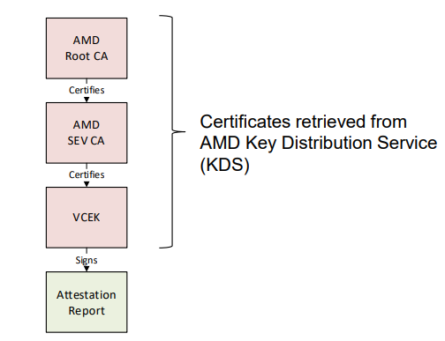
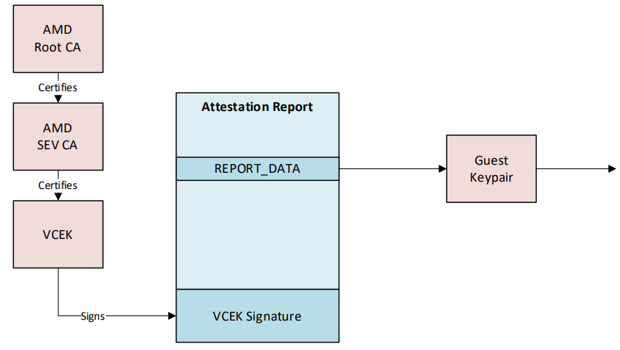
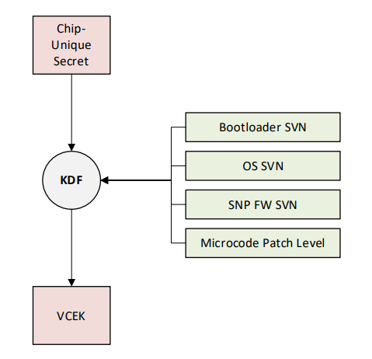
[ Reference ] Keys and certificates in Attestation
In the case of AMD SEV-SNP
Reference: AMD SEV-SNP Attestation: Establishing Trust in Guests
https://www.amd.com/content/dam/amd/en/documents/developer/lss-snp-attestation.pdf

Slide 17
Research steps
A. Examination of technical requirements
Define a system model for an advanced CC (specifying use cases, stakeholders, prerequisites, and relationships between actors).
We formulated hypotheses for the "trust model" and "security model" required for the system model, and analyzed the technical requirements that necessitate improvements/extensions to CoT and RA.
study investigates the design and implementation of conventional TEEs and CCs to clarify the mechanisms of cryptography, signing, and key management. (e.g., AMD SEV-SNP, Azure Confidential Computing )
Based on related research, we propose ideas for supplementing and improving upon the shortcomings of conventional TEE and CC . （ Swarm Attestation /Collective Attestation, Attested (TLS , etc.)
TEE hardware vendors, CC cloud providers, and service providers utilizing CC
End users of the service (data providers, data processing program providers, etc.)
Use cases for handling distributed computing resources ( e.g., distributed processing using multiple computing resources, integration with GPU -based TEEs )

Slide 18
Research steps
B. Proposal/Verification of Implementation Methods
Based on the aforementioned idea, Chain of We propose an extension method for Trust and Remote Attestation.
( symmetric-key cryptography, public-key cryptography, key derivation functions, hash functions, etc.) that combine cryptographic primitives.
Utilization of related technologies closely associated with cryptography, and integration with peripheral systems ( PKI , TLS , authentication and authorization, and identity management).
Also refer to RATs (Remote Attestation Procedures , RFC9334), which are currently under discussion at the IETF.
Regarding the expansion method, we will analyze the differences from existing technologies and evaluate it from the perspectives of feasibility and safety.
Differences: Differences from current CC , differences from related research
Feasibility: Implement a prototype using experimental programs and open-source software , then verify its operation and measure its performance.
Security: Verification of compliance with security requirements through evaluation methods such as threat analysis and formal verification.

Slide 19
Announcement plan
The research will proceed by simultaneously examining technical requirements ( A. ) and proposing/verifying implementation methods ( B. ). The research results obtained will be presented at international conferences and in academic journals, and compiled into a doctoral dissertation.
 | 2024 |  | 2024 |  | 2025 |  |  |  | 2026 |  |  |  | 2027
 | First half |  | Second half |  | First half |  | Second half |  | First half |  | Second half |  | First half
dissertation writing
Task 1 the TEE usage environment.
Task 2 Advanced CC
Domestic Conference
Submission / Announcement
International conference
Preparation/Presentation
Preparing for/presenting at an international conference
journal submission/presentation
doctoral dissertation
Writing/Submission
(Issues raised)
Distributed Attestation Proposal​
Attestation proposal for confidential information
Detailed feasibility assessment
and safety verification
Writing a doctoral dissertation
A. Trust Model Consideration
B. RA improvement proposal
Evaluation/Verification
Evaluation/Verification
Systematization
A. Security Model Consideration
B. Proposal for RA extension
Evaluation/Verification
▲Enrollment
Completion ( expected ) ▲

Slide 20
In conclusion (Aspirations)
Regarding the field of CC
across hardware, software, cloud, and networking , we approach these challenges with a strong focus on cryptographic technology.
As a security researcher
further deepen my knowledge and experience in various security-related tasks and acquire expertise in security system architecture.
Returning to the basics
provide highly secure and reliable information and communication systems, and create a convenient and safe information society (we want to generate knowledge and deliver it to the world!).

Slide 21
Supplementary information below

Slide 22
[ Reference ] Keys and certificates in Attestation
* Created based on hypotheses, referencing the provided materials.
Keypair
In the case of AMD SEV-SNP
PubKey Certificate
Self-Sign
AMD Root CA
(ARK)
Signing Key
Sign
Verify
PubKey Certificate
Security Version Number
Bootloader​
OS​
SNP FW
Microcode Patch Level
Signing Key
AMD SEV CA
(ASK)
Sign
Verify
Chip - Unique Secret
PubKey Certificate
Versioned Chip
Endorsement Key
(VCEK)
Key Derivation
Signing Key
Sign
Verify
Guest Keypair
REPORT_DATA
Public Key
Attestation
Report
Guest Measurements
Secret Key
Root of Trust
Reference: Versioned Chip Endorsement Key (VCEK) Certificate and KDS Interface Specification
https://www.amd.com/content/dam/amd/en/documents/epyc-technical-docs/specifications/57230.pdf
Reference: AMD SEV-SNP Attestation: Establishing Trust in Guests
https://www.amd.com/content/dam/amd/en/documents/developer/lss-snp-attestation.pdf

Slide 23
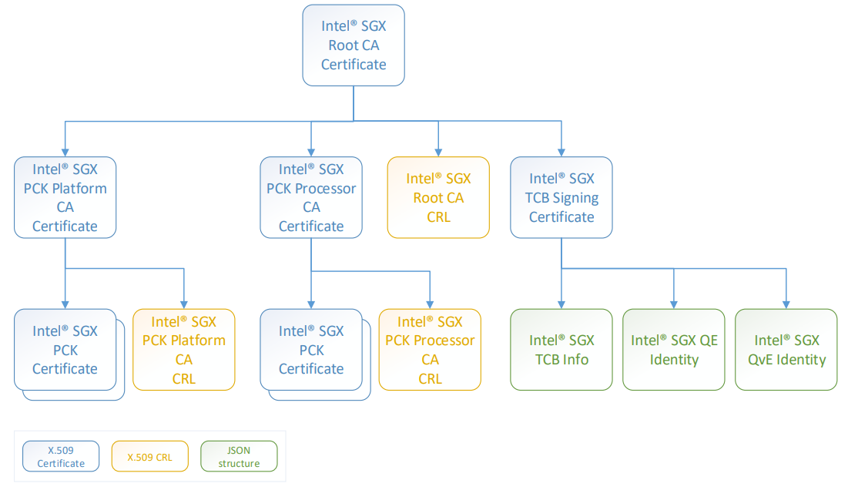
[ Reference ] Keys and certificates in Attestation
In the case of Intel SGX
Reference: Design Guide for Intel® SGX Provisioning Certificate Caching Service (Intel® SGX PCCS)
https://download.01.org/intel-sgx/sgx-dcap/1.14/linux/docs/SGX_DCAP_Caching_Service_Design_Guide.pdf

Slide 24
[ Reference ] Keys and certificates in Attestation
* Created based on hypotheses, referencing the provided materials.
In the case of Intel SGX
Keypair
Intel SGX Root CA
PubKey Certificate
Self-Sign
CRL
Signing Key
Verify
Verify
Verify
Sign
Intel SGX PCK Platform CA
Intel SGX PCK Processor CA
Intel SGX TCB
Signing Test
PubKey Certificate
PubKey Certificate
PubKey Certificate
Signing Key
CRL
Signing Key
CRL
Signing Key
Sign
Verify
Verify
Intel SGX PCK
Certificate
Intel SGX PCK
Certificate
JSON Structure
PubKey Certificate
PubKey Certificate
Signing Key
Signing Key
TCB
Info
QE Identity
QvE Identity
Processing in Root of Trust ??
Reference: Intel® SGX PCK Certificate and Certificate Revocation
https://api.trustedservices.intel.com/documents/Intel_SGX_PCK_Certificate_CRL_Spec-1.5.pdf
Reference: Design Guide for Intel® SGX Provisioning Certificate Caching Service (Intel® SGX PCCS)
https://download.01.org/intel-sgx/sgx-dcap/1.14/linux/docs/SGX_DCAP_Caching_Service_Design_Guide.pdf

Slide 25
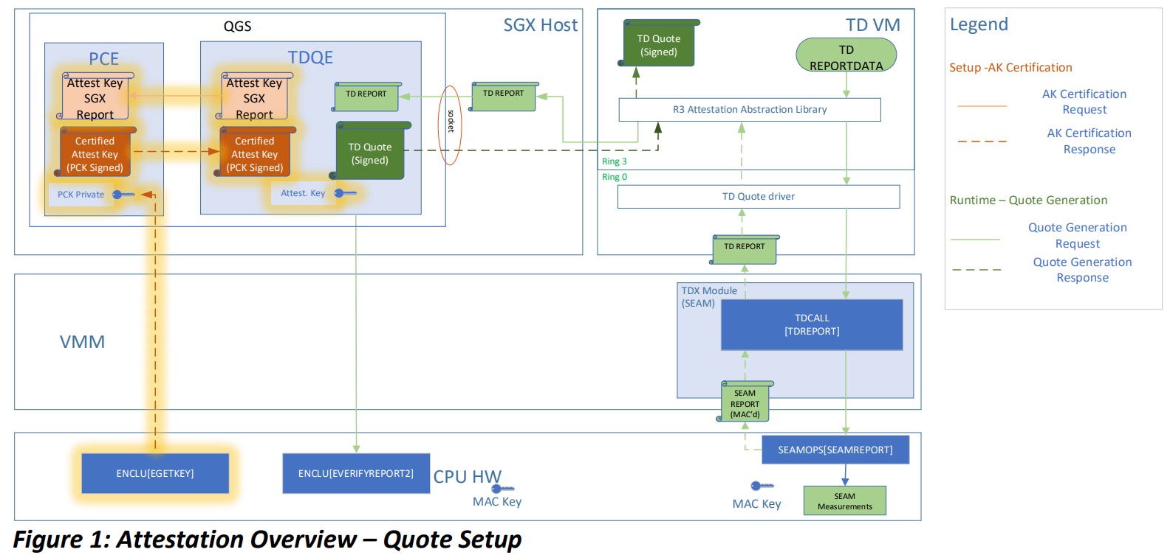
[ Reference ] Keys and certificates in Attestation
In the case of Intel TDX
Reference: Intel® Trust Domain Extensions Data Center Attestation Primitives (Intel® TDX DCAP): Quote Generation Library and Quote Verification Library
https://download.01.org/intel-sgx/latest/dcap-latest/linux/docs/Intel_TDX_DCAP_Quoting_Library_API.pdf

Slide 26
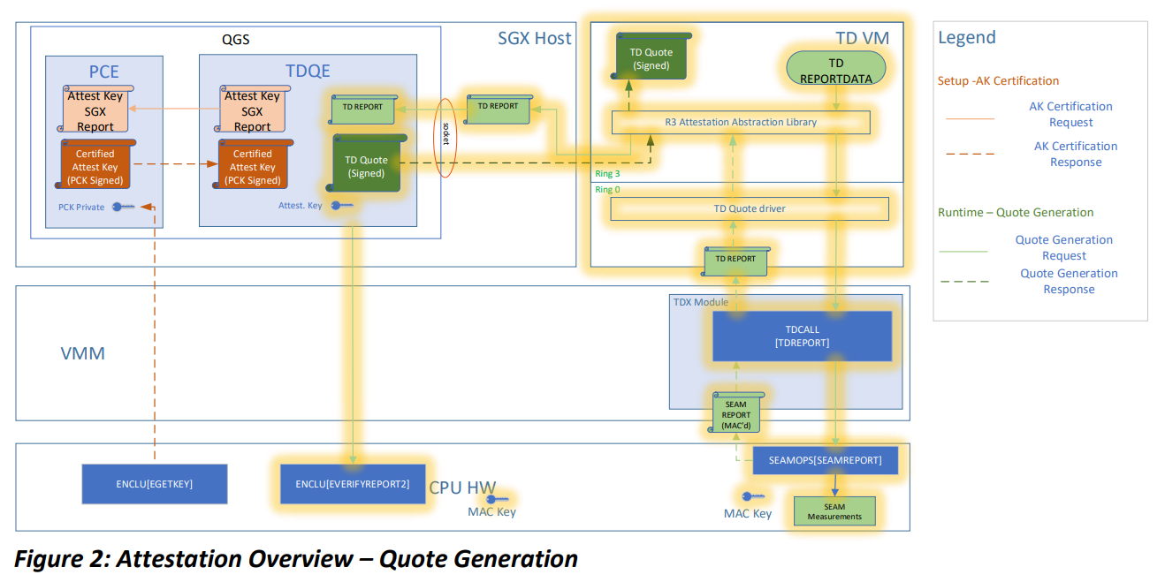
[ Reference ] Keys and certificates in Attestation
In the case of Intel TDX
Reference: Intel® Trust Domain Extensions Data Center Attestation Primitives (Intel® TDX DCAP): Quote Generation Library and Quote Verification Library
https://download.01.org/intel-sgx/latest/dcap-latest/linux/docs/Intel_TDX_DCAP_Quoting_Library_API.pdf

Slide 27
[ Reference ] Keys and certificates in Attestation
* Created based on hypotheses using reference materials (especially the Sign and Verify processes require further examination).
Keypair
In the case of Intel TDX
Intel Root CA??
Verify
Certificate Chain
Extending Intel SGX 's CA ? ?
Intel PCK CA ??
Processing in Root of Trust ??
EGETKEY
PubKey Certificate
PCK Certificate
Signing Key
PCE
Attest Key SGX Report
Sign
Verify
MAC
Verify?
MAC?
PubKey Certificate
Certified
AttestKey
MAC Key
Signing Key
TD QE
MAC
Verify?
Quoting Generation Service
Verify
MAC
Sign
SEAM
Measurements
TD REPORT
TD Quote
TD REPORTDATA
Reference: Intel® Trust Domain Extensions Data Center Attestation Primitives (Intel® TDX DCAP): Quote Generation Library and Quote Verification Library
https://download.01.org/intel-sgx/latest/dcap-latest/linux/docs/Intel_TDX_DCAP_Quoting_Library_API.pdf

Slide 28
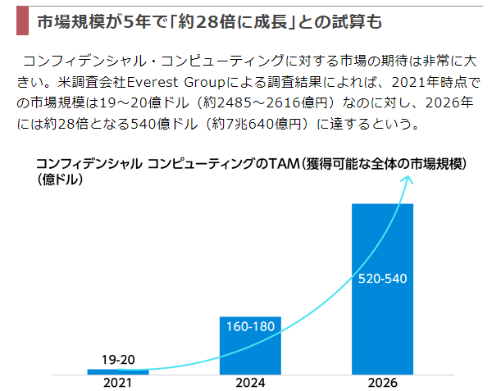
[ Reference ] Market size of CC
Reference: The cloud is entering an era where it can protect " data in use " as well.
https://toyokeizai.net/articles/-/594973

Slide 29
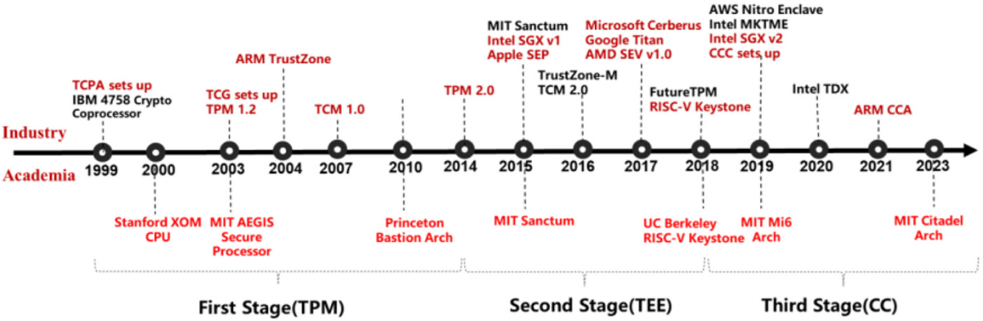
[ Reference ] History of CC
reference:
Dengguo Feng, Yu Qin, Wei Feng, Wei Li, Ketong Shang, Hongzhan Ma “Survey of research on confidential computing”, IET Communications, April 2024. https://ietresearch.onlinelibrary.wiley.com/doi/10.1049/cmu2.12759

