Slide 1

Predicting Household Fuel Poverty from Aggregate Statistics Using Machine Learning Approaches

Slide 2
Business Understanding
Macro Instability
- COVID
- Russia’s Invasion of Ukraine
Increasing Fuel Poverty
- Energy market volatility
- Vulnerability of households to Fuel Poverty
Flexible Pricing Strategy
- KrakenFlex
- E7 pricing for off-peak usage
Subsequent sanctions
- Winter Fuel Payment by Government

Slide 3
Data Understanding
Broader Aggregate Level Data
Low-Income Low Energy Efficiency (LILEE)
Characteristic-based aggregate probability
Household Level Data
Energy Efficiency Certificates (EPC datasets)
Narrower Aggregate Level Data
Weather
Income Projections
Energy Price and Consumptions

Slide 4
Data Preparation
EPC Data (Household Level)
LMK Key
Energy Prices and Payment Data (Derived using Local Average Pricing and Household Level Consumption from EPC)
Electricity – Average Variable Price per kWh
Income Data (Local Authority Level)
Net Income 2024 (adjusted from 2020 data for local authority average)
Net Income before housing costs
Net Income after housing costs
Number of Low Income Households (Estimated based on 60% of national median income)
Temperature At Surface (Under different Global Warming Assumptions)
Percentage of Low-Income Households
Unemployment Rate in Local Authority
Higher Degree Days
Weather Data (Local Authority Level)
Urban/Rural Classification
Minimum Temperature
Population Data (Local Authority Level)
Senior Population
Child Population
Working Age Population
Age Dependency Ratio
Average Household Size
Current Energy Rating
Current Energy Efficiency
Energy Consumption (Current)
CO₂ Emissions (Current)
Roof Energy Efficiency
Walls Energy Efficiency
Main Fuel
Property Type
Built Form
Total Floor Area
Number of Habitable Rooms
Tenure
Construction Age Band
Local Authority
Postcode
Lodgement Date
Electricity – Average Annual Fixed Cost
Gas – Average Variable Price per kWh
Gas – Average Annual Fixed Cost
Average Annual Fuel Bill (Individual Estimate) (Derived)
Local Authority – Average Electricity Consumption
Local Authority – Average Gas Consumption
Households Receiving Winter Fuel Payment (2023)
Add data collected from different gov.uk websites, including but not limited to Stat-Xplore, ONS, NOMIS, Climate Data Portal etc.

Slide 5
Feature Split for Synthetic Target Generation
MCMC Variables | ML Modeling Variables
LMK Key | LMK Key | Winter Avg Temp (Median, 2001–2020) | Electricity – Avg Variable Price per kWh
EPC Rating (Numeric) | Current Energy Efficiency | Winter Avg Temp (1.5°C Threshold) | Electricity – Avg Annual Fixed Cost
Urban or Rural Classification | Energy Consumption (Current) | Winter Avg Temp (2.0°C Threshold) | Gas – Avg Variable Price per kWh
Region Name | CO₂ Emissions (Current) | Winter Avg Temp (2.5°C Threshold) | Gas – Avg Annual Fixed Cost
Property Type | Built Form | Winter Avg Temp (5.5°C Threshold) | Households Receiving Winter Fuel Payment (2023)
Construction Age Band | Local Authority Code | Winter Avg Temp (3.5°C Threshold) | Average Annual Fuel Bill (Individual Estimate)
Total Floor Area | Lodgement Date | Winter Avg Temp (4.0°C Threshold) | Avg Electricity Consumption per Household (Local Authority)
Fuel Category | Postcode District | Minimum Winter Temp (2001–2020 Median) | Avg Gas Consumption per Meter (Local Authority)
Walls Energy Efficiency | Insulation Score | Population (2024) | Average Annual Fuel Bill (Local Average Estimate)
Tenure | Local Authority | Child Population | Fuel Bill Difference
 | Net Income (2024) | Senior Population | Fuel Cost to Income Ratio
 | Income Before Housing Costs (2024) | Working-Age Population | Floor Area per Room
 | Income After Housing Costs (2024) | Average Household Size (2023) | CO₂ Emissions per m²
 | Percentage of Low-Income Households | Area (km²) | Energy Consumption per m²
 | Unemployment Rate | Population Density | Energy Consumption per Room
 | Index of Multiple Deprivation (2019) | Age Dependency Ratio
 | Heating Degree Days (Median, 2001–2020) | Total Floor Area
Carefully avoiding possible signal leak

Slide 6
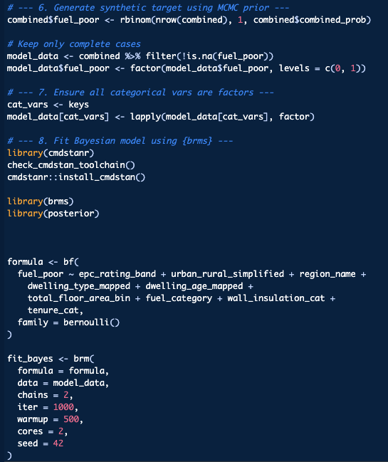
Data Preparation – Synthetic Target
LILEE - Aggregate Level Probability as Priors
Bayesian Regression using Markov-chain Monte Carlo Simulation
Generating Fuel Poverty Risk Band (Less Likely to Highly Likely)
Simulation Reached Convergence after 1000 iterations
Computationally Hungry, hence 2.6M rows had to be reduced to 10K only.

Slide 7
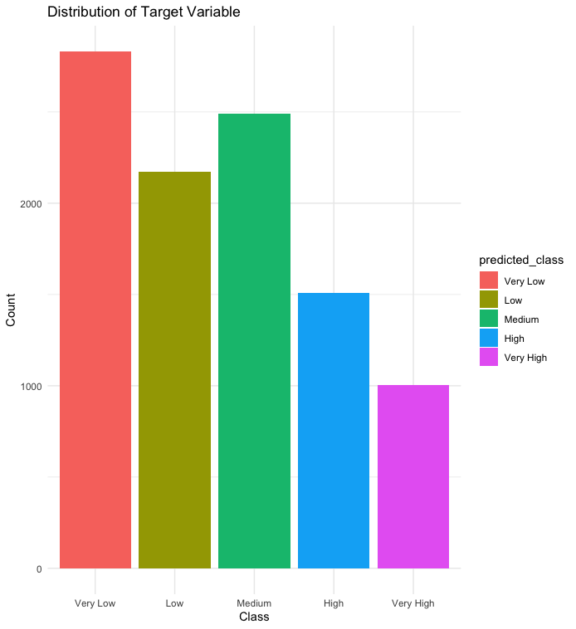
ML Models - Data Preprocessing
Class Imbalance

Slide 8
ML Models – Normalisation
Data with outliers Capped at 99th percentile, rows with outliers removed. Imputation may introduce bias, since target is already synthetic
Metadata Entirely removed (like LMK_KEY, Lodgement Date etc.)
Derived features Removed if they have low variation (hence, very little signal) unless highly relevant or multiplicative in practice

Slide 9
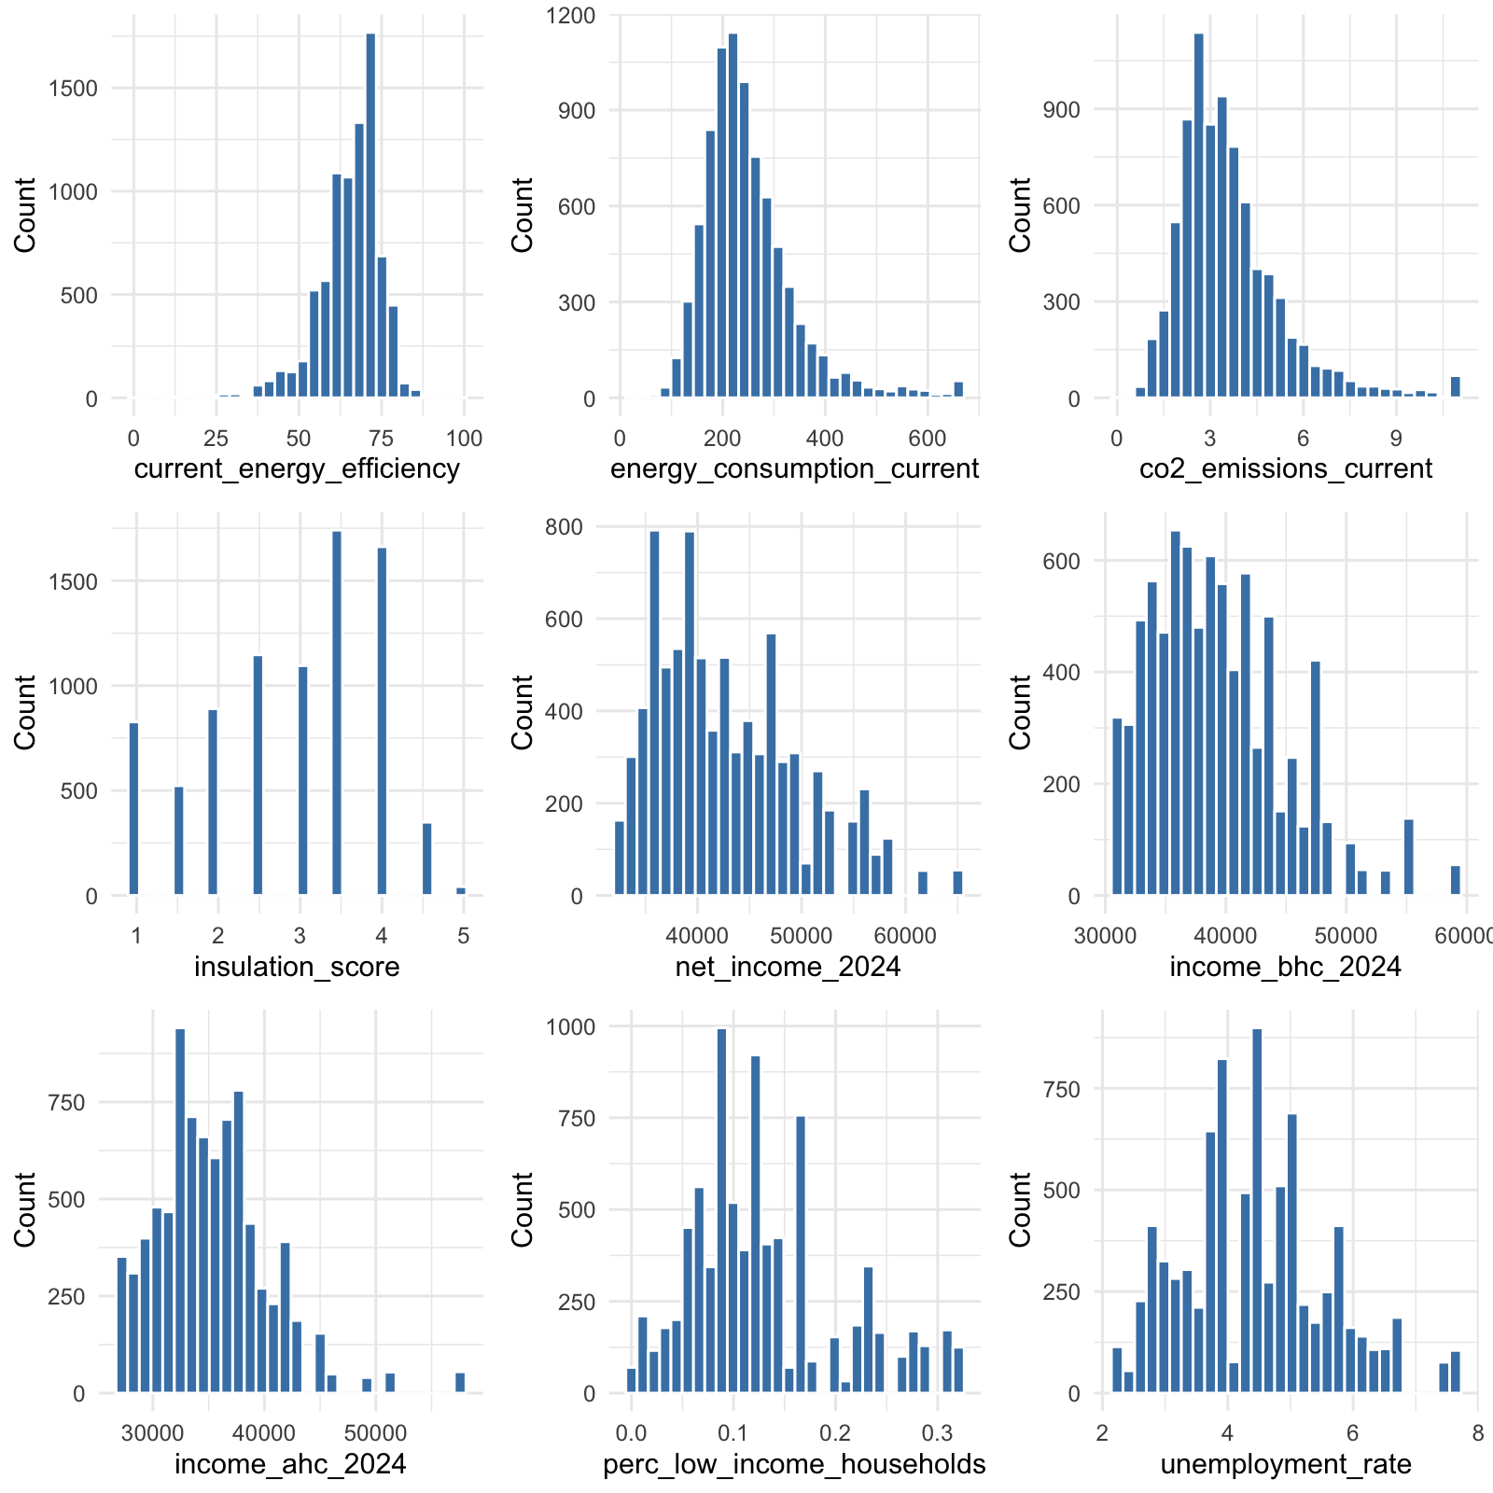
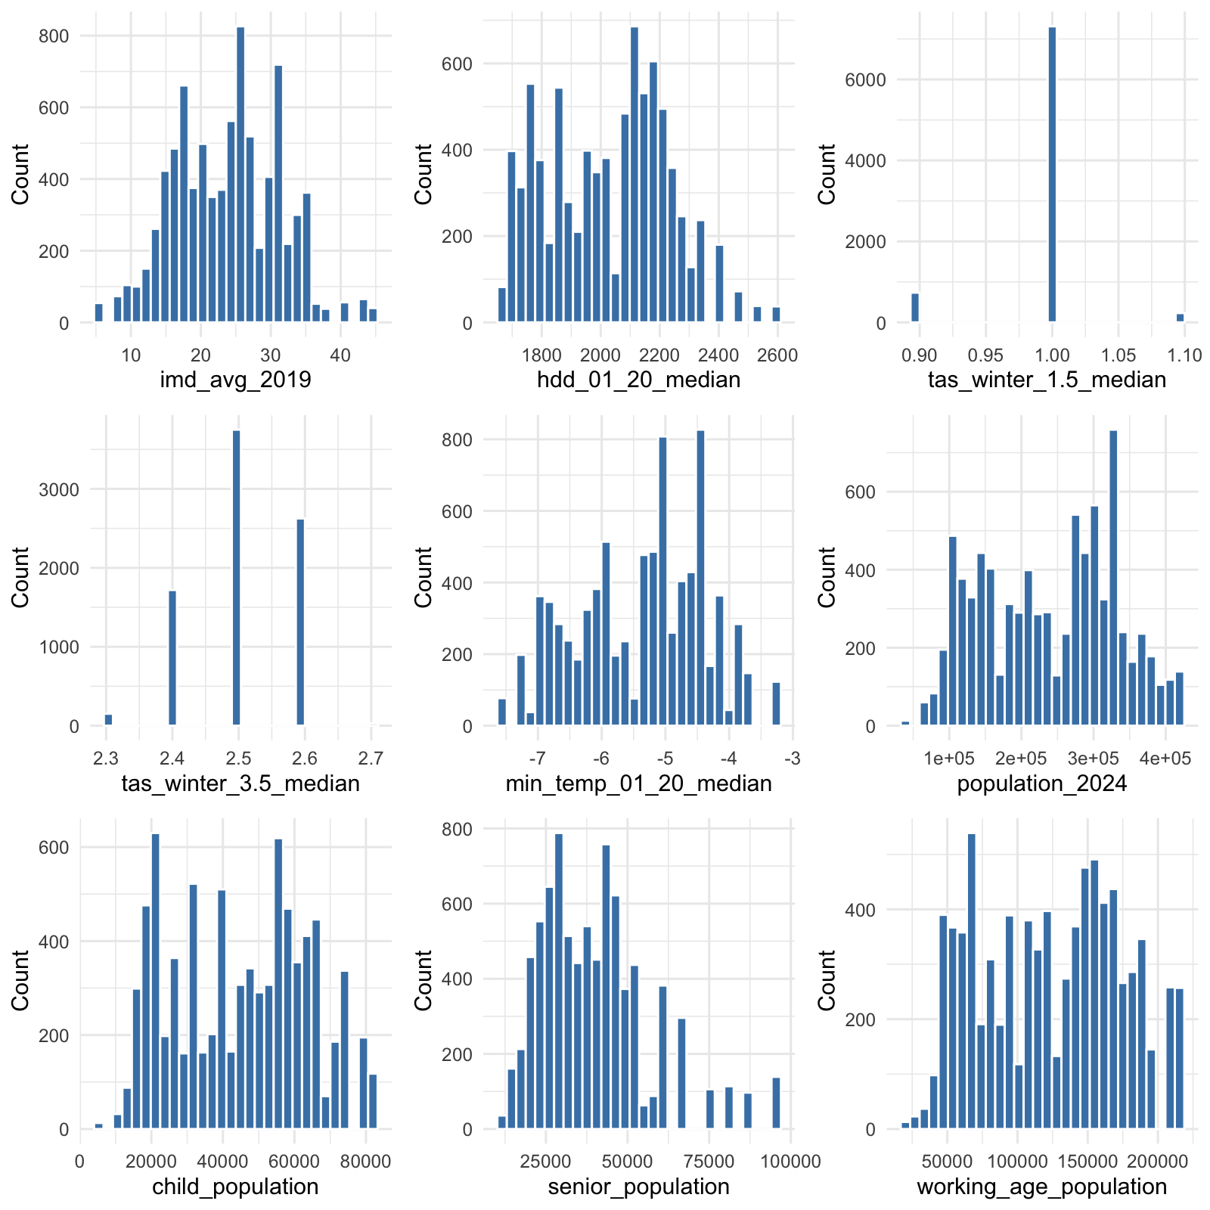
ML Models – Distribution of Features

Slide 10
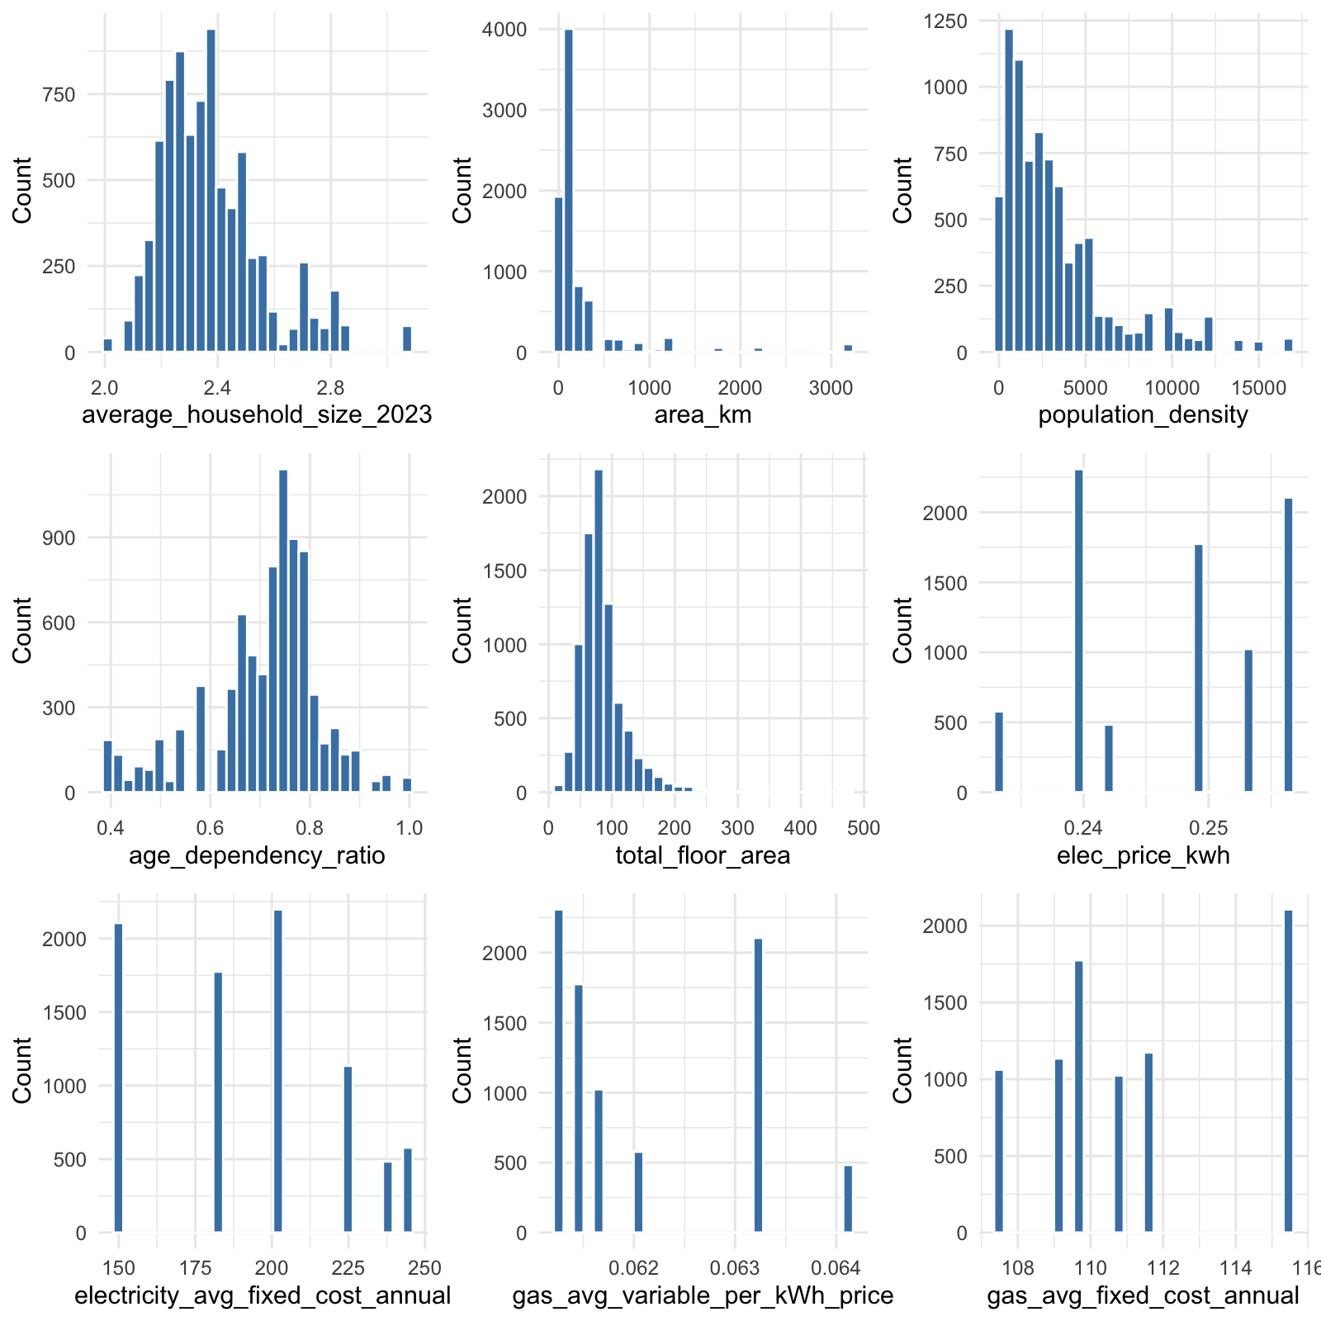
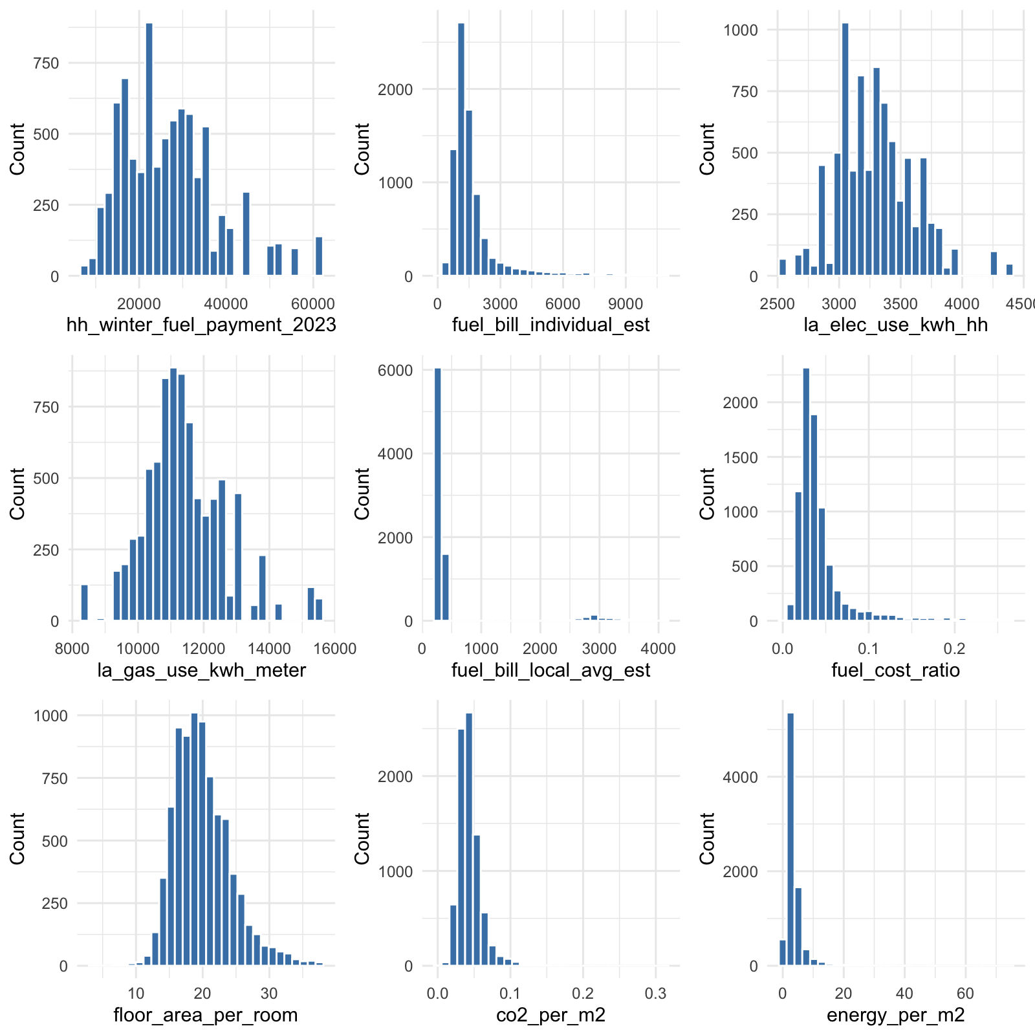
ML Models – Distribution of Features

Slide 11
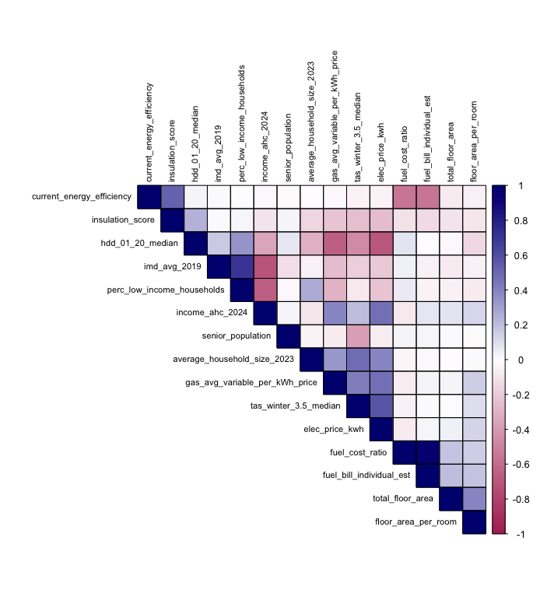
ML Models – Association of Features
Low-income households have negative association with average income, which is expected
Gas and Electricity prices have positive association with weather data, which is also realistic.
Fuel costs are negatively correlated with energy efficiency, which is very realistic.
No abnormal correlations found
Derivative values have somewhat association with the used variables.

Slide 12
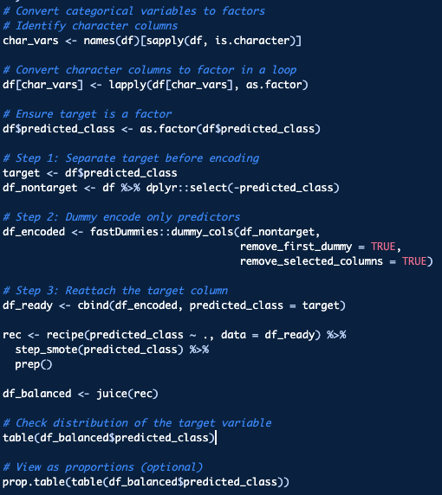
ML Models – Balancing

Slide 13
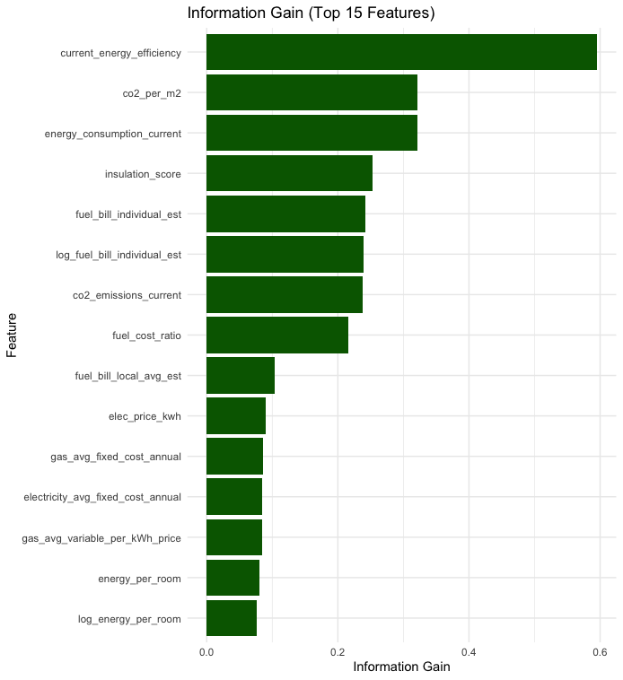
Feature Importance
Most relevant feature might introduce signal leakage from synthetic data generation model.
Creating two different pipelines of models, one with current_energy_efficiency, another without. For all the models. Namely, Pipeline A and Pipeline B.

Slide 14
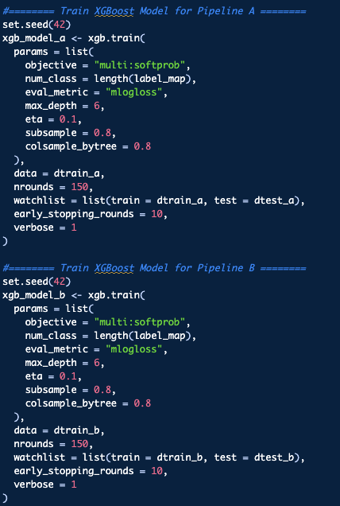
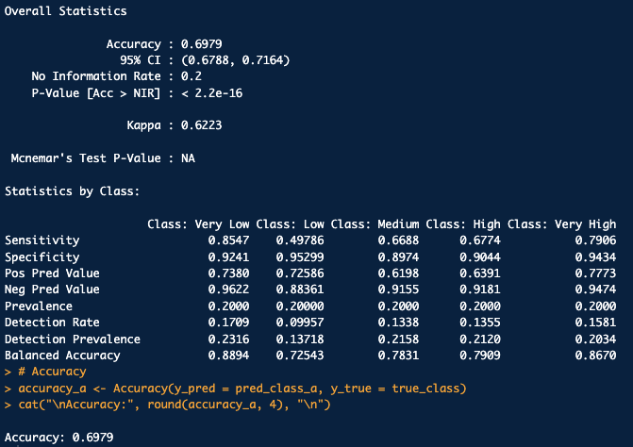
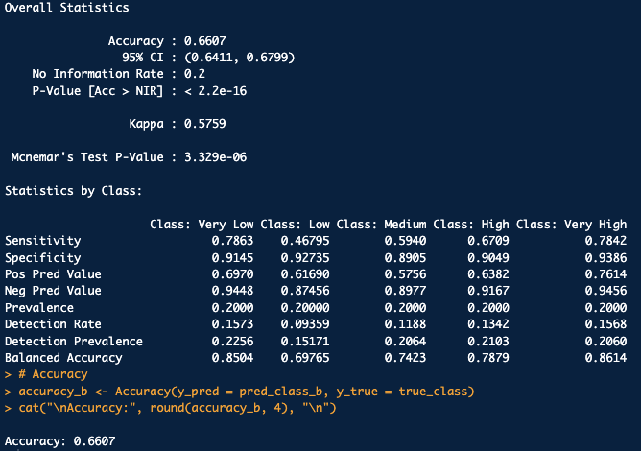
Modelling – XGBOOST
A
Evaluation
Code Snippet
B

Slide 15
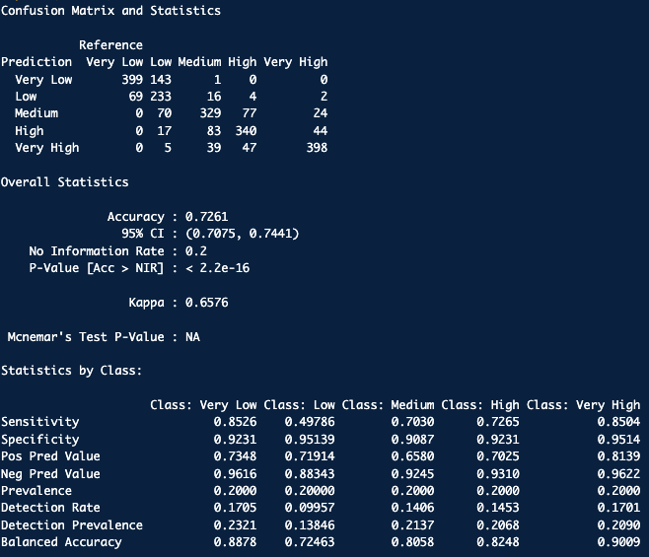
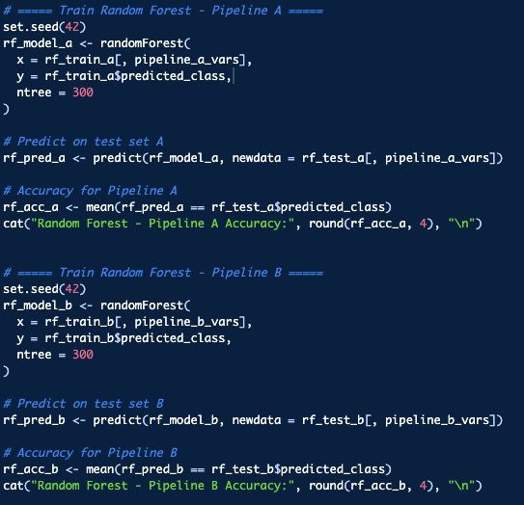
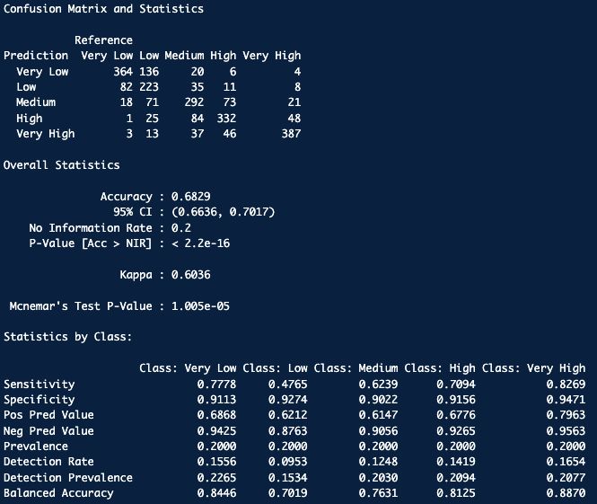
Modelling – RF
A
Evaluation
Code Snippet
B

Slide 16
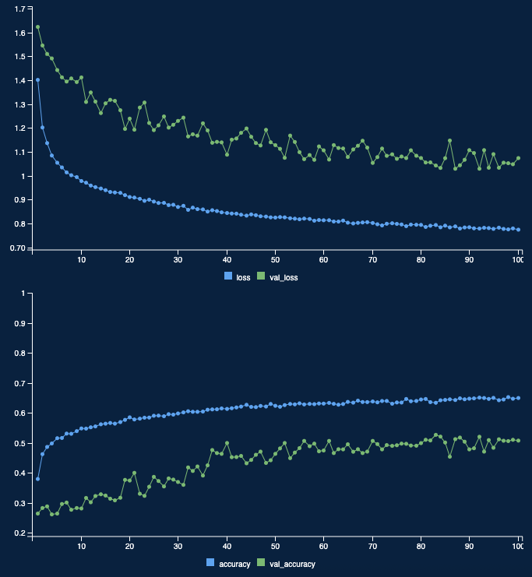
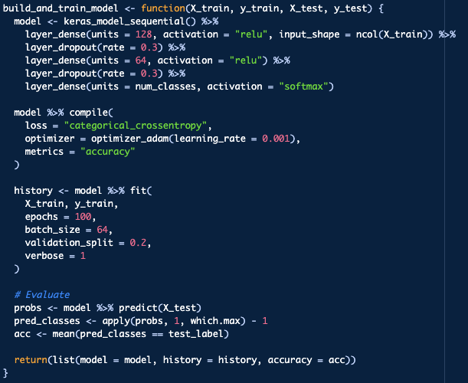
Modelling – DNN
A
Evaluation
Code Snippet
Features Selected:
Current Energy Efficiency
Insulation Score
CO₂ Emissions (Current)
Fuel Bill (Individual Estimate)
Fuel Cost to Income Ratio
Fuel Bill (Local Average Estimate)
Electricity Price per kWh
Gas – Average Annual Fixed Cost
Energy Consumption per Room
Electricity – Average Annual Fixed Cost
Log of Energy Consumption per Room
Income Before Housing Costs (2024)
Area (km²)
Energy Consumption per m²
Population Density
Senior Population
Built Form: Mid-Terrace
Built Form: Semi-Detached
Accuracy : 58.89%

Slide 17
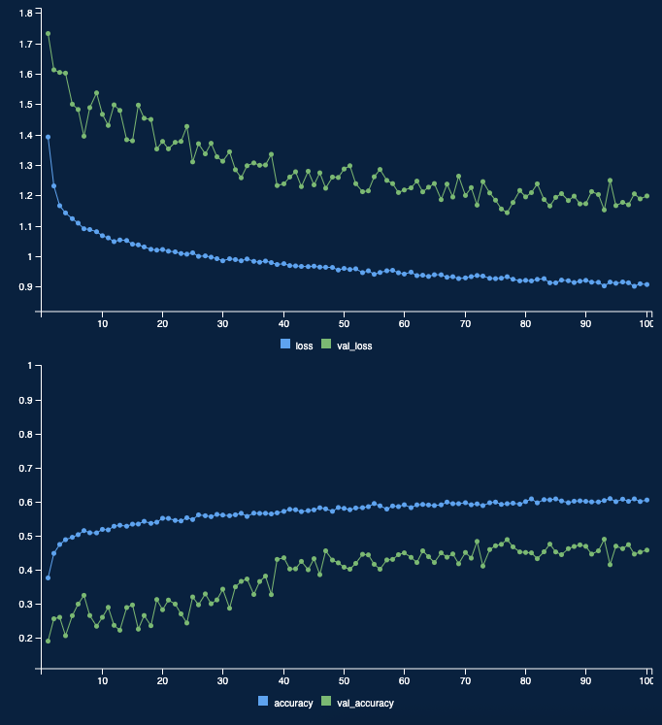
Modelling – DNN
B
Evaluation
Code Snippet
Features Selected
Energy Consumption (Current)
CO₂ Emissions per m²
Energy Consumption per m²
Insulation Score
Fuel Bill (Individual Estimate)
Fuel Cost to Income Ratio
Fuel Bill (Local Average Estimate)
Electricity Price per kWh
Gas – Average Annual Fixed Cost
Energy Consumption per Room
Electricity – Average Annual Fixed Cost
Log of Energy Consumption per Room
Income Before Housing Costs (2024)
Area (km²)
Population Density
Senior Population
Built Form: Mid-Terrace
Built Form: Semi-Detached
Accuracy : 55.26%

Slide 18
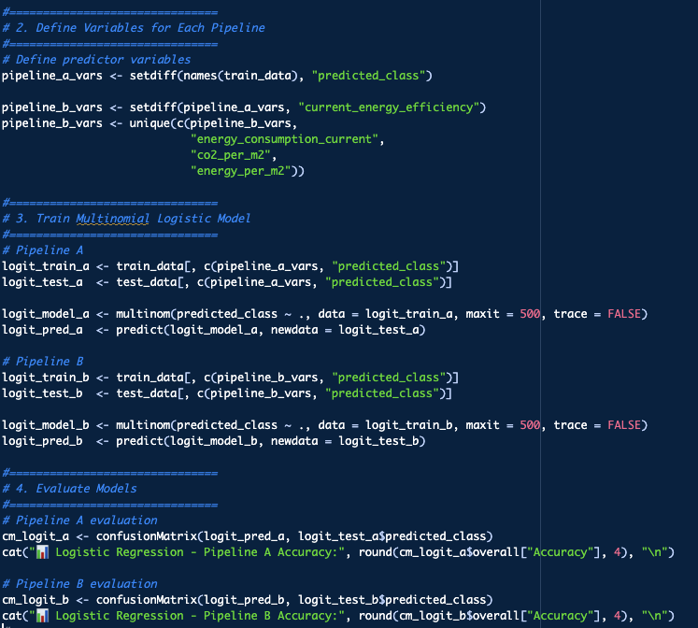
Modelling – Multinomial Logistic Regression
Pipeline A Accuracy : 53.33%
Pipeline B Accuracy : 52.09%

Slide 19
Pipeline A Model Comparison

Slide 20
Pipeline B Model Comparison

Slide 21
Way Forward
Computational Power
We could only model it for 10000 data out of a total 2.6 million rows we collected, due to lack of computational power
LILEE indicator supplementary tables provide more detailed data, percentage of fuel poverty based on 23 different categorical segregations, many of which we could not include due to lack of computational power
Academic Studies
Previous academic studies on this prediction only predicted until local authority level probability of fuel poverty, we are suggesting a new Markov Chain Monte Carlo (MCMC) based Bayesian Inference model to predict this, which using a totally different set of features can be predicted by ML models.

