Slide 1




Timing Analysis of Safety-Critical Automotive Software: The AUTOSAFE Tool Flow
M. Becker¹, S. Mohamed², K. Albers³, P.P. Chakrabarti², S. Chakraborty¹, P. Dasgupta², S. Dey², R. Metta⁴
² Indian Institute of Technology (IIT) Kharagpur, Computer Science and Engineering (CSE)
¹ Technische Universität München,
Real-Time Computer Systems (RCS)
⁴ Tata Research Development and Design Centre (TRDDC)
³ INCHRON GmbH

Slide 2
Outline
Introduction
Motivation and Goals
AUTOSAFE flow
A. From High-Level Specification to Task Mapping
B. Timing Analysis
C. Automata Generation and Formal Verification
D. Closing the loop
Example
Conclusion

Slide 3
Introduction
Currently: automotive architectures getting complex:
Hardware: 50-100 ECUs, numerous sensors and actuators, kilometers of cabling, ...
Software: ≈100M lines of code, many safety-critical functions
More functionality, more interfaces, much more software
Testing becomes infeasible!
How to guarantee that the software is „correct“?

Slide 4
Motivation and Goals
Co-design of real-time control – typical design flow
Requires analysis and optimisation skills from multiple disciplines
Control design
Real-time analysis
Formal verification
Tool flows in each realm lacks interface points between each other
Goal: To create an interface between multiple disciplines

Slide 5
Typical Design Flow
Motivation and Goals
Control design
Numerous Assumptions
Negligible delays
Computation – Instantaneous, Periodic
Real-time analysis
Formal Verification
Several design iterations needed
Design without any analytic backup
Hinders Certification
A semantic gap exists between high-level models and their implementation
Goal: To bridge this semantic gap
High-level Model
Control Performance satisfied
Code Generation
Execution Time satisfied
Low-level Platform Model
Response Time satisfied
Implementation
Performance not met

Slide 6
AUTOSAFE Flow - Overview
High-level Model
Performance criteria not satisfied
Control Performance
satisfied
Code Generation
High-level Model
Performance criteria satisfied
Implementation
Execution Time satisfied
Timing Information
Low-level Platform Model
Response Time satisfied

Slide 7
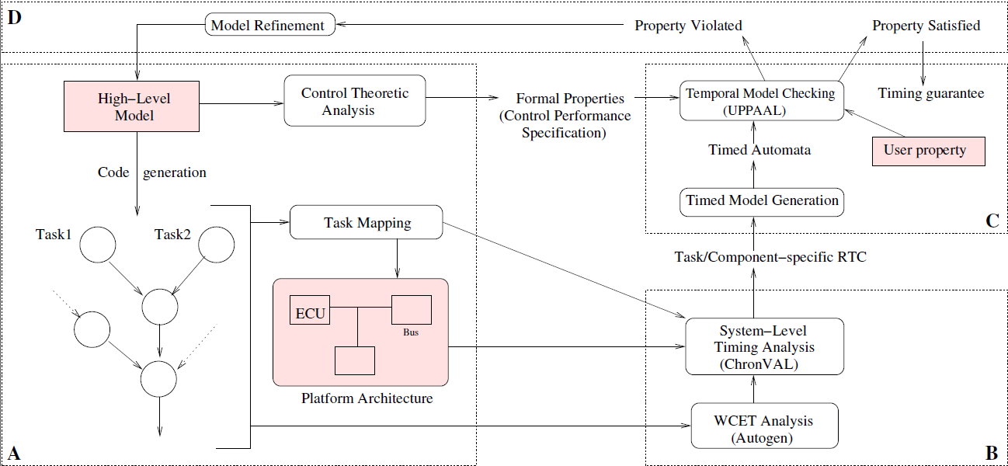
AUTOSAFE Flow

Slide 8
A. From High-Level Specification to Task Mapping
High-level specification
Functional behaviour of the system
Timing constraints
Functional modeling of the system
Tools like MATLAB Simulink
Control theoretic analysis
Generate formal properties (control performance specification)
Generate C code
Modeling system architecture
Mapping
Binding of functional parts to the architecture blocks

Slide 9
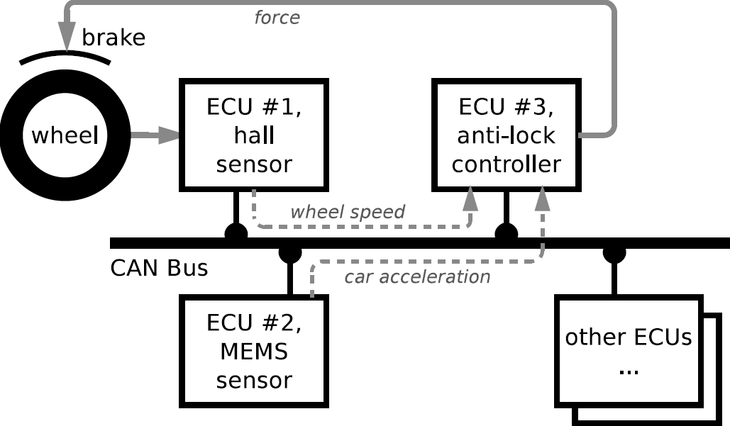
From High-Level Specification to Task Mapping
Example: ABS
Performance specification
Car shall stop within a certain distance when the brakes are applied
Functional specification
Regulate brake pressure to keep slip at an optimal value (20%)
Timing constraint
Threshold for fresh or stale sensor data
Control theoretic analysis
Quantify freshness in terms of (m,k)-firm deadline ^{[1]}
m out of k successive runs meet deadline
Fig: Anti-lock braking system with distributed sensors and controller
[1] Hamdaoui, Moncef, and Parameswaran Ramanathan. "A dynamic priority assignment technique for streams with (m, k)-firm deadlines."
Computers, IEEE Transactions on 44.12 (1995): 1443-1451.

Slide 10
B. Timing Analysis
Goal: predict safe upper bound for end-to-end timing of implementation (incl. scheduling, bus arbitration, etc.)
A) task-level timing analysis ➔ worst-case execution time per task
B) system-level timing analysis ➔ compose tasks via shared resources

Slide 11
Timing Analysis: Task Level
Scheduling diagrams for each ecu
Sensor 1
task
Sensor 2
task
t
ECU 1
ECU 2
t
Bus
t
Controller ECU

Slide 12
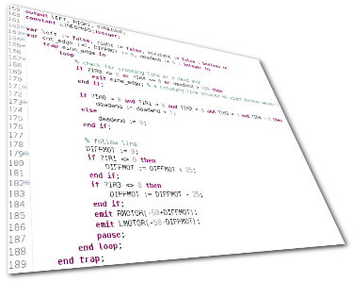
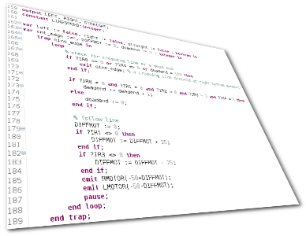
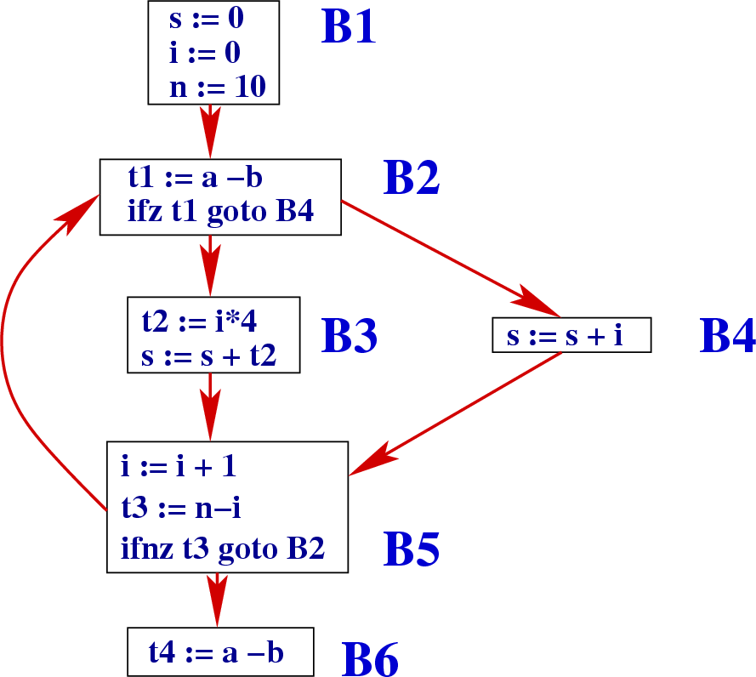

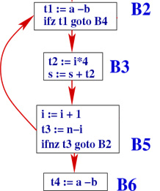
Timing Analysis: Task Level (AutoGen ^{[5]})
Based on explicit-state model checking
Idea: work at source level, allows better abstractions
Problem: differences in control flow between source and binary
„backtranslate“ differences & timing
Slicing and abstraction
Ask MC for timing
➔ WCET estimate
7. Timer <= X
8 paths?
Model checker
Yes ➔ WCET <= X
abstract
source
w/ timing
no
3. Extract
timing
6. Slicing & abstraction w.r.t. timing
binary
3. Extract
Control flow
source
w/ timing
2. Cross-Compile
4.
compare
flow
differences
5.
Translate
Binary flow to source
1. Extract
Control flow
source
[5] Bokil, Prasad, et al. "Automatic test data generation for c programs."
Third IEEE International Conference on Secure Software Integration and Reliability Improvement, SSIRI 2009.

Slide 13
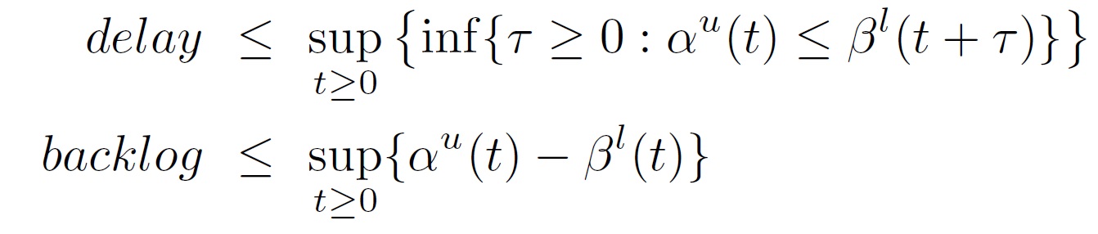
Timing Analysis: System Level (chronVAL ^{[6]})
Real-Time Calculus (RTC) ^{[2]}
Architectural nodes: buses, ECUs, etc.
Each node manipulates a stream of incoming tasks
Nodes have capacities according to their policy
Needs WCET
➔ bounds for end-to-end delays
service
curve
(β^{l}, β^{u})
(α^{l}, α^{u})
(α^{l’}, α^{u’})
RTC
arrival
curve
(β^{l’}, β^{u’})
[2] Samarjit Chakraborty, et al. "A General Framework for Analysing System Properties in Platform-Based Embedded System Designs." DATE. Vol. 3. 2003.
[6] Anssi, Saoussen, et al. "chronVAL/chronSIM: A Tool Suite for Timing Verification of Automotive Applications." Proc. Embedded Real-Time Software and Systems, ERTS (2012).

Slide 14
Abs on architetcure :: RTCs generated
α^{l}={(0,0), (10,1), (20,2),..}
α^{u}={(0,1), (10,2), (20,3),..}
Sensor 1
task
Sensor 2
task
α^{l} = {(0,0), (20,1), (40,2),..}
α^{u} = {(0,1), (20,2), (40,3),..}
ECU 1
ECU 2
Bus
α^{l}={(15.34,1), (25.34,2), (35.34,3),..}
α^{u}={(0,1), (4.66,2), (14.66,3),..}
α^{l} = {(26.29,1,0),(30.29,2,0),(46.29,3,0),…}
α^{u} = {(0,1), (1.11,2), (11.11,3),..}
Controller ECU
WCRT = 5.4
BCRT = 1.11

Slide 15
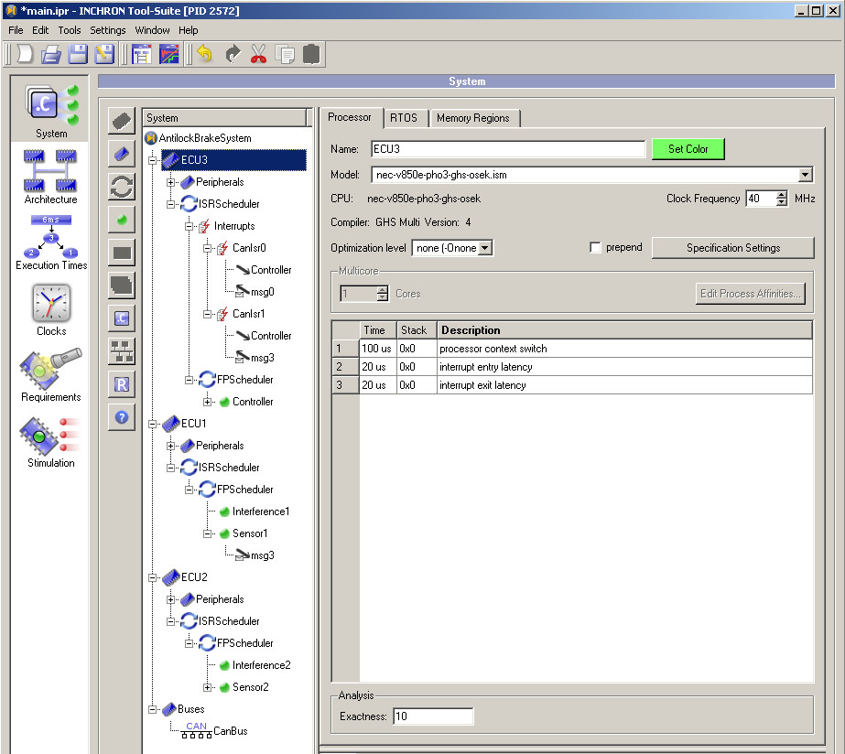
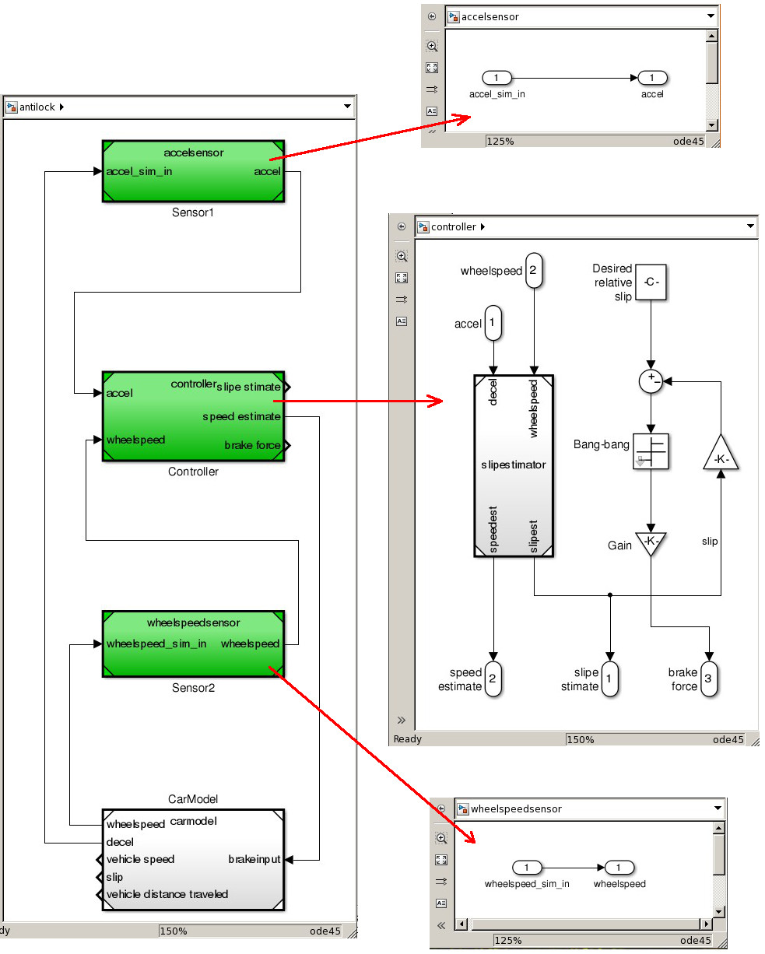
Example: ABS

Slide 16
C. Automata Generation and Formal Verification
High-level timed automata model of the system
Event or task generating automata
Uses system level timing analysis results – RTC curves
Task automaton
Uses task level timing analysis results – WCET
Tracks task generation, execution and completion
Scheduler automaton
To specify tasks’ scheduling policy
Resource automaton
Models and simulates system architecture
Observer automaton
Quantifies the parameters for verification
Formal verification using UPPAAL ^{[3]}.
^{[3]} Behrmann, Glenn, et al. "UPPAAL 4.0." IEEE Third International Conference on Quantitative Evaluation of Systems, QEST 2006.

Slide 17
C. Automata Generation and Formal Verification
ABS properties
For time threshold = 4 s, the maximum (m,k)-firm tolerance for sensor1 data = fresh and sensor2 data = stale is (4,5)
For time threshold = 6 s, the (m,k)-firm tolerance for both sensor data = fresh, does not go below (8,10)
RTC → TA
Timed event Generation satisfying RTC is easier
Abstractions of the system can be easily represented
Formal verification tools available

Slide 18
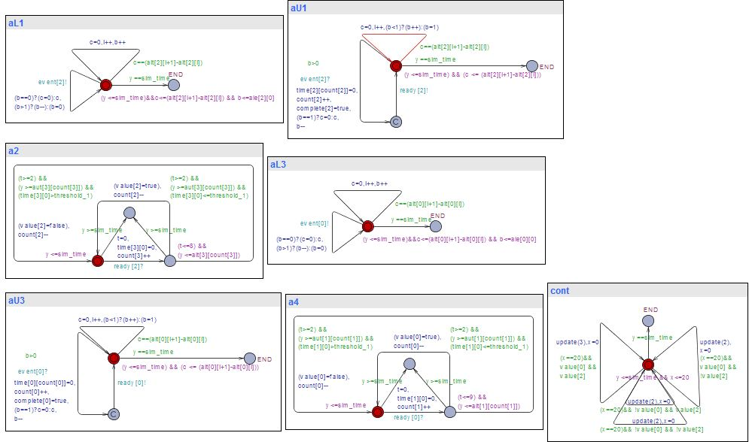
Example: ABS
Query: If m is reachable?

Slide 19
D. Closing the loop
Properties are satisfied
Formal guarantee provided by the tool flow
Property violations
Counterexample trace
If spurious?
Modify respective RTC curves
Re-execute tool flow like CEGAR loop ^{[4]}
[4] Clarke, Edmund, et al. "Abstraction and counterexample-guided refinement in model checking of hybrid systems."
International Journal of Foundations of Computer Science 14.04 (2003): 583-604.

Slide 20
Conclusion
AUTOSAFE flow – an integrated approach to system design
An interface between different realms
Control designer species the control law
Embedded systems engineer comes up with implementation mapping
Verification engineer checks for target property
Co-design of real-time control made easier
Automating model refinement using CEGAR loop is part of future work

Slide 21
References
Hamdaoui, Moncef, and Parameswaran Ramanathan. "A dynamic priority assignment technique for streams with (m, k)-firm deadlines." Computers, IEEE Transactions on 44.12 (1995): 1443-1451.
Samarjit Chakraborty, Simon Künzli, and Lothar Thiele. "A General Framework for Analysing System Properties in Platform-Based Embedded System Designs." DATE. Vol. 3. 2003.
Behrmann, Glenn, et al. "UPPAAL 4.0." IEEE Third International Conference on Quantitative Evaluation of Systems, QEST 2006.
Clarke, Edmund, et al. "Abstraction and counterexample-guided refinement in model checking of hybrid systems." International Journal of Foundations of Computer Science 14.04 (2003): 583-604.
Bokil, Prasad, et al. "Automatic test data generation for c programs." Third IEEE International Conference on Secure Software Integration and Reliability Improvement, SSIRI 2009.
Anssi, Saoussen, et al. "chronVAL/chronSIM: A Tool Suite for Timing Verification of Automotive Applications." Proc. Embedded Real-Time Software and Systems, ERTS (2012).

Slide 22
THANK YOU !!! Sajid Mohamed sajidm@atdc.iitkgp.ernet.in

