Slide 1
Structural Health Monitoring System
Group No：09
Name:
Tahmid Jawad ID: 20200208133
Sajid Sadman ID: 20200208153
Riad Ali ID: 20200208166
Sakib Md. Minhajul Alam ID: 20200208171

Slide 2
Topics
Introduction
Problem Specification and Constraints
Objective
Methodology
Result & Discussion

Slide 3
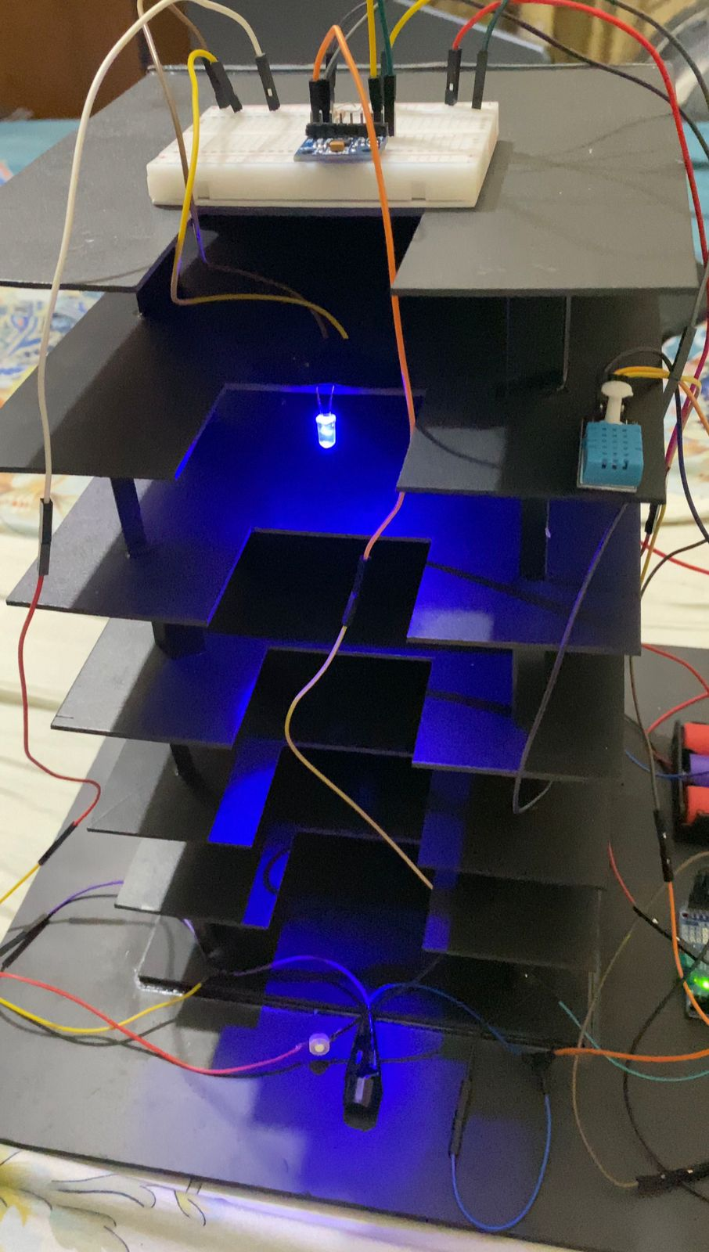
Introduction
Disaster (Earthquake, landslides etc.)
Damages (Surface crack, segregation, settlements)
Mismanagement in Construction

Slide 4
Problem Specification & Constraints
Personalized threshold value for each structure
Data Processing and Analysis
Constraints due to Terrain types
Sound knowledge of Arduino and Machine language
Signal filtering
Environmental Factors

Slide 5
Objective
Real-Time Monitoring and Condition Assessment
Early Warning and Alarms
Decision Support and Maintenance Planning
Data Visualization and Reporting

Slide 6
Methodology
Sensor Placement
Sensor Calibration
Data Acquisitions
Data Storage and Analysis
Visualization and Reporting

Slide 7
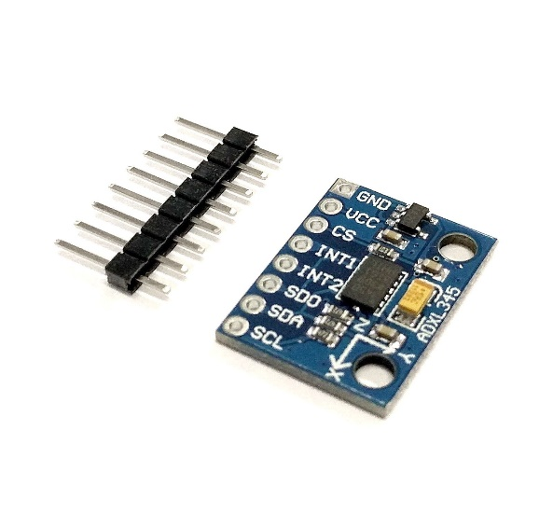
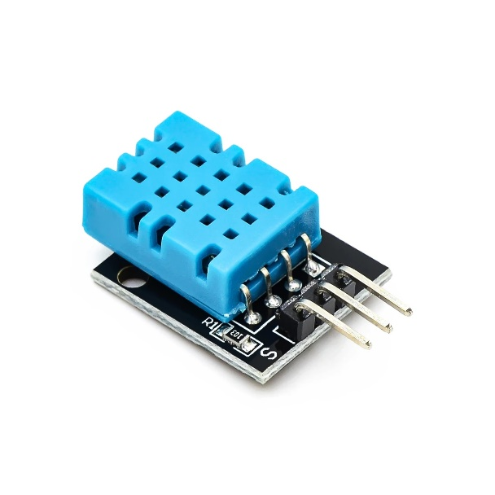
Sensors
ADXL 345 Accelerometer
DHT11 sensor
Used to measure vibrations in a structure
Captures dynamic responses to external forces of internal excitations
Sends live data to control unit
Digital Temperature & Humidity Sensor
Detects changes in humidity & temperature

Slide 8
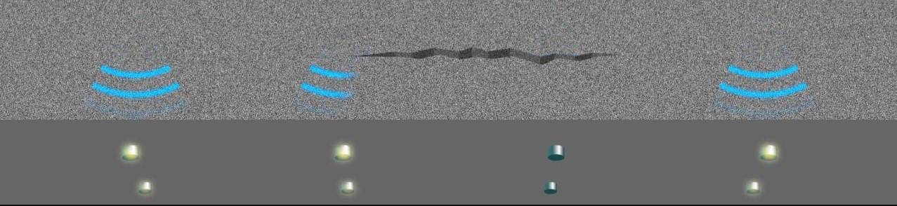
Sensor Placement
Close to the Source of Vibration
Temporary or Permanent Mounting
Numerical Analysis to asses the number
& location
Fisher Information Matrix for the optimal
positioning configuration
Source: https://asia.toshiba.com/highlights/an-aging-population-an-aging-infrastructure-how-structural-health-monitoring-combats-both-of-these-social-issues/

Slide 9
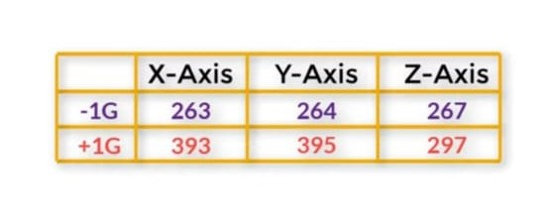
Sensor Calibration
Arduino Excitation
Minimum and maximum value calibration in X, Y, and Z .
Sample vibrations to reduce noise.
Rescaling to fractional values of G.

Slide 10
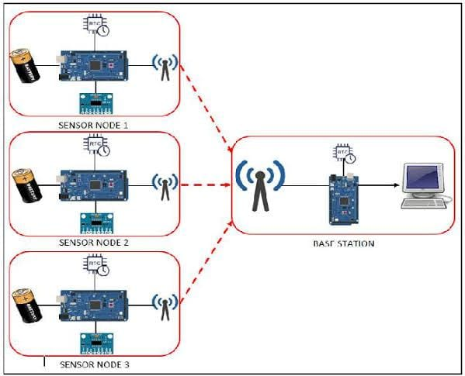
Data Storage & Analysis
Data transmission to storage device
Live data comparison & analysis
Analysis of any sharp change or fluctuation
Constant increment/decrement of values
Source: https://www.semanticscholar.org/paper/Vibration-based-Structural-Health-Monitoring-System-Torre-Pasobillo/df8ca2784b49eccf50903da69044aa94e2f205d3

Slide 11
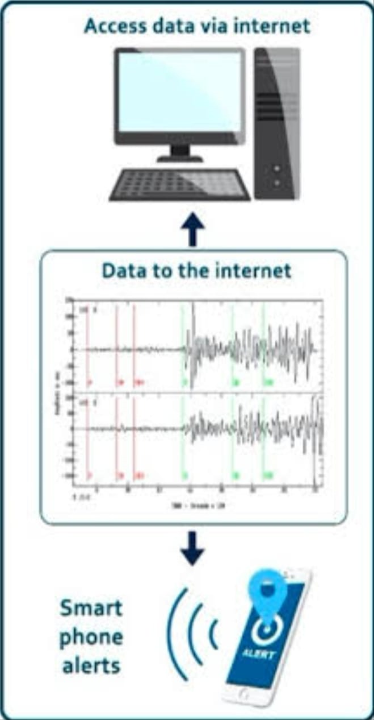
Visualization & Reporting
Visualization of live data
Setting safe range for vibration
Alarm if it exceeds the safety range
Reporting data for further inspection & recondition
Source: https://www.mdpi.com/2075-5309/11/6/263

Slide 12
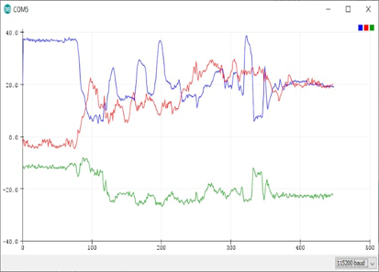
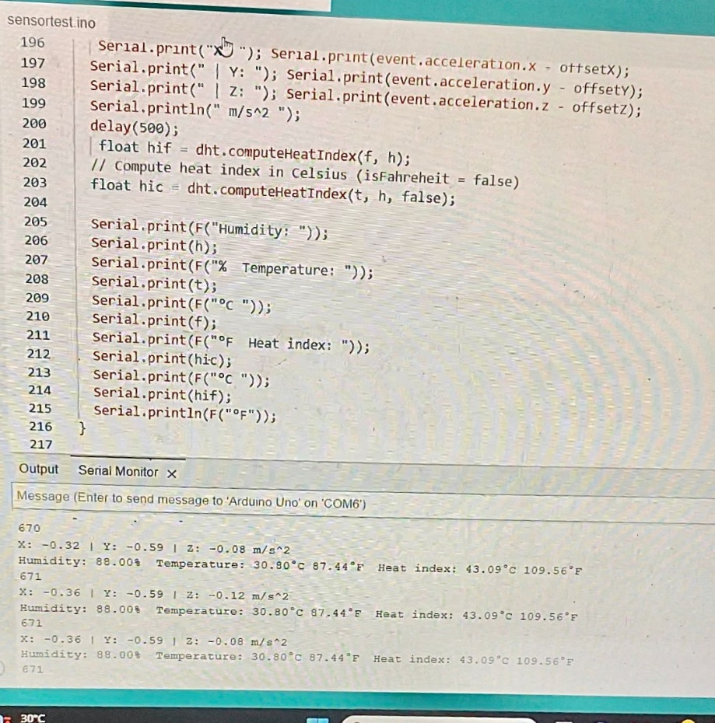
Result & Discussion
% of error < 5%

Slide 13
Result & Discussion
Future Implications:
Pin point the location & nature of defect by use of multiple sensors at multiple locations
Overall health monitoring by using other sensors like- strain gauge, displacement sensor, tilt sensor
Limitations:
Unique threshold for different structure
Understanding the significance of sensor data

Slide 14


