Slide 1
Project PatientPal
IOT Based Healthcare System

Slide 2
Key Features
01
02
03
04
IOT Healthcare Sensors
SMS and Call Alert
Custom Camera Webserver
Medicine Dispenser

Slide 3
01 IOT Healthcare Sensors
We can monitor patients heartrate, blood oxygen level, room temperature, toxic gas level.
To monitor the given values we have used a service called Blynk. It allows us to monitor data from anywhere in the world.
Name of used sensors
Temperature sensor
Humidity Sensor
Gas sensor
Heart rate and blood oxygen sensor

Slide 4
02 SMS and Call Alert
Patients can send messeges just by pressing a buton. Like if they need anything like water, food etc they can use this feature.
We have also implemented an emergency button, pressing which will make an automatic call to a saved number such as the police or the ambulance.

Slide 5
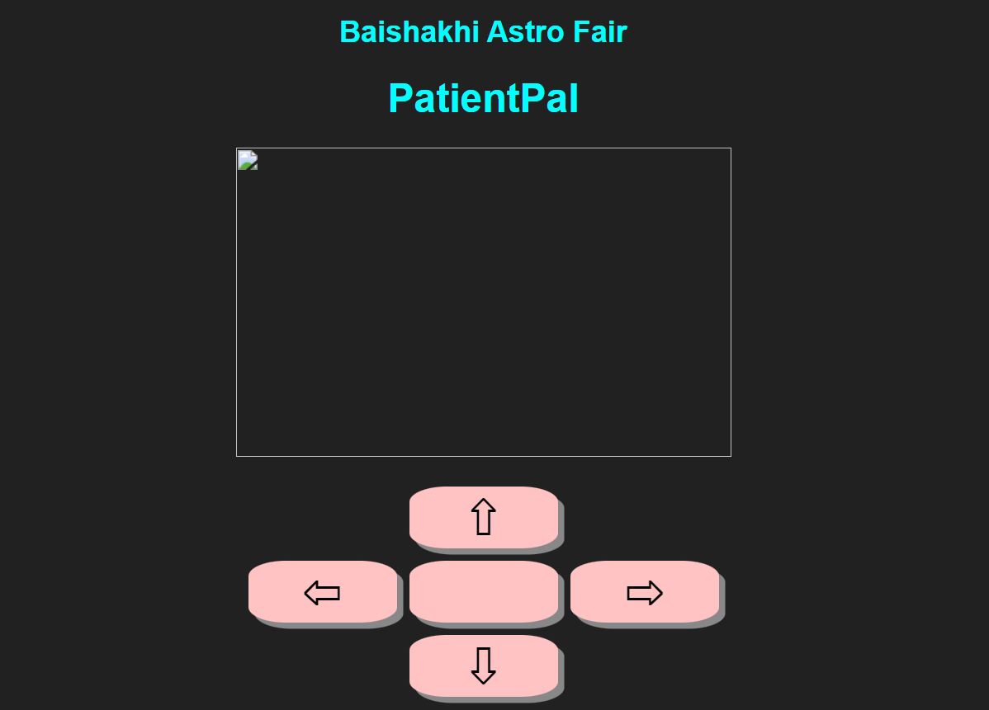
03 Dedicated Web-Server
We developed a dedicated web server for controlling and monitoring the camerand the wheels of our robot. The live video footage from the camera will also show up here.
We developed the webserver completely ourselves by using different languages like html, css and javascript.

Slide 6
04 Medicine Dispenser
Sometimes patients forget to take their medicines in time. Sometimes they also take wrong medicines or take it in the wrong time.
We have made a solution for it. We made three different boxes where different medicines are kept. The caretaker of the patient can set time for every boxes when to take which medicines.
When the actual time of taking medicines came, a light will be turned on of the actual box as well as a buzzer will be on. Thus the patient can know which medicine he have to take at that time.

Slide 7
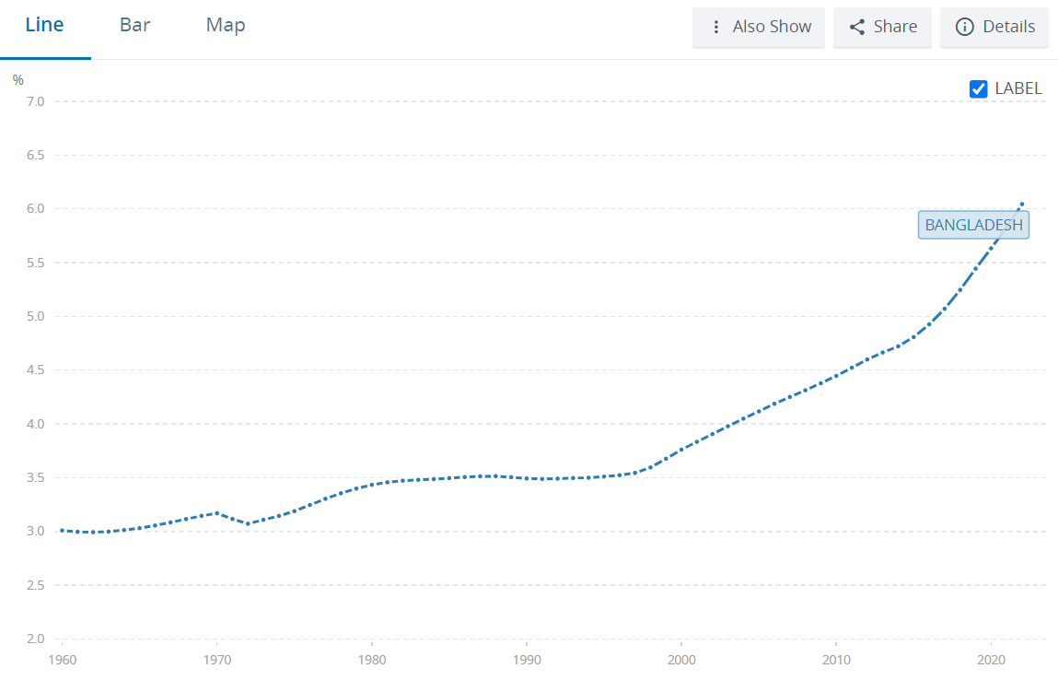
Smart Health for Smart Bangladesh
Population Aging: Bangladesh's population is rapidly aging. According to the World Bank [1], the percentage of people aged 65+ is projected to increase from 7.4% in 2020 to 16.2% by 2050. This growing demographic requires increased healthcare and social support.
Increased Workforce Participation: When families have access to affordable care options for their elderly members, younger generations can participate more fully in the workforce. According to the International Labour Organization.

Slide 8
THANKS!
Our website –
https://dev-oxygenrobotics.pantheonsite.io/

