Slide 1






$\frac{{T_{i,j}}^{n+1}−{T_{i,j}}^{n}}{\text{Δ}t}$= $\frac{1}{{\text{Δ}y}^{2}}$ $\left(\frac{c^{i,j}+c^{i,j−1}}{\text{2}}\right)$ ${T_{i,j−1}}^{n+1}$+ $\frac{1}{{\text{Δ}x}^{2}}$ $\left(\frac{c^{i,j}+c^{i−1,j}}{\text{2}}\right)$ ${T_{i−1,j}}^{n+1}$
$−\left\{\frac{1}{{\text{Δ}x}^{2}} \left(\frac{c^{i−1,j}+2c^{i,j}+c^{i+1,j}}{\text{2}}\right)+\frac{1}{{\text{Δ}y}^{2}} \left(\frac{c^{i,j−1}+2c^{i,j}+c^{i,j+1}}{\text{2}}\right)\right\}$ ${T_{i,j}}^{n+1}$
+ $\frac{1}{{\text{Δ}x}^{2}}$ $\left(\frac{c^{i+1,j}+c^{i,j}}{\text{2}}\right)$ ${T_{i+1,j}}^{n+1}$+ $\frac{1}{{\text{Δ}y}^{2}}$ $\left(\frac{c^{i,j+1}+c^{i,j}}{\text{2}}\right)$ ${T_{i,j+1}}^{n+1}$+$q_{i,j}$
${ T}^{n}$=$\left[\begin{matrix}T_{0,0}^{n} \\ T_{1,0}^{n} \\ \begin{matrix}T_{2,0}^{n} \\ ⋮ \\ \begin{matrix}T_{n_{x}−1,0}^{n} \\ T_{0,1}^{n} \\ \begin{matrix}⋮ \\ T_{i,j−1}^{n} \\ \begin{matrix}⋮ \\ T_{i−1,j}^{n} \\ \begin{matrix}T_{i,j}^{n} \\ T_{i+1,j}^{n} \\ \begin{matrix}⋮ \\ T_{i,j+1}^{n} \\ \begin{matrix}⋮ \\ T_{n_{x}−1,n_{y}−1}^{n}\end{matrix}\end{matrix}\end{matrix}\end{matrix}\end{matrix}\end{matrix}\end{matrix}\end{matrix}\right]$ ${ T}^{n+1}$=$\left[\begin{matrix}T_{0,0}^{n+1} \\ T_{1,0}^{n+1} \\ \begin{matrix}T_{2,0}^{n+1} \\ ⋮ \\ \begin{matrix}T_{n_{x}−1,0}^{n+1} \\ T_{0,1}^{n+1} \\ \begin{matrix}⋮ \\ T_{i,j−1}^{n+1} \\ \begin{matrix}⋮ \\ T_{i−1,j}^{n+1} \\ \begin{matrix}T_{i,j}^{n+1} \\ T_{i+1,j}^{n+1} \\ \begin{matrix}⋮ \\ T_{i,j+1}^{n+1} \\ \begin{matrix}⋮ \\ T_{n_{x}−1,n_{y}−1}^{n+1}\end{matrix}\end{matrix}\end{matrix}\end{matrix}\end{matrix}\end{matrix}\end{matrix}\end{matrix}\right]$ ${ Q}^{ }$=$\left[\begin{matrix}Q_{0,0}^{ } \\ Q_{1,0}^{ } \\ \begin{matrix}Q_{2,0}^{ } \\ ⋮ \\ \begin{matrix}Q_{n_{x}−1,0}^{ } \\ Q_{0,1}^{ } \\ \begin{matrix}⋮ \\ Q_{i,j−1}^{ } \\ \begin{matrix}⋮ \\ Q_{i−1,j}^{ } \\ \begin{matrix}Q_{i,j}^{ } \\ Q_{i+1,j}^{ } \\ \begin{matrix}⋮ \\ Q_{i,j+1}^{ } \\ \begin{matrix}⋮ \\ Q_{n_{x}−1,n_{y}−1}^{ }\end{matrix}\end{matrix}\end{matrix}\end{matrix}\end{matrix}\end{matrix}\end{matrix}\end{matrix}\right]$
$$J\left(c\right)=\frac{1}{n} \sum_{j=0}^{n−1}{{\left(T_{j}^{O}\left(c\right) −T_{j}^{M}\left(c\right)\right)}^{2}}$$
$$c^{i+1}{=c}^{i}−{\text{∇}}_{\text{c}}J\left(c\right){=c}^{i}−\text{α}\frac{\text{∂}\text{J}}{\text{∂}\text{c}}$$
$$\frac{∂T}{∂t}=\frac{∂}{∂x}\left(c\left(x,y\right)\frac{∂T}{∂x}\right)+\frac{∂}{∂y}\left(c\left(x,y\right)\frac{∂T}{∂y}\right)+q\left(x,y\right)$$
Δ𝑥$=\frac{L_{x}}{n_{x }−1}\text{ , }\text{Δ}y=\frac{L_{y}}{n_{y }−1}$
Parameter Estimation Of 2D Heat Distribution In Heterogeneous Media
SiSc Laboratory
Project group 2
Muhammad Sajid Ali
Shubhaditya Burela
Aneesh Futane
Pourya Pilva
Supervisors:
Univ.-Prof. Dr.rer. nat. Uwe Naumann
Leppkes Klaus

Slide 2
Overview
Introduction
Heat Distribution
Parameter Estimation
FDM
Discretization in space
Discretization in time
Linear system of equations
Implementation
The code
Input file
Linear solvers
Optimization
Visualization
Results
Test case 1
Test case 2
Test case 3
Solver timings
Adjoint vs Tangent timings
Project management
Conclusion

Slide 3
Introduction

Slide 4
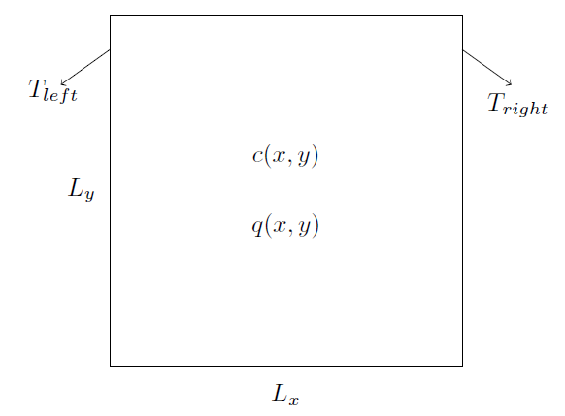

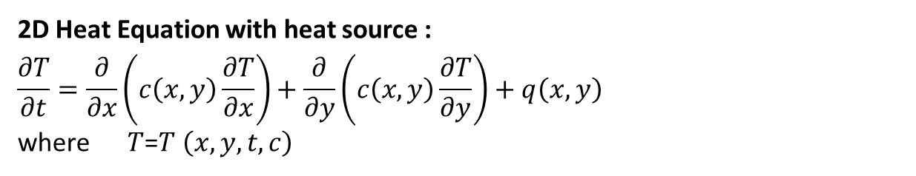
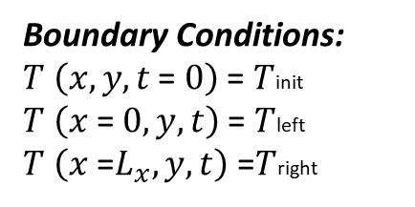
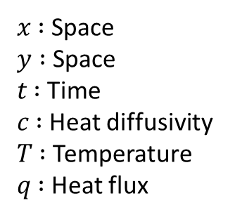
Introduction: Heat Distribution
2D Heat Equation with heat source :
$$\frac{∂T}{∂t}=\frac{∂}{∂x}\left(c\left(x,y\right)\frac{∂T}{∂x}\right)+\frac{∂}{∂y}\left(c\left(x,y\right)\frac{∂T}{∂y}\right)+q\left(x,y\right)$$
where $T$=$T$ $\left(x,y,t,c\right)$
𝑥 ∶ Space
$y$ ∶ Space
𝑡 ∶ Time
𝑐 ∶ Heat diffusivity
𝑇 ∶ Temperature
𝑞 ∶ Heat flux
Boundary Conditions:
$T$ $\left(x,y,t \text{=} 0\right)$ = $T$init
$T$ $\left(x \text{=} 0,y,t\right)$ = $T$left
$T$ $\left(x \text{=}L_{x},y,t\right)$ =$T$right

Slide 5
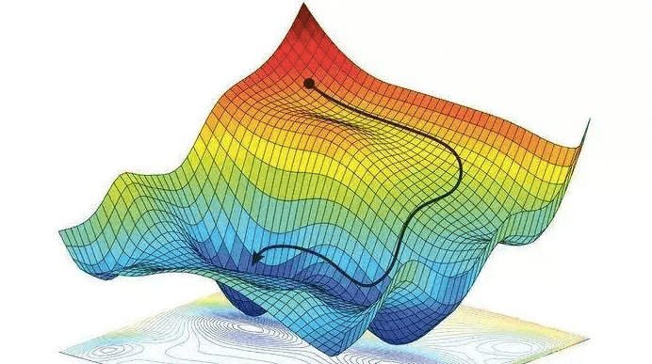

Introduction: Parameter Estimation
Minimizing the objective function:
$J\left(c\right)=\frac{1}{n} \sum_{j=0}^{n−1}{{\left(T_{j}^{O}\left(c\right) −T_{j}^{M}\left(c\right)\right)}^{2}}$
...….with the help of gradient descent
$$c^{i+1}{=c}^{i}−{\text{∇}}_{\text{c}} J\left(c\right){=c}^{i}−\text{α}\frac{\text{∂}\text{J}}{\text{∂}\text{c}}$$
$c\left(x,y\right)$ is the optimal parameter
$J\left(c\right)$ is the objective function
$T_{j}^{O}$ is the observed temperature
$T_{j}^{M}$ is the measured temperature
Source: easyai.tech

Slide 6
FDM

Slide 7
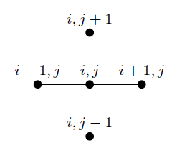
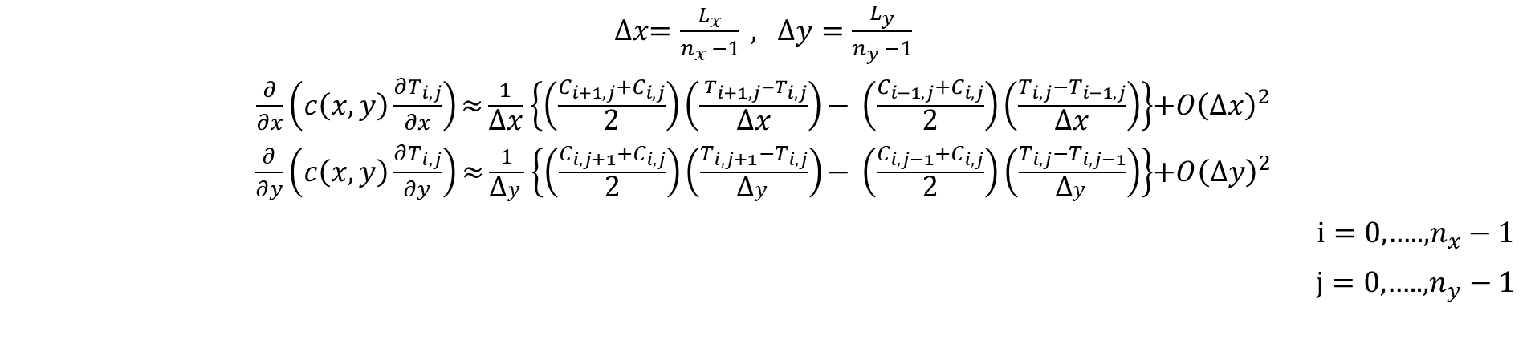
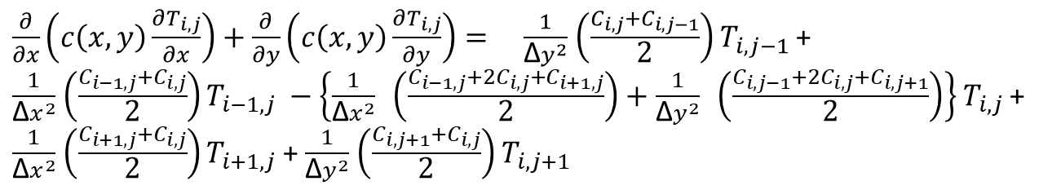
Discretization in Space
Central difference scheme
Δ𝑥$=\frac{L_{x}}{n_{x }−1}\text{ ,} \text{Δ}y=\frac{L_{y}}{n_{y }−1}$
$\frac{∂}{∂x}\left(c\left(x,y\right)\frac{∂T_{i,j}}{∂x}\right)\text{≈}\frac{1}{\text{Δ}\text{x}}$ $\left\{\left(\frac{C_{i+1,j}+C_{i,j}}{\text{2}}\right)\left(\frac{ _{T_{i+1,j}−T_{i,j}}}{\text{Δ}\text{x}}\right)\text{−} \left(\frac{C_{i−1,j}+C_{i,j}}{\text{2}}\right)\left(\frac{T_{i,j}−T_{i−1,j}}{\text{Δ}\text{x}}\right)\right\}$+${O\left(\text{Δ}\text{x}\right)}^{2}$
$\frac{∂}{∂y}\left(c\left(x,y\right)\frac{∂T_{i,j}}{∂y}\right)\text{≈}\frac{1}{\text{Δ}y}$ $\left\{\left(\frac{C_{i,j+1}+C_{i,j}}{\text{2}}\right)\left(\frac{T_{i,j+1}−T_{i,j}}{\text{Δ}y}\right)\text{−} \left(\frac{C_{i,j−1}+C_{i,j}}{\text{2}}\right)\left(\frac{T_{i,j}−T_{i,j−1}}{\text{Δ}y}\right)\right\}$+${O\left(\text{Δ}y\right)}^{2}$
$i=0$,…..,$n_{x}−1$
$j=0$,…..,$n_{y}−1$
Combining
$\frac{∂}{∂x}\left(c\left(x,y\right)\frac{∂T_{i,j}}{∂x}\right)+\frac{∂}{∂y}\left(c\left(x,y\right)\frac{∂T_{i,j}}{∂y}\right)= \frac{1}{{\text{Δ}y}^{2}}$ $\left(\frac{C_{i,j}+C_{i,j−1}}{\text{2}}\right)$ ${T_{i,j−1}}^{ }$+ $\frac{1}{{\text{Δ}x}^{2}}$ $\left(\frac{C_{i−1,j}+C_{i,j}}{\text{2}}\right){T_{i−1,j}}^{ }−\left\{\frac{1}{{\text{Δ}x}^{2}} \left(\frac{C_{i−1,j}+2C_{i,j}+C_{i+1,j}}{\text{2}}\right)+\frac{1}{{\text{Δ}y}^{2}} \left(\frac{C_{i,j−1}+2C_{i,j}+C_{i,j+1}}{\text{2}}\right)\right\}$ ${T_{i,j}}^{ }$+ $\frac{1}{{\text{Δ}x}^{2}}$ $\left(\frac{C_{i+1,j}+C_{i,j}}{\text{2}}\right){T_{i+1,j}}^{ }$+ $\frac{1}{{\text{Δ}y}^{2}}$ $\left(\frac{C_{i,j+1}+C_{i,j}}{\text{2}}\right)$ ${T_{i,j+1}}^{ }$

Slide 8
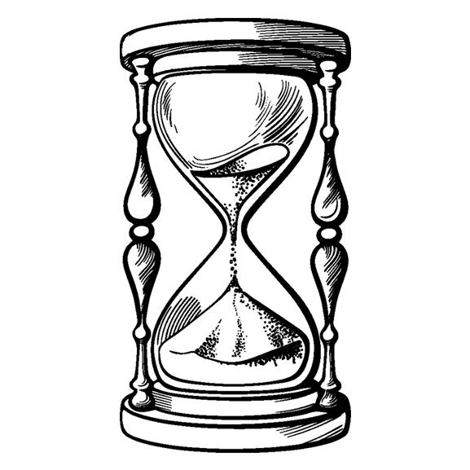
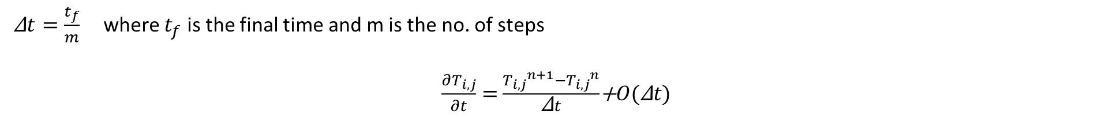
Discretization in Time
Implicit Euler
Δ$t=\frac{t_{f}}{m}$ where $t_{f}$ is the final time and m is the no. of steps
$\frac{∂T_{i,j}}{∂t}=$ $\frac{{T_{i,j}}^{n+1}−{T_{i,j}}^{n}}{\text{Δ}t}$+$O(\text{Δ}t)$

Slide 9
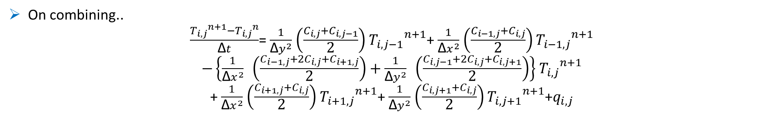
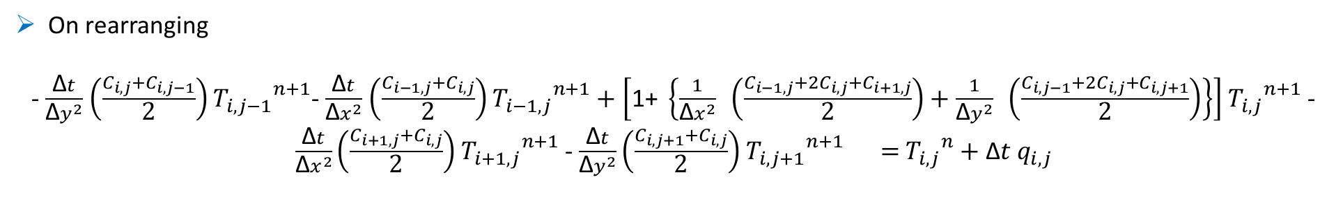
Combining
On combining..
$\frac{{T_{i,j}}^{n+1}−{T_{i,j}}^{n}}{\text{Δ}t}$= $\frac{1}{{\text{Δ}y}^{2}}$ $\left(\frac{C_{i,j}+C_{i,j−1}}{\text{2}}\right)$ ${T_{i,j−1}}^{n+1}$+ $\frac{1}{{\text{Δ}x}^{2}}$ $\left(\frac{C_{i−1,j}+C_{i,j}}{\text{2}}\right)$ ${T_{i−1,j}}^{n+1}$
$−\left\{\frac{1}{{\text{Δ}x}^{2}} \left(\frac{C_{i−1,j}+2C_{i,j}+C_{i+1,j}}{\text{2}}\right)+\frac{1}{{\text{Δ}y}^{2}} \left(\frac{C_{i,j−1}+2C_{i,j}+C_{i,j+1}}{\text{2}}\right)\right\}$ ${T_{i,j}}^{n+1}$
+ $\frac{1}{{\text{Δ}x}^{2}}$ $\left(\frac{C_{i+1,j}+C_{i,j}}{\text{2}}\right)$ ${T_{i+1,j}}^{n+1}$+ $\frac{1}{{\text{Δ}y}^{2}}$ $\left(\frac{C_{i,j+1}+C_{i,j}}{\text{2}}\right)$ ${T_{i,j+1}}^{n+1}$+$q_{i,j}$
On rearranging
- $\frac{\text{Δ}t}{{\text{Δ}y}^{2}}$ $\left(\frac{C_{i,j}+C_{i,j−1}}{\text{2}}\right)$ ${T_{i,j−1}}^{n+1}$- $\frac{\text{Δ}t}{{\text{Δ}x}^{2}}$ $\left(\frac{C_{i−1,j}+C_{i,j}}{\text{2}}\right)$ ${T_{i−1,j}}^{n+1}+\left[\text{1+ }\left\{\frac{1}{{\text{Δ}x}^{2}} \left(\frac{C_{i−1,j}+2C_{i,j}+C_{i+1,j}}{\text{2}}\right)+\frac{1}{{\text{Δ}y}^{2}} \left(\frac{C_{i,j−1}+2C_{i,j}+C_{i,j+1}}{\text{2}}\right)\right\}\right]$ ${T_{i,j}}^{n+1}$ - $\frac{\text{Δ}t}{{\text{Δ}x}^{2}}\left(\frac{C_{i+1,j}+C_{i,j}}{\text{2}}\right)$ ${T_{i+1,j}}^{n+1}$- $\frac{\text{Δ}t}{{\text{Δ}y}^{2}}\left(\frac{C_{i,j+1}+C_{i,j}}{\text{2}}\right)$ ${T_{i,j+1}}^{n+1} =$ ${T_{i,j}}^{n}+$ $\text{Δ}t$ $q_{i,j}$

Slide 10
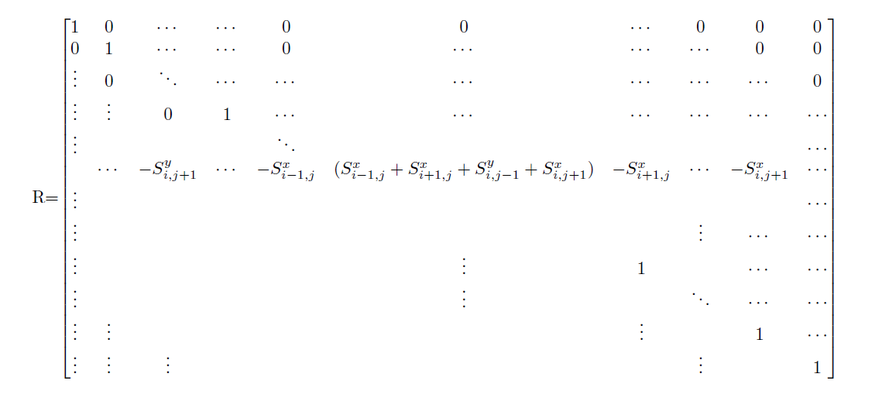

The linear system
In matrix form :
$\left(I−\text{Δ}t.R\right)T^{n+1}$= $T^{n}$+ $\text{Δ}t.Q$
${ T}^{n}$=$\left[\begin{matrix}T_{0,0}^{n} \\ T_{1,0}^{n} \\ \begin{matrix}T_{2,0}^{n} \\ ⋮ \\ \begin{matrix}T_{n_{x}−1,0}^{n} \\ T_{0,1}^{n} \\ \begin{matrix}⋮ \\ T_{i,j−1}^{n} \\ \begin{matrix}⋮ \\ T_{i−1,j}^{n} \\ \begin{matrix}T_{i,j}^{n} \\ T_{i+1,j}^{n} \\ \begin{matrix}⋮ \\ T_{i,j+1}^{n} \\ \begin{matrix}⋮ \\ T_{n_{x}−1,n_{y}−1}^{n}\end{matrix}\end{matrix}\end{matrix}\end{matrix}\end{matrix}\end{matrix}\end{matrix}\end{matrix}\right]$ ${ T}^{n+1}$=$\left[\begin{matrix}T_{0,0}^{n+1} \\ T_{1,0}^{n+1} \\ \begin{matrix}T_{2,0}^{n+1} \\ ⋮ \\ \begin{matrix}T_{n_{x}−1,0}^{n+1} \\ T_{0,1}^{n+1} \\ \begin{matrix}⋮ \\ T_{i,j−1}^{n+1} \\ \begin{matrix}⋮ \\ T_{i−1,j}^{n+1} \\ \begin{matrix}T_{i,j}^{n+1} \\ T_{i+1,j}^{n+1} \\ \begin{matrix}⋮ \\ T_{i,j+1}^{n+1} \\ \begin{matrix}⋮ \\ T_{n_{x}−1,n_{y}−1}^{n+1}\end{matrix}\end{matrix}\end{matrix}\end{matrix}\end{matrix}\end{matrix}\end{matrix}\end{matrix}\right]$ ${ Q}^{ }$=$\left[\begin{matrix}Q_{0,0}^{ } \\ Q_{1,0}^{ } \\ \begin{matrix}Q_{2,0}^{ } \\ ⋮ \\ \begin{matrix}Q_{n_{x}−1,0}^{ } \\ Q_{0,1}^{ } \\ \begin{matrix}⋮ \\ Q_{i,j−1}^{ } \\ \begin{matrix}⋮ \\ Q_{i−1,j}^{ } \\ \begin{matrix}Q_{i,j}^{ } \\ Q_{i+1,j}^{ } \\ \begin{matrix}⋮ \\ Q_{i,j+1}^{ } \\ \begin{matrix}⋮ \\ Q_{n_{x}−1,n_{y}−1}^{ }\end{matrix}\end{matrix}\end{matrix}\end{matrix}\end{matrix}\end{matrix}\end{matrix}\end{matrix}\right]$
where $S_{i−1,j}^{x}$ is defined as $\frac{1}{{\text{Δ}x}^{2}}$ $\left(\frac{C_{i−1,j}+C_{i,j}}{\text{2}}\right)$. Similarly $S_{i+1,j}^{x}$ = $\frac{1}{{\text{Δ}x}^{2}}$ $\left(\frac{C_{i+1,j}+C_{i,j}}{\text{2}}\right)$ , $S_{i,j−1}^{y}$= $\frac{1}{{\text{Δ}y}^{2}}$ $\left(\frac{C_{i,j−1}{+C}_{i,j}}{\text{2}}\right)$ and $S_{i,j+1}^{y}$= $\frac{1}{{\text{Δ}y}^{2}}$ $\left(\frac{C_{i,j+1}+C_{i,j}}{\text{2}}\right)$

Slide 11
Implementation

Slide 12
The code: Flowchart
Read input file
Initialize T, C, Q,
Compute Δx, Δy, Δt
Solver
Make R
Make LHS I - Δt R
Optimizer
While(error > opt_err){
dJdc = Compute gradient()
c_{i+1} = c_{i} - α * dJdc
}
c_{opt}
T, C
Write vtk
While(iter < m ){
Make RHS T^{n} + Δt Q
Solve (I - Δt R)T^{n+1} = T^{n} + Δt Q
T^{n} = T^{n+1}
}
Initialize C_{pert}
T_{obs} = T^{n}

Slide 13
The code: Structure
Input.h
Input class to read from an input json file
Diffusion.h
All helper functions required
Main.cpp
The main code
Solver.h
The main time loop with gauss/dense/sparse solver
Optimizer.h
Optimization loop with computation of gradients and cost function
Visualize.h
Vtk files written
Tests_solve.cpp
Google tests

Slide 14
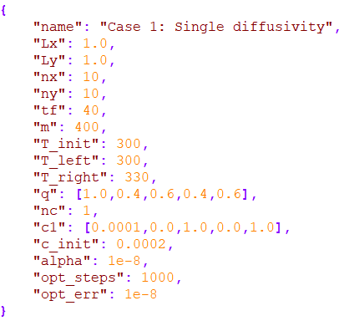
Input
Json file to read input
Rapidjson library used
Case_1.json
Name - The name of the test case
Lx - Length in x-direction
Ly - Length in y-direction
nx - Number of points in x-direction
ny - Number of points in y-direction
tf - Final time
m - Number of time steps
T_init - Initial temperature
T_left - Left wall boundary temperature
T_right - Right wall boundary temperature
nc - Number of different heat diffusivity cases
c1 - Heat diffusivity values in the form of [c; x-start; x-end; y-start; y-end]
q - Heat source values in the form of [q; x-start; x-end; y-start; y-end]
c_init - Heat diffusivity starting value for parameter optimization
α- Descent step size
opt steps - Number of maximum optimization steps
opt err - RMS error of gradient to stop the optimization loop

Slide 15
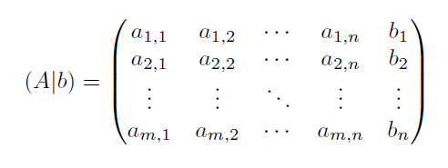
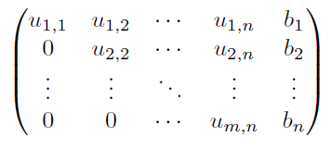


Linear solvers
Gauss elimination
Eigen/Dense
P - permutation matrix
L - Lower triangular matrix
U - upper triangular matrix
Eigen/Sparse
LU decomposition (same as Eigen/Dense)
Sparse column major storage of matrix A

Slide 16
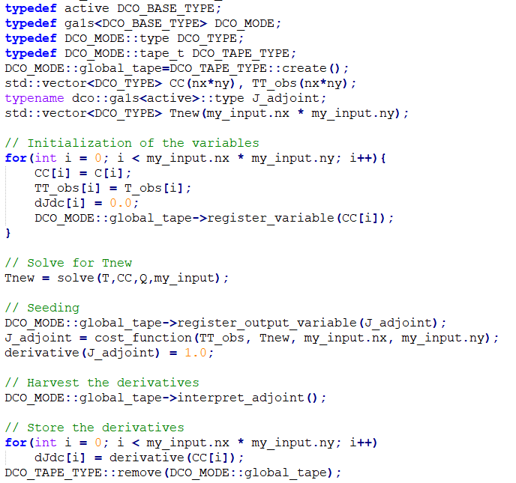
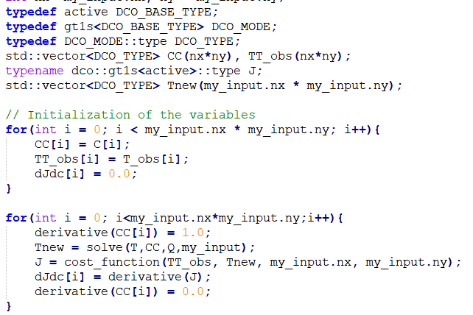
Optimizer
Adjoint mode
Tangent mode

Slide 17
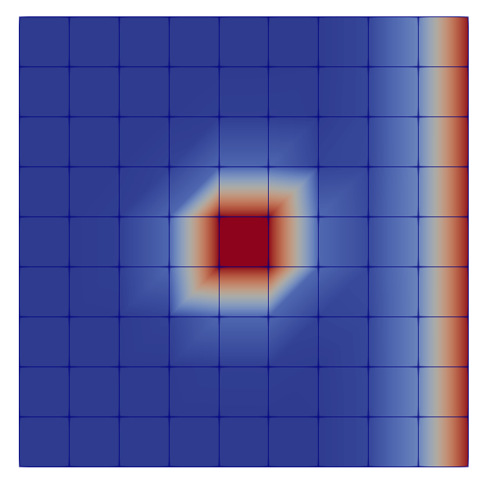

Visualize
Vtk files written
Rectilinear grid
Field data 2
Temperature
Heat diffusivity
Visualized with Paraview

Slide 18
Results

Slide 19
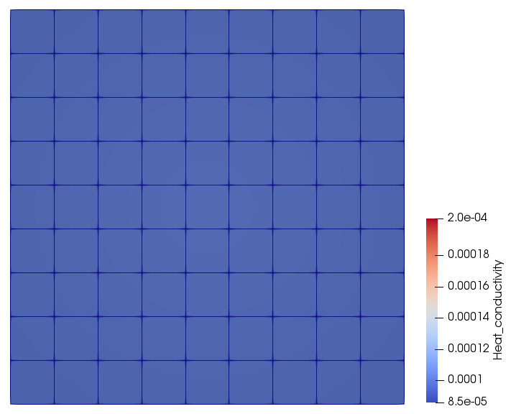
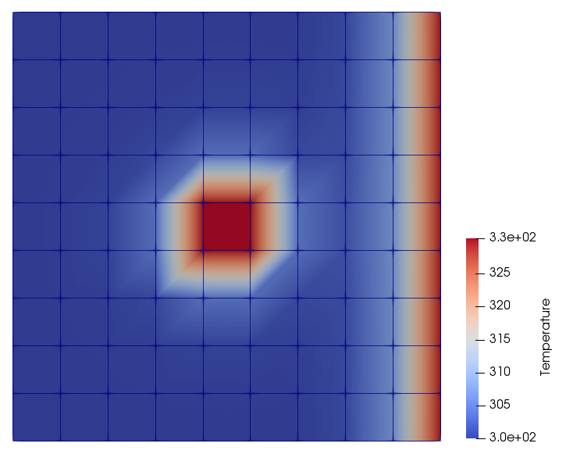
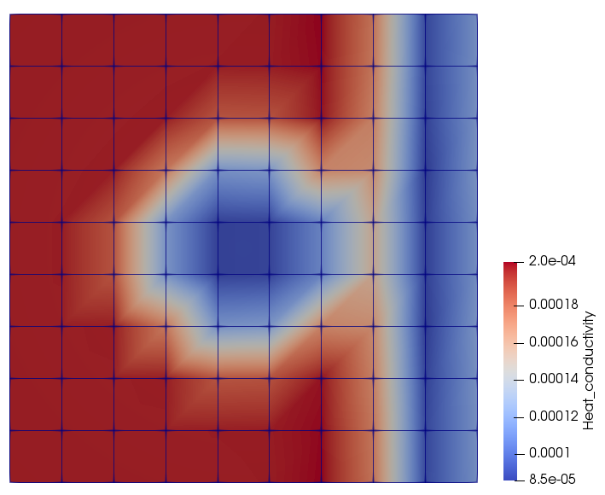
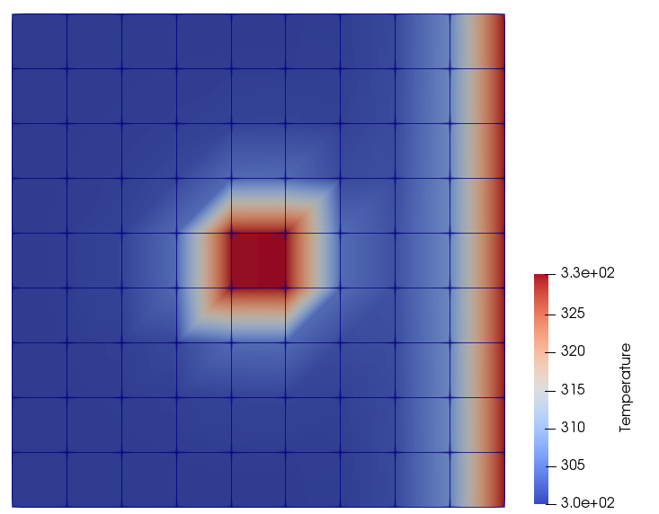
Test case 1
Case_1.json
solve
Target heat diffusivity
Observed temperature
optimization
solve
Optimized heat diffusivity
Measured temperature

Slide 20
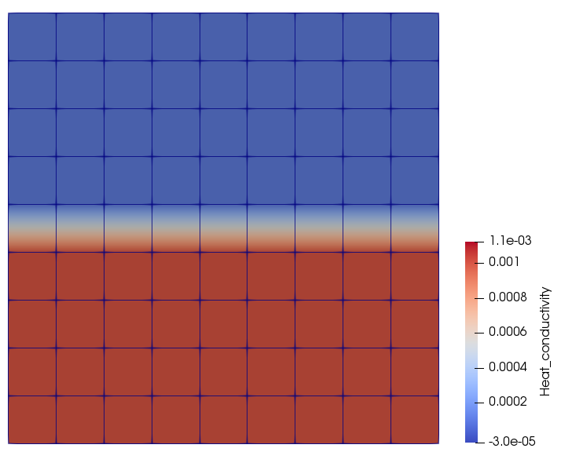
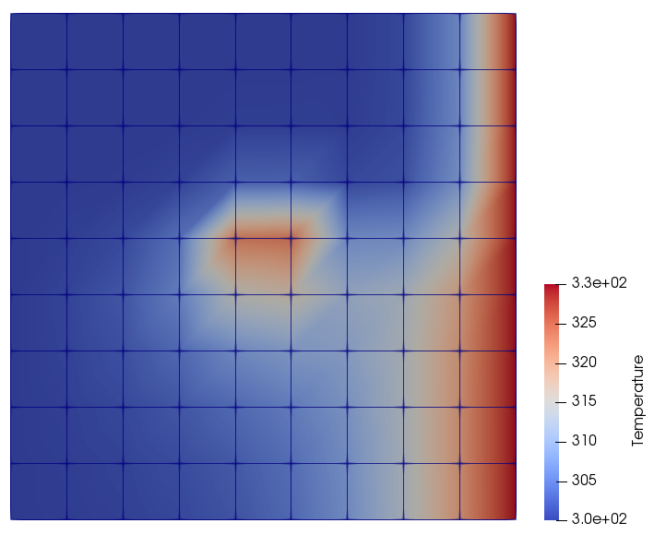
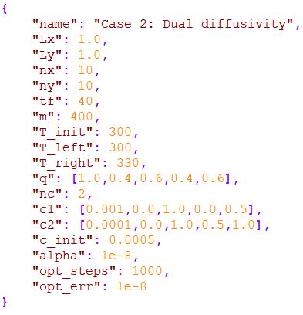
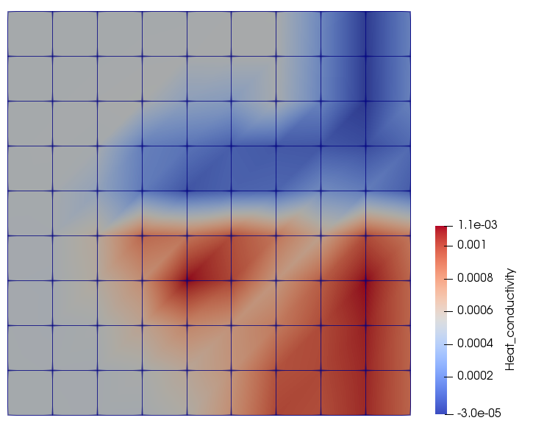
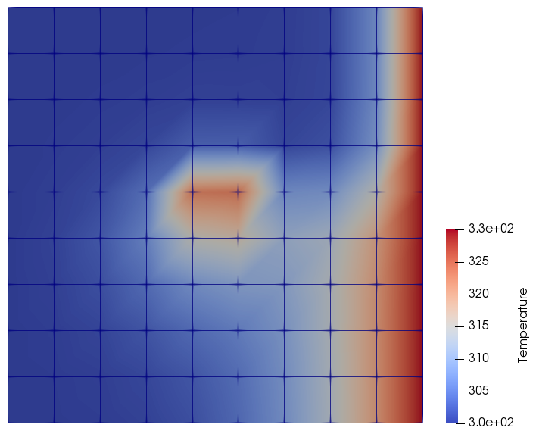
Test case 2
Case_2.json
solve
Target heat diffusivity
Observed temperature
optimization
solve
Optimized heat diffusivity
Measured temperature

Slide 21
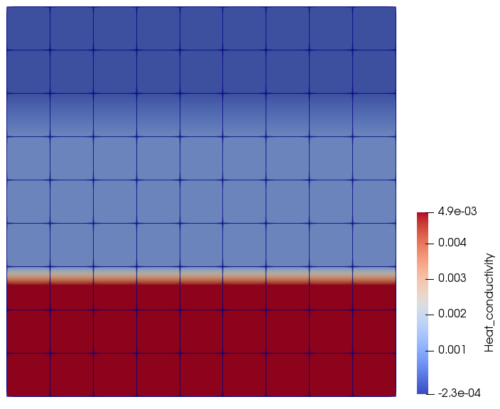
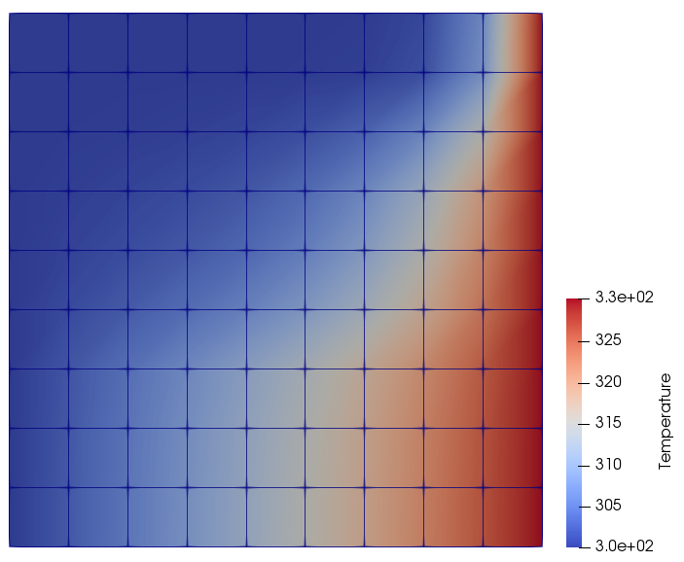
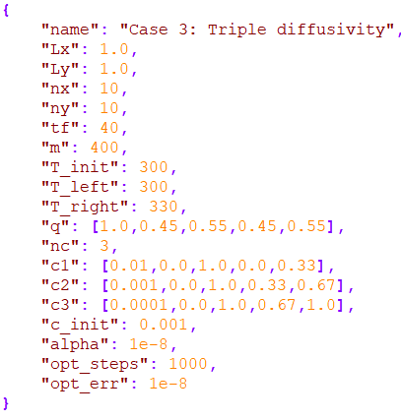
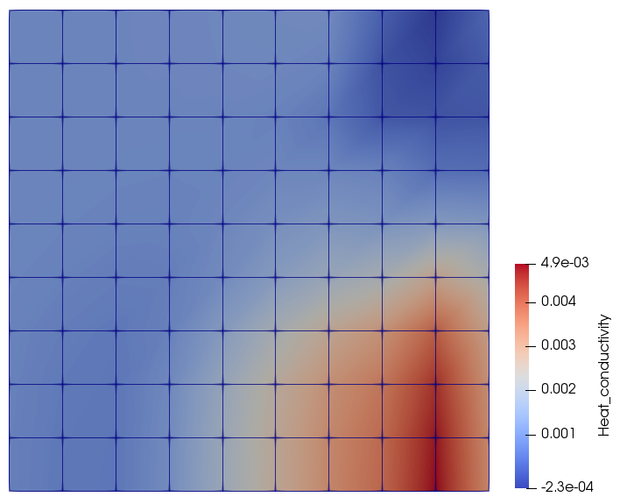
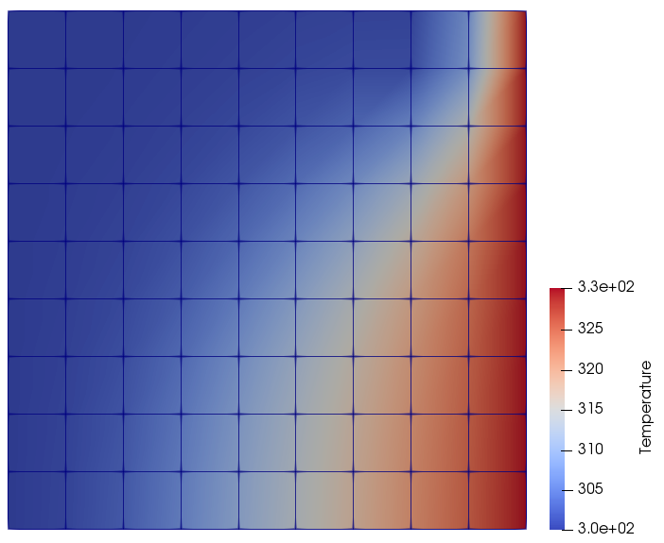
Test case 3
Case_3.json
solve
Target heat diffusivity
Observed temperature
optimization
solve
Optimized heat diffusivity
Measured temperature

Slide 22
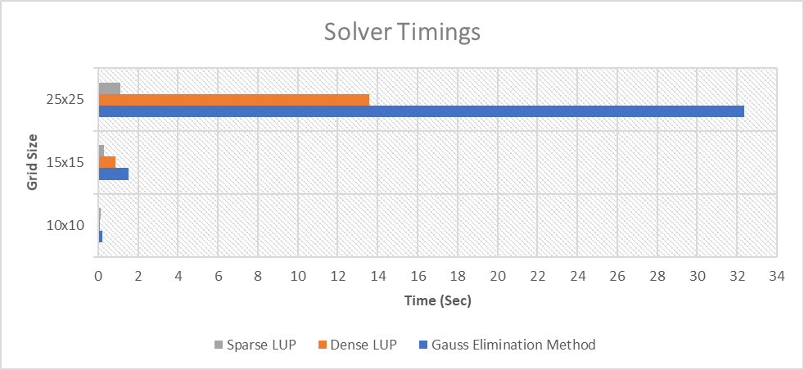
Solver Timings
Note: Timings for 1 solve

Slide 23
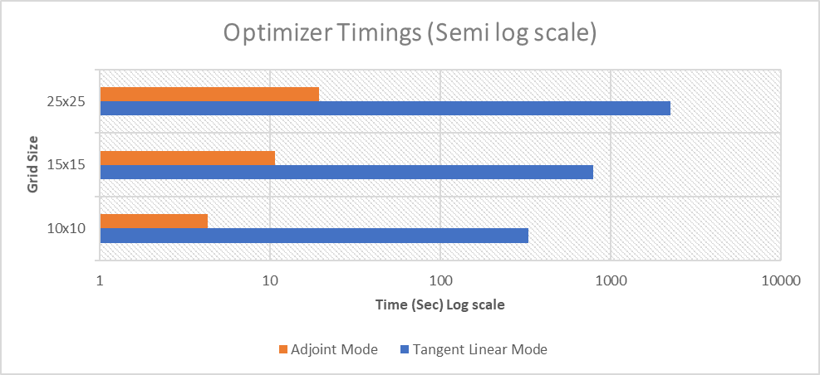
Tangent vs Adjoint Timings
Note: Timings for 20 optimization steps

Slide 24
Project Management

Slide 25
Project management
Code written in C++
RWTH GitLab used
Member | Main Responsibility
Muhammad Sajid Ali | Main code, input parser, solvers, code integration
Shubhaditya Burela | Optimizer (dco), cmake, RWTH cluster integration, running tests on cluster
Aneesh Futane | Google tests, presentation
Pourya Pilva | Visualization (vtk), report

Slide 26
Conclusion

Slide 27
Conclusion
The problem successfully solved with FDM and parameters successfully optimized by Gradient Descent method
Sparse solvers the fastest
Adjoint mode better than Tangent mode for our problem
Parallelize?
Max time taken by linear solver and dco::interpret_adjoint()
Both are external libraries and hence hard to parallelize them
Scope for further work
Non-gradient optimization methods
Training Neural Networks using the inputs and/or gradients to predict temperature

Slide 28
Thank you ☺
Any questions???

