Slide 1
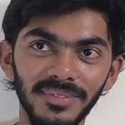

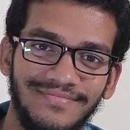
Smart Attendance System
LIVE FEED
attendance_2026-03-27.xlsx
Classroom
KRISHNA
MANIDEEP
UNKNOWN
Name
Date
Time
KRISHNA
2026-03-27
11:21:02
📷 IP CAM
GIRI
2026-03-27
11:21:02
GURUDEEP
2026-03-27
11:21:02
ABHINAV
2026-03-27
11:21:02
MRIDHUL
2026-03-27
11:21:02
Students entering
PRAVEEN
2026-03-27
11:21:02
Face Recognition • Bounding Boxes
RISHI
2026-03-27
11:21:02
SANDEEP
2026-03-27
11:21:02
ENTRANCE
MANIDEEP
2026-03-27
11:21:02
5
1
2
4
Attendance
Marking
Video
Input
Face
Detection
3
Identity
Matching
Embedding
Extraction
9 Students Marked Present
M
To: faculty@iiitk.ac.in
Sub: Attendance Report – 2026-03-27
Auto Email Report to Faculty
📎 attendance_2026-03-27.xlsx
SEND ✉
Camera placed near Door
Recognized Face
ArcFace AI Model
Excel Report
Gmail Report
D. Sajid Ali · P. Omkar · D. Manideep Reddy | IIITDM Kurnool — ECE Dept |Dr. Sreenivasa Reddy Yeduri | 2025–26

