Slide 1
Word2Vec Implementation – Presentation by Sajid Ahmed

Slide 2
What is word2vec?
Word2vec is an approach to create word embeddings.
Word embedding is a representation of a word as a numeric vector.
Except for word2vec there exist other methods to create word embeddings, such as fastText, GloVe, ELMO, BERT, GPT-2, etc.
There are two word2vec architectures proposed in the paper:
CBOW (Continuous Bag-of-Words) : a model that predicts a current word based on its context words.
Skip-Gram: a model that predicts context words based on the current word.

Slide 3
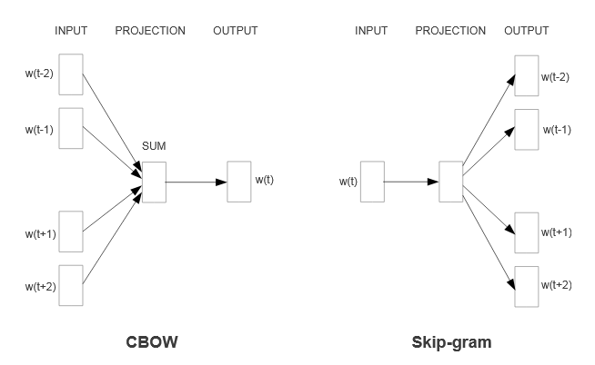
Word2Vec Model Architecture
Word2vec is based on the idea that a word’s meaning is defined by its context. Context is represented as surrounding words.

Slide 4
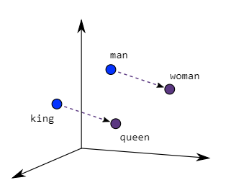
CBOW & Skip Gram Model
The Model consists of two models:
Continuous Bag-of-Words model (CBOW)
In this approach, the model uses context words to predict the target words.
The input may be a group of words or a single word.
Skip-gram model
In this approach, the model uses the target words to predict the context words.
involves training a neural network to learn the weights of the hidden layer
Given a specific word as its input, the model’s goal is to look into the dictionary and pick a word whose context is closely related to the target word.

Slide 5
Model Architecture and Training
The initial step would be to encode all words with their IDs. ID is an integer (index) that identifies word position in the vocabulary
Then it passed the word Ids to the Embedding layer, which takes word ID and returns its 300-dimensional vector. Word2vec embeddings are 300-dimensional, as authors proved this number to be the best in terms of embedding quality and computational costs.
embedding layer as a simple lookup table with learnable weights, or as a linear layer without bias and activation.
Then the Linear (Dense) layer with a SoftMax activation.
A model for a multi-class classification task, where the number of classes is equal to the number of words in the vocabulary.
The difference between CBOW and Skip-Gram model is in the number of input words. CBOW model takes several words, each goes through the same Embedding layer, and then word embedding vectors are averaged before going into the Linear layer
The Skip-Gram model takes a single word instead

Slide 6
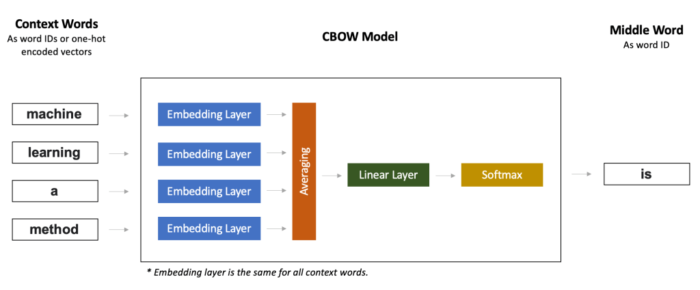
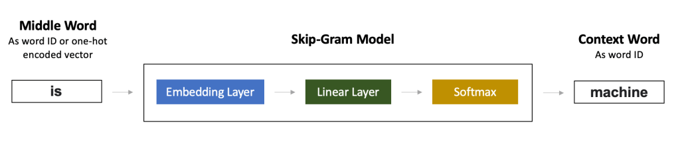

Slide 7
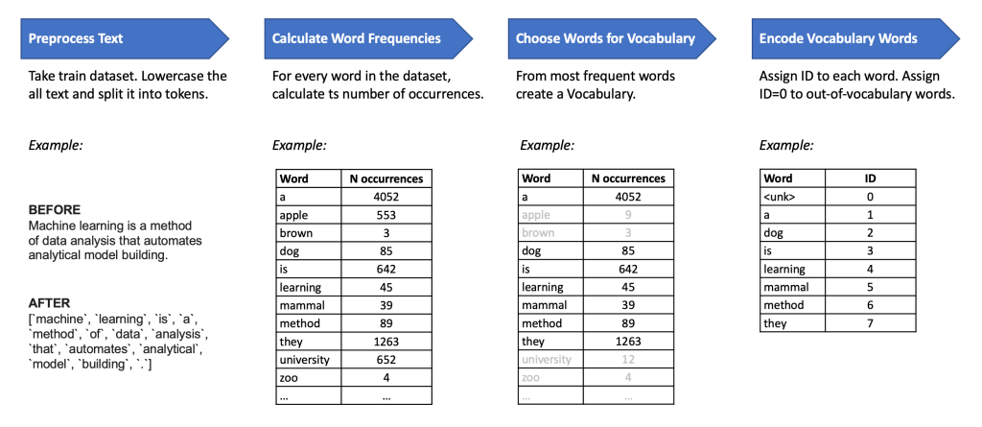
Data Preparation
The main step in data preparation is to create a vocabulary by filtering out rare words, that occurred less than 5 times in the corpus;
vocabulary created only from the words that appeared at least countable times within a text.
word_counts = Counter(index_words)
Used basic_english tokenizer from PyTorch that lowercases text, splits it into tokens by whitespace, but putting punctuation into separate tokens.

Slide 8

Skip Gram Training
Subsampling
To make optimization more efficient, the researchers subsampled the dataset so that words with high occurrence can be ignored while training. To be specific, they calculated the subsampling probability to be
With the skipgram architecture, for each word in the text, we want to define a surrounding _context_ and grab all the words in a window around that word, with size C.
Since the more distant words are usually less related to the current word than those close to it, we give less weight to the distant words by sampling less from those words in our training examples.
If we choose C = 5, for each training word we will select randomly a number R in range [ 1: C ], and then use R words from previous words and R words from the future words and make the Word as correct labels.

Slide 9

Negative Sampling
For every example we give the network, we train it using the output from the softmax layer. That means for each input, we're making very small changes to millions of weights even though we only have one true examples. This makes training the network very inefficient.
We can approximate the loss from the softmax layer by only updating a small subset of all the weights at once. We'll update the weights for the correct example, but only a small number of incorrect, or noise, examples. This is called "negative sampling".

Slide 10
Cbow Model Results
'beautiful' 'over', 'but', 'brown’,
'brown': 'has', 'jumps', "king's,
'fox': 'a', 'toast', 'brown’,
'lazy': 'quick', 'a', 'this’,
'the': 'is', 'over', 'quick'

Slide 11
Skip-Gram Results
Epoch: 1/30 Loss: 8.31590747833252 <= Initial Training epoch
Target Word | predicted context words / Similar words
can't | firefox, ctrl+w, visible, right-click, error
this | loop, skin, shouldn't, script, management
not | cvs, launch, quickly, migration, than
to | tabbing, everything, empty, drawn, plugin
password | chars, connection, below, 2003, contain
all | exists, xp, ibm, blocked, do
firefox | can't, strict, ctrl+w, history, starts
for | select, background, selection, centered, any
quickly | not, every, app, server, options
garbled | small, see, closes, position, destination
modern | applet, text, tar, holding, because
crashing | most, control, wish, blue, occurs
produces | pages, talkback, each, dialogs, check
management | parent, this, amount, quickly, manually
finishes | paint, filename, redirects, rfe, write
anchor | standard, happens, tags, fault, middle

Slide 12
Skip-Gram Results
Epoch: 30/30 Loss: 0.06470464915037155 <= Last Training epoch
Target Word | predicted context words / Similar words
open | impossible, png, radio, fast, don’t
error | started, was, strict, existing, rather
option | accesskeys, realplayer, which, progress, visible
to | whenever, searching, encryption, brings, secure
should | malformed, responding, profile, 4, logging
firebird | users, column, more, speed, return
javascript | talkback, extension, install, leaving, sends
button | checked, horizontal, child, something, every
hit | protocol, follow, overflow, focus, true
servers | offer, highlighted, sites, responding, way
such | few, weird, changes, instances, fonts
separate | take, renaming, moving, tar, scroll
case | browse, fullscreen, addressbar, creating, dragged
dragged | case, brings, transparent, created, unexpected
handler | compile, closes, skin, having, breaks
example | filename, your, numbers, advanced, macos

Slide 13
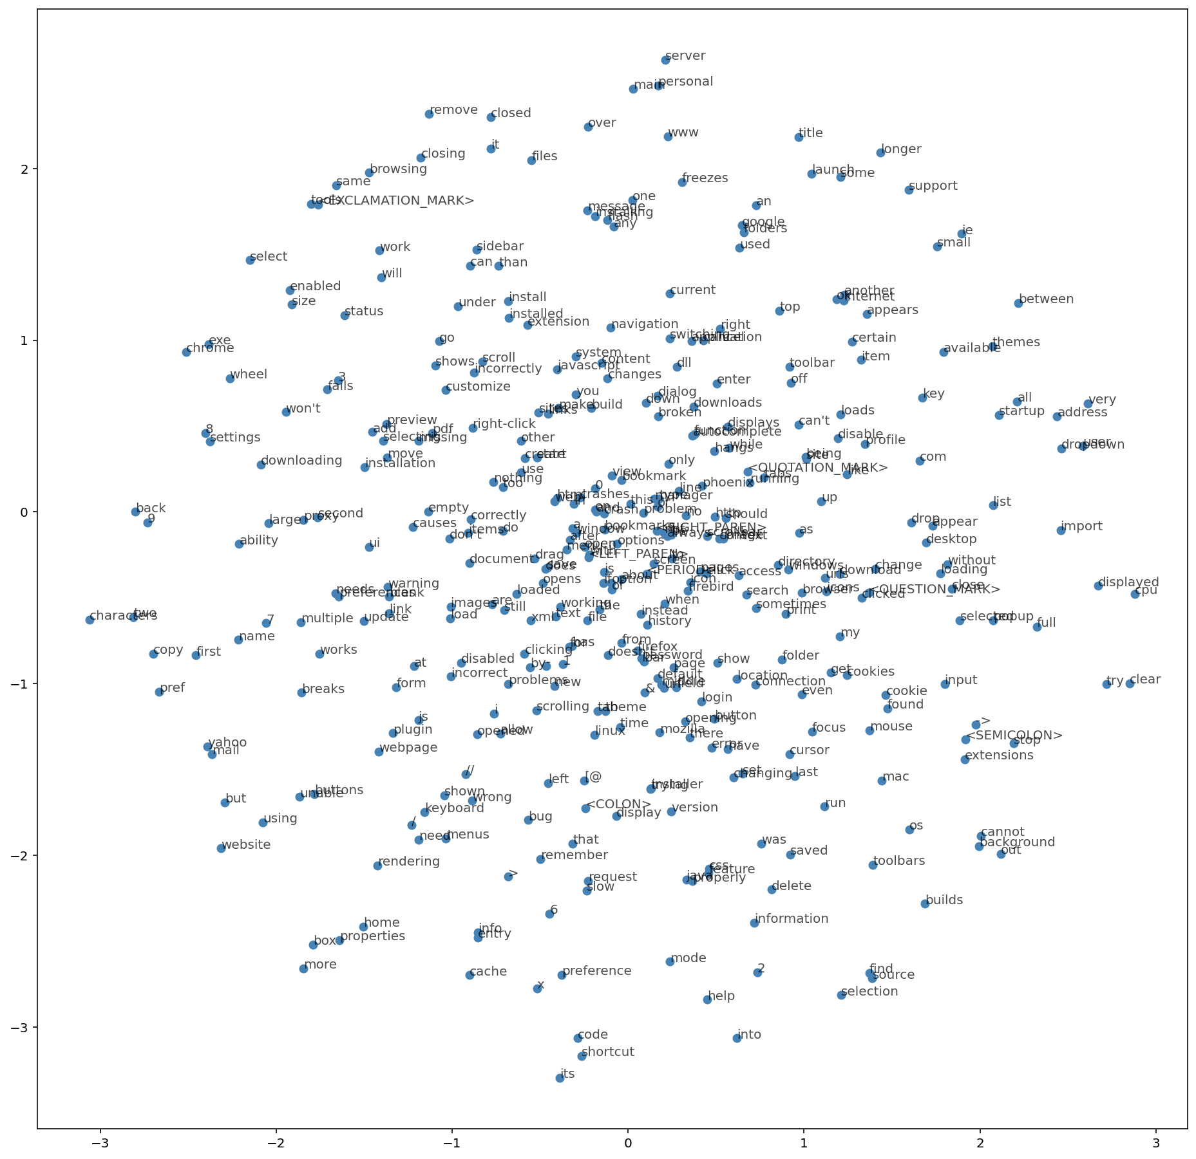
Word Visualization with t-SNE

