Slide 2
Word 2 Vec Implementation
Word2Vec is a classical method that creates word embeddings in the field of Natural Language Processing (NLP). It was developed by Tomas Mikolov and his team at Google in 2013. Word2vec takes in words from a large corpus of texts as input and learns to give out their vector representation.
• Neural network-based
• Word embeddings
• Mapping to semantical/syntactcal s space
• Co-occurrence-based
word2vec creates vectors that represent a word in the vector space
vectors are chosen using the cosine similarity function, = semantic similarity between words
Cosine similarity of 1 mean similar words and 0 means different.
For example, the words “intelligent” and “smart” would appear closer together in this vector space.
The words “engine” and “car” will be far from “intelligent” and “smart”

Slide 3
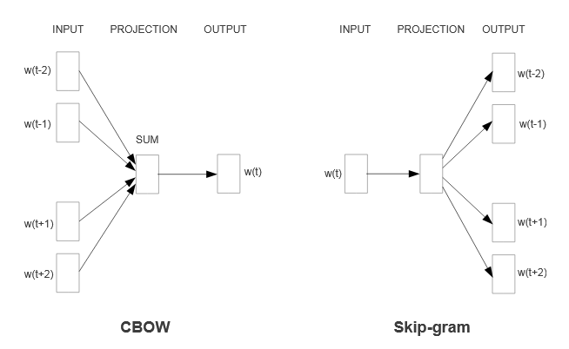
Word2Vec Model Architecture

Slide 4
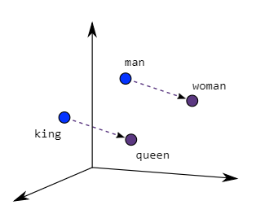
CBOW & Skip Gram Model
The Model consists of two models:
Continuous Bag-of-Words model (CBOW)
In this approach, the model uses context words to predict the target words.
The input may be a group of words or a single word.
Skip-gram model
In this approach, the model uses the target words to predict the context words.
involves training a neural network to learn the weights of the hidden layer
Given a specific word as its input, the model’s goal is to look into the dictionary and pick a word whose context is closely related to the target word.

Slide 5
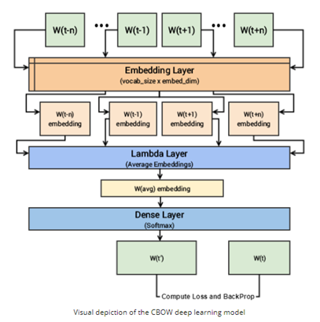
CBOW Implementation
The following steps describe how the model works:
The context words are first passed as an input to an embedding layer (initialized with some random weights) as shown in the Figure.
The word embeddings are then passed to a lambda layer where we average out the word embeddings.
We then pass these embeddings to a dense SoftMax layer that predicts our target word. We match this with our target word and compute the loss and then we perform backpropagation with each epoch to update the embedding layer in the process.
We can extract out the embeddings of the needed words from our embedding layer, once the training is completed.

Slide 6
CBOW Implementation PyTorch Code
import torch
import torch.nn as nn
import numpy as np
class CBOW(torch.nn.Module):
def __init__(self, inp_size , vocab_size, embedding_dim=100):
super(CBOW, self).__init__()
self.embeddings = nn.Embedding(vocab_size, embedding_dim)
self.linear1 = nn.Linear(embedding_dim, 100)
self.activation_function1 = nn.ReLU()
self.linear2 = nn.Linear(100, vocab_size)
self.activation_function2 = nn.LogSoftmax(dim = -1)
def forward(self, inputs):
embeds = sum(self.embeddings(torch.from_numpy(inputs).long())).view(1,-1)
out = self.linear1(embeds)
out = self.activation_function1(out)
out = self.linear2(out)
out = self.activation_function2(out)
return out
model = CBOW(window_size*2,vocab_size)
loss_function = nn.NLLLoss()
optimizer = torch.optim.SGD(model.parameters(), lr=0.001)
Training CBOW Model
for epoch in range(1, 10):
loss = 0
i = 0
X,Y = generate_context_word_pairs(corpus=wids, window_size=window_size, vocab_size=10000)
for x, y in zip(X,Y):
i += 1
optimizer.zero_grad()
log_probs = model(x[0])
loss = loss_function(log_probs,torch.Tensor([y]).long())
loss.backward()
optimizer.step()
loss += loss.data
print('Epoch:', epoch, '\tLoss:', loss)

Slide 7
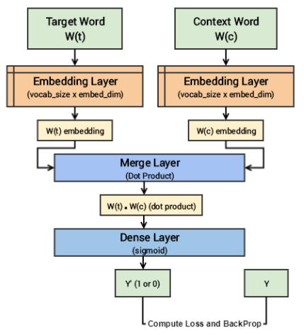
Skip-Gram Implementation
Since the skip-gram model has to predict multiple words from a single given word, we feed the model pairs of (X, Y) where X is our input and Y is our label. This is done by creating positive input samples and negative input samples.
Positive Input Samples : [(target, context),1]
Negative Input Samples : [(target, context),0]
Both the target and context word pairs are passed to individual embedding layers from which we get dense word embeddings.
We then use a ‘merge layer’ to compute the dot product of these two embeddings and get the dot product value.
This dot product value is then sent to a dense sigmoid layer that outputs either 0 or 1.
The output is compared with the actual label and the loss is computed followed by backpropagation with each epoch to update the embedding layer in the process.

Slide 8
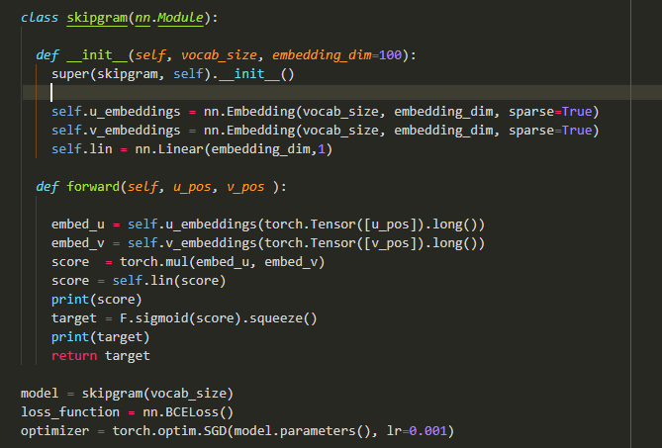
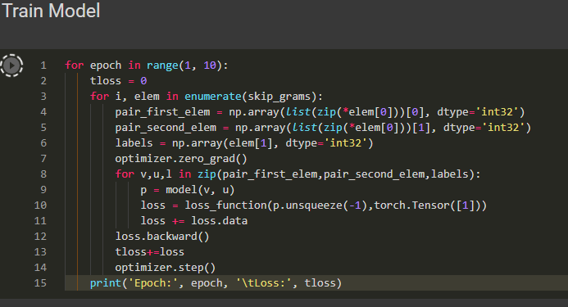
Skip-Gram Implementation (PyTorch Code)
This model takes out the complexity of calculating probability distribution over all the words in the vocabulary by just calculating the log2(V), where V is the vocabulary size

Slide 9
Training
The system is trained using backpropagation and stochastic gradient descent to tune the weights and reduce the cost function. By doing so, those weights become the vectors for the words in question.
Key takeaways
The Continuous Bag-of-Words (CBOW) model uses context words to predict the target words. Conversely, the skip-gram model, uses the target words to predict the context words.
The Word2Vec algorithm causes words that have similar contexts to have similar vector embeddings (be closer together) and words that have different contexts to be far apart.
Skipgram is relatively slower than CBOW and usually works well with a large corpus of training data.
CBOW is faster to train than skip-gram.

