Slide 1
Data Lake Architecture
Sajida Shaik

Slide 2
Definition of a Data Lake
Definition: A data lake is a centralized repository designed to store, process, secure large amounts of structured, semistructured, and unstructured data. It can store data in its native format and process any variety of it, ignoring size limits.
Key Characteristics:
Scalable: Handles large volumes of diverse data.
Flexible: Accommodates various data formats and sources.
Cost-Effective: Uses commodity hardware and open-source technologies.

Slide 3
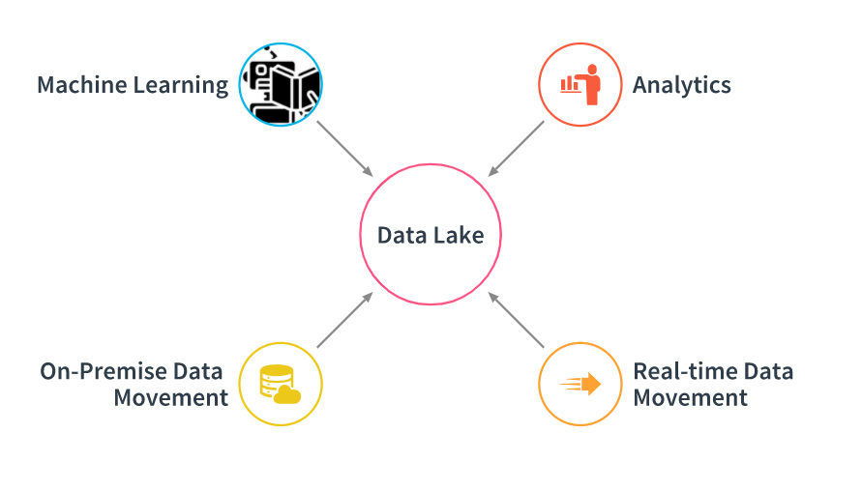
Uses of Data Lake

Slide 4
Uses of Data Lake
Data Storage: Centralized storage for large volumes of structured and unstructured data.
Machine Learning: Supports the development and training of machine learning models by providing access to diverse data sets.
On-Premise Data Movement: Efficiently ingests and moves large amounts of data from on-premise systems to the cloud or central storage.
Analytics: Enables advanced analytics and business intelligence by processing large data sets across various tools.
Real-Time Data Movement: Facilitates the ingestion and analysis of real-time data streams, providing immediate insights and actionability.

Slide 5


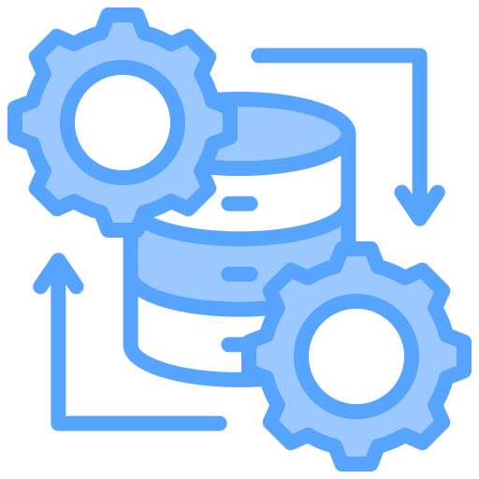

Components of a Data Lake
Ingestion
Storage
Processing
Orchestration

Slide 6
Ingestion Layer:
Description: Captures and streams data from various sources (APIs, databases, FTP). This is where all the data flows into the lake.
Tools: Apache Kafka, Apache Nifi.
Storage Layer:
Description: Stores data in a raw format with high durability and scalability, ensuring it's security and high availability
Tools: Hadoop HDFS, AWS S3.
Processing Layer:
Description: Processes, analyzes data using batch and real-time processing frameworks, and ensuring flexibility based on need.
Tools: Apache Spark, Apache Flink.
Orchestration Layer:
Description: Coordinates and manages data workflows, ensuring smooth movement and execution of data processing tasks across the lake.
Tools: Apache Airflow, Apache ZooKeeper.

Slide 7
Data Lake vs. Data Warehouse
Characteristic | Data Lake | Data Warehouse
Data Structure | Raw, unstructured | Processed, structured
Schema | Flexible (schema-on-read) | Fixed (schema-on-write)
Storage | Object storage (e.g., S3) | Relational databases
Data Types | All types | Primarily structured
Cost | Lower for large volumes | Higher, especially at scale
Query Speed | Slower for complex queries | Optimized for fast querying
Ideal Users | Data scientists | Business analysts
Use Cases | Advanced analytics, machine learning | Business intelligence, reporting
Data Quality | Varies (raw data) | High (curated data)
Scalability | Highly scalable | Can be challenging to scale
Data Processing | ELT (Extract, Load, Transform) | ETL (Extract, Transform, Load)
Data Governance | More challenging | Easier to implement

Slide 8

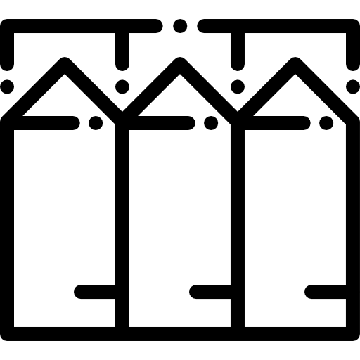


Business Value of the Data Lake
Innovation
Speed
Self service
Break Silos

Slide 9
Innovation:
Description: Encourages innovation by making diverse datasets available for new insights, model development, and experimentation.
Speed:
Description: Accelerates time-to-insight by enabling fast access to data and reducing processing delays, which is crucial for real-time healthcare decisions.
Self-Service:
Description: Empowers users across departments to access and analyze data independently, reducing reliance on IT and increasing efficiency.
Break Silos:
Description: Combines data from various sources and departments, breaking down silos and creating a unified view of the organization’s data, which is essential for comprehensive analytics and decision-making.

Slide 10
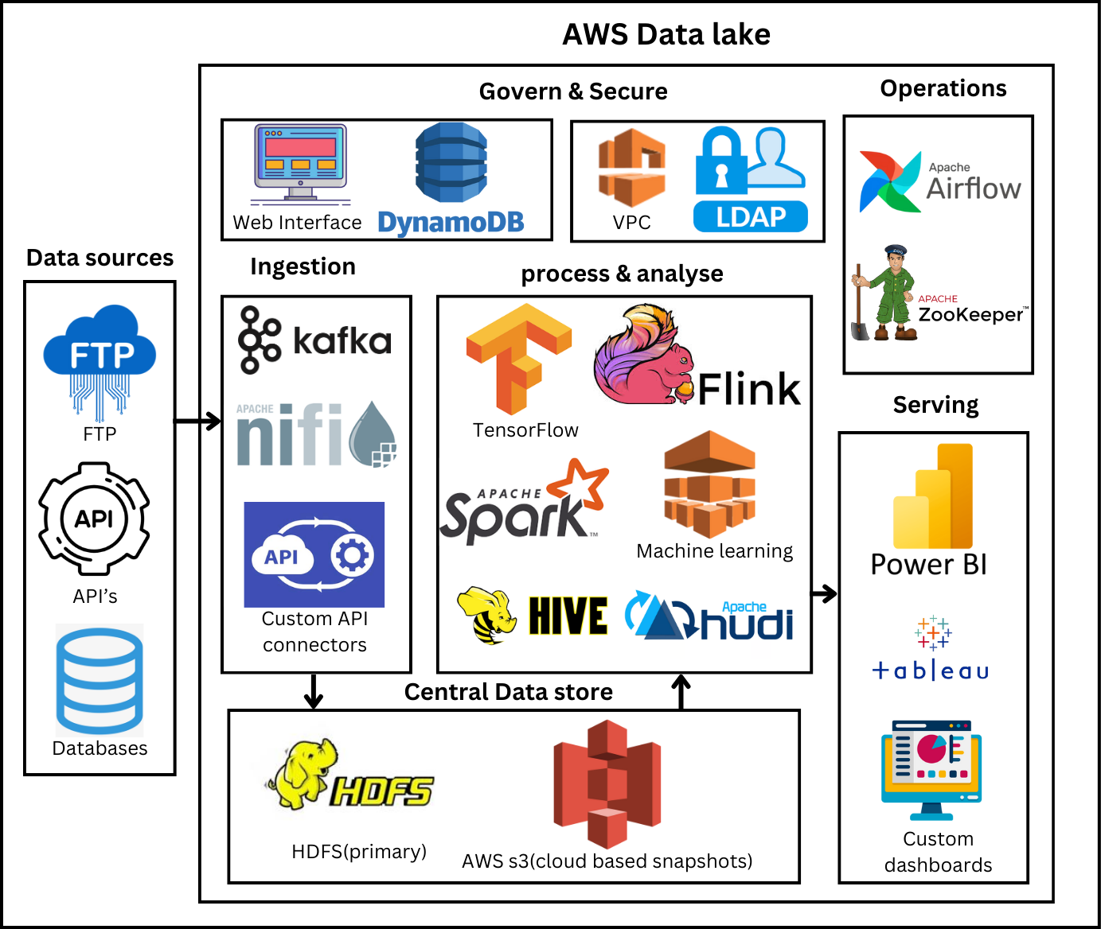
Data Lake Architecture Design Diagram

Slide 11

Thank you

