Slide 1

Share Ride
Ride Sharing App

Slide 2
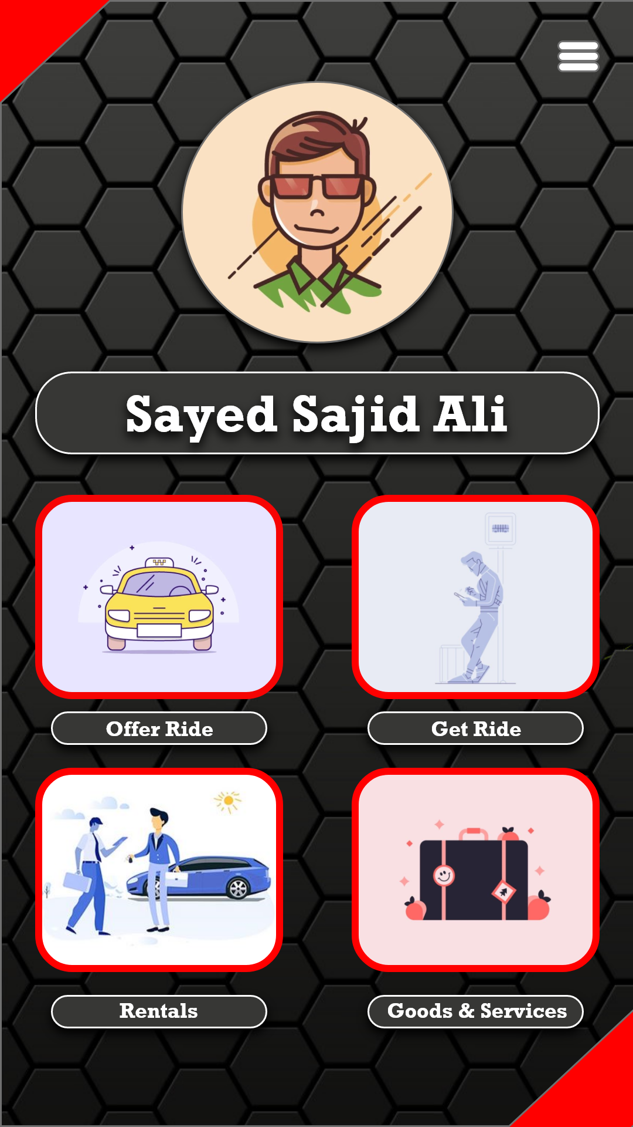
User Interface

Slide 3
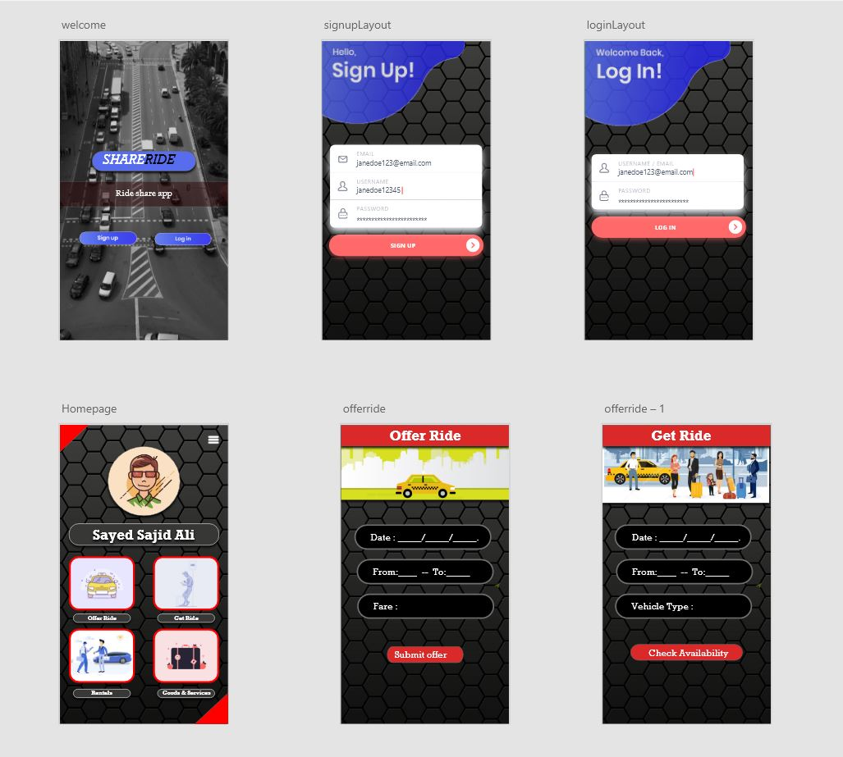
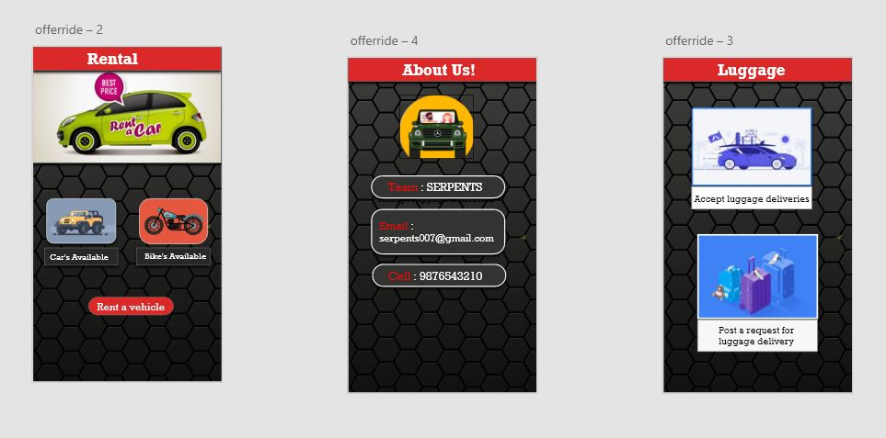
UI / UX Designs

Slide 4
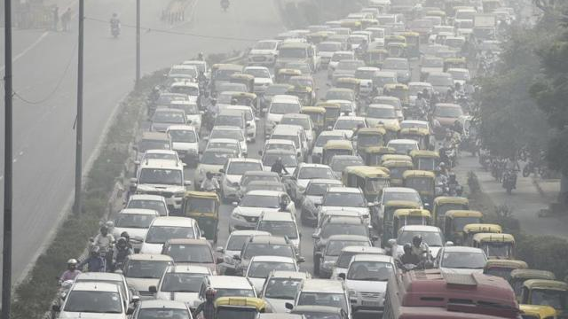
Pollution
Air pollution in India is a serious issue with the major sources being fuelwood and biomass burning, fuel adulteration, vehicle emission and traffic congestion.
Air pollution is also the main cause of the Asian brown cloud, which is causing the monsoon to be delayed

Slide 5
Traffic
Wasted fuel increasing air pollution and carbon dioxide emissions owing to increased idling, acceleration and braking. Wear and tear on vehicles as a result of idling in traffic and frequent acceleration and braking, leading to more frequent repairs and replacements.

Slide 6
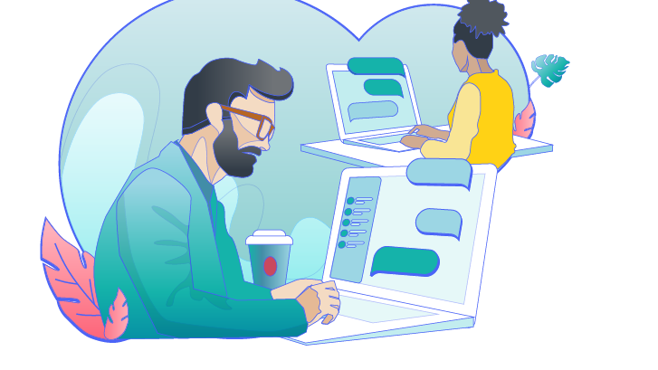
Solution
Main concept is CAR POOLING.
But Share Ride gives more accessibility to users. Like deciding the Fare themselves by their own desire.
Its Basic functionality is that when a person has car and he had to drive through to another city and he is interested in Sharing Journey and reduce his expenses of journey Then we provide a Platform to share the ride.
This Platform Not only gives a Opportunity to Share Rides, But also for Truck Drivers and all other types of transportation vehicles.

Slide 7

Features
Technologies used
Impact on society

Slide 8
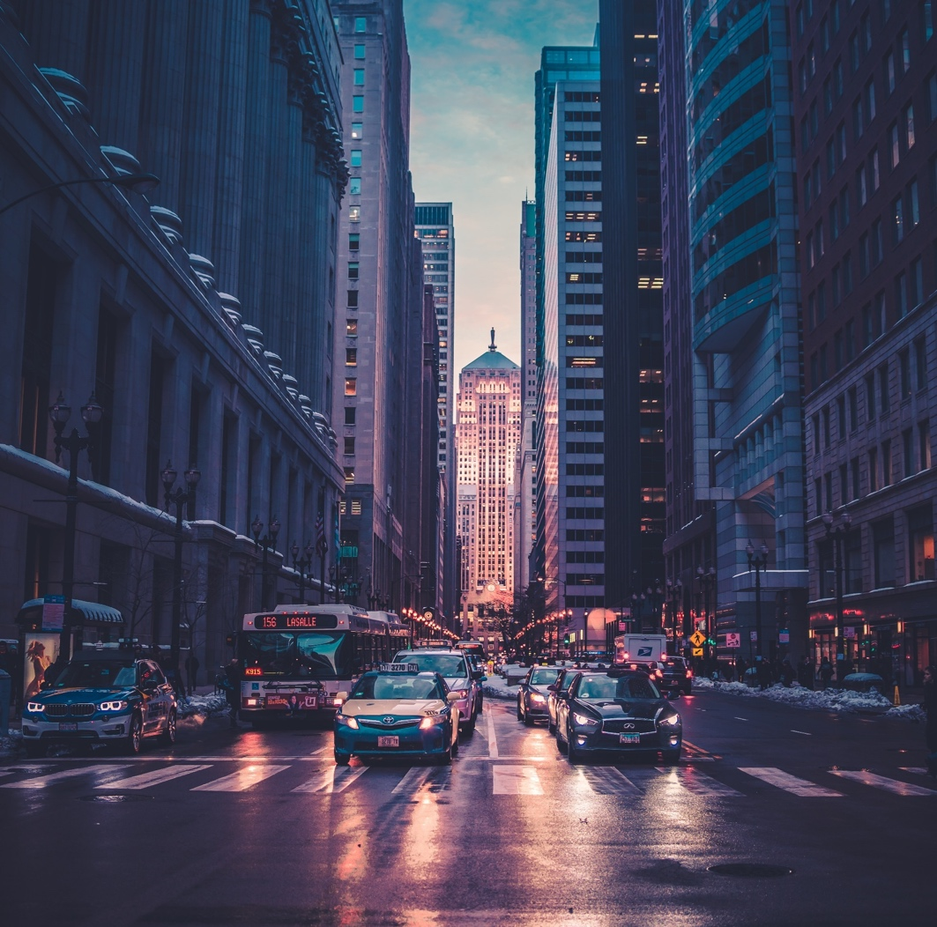
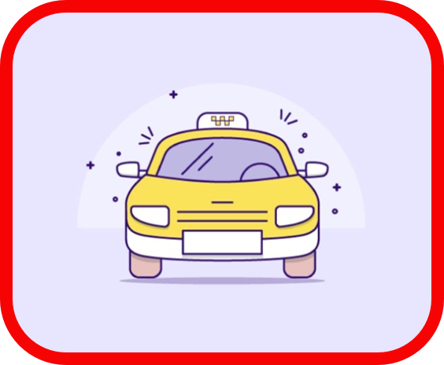

Feature’s
Offer Ride
Get RIDE
Person who has Vehicle and want to share the Ride
Fair will be decided by the service Provider
Person who wants to ride will find the availability of Vehicle in this session or scheduled time slots.

Slide 9
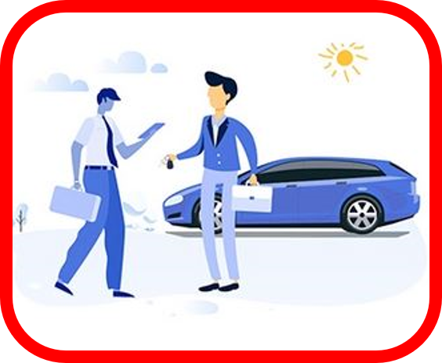

Feature’s
Rentals
We know that many Trucks have Duty on One way mostly. So instead of returning with out any load we sorted out another way that they can bring the Luggage in Empty Trucks.
--This Feature helps the People who has the
Vehicle and want to Lend it to someone to earn money out of it.
Goods & Services

Slide 10
Technology Used!
XML (Front End)
Java (Back End)
Firebase (Database)
Adobe XD (UI/UX Design)
Photoshop (UI/UX Design)

Slide 11
Impact on society
Plays a major role in reduction of Pollution
Helps in reducing the Traffic.
Save money. Share the costs of driving with other riders.
Helps in Fuel conservation .
Connects people who are interested to Share their Rides.

Slide 12
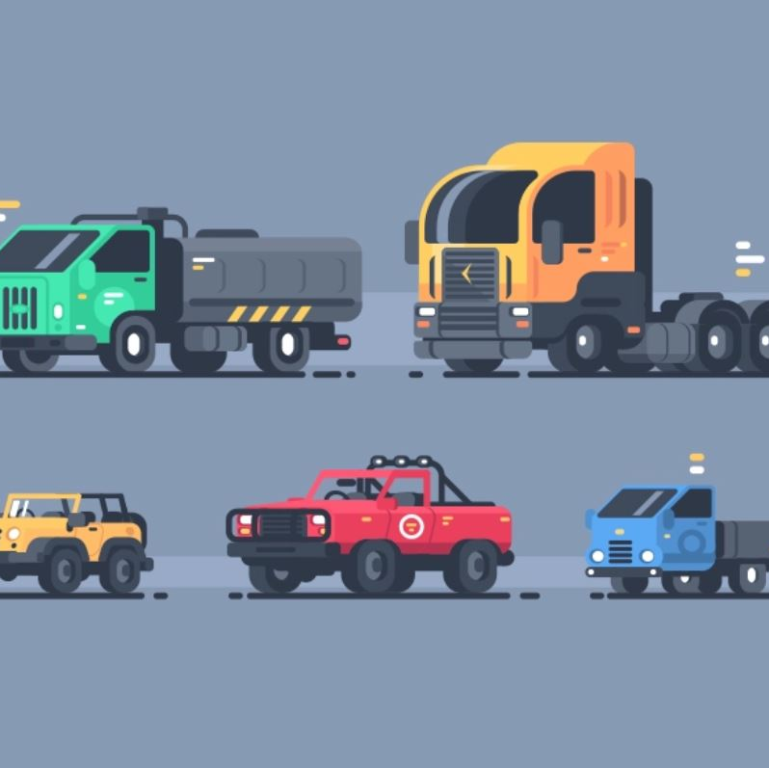
Thank you!
serpents@gmail.com
http://www.serpents.blogspot.com/

