Slide 1
Facebook marketplace dataset
ANALYSIS ON THE PROBLEM STATEMENTS

Slide 2
DESCRIPTION:
The Facebook Live Sellers in Thailand dataset contains information about the Facebook pages of 10 Thai fashion and cosmetics retail sellers. Below is a description of the dataset:
1. Title: Facebook Live Sellers in Thailand Dataset
2. Source: The dataset is sourced from the UCI Machine Learning Repository.
3. Data Type: The dataset is in a tabular format, typically stored in a CSV (Comma Separated Values) file.
4. Number of Instances: There are a total of 7050 instances (rows) in the dataset.
5. Number of Attributes: The dataset initially consists of 16 attributes (columns). After removing redundant columns, there are 14 attributes remaining.
6. Attribute Information:
- status_id: Unique identifier for each status post.
- status_published: Date and time when the status post was published.
- status_type: Nature of the status post (e.g., video, photo, status, link).
- num_reactions: Number of reactions (e.g., likes, loves, wow, haha, sad, angry) received on the status post.
- num_comments: Number of comments received on the status post.
- num_shares: Number of shares received on the status post.
- Additional numerical and categorical attributes related to engagement metrics and status post features.
7. Missing Values: The dataset may contain missing values, which need to be handled during data preprocessing.

Slide 3
QUESTIONS
How does the time of upload (`status_published`) affects the `num_reaction`?
Is there a correlation between the number of reactions (num_reactions) and other engagement metrics such as comments (num_comments) and shares (num_shares)? If so, what is the strength and direction of this correlation?
Use the columns status_type, num_reactions, num_comments, num_shares, num_likes, num_loves, num_wows, num_hahas, num_sads, and num_angrys to train a K-Means clustering model on the Facebook Live Sellers dataset.
Use the elbow method to find the optimum number of clusters.
What is the count of different types of posts in the dataset?
What is the average value of num_reaction, num_comments, num_shares for each post type?

Slide 4
SOLUTIONS
1. Effect of Time of Upload on Reactions (status_published vs num_reactions)
Approach: Convert the status_published column to extract features such as the time of day, day of the week, or month, and then perform a comparative analysis with num_reactions. You can visualize this relationship using scatter plots or box plots to see if specific times correlate with higher reactions.
2. Correlation between Engagement Metrics (num_reactions, num_comments, num_shares)
Approach: Compute the Pearson or Spearman correlation coefficients between num_reactions, num_comments, and num_shares to measure the strength and direction of their relationships. A correlation matrix or heatmap can help visualize these relationships.
3. Training K-Means Clustering Model
Selected Columns: Use status_type, num_reactions, num_comments, num_shares, num_likes, num_loves, num_wows, num_hahas, num_sads, and num_angrys as features.
Data Preprocessing: Standardize the numeric columns and encode the categorical column (status_type) before applying K-Means.
Elbow Method: To find the optimal number of clusters, calculate the sum of squared distances (inertia) for different numbers of clusters and plot it. The point where the inertia starts to decrease slowly is the "elbow," which indicates the optimal number of clusters.
4. Count of Different Types of Posts (status_type)
Approach: Use the status_type column to get the count of each post type. This can be done through simple aggregation or by using a bar plot to visualize the distribution of post types.

Slide 5
SOLUTIONS
5. Average Values of num_reactions, num_comments, and num_shares per Post Type
Approach: Group the data by status_type and calculate the mean values of num_reactions, num_comments, and num_shares for each post type. A table or bar plot can then show the results clearly.

Slide 6
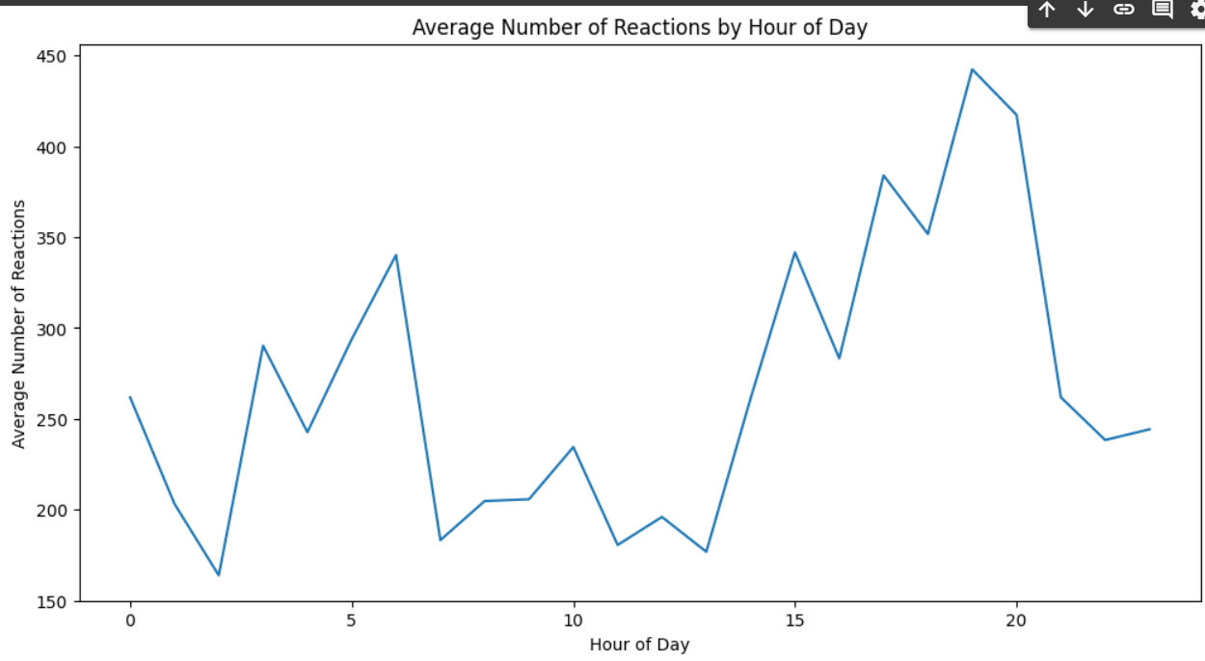
ANALYSIS OBTAINED

Slide 7
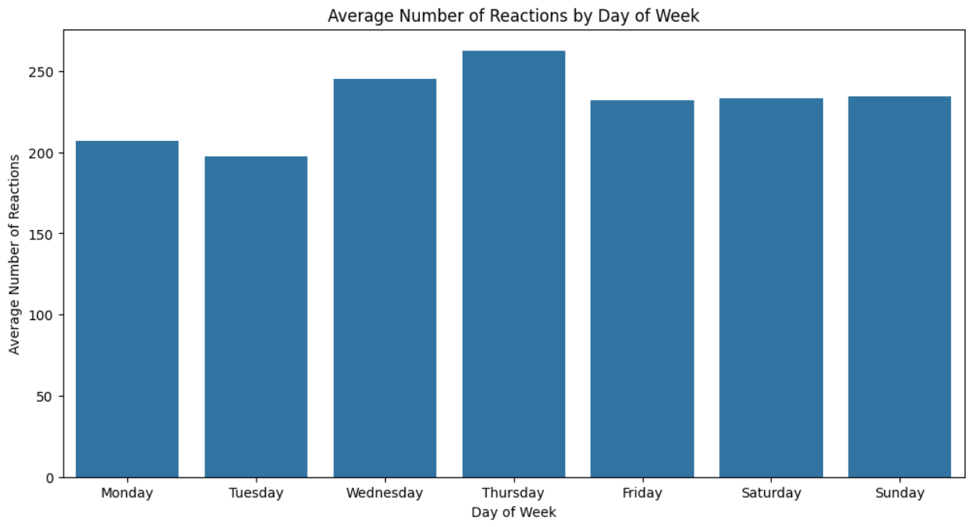
ANALYSIS OBTAINED

Slide 8
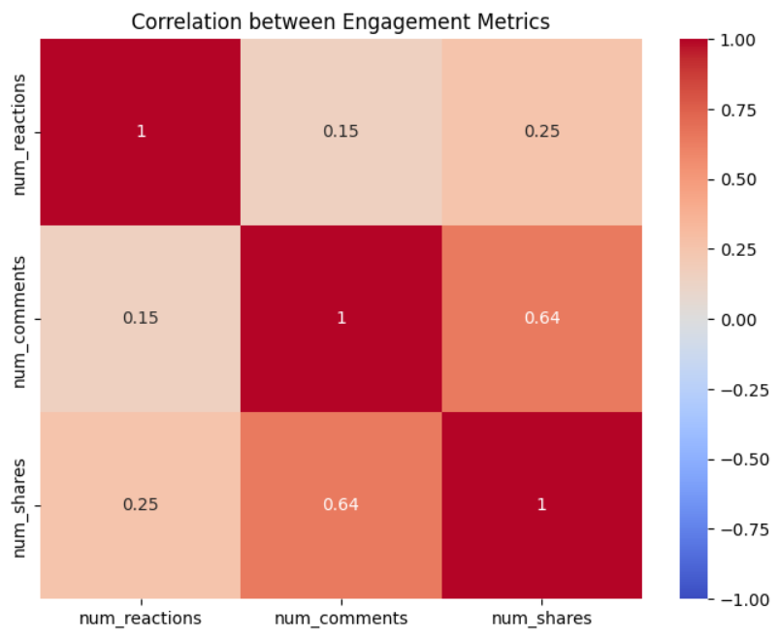
ANALYSIS OBTAINED

Slide 9
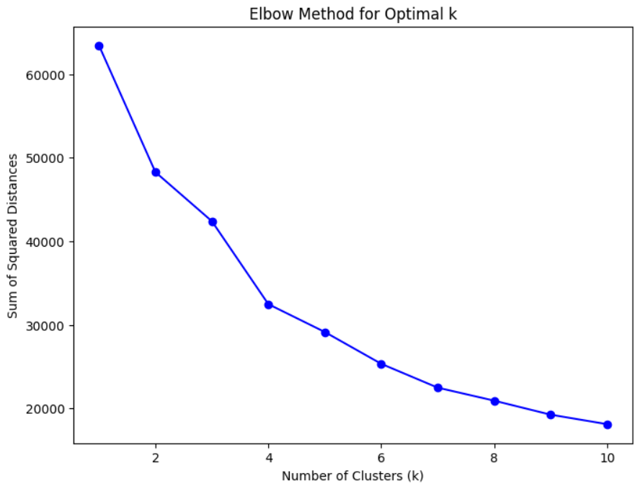
ANALYSIS OBTAINED

