Slide 1
The BreakOut
Team Members
Shirza Firtas
Nimra Imran
Sajid Khan
Supervisor
Dr. Hasan Mujtaba
Department of Computer Science
Fall - 2017
Notes:
AOA, I am Nimra Imran and along with my group member, shiraz and sajid khan, we present The Breakout

Slide 2
Problem Statement
We aim to increase the user engagement level towards game by incorporating Artificial Intelligence for improving quality and replay-ability.
Notes:
PROBLEM STATEMENT
The saturation in the gaming industry has increased subsequently, that results in the demand of more advanced and modernise games. Since gaming industry is increasing quickly, locally and internationally. The main focus while developing a game is on the graphics which may provide an exciting user experience but compromising the replay-ability factor resulting in a collaborated and less interactive user experience.

Slide 3
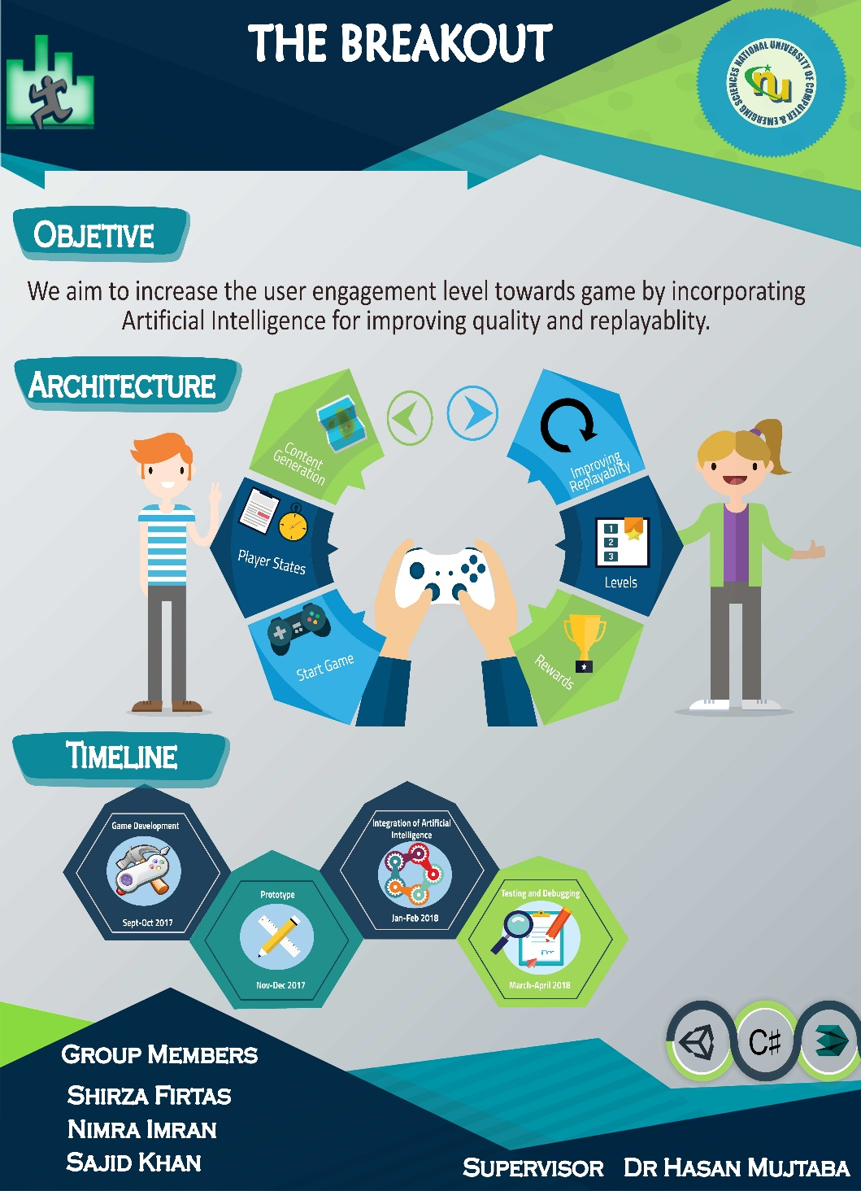

Slide 4
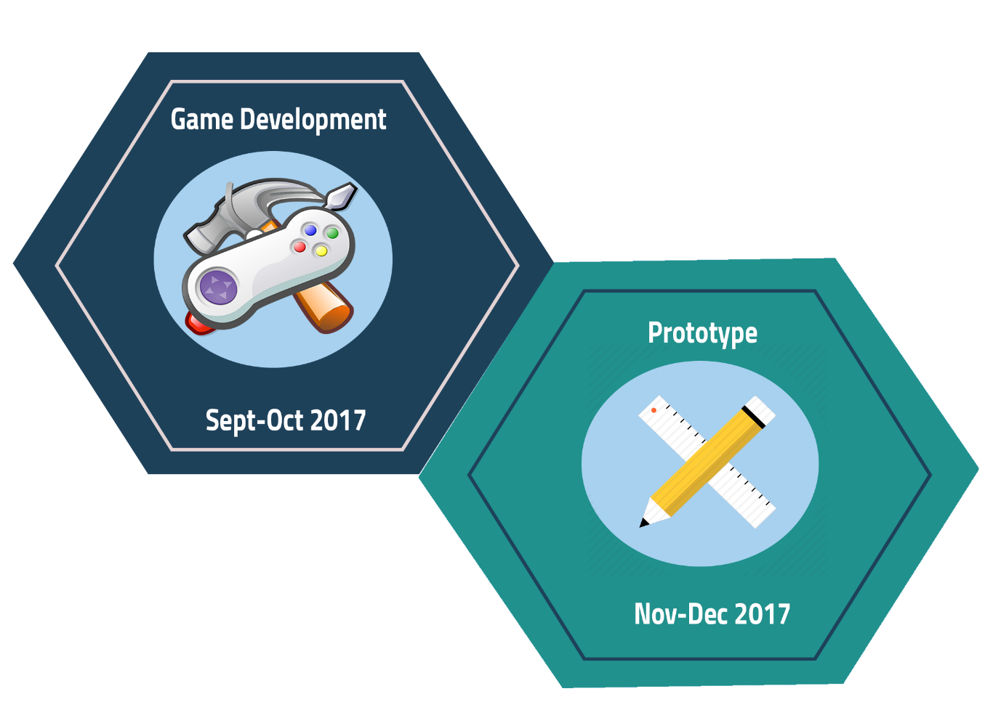
Iteration 2
Notes:
In this iteration, we have developed the full functioning game including scoring. Scoring is done when the player kills a bot and puzzles are generate, basically puzzles are objects which player has to collect in order to complete the level. In the future these puzzle objects will be generated on the basis of the difficulty level automated by the AI so that the level becomes difficult and most importantly it should be a possible level.

Slide 5
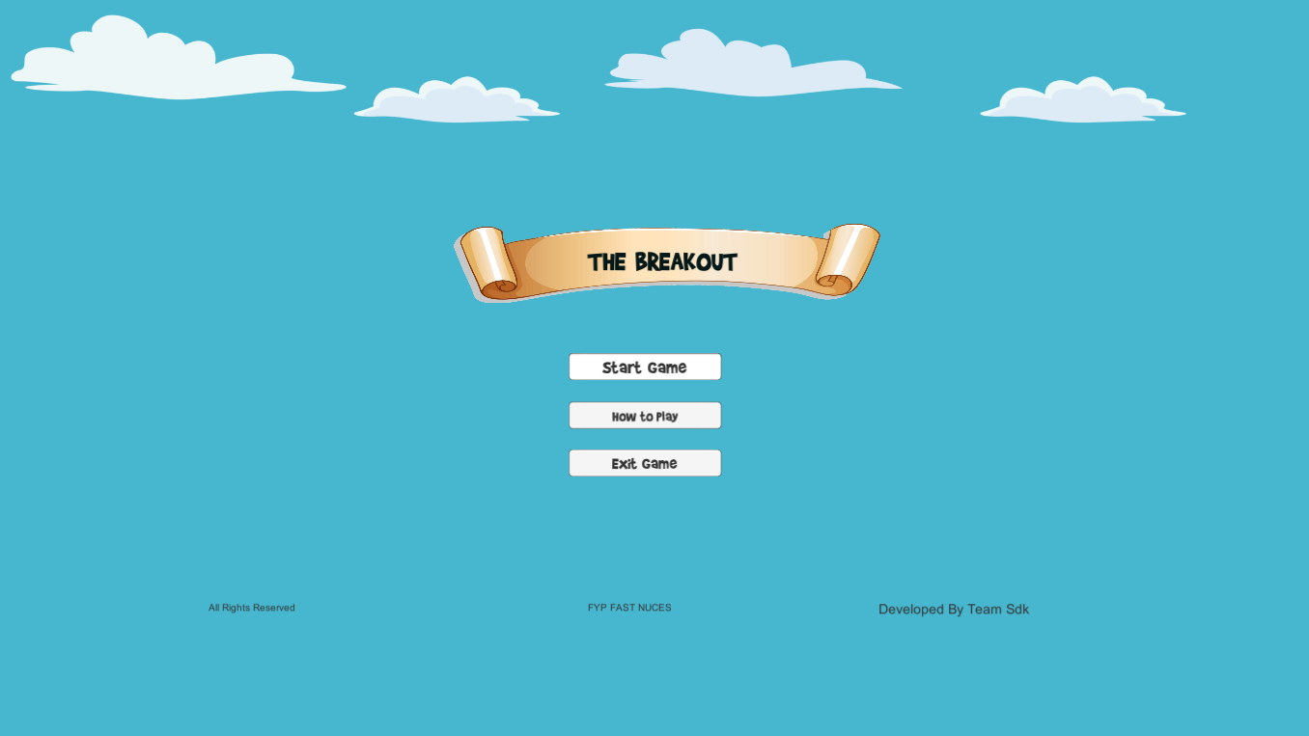
Game Interface

Slide 6
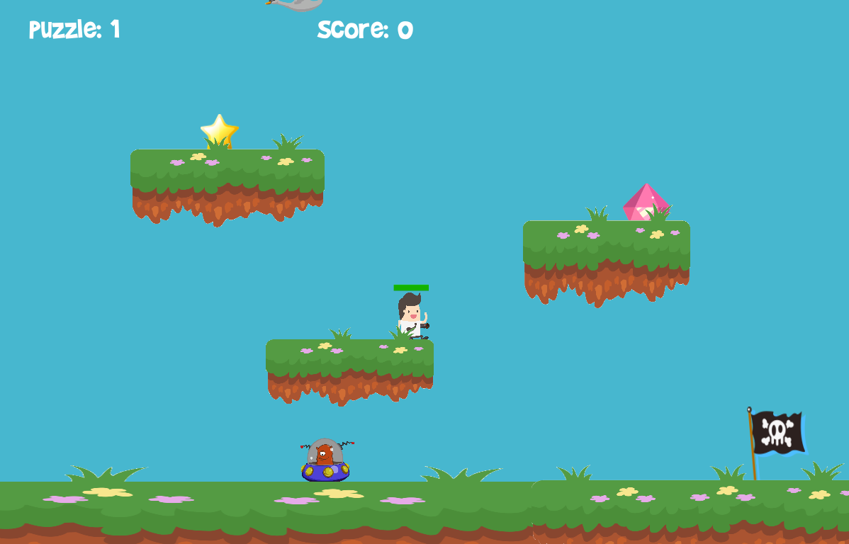

Slide 7
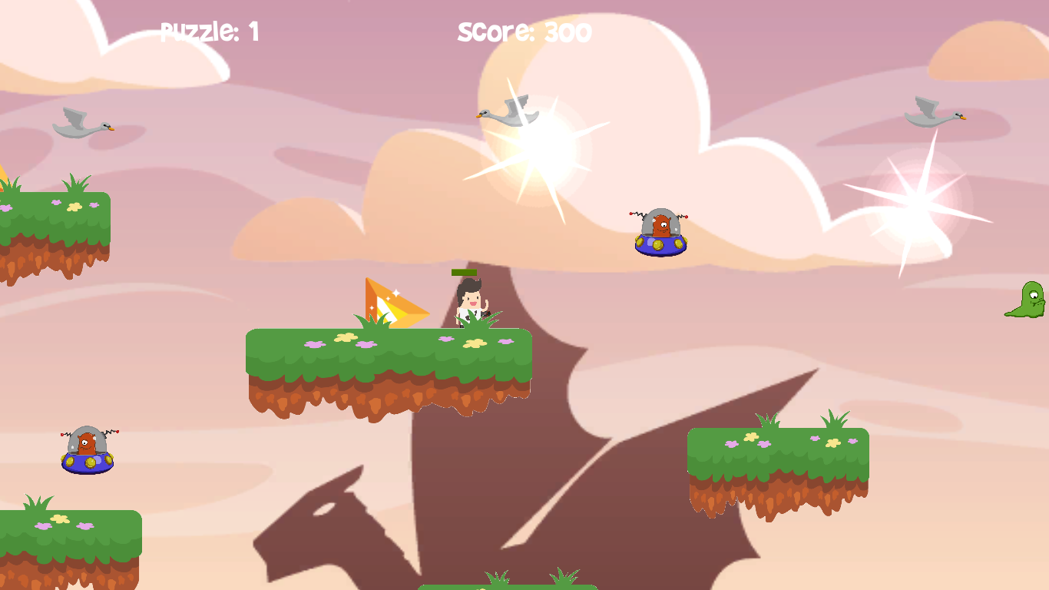

Slide 8
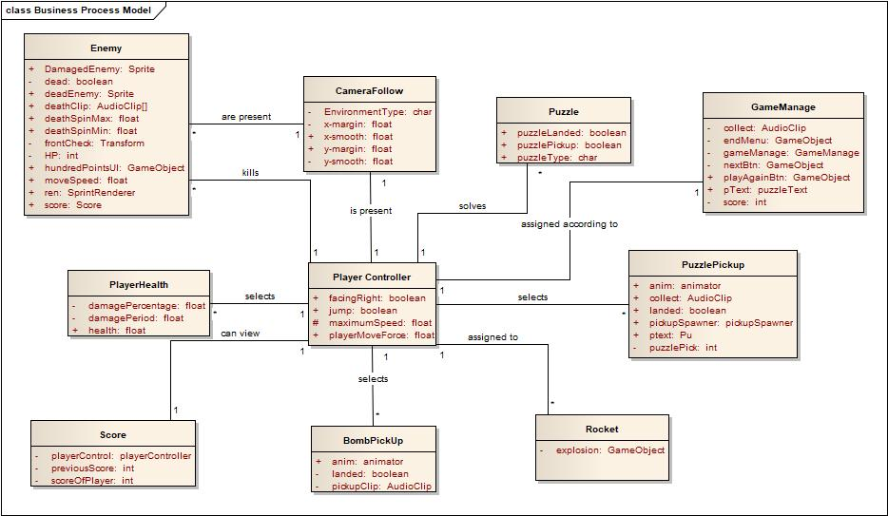
Domain Model

Slide 9
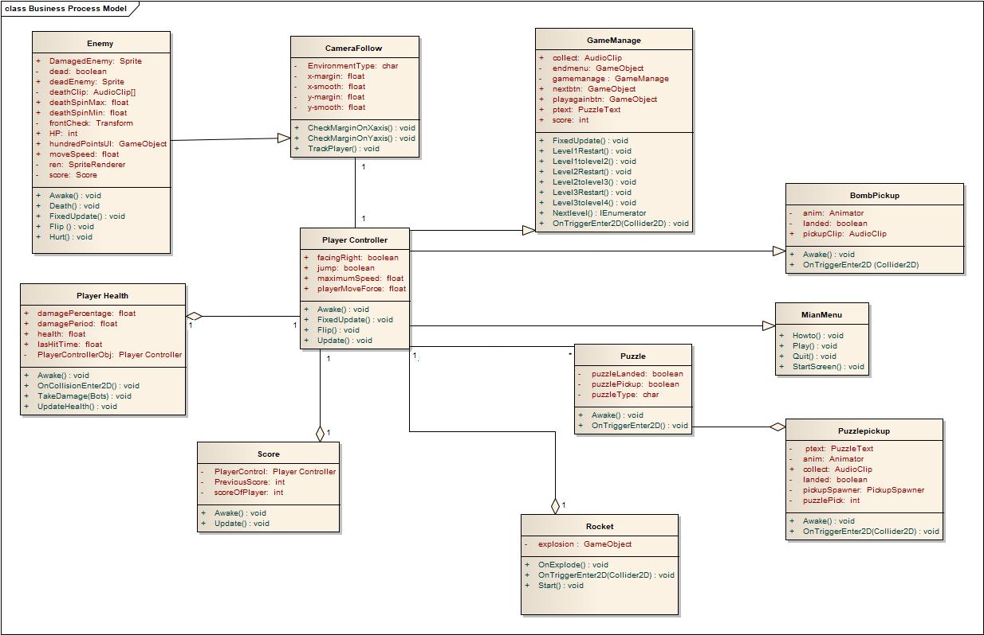
Class Diagram

Slide 10
Work to be done in FYP-2
We have already implemented a fully functioning game.
Main focus of FYP-2 is the integration of Artificial Intelligence

Slide 11
Game Demonstration

