Slide 1
CSC 733 • GROUP 2 • PROJECT DELIVERABLE 4
Extending Redis Cluster Live Patching
Gabriel Law • Derek Taylor • Sajim Ahmed
November 2026 | University of Southern Mississippi
Notes:
This is Group 2’s final presentation for CSC 733. We review Fruth and Scherzinger’s original Redis live-patching work, introduce three follow-up research questions, and present the results of a reproducible discrete-event simulation. We emphasize the scope of our evidence: the data and charts from our group are simulation outputs, not actual Redis performance measurements. Our peer reviewers successfully regenerated those outputs, and Dr. Koh approved revising this simulation artifact while documenting the unexecuted native testbed.

Slide 2
1.1 • SUMMARY REVIEW
Research questions and context
Why conventional rolling updates are costly
Questions addressed by the authors
• Restarted replicas may need partial or full resynchronization.
• State transfer and primary forking can delay urgent fixes.
• Distributed updates should preserve availability and tail latency.
• Can individual Redis nodes apply patches without restart?
• Can versions spread automatically to every cluster node?
• Can updates avoid noticeable throughput and latency costs?
ORIGINAL PAPER • [1], [2], [3]
02
Notes:
The assigned paper asks whether distributed in-memory database software can be patched while the service continues running. Conventional rolling Redis Cluster updates restart replicas and sometimes primaries. Replicas can require expensive state handling, especially when the in-memory database holds large amounts of data. This introduces update lag and can create latency spikes. The research questions are whether an integrated user-space live-patching design can avoid those restarts, disseminate patches automatically, and maintain service performance. These are the authors’ questions and results, separate from our extensions.

Slide 3
1.2 • SUMMARY REVIEW
Previous and relevant work
Redis Cluster
Existing update methods
Dynamic updating
• 16,384 hash slots
• Primaries with asynchronous replicas
• PING/PONG heartbeat gossip
• clusterCron approximately 100 ms
• Rolling restart / resync
• Partial replication offsets
• Full snapshot and fork
• Online replacement needs capacity
• Kpatch creates ELF patches
• WfPatch uses quiescence
• Kitsune, MVEDSUA, UpStare
• Earlier work focuses on single nodes
ORIGINAL PAPER • [1]–[10]
03
Notes:
Redis Cluster partitions keys across 16,384 hash slots, with primaries and asynchronous replicas. Nodes exchange heartbeat and gossip traffic. Rolling updates restart nodes and may require partial or full synchronization. The technical background includes Kpatch, which builds patch objects, and WfPatch, which allows user-space threads to move to updated code at quiescence points. Previous dynamic software updating systems included Kitsune, MVEDSUA and UpStare, but the assigned paper addresses cluster-wide patch distribution, rather than a single server process.

Slide 4
1.3 • SUMMARY REVIEW
Methods assumptions and scope
Design assumptions
Experimental scope
• Function-level patches; no arbitrary data layout migration
• Versions applied strictly in order
• Developer-defined, safe quiescence points
• Mostly single-threaded Redis event loop
• Redis 7.0.11; MMView/WfPatch Linux
• All nodes and clients on one server, loopback network
• Controlled GET/SET; persistence disabled
• Synthetic single-line updates + real fix sample
Gap motivating our extension: loopback excludes real delays, loss, failures and activation coordination.
ORIGINAL PAPER • [1], [4], [5], [6]
04
Notes:
The paper’s method assumes that a patch can be represented as replacement functions and read-only data, without arbitrary data layout migration. Developers insert quiescence points and judge whether old and new versions can coexist briefly. The cluster applies patches in version order, and the chosen implementation mainly patches Redis’s main thread. The central experimental setup uses a single large server and a loopback network, with controlled GET and SET workloads. That decision isolates patching costs but does not reveal the effect of realistic network delay, packet loss, temporary partitions or coordinated activation.

Slide 5
1.4 • SUMMARY REVIEW
How the live-patching method works
1. Build
2. Register
3. Propagate
4. Apply
Original and updated binary → ELF patch
›
WfPatch prepares updated address space
›
Cluster PING/PONG gossip or eager push
›
Redis reaches clusterCron quiescence
Hybrid = eager push + pull recovery • patch version + bitmap add 4 bytes to cluster headers
ORIGINAL PAPER • [1], [5], [6]
05
Notes:
The integration first builds a live patch from a base and updated Redis binary, then registers it with the WfPatch runtime. A background component prepares the new address space and the Redis main thread migrates at a selected quiescence point in clusterCron. For dissemination, the authors support lazy pull through existing heartbeat version advertisements and eager push from the node receiving a patch. Importantly, eager push leaves the pull mechanism active, so we call it hybrid. Version fields and patch availability bitmap add only four bytes to the cluster message header.

Slide 6
1.4 • SUMMARY REVIEW
Original experimental design
0–200 GiB
100
392
state-size sweep
synthetic patches
real patch applications
Evaluated comparisons
• Pull / eager push vs no patching and rolling update
• Cluster size and replication patterns; GET/SET workloads
• Update lag, application cost, throughput, per-request tail latency and resource overhead
ORIGINAL PAPER • [1], [11], [12]
06
Notes:
The authors evaluated update lag while varying in-memory state up to 200 gigabytes and cluster configurations. Their propagation evaluation disseminates a sequence of one hundred synthetic patches, generally three seconds apart. The throughput and tail latency evaluation uses a separate 140-second workload with both GET and SET operations. They also measure patch application time for real Redis bug-fix patches. This setup compares live patching against no patching and against rolling update strategies, distinguishing dissemination delay from state resynchronization cost.

Slide 7
1.5 • SUMMARY REVIEW
Original paper: reported results
0.1–0.2 s
~1.5 s
22–35 min
eager / hybrid update lag
pull median update lag
rolling update with 200 GiB
Interpretation
• Live patching avoids resynchronizing in-memory state during updates.
• Authors report throughput near baseline and tail latency around 5 ms; rolling full sync produces large spikes.
• Reduction in update lag: approximately two to four orders of magnitude.
ORIGINAL PAPER • [1], [12], [13]
07
Notes:
These are the original authors’ measurements. Their eager push strategy distributes updates in about 0.1 to 0.2 seconds, and pull has a median around 1.5 seconds. By contrast, when a 200-gigabyte state must be handled using rolling updates, update lag can reach roughly 22 to 35 minutes. Their live-patching throughput stays close to the no-patching baseline; they report around five milliseconds of tail latency under live patching, while full resynchronization can produce much larger spikes. The principal improvement is removing state transfer from the patching critical path.

Slide 8
1.6 • SUMMARY REVIEW
Contributions, strengths and weaknesses
Contributions
Strengths
Limits
• First cluster-integrated live patch distribution design
• Pull, eager push and strict version order
• Approximately 700 changed lines
• Direct comparison with rolling updates
• Broad state/topology/workload evaluation
• Public, independently reproduced artifact
• Function patching cannot solve arbitrary layout changes
• Semantic compatibility judged manually
• Loopback has no network impairment or partitions
ORIGINAL PAPER • [1], [12], [13]
08
Notes:
The main contribution is a practical distributed patching design with automatic gossip-based distribution, eager push, ordered application and low protocol overhead. Strengths include direct comparison to rolling updates, multiple cluster and workload settings, and a high-quality publicly reproduced artifact. Weaknesses are equally important: patches cannot arbitrarily transform in-memory data structures, semantic safety is partly a developer responsibility, and the experimental network is loopback. The paper also does not evaluate temporary partitions during propagation or measure the time during which different nodes execute different patch versions.

Slide 9
2 • PROPOSED RESEARCH QUESTIONS AND PLANS
Three proposed research extensions
RQ1: Network realism
RQ2: Failure resilience
RQ3: Activation
How do network delay, jitter and loss change propagation lag and resilience?
Can patches converge correctly after temporary failures and partitions?
Can nodes switch versions together without excessive update lag?
Each question has an implementation plan (Section 2) and a separate model evaluation (Section 3).
RESEARCH PLAN • [1], [12]; Group 2 PD2 §2
09
Notes:
Our three-member CSC 733 group proposed three extended research questions. The first studies network realism, especially transmission delay, jitter and packet loss. The second studies temporary node isolation and partition recovery, with emphasis on whether pull can repair missed push deliveries and maintain version ordering. The third studies coordinated activation and the duration of mixed-version execution. In our original plan, Linux namespaces and a modified Redis testbed were planned for native tests. The completed work, approved by Dr. Koh, evaluates these questions with an executable discrete-event simulator.

Slide 10
2.1 • PROPOSED QUESTION AND IMPLEMENTATION
RQ1 plan — network realism
Planned native extension
Controls and interpretation
• Use network namespaces and tc-netem
• Impose 1–50 ms one-way delays, 2 ms jitter, 0.1–5% loss
• Compare 6-node and 15-node clusters
• Record patch update lag and matched no-patch client baselines
• 0-ms namespace baseline separates plumbing overhead
• 10 trials per condition and bootstrap intervals
• CPU pinning/state size adjusted to available hardware
• Same experimental conditions without patching
RESEARCH PLAN • Group 2 PD2 §2.1; [15]–[18]
10
Notes:
RQ1 asks whether the fast update propagation measured on loopback persists on realistic networks. Our native plan was to put Redis nodes in separate network namespaces, use netem to impose between one and fifty milliseconds of delay and introduce jitter and packet loss. We also planned matched unpatched workload controls, topology variants and repeated trials with confidence intervals. In the completed simulation, we model these network conditions and measure patch convergence. Throughput and client latency remain untested because our simulator has no client workload model.

Slide 11
2.2 • PROPOSED QUESTION AND IMPLEMENTATION
RQ2 plan — failure resilience
Partition protocol
Outcome measures
• One replica, one primary or paired nodes
• Outages of 1, 5 or 10 seconds
• Partition just before vs. after patch submission
• Compare lazy pull, hybrid and push-only ablation
• Healthy-node convergence and isolated-node catch-up
• Strict version ordering after recovery
• Convergence share within 60 seconds
• 5-s and 15-s node timeout comparison
RESEARCH PLAN • Group 2 PD2 §2.2; [1], [4]
11
Notes:
RQ2 focuses on node failures and network partitions during dissemination. The planned design isolates a replica, primary or a two-node group just before or just after the patch is submitted. We vary isolation duration and Redis node-timeout settings, and compare pull, hybrid and a push-only ablation. The outcome is whether versions converge in order and how long isolated nodes need to catch up after reconnection. In the simulator, this means network partitions only: nodes preserve memory, and process crashes, actual Redis failover elections and client errors are not modeled.

Slide 12
2.3 • PROPOSED QUESTION AND IMPLEMENTATION
RQ3 plan — coordinated activation
Distribute then activate
Questions and controls
• Receive and prepare patch without immediately applying
• Controller: ACTIVATE after readiness reports
• Gossip: activate when peers advertise possession
• Timed event-loop activation as hypothetical variant
• Mixed-version window = first-to-last application time
• Extra control messages and update lag
• Compare immediate and artifact sync baselines
• Clock error and quiescence timing sensitivity
RESEARCH PLAN • Group 2 PD2 §2.3; [1], [6], [19]
12
Notes:
RQ3 asks whether distributing a patch before activating it can reduce the interval during which cluster nodes run different code versions. We proposed a HOLD state, a controller signal or a gossip barrier, and a hypothetical timed activation from the event loop. We compare the mixed-version window, lag and message overhead with immediate activation and the artifact’s existing sync mode. The key design limitation is quiescence: nodes may each wait until their next 100-millisecond cronjob. Our actual Redis HOLD or ACTIVATE changes remain a design specification, not implemented or compiled native code.

Slide 13
3 • IMPLEMENTATION METHODOLOGY AND RESULTS
Completed implementation — simulation model
Event queue
Per-node state
Cron ticks, arrivals, patch submissions
Version, peers, pending patch bitmap
Network
Outputs
Delay, loss, jitter, simplified TCP backoff
Lag, skew, convergence, message counts
Important exclusion: no real patch execution, Redis workload, failover election, throughput or tail-latency measurement.
GROUP SIMULATION • Group 2 PD2 §§3, 5; [1], [4], [12]
13
Notes:
The completed artifact is a Python discrete-event simulator. It processes a time-ordered event queue, tracks every modeled node’s versions and peer state, and simulates heartbeat gossip, patch requests, eager transmission, delays, losses, TCP-like retransmission and temporary partitions. Patch application occurs in the model after quiescence-related timing. The analysis computes update lag, version skew, convergence and message counts. We calibrated loopback behavior against the authors’ paper and then applied new conditions. Client throughput, latency, failover election behavior, memory pressure and real patch execution are absent, so we do not claim measured Redis behavior.

Slide 14
3.1.1–3.1.2 • ASSUMPTIONS AND METHODS
RQ1 method: reproducible delay and loss sweeps
6 / 15
10 × 30
0–50 ms
modeled nodes
seeds × patches per cell
added one-way delay
Timing logic and controls
• Random independent cron phase; 100-ms maintenance period
• Pull vs eager/hybrid vs push-only; 3 seconds between patches
• Simplified retransmission; modeled 0.2-ms application time; no client traffic
GROUP SIMULATION • Group 2 PD2 §3.1; sim/run_all.py
14
Notes:
RQ1 is a controlled simulation sweep. We use six and fifteen modeled nodes, vary one-way network delay from zero to fifty milliseconds, and introduce two milliseconds of jitter and loss from a tenth of a percent to five percent at a ten-millisecond delay. Each full condition uses ten seeds, thirty patches per seed, and a fixed three-second submission interval. The model uses independent random Redis cron phases, ordered version application, and simplified TCP retransmission. These choices are documented assumptions, not a claim of exact kernel TCP emulation.

Slide 15
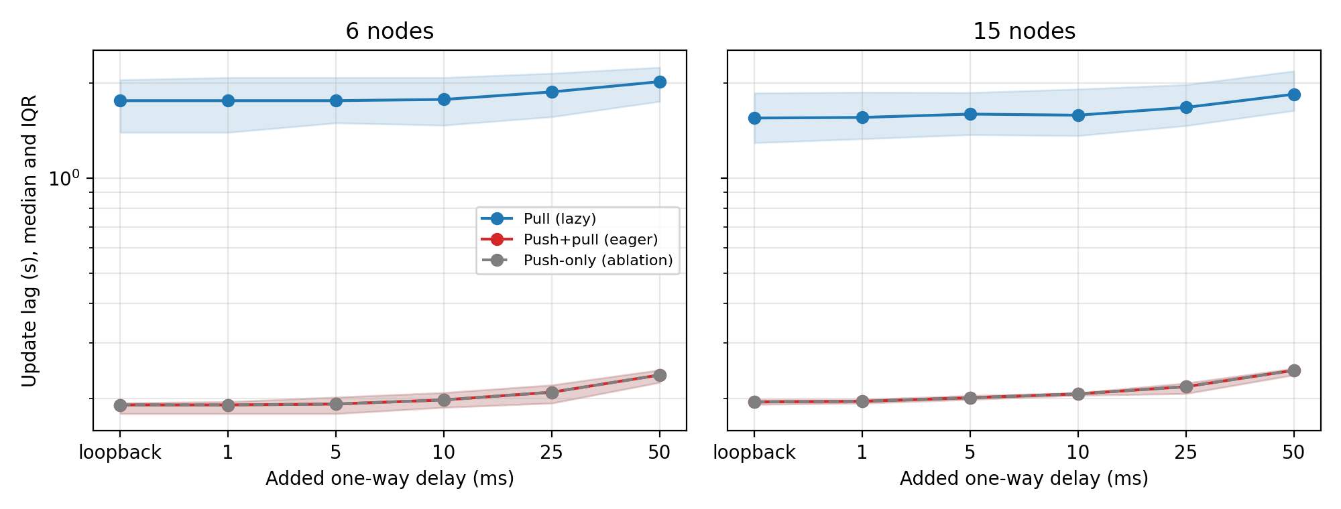
3.1.3 • RESULTS
RQ1 results: delay affects pull more than hybrid
Model medians
• 15 nodes / 0 ms: pull 1.55 s, hybrid 195 ms
• 15 nodes / 50 ms: pull 1.84 s, hybrid 246 ms
• Hybrid remains markedly faster
GROUP SIMULATION • Group 2 PD2 Table 3.1, Figure 3.1
15
Notes:
Figure 3.1 is generated from our simulator, not from a running Redis cluster. At fifteen nodes, the simulated pull median is about 1.55 seconds on loopback and 1.84 seconds with fifty milliseconds of one-way delay. Hybrid increases from 195 to 246 milliseconds. Similar behavior holds in six nodes. Pull needs heartbeats and several request-response interactions, so extra network delay accumulates more strongly. Hybrid sends the patch eagerly and remains substantially faster across the tested delays. These numbers are entirely model-based, as the figure label states.

Slide 16
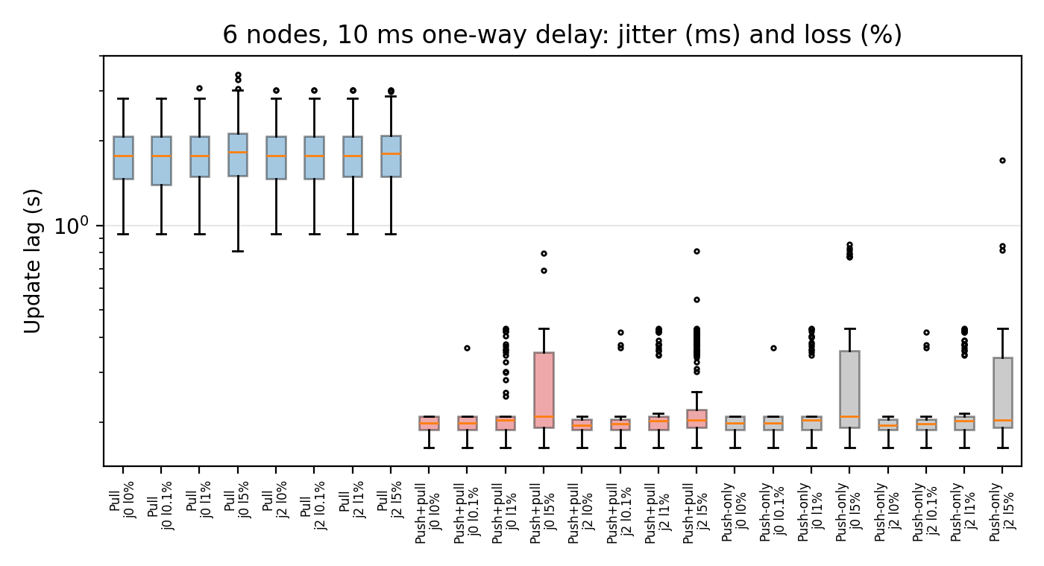
3.1.3 • RESULTS
RQ1 results: packet loss raises the tail
233 ms
hybrid median at 5% loss
810 ms
maximum at 5% loss
GROUP SIMULATION • Group 2 PD2 §3.1.3; fig_rq1_impair.png
16
Notes:
Under modeled packet loss, hybrid’s median update time is much less sensitive than the worst case. In the fifteen-node example with five percent loss, the reported hybrid median is 233 milliseconds, but the maximum reaches 810 milliseconds. That tail arises when an eager patch message is lost and simplified TCP retransmission delays its arrival. Two milliseconds of jitter had little visible impact in these simulated conditions. This result extends the authors’ loopback hypothesis, but it does not demonstrate production traffic or actual client-response resilience.

Slide 17
3.2.1–3.2.2 • ASSUMPTIONS AND METHODS
RQ2 method: controlled temporary partitions
Model assumptions
Grid and metrics
• Network isolation, not a Redis process crash
• Link drops after silence; retransmission backoff
• Healthy nodes continue exchanging gossip
• Failover elections and client errors excluded
• 9 nodes: 3 primaries, 2 replicas each
• 1, 5, 10-s isolation durations
• 5 vs 15-s node timeouts
• 20 seeds per full condition; 60-s catch-up horizon
GROUP SIMULATION • Group 2 PD2 §3.2
17
Notes:
RQ2 models three primary nodes with two replicas each, for nine nodes total. It isolates one replica, one primary or a two-node partition before or after patch submission. Isolation lasts one, five or ten seconds; the two modeled Redis node-timeouts are five and fifteen seconds. The full sweep uses twenty seeds per condition and observes whether all nodes converge within sixty seconds after the outage. Catch-up timing starts when the partition heals. Because our nodes do not crash, there is no state reload, and because failover elections are not implemented, we cannot make availability conclusions.

Slide 18
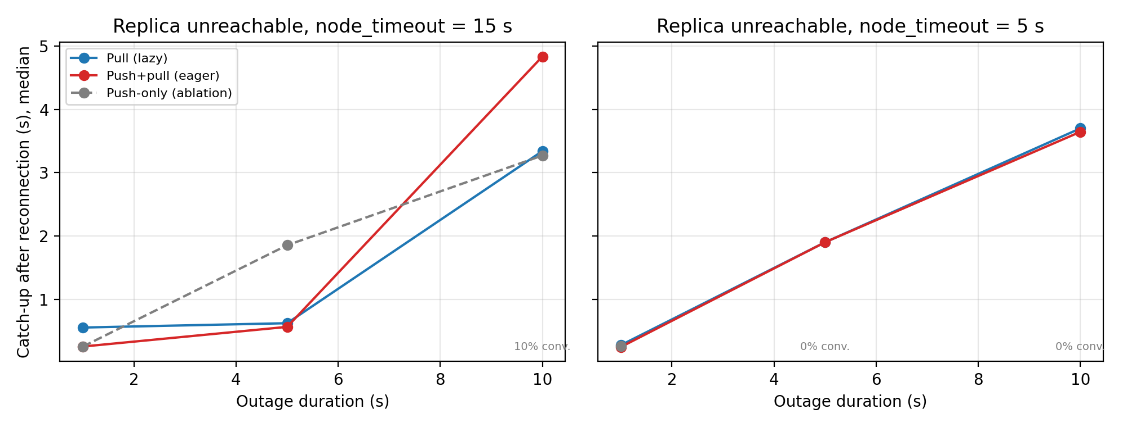
3.2.3 • RESULTS
RQ2 results: pull enables missed-patch recovery
Model findings
• Pull and hybrid: 100% convergence in reported trials
• 10-s outages: 3.3–4.8-s recovery medians
• Push-only: 0% with 5-s timeout and 5–10-s outage
GROUP SIMULATION • Group 2 PD2 Table 3.2, Figure 3.2
18
Notes:
In the reported simulation trials, both pull and hybrid delivered all patches in order after temporary isolation, whereas push-only often failed once a disconnected link was dropped. Under five-second node timeout and outages of five or ten seconds, push-only convergence was zero in the table’s replica-unreachable scenario. With ten-second outages, hybrid and pull catch-up medians are typically around three to five seconds depending on the timeout and scenario. The key mechanism is that pull discovers missed versions from resumed gossip; push-only does not automatically resend a patch that was lost when the link was removed.

Slide 19
3.3.1–3.3.2 • ASSUMPTIONS AND METHODS
RQ3 method: separate delivery from activation
Five modeled modes
Key model assumptions
• Immediate: apply on arrival/quiescence
• Sync: wait for peer-version condition
• Controller: wait for readiness → ACTIVATE
• Gossip barrier and timed event-loop activation
• Held patches remain distributable
• Cronjob gating limits synchronous switching
• Event-loop alignment is hypothetical
• One-millisecond clock error sensitivity tested
GROUP SIMULATION • Group 2 PD2 §3.3; rq3-design/DESIGN.md
19
Notes:
RQ3 evaluates five simulated modes: immediate activation, the original artifact’s sync concept, a readiness controller, a gossip barrier and timed event-loop activation. We measure the mixed-version window as the time between the first and last nodes applying a patch. The controller and gossip modes still depend on each node’s next clusterCron iteration, so they may remain separated by close to a hundred milliseconds. Event-loop activation assumes far tighter scheduling and synchronized clocks. These assumptions allow comparison of potential mechanisms but are not validated implementations in Redis.

Slide 20
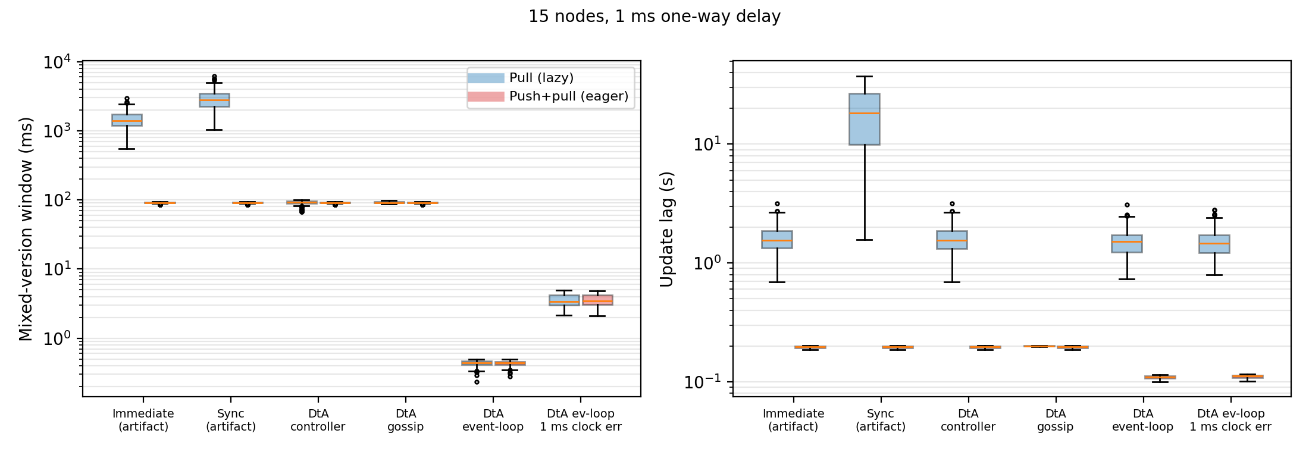
3.3.3 • RESULTS
RQ3 results: coordination narrows version skew
15 nodes, 1 ms delay
• Pull immediate: 1,404-ms skew
• Controller: 93-ms skew
• Event loop: 0.44-ms skew (ideal clocks)
• 1-ms clock error: 3.41-ms pull skew
GROUP SIMULATION • Group 2 PD2 Table 3.3, Figure 3.3
20
Notes:
Figure 3.3 compares the modeled activation modes with fifteen nodes and one millisecond of one-way delay. Under pull, immediate patching leaves a median mixed-version window of 1,404 milliseconds. A controller reduces this to about 93 milliseconds, without adding to the reported pull lag in that simulation. The hypothetical event-loop mode reduces skew to around 0.44 milliseconds under ideal clock alignment. When one millisecond of clock error is introduced, skew rises to around 3.41 milliseconds. These results should be interpreted as sensitivity analysis under explicit scheduling assumptions.

Slide 21
3.3.3 • RESULTS AND INTERPRETATION
RQ3 tradeoffs: faster is not automatically safer
91 ms
0.11 s
18.3 s
hybrid cron-based skew
hybrid event-loop lag
modeled pull-sync lag
What the model suggests — not a native validation
• Coordination largely removes dissemination-driven skew under pull.
• Reducing skew below one cronjob period requires a different activation location.
• Clock error, compatibility and workload effects remain open system questions.
GROUP SIMULATION • Group 2 PD2 §3.3
21
Notes:
Several tradeoffs emerged in the simulation. For hybrid distribution, every cronjob-gated activation strategy produced approximately 91 milliseconds of mixed-version skew, because nodes reach quiescence at different times. The hypothetical event-loop variant reduced hybrid lag to about 0.11 seconds and skew below one millisecond. Meanwhile the simulated pull-sync mode had a much larger lag in the fifteen-node setting, about 18.3 seconds. These comparisons help identify mechanisms worth implementing later, but real semantic compatibility, clock synchronization, workload interference and correctness remain open.

Slide 22
4 • REFERENCES
References — foundational methods
[1] Fruth & Scherzinger (2024)
Live patching for distributed in-memory key-value stores. PACMMOD. DOI 10.1145/3698816.
[2] Redis
Redis Cluster specification. redis.io/docs/latest/operate/oss_and_stack/reference/cluster-spec/.
[3] Redis
Redis replication documentation. redis.io/docs/latest/operate/oss_and_stack/management/replication/.
[4] Redis
Redis 7.0.11 source, src/cluster.c. github.com/redis/redis/tree/7.0.11.
[5] dynup
kpatch repository. github.com/dynup/kpatch.
[6] Rommel et al. (2020)
From global to local quiescence. OSDI 2020, pp. 651–666.
[7] Hayden et al. (2012)
Kitsune: efficient general-purpose dynamic software updating for C. OOPSLA.
[8] Pina et al. (2019)
MVEDSUA: higher availability dynamic software updates. ASPLOS.
REFERENCES • Original PD2 §§4; references [1]–[8]
22
Notes:
These are our foundational references. Our central source is Fruth and Scherzinger’s 2024 paper. Redis cluster and replication documentation, together with Redis 7.0.11 source code, support cluster semantics. Kpatch and WfPatch provide live-patching foundations, and prior dynamic updating work includes Kitsune and MVEDSUA. Full bibliographic information is in the revised PD2 report, Section 4. We have retained source IDs on the relevant slides to distinguish original paper findings from our simulated results.

Slide 23
4 • REFERENCES
References — tools and experimental design
[9] Makris & Bazzi (2009)
Immediate multi-threaded dynamic updates using stack reconstruction. USENIX ATC.
[15] Linux man-pages
ip-netns(8), Linux network namespace management. man7.org/linux/man-pages/.
[10] Fruth & Scherzinger (2024)
The Case for DBMS Live Patching. PVLDB 17(13), 4557–4570.
[16] Hemminger (2005)
Network Emulation with NetEm. linux.conf.au (LCA 2005).
[11] Redis Ltd.
memtier_benchmark repository: github.com/redis/memtier_benchmark.
[17] Linux man-pages
tc-netem(8), network impairment queue discipline. man7.org/linux/man-pages/.
[12] Fruth & Scherzinger
Reproduction package: github.com/sdbs-uni-p/sigmod25-distributed-imkvs-live-patching.
[18] Efron & Tibshirani (1993)
An Introduction to the Bootstrap. Chapman & Hall.
[13] Deng et al. (2025)
SIGMOD reproducibility report. DOI: 10.1145/3785021.3788011.
[19] chrony project
chrony documentation. chrony-project.org.
[14] ACM SIGMOD
Availability & Reproducibility Initiative: reproducibility.sigmod.org.
[20] Linux kernel source
include/net/tcp.h; TCP_RTO_MIN. github.com/torvalds/linux.
REFERENCES • Original PD2 §§4; references [9]–[20]
23
Notes:
The remaining published references support the design of our methods. They include related database updating work, the memtier benchmark, the original reproduction package, and the official reproducibility report. SIGMOD ARI guidelines define the artifact evaluation and packaging context. Linux namespace and netem references motivate the proposed testbed, while the bootstrap reference, chrony and Linux TCP timing source support details of the simulation protocol. Our submitted report contains complete source metadata, URLs and DOIs.

Slide 24
4 • REFERENCES
References — course review and current revision
Independent review and artifact provenance
• [21] Wroten, Amanuel & Searcy (2026), Project Deliverable 3: Reproducibility Peer Review Report, CSC 633, November 4, 2026.
• [R2] Law, Taylor & Ahmed (2026), Group 2 Project Deliverable 2, original October 14 and revised November 12.
• Verification artifact: exact CSV hash manifest, generated output logs and updated README in the revised ZIP.
• Course scope clarified by Dr. Koh: corrected reproducible simulation with explicit native limitations is sufficient.
REFERENCES • Revised PD2 [21]; Group 2 artifact files
24
Notes:
Our peer reviewers were William Wroten, Hana Amanuel and Kennedy Searcy of Group 1. Their November fourth report is the direct source for the independent reproducibility findings and for the actionable revision list. Our revised PD2 document preserves the scientific results and adds a review-driven correction section. The ZIP includes independent hash checking and logs from our final full run. Finally, we sought specific clarification from Dr. Koh; he explicitly approved addressing the simulator’s actionable issues and documenting the unexecuted Redis testbed for this deliverable.

Slide 25
5 • SUPPLEMENTAL MATERIAL
5.1 — Confirmation of the original paper’s artifact
Evidence linked to claims
Claims not directly reproduced
• Source-level patch checks: the Redis patch inserts a clusterCron quiescence point.
• Message-structure checks: version/bitmap and patch transport code support propagation design.
• Ordering checks: source contains ordered patch-version handling.
• 16 source smoke checks passed (not runtime measurements).
• We did not boot the custom kernel or execute the native Redis patch experiments.
• Therefore, update-lag, throughput, tail-latency, and rolling-update results were not independently measured by our group.
• Simulation timing was calibrated to the paper; independent SIGMOD replication is external evidence [13].
REPRODUCIBILITY • Group 2 PD2 §§5.1, 5.3; [12], [13], [21]
25
Notes:
We evaluated the original artifact only at source level. The 16 smoke tests check that patches apply and that the integration contains quiescence, version bitmap and ordering constructs, supporting the corresponding implementation claims but not measuring performance. We did not boot the custom kernel or run a native Redis cluster, so we cannot claim to have reproduced the paper’s update lag, throughput, tail latency or rolling-upgrade measurements. Our simulation calibration matches the paper’s reported trends but is not independent validation. The published independent SIGMOD reproducibility report is external evidence, not our own experiment.

Slide 26
5 • SUPPLEMENTAL MATERIAL
5.2 — Our reproducible artifact package
Run and configure
Outputs and provenance
Checks and native scaffolds
• README.md; requirements.txt — setup
• reproduce.py — full workflow
• sim/*.py — model and experiment grid
• analysis/analyze.py — statistics/plots
• tools/run_custom.py — exploratory runs
• results/rq*.csv — trial observations
• results/fig_*.png — four graphs
• results/summary.json — statistics
• results/run_meta.json — run metadata
• reference/sha256_csv.json — baseline hashes
• LICENSE — reuse terms
• smoke/* — model and source checks
• tools/verify_reference.py — CSV hashes
• testbed/test_parser.py — parser tests
• verification/* — recorded test logs
• testbed/*.sh, parse_wflog.py — unexecuted
• rq3-design/DESIGN.md — proposed only
REPRODUCIBILITY • Revised artifact README §§2–4; revised PD2 Table 5.1
26
Notes:
Our revised artifact package contains all model code, deterministic experiment grids, raw CSV results, analysis code and reproduced figures. The user runs python reproduce.py to regenerate the full reported results. We include the original PD2 CSV digests so another reviewer can check exact matches with tools/verify_reference.py. The ten simulation smoke tests and four synthetic parser regressions provide additional assertions. README instructions describe installation and map each table or figure to its underlying file. Native testbed scripts remain explicitly labeled as unexecuted scaffolds, rather than being represented as successful experiments.

Slide 27
5 • SUPPLEMENTAL MATERIAL / PEER REVIEW
Independent reviewer results: successfully reproduced
23,400
2,580
21,600
RQ1 CSV records
RQ2 CSV records
RQ3 CSV records
Reproduction findings
• MacBook Air M4 + Python 3.11.18; all 10 simulation smoke checks passed
• Three CSVs matched exact submitted values; four graphs successfully regenerated
• PNG bytes not identical; reviewers did not execute a Redis/WfPatch cluster
PEER-VERIFIED SIMULATION • Peer Group 1 PD3, pp. 2–6 [21]
27
Notes:
Our peer group reproduced the simulation on a MacBook Air M4, Python 3.11.18, rather than the original Windows environment. Their full run regenerated 23,400 records for RQ1, 2,580 for RQ2 and 21,600 for RQ3. The CSV outputs exactly matched the originally submitted datasets, and all ten simulation smoke checks passed. They regenerated all four graphs. The rendered PNG bytes were not exactly identical, which they did not consider a graph-generation defect. Importantly, they did not reproduce any native Redis experiments, and we consistently separate that evidence from simulation reproducibility.

Slide 28
5 • SUPPLEMENTAL MATERIAL / PD4 CORRECTIONS
Review-driven fixes and new validation evidence
Corrections made
Verification and boundaries
• All Bash scripts now LF, with syntax check
• Documented Python venv, outputs, cleanup and tool inventory
• Parser now requires every expected node; four regression tests pass
• New CLI for exploratory RQ1–RQ3 scenarios
• Fresh complete simulation: 10 smoke checks pass
• 3/3 original CSV SHA-256 matches
• Verification environment and logs included
• Native driver and Redis activation still unexecuted by approved scope
PD4 REVISION • Revised PD2 §§5.3–5.4; artifact README §8
28
Notes:
We incorporated the peer review by normalizing Bash line endings, documenting isolated Python environments, and clarifying the difference between executed and unexecuted workflows. The most substantive code fix is in the log parser: it now requires a manifest of every expected cluster node, so a silent node cannot disappear from the convergence denominator. Four synthetic regression tests pass. We also added a separate exploratory command-line interface and original-reference CSV fingerprints. The full revised simulation passed all ten checks and all three generated CSVs matched the original PD2 values exactly. These improvements do not claim a completed native Redis benchmark.

Slide 29
THANK YOU
28

