Slide 1


Lecture 5: K-Nearest Neighbours
PUSL3123 AI and Machine Learning
Neamah Al-Naffakh
School of Engineering, Computing and Mathematics
Neamah.al-naffakh@plymouth.ac.uk

Slide 2
Today’s Topics
K-Nearest Neighbours
Lesson learning outcomes: By the end of today’s lesson, you would be able to:
Explain K-Nearest Neighbours (K-NN)
Implement K-NN

Slide 3
K-nearest neighbors (K-NN)
K-NN is a supervised learning algorithm that can be used to predict what class data should be put into.
It requires some training examples (reference vector) with the correct class indicated.
K-NN tries to predict the correct class for the test data by calculating the distance between the test data and all the training points
User sets a value for K (must be positive integer).

Slide 4
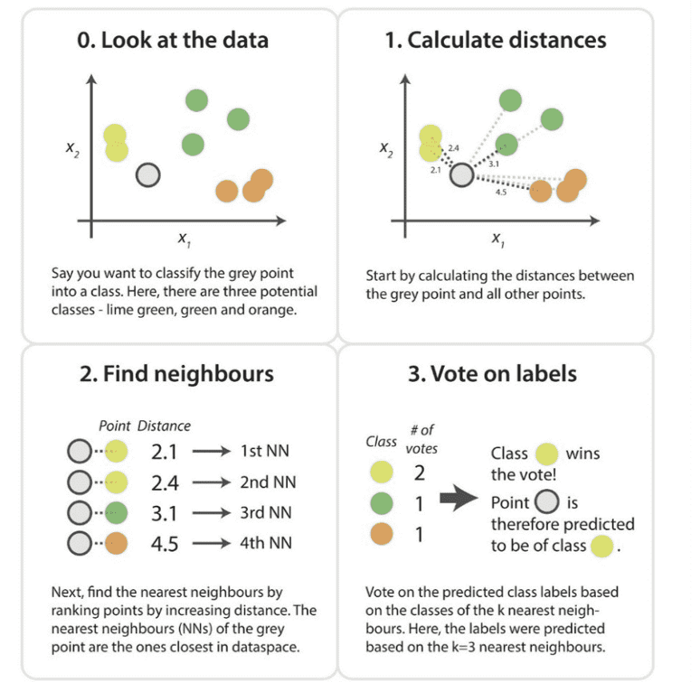
K-NN Example

Slide 5
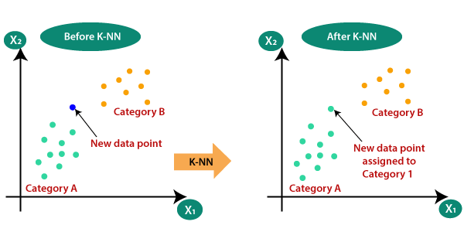

Slide 6
How does K-NN work?
Step-1: Select the number K of the neighbors
Step-2: Calculate the Euclidean distance of K number of neighbors
Step-3: Take the K nearest neighbors as per the calculated Euclidean distance.
Step-4: Among these K neighbors, count the number of the data points in each category.
Step-5: Assign the new data points to that category for which the number of the neighbor is maximum.

Slide 7
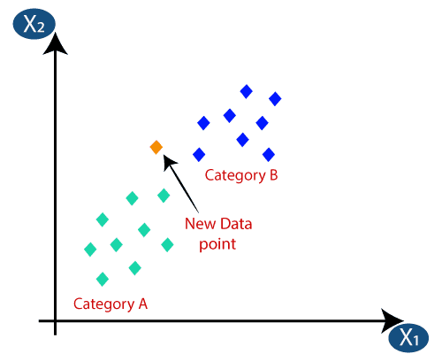
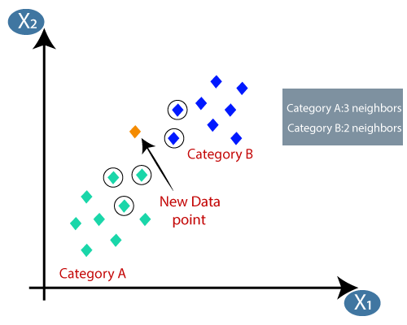
K-NN with Example

Slide 8
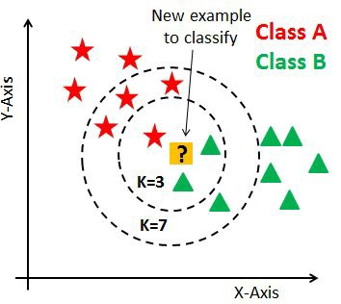
How to select the optimal K value?
No pre-defined statistical methods to find optimal K value
Random Initialization of K
Choosing a small value of K leads to unstable decision boundaries
Inversely, as we increase the value of K, our predictions become more stable due to majority voting
In cases where we are taking a majority vote (e.g. picking the mode in a classification problem) among labels, we usually make K an odd number to have a tiebreaker.

Slide 9
K-NN Remarks
1- Select an odd K value for a 2 classes problem; this is because if we set
K=2 for a binary classification problem, we can have a tie what would be the class?
2- The main drawback of K-NN is the complexity in searching the nearest neighbours for each sample in case of a big dataset. Therefore, this would require expensive computation overhead and more memory space.
3- KNN makes predictions just-in-time by calculating the similarity between an input sample and each training instance

Slide 10
15 Minutes Break

Slide 11
Lab 4 Explanation
About coursework

Slide 12
Steps to Implement K-NN
Divide the dataset randomly into training and testing examples (e.g., 80% for training and 20% for testing).
Set the K value for K-NN classification
Fit K-nearest neighbor classifier by using MATLAB functions (fitcknn)
Fitcknn (Training dataset, Class_Label_Training, 'NumNeighbors’,K )
4. Predict the class of an input data using MATLAB functions (Predict).
5. Display the Confusion Matrix for testing data

Slide 13
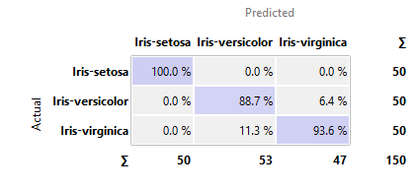
Confusion Matrix
A confusion matrix is a table that is often used to describe the performance of a classification model (or "classifier") on a set of test data for which the true values are known.

Slide 14
K-Mean Implementation
% Gender Recognition by Voice
% Load data
% Prepare the training and testing data
% Standardization of Training data and Testing data
% Training the K-NN model
% Testing the model
%Reading the table
clear;close all; clear all; clc;
warning off
data=readtable('voice.csv');
DataC=data;
%Checking the Null values
disp(sum(ismissing(data)));
% Labeling our data with (1 for Male and 0 for Female)
k=["male","female"];
l=[1,0];
g=DataC.label;
% generete vector of 0 and 1 values
number=zeros(length(g),1);
for i=1:length(k)
rs=ismember(g,k(i)); number(rs)=l(i);
end
DataC.label=number;

Slide 15
K-Mean Implementation
%Standardization of Test data
m = table2array(Testing_Data);
meanArray = mean(m)
stdArray = std(m)
Testing_Data= (m - meanArray) ./ stdArray;
Testing_Data = array2table(Testing_Data, 'VariableNames',{'meanfreq' 'sd' 'median'...
'Q25' 'Q75' 'IQR' 'skew' 'kurt' 'sp_ent' ...
'sfm' 'mode' 'centroid' 'meanfun' 'minfun' 'maxfun' ...
'meandom' 'mindom' 'maxdom' 'dfrange' 'modindx'});
dataTest=[Testing_Data Class_Label_Testing];
%Dividing data into train & test set
cv = cvpartition(size(DataC,1),'HoldOut',0.2);
idx = cv.test;
% Separate to training and test data
dataTrain = DataC(~idx,:);
Training_Data=dataTrain(:,1:end-1);
Class_Label_Training=dataTrain(:,end);
dataTest = DataC(idx,:);
Testing_Data=dataTest(:,1:end-1);
Class_Label_Testing=dataTest(:,end);
%%%%%%%%%%%%%%%%%%%%%%%%%%%%%%
%Standardization of Training data
m = table2array(Training_Data);
meanArray = mean(m);
stdArray = std(m);
zam= (m - meanArray) ./ stdArray;
Training_Data = array2table(zam, 'VariableNames',{'meanfreq' 'sd' 'median'...
'Q25' 'Q75' 'IQR' 'skew' 'kurt' 'sp_ent' ...
'sfm' 'mode' 'centroid' 'meanfun' 'minfun' 'maxfun' ...
'meandom' 'mindom' 'maxdom' 'dfrange' 'modindx'});
dataTrain=[Training_Data Class_Label_Training];

Slide 16
K-Mean Implementation
%Training the model
K=3;
% modelformed=fitcknn(dataTrain,'label');
modelformed=fitcknn(Training_Data,Class_Label_Training, 'NumNeighbors',K);
%Accuracy with default model parameters
mk=predict(modelformed,Testing_Data);
accuracy_check=((sum((mk==table2array(dataTest(:,end)))))/size(dataTest,1))*100;
disp(accuracy_check);
%Running KNN for every possible value on this dataset
accuracy=[];
k=1;
for i=1:size(dataTrain,1)
modelformed=fitcknn(Training_Data,Class_Label_Training,'NumNeighbors',k);
modelformed.NumNeighbors=i;
mk=predict(modelformed,Testing_Data);
accuracy_check=((sum((mk==table2array(dataTest(:,end)))))/size(dataTest,1))*100;
accuracy=[accuracy accuracy_check];
end
%Plot
plot((1:size(dataTrain,1)),accuracy);

Slide 17
K-NN Coding Exercise
Modify the previous example, to do the following
Load the fisheriris.mat data
Initialize K to your chosen number of neighbors
Prepare the training and testing data
Standardization of Training data and Testing data % Training the K-NN model (if needed)
train the K-NN model
test the model
calculate the accuracy
Report the optimal K value

