Slide 1
Arduino hardware

Slide 2
What is Arduino? An Arduino is an open-source hardware development platform used to develop easy-to-use electronic devices to interact with the real world. The hardware configuration of an Arduino is open source which means that it can be modified in order to make different versions of itself.

Slide 3
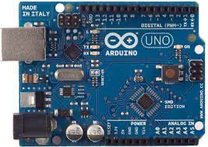
Arduino UNO An Arduino UNO is an open-source microcontroller board which is based on Atmega328p. It is a standard board of Arduino which is easy to operate in comparison to other Arduino boards.

Slide 4
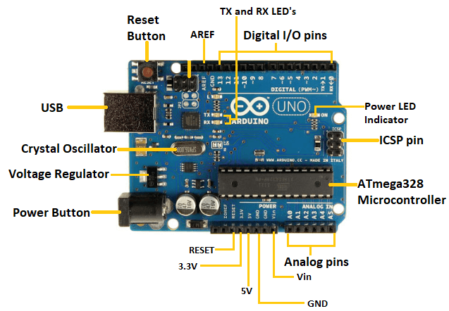
Components of Arduino UNO

Slide 5
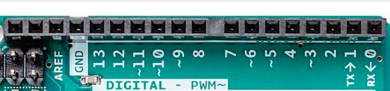
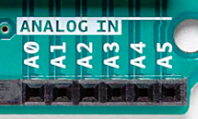

Analog pins There are a total of 6 analog input pins which can read voltage from external devices like sensors.
Digital I/O pins
There are a total of 14 digital pins in Arduino Uno where 6 pin support PWM.

Slide 6
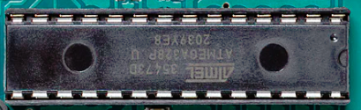
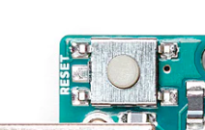
Microcontroller It is a main component of the Arduino UNO board based on ATmega328.
Reset Button
Reset the device to the initialized state

Slide 7
Tx Rx LED Blinks when data is transmitted or received from the computer to Arduino
AREF(Analog Reference)
For providing the external reference voltage for analog–to–digital converter.

Slide 8

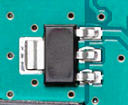
Crystal Oscillator provides a precise clock signal to the microcontroller and synchronized internal operation.
Voltage Regulator
Regulate the input voltage to a constant suitable voltage.

Slide 9


ICSP(In-Circuit Serial Programming) pins Allows interworking of two or more Arduino board
ATmega16U2
Act as a bridge between the computer USB and serial port

Slide 10


Power supply pin supply power to input and output component
Capacitor
Back up power supplies for Arduino and filtering out noise

Slide 11
Arduino modules
It is a ready-to-use board for enhancing the functionality of Arduino

Slide 12
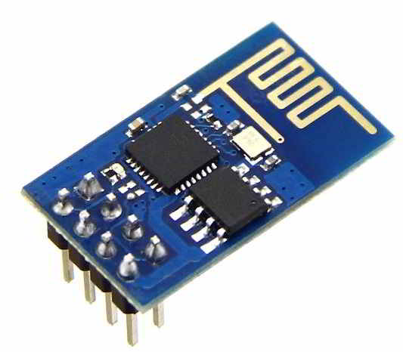
ESP8266 WIFI Module
Add WIFI connectivity feature on Arduino

Slide 13
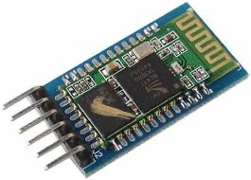
HC-05 Bluetooth Module
Add Bluetooth connectivity feature on Arduino

Slide 14
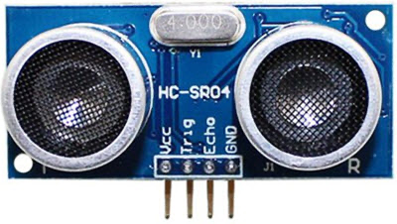
HC-SR04 Ultrasonic Module
For Detection of objects up to 4 meters.

Slide 15
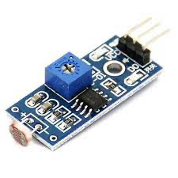
LDR Sensor module
For the detection of the intensity of light

