Slide 1
Arduino hardware

Slide 2
What is Arduino?

Slide 3
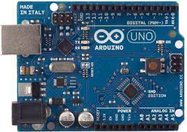
Arduino UNO

Slide 4
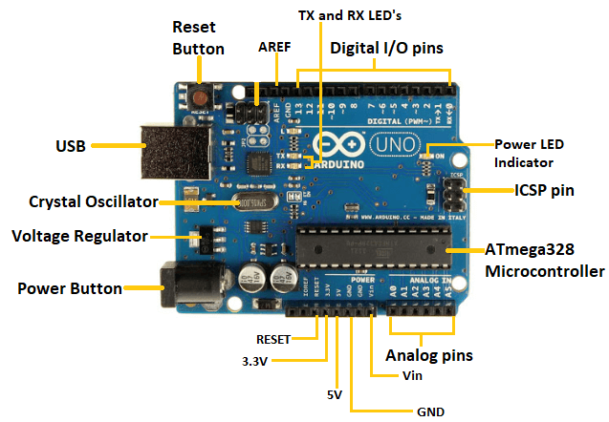
Components of Arduino UNO

Slide 5
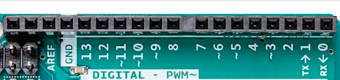
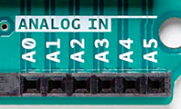

Analog pins
Digital input/output pins

Slide 6
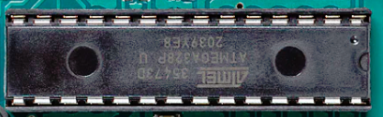
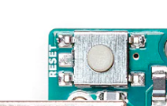
Microcontroller
Reset Button

Slide 7
Tx Rx LED
AREF(Analog Reference)

Slide 8

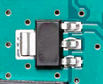
Crystal Oscillator
Voltage Regulator

Slide 9


ICSP(In-Circuit Serial Programming)
ATmega16U2

Slide 10


Power supply pin
capacitor

