Slide 1
Arduino Program
Arduino Board is a facilitating board that consists of a main microcontroller , which is known as Atmel AVR.
This Microcontroller is manipulated with pins attached in the board and that can happen only with an Arduino Program.
Programming is the very basic engineering component of any system.
In Arduino, an effective program is created to control micro-controllers and other components such that an entire system or a network of such systems can be manipulated.
While programming in an Arduino Board, a language similar to C/C++
is used.
With this, pins in Arduino Board can be controlled .

Slide 2
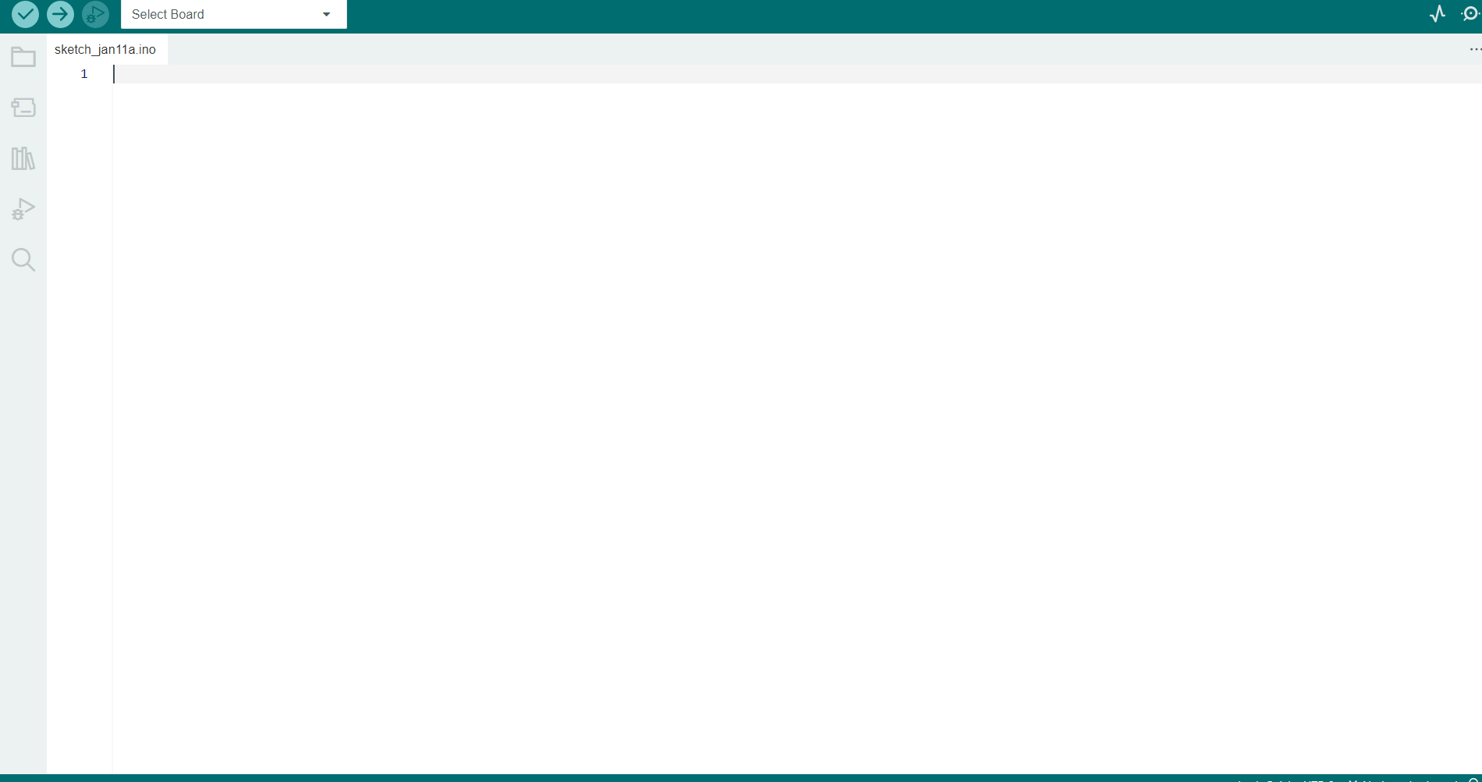
Arduino IDE
An Arduino IDE(Integrated Development Environment) is a software that is used to develop Arduino programs.
It can be linked with other simulation softwares such as Proteus or TinkerCad such that we can simulate the program alongside design.

Slide 3
Pin Control (I/O)
Digital Input and Output in Arduino Board can be done only in HIGH and LOW or ON and OFF or 0 and 1.
Digital inputs are used to read the state of a button, sensor, or other device that outputs a digital signal, and can be done using the digitalRead() function in the Arduino programming language. When a digital input pin is set to be an input (using the pinMode() function).
Digital outputs, on the other hand, are used to control the state of an electronic device such as an LED, relay or transistor, and can be done using the digitalWrite() function. When a digital output pin is set to be an output (using the pinMode() function), it can output a digital signal with a value of either HIGH or LOW to control the state of a connected device.

Slide 4
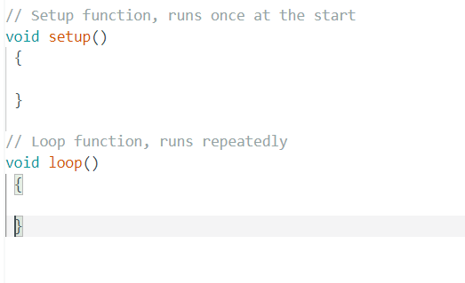
Program BoilerPlate
Setup Function is used to set the pin mode in Arduino Board.
Loop Function is used to repeatedly run the instructions inside the function.

Slide 5


Variables and Data Type
Constants:
Constants can be declared with there data type and variable name:
Integers:
Integer Variables can be declared in:
Character Variables:
Character Variables can be declared in:

Slide 6


Functions:Inbuilt
Inbuilt Functions :
These functions are defined in System by default.
pinMode(pin,mode)
digitalWrite(pin,value)
delay(ms)

Slide 7
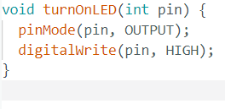
Functions:User Defined
User Defined Functions :
Other than inbuilt functions, user defined functions can also be used:
For which void keyword should be specified along with function name.

Slide 8
Features of Arduino Programming
PWM:
Pulse Width Modulation, or PWM, is a technique for getting analog results with digital means. (Analog-Digital Conversion)
Inbuilt Functions:
There are several inbuilt functions in Arduino, that make it easier to program for different pins and control electronic components without coding in assembly language.
Supports For Multiple Architecture:
Arduino supports a variety of microcontroller architectures and modules.

Slide 9
Limitations of Arduino Programming
For larger algorithms and data tracing, Arduino Programming becomes less relevant.
The optimization is relatively less compared to other languages.
The limited capacity of AVR in Arduino Board can make it limiting for large scale projects

