Slide 1
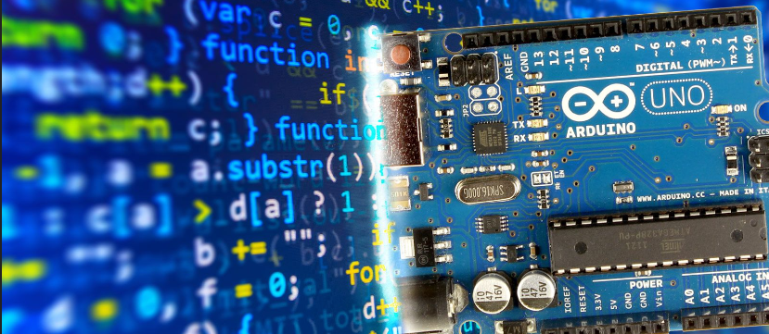
Arduino Programming

Slide 2
Programming
Creating automated instructions to carry out specific tasks.
Instructional C/C++ is used .
Can be used to create simple to complex level applications of circuits and components.
Problem solving and creativity can be displayed.

Slide 3
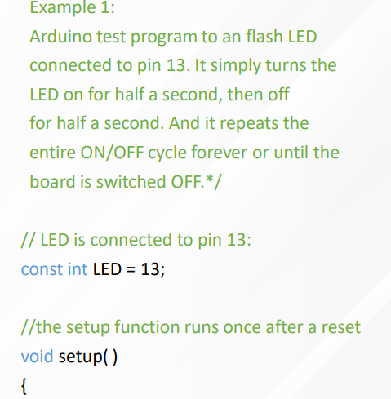
Arduino IDE
The Arduino IDE is a versatile and user-friendly text editor for writing code in C or C++.
It has built-in libraries for accessing hardware functions such as digital I/O pins, serial communication protocols, timers and interrupts.
It also has a compiler which translates programs into machine language understandable by microcontrollers.
The IDE also supports debugging with breakpoints and uploading sketches directly from within the environment.
It makes it easier than ever before to get started programming with your own custom projects.

Slide 4
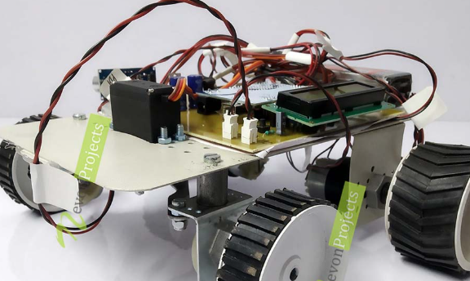

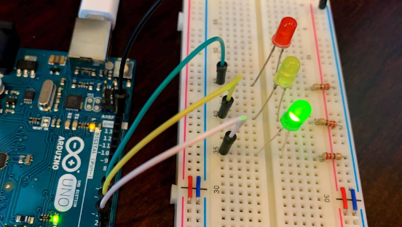
Applications Of Arduino Programming

