Slide 1
Arduino hardware

Slide 2
What is Arduino? An Arduino is an open-source hardware development platform used to develop easy-to-use electronic devices to interact with the real world. The hardware configuration of an Arduino is open source which means that it can be modified in order to make different versions of itself.

Slide 3
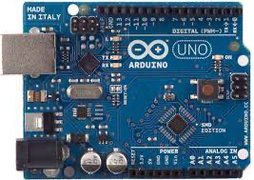
Arduino UNO An Arduino UNO is an open-source microcontroller board which is based on Atmega328p. It is a standard board of Arduino which is easy to operate in comparison to other Arduino boards.

Slide 4
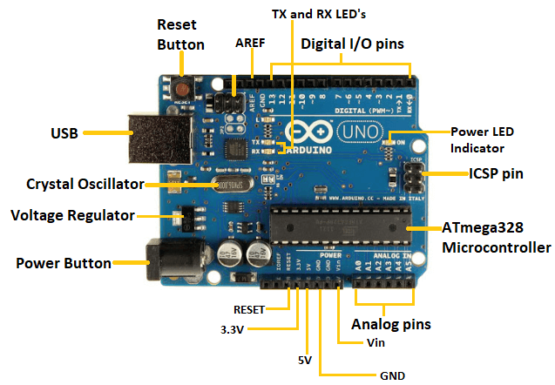
Components of Arduino UNO

Slide 5
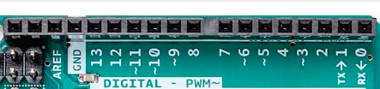
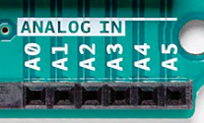

Analog pins There are a total of 6 analog input pins which can read voltage from external devices like sensors.
Digital I/O pins
There are a total of 14 digital pins in Arduino Uno where 6 pin support PWM.

Slide 6
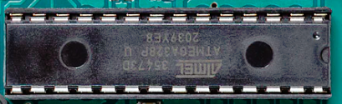
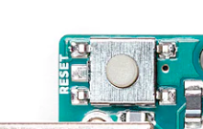
Microcontroller It is a main component of the Arduino UNO board based on ATmega328.
Reset Button
Reset the device to the initialized state

Slide 7
Tx Rx LED Blinks when data is transmitted or received from the computer to Arduino
AREF(Analog Reference)
For providing the external reference voltage for analog–to–digital converter.

Slide 8

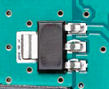
Crystal Oscillator provides a precise clock signal to the microcontroller and synchronized internal operation.
Voltage Regulator
Regulate the input voltage to a constant suitable voltage.

Slide 9


ICSP(In-Circuit Serial Programming) pins Allows interworking of two or more Arduino board
ATmega16U2
Act as a bridge between the computer USB and serial port

Slide 10


Power supply pin supply power to input and output component
Capacitor
Back up power supplies for Arduino and filtering out noise

Slide 11
Arduino modules
It is a ready-to-use board for enhancing the functionality of Arduino

Slide 12
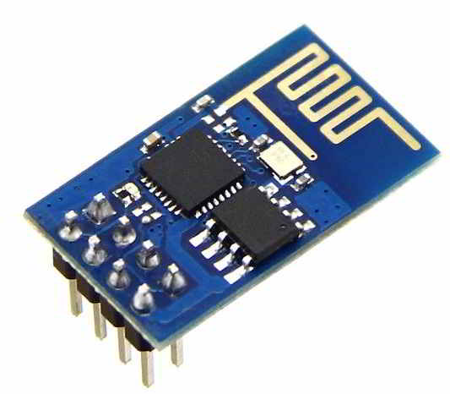
ESP8266 WIFI Module
Add WIFI connectivity feature on Arduino

Slide 13
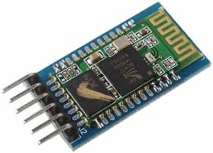
HC-05 Bluetooth Module
Add Bluetooth connectivity feature on Arduino

Slide 14
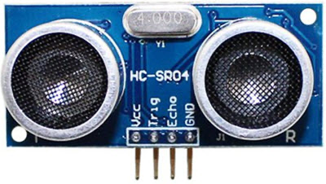
HC-SR04 Ultrasonic Module
For Detection of objects up to 4 meters.

Slide 15
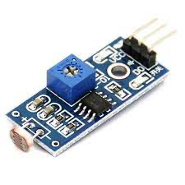
LDR Sensor module
For the detection of the intensity of light

Slide 16
Arduino Program
Arduino Board is a facilitating board that consists of a main microcontroller , which is known as Atmel AVR.
This Microcontroller is manipulated with pins attached in the board and that can happen only with an Arduino Program.
Programming is the very basic engineering component of any system.
In Arduino, an effective program is created to control micro-controllers and other components such that an entire system or a network of such systems can be manipulated.
While programming in an Arduino Board, a language similar to C/C++
is used.
With this, pins in Arduino Board can be controlled .

Slide 17
Pin Control (I/O)
Digital Input and Output in Arduino Board can be done only in HIGH and LOW or ON and OFF or 0 and 1.
Digital inputs are used to read the state of a button, sensor, or other device that outputs a digital signal, and can be done using the digitalRead() function in the Arduino programming language. When a digital input pin is set to be an input (using the pinMode() function).
Digital outputs, on the other hand, are used to control the state of an electronic device such as an LED, relay or transistor, and can be done using the digitalWrite() function. When a digital output pin is set to be an output (using the pinMode() function), it can output a digital signal with a value of either HIGH or LOW to control the state of a connected device.

Slide 18
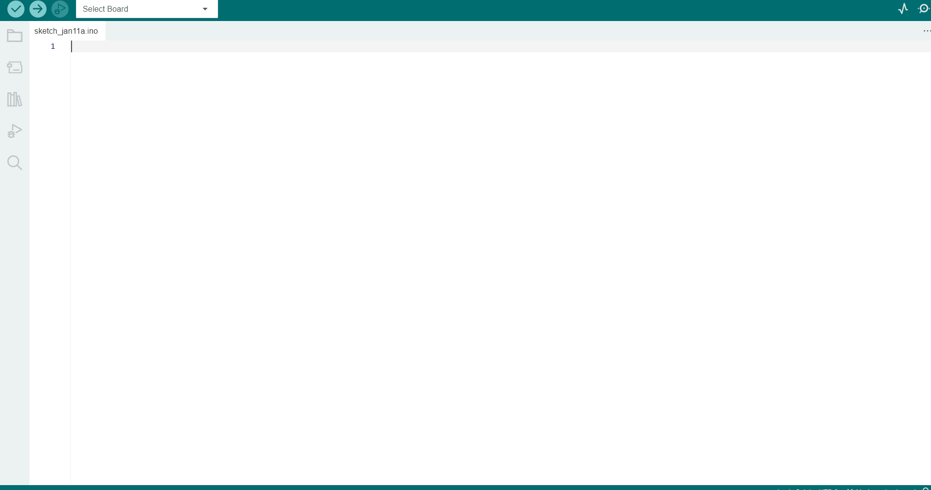
Arduino IDE
An Arduino IDE(Integrated Development Environment) is a software that is used to develop Arduino programs.
It can be linked with other simulation softwares such as Proteus or TinkerCad such that we can simulate the program alongside design.

Slide 19
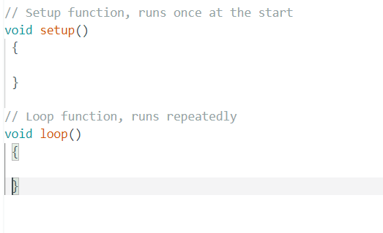
Program BoilerPlate
Setup Function is used to set the pin mode in Arduino Board.
Loop Function is used to repeatedly run the instructions inside the function.

Slide 20


Variables and Data Type
Constants:
Constants can be declared with there data type and variable name:
Integers:
Integer Variables can be declared in:
Character Variables:
Character Variables can be declared in:

Slide 21


Functions:Inbuilt
Inbuilt Functions :
These functions are defined in System by default.
pinMode(pin,mode)
digitalWrite(pin,value)
delay(ms)

Slide 22
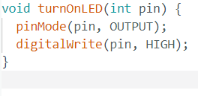
Functions:User Defined
User Defined Functions :
Other than inbuilt functions, user defined functions can also be used:
For which void keyword should be specified along with function name.

Slide 23
Features of Arduino Programming
PWM:
Pulse Width Modulation, or PWM, is a technique for getting analog results with digital means. (Analog-Digital Conversion)
Inbuilt Functions:
There are several inbuilt functions in Arduino, that make it easier to program for different pins and control electronic components without coding in assembly language.
Supports For Multiple Architecture:
Arduino supports a variety of microcontroller architectures and modules.

