Slide 1
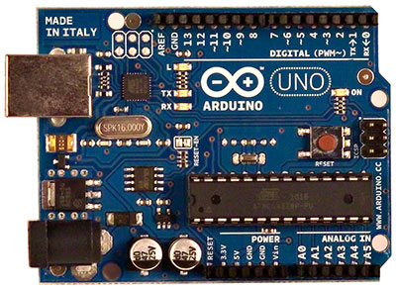
POW (3 – 5.5V)
DHT11
POW 5V
MPX4115A
DIG/IN
Geiger
BIKE SENSOR OVERVIEW
DIG/IN
DHT11
ANL/GND
DIG = Digital
ANL = Analog
MPX4115A – Pressure sensor
DHT11 – Temp/Hum sensor
Geiger – Geiger counter board
ANL/IN
MPX4115A
Note – The pins 10,11,12,13 are SPI
ones use for WiFi or Ethernet
- Pins 0 and 1 are for Serial UART
Don't use these pins for anything else
DIG/GND
POW 5V
Geiger

Slide 2

Deployment
Geiger Board
Ribbon cable
Sensor
board
USB Power
supply

