Slide 1

Introduction to Digital Forensics
Slides are modified from Guide to Computer Forensics and Investigations. Sixth Edition. Cengage Learning, 2018, ISBN-13: 978-1-337-56894-4. Chapter 1

Slide 2
Outline
What is digital forensics?
Steps of digital investigation
Autopsy lab

Slide 3

What is digital forensics

Slide 4
Definition
The application of computer science and investigative procedures for a legal purpose involving the analysis of digital evidence after
proper search authority,
chain of custody (Evidence Transmittal Letter)
validation with mathematics (hash function),
use of validated tools,
repeatability,
reporting,
possible expert presentation.

Slide 5
NIST definition of Digital Forensics
The application of science to
identification,
collection,
examination, and
analysis
of data while
preserving the integrity of the information and
maintaining a strict chain of custody of the data

Slide 6
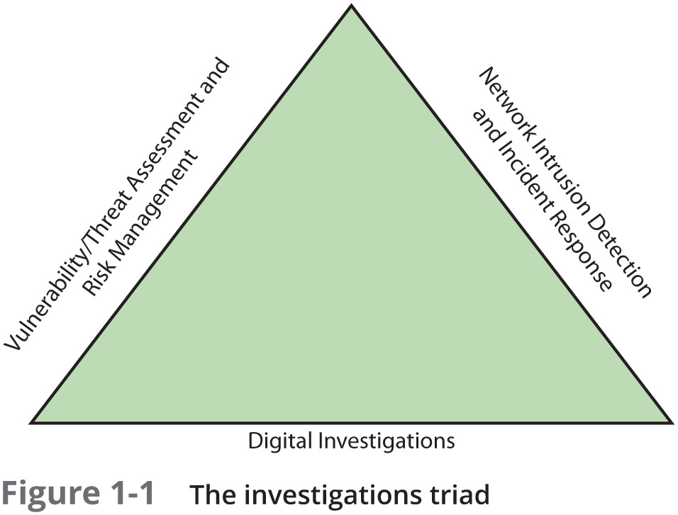
Digital Forensics and Other Related Disciplines

Slide 7
Digital Investigation Types
Public-sector investigations
involve government agencies responsible for criminal investigations and prosecution
Private-sector investigations
policy violations
E-mail harassment, falsification of data, gender and age discrimination, embezzlement, sabotage, and industrial espionage

Slide 8
Digital forensics vs. data recovery
DF ensure recovered data is valid for evidence
Often don’t know whether digital devices contain evidence

Slide 9
Steps of digital investigation

Slide 10
Steps
Procedure of gathering the evidence (evidence media)
1
Acquiring an image of evidence media
2
Analyzing digital evidence
3
Produce a final report
4
Critiquing the case
5

Slide 11
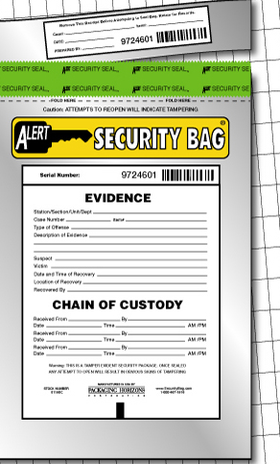
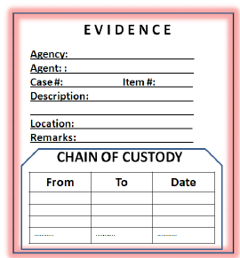
Procedure of gathering the Evidence
Meet the IT manager to interview him
Fill out the evidence form, have the IT manager sign
Place the evidence in a secure container
Carry the evidence to the computer forensics lab
Complete the evidence custody form
Secure evidence by locking the container

Slide 12
Acquiring an image of evidence media
File1 | File2 | Deleted file
Bit-stream copy
Bit-by-bit copy of the original storage medium
copy deleted files, e-mail messages or recover file fragments
known as “image” or “image file”
Backup copy
Backup software only copy known files
Backup software cannot copy deleted files, e-mail messages or recover file fragments
Bit-stream copy
backup copy

Slide 13
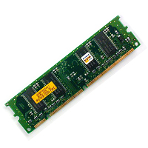
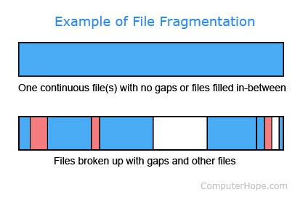

Analyzing Digital Evidence
OS, applications, file, logs
Deleted files
File fragments
Memory

Slide 14
Produce a final report
Document your work
Repeatable findings
Conclusive evidence that suspect did or did not commit a crime or violate a company policy
Who, what, when, where, why, and how
Formalize evidence (https://github.com/frankwxu/digital-forensics-lab/tree/main/STIX_for_digital_forensics)

Slide 15
Critiquing the Case
How could you improve your performance in the case?
Did you expect the results you found? Did the case develop in ways you did not expect?
Was the documentation as thorough as it could have been?
What feedback has been received from the requesting source?
Did you discover any new problems? If so, what are they?
Did you use new techniques during the case or during research?

Slide 16

Autopsy lab

Slide 17
Background
Investigate a USB drive
Owned by George Montgomery
Assume we have the image file
https://www.dropbox.com/s/nw23q14vzsykyup/Ch01InChap01.dd
(from book Guide to Computer Forensics and Investigations. Sixth Edition)
Software
Autopsy
Tasks
Recover Word files, images
Search key words

Slide 18
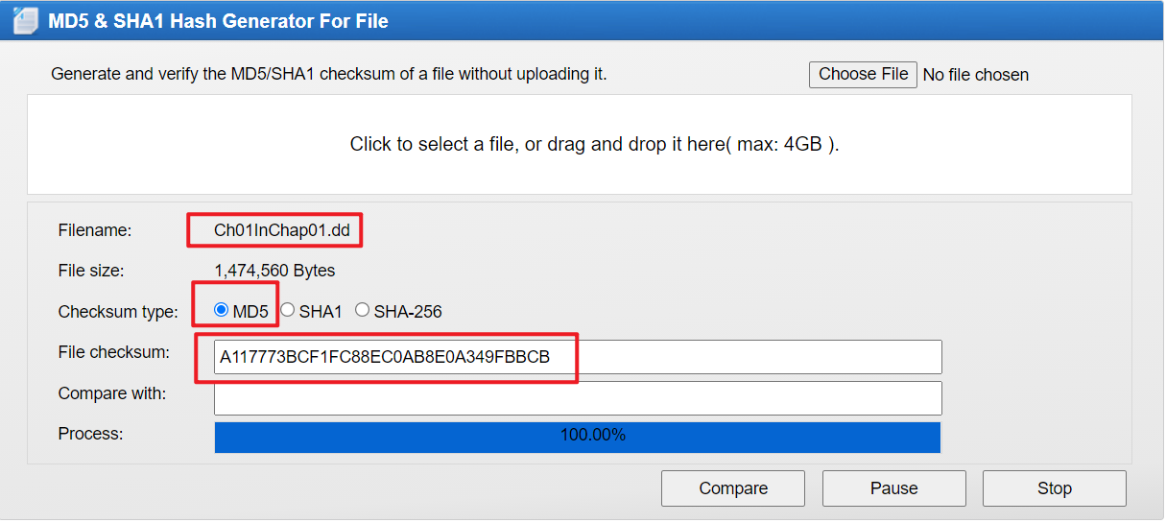
Check hash code online
http://onlinemd5.com/

Slide 19
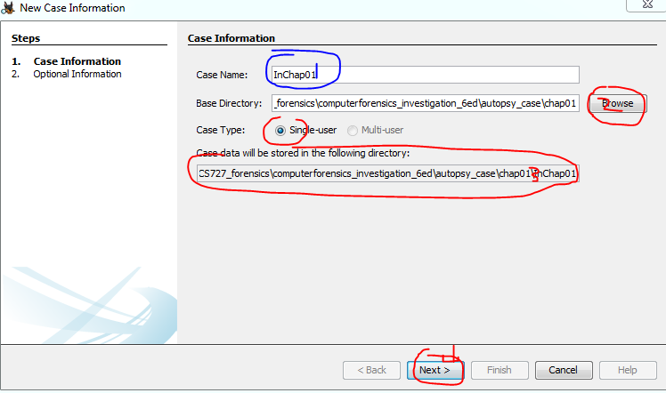
Create a case with name

Slide 20
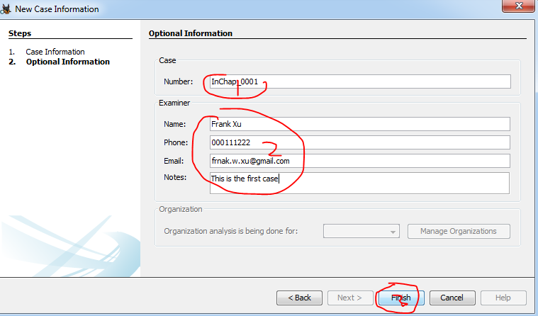
Details of the case

Slide 21
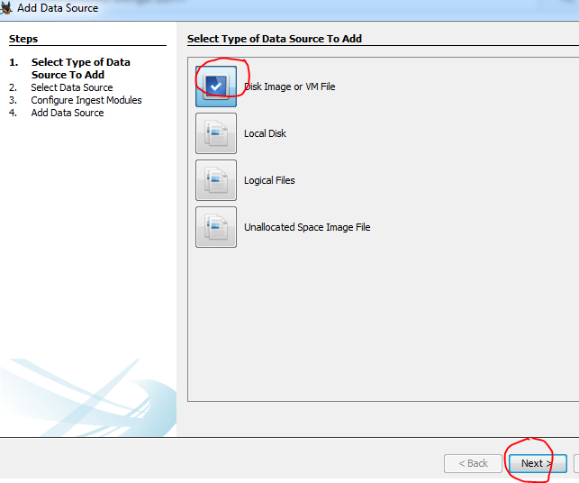
Choose Data Format

Slide 22
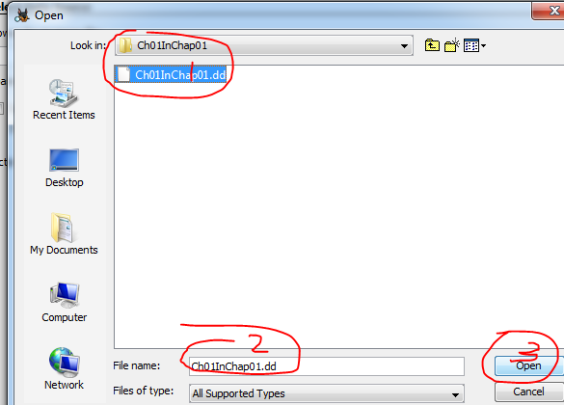
Choose the image file

Slide 23
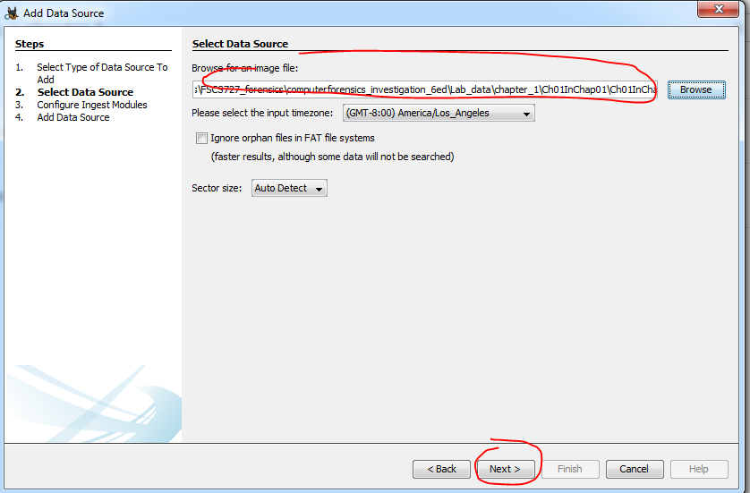

Slide 24
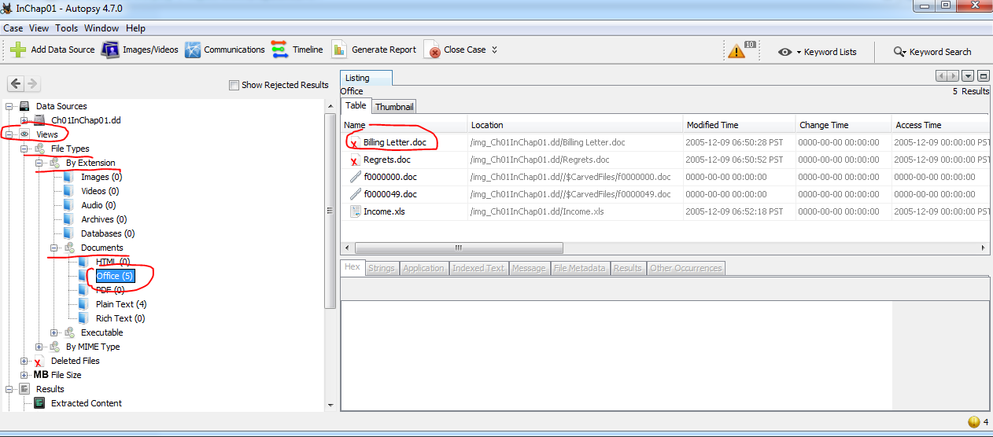
Find deleted files

Slide 25
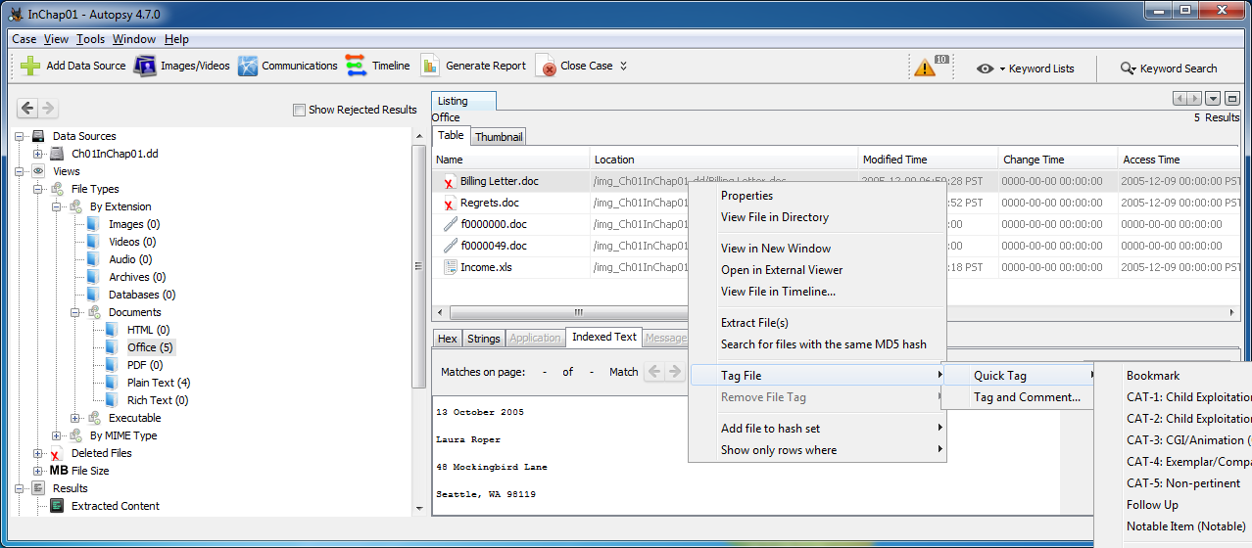
Tag the file: right click
Right click

Slide 26
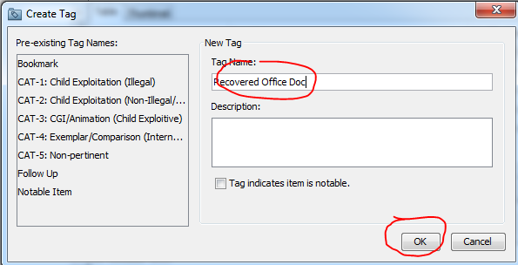
Create a tag for reporting

Slide 27
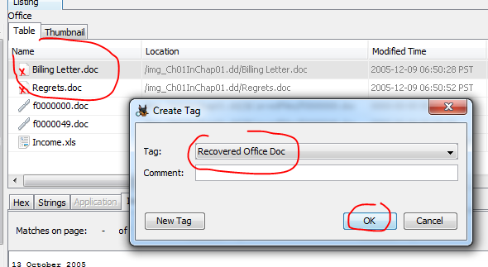
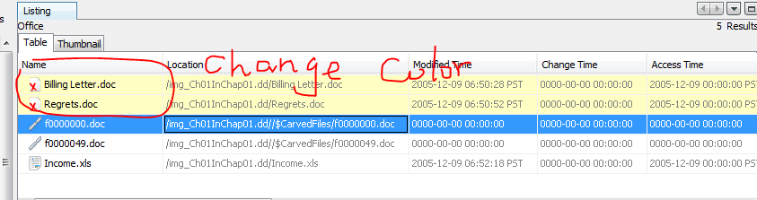
Tag both deleted files

Slide 28
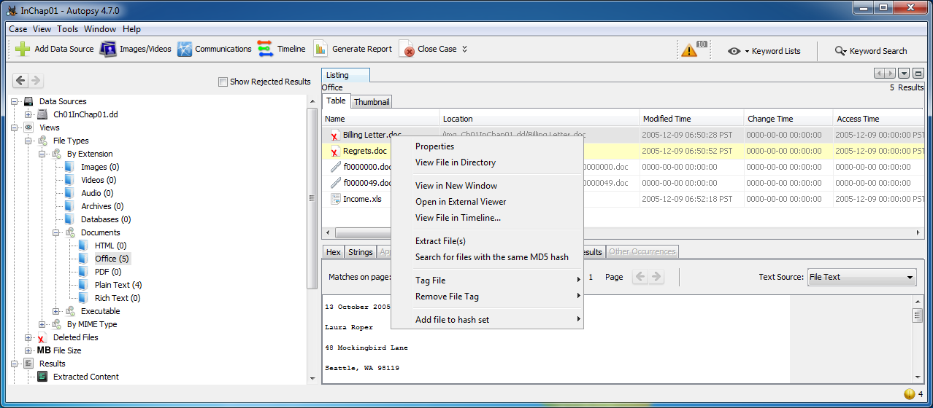
Recover deleted file

Slide 29
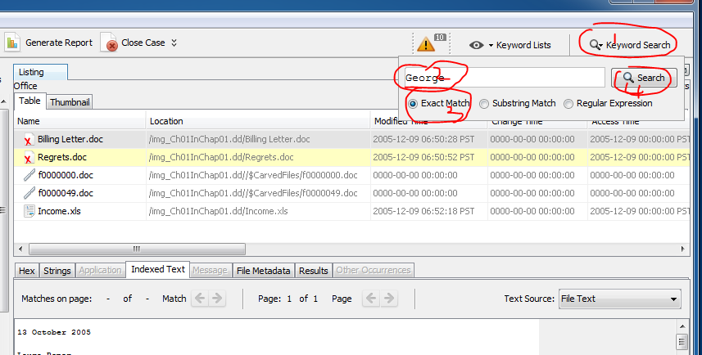
Search keywords

Slide 30
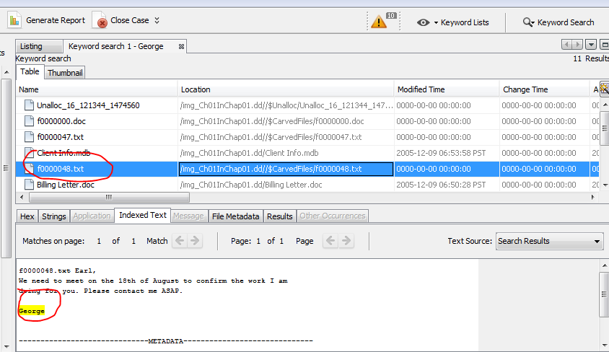
Search results

Slide 31
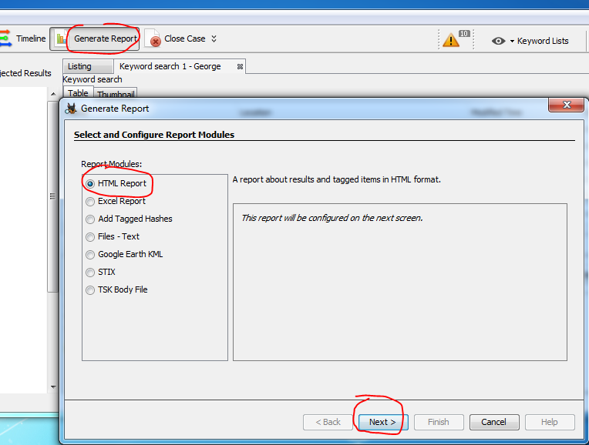
Generate reports

Slide 32
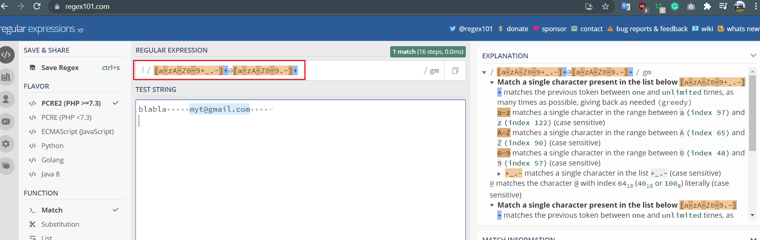
Email search [a-zA-Z0-9+_.-]+@[a-zA-Z0-9.-]+
[] square bracket: match one element

Slide 33
Assignments- highlighting search results
Find all zip code using regular expression using https://regex101.com/
the zip code is 90210
the zip code is 70313
Find all phone number using regular expression
my phone number is (123)3456789
my phone number is 123-345-6789
my phone number is 123456789

