Slide 1
Investigating Pixel 3
Android 10
Notes:
https://digitalcorpora.s3.amazonaws.com/corpora/mobile/android_10/Non-Cellebrite%20Extraction/Pixel%203.zip

Slide 2

Introduction to Android

Slide 3
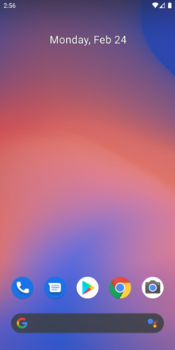
What is Android?
Android is a mobile operating system
based on a modified version of the Linux kernel
was unveiled in November 2007
Android is open-source software
its source code is known as Android Open-Source Project (AOSP)
licensed under the Apache License
Most Android devices ship with additional proprietary software pre-installed, e.g., Google Mobile Services (GMS)
Google Search, Google Chrome, YouTube, Google Play Store
Google Drive, Gmail, Google Duo, Google Maps, Google Photos, Google TV, YouTube Music
Notes:
https://en.wikipedia.org/wiki/Android_(operating_system)
https://en.wikipedia.org/wiki/Google_mobile_services

Slide 4
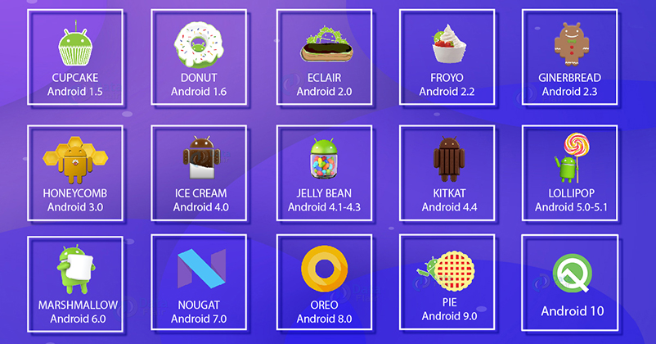
History of Android (1-10)

Slide 5
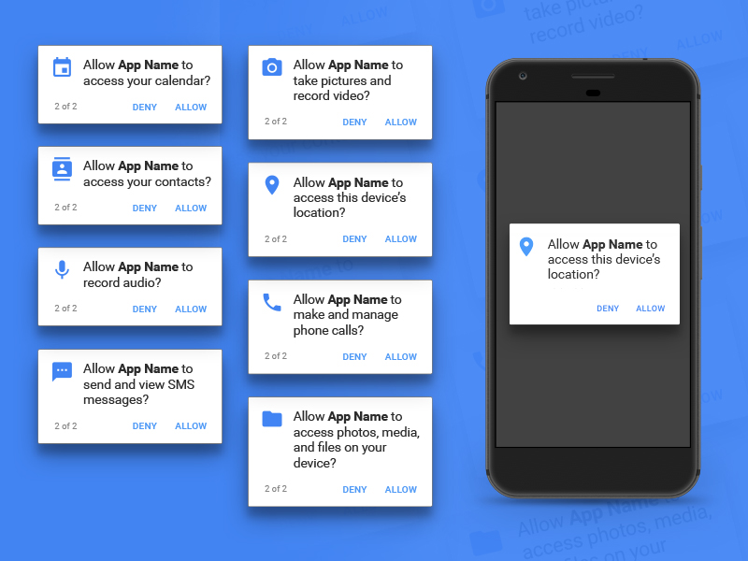
History of Android (11)
Launched in September 2020
The most significant changes revolve around privacy
Pushes the background location permission even deeper into the system
makes it more difficult for apps to request
Removes an app's ability to see what other apps are installed on your phone
https://www.sketchappsources.com/resources/source-image/android-permission-groups-prompts.jpg

Slide 6
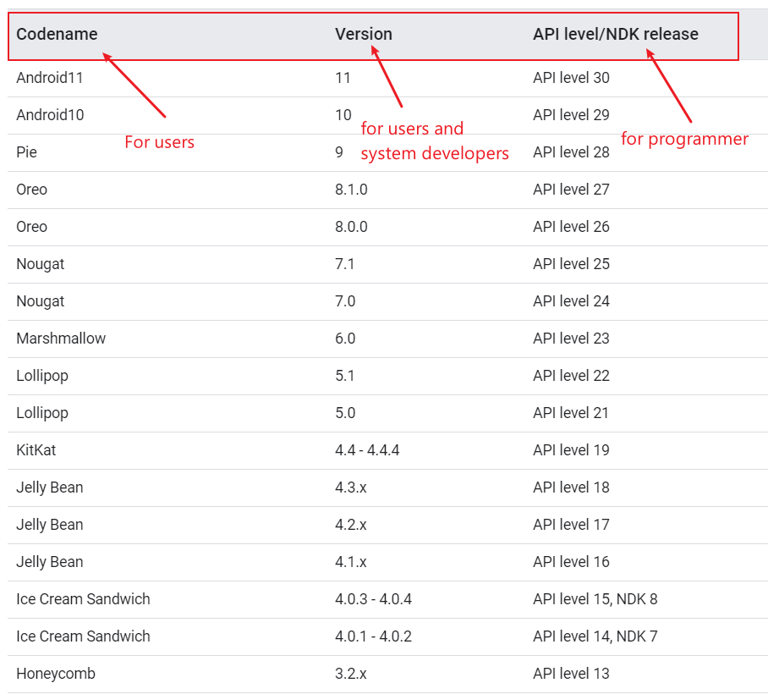
Codename, Version, API
The Android NDK is a toolset that lets you implement parts of your app in native code, using languages such as C and C++.
blueline
Notes:
https://source.android.com/setup/start/build-numbers

Slide 7
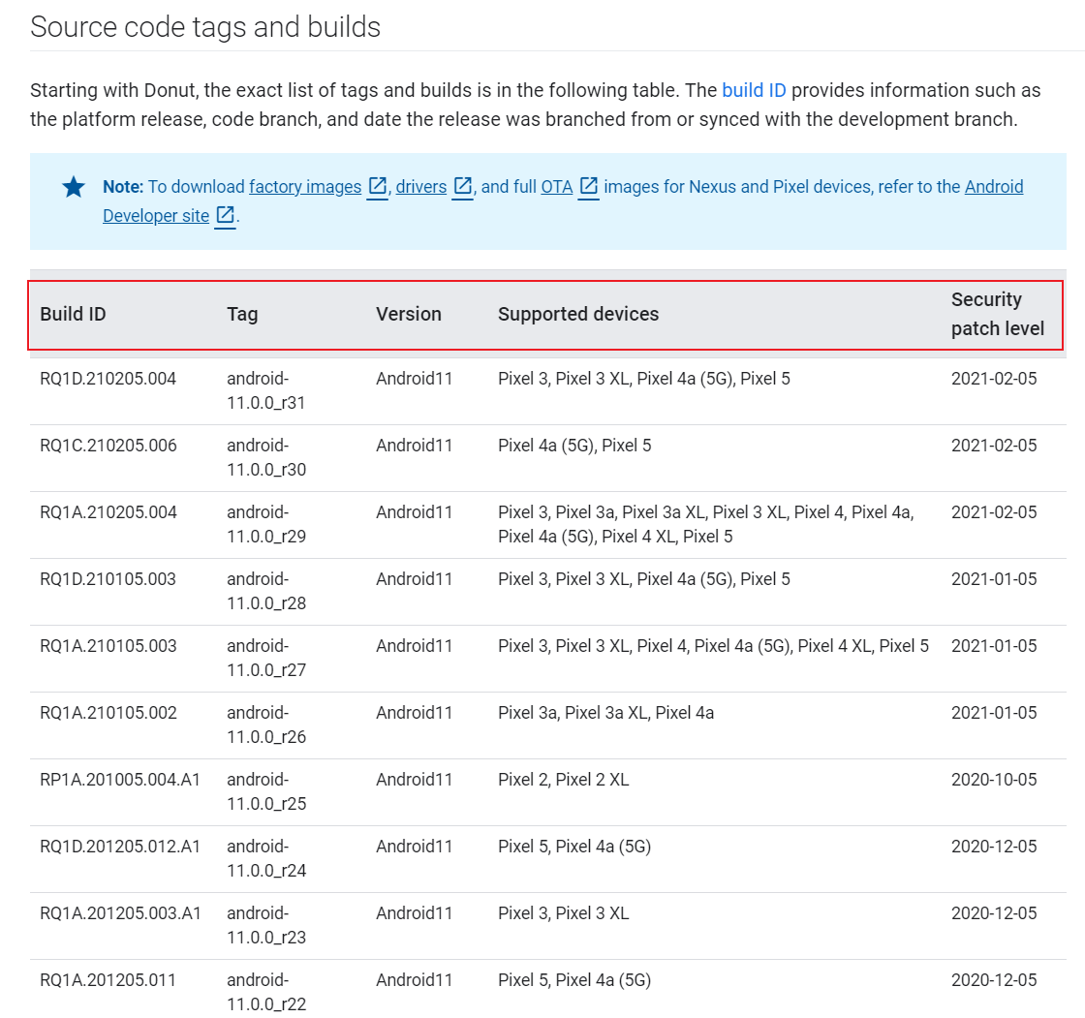
Source code tags and builds
build ID provides information such as the platform release, code branch, and date the release was branched from or synced with the development branch.
Notes:
https://source.android.com/setup/start/build-numbers

Slide 8
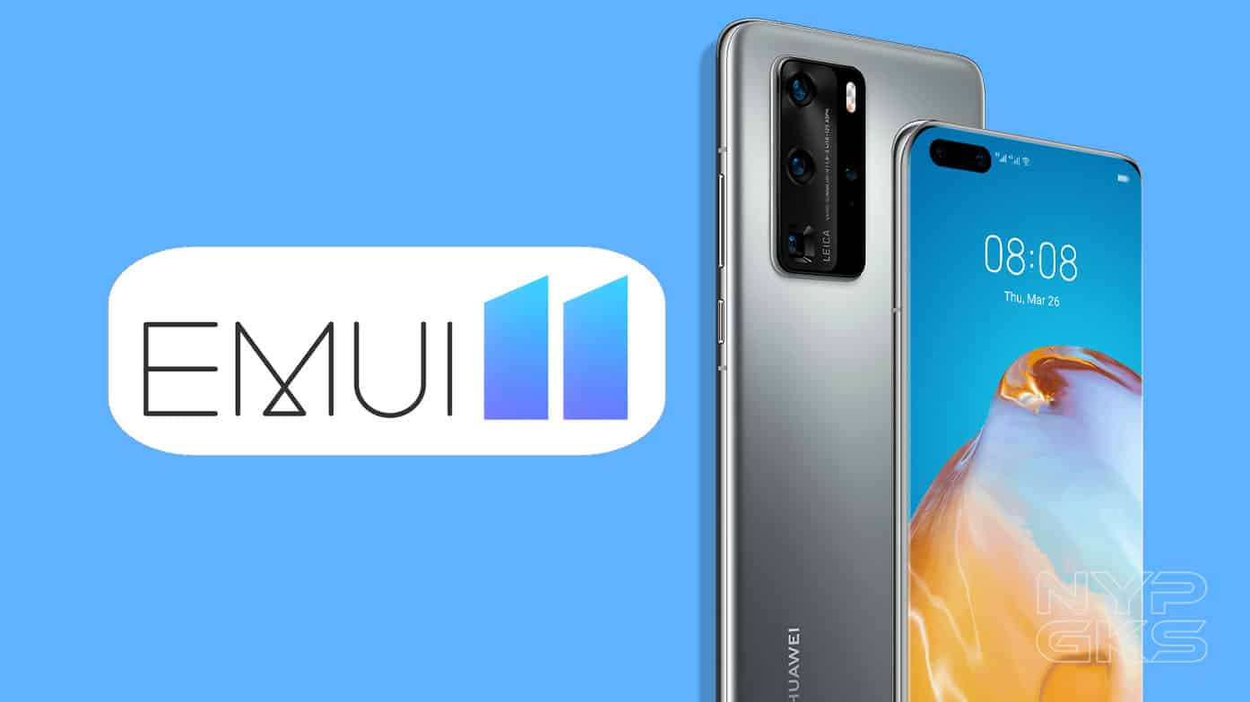
What is Stock Android and Android Skins?
Unmodified version of Android
known as vanilla or pure Android
Companies can modify Android
adding a custom skin
new features.
Popular skins
Samsung Experience,
HTC Sense,
EMUI (Huawei), and
OxygenOS (OnePlus)

Slide 9
Stock Android
Advantages
Fast updates
Bloatware-free: pre-installed software can’t be deleted from a device, unless you root it.
Popular stock Android smartphones are those made by Google
older Nexus devices
Pixel, Pixel 2, and Pixel 3 handsets
Android holds over 71% of the global mobile OS market share
as of November 2020 (StatCounter)

Slide 10

Android Architecture

Slide 11
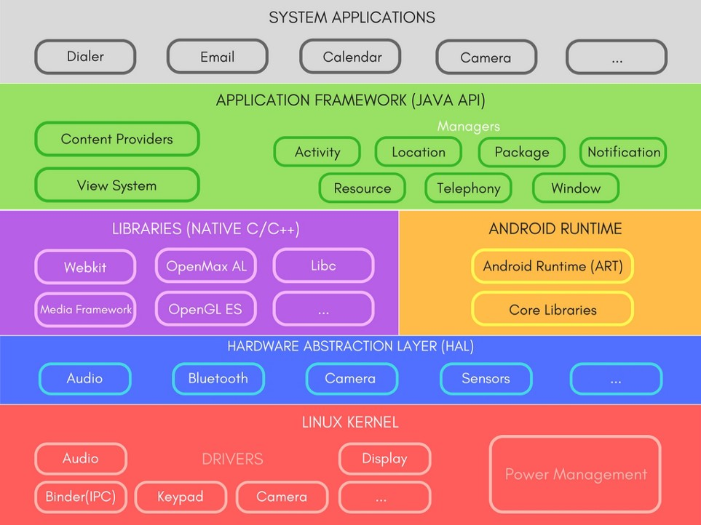
Apps we use everyday
Java APIs for developer
A set of Libraries and Android Runtime.
defines a standard interface for hardware vendors to implement
Security, Process management, Memory management, Device management
Multitasking
Notes:
https://medium.com/@deepamgoel/understanding-android-architecture-1f0fb4b52f90
https://source.android.com/devices/architecture

Slide 12


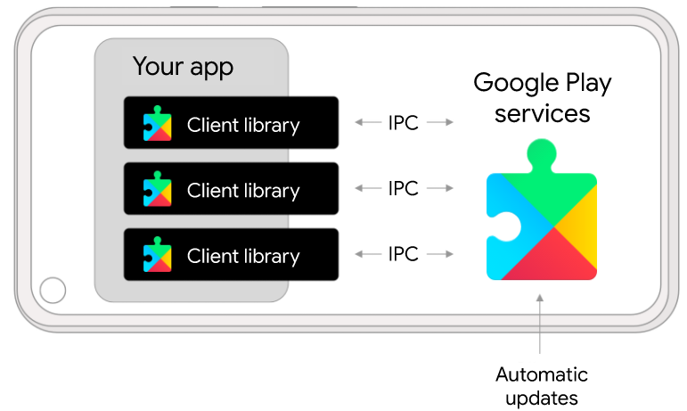
google mobile services (GMS)
Google Play Services
(Google Service Framework, GFS)
1.Google Backup
2.Play Store Services
3.Contacts Sync
4.Account Manager
Google Play services receives regular updates that contain improvements and bug fixes.
Notes:
https://developers.google.com/android/guides/overview

Slide 13
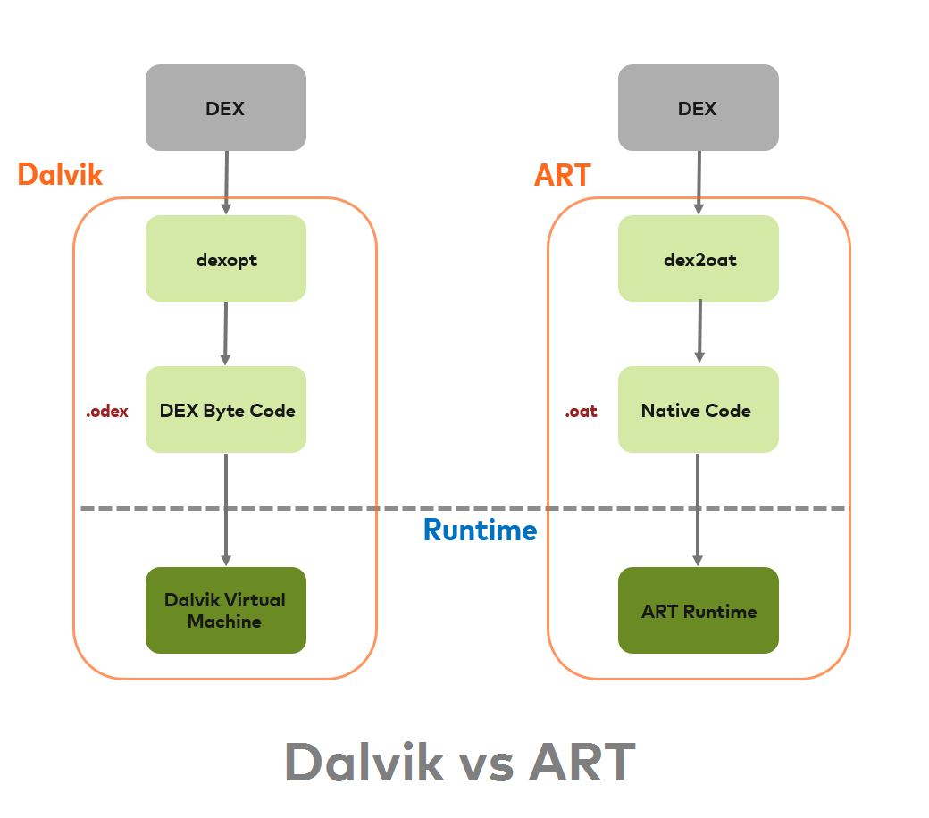
Android RunTime (ART)
.Java
.dex
Source code
DEX
Resource and Native code
zip
.APK
install
install
An Android application can be run on runtime environment
new: ART
old: Dalvik Virtual Machine(DVM) till Kitkat
ART is faster than DVM
ART does ahead-of-time (AOT) compiles higher-level program languages to machine code
.oat: : Of Ahead Time, a reordering of AOT; After Android 5.0
.vdex: After Android 8.0: optimize Android apps' compilation and loading process.
Resource and Native code
Optimized Dalvik EXcutable
.oat: Of Ahead Time, a reordering of Ahead Of Time
Do not trust extensions: .dex can be DEX or OAT, .odex are OAT, .oat are OAT, …
Notes:
https://medium.com/android-news/closer-look-at-android-runtime-dvm-vs-art-1dc5240c3924
https://stackoverflow.com/questions/28435860/what-does-oat-mean

Slide 14
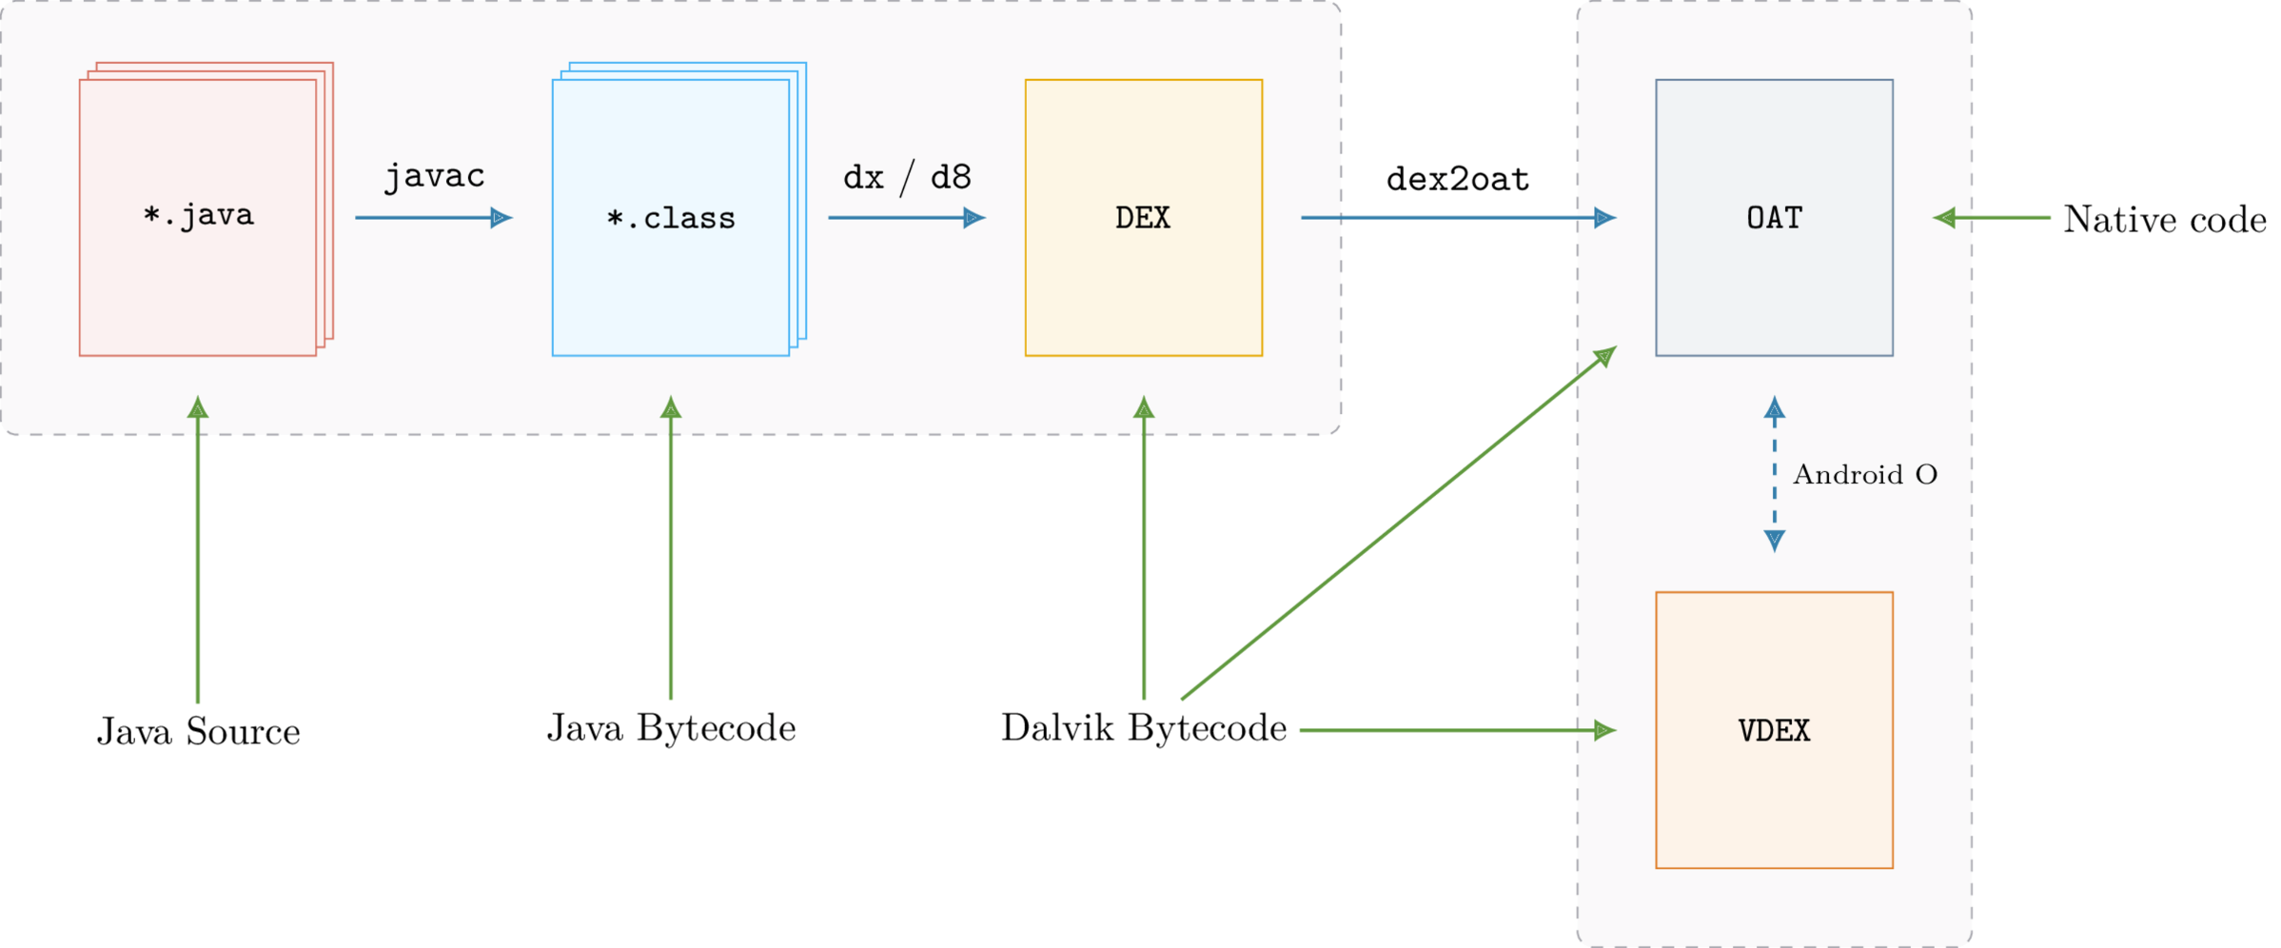
The process of converting Java sources into the OAT
https://lief.quarkslab.com/doc/latest/tutorials/10_android_formats.html
Notes:
https://lief.quarkslab.com/doc/latest/tutorials/10_android_formats.html

Slide 15

Android Booting Process

Slide 16
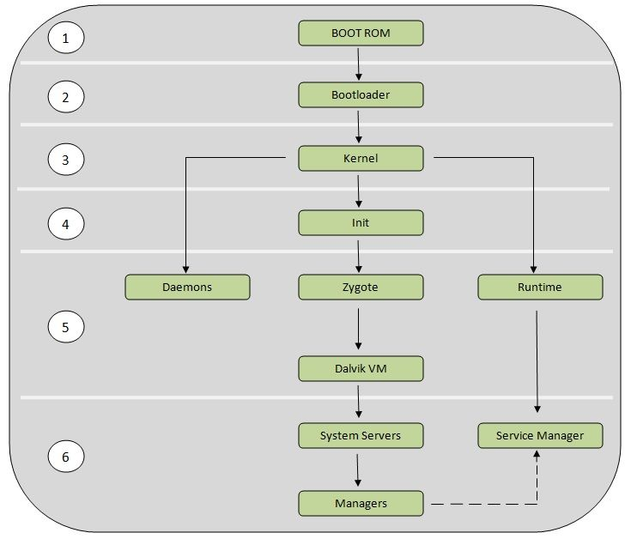
Booting Process
Boot ROM (Read-only Memory)
The bootloader
The Linux kernel
The init process
Zygote and Dalvik
The System server

Slide 17
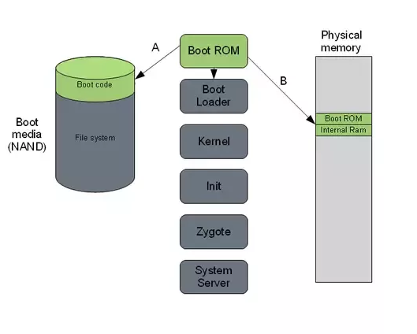
1. Boot ROM
Power On and Boot ROM code execution
A: ROM Code detects the boot media to determine where to find the boot loader.
B: ROM Code loads the first stage Bootloader into RAM, and the Bootloader starts executing in RAM.
Notes:
https://community.nxp.com/t5/i-MX-Processors-Knowledge-Base/The-Android-Booting-process/ta-p/1129182
https://www.quora.com/How-does-Android-boot-process-work

Slide 18
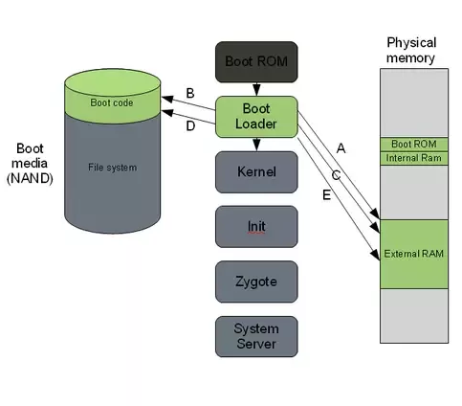
2. Bootloader
A special program to set up initial memories and load the kernel to RAM.
The place where manufacturer puts their locks and restrictions.
Like GRUB Windows and in embedded Linux uBoot
Flash Kernel and Ramdisk (/init and a few config files) are flashed to /root partition
Notes:
https://community.nxp.com/t5/i-MX-Processors-Knowledge-Base/The-Android-Booting-process/ta-p/1129182
https://www.quora.com/How-does-Android-boot-process-work

Slide 19
A. The first boot loader stage will detect and set up external RAM.
B. Once external RAM is available and the system is ready the to run something more significant, the first stage will load the main boot loader and place it in external RAM.
C. The second stage of the boot loader is the first major program that will run.
This may contain code to set up file systems, additional memory, network support and other things.
On a mobile phone it may also be responsible for loading code for the modem CPU and setting up low level memory protections and security options.

Slide 20
D. Once the boot loader is done with any special tasks it will look for a Linux kernel to boot.
It will load this from the boot media (or some other source depending on system configuration) and place it in the RAM.
It will also place some boot parameters in memory for the kernel to read when it starts up.
E. Once the boot loader is done it will perform a jump to the Linux kernel
usually some decompression routine, and the kernel assumes system responsibility.

Slide 21
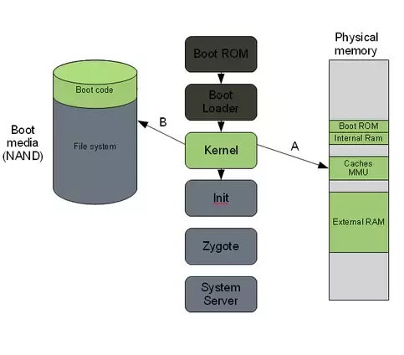
3. The Linux kernel
Set up everything that is needed for the system to run.
Initialize interrupt controllers
Set up memory protections, caches and scheduling.
A. Once the memory management units and caches have been initialized, the system will be able to use virtual memory and launch user space processes.
B. The kernel will look in the root file system for the init process (found under system/core/initial the Android open source tree) and launch it as the initial user space process.

Slide 22
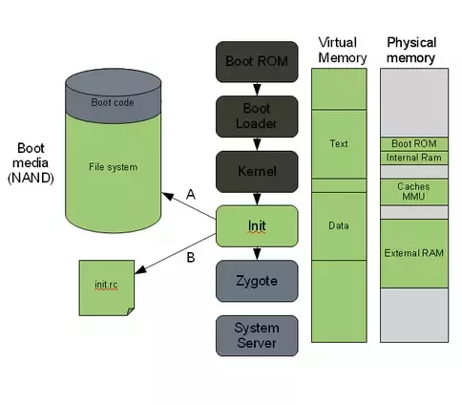
4. The init process
.rc. Early Unix used run commands(rc) for the name of the operating system's boot script
The "grandmother" of all system processes.
Every other process in the system will be launched from this process or one of its descendants.
A. The init process in Android will look for a file called init.rc. or init<machine name>.rc
This is a script that describes the system services, file system and other parameters that need to be set up.
The script is placed in system/core/rootdir in the Android open source project.
B. The init process will parse the init script and launch the system service processes.

Slide 23
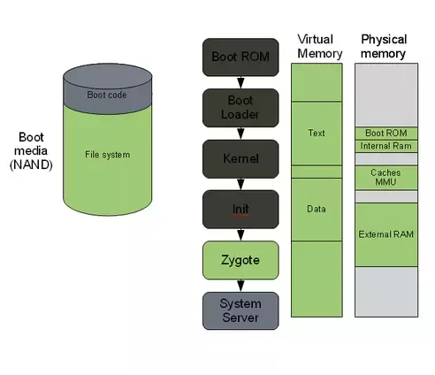
5. Zygote and Dalvik
A process of Android Runtime
The Zygote is launched by the init process and will basically just start executing and initialize the Dalvik VM.
Zygote enables code sharing across the Dalvik VM, achieving a lower memory footprint and minimal startup time.

Slide 24
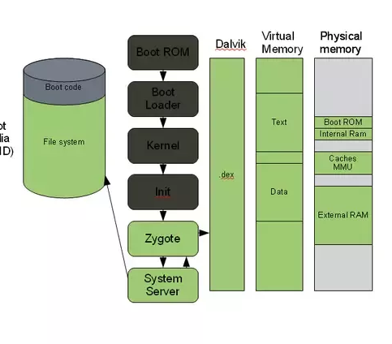
6. The system server
The system server is the first java component to run in the system.
Core services: Creating the Activity Manager, Starting telephony registry, context manager, system contact providers Starting alarm manager, sensor service, window manager, Bluetooth service, mount service
Other services: Starting hardware service, Starting NetStat service, connectivity service, Notification Manager, Device Storage Monitor service, Location Manager, Search Service, Clipboard Service, checkin service, Wallpaper service, Audio Service, Headset Observer, AdbSettings Observer

Slide 25
7. Start your own service
Once the System Server is up and running and the system boot has completed
there is a standard broadcast action called ACTION_BOOT_COMPLETED.
To start your own service
register an alarm or otherwise make your application perform some action after boot
register to receive this broadcast intent.

Slide 26
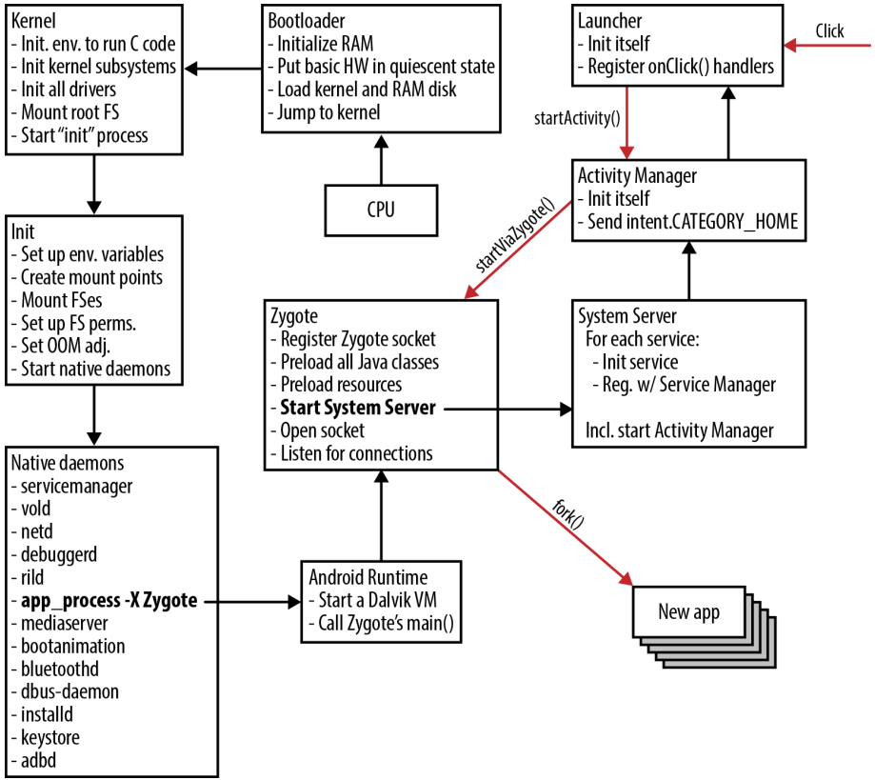
Booting process with focus on Zygote
Notes:
https://medium.com/@voodoomio/what-the-zygote-76f852d887d9

Slide 27

Android partition layout
mapping booting process to file partitions

Slide 28
Android partition
Boot
System
Recovery
Data
Cache
Misc
Android partition is different from PC partition table.
partitions are logical storage units made inside the device's persistent storage
logically divide the available space into sections that can be accessed independently of each other
each partition has a distinct role in the functionality of the device
Common partitions
/boot: to boot a phone to boot, including kernel and RAMDISK (a few config files)
/system: entire Android OS, mounted by system.img, Not include Google GMS and GSF,
/recovery:
an alternative boot partition that lets you boot the device into a recovery model for performing advanced recovery and maintenance operations on it
When flash a custom recovery such as TWRP or CWM, you are overwriting this partition
Notes:
https://forum.xda-developers.com/t/android-partitions-explained.3657183/
https://forum.xda-developers.com/t/info-android-device-partitions-and-filesystems.3586565/

Slide 29
Common partitions (continues)
/data: called userdata,
including contacts, messages, settings and installed apps
factory reset will wipe it
many forensic information can be found here
/metadata: is used when device is encrypted
/cache
stores frequently accessed data
forensics data can be found here before it is wiped
/misc
miscellaneous system settings in form of on/off switches
may include CID (Carrier or Region ID), USB configuration and certain hardware settings etc
if it is corrupt or missing, several of the device’s features will not function normally

Slide 30
Common partitions (continues)
/sdcard
SD storage space to store your media, documents, downloads, pictures, videos, ROMs etc.
a symlink to /storage/emulated/0 (for compatibility)
/sd-ext
not a standard Android partition, but has become popular in the custom ROM scene
an additional partition on your SD card that acts as the /data partition when used with certain ROMs that have special features called APP2SD+ or data2ext enabled.
/Product
contain customizations (e.g., locales or carriers ) makes Android possible to use a single system image for multiple software
/vendor
vendor specific binary
contains any binary that isn't distributable to AOSP.
share code based on SoC (system on a chip)

Slide 31

Acquisition

Slide 32
Mobile Forensics Steps
Preparation
01
Seizure
02
Acquisition
03
Analysis
04
Report
05

Slide 33
Acquisition
Physical acquisition
bit-by-bit copy or disk imaging, tricky
Logical acquisition
extracting the logical storage objects, such as files and directories
data may be modified
Evidence only (Logical acquisition)
message, call log, contacts, social apps, GPS, images, videos, and
other common activates, browser history

