Slide 1

A Pixel 3 image

Slide 2
Overview
Pixel 3 Image Description
File System Structure
Understand the Apps/Package

Slide 3

Pixel 3 Image Description

Slide 4
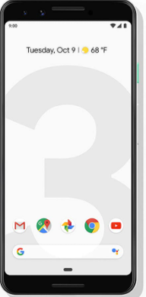

About the Pixel 3 Image
Created by Joshua Hickman
Associate with Team Win Recovery Project (TWRP)
Android 10 make big changes
A lot of components in AOSP recovery were moved into subfolders,
Not a real “dd image”
is a logic copy and missing some folders and files (you will figure it out)
Cellebrite .z and .zip file
Non-Cellebrrite .zip
Notes:
https://twrp.me/site/update/2019/10/23/twrp-and-android-10.html

Slide 5
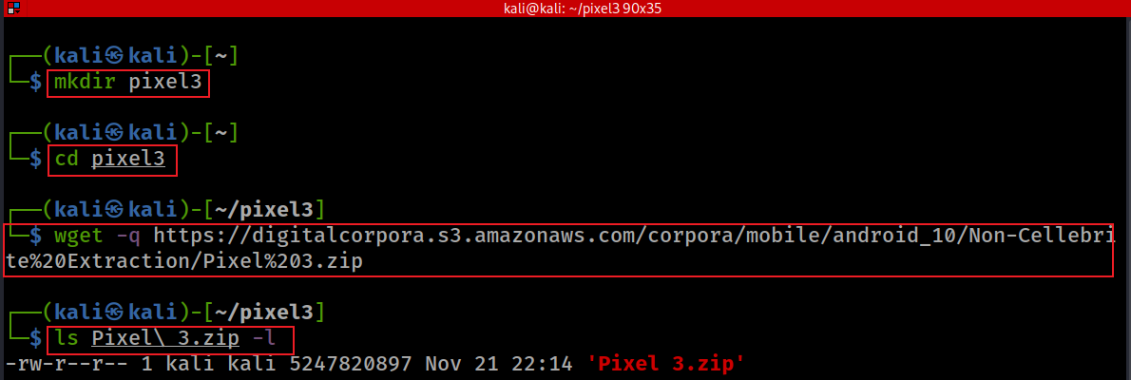
Download Pixel 3 image
A stock image of Android 10
Notes:
mkdir pixel3
cd pixel3
wget -q https://digitalcorpora.s3.amazonaws.com/corpora/mobile/android_10/Non-Cellebrite%20Extraction/Pixel%203.zip
ls Pixel\ 3.zip -l
https://linuxhint.com/kali_linux_top_forensic_tools/#:~:text=The%20hashdeep%20tool%20is%20a,are%20generated%20with%20every%20output.

Slide 6
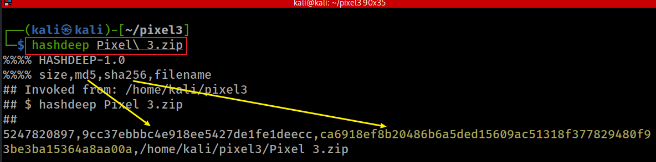
Verify hashes
SHA2-256: ca6918ef8b20486b6a5ded15609ac51318f377829480f93be3ba15364a8aa00a
Notes:
hashdeep Pixel\ 3.zip
5247820897,9cc37ebbbc4e918ee5427de1fe1deecc,ca6918ef8b20486b6a5ded15609ac51318f377829480f93be3ba15364a8aa00a,/home/kali/pixel3/Pixel 3.zip

Slide 7
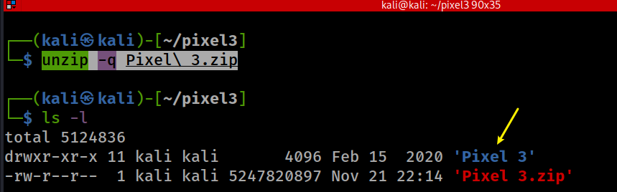
unzip to get Pixel 3 image
Notes:
unzip -q Pixel\ 3.zip

Slide 8
unzip to get Pixel 3 image
Notes:
unzip -q Pixel\ 3.zip

Slide 9

File System Structure

Slide 10
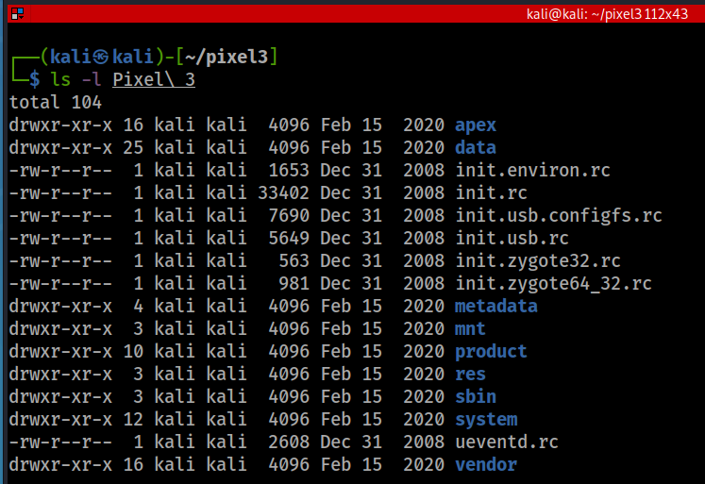
list root directory
To speed up security updates
Android Pony EXpress (APEX) is a container format introduced in Android 10 that is used in the install flow for lower-level system modules.
This format facilitates the updates of system components that don’t fit into the standard Android application model.
device
run commands(rc): OS boot script
mount point for other file systems
Resource, e.g., layout, color
binaries for several important daemons.
Android OS, exclude Google services
Notes:
https://www.cnblogs.com/shangdawei/p/4513604.html
https://saketupadhyay.medium.com/apex-androids-new-file-format-187e21b8261

Slide 11
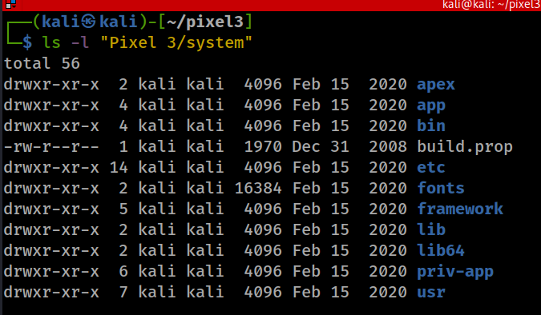
/System: Android OS Project (AOSP)
Android OS pre-installed bloatware apps, often can’t uninstall
"rooting" is required to modify the contents of this partition.
executable binaries, daemons or bash
App Framework
native libraries
Privileged apps, apps that are eligible for system permissions
all system-wide, read-only files installed by (or provided by) the OS

Slide 12
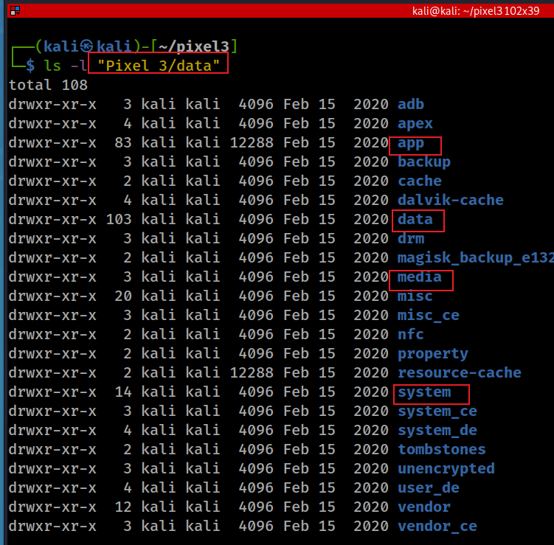
/data
Contains
all android apps
native apps or
3rd party
all system config/log
all app generated data

Slide 13
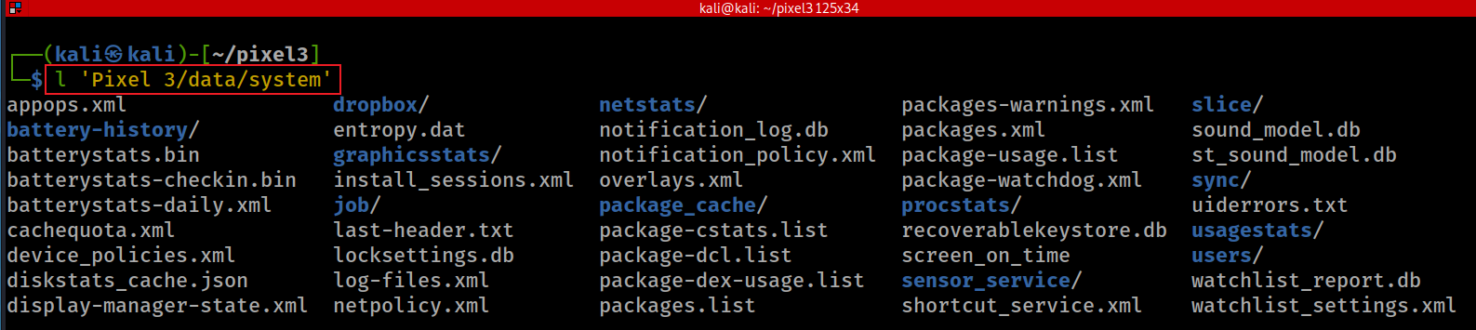
data/system settings (don’t confuse with /system)
Contains system configuration files critical to maintaining device's state.
Contain system state logs
Access to the directory is restricted by the system apps only, so if the device is not rooted the folder content can't be seen.
for newer devices: /data/system_xx/<userID>
Notes:
https://android.stackexchange.com/questions/157691/what-does-the-data-system-folder-store-and-its-significance/157862

Slide 14
appops.xml - a configuration file used by the AppOps service which controls application permissions;
called_pre_boots.dat - a file used by ActivityManager to hold pre-boot broadcast receivers;
batterystats.bin - a binary used by the BatteryStats service to keeps power statistics of application installed;
gesture.key - lockscreen pattern;
inputmethod/ - a directory used to store IME configuration. Contains subtypes.xml with IME locales, keyboard layout sets etc;
locksettings.db - a SQLite database containing the lock screen settings;
netpolicy.xml - a configuration file used by the NetworkPolicyManagerService;
netstats/ - a directory used to hold NetworkStatsService statistics;
P48. http://newandroidbook.com/
Notes:
http://newandroidbook.com/
https://android.stackexchange.com/questions/157691/what-does-the-data-system-folder-store-and-its-significance/157862
https://github.com/lywschxd/Understanding-Android-Internals-Volume-One

Slide 15
packages.list - a file used by the PackageManager service containing the list of all packages (apks) installed in the system (same as executing pm list packages within shell);
packages.xml - a file used by the PackageManager service to hold metadata of all installed packages, like UIDs, requested permissions etc;
profiles.xml - a configuration file to keep metadata of device profiles including sound mode, airplane mode, vibration etc.;
password.key - password hash;
usagestats/ - a directory used to store files for the UsageStats service. Contains usage-history.xml that holds info on all apps and its components with the last time a user used them;
users/ - a directory used for multi-user support. Contains userlist.xml which keeps info on all users in the system (0 - is a device owner/primary user); e.g. a sub-directory users/0/ holds info on the user account (accounts.db), widgets (appwidgets.xml), wallpaper (wallpaper_info.xml) etc.

Slide 16
Where are applications installed? (1)
Pre-installed bloatware with ROM
/system/app: camera, settings, messages, Google Play Store, etc.
/system/priv-app: implicitly granted system privilege
/custpack/app
.apk
/data/app: downloaded .apk from Google Play Store
Move to SD card feature
Apps stored on external memory go to an encrypted container in /mnt/sdcard/.android_secure.
Android decrypts them at runtime and stores a decrypted copy on in /mnt/asec/tmpfs
Need to use a card reader and attach the card to PC to see the files
.asec (Android Secure External Cache) instead of .apk -- from which you will get the connection to the name /mnt/asec
Notes:
https://android.stackexchange.com/questions/3002/where-in-the-file-system-are-applications-installed

Slide 17
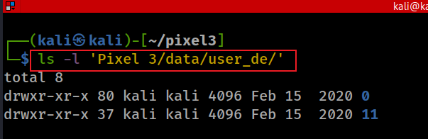
Where are applications installed? (1)
User apps/app generated data
not tight to specific users: /data/data/<package_name>
associate with specific users:
/data/user/<userid> (is a symlink to /data/data)
/data/user_de/<userid> for newer devices
External storage for user app generated data
/mnt/sdcard/Android/data/<package_name>

Slide 18

Understand the Apps/Package

Slide 19
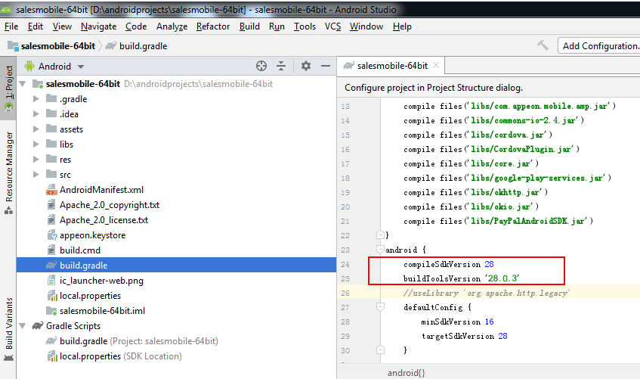
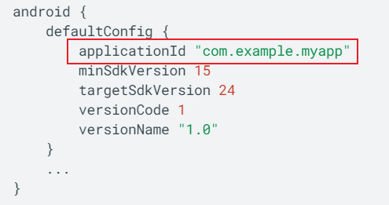
What is Android (application) package .APK?
Android Package (APK) is the package file format
used by the Android OS
zip + pre-defined specific structure
compiled to .dex format
application ID is defined with the applicationId property in build.gradle
exactly matches the Java-style package name
As a developer, you should never change the application ID.
Notes:
https://docs.appeon.com/pb2019r2/appeon_mobile_tutorials/ch04s03s02.html

Slide 20
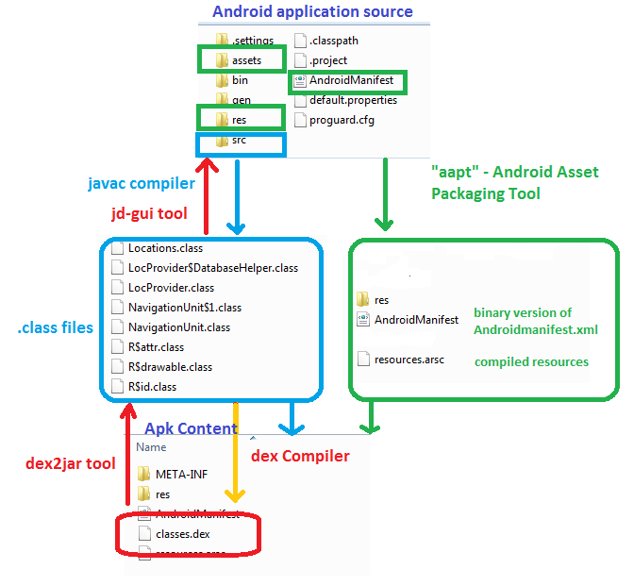
APK compilation and de-compilation
https://www.dunebook.com/apk-decompiler/
DEX (Dalvik Executable):
translates JVM bytecode to DVM bytecode and put all class files to one dex file.

Slide 21
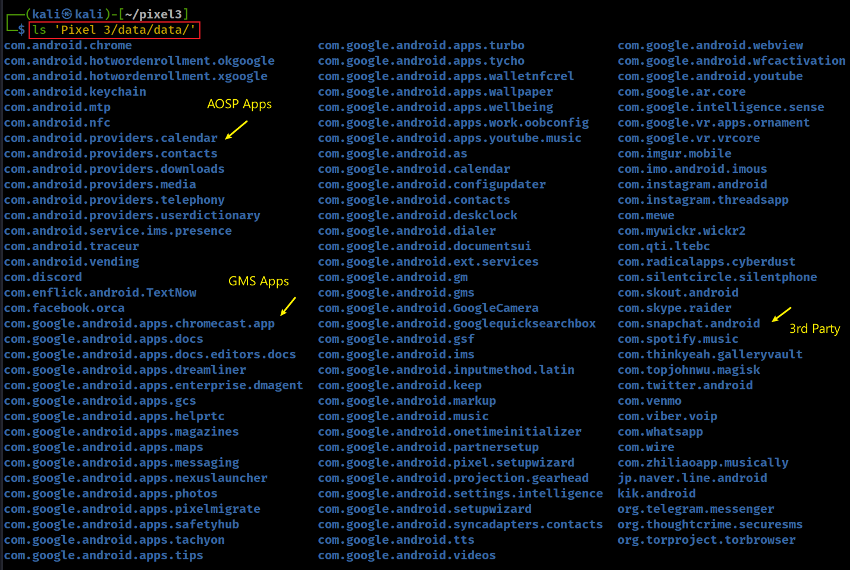
Use ApplicationID as a folder to save application data
Notes:
ls 'Pixel 3/data/data/'

Slide 22
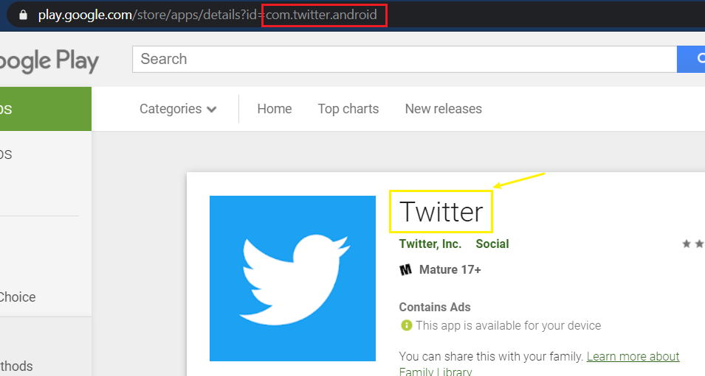
What is the name of Application for a given applicationID? (Twitter vs. com.twitter.android)
https://play.google.com/store/apps/details?id=com.twitter.android

Slide 23
How to find the name of the application automatically? (com.twitter.android)
Steps
Send a http request to https://play.google.com/store/apps/details?id=com.twitter.android
Parse the html
Search for a string (name of the application) from a specific location
How to identify the location? (next slice)

Slide 24
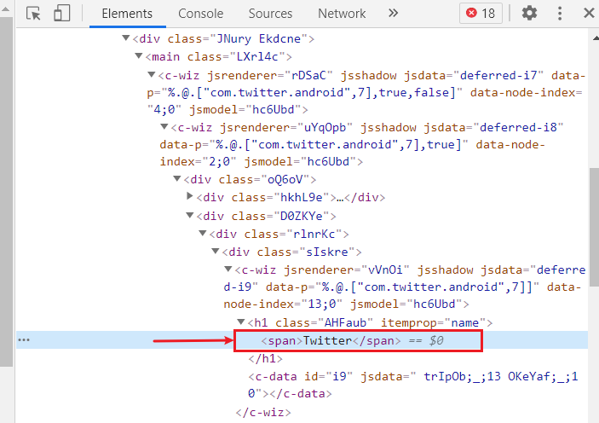
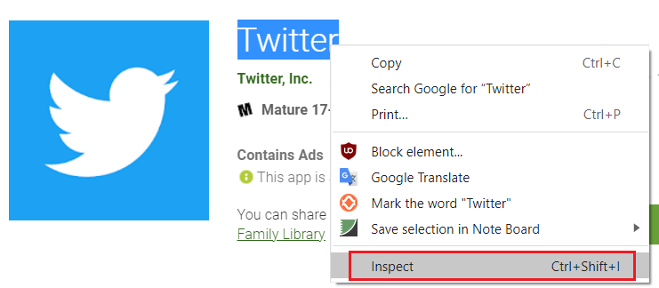
Find inspect the Twitter name location in Chrome

Slide 25
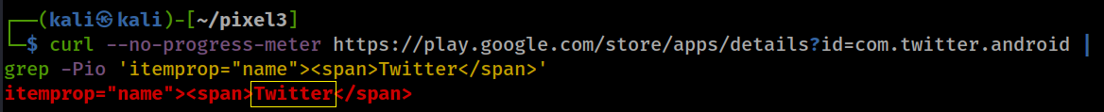
Show the location of Twitter name
-P, --perl-regexp PATTERNS are Perl regular expressions
-o, --only-matching show only nonempty parts of lines that match
-i, --ignore-case ignore case distinctions in patterns and data
Only show the name Twitter name (only match the word between 'itemprop="name"><span> and </span> )
? : lazy match
\K , (?<=pattern) : used as a zero-width look-behind assertion before the text you want to output
(?=pattern) : used as a zero-width look-ahead assertion after the text you want to output
Notes:
curl --no-progress-meter https://play.google.com/store/apps/details?id=com.twitter.android | grep -Pio 'itemprop="name"><span>Twitter</span>’
curl --no-progress-meter https://play.google.com/store/apps/details?id=com.twitter.android | grep -Pio 'itemprop="name"><span>\K.*?(?=</span>)'

Slide 26
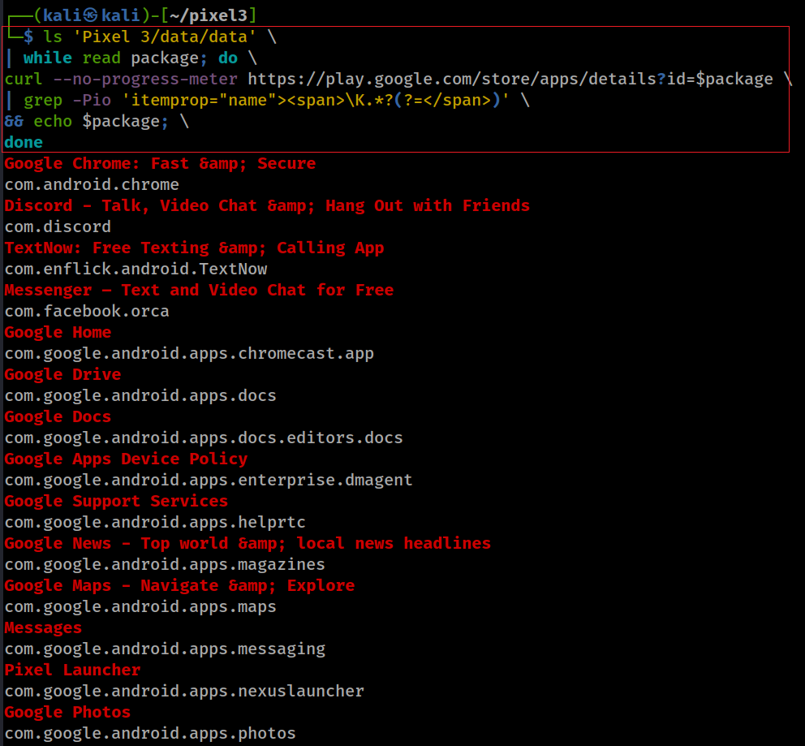
List all app names and package ID
ls 'Pixel 3/data/data' \
| while read package; do \
curl --no-progress-meter https://play.google.com/store/apps/details?id=$package \
| grep -Pio 'itemprop="name"><span>\K.*?(?=</span>)' \
&& echo $package; \
done
Notes:
ls 'Pixel 3/data/data' \
| while read package; do \
curl --no-progress-meter https://play.google.com/store/apps/details?id=$package \
| grep -Pio 'itemprop="name"><span>\K.*?(?=</span>)' \
&& echo $package; \
done
Google Chrome: Fast &amp; Secure
com.android.chrome
Discord - Talk, Video Chat &amp; Hang Out with Friends
com.discord
TextNow: Free Texting &amp; Calling App
com.enflick.android.TextNow
Messenger – Text and Video Chat for Free
com.facebook.orca
Google Home
com.google.android.apps.chromecast.app
Google Drive
com.google.android.apps.docs
Google Docs
com.google.android.apps.docs.editors.docs
Google Apps Device Policy
com.google.android.apps.enterprise.dmagent
Google Support Services
com.google.android.apps.helprtc
Google News - Top world &amp; local news headlines
com.google.android.apps.magazines
Google Maps - Navigate &amp; Explore
com.google.android.apps.maps
Messages
com.google.android.apps.messaging
Pixel Launcher
com.google.android.apps.nexuslauncher
Google Photos
com.google.android.apps.photos
Data Transfer Tool
com.google.android.apps.pixelmigrate
Personal Safety
com.google.android.apps.safetyhub
Google Duo - High Quality Video Calls
com.google.android.apps.tachyon
Google Fi
com.google.android.apps.tycho
Google Pay (old app)
com.google.android.apps.walletnfcrel
Wallpapers
com.google.android.apps.wallpaper
Digital Wellbeing
com.google.android.apps.wellbeing
YouTube Music - Stream Songs &amp; Music Videos
com.google.android.apps.youtube.music
Google Calendar
com.google.android.calendar
Contacts
com.google.android.contacts
Clock
com.google.android.deskclock
Phone by Google - Caller ID &amp; Spam Protection
com.google.android.dialer
Gmail
com.google.android.gm
Google Play services
com.google.android.gms
Google Camera
com.google.android.GoogleCamera
Google
com.google.android.googlequicksearchbox
Carrier Services
com.google.android.ims
Gboard - the Google Keyboard
com.google.android.inputmethod.latin
Google Keep - Notes and Lists
com.google.android.keep
Google Play Music
com.google.android.music
Android Auto - Google Maps, Media &amp; Messaging
com.google.android.projection.gearhead
Google Text-to-Speech
com.google.android.tts
Google TV (previously Play Movies &amp; TV)
com.google.android.videos
Android System WebView
com.google.android.webview
YouTube
com.google.android.youtube
Google Play Services for AR
com.google.ar.core
Pixel Ambient Services
com.google.intelligence.sense
Playground (was AR Stickers)
com.google.vr.apps.ornament
Google VR Services
com.google.vr.vrcore
Imgur: Find funny GIFs, memes &amp; watch viral videos
com.imgur.mobile
imo free HD video calls and chat
com.imo.android.imous
Instagram
com.instagram.android
Threads from Instagram
com.instagram.threadsapp
MeWe
com.mewe
Wickr Me – Private Messenger
com.mywickr.wickr2
Dust - a safer place to text
com.radicalapps.cyberdust
Silent Phone - Secure Calling &amp; Messaging
com.silentcircle.silentphone
SKOUT - Meet, Chat, Go Live
com.skout.android
Skype - free IM &amp; video calls
com.skype.raider
Snapchat
com.snapchat.android
Spotify: Listen to podcasts &amp; find music you love
com.spotify.music
Gallery Vault - Hide Pictures And Videos
com.thinkyeah.galleryvault
Twitter
com.twitter.android
Venmo
com.venmo
Viber Messenger - Free Video Calls &amp; Group Chats
com.viber.voip
WhatsApp Messenger
com.whatsapp
Wire • Secure Messenger
com.wire
TikTok
com.zhiliaoapp.musically
LINE: Free Calls &amp; Messages
jp.naver.line.android
Kik
kik.android
Telegram
org.telegram.messenger
Signal Private Messenger
org.thoughtcrime.securesms
Tor Browser: Official, Private, &amp; Secure
org.torproject.torbrowser

Slide 27
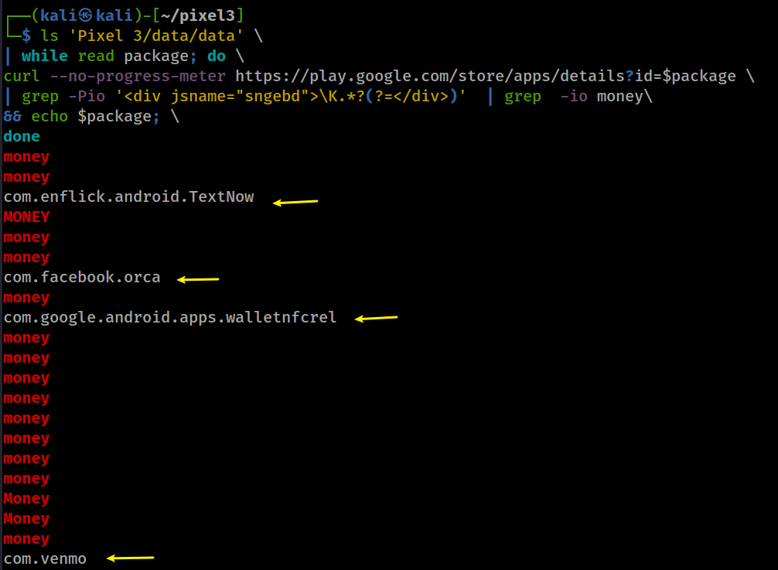
Are there any apps with money transfer function?
Interesting: It seems vemo mentioned money 10 times
Notes:
ls 'Pixel 3/data/data' \
| while read package; do \
curl --no-progress-meter https://play.google.com/store/apps/details?id=$package \
| grep -Pio '<div jsname="sngebd">\K.*?(?=</div>)' | grep -io money\
&& echo $package; \
money
money
com.enflick.android.TextNow
MONEY
money
money
com.facebook.orca
money
com.google.android.apps.walletnfcrel
money
money
money
money
money
money
money
money
Money
Money
money
com.venmo

