Slide 1

AOSP Apps/Packages Investigations
Part 3: Investigating calendar services
Notes:
https://digitalcorpora.s3.amazonaws.com/corpora/mobile/android_10/Non-Cellebrite%20Extraction/Pixel%203.zip

Slide 2
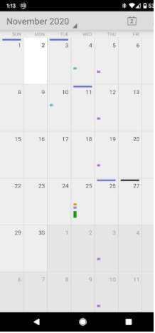
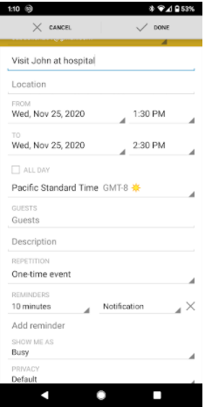
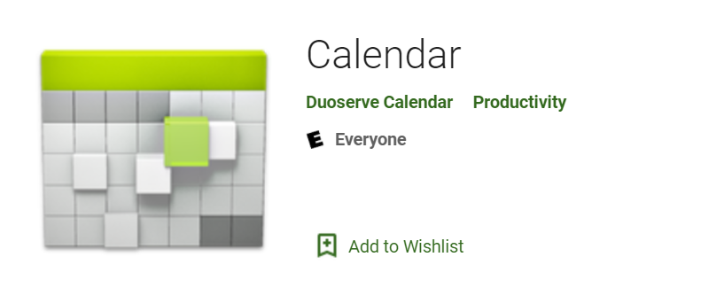
What are calendar services?
Service for calendar apps
Calendar is a tool to keep track of:
Appointments
Events
Birthdays
Evidence types:
Events
Reminders

Slide 3
Why it's important to investigate calendar evidence?
Calendar saves the information about the appointments, events etc.
It can give the information about:
Date/time of appointments
Place of appointment
Events created
Attendees

Slide 4
Note
Calendar app can be very useful in an investigation but in this case there isn't any data to look at in any of the tables
In future, you may use this approach to look through the suspect's calendar data

Slide 5
Calendar scenario
Assume that suspect added an event along with the attendees for any date and added a reminder about that event
Questions
What is the date of the scheduled event?
Who are the attendees?
For which date is the reminder set?
Are there any other events saved by the suspect?

Slide 6
Strategies to find the message evidence
Understand how events/reminders are stored in disks
often organized and stored in centralized locations such as database, xml, text file.
Steps
Remember the list of questions to be answered
for each question, repeat
find potential locations of evidence, e.g., folder
find database/files
examine database/file

Slide 7
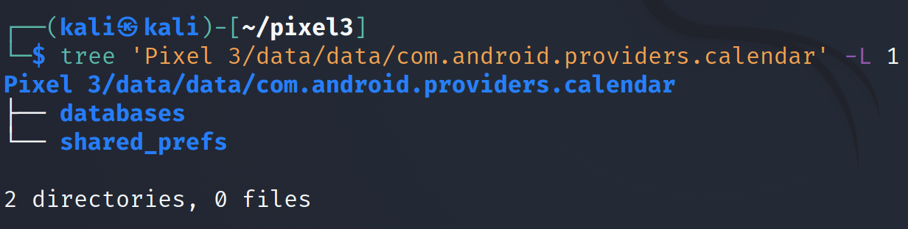
Step 1: find the location of the evidence
Notes:
Cmd: tree 'Pixel 3/data/data/com.android.providers.calendar' -L 1

Slide 8
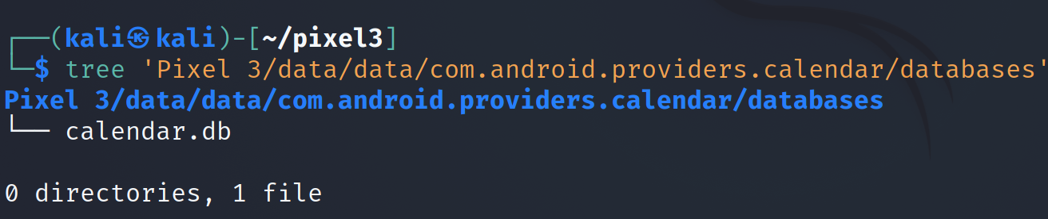
Step 2: Find the database
Notes:
Cmd: tree 'Pixel 3/data/data/com.android.providers.calendar/databases'

Slide 9
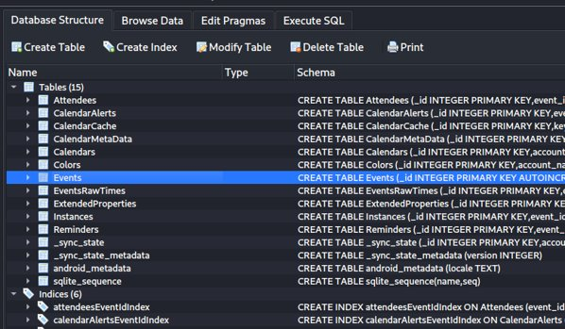
Step 3: examine the database
Tables in database
Tables to focus: attendees, events, reminders
In this case there isn't any data to look at in any of the tables
Notes:
Cmd: sqlitebrowser 'Pixel 3/data/data/com.android.providers.calendar/databases/calendar.db'

Slide 10
Solutions
What is the date of the scheduled event?
Events table
Who are the attendees ?
Attendees table
For which date is the reminder set?
Reminders table
Are there any other events saved by the suspect?
Events table

Slide 11
To summarize
Understand the application
Locate the calendar package
Look at the application directories
Go to the "databases" directory
Open calendar.db
Explore these tables: events, reminders

