Slide 1

Number Systems
Frank Xu
wxu@ubalt.edu

Slide 2
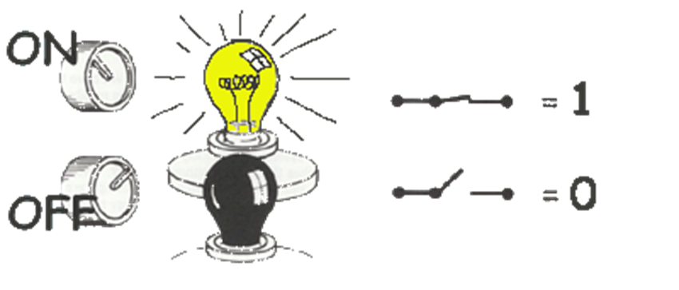

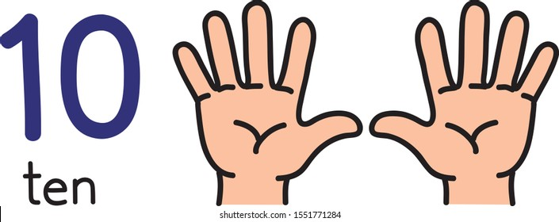
Common number systems
System | Base | Symbols | Used by humans? | Used in computers? | Used by Forensic Professionals?
Decimal | 10 | 0, 1, … 9 | Yes | No | Yes
Binary | 2 | 0, 1 | No | Yes | Yes
Hexa- decimal | 16 | 0, 1, … 9, A, B, … F | No | No | Yes

Slide 3
Conversion among number systems
Decimal
Binary
Hexadecimal

Slide 4

Conversion
Decimal | Binary | Hexa- decimal
0 | 0 | 0
1 | 1 | 1
2 | 10 | 2
3 | 11 | 3
4 | 100 | 4
5 | 101 | 5
6 | 110 | 6
7 | 111 | 7
Decimal | Binary | Hexa- decimal
8 | 1000 | 8
9 | 1001 | 9
10 | 1010 | A
11 | 1011 | B
12 | 1100 | C
13 | 1101 | D
14 | 1110 | E
15 | 1111 | F

Slide 5
Decimal to Decimal
placeholder
Weight
126₁₀ => 6 x 10⁰ = 6 2 x 10¹ = 20 1 x 10² = 100 126
Decimal
Base

Slide 6

Binary to Decimal
placeholder
Weight
Multiply each bit by 2^{n}, where n is the “weight” of the bit
The weight is the position of the bit, starting from 0 on the right
Add the results
101010₂ => 0 x 2⁰ = 0 1 x 2¹ = 2 0 x 2² = 0 1 x 2³ = 8 0 x 2⁴ = 0 1 x 2⁵ = 32
42₁₀
Base
$(()): Shell Arithmetic
2# base 2

Slide 7

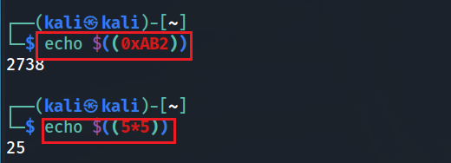
Hexadecimal to Decimal
Multiply each bit by 16^{n}, where n is the “weight” of the bit
The weight is the position of the bit, starting from 0 on the right
Add the results
AB2₁₆ => (?)₁₀
2 x 16⁰ = 2 x 1 = 2 B x 16¹ = 11 x 16 = 176 A x 16² = 10 x 256 = 2560
2738₁₀
$(()): Shell Arithmetic
Notes:
https://www.gnu.org/software/bash/manual/html_node/Shell-Arithmetic.html

Slide 8


Decimal to Binary
126₁₀ = (?)₂
2 126 63 0
Divide by 2, keep track of the remainder
First remainder is bit 0 (LSB, least-significant bit)
Second remainder is bit 1
Etc.
2 31 1
2 15 1
2 7 1
2 3 1
2 1 1
2 0 1
stop
126₁₀ = 1111110₂
basic calculator
Notes:
echo "obase=2;126" | bc

Slide 9


Decimal to Hexadecimal
2738₁₀ = (?)₁₆
Divide by 16
Keep track of the remainder
16 2738
171 2
16
10 11 = B
16
0 10 = A
2738₁₀ = AB2₁₆
controls the output as in C printf %d - Print the argument as a signed decimal integer.
%x - Print the argument as an unsigned hexadecimal integer.
%s - Print the argument as a string.
Notes:
https://linuxize.com/post/bash-printf-command/

Slide 10
Binary to Hexadecimal
101010110010₂ = ?₁₆
Group bits in fours, starting on right
Convert to hexadecimal digits
1010 1011 0010
10 11 2
A B 2
101010110010₂ = AB2₁₆

Slide 11
Binary Addition
A | B | A + B
0 | 0 | 0
0 | 1 | 1
1 | 0 | 1
1 | 1 | 10
1
1
10101 21 + 11001 + 25 101110 46
carry bit

Slide 12




Bit, Byte
A ‘bit’ (from Binary + digIT)
is the smallest unit of memory,
the unit of measurement of data information.
Byte 8-bit collections
A single bit holds so little information.
A byte holds one ASCII

Slide 13
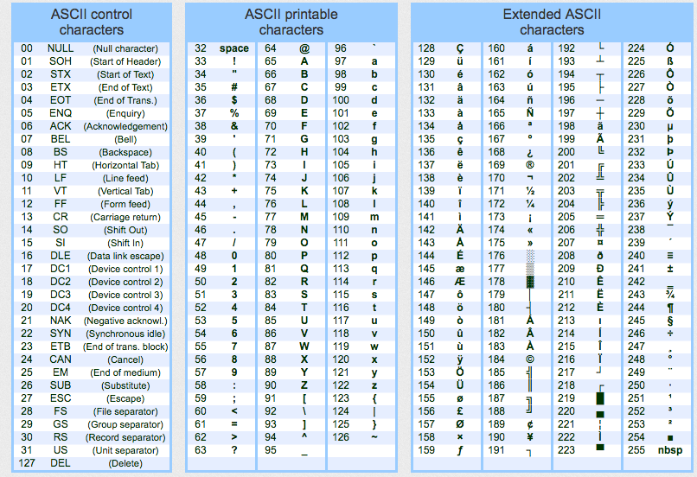
ASCII - American Standard Code for Information Interchange
ASCII codes represent text in computing devices.

Slide 14
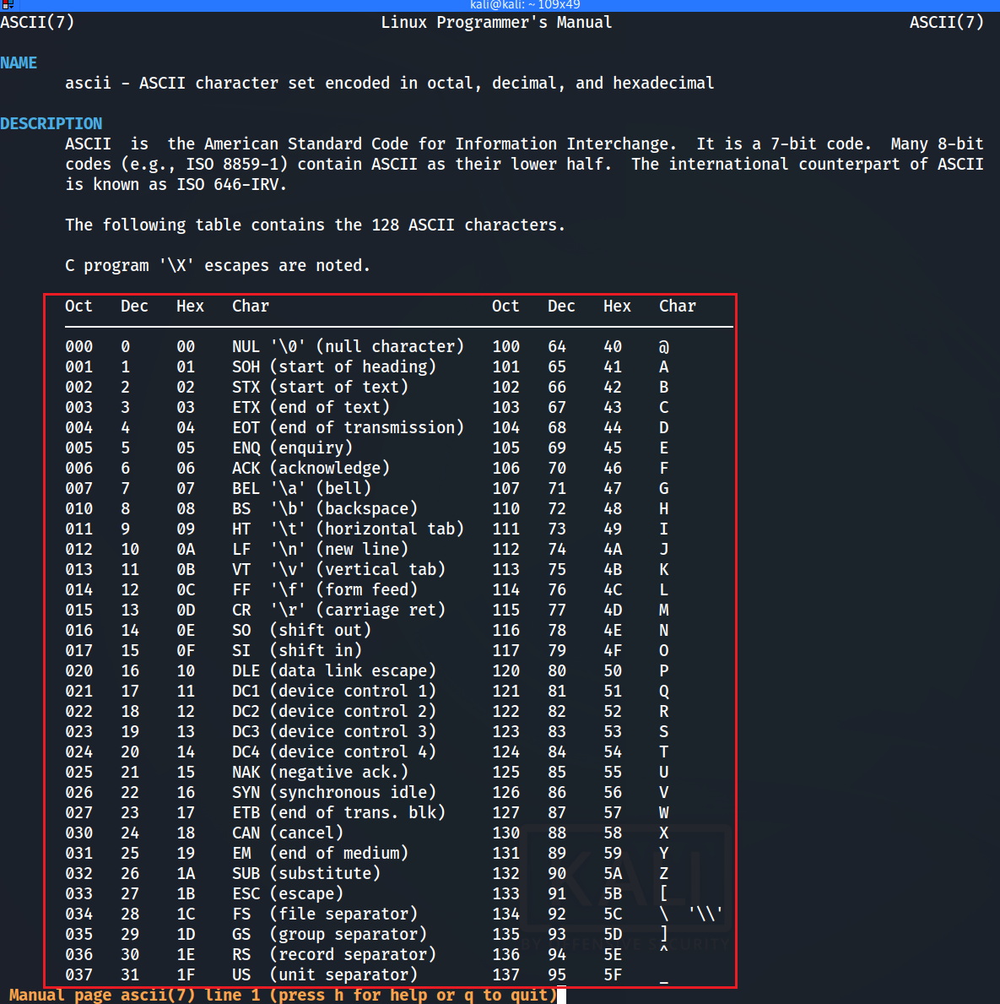


Slide 15
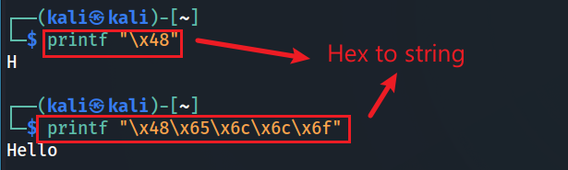

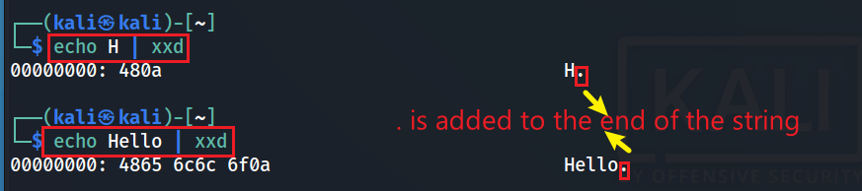
Number and ASCII conversion
Hex to ASCII string
Decimal to ASCII string
ASCII to Hex
Notes:
printf "\x48\x65\x6c\x6c\x6f"

Slide 16
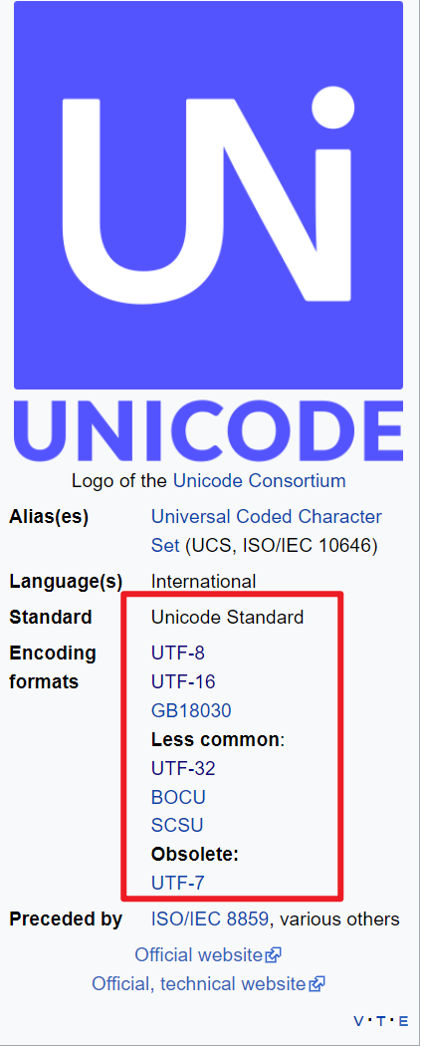
Unicode
Unicode, formally The Unicode Standard is an information technology standard for the consistent encoding, representation, and handling of text expressed in most of the world's writing systems.
https://en.wikipedia.org/wiki/Unicode

Slide 17
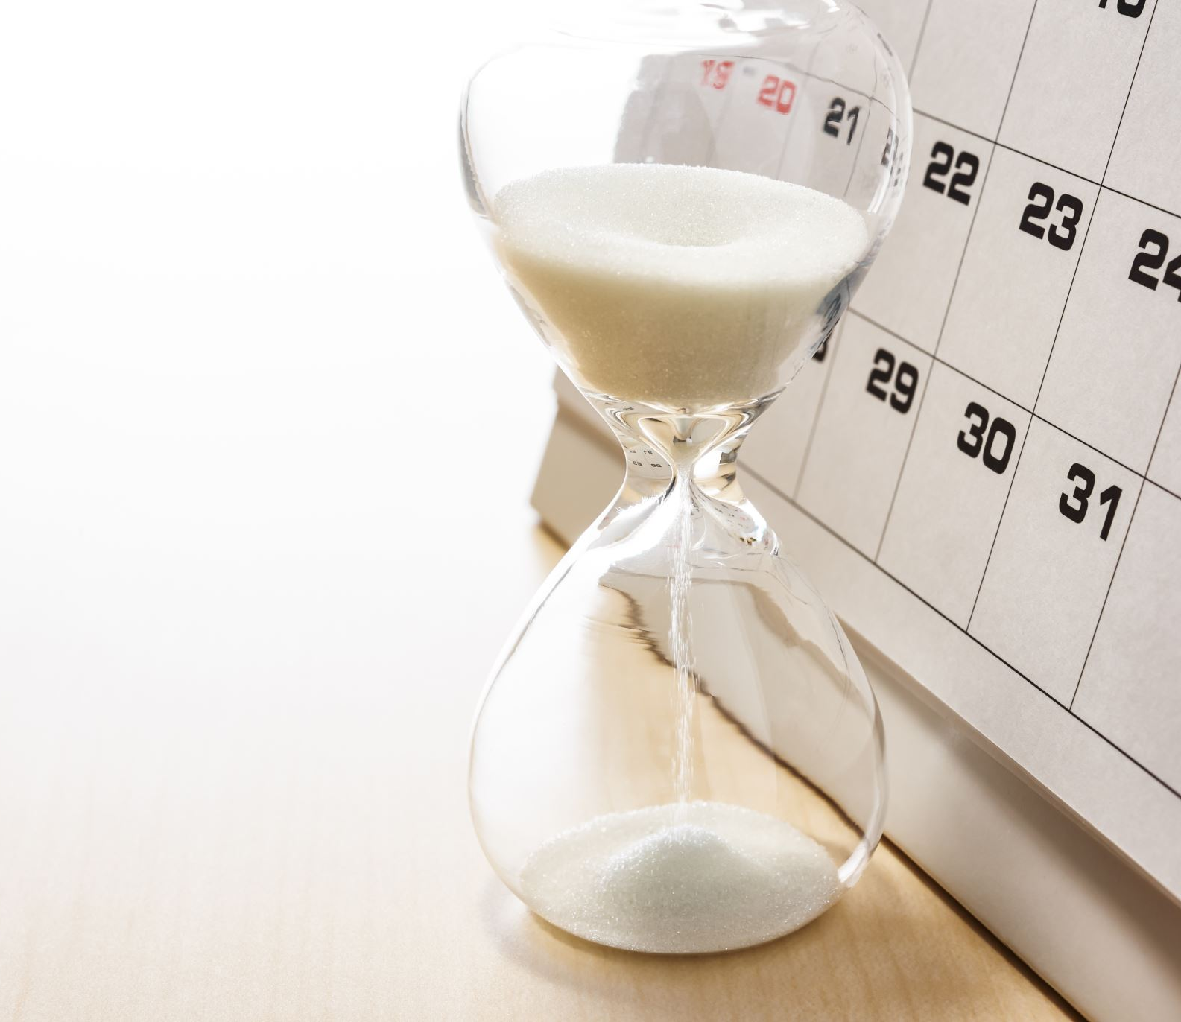
Date conversion

Slide 18
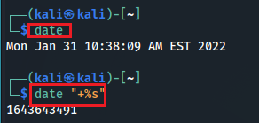
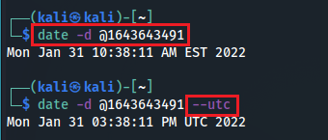
Unix time
Unix time, or POSIX time, is a system for describing points in time.
It is the number of seconds that have elapsed since the Unix epoch,
The Unix epoch is 00:00:00 UTC on 1 January 1970
Current time to Unix time
Unix time to readable time
Notes:
1643643491

Slide 19
Mac "epoch time"
Mac uses a different "epoch time" than the UNIX epoch time.
Mac OS epoch date is Midnight January 1, 2001 UTC
Different is 31 years (978264705 second)
Notes:
date - d ‘1970-01-01 00:00:00 UTC’ +%s
date - - date=20010101 +$s
expr 1657166400 - 1609390800
datediff 1970-01-01 2001-01-01 –f %Ss

Slide 20
Data stored in memory - Endianness
Endianness is a term that describe the order in which a sequence of bytes (byte order) is stored in memory.
Little-endian
is an order in which the "little end" (least significant value in the sequence) is stored first.
Big-endian
is an order in which the "big end" (most significant value in the sequence) is stored first (at the lowest storage address).

Slide 21
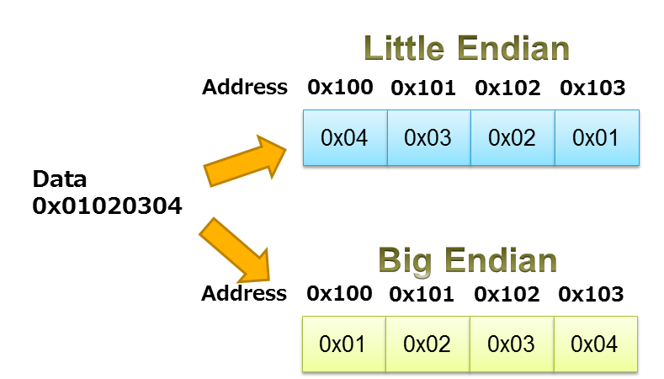





Least significant value
https://www.iar.com/knowledge/learn/programming/migration-techniques-for-different-endianness/

Slide 22
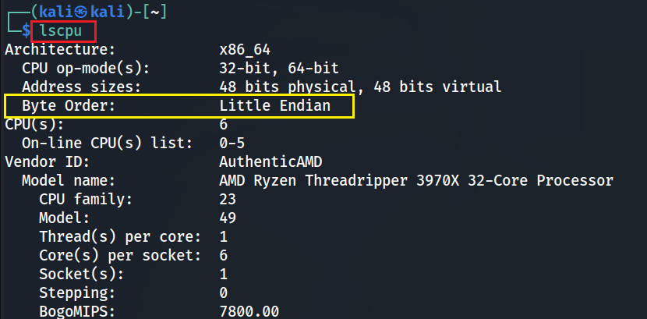
Check Byte order

