Slide 1
Carving a file without using a carving tool

Slide 2
Background

Slide 3
File carving
A well known computer forensics term
To identify and extract (carve) the file
from unallocated clusters
without the assistance of the file system that originality created the file.
How to extract files?
based on signature information alone.

Slide 4
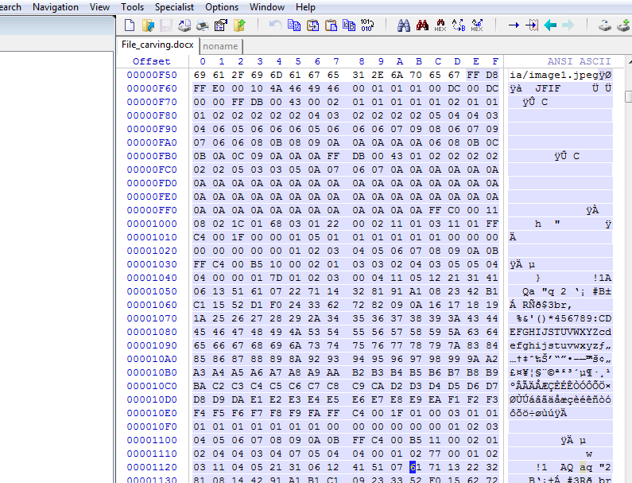
An example scenario
A suspect deleted a file
The files contains an important image
Image occupies a few clusters
Unfortunately, some clusters are reused (0verwirtten) by new files
A forensic expert really wants to recover the image, even a partial image

Slide 5
File signature
Referred to as a magic number,
Used to identify a file format
a constant numerical or
text value used to.

Slide 6
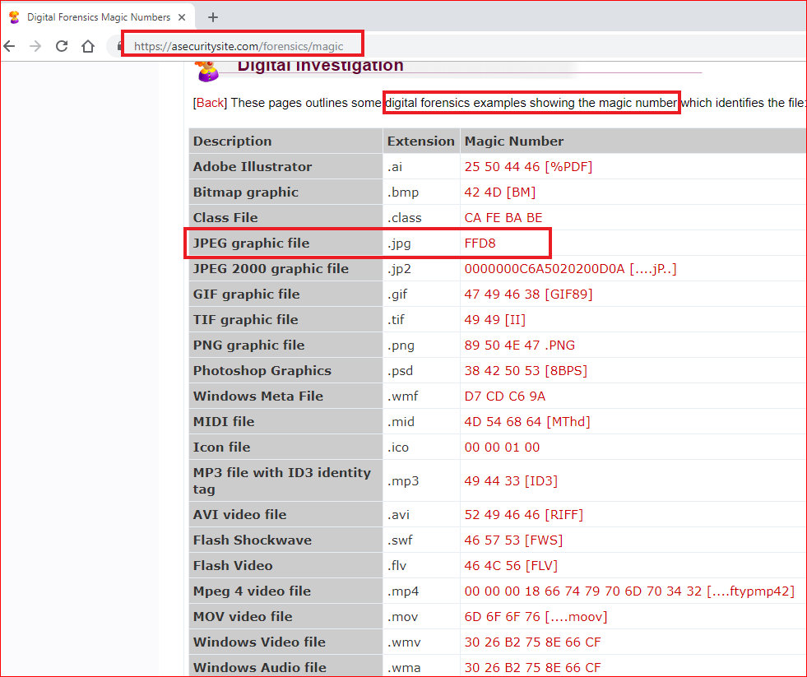
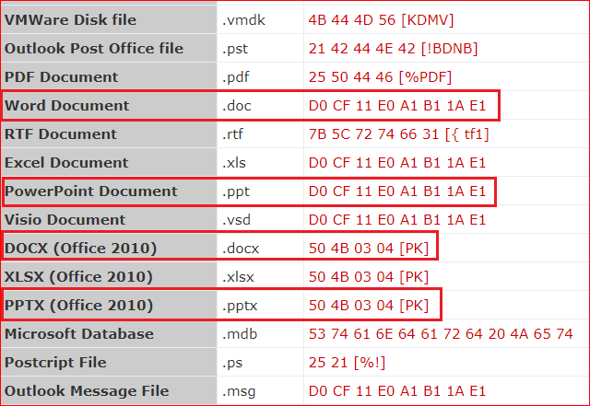

Slide 7
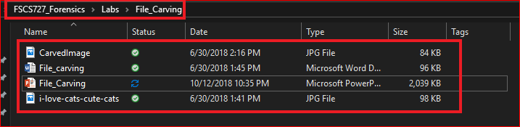
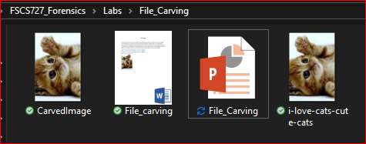
Find file signature of Word, JPG, and PPT

Slide 8
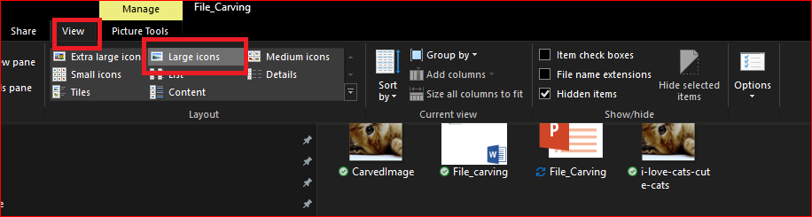
View large icons

Slide 9
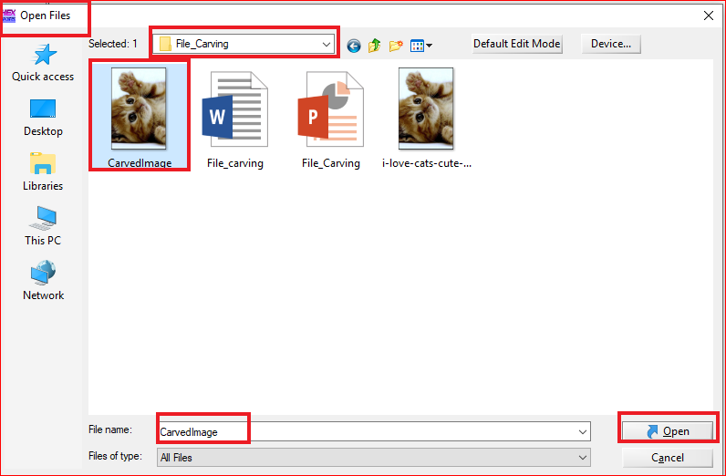

Slide 10




Slide 11
Extract the jpg file from an unknown file

Slide 12
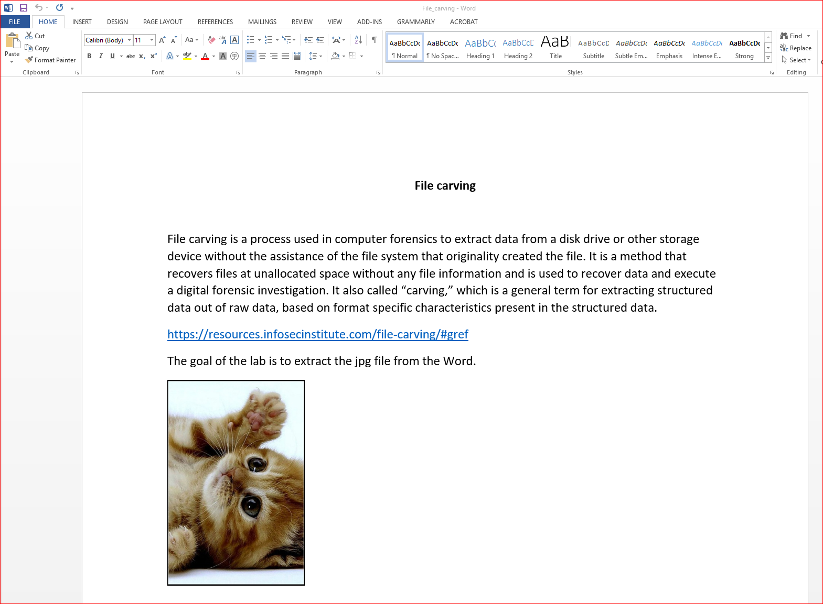
Assumption: the unknown file is a Word file

Slide 13
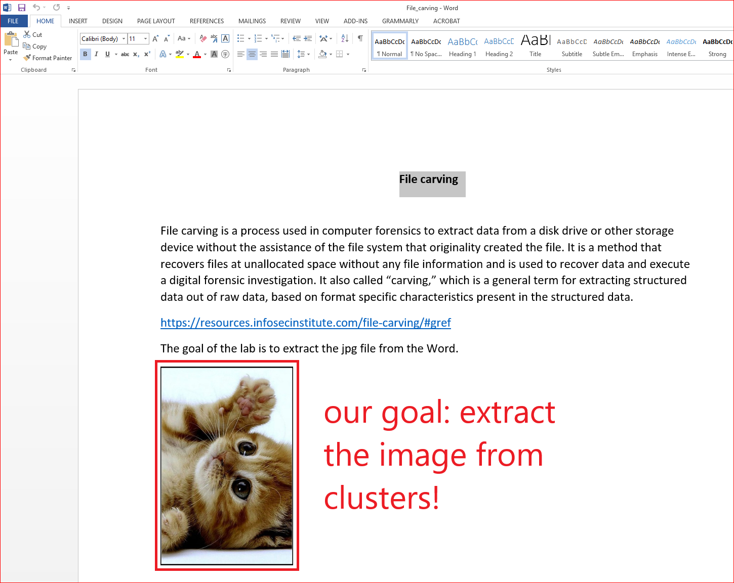
Goal of the lab

Slide 14
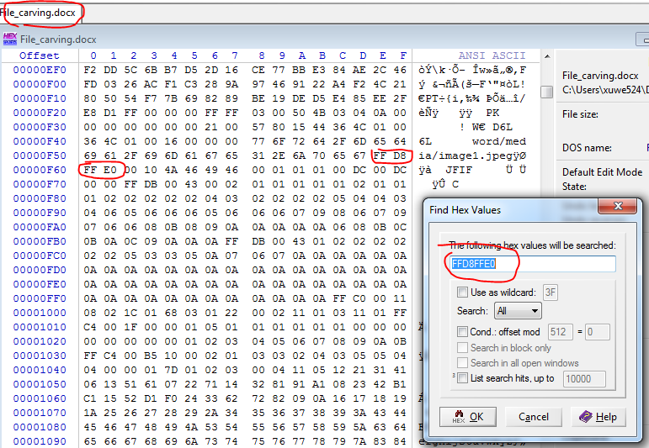
File Header offset – 0F5E

Slide 15
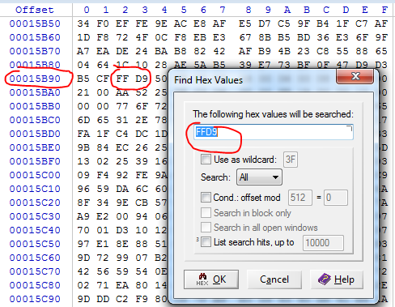
File Trailer offset – 15B92

Slide 16
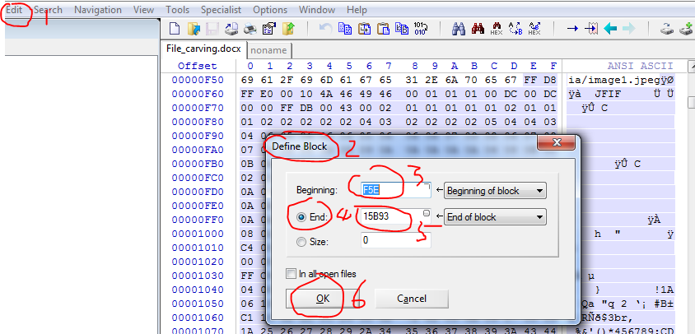
File Header offset – 0F5E File Trailer offset – 15B93

Slide 17
Edit->copy block

Slide 18
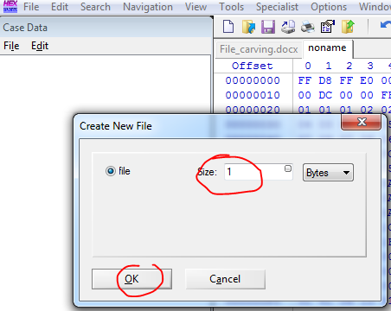
Paste to a new file

Slide 19
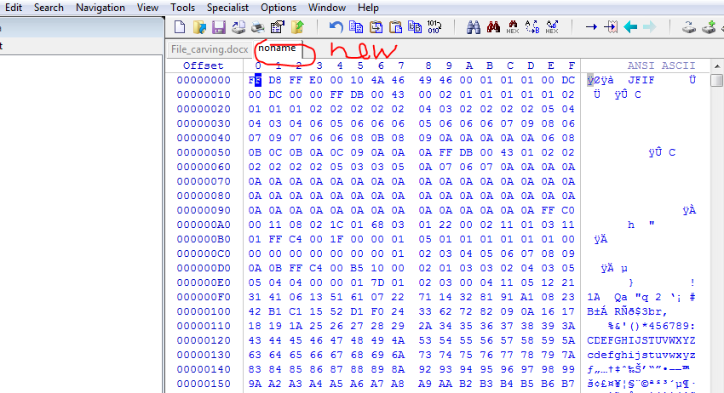
File->

Slide 20
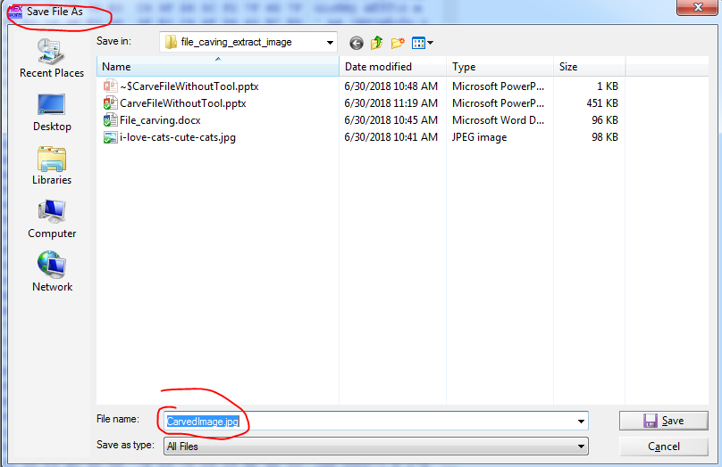
File->save File As

Slide 21
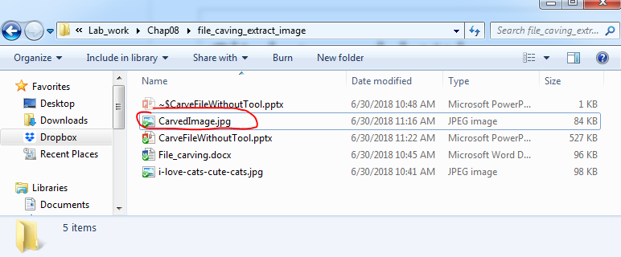
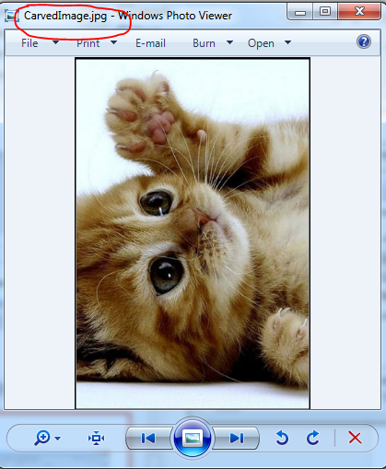
Carved File

Slide 22
Using Tools to Recover
PhotoRec is open source recovery software designed to recover lost files, including video, documents, and archives from hard disks, CD-ROMs, and lost pictures (thus the “photo recovery” name) from digital camera memory.
PhotoRec ignores the file system and goes after the underlying data, so it will still work even if your media’s file system has been severely damaged or reformatted.
It is available for the Windows, Linux, and MAC operating systems
http://www.cgsecurity.org/testdisk-6.14.win64.zip

