Slide 1
Number System

Slide 2
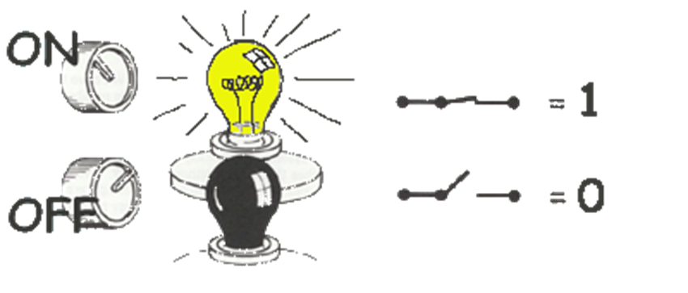

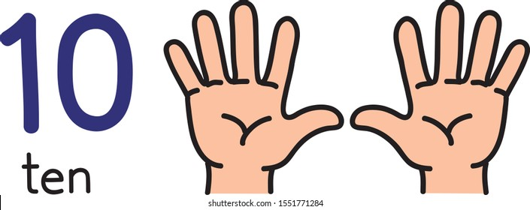
Common number systems
System | Base | Symbols | Used by humans? | Used in computers? | Used by Forensic Professionals?
Decimal | 10 | 0, 1, … 9 | Yes | No | Yes
Binary | 2 | 0, 1 | No | Yes | Yes
Hexa- decimal | 16 | 0, 1, … 9, A, B, … F | No | No | Yes

Slide 3
Conversion among number systems
Decimal
Binary
Hexadecimal

Slide 4
Conversion
Decimal | Binary | Hexa- decimal
0 | 0 | 0
1 | 1 | 1
2 | 10 | 2
3 | 11 | 3
4 | 100 | 4
5 | 101 | 5
6 | 110 | 6
7 | 111 | 7
Decimal | Binary | Hexa- decimal
8 | 1000 | 8
9 | 1001 | 9
10 | 1010 | A
11 | 1011 | B
12 | 1100 | C
13 | 1101 | D
14 | 1110 | E
15 | 1111 | F

Slide 5
Decimal to Decimal
placeholder
Weight
126₁₀ => 6 x 10⁰ = 6 2 x 10¹ = 20 1 x 10² = 100 126
Decimal
Base

Slide 6
Binary to Decimal
Bit “0”
Weight
Multiply each bit by 2^{n}, where n is the “weight” of the bit
The weight is the position of the bit, starting from 0 on the right
Add the results
101010₂ => 0 x 2⁰ = 0 1 x 2¹ = 2 0 x 2² = 0 1 x 2³ = 8 0 x 2⁴ = 0 1 x 2⁵ = 32
42₁₀
Base

Slide 7
Hexadecimal to Decimal
Multiply each bit by 16^{n}, where n is the “weight” of the bit
The weight is the position of the bit, starting from 0 on the right
Add the results
AB2₁₆ =>
2 x 16⁰ = 2 x 1 = 2 B x 16¹ = 11 x 16 = 176 A x 16² = 10 x 256 = 2560
2738₁₀

Slide 8
Decimal to Binary
126₁₀ = ?₂
Divide by 2, keep track of the remainder
First remainder is bit 0 (LSB, least-significant bit)
Second remainder is bit 1
Etc.
2 126 63 0
2 31 1
2 15 1
2 7 1
2 3 1
2 1 1
2 0 1
stop
126₁₀ = 1111110₂

Slide 9
Decimal to Hexadecimal
2738₁₀ = ?₁₆
Divide by 16
Keep track of the remainder
16 2738
171 2
16
10 11 = B
16
0 10 = A
2738₁₀ = AB2₁₆

Slide 10
Binary to Hexadecimal
101010110010₂ = ?₁₆
Group bits in fours, starting on right
Convert to hexadecimal digits
1010 1011 0010
10 11 2
A B 2
101010110010₂ = AB2₁₆

Slide 11
Binary Addition
A | B | A + B
0 | 0 | 0
0 | 1 | 1
1 | 0 | 1
1 | 1 | 10
1
1
10101 21 + 11001 + 25 101110 46
carry bit

Slide 12
Bit, Byte
A ‘bit’ (from Binary + digIT)
is the smallest unit of memory,
the unit of measurement of data information.
Byte 8-bit collections
A single bit holds so little information.

Slide 13
Endianness
Endianness is a term that describe the order in which a sequence of bytes is stored in memory.
Big-endian
is an order in which the "big end" (most significant value in the sequence) is stored first (at the lowest storage address).
Little-endian
is an order in which the "little end" (least significant value in the sequence) is stored first.

Slide 14
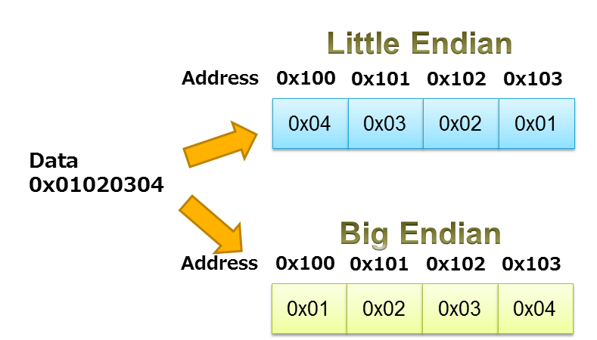
https://www.iar.com/knowledge/learn/programming/migration-techniques-for-different-endianness/

Slide 15
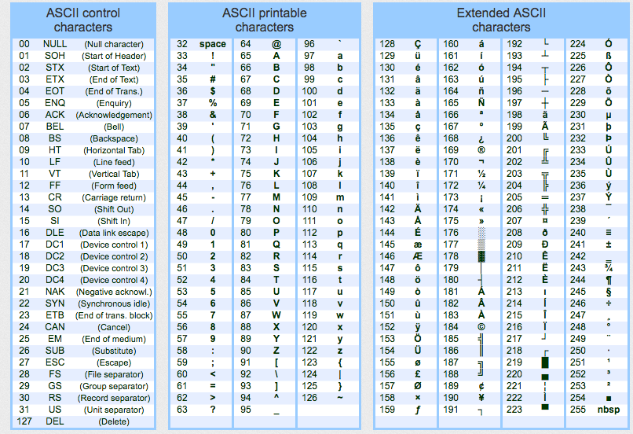
ASCII - American Standard Code for Information Interchange
ASCII codes represent text in computing devices.

