Slide 1

DJI Mavic Air Investigations
Mavic internal SDcard
The image and report are provided by vtolabs
Notes:
https://www.vtolabs.com/drone-forensics
https://digitalcorpora.s3.amazonaws.com/corpora/mobile/android_10/Non-Cellebrite%20Extraction/Pixel%203.zip

Slide 2
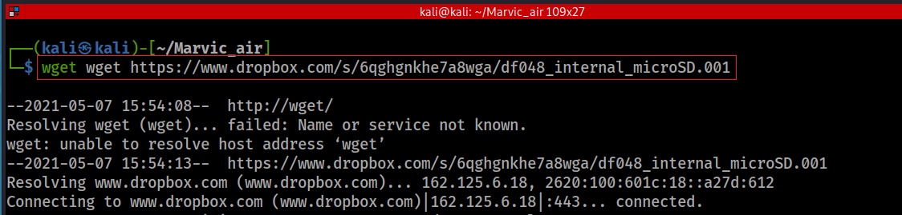
Obtain the internal microSD image
Download microSD card image
Verify hash code
Notes:
wget https://www.dropbox.com/s/6qghgnkhe7a8wga/df048_internal_microSD.001
08cf90ed4d61e232959b568a8fe5aee6

Slide 3
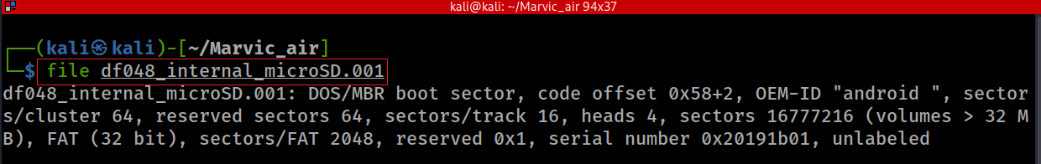
Show the image file type
size=512 bytes / sector * 16777216 sectors =8.59G
Notes: the although the spec indicate the size of 32G, however, only 8G (partition 1) is used, the rest of unallocated space

Slide 4
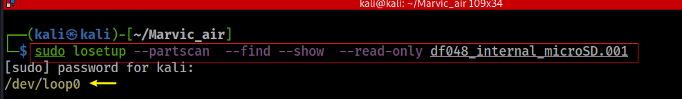
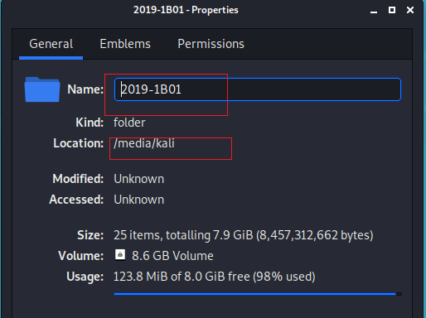
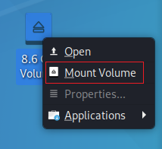
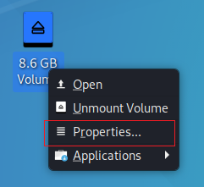
Mount Mavic internal microSD
Search a loop device
Find the path to the mounted disk image
Notes:
sudo losetup --partscan --find --show --read-only df048_internal_microSD.001

Slide 5
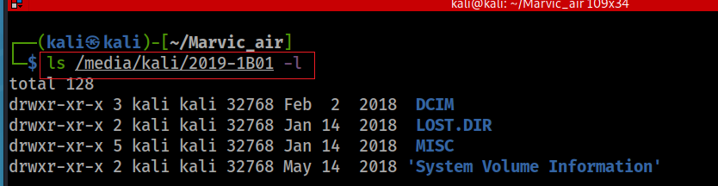
Verify the mounted image (method 1)
Notes:
ls /media/kali/2019-1B01 –l
lsblk -f

Slide 6
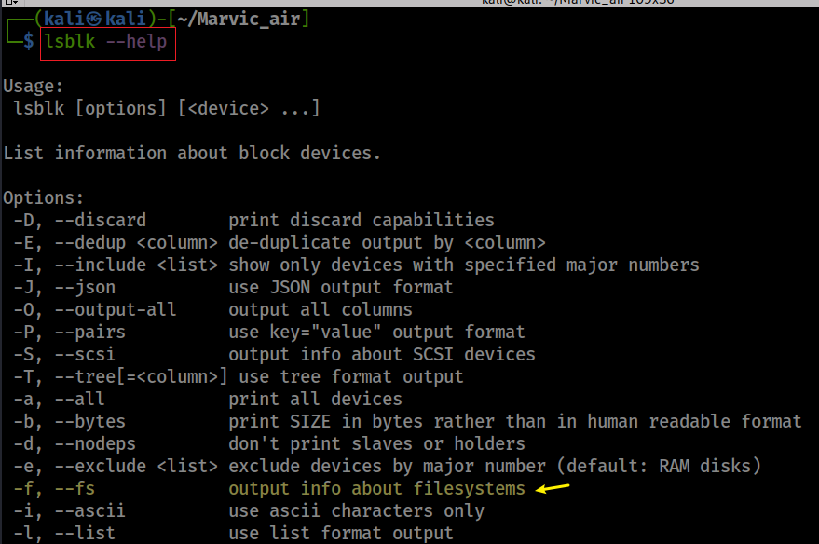
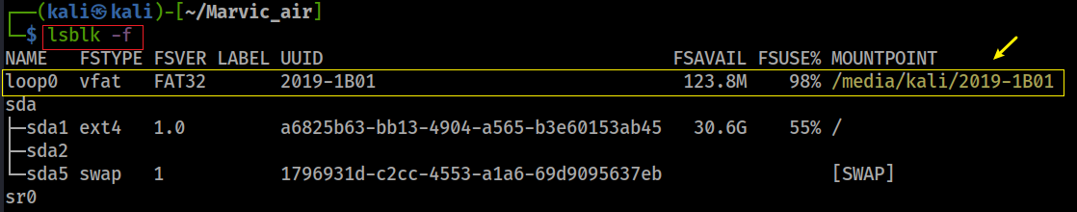
Verify the mounted image (method 2)
Show help command
Verify
Notes:
ls /media/kali/2019-1B01 –l
lsblk –f
https://devconnected.com/how-to-mount-and-unmount-drives-on-linux/

Slide 7
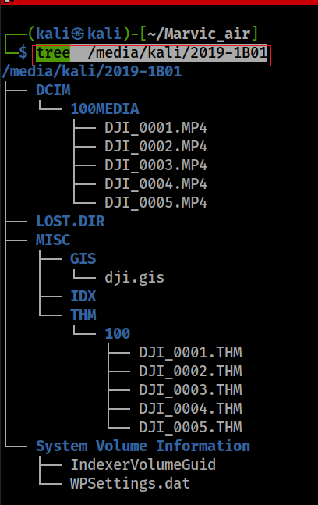
Structure of internal microSD
binary file/DJI proprietary
Notes:
tree /media/kali/2019-1B01

Slide 8
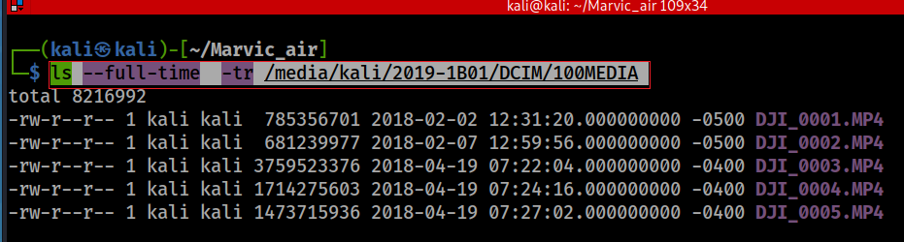
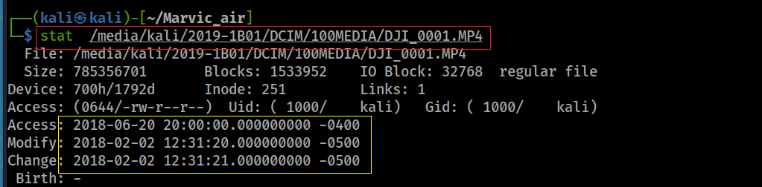
How many videos captured in 2018?
Access date will not change when mounted in read-only
Notes:
ls --full-time -tr /media/kali/2019-1B01/DCIM/100MEDIA

Slide 9
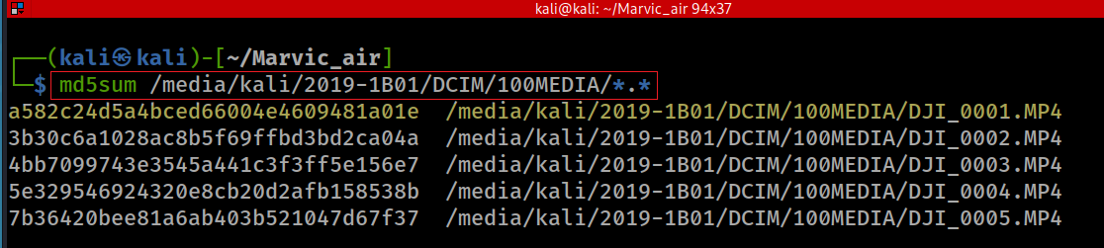
Computer hashes of videos

Slide 10
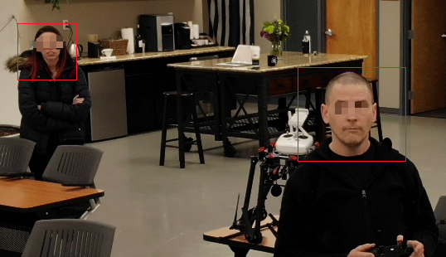
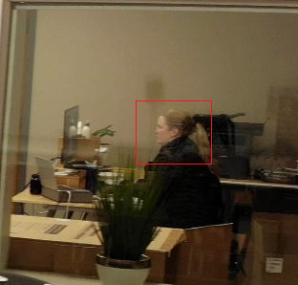
How many people were shown on the first video?
DJI_0001.MP4
three

Slide 11
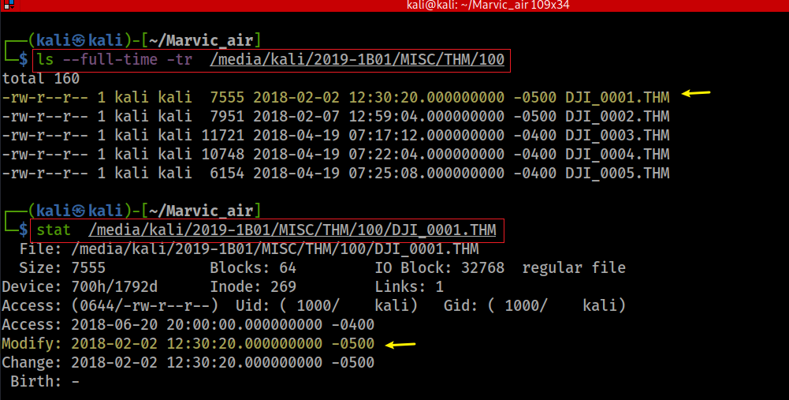
How many pictures were taken in 2018?
List all files
Show the first file timestamps
Verify the first file type is JPEG
Notes:
ls --full-time -tr /media/kali/2019-1B01/MISC/THM/100
stat /media/kali/2019-1B01/MISC/THM/100/DJI_0001.THM
file /media/kali/2019-1B01/MISC/THM/100/DJI_0001.THM

Slide 12
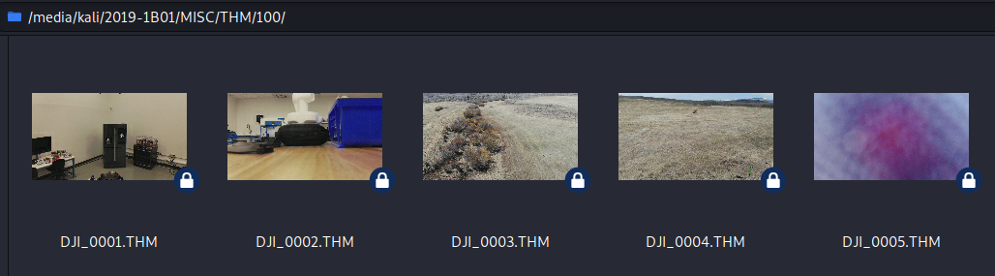
How many people were captured in 2018?
none

Slide 13
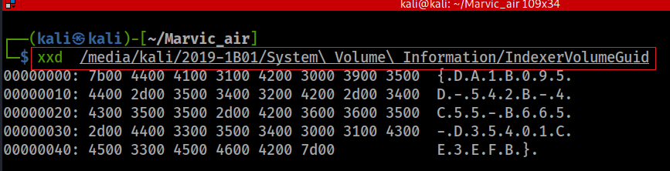
microSD card GUID
Notes:
xxd /media/kali/2019-1B01/System\ Volume\ Information/IndexerVolumeGuid

Slide 14
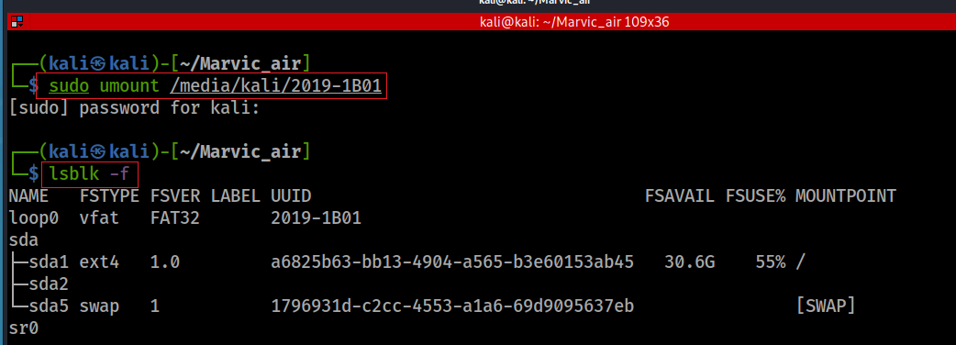
unmount the device

