Slide 1

DJI Mavic Air Investigations
Mavic microSD card Expert Witness/Encase format
The image and report are provided by vtolabs
Notes:
https://www.vtolabs.com/drone-forensics
https://digitalcorpora.s3.amazonaws.com/corpora/mobile/android_10/Non-Cellebrite%20Extraction/Pixel%203.zip

Slide 2
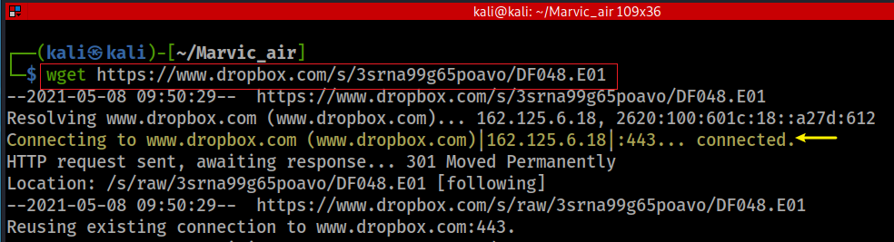

Obtain the microSD image
Download microSD card image
Verify hash code
Notes:
wget https://www.dropbox.com/s/3srna99g65poavo/DF048.E01
md5sum DF048.E01
d1651cfacd5b1827e337ad0a826002ae

Slide 3
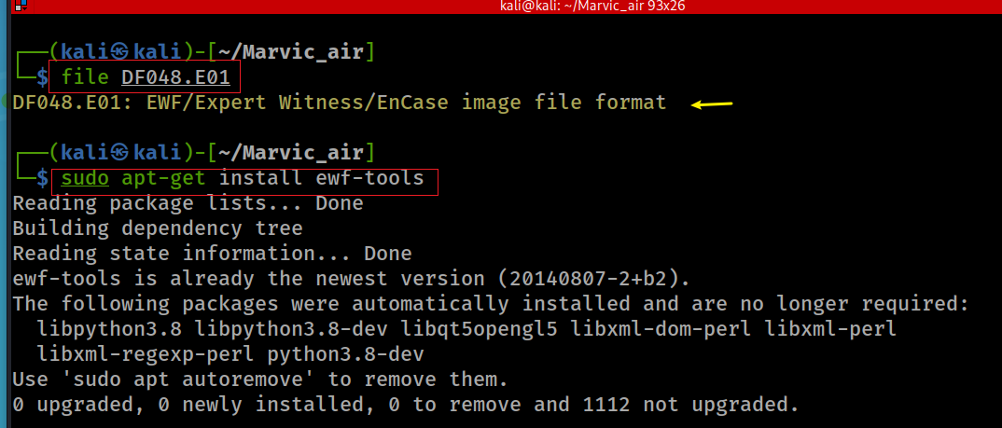
Find the format of Mavic microSD
Notes:
file DF048.E01
sudo apt-get install ewf-tools

Slide 4
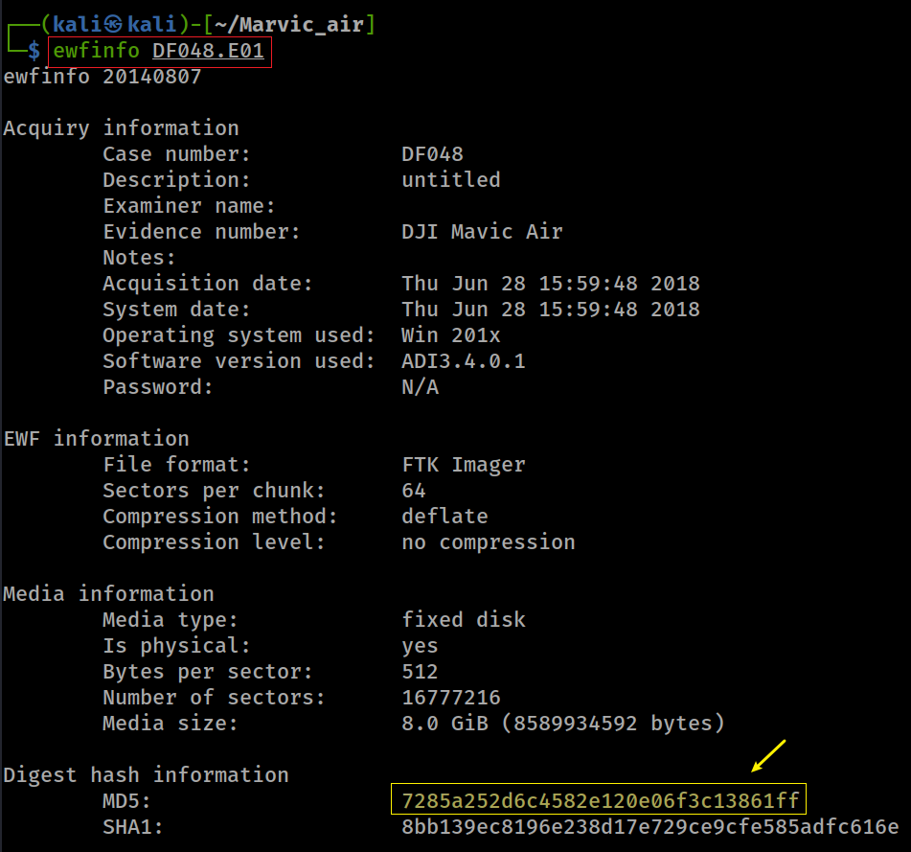
Show image information
Notes:
ewfinfo DF048.E01

Slide 5
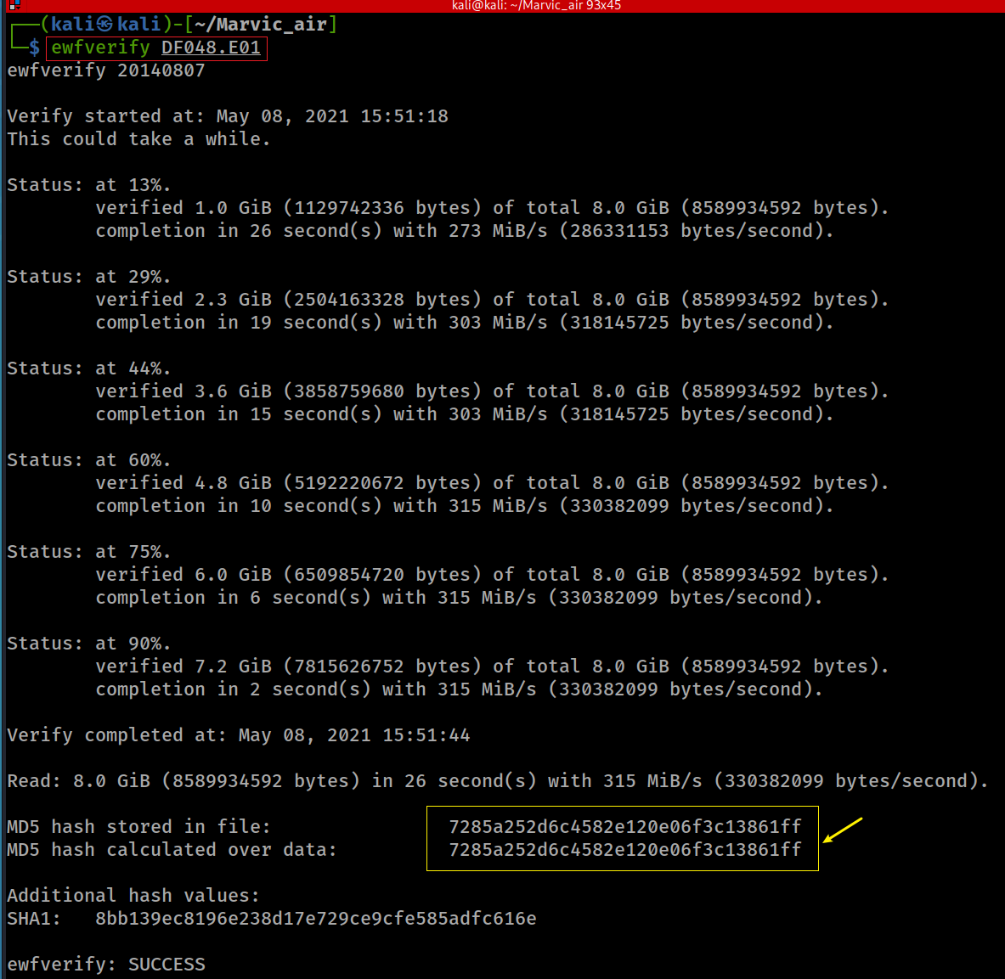
Verify image hash
Notes:
ewfverify DF048.E01

Slide 6
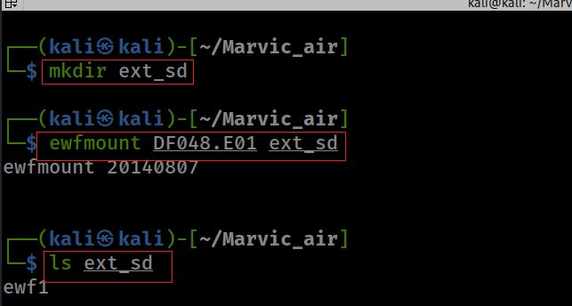
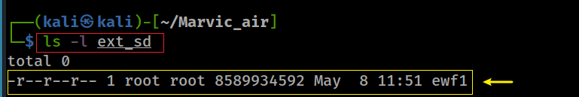
Mount an Expert Witness Compression Format (EWF) image file
usage: ewfmount image mount_point
image: an Expert Witness Compression Format (EWF) image file
mount_point: the directory to serve as mount point
Notes:
ewfmount DF048.E01 ext_sd

Slide 7
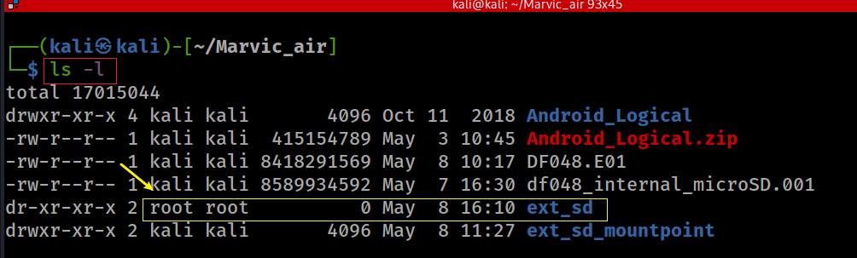
Note: the permission and owner have been changed

Slide 8
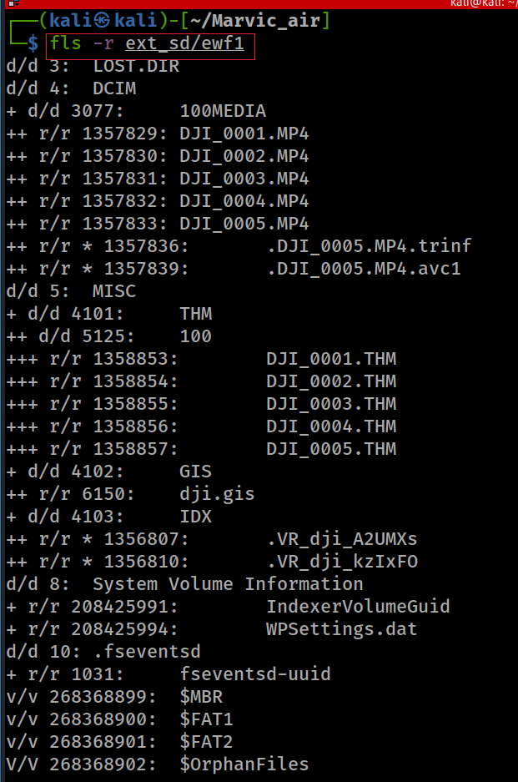
Show all files

Slide 9
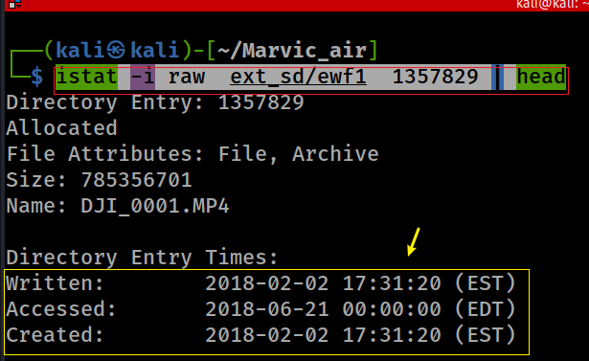
Where was the first video taken?
2018-02-02T17:31:20 EST
Notes:
istat -i raw ext_sd/ewf1 1357829 | head

Slide 10
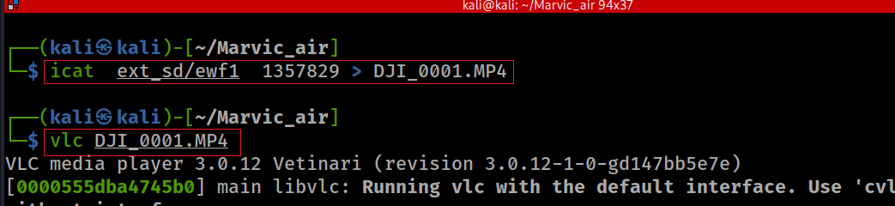
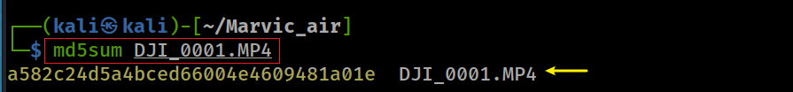
How to play the video?

Slide 11
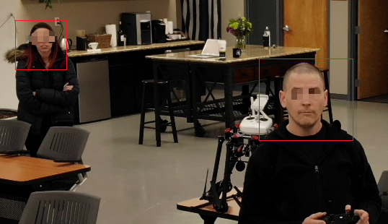
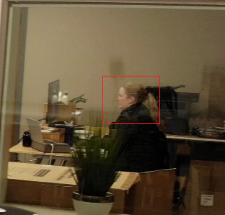
How many people were shown on the first video?
DJI_0001.MP4
three

Slide 12
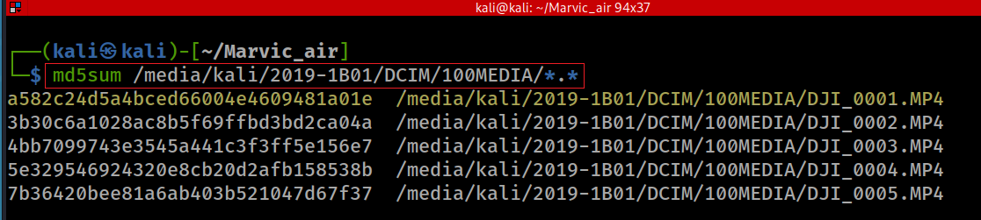
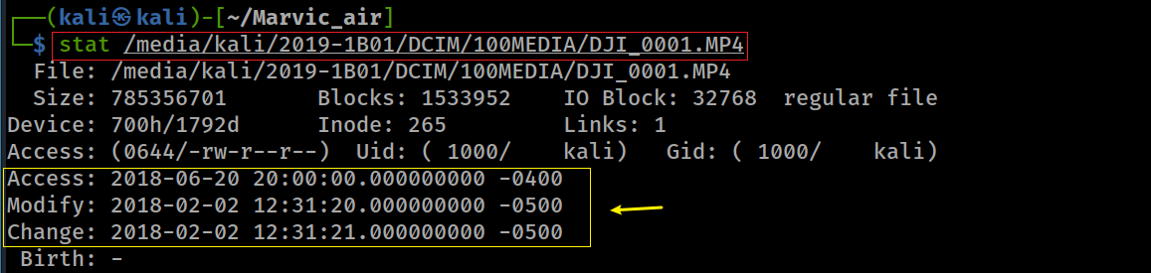
Is this video same as the video in internal microSD card?
recall the hashes/timestamps of videos in internal microSD card
same

Slide 13
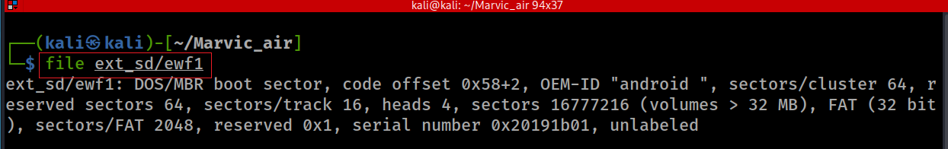
Verify the serial number of the image
It turns out the microSD card is the same as internal microSD card
Notes:
file ext_sd/ewf1

