Slide 1

TShark and Digital Forensics

Slide 2

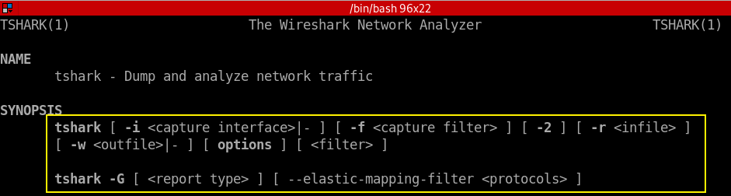
What is TShark
Terminal-based Wireshark
It supports the same options as wireshark
Notes:
https://www.wireshark.org/docs/wsug_html_chunked/AppToolstshark.html

Slide 3

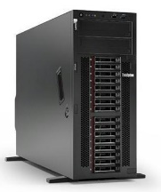
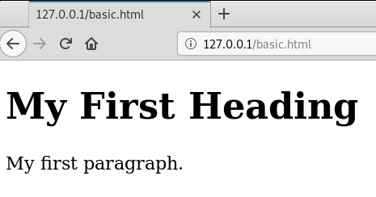
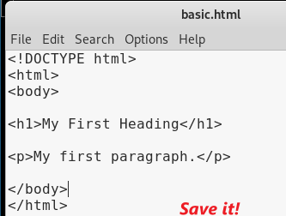
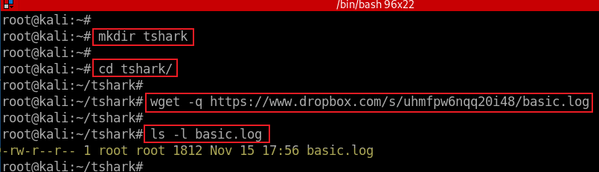
Port 52054
Port 80
HTTP Request
HTTP Response
Generated using curl
Notes:
wget -q https://www.dropbox.com/s/uhmfpw6nqq20i48/basic.log

Slide 4
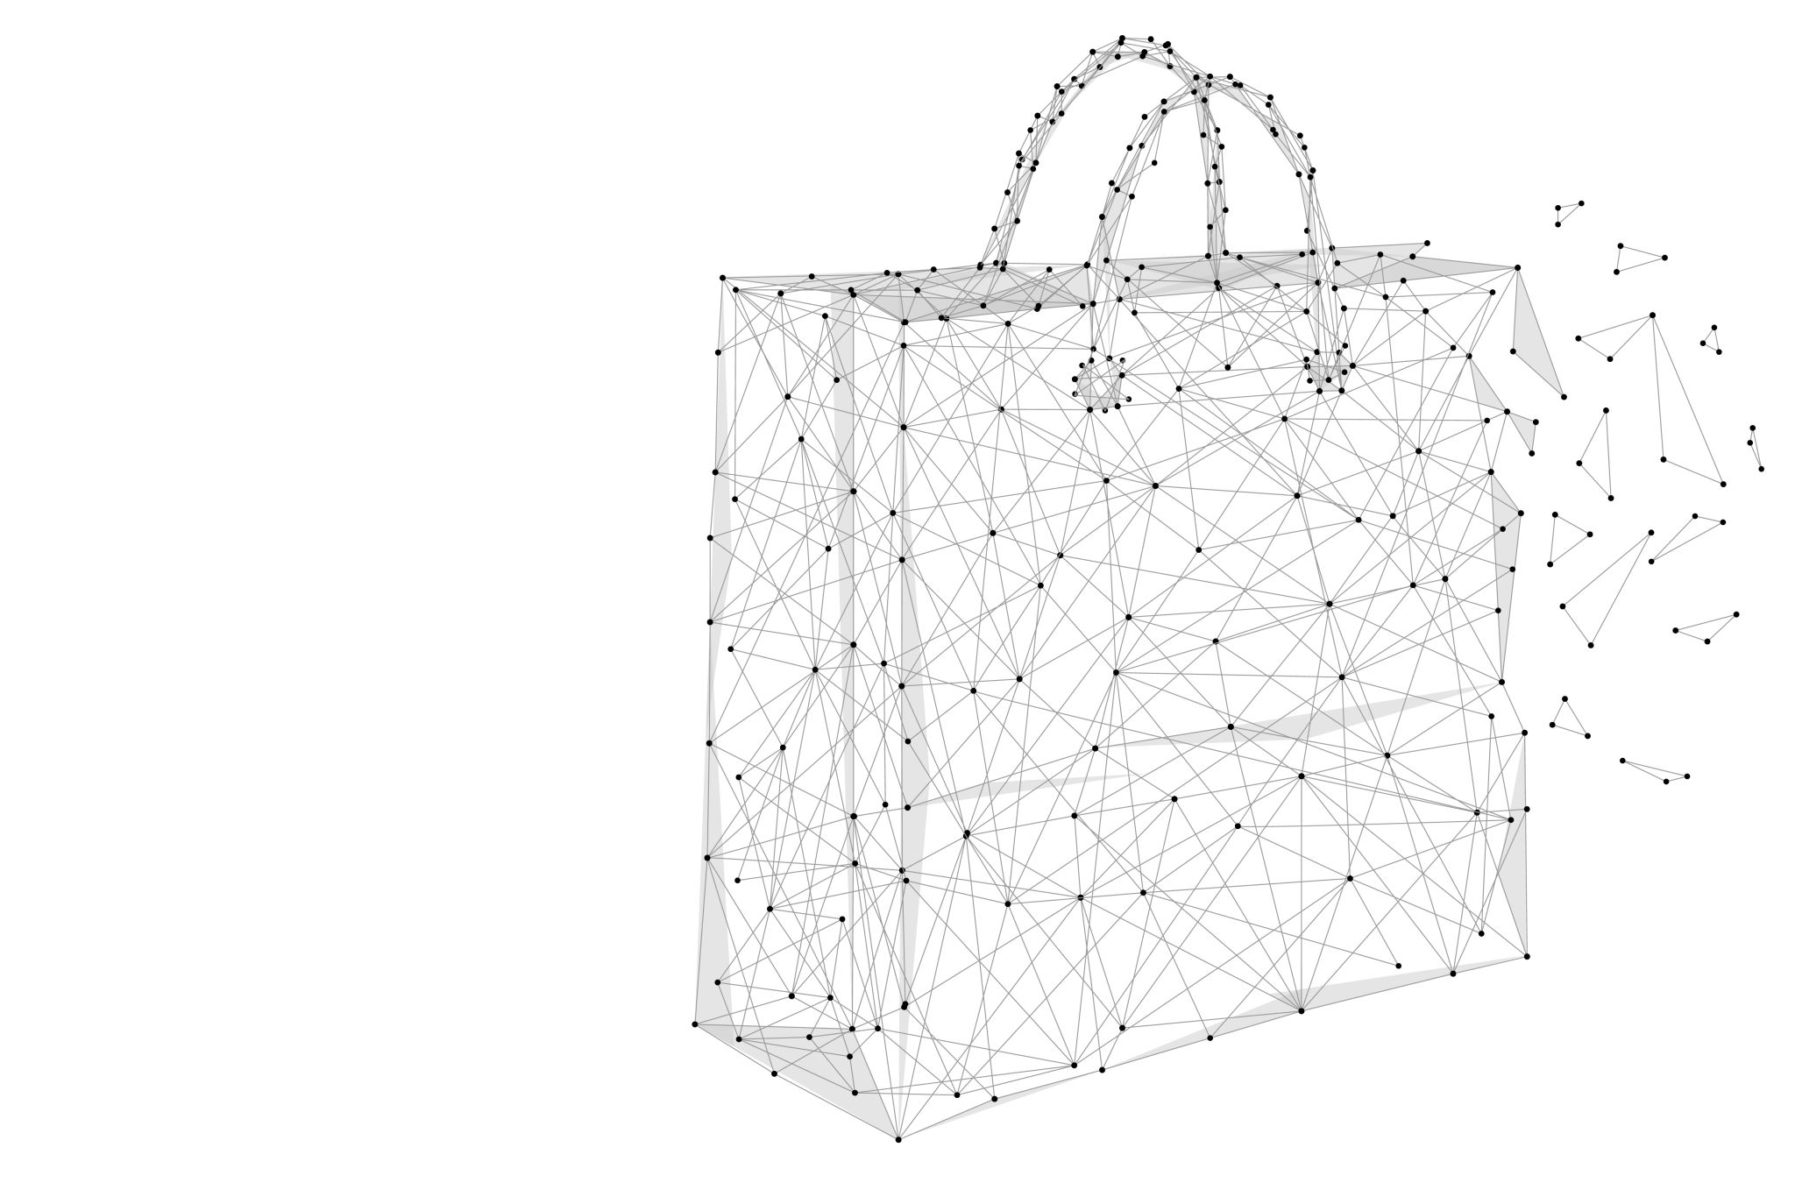
Show all packets

Slide 5
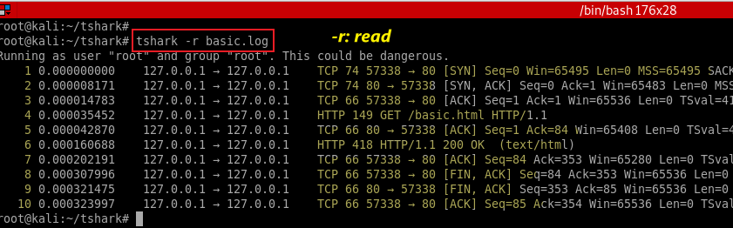
Show all packets
Notes:
https://www.wireshark.org/docs/man-pages/tshark.html

Slide 6
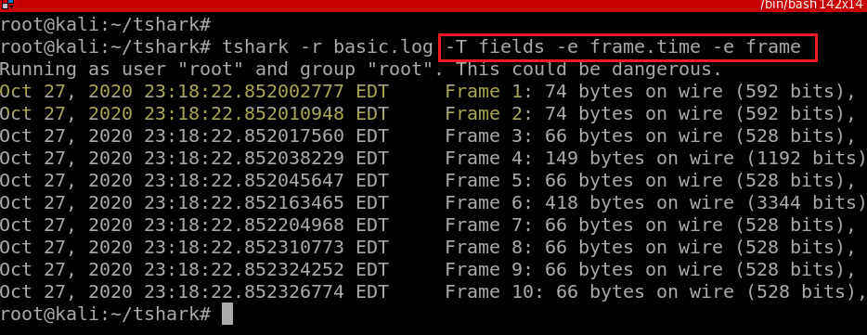
Show all packets with readable time

Slide 7
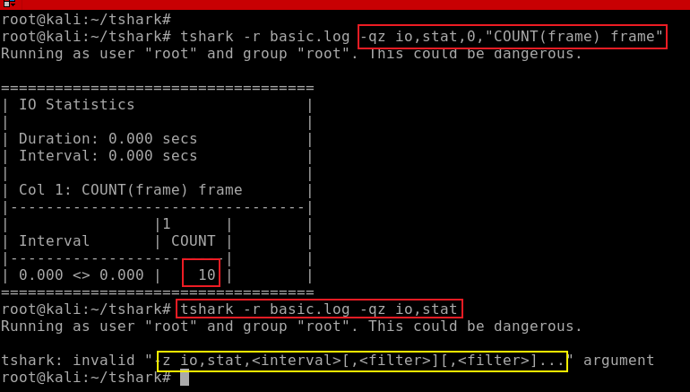
Count the numbers of packets
-q: quit (don’t show packets)
-z: statistics, io,stat is one of stats
0: over all packets, otherwise is interval seconds
[COUNT|SUM|MIN|MAX|AVG](<field>)<filter>
Notes:
tshark -r basic.log -qz io,stat,0,"COUNT(frame) frame"

Slide 8
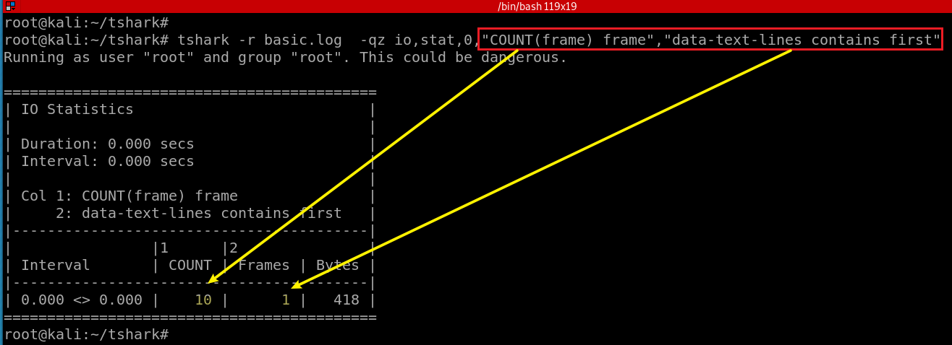
Count the numbers of packets that contain the key word “first”

Slide 9
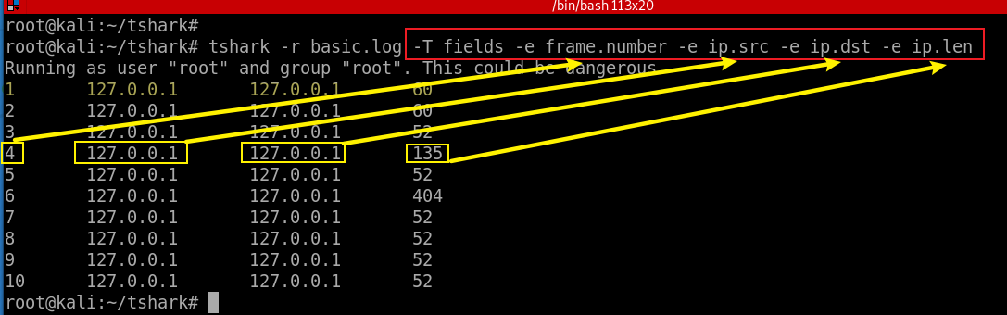
-Y <display filter>
Show fields of packets
-T : set the format of the output
-e: add a field to the list of fields
Notes:
https://tshark.dev/analyze/packet_hunting/packet_hunting/
http://yenolam.com/writings/tshark.pdf

Slide 10

Filter packets with -Y option With field properties

Slide 11
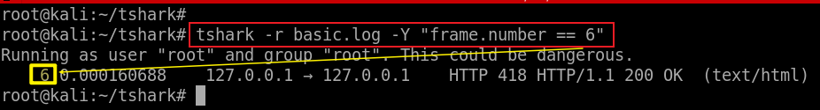
Find a specific packet with a frame number
-Y: display filter
frame: field name
frame.number: a filed name
Notes:
tshark -r basic.log -Y "frame.number == 6"

Slide 12
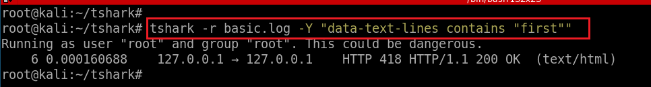
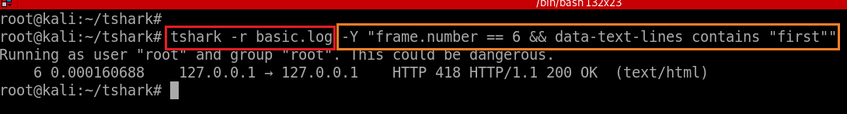
Find frame numbers if packets have HTTP content
Find frame numbers with both conditions
Notes:
tshark -r basic.log -Y "data-text-lines contains "first""

Slide 13
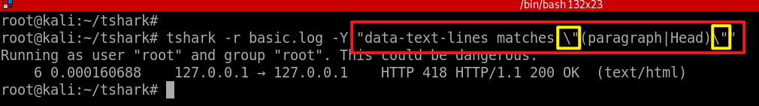
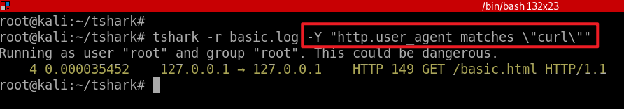
Find frame numbers with both matches Perl-compatible regular expression
contains Does the protocol, field or slice contain a value
matches, ~ Does the protocol or text string match the given
case-insensitive Perl-compatible regular expression
https://perldoc.perl.org/perlre
(paragraph|Head): paragraph or head
Find frame numbers with the user agent matches “curl”
Notes:
tshark -r basic.log -Y "data-text-lines matches \"(paragraph|Head)\""

Slide 14

How to find protocol and field name?

Slide 15
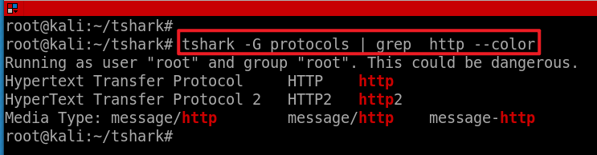
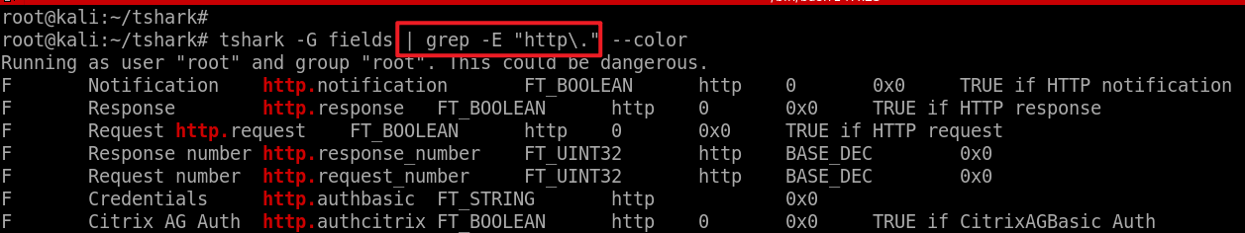
HTTP and fields
Find HTTP protocol name
Find HTTP field names
Note: \. matches . Literal, otherwise matches any one character
-G fields: dump field name
-E: pattern match
--color: highlights

Slide 16
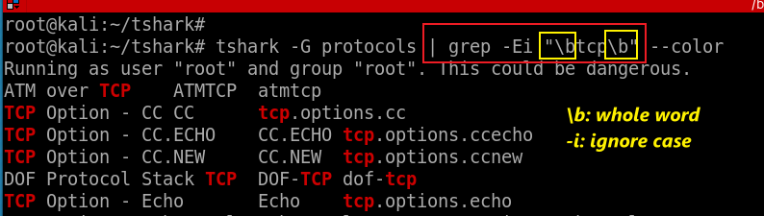
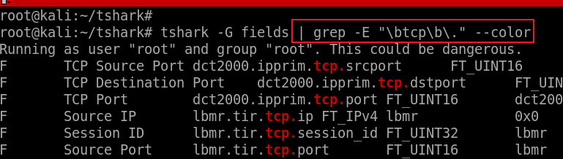
TCP and field names
Find TCP protocol name (the whole word ) => tcp
Find field names that are associated with tcp

Slide 17
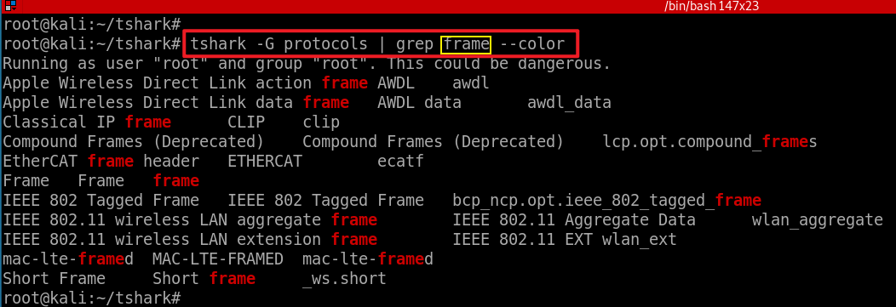
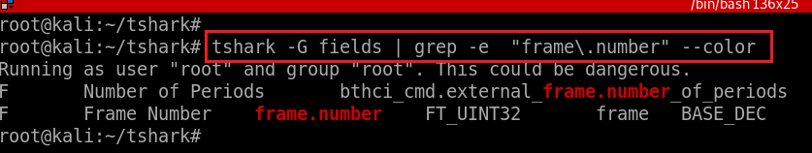
Frame and field names
Find Ethernet frame protocol name => frame
Find Ethernet frame field name
Notes:
tshark -G fields | grep -E "frame.number" --color

Slide 18
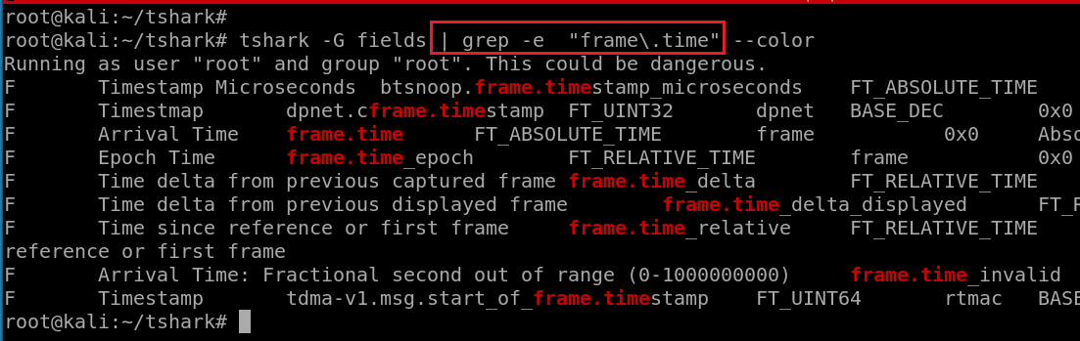
Find details of frame.time

Slide 19
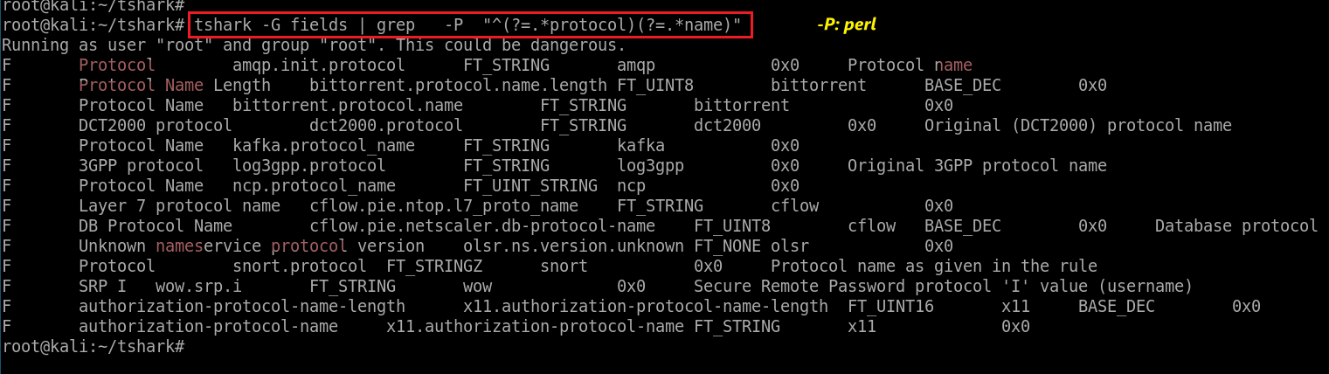
Metacharacter Sequence | Meaning | Example Expression | Example Match
^ | Start of string or line | ^abc | abc (appearing at start of string or line)
() | group
(?=) | look ahead | foobarbarfoo bar(?=bar) | finds the 1st bar ("bar" which has "bar" after it)
Match any two words, can be in a different order
Notes:
tshark -G fields | grep -P "^(?=.*protocol)(?=.*name)"
https://www.computerhope.com/unix/regex-quickref.htm

Slide 20
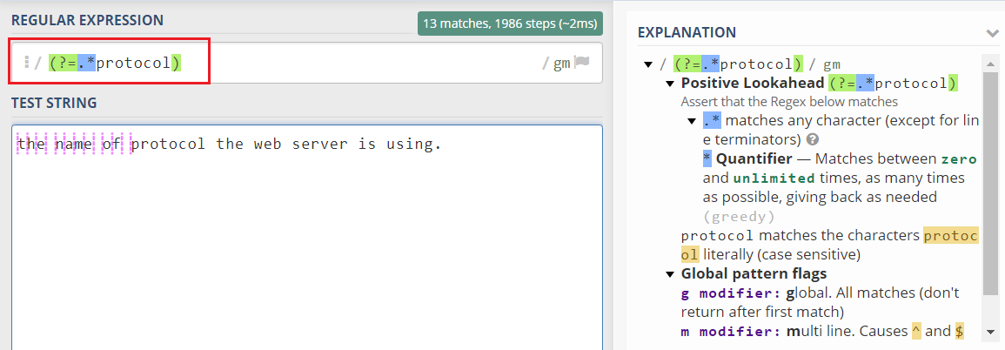
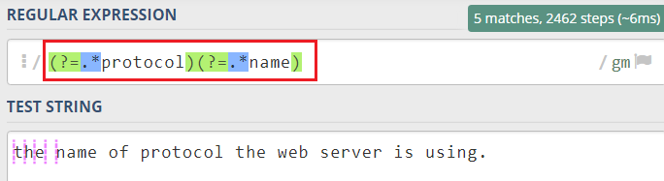
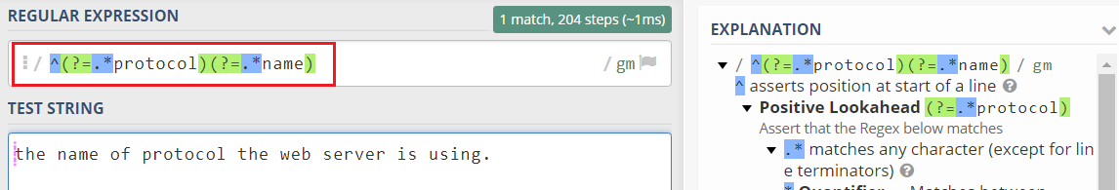
https://regex101.com/
Notes:
https://regex101.com/
^(?=.*protocol)(?=.*name)

Slide 21
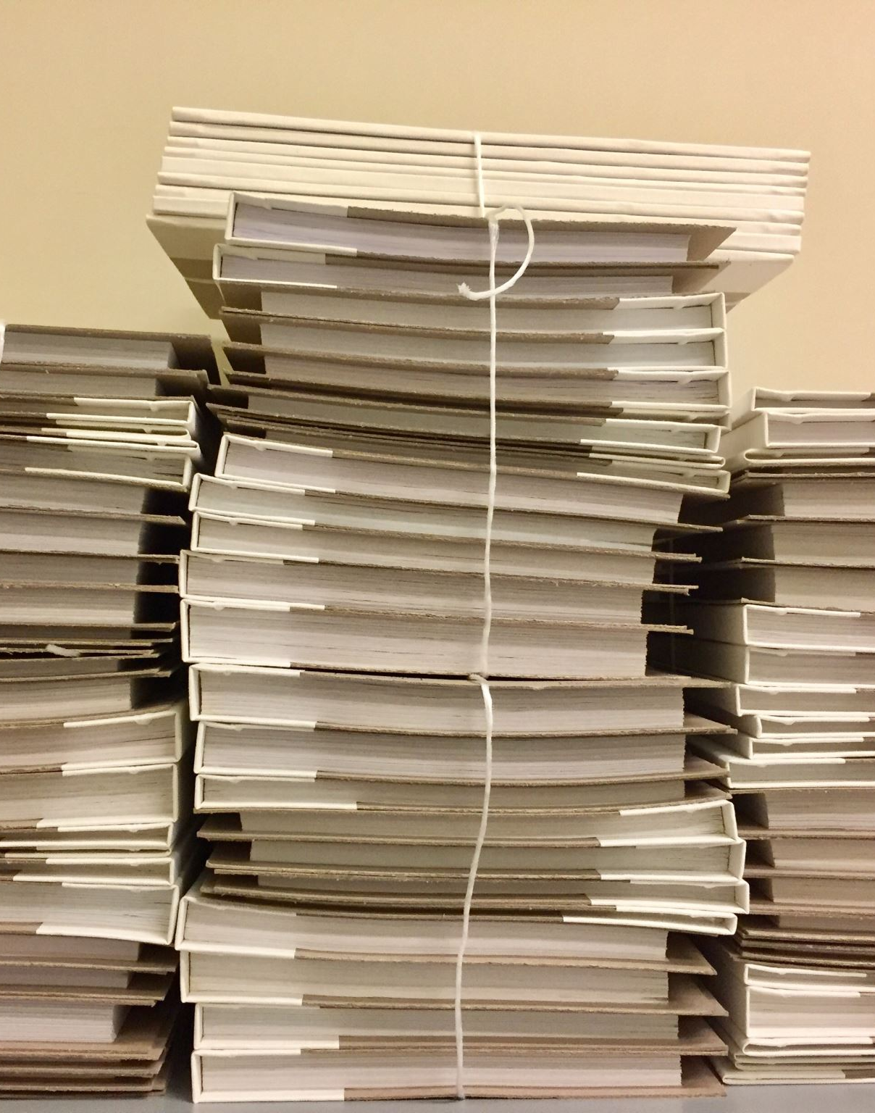
View the content of packets with -V

Slide 22
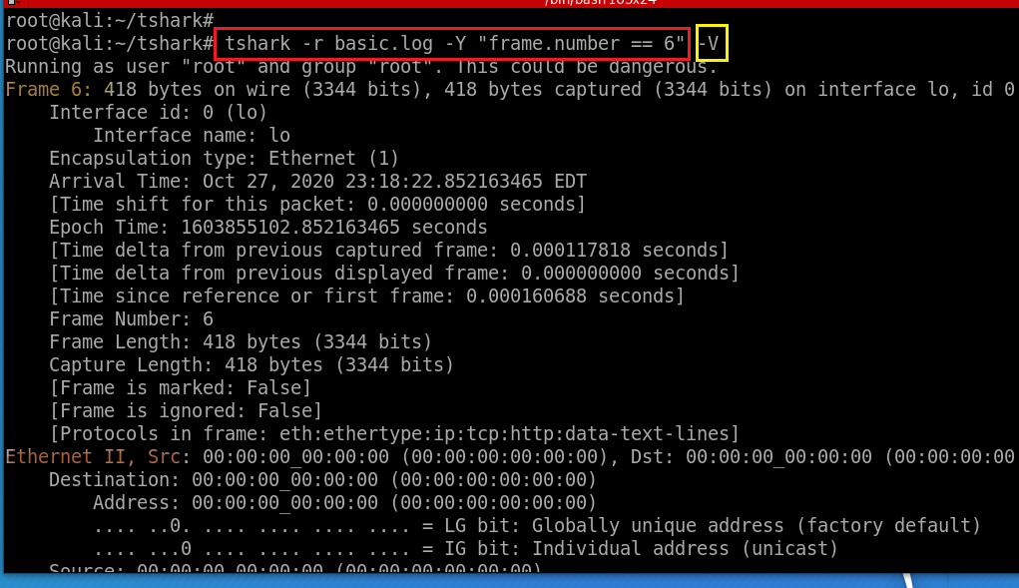
Find packet details -V
Notes:
tshark -r basic.log -Y "frame.number == 6" -V

Slide 23
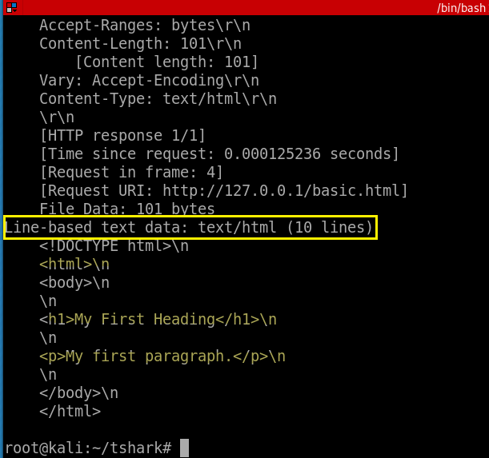

Slide 24
grep the content of packets

Slide 25
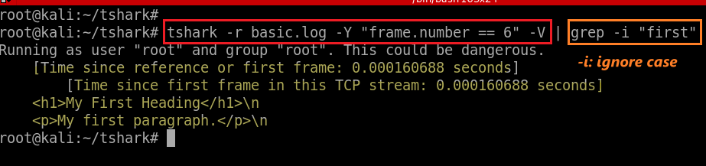
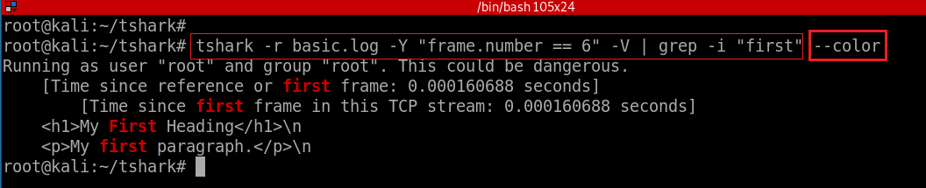
Find lines in packets contain the key word “first”
Find lines in packets contain the key word “first” and highlights them
We are only interested in html pages. Need to revise the grep command
Notes:
tshark -r basic.log -Y "frame.number == 6" -V | grep -i "first" --color

Slide 26
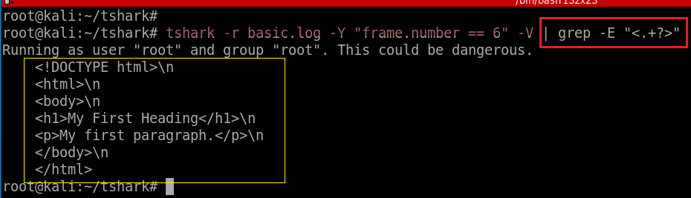
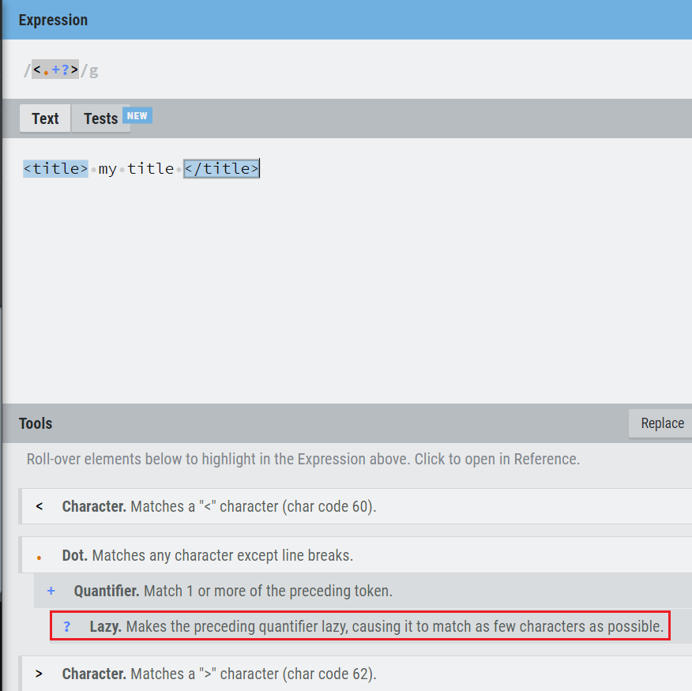
Find lines in packets contain HTML
https://regexr.com/

Slide 27
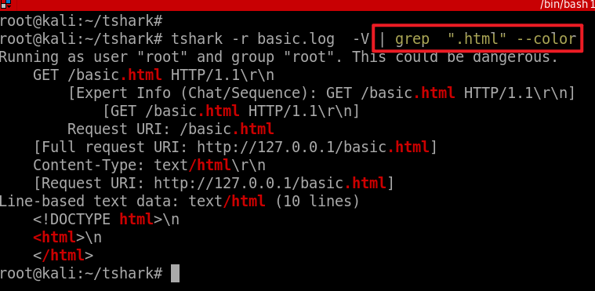
Match any lines contains the key word “.html”

Slide 28
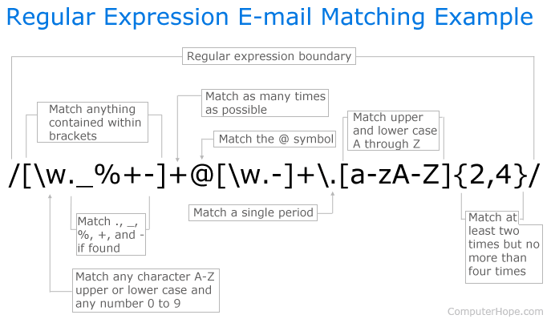
Notes:
https://www.computerhope.com/unix/regex-quickref.htm
\b[\w._%+-]+@[\w.-]+\.[a-zA-Z]{2,4}\b

