Slide 1

Investigating Harassment Emails
Email, TShark, and Digital Forensics

Slide 2

Background

Slide 3
Harassment Scenario
Created by Dr. Simson Garfinkel at Naval Postgraduate School
Mimics an University Harassment case
named "Nitroba University Harassment Scenario”
Scenario, network traffic, and slides can be accessed here: https://digitalcorpora.org/corpora/scenarios/nitroba-university-harassment-scenario

Slide 4
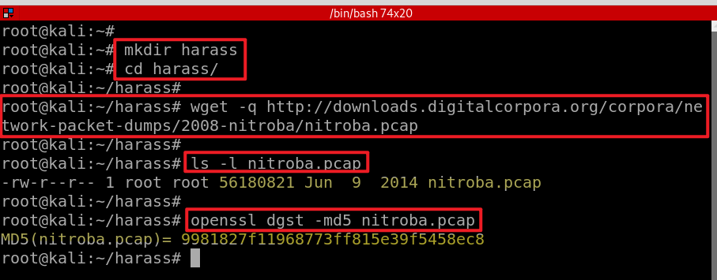
Prepared traffic log
Create a working folder
Download traffic log
Verify hash code

Slide 5
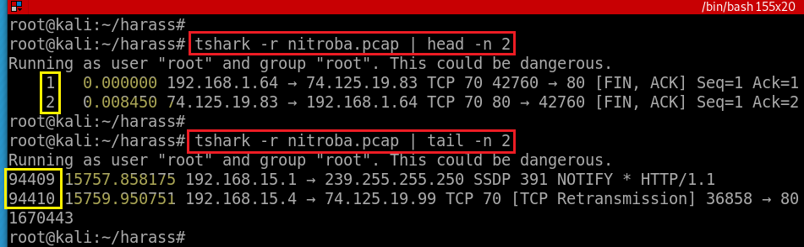
Traffic data review
Notes:
https://linux.die.net/man/1/tshark

Slide 6
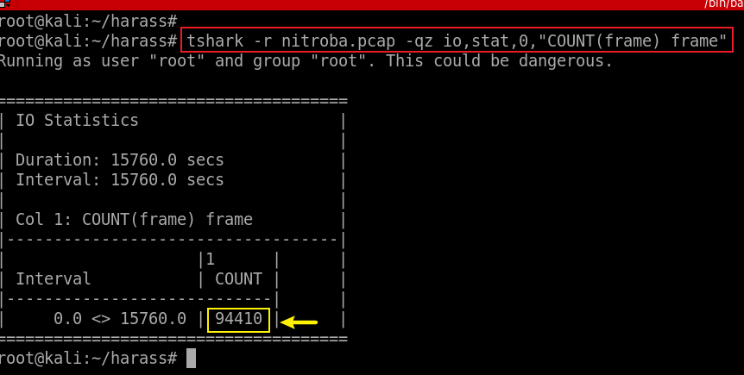
Count the number of packets
-q: quit (don’t show packets)
-z: statistics, io,stat is one of stats
0: over all packets, otherwise is interval seconds
[COUNT|SUM|MIN|MAX|AVG](<field>)<filter>
Notes:
tshark -r nitroba.pcap -qz io,stat,0,"COUNT(frame) frame"

Slide 7
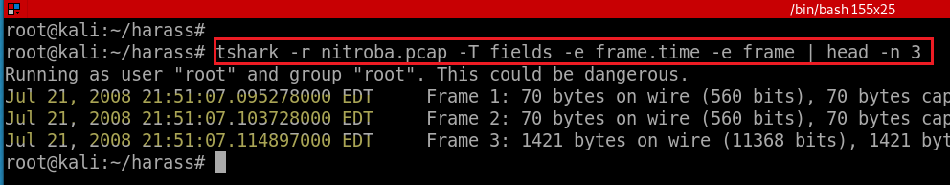
Show the first three packets
Notes:
tshark -r nitroba.pcap -T fields -e frame.time -e frame | head -n 3

Slide 8

Scenario Analysis

Slide 9
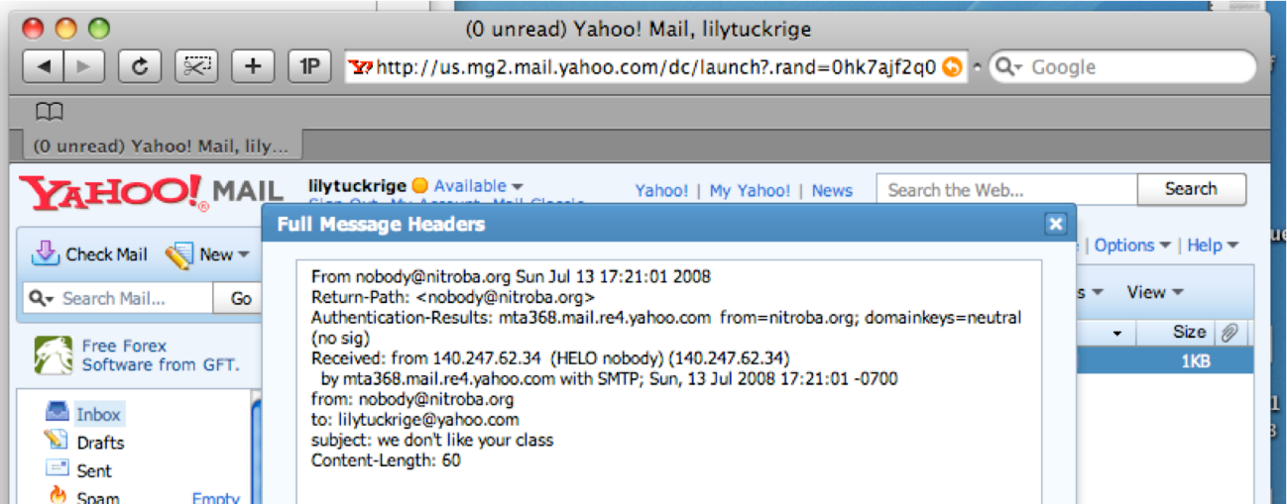
Scenario Analysis
The first email was sent from university dorm ( Email header IP address)
Evidence collection
If we capture all traffic between the dorm and outside, we can extract useful information from traffic logs

Slide 10
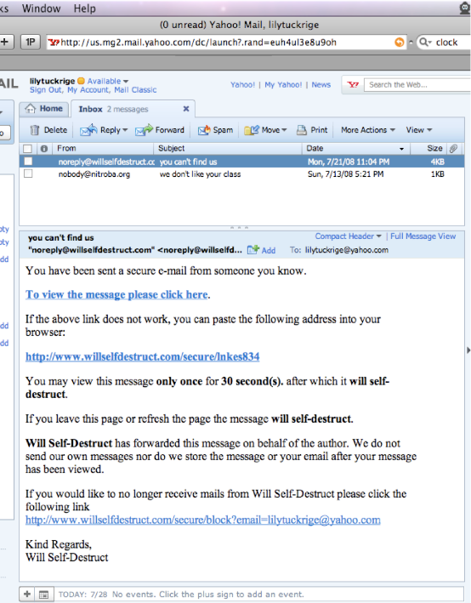
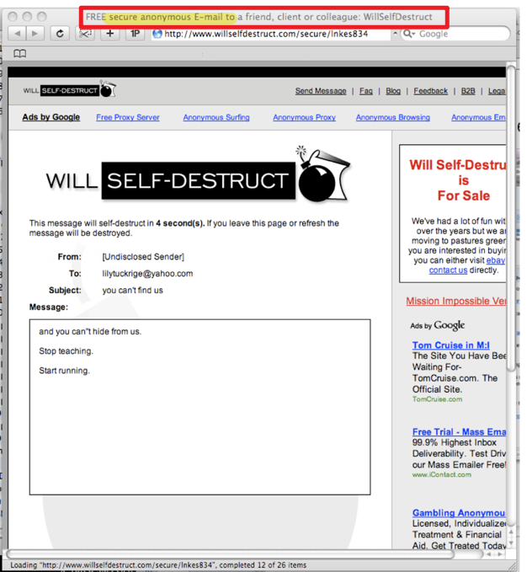
Scenario Analysis
The second email was sent from www.willselfdestruct.com
When the faculty click a link in the email, the faculty read the content provided by the website
The screenshot is provided by faculty

Slide 11





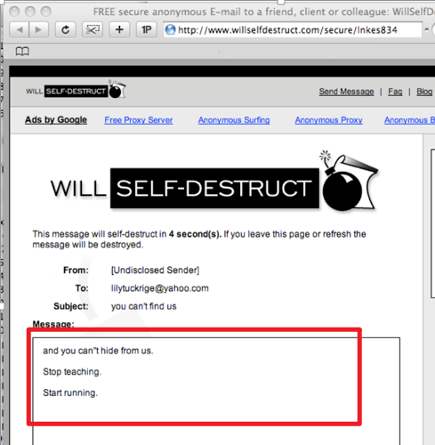
Scenario Traffic Analysis
A student in dorm
www.willselfdestruct.com
1
Get www.willselfdestruct.com
A student accesses the website
Website provides a form
A student fills out the form (contains harassment content) on the website
The website sends a notification email to faculty
Faculty click the link in the email
Website sends the harassment content saved on the website
1
2
2
3
POST www.willselfdestruct.com/form
3
Faculty
Save harassment content on server
4
4
5
5
Get www.willselfdestruct.com/secure/linkes834
6
6

Slide 12

Approach to find the suspect

Slide 13
List of questions
Which IP accessed the www.willselfdestruct.com?
Does the IP post harassing comments to the website?
Does the HTTP post contains harassment message?
Is the IP associated with any suspects?
Is the suspect in faculty’s class?
When did the suspect use www.willselfdestruct.com?

Slide 14
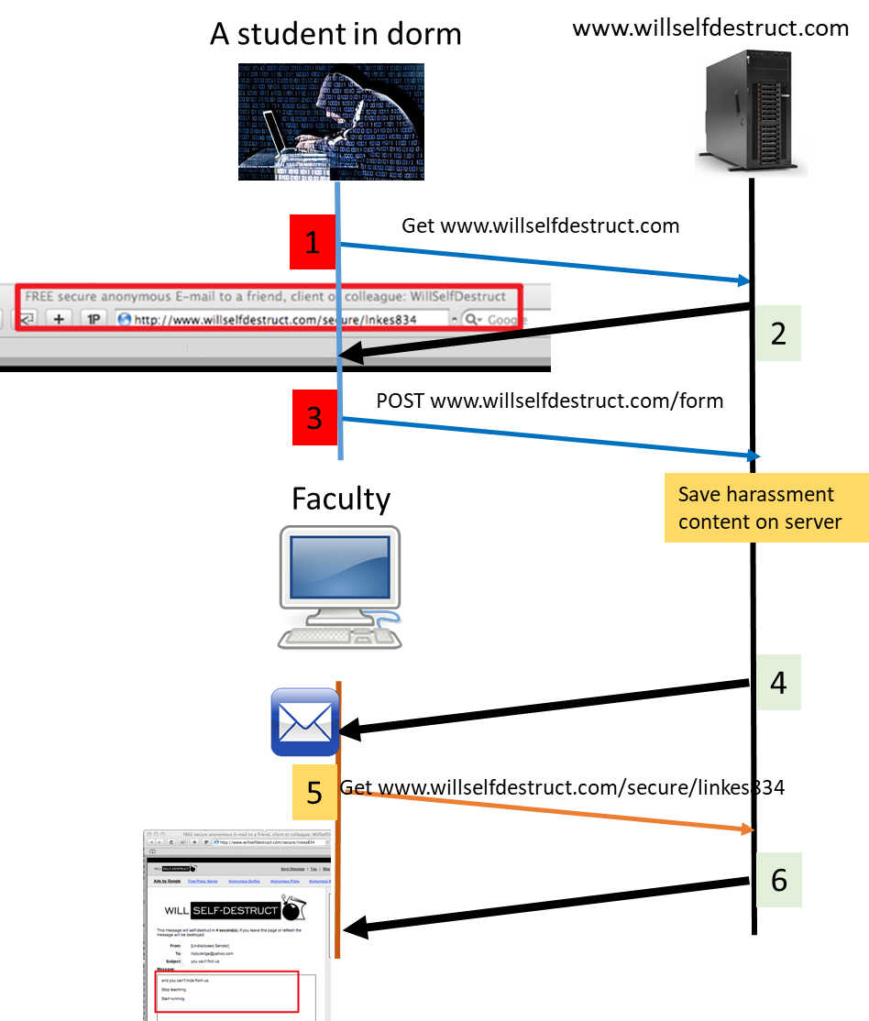
Which IP accessed www.willselfdestruct.com?
The IP is associated with HTTP Requests and Reponses
Is it feasible to find HTTP request ?
No
Is it feasible to find HTTP response ?
Yes (Why, next slide)
1
2
3
1
2

Slide 15
Is it feasible to find HTTP response ?
2
Anyone accessed the website will see the webpage title
Title in .html
<title>FREE secure anonymous E-mail to a friend, client or colleague: WillSelfDestruct</title>
We can search keywords in the title
How?

Slide 16
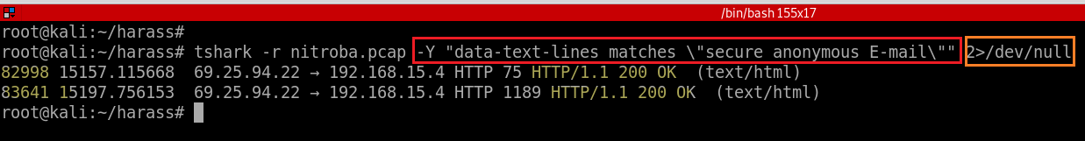
Search title keywords in the .html page
<title>FREE secure anonymous E-mail to a friend, client or colleague: WillSelfDestruct</title>
2>/dev/null : redirect error message
Make conclusion: 69.25.94.22 is the web’s IP and 192.168.15.4 is the suspect’s ID
Notes:
tshark -r nitroba.pcap -Y "data-text-lines matches \"secure anonymous E-mail\"" 2>/dev/null

Slide 17
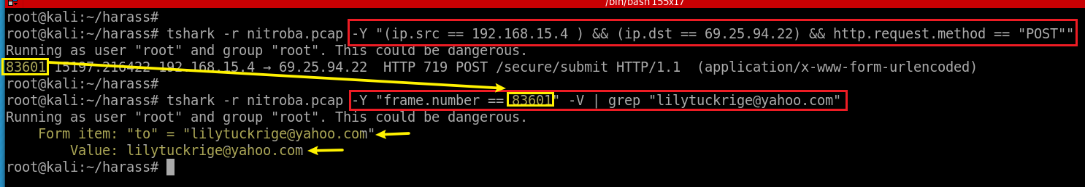
Does the IP post harassing comments to the website?
Search HTTP POST request.
Note: We are only interested in the traffic between 69.25.94.22 (suspect’s IP) and 192.168.15.4 (the web’s IP)
Harassing email founded!
Notes:
(ip.src == 192.168.15.4 ) && (ip.dst == 69.25.94.22) && http.request.method == "POST"

Slide 18
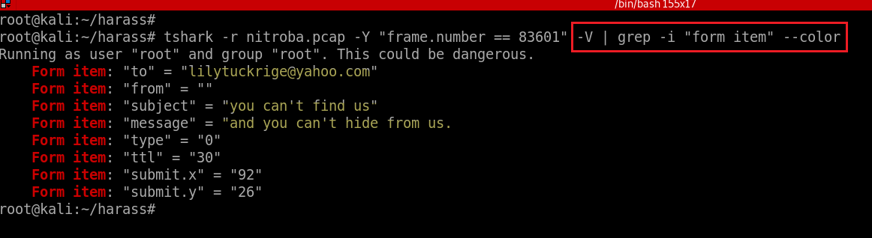
Grep form filled by suspects using key words “form item”
Notes:
tshark -r nitroba.pcap -Y "frame.number == 83601" -V | grep -i "form item" --color

Slide 19
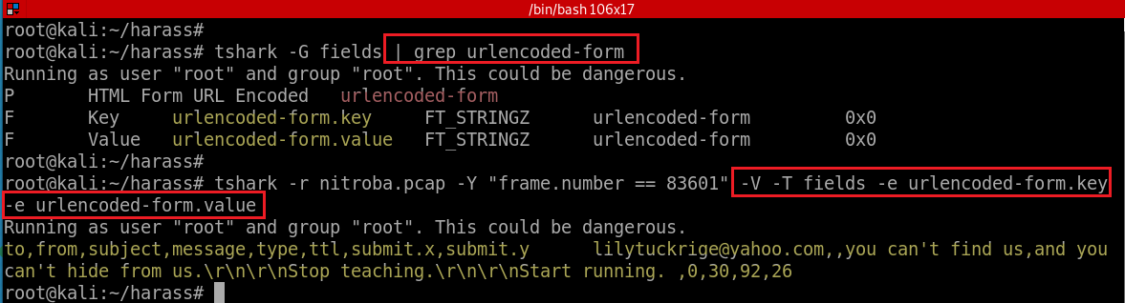
Grep form filled by suspects using field names

Slide 20
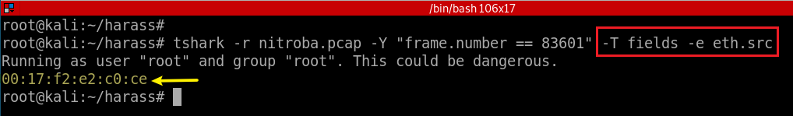
Is the IP associated with any suspects?
No: A few students may use the same IP
Need to find the unique MAC address
Show mac address of packet 83601
Notes:
tshark -r nitroba.pcap -Y "frame.number == 83601" -T fields -e eth.src
00:17:f2:e2:c0:ce

Slide 21
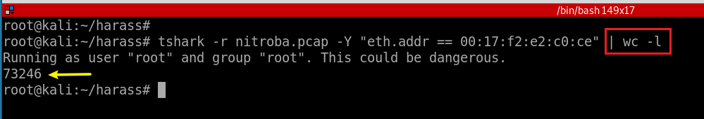
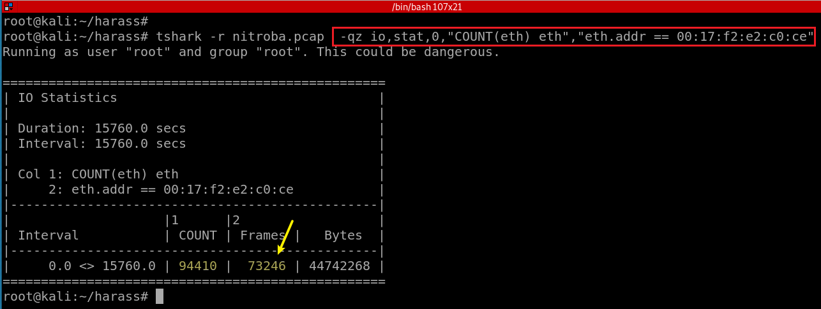
Search all packets sending and receiving by the suspect’s Apple device (Method 1)
Too many packets, need refine the results
(Method 2)
Total Ethernet frame
Ethernet with mac address “00:17:f2:e2:c0:ce”
No space between two filters
Notes:
eth.addr == 00:17:f2:e2:c0:ce
tshark -r nitroba.pcap -qz io,stat,0,"COUNT(frame) frame","eth.addr == 00:17:f2:e2:c0:ce"

Slide 22
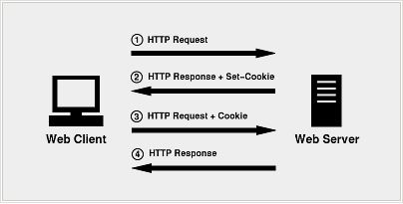
How to connect MAC address with suspect’s ID?
HTTP is a stateless protocol
each request is executed by server independently, without any knowledge of the requests that were executed before it
How to let server remember you?
HTTP cookie (web cookie, browser cookie)
A cookie
Is a small piece of data that a server sends to the user's web browser.
The client browser may store it and send it back with later requests to the same server.
Notes:
eth.addr == 00:17:f2:e2:c0:ce && http.cookie contains "@"

Slide 23
Purpose of Cookies
Session management
Logins, shopping carts, game scores, or anything else the server should remember
Personalization
User preferences, themes, and other settings
Tracking
Recording and analyzing user behavior
We may be able to find suspects’ profiles from Cookies!
Notes:
eth.addr == 00:17:f2:e2:c0:ce && http.cookie contains "@"

Slide 24
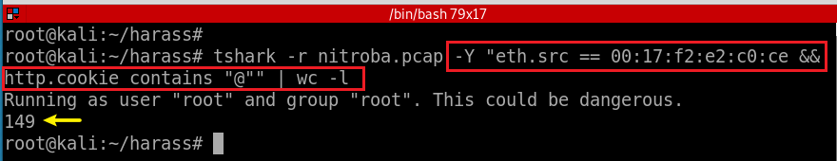
Narrow down the search result using cookie
@ hopefully cookies have email information.
Notes:
tshark -r nitroba.pcap -Y "eth.src == 00:17:f2:e2:c0:ce && http.cookie contains "@""

Slide 25
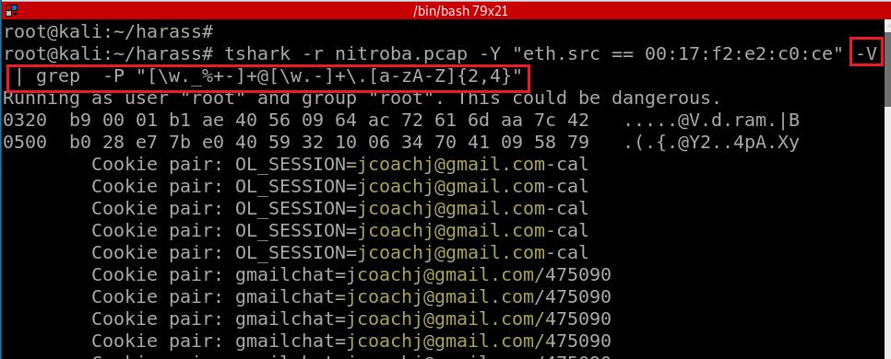
Search all email associated with the mac address
[\w-] is the same as [A-Za-z0-9_-]
Notes:
tshark -r nitroba.pcap -Y "eth.src == 00:17:f2:e2:c0:ce" -V | grep -P "[\w._%+-]+@[\w.-]+\.[a-zA-Z]{2,4}"

Slide 26
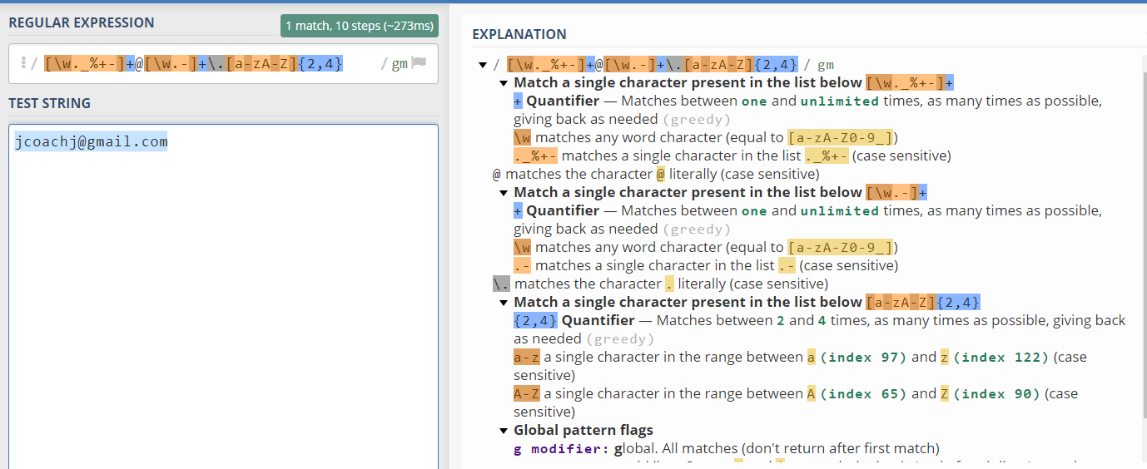
https://regex101.com/

Slide 27
Is the suspect in faculty’s class?
Teacher: Lily Tuckrige
Students:
Amy Smith
Burt Greedom
Tuck Gorge
Ava Book
Johnny Coach
Jeremy Ledvkin
Nancy Colburne
Tamara Perkins
Esther Pringle
Asar Misrad
Jenny Kant

Slide 28
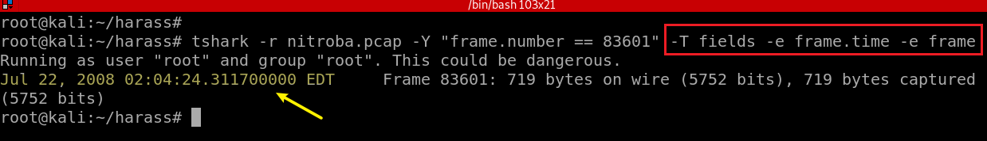
When did the suspect use www.willselfdestruct.com?
Show the form submitted time in EDT
Notes:
tshark -r nitroba.pcap -Y "frame.number == 83601" -T fields -e frame.time -e frame

Slide 29
Other helpful filters
http.set_cookie
ip.dst == 192.168.15.4
http.user_agent == "Mozilla/4.0 (compatible; MSIE 6.0; Windows NT 5.1; SV1)“
http.request.uri contains "?"
http.request.method=="POST"

