Slide 1
Disable Security Setting

Slide 2
How to Disable Windows 10 Virus Protection?

Slide 3
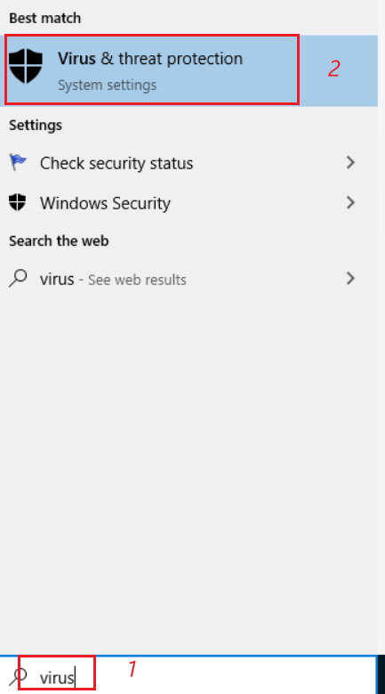
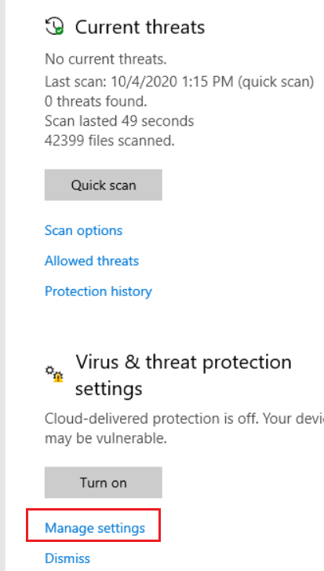
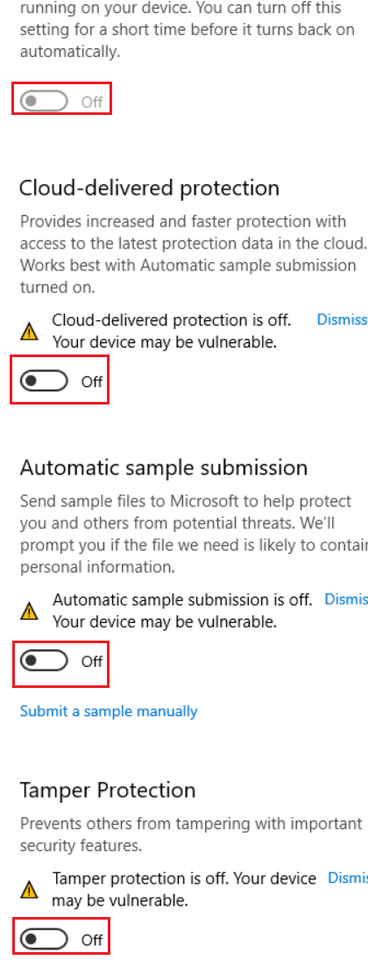

Slide 4
How Disable Chrome Security Setting?

Slide 5
