Slide 1
Kali 2020 Installation and Configuration
Notes:
https://www.youtube.com/watch?v=SsUXQHHmTNc&t=966s

Slide 2
Installation

Slide 3
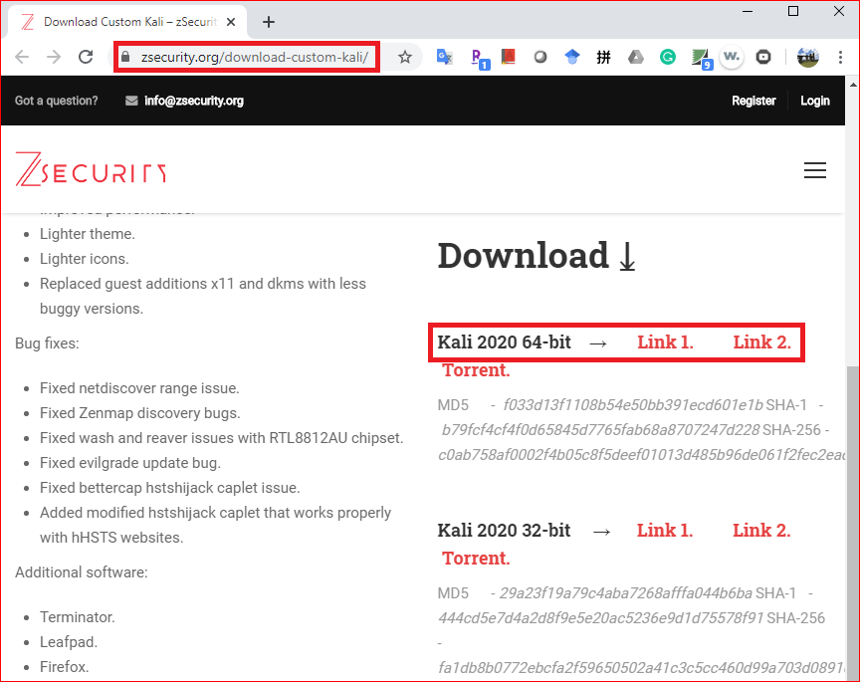
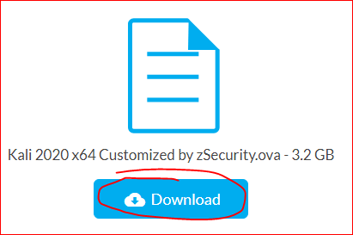
Download Kali from https://zsecurity.org/download-custom-kali

Slide 4
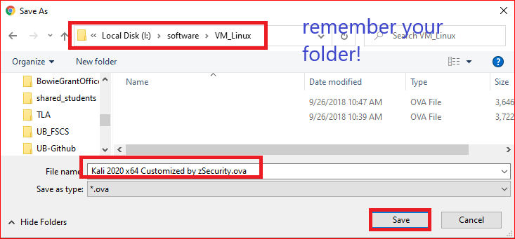
Save to any folder

Slide 5

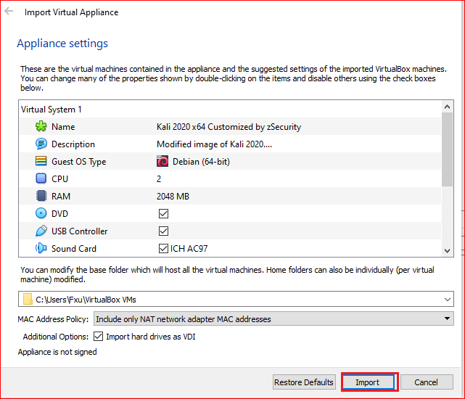
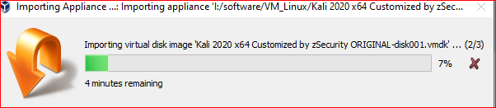
Run the .ova
Import .ova
Waiting for importing

Slide 6
Configuration

Slide 7
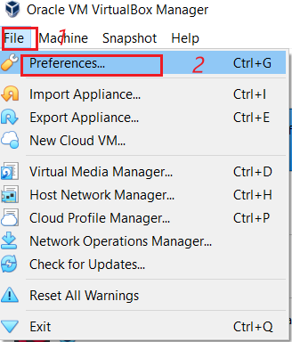
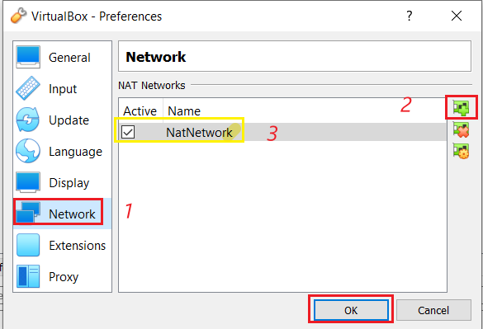
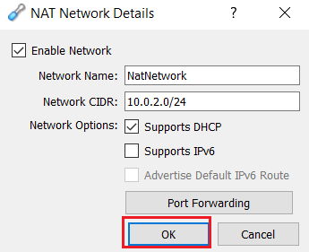
Change VirtualBox Preference
Set VirtualBox Preference
Set NatNetwork Preference
Verify Network

Slide 8
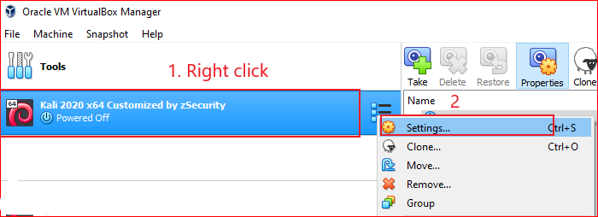
Change Kali Setting

Slide 9
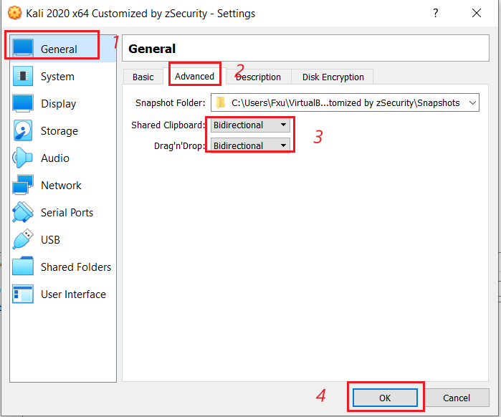


Enable copy and paste between VM and host
If clipboard doesn’t work

Slide 10
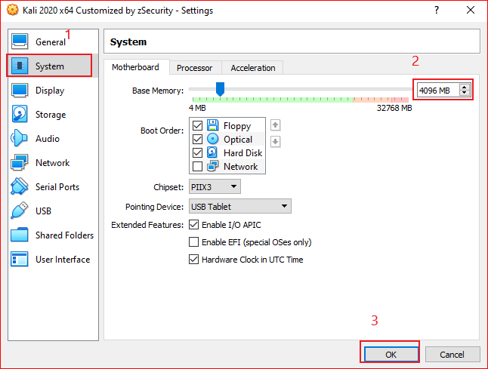
Set Kali memory

Slide 11
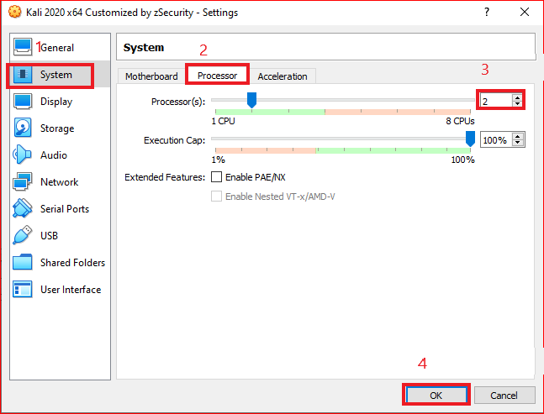
Set Kali Process

Slide 12
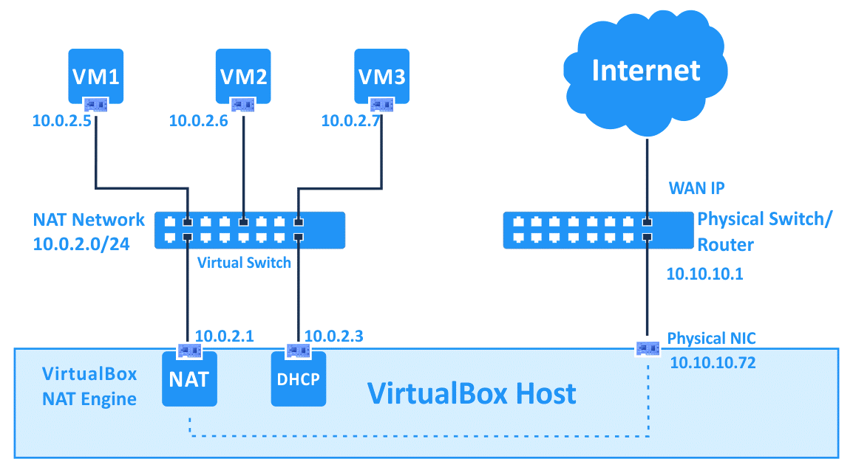
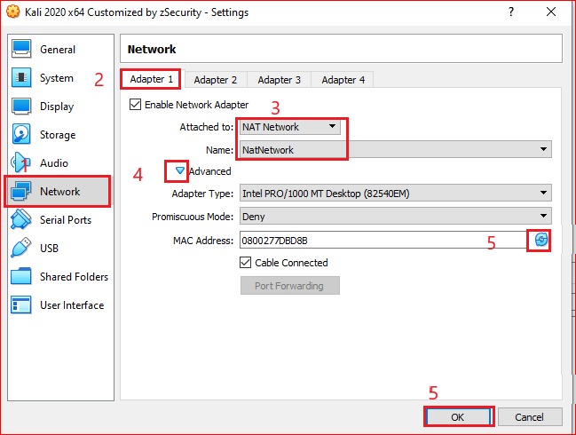
Set Kali network
Notes:
https://www.nakivo.com/blog/virtualbox-network-setting-guide

Slide 13
Start Kali

Slide 14
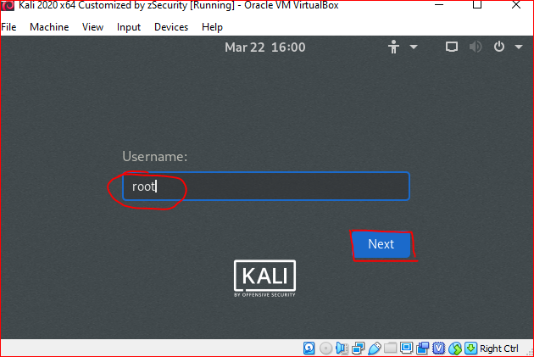
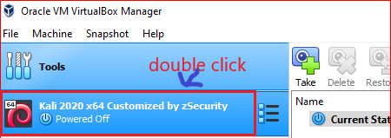
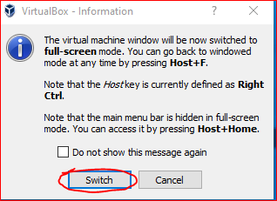
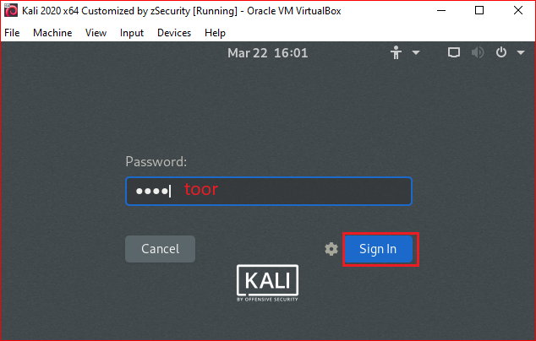
Log in
Start Kali

Slide 15
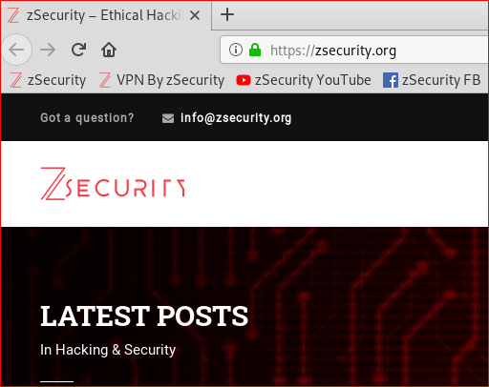
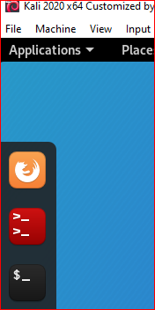
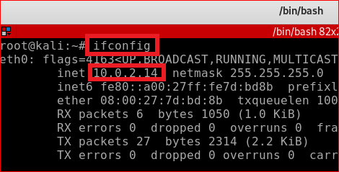
Test all settings
Verify Internet
Check IP
Your PC IP maybe different

Slide 16
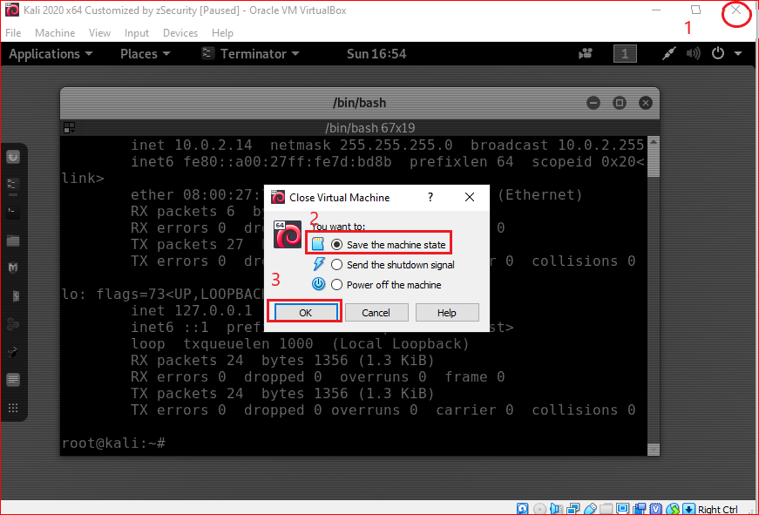
Shut down Kali: save the machine state

Slide 17
Snapshots

Slide 18
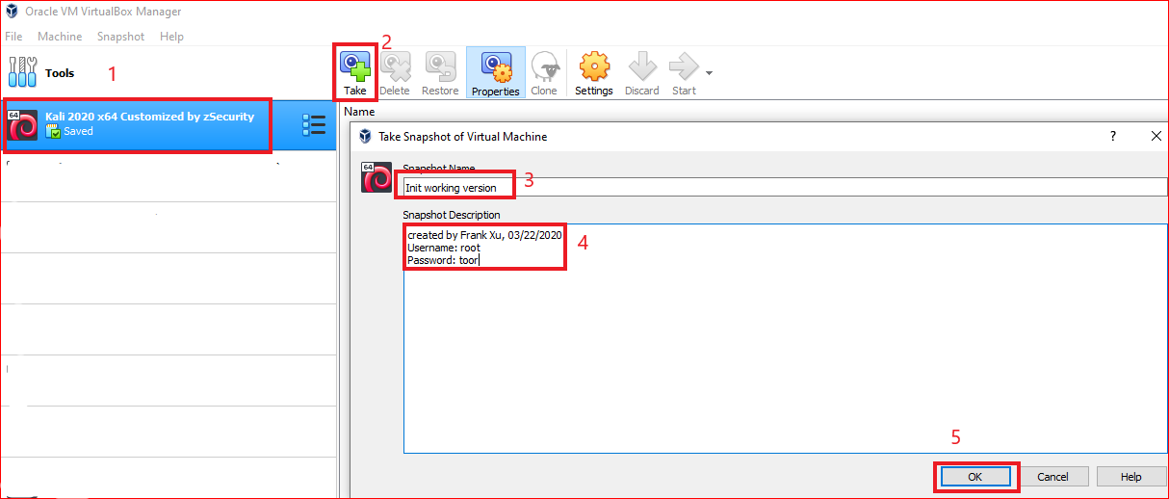
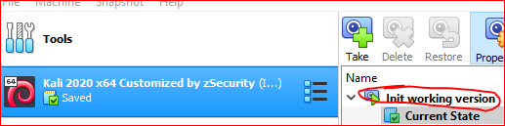
Take the first snapshot and write notes
Results

Slide 19
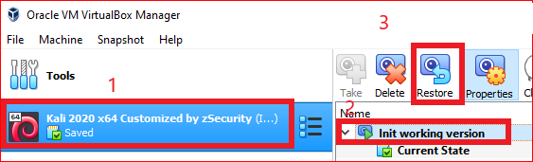
Restore a snapshot

