Slide 1
Tools Installation

Slide 2
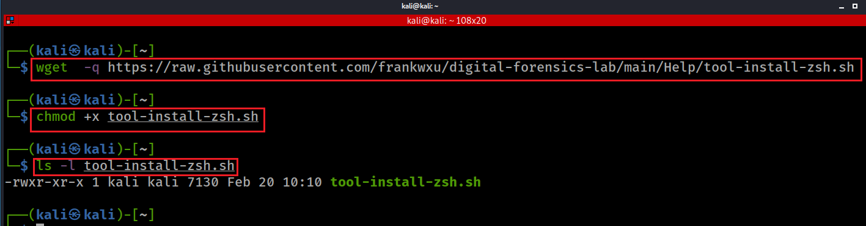
Notes:
wget https://raw.githubusercontent.com/frankwxu/digital-forensics-lab/main/Help/tool-install-zsh.sh
chmod +x tool-install-zsh.sh
ls -l tool-install-zsh.sh

Slide 3
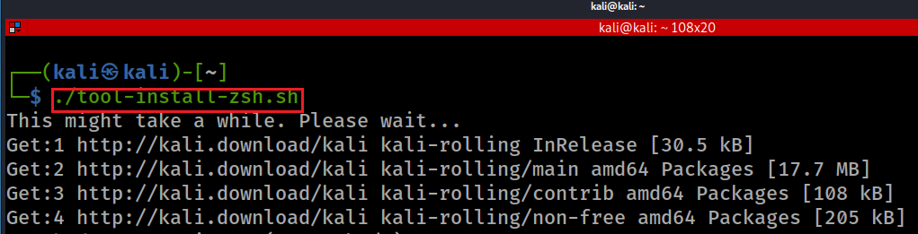
Press “enter” till you see the next screen.
Notes:
./tool-install-zsh.sh

Slide 4
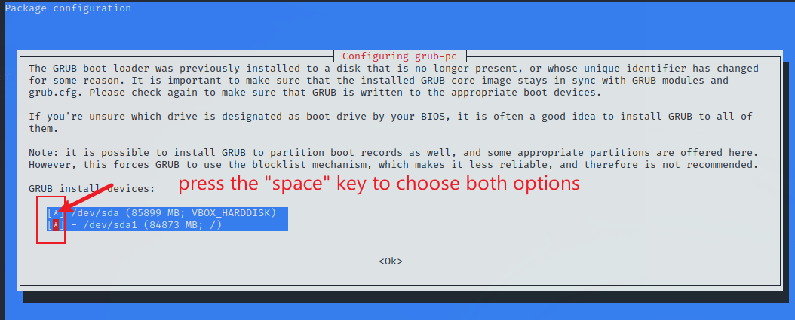
Press enters till you see the following screen. Provide password if necessary

Slide 5
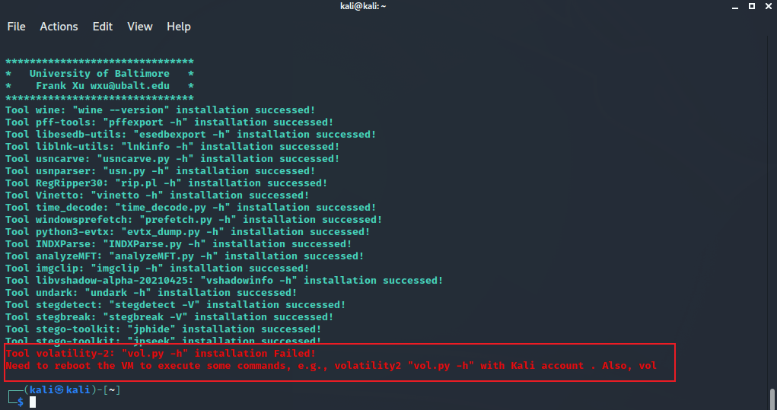
Show installation report and command line for list tools installed
Notes:
Tool wine: "wine --version" installation successed!
Tool pff-tools: "pffexport -h" installation successed!
Tool libesedb-utils: "esedbexport -h" installation successed!
Tool liblnk-utils: "lnkinfo -h" installation successed!
Tool usncarve: "usncarve.py -h" installation successed!
Tool usnparser: "usn.py -h" installation successed!
Tool RegRipper30: "rip.pl -h" installation successed!
Tool Vinetto: "vinetto -h" installation successed!
Tool time_decode: "time_decode.py -h" installation successed!
Tool windowsprefetch: "prefetch.py -h" installation successed!
Tool python3-evtx: "evtx_dump.py -h" installation successed!
Tool INDXParse: "INDXParse.py -h" installation successed!
Tool analyzeMFT: "analyzeMFT.py -h" installation successed!
Tool imgclip: "imgclip -h" installation successed!
Tool undark: "undark -h" installation successed!
Tool stegdetect: "stegdetect -V" installation successed!
Tool stegbreak: "stegbreak -V" installation successed!
Tool stego-toolkit: "jphide" installation successed!
Tool stego-toolkit: "jpseek" installation successed!

Slide 6

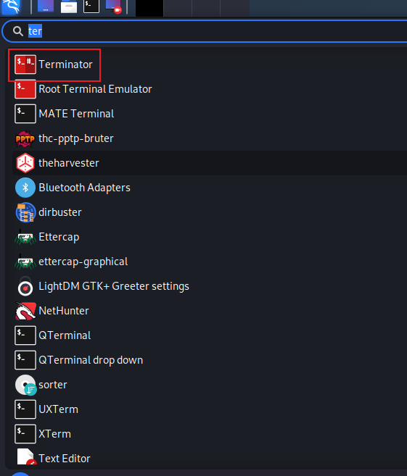
Reboot
Open a boot terminator

Slide 7
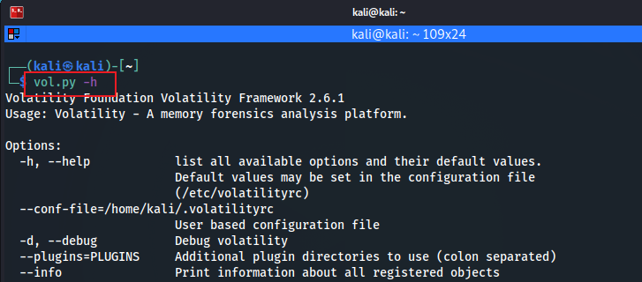
volatility 2 only works for Kali account (not root)

