Slide 1
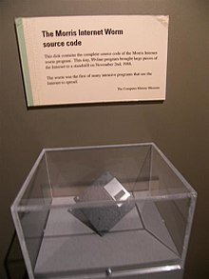
Morris Worm Attack

Slide 2
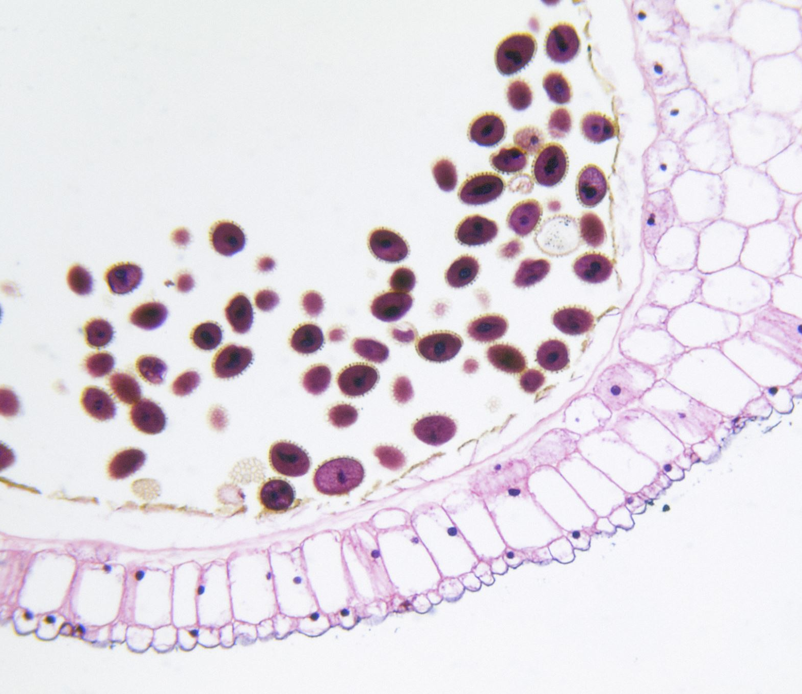
Overview
What is Morris Worm?
How to demonstrate the attack?
Morris Worm lab
Setup VM https://github.com/seed-labs/seed-labs/blob/master/manuals/vm/seedvm-manual.md
Credits https://seedsecuritylabs.org/Labs_20.04/Networking/Morris_Worm/

Slide 3
What is Morris Worm?
http://www.loundy.com/CASES/US_v_Morris2.html
A malware was developed by Robert Tappan MORRIS,
was a first-year graduate student in Cornell University's computer science Ph.D. program
did undergraduate work at Harvard
a tenured professor at MIT in 2006
had a Unix account the Cornell
Morris’ goal
a program can self-spread across a national network of computers after being inserted at one computer location connected to the network
not destructive
demonstrate the inadequacies of current security measures on computer networks by exploiting the security defects that he had discovered

Slide 4
Attacking Method
through a "hole" or "bug" (an error) in sendmail
a computer program that transfers and receives electronic mail on a computer
through a bug in the "finger deamon" program
a program that permits a person to obtain limited information about the users of another computer
through the "trusted hosts" feature
which permits a user with certain privileges on one computer to have equivalent privileges on another computer without using a password; and
through a program of password guessing,
whereby various combinations of letters are tried out in rapid sequence in the hope that one will be an authorized user's password, which is entered to permit whatever level of activity that user is authorized to perform.

Slide 5
Morris Worm vs. Ransomware
non-destructive vs. asking ransom fee
The techniques are still the same
exploit vulnerabilities
self-duplication
self-spreading

Slide 6
How to demonstrate the attack?
A virtual lab design by Wenliang Du at Syracuse university in 2021
Running on an Internet emulator
A simplified version writing in Python

Slide 7


attacking machine
Victim
1 create badfile
if there is no badfile
4 sending worm.py
2 send badfile to another machine via buffer overflow attack
3 code in badfile is executed
waiting for worm.py and execute it
5 get worm.py running forever
worm.py
worm.py + exe permission

Slide 8
Characters of Du’s worm.py
Exploit buffer overflow vulnerability
with a crafted badfile containing shellcode and commands
Use shellcode
to gain the control of victim’s machines
Use commands
Receive worm.py at victim’s machines in Bash Shell sent by attacking machines
Ensures only one copy of worm.py is running
keeps spreading from attack machine to victim machines and being executed
tests the exists of badfile to identify whether a victim has been infected
if true, it assume other worm.py is running and kills itself

Slide 9

Morris Worm lab
Please follow https://seedsecuritylabs.org/Labs_20.04/Files/Morris_Worm/Morris_Worm.pdf

Slide 10
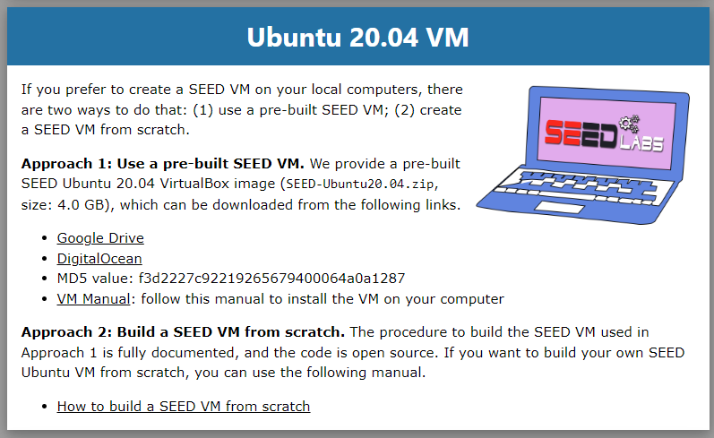
Download Ubuntu Image
Notes:
https://seedsecuritylabs.org/labsetup.html

Slide 11
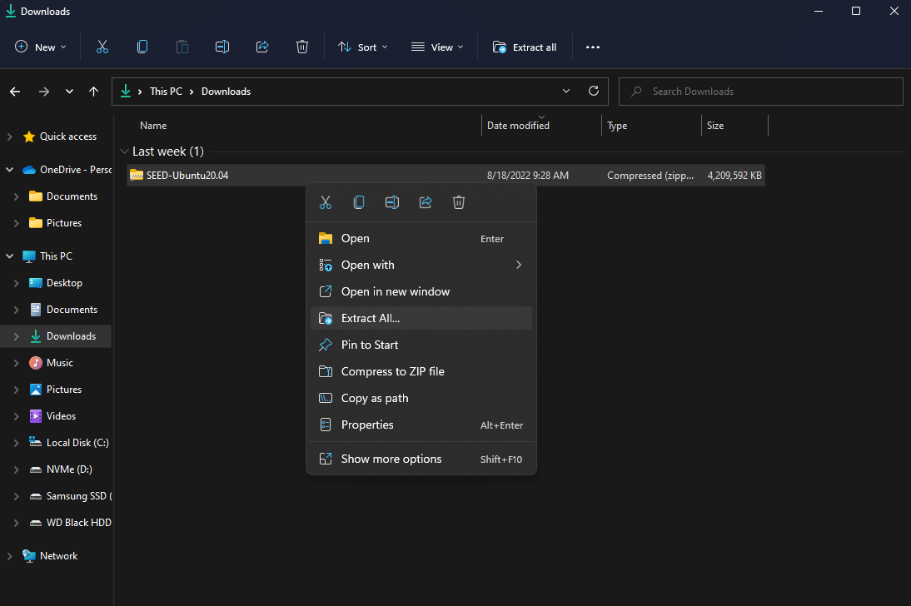
Extract zip file

Slide 12
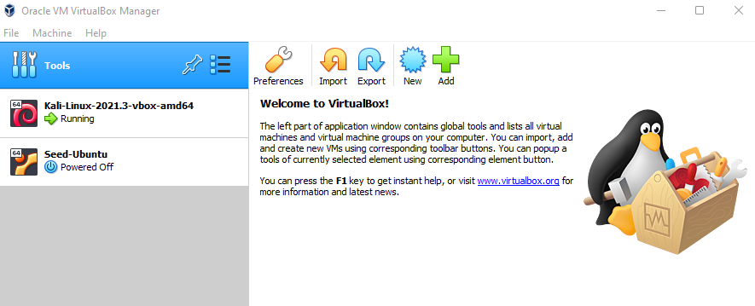
Open Oracle VM VirtualBox Manager

Slide 13
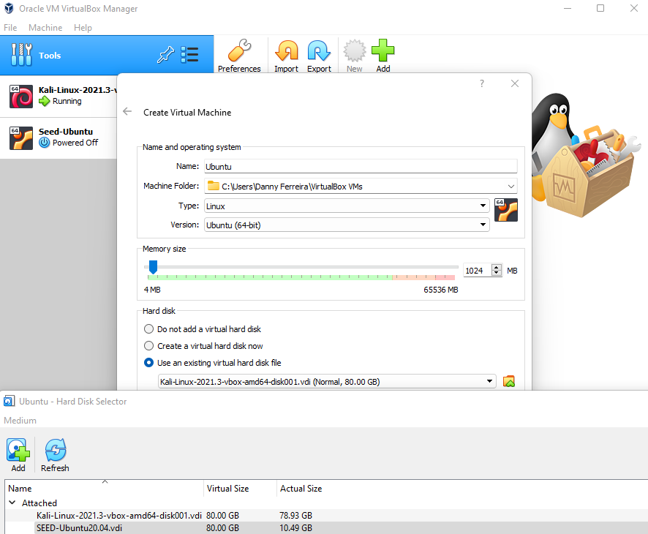
1: Select Use an existing virtual hard disk file.
2: Select folder icon to browse files.
3: Point to SEED-Ubuntu20.04.vdi
4: Click Finish
2
1
3

Slide 14
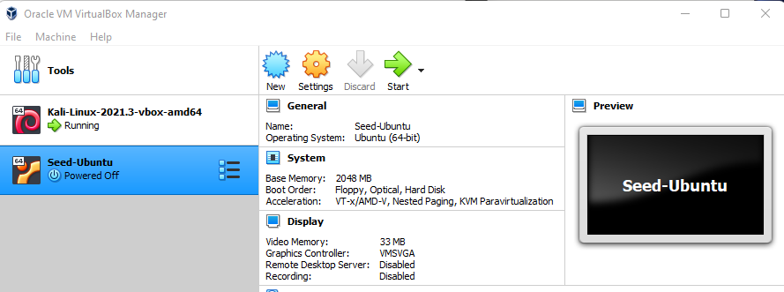
Click start to launch

Slide 15
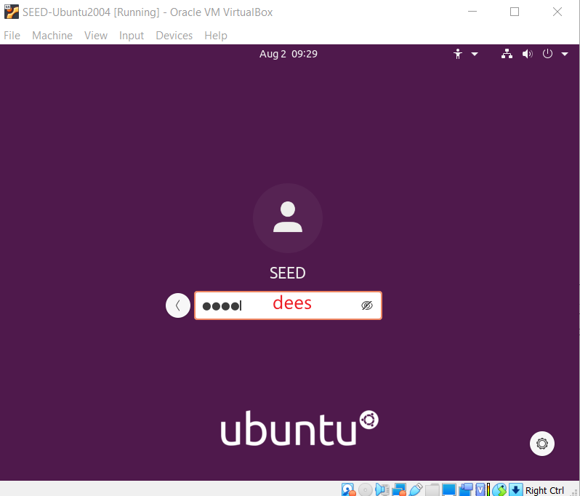

Slide 16
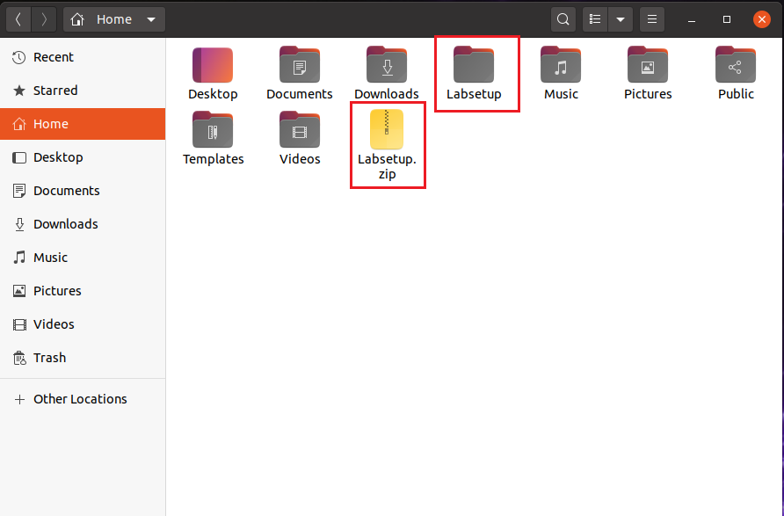
Download lab files

Slide 17
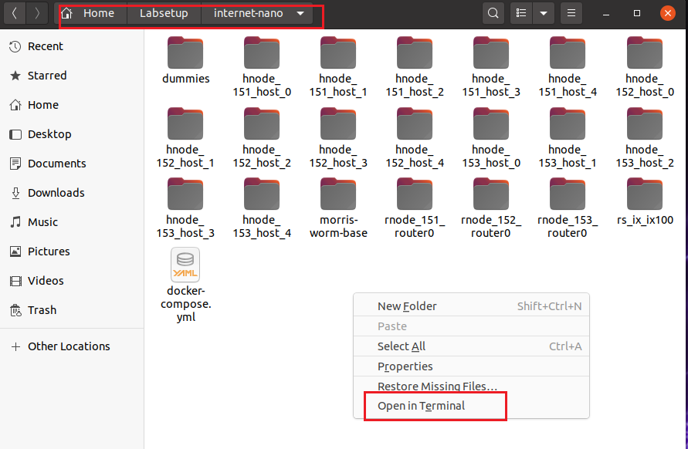

Start nano internet

Slide 18
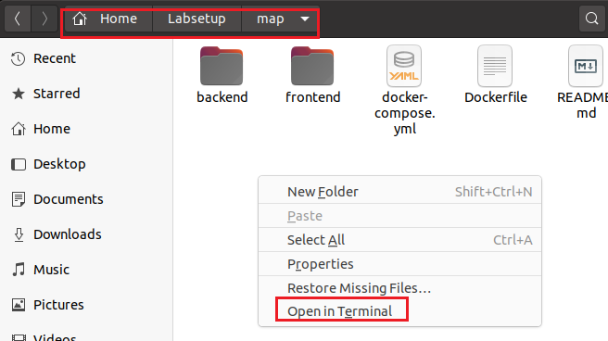

Start internet map for visualization

Slide 19
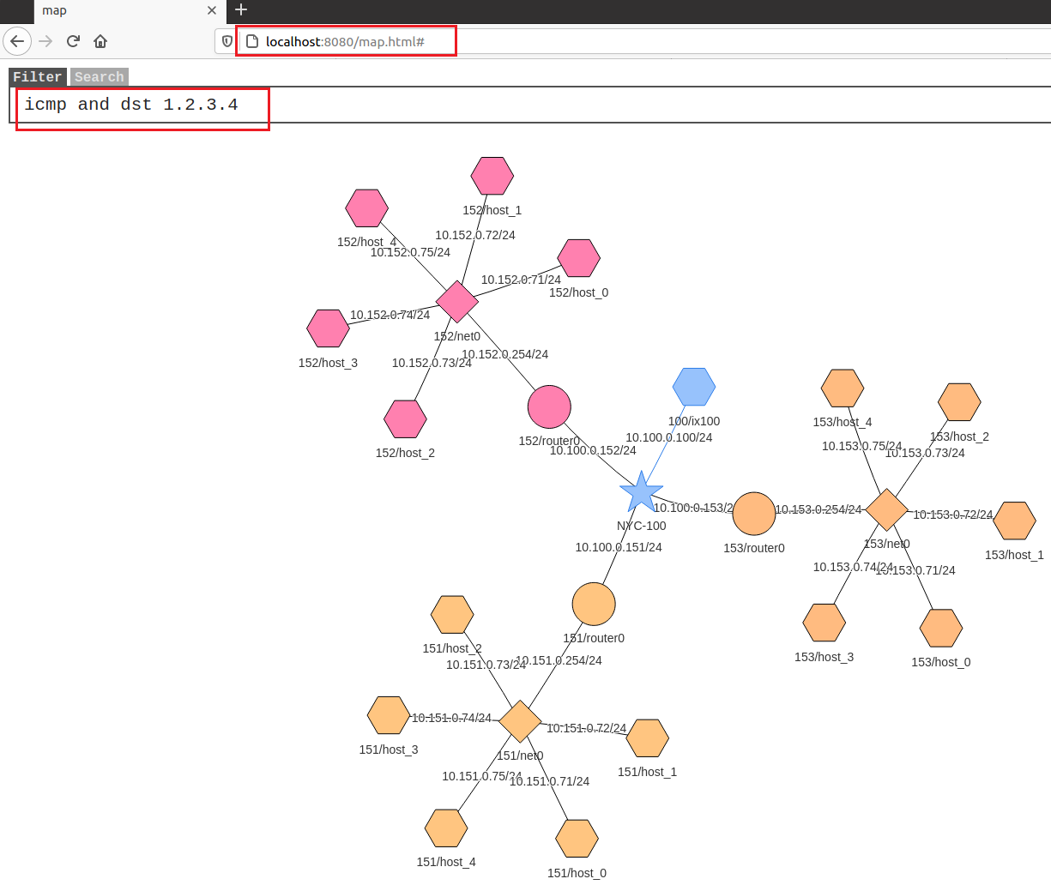
Open Firefox and visit localhost:8080/map.html#
once a host is infected, we run "ping 1.2.3.4", so the node
corresponding to the host can flash on the map.
10.X.0.Y
X = [151-153]
Y = [71 - 75]
Notes:
icmp and dst 1.2.3.4

Slide 20
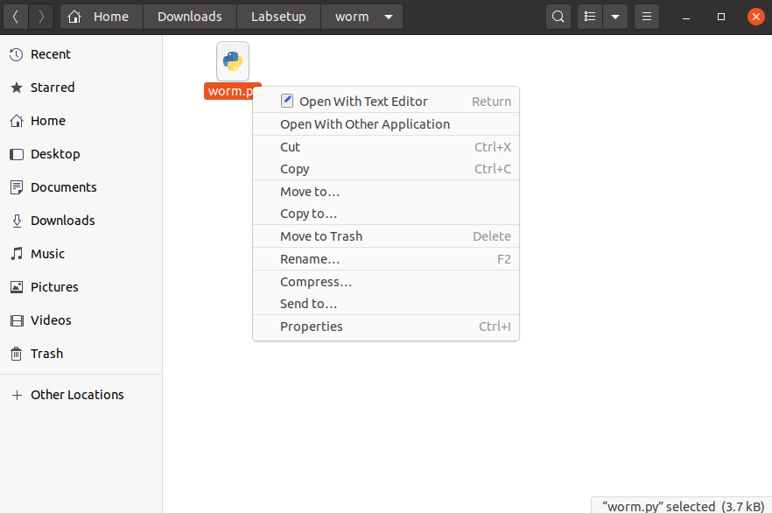
Open worm.py and replace original code from Instructor
Notes:
https://ubalt-my.sharepoint.com/personal/id31ga53_ubalt_edu/_layouts/15/onedrive.aspx?id=%2Fpersonal%2Fid31ga53%5Fubalt%5Fedu%2FDocuments%2FUBal%2Fresearch%2FDOJ%2FDOJ%5FTeam%5FRepositoy%2FDOJ%5FCase%5FStudy%2F14%5FMorris%2Fseedmanuals%2FMorris%5FWorm

Slide 21
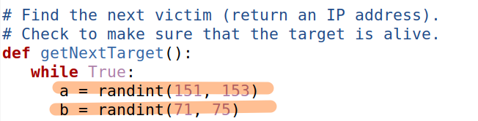
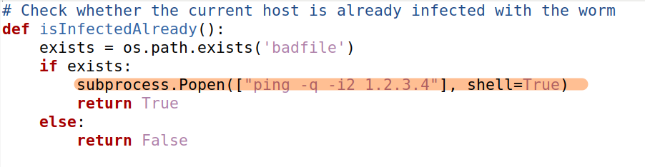
Review attacking code
Make sure generate valid IPs for attacking automatically
Visualizing attacked hosts even the badfile exists
Notes:
a = randint(151, 153)
b = randint(71, 75)
subprocess.Popen(["ping -q -i2 1.2.3.4"], shell=True)

Slide 22
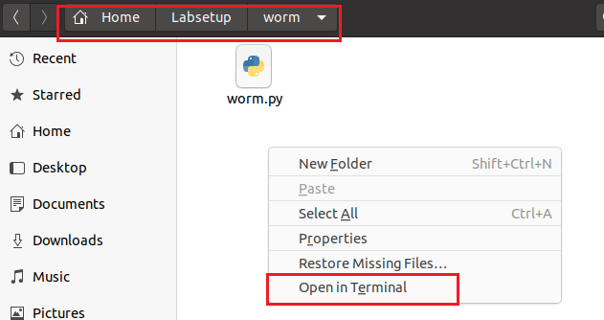
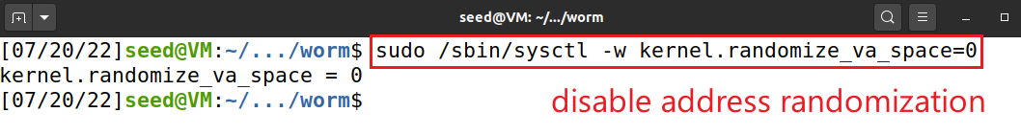
Start attack
Notes:
sudo /sbin/sysctl -w kernel.randomize_va_space=0

Slide 23
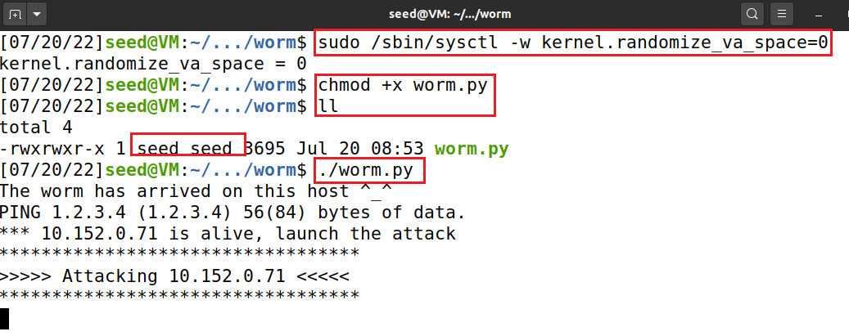
Notes:
sudo /sbin/sysctl -w kernel.randomize_va_space=0

Slide 24
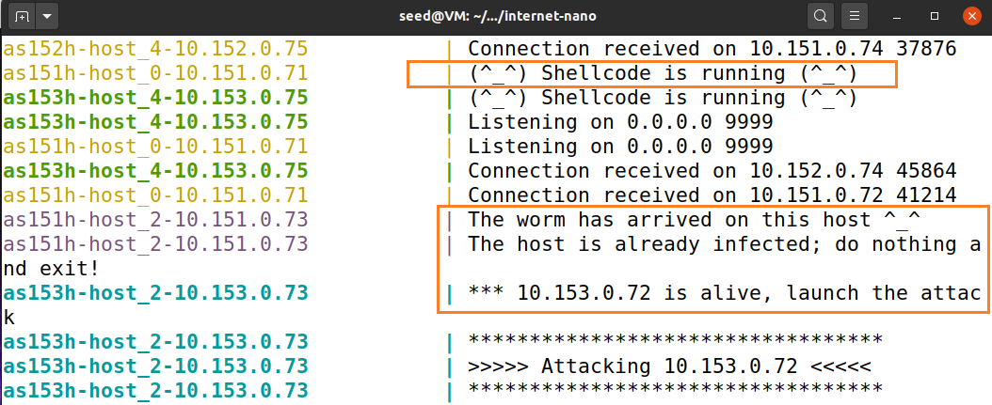

Slide 25
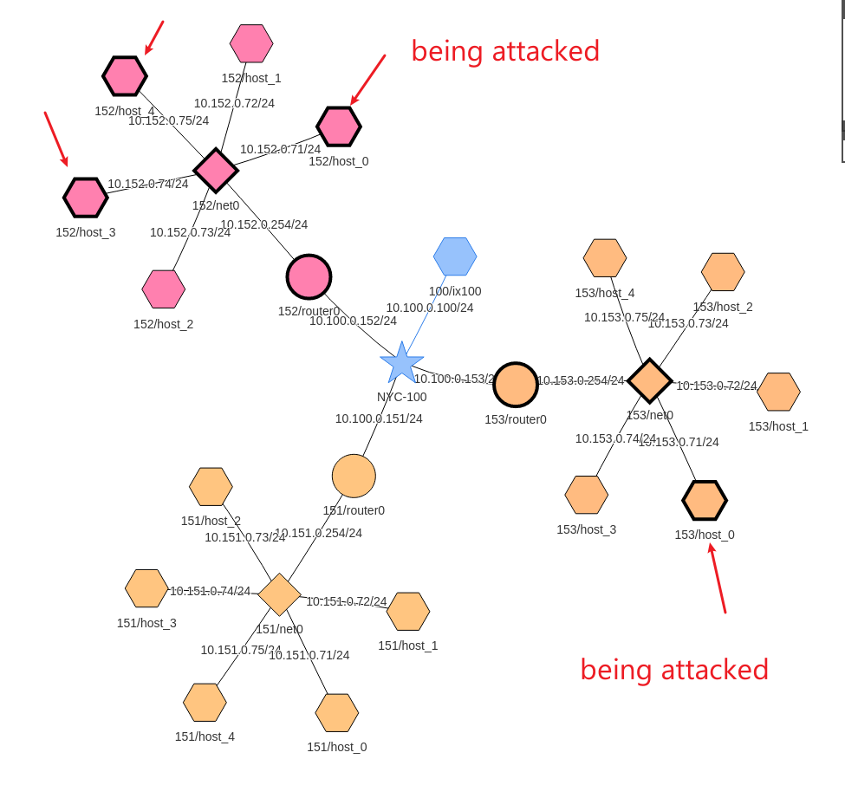

Slide 26
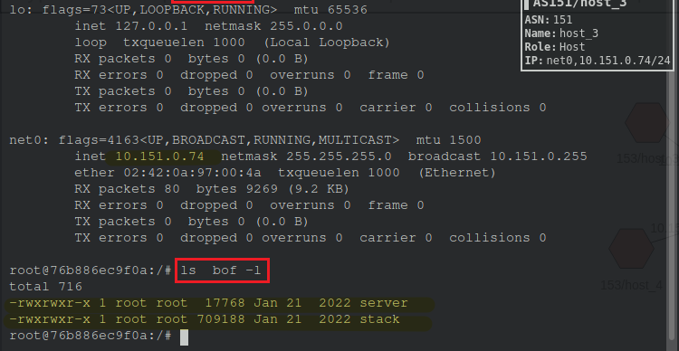

Slide 27
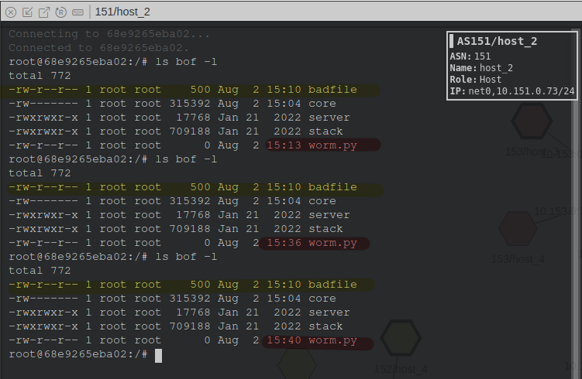
badfile doesn’t change
worm.py keeps changing

