Slide 1

Morris Worm Investigations

Slide 2
Overview
Analyze network ports used by worm
Analyze worm running processes
Create a timeline with file timestamps

Slide 3

Analyze network ports used by worm

Slide 4
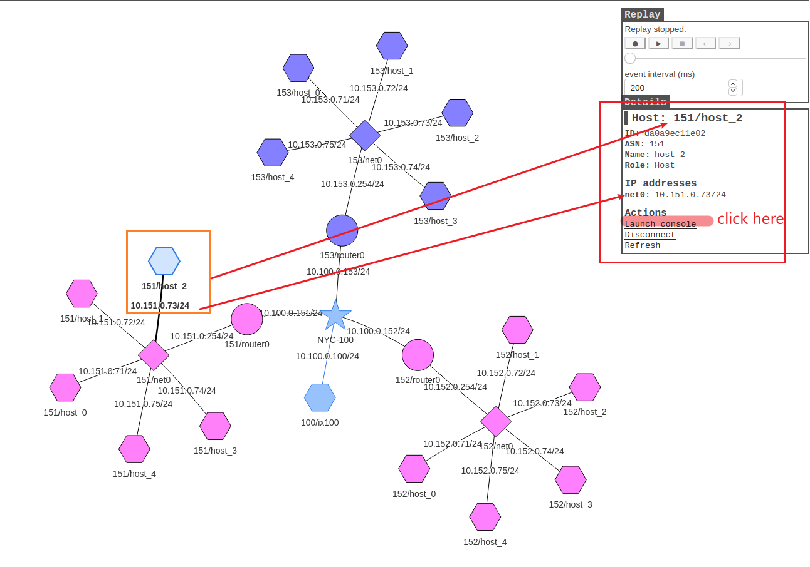

Slide 5
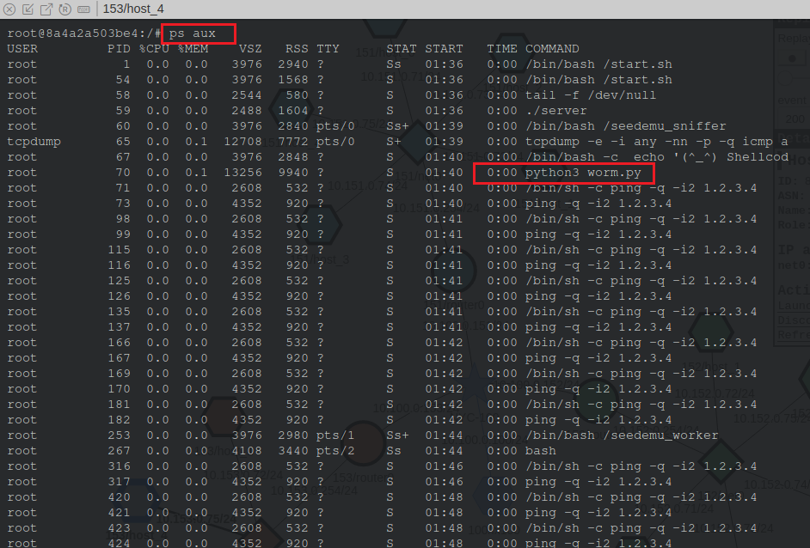
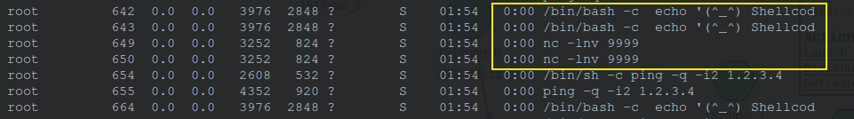
Check processes
worm.py process
listening to port 9999

Slide 6
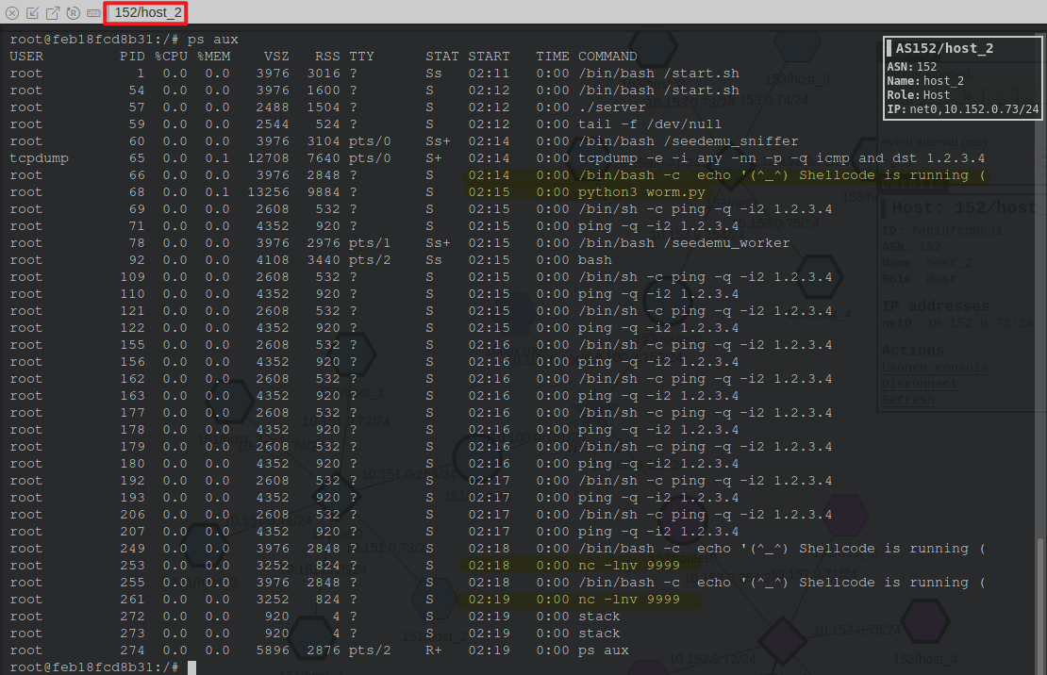
Another machine

Slide 7

Analyze worm running processes

Slide 8
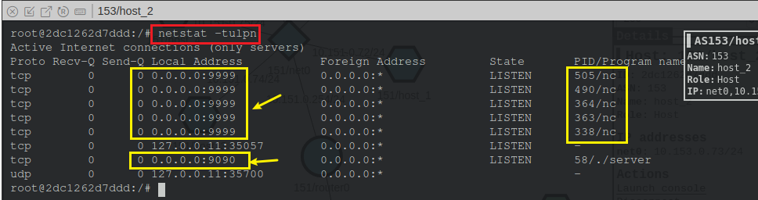
What ports are listening?
nc command
listen to port 9999
Notes:
netstat -tulpn | grep LISTEN

Slide 9
Create a timeline with file timestamps

Slide 10
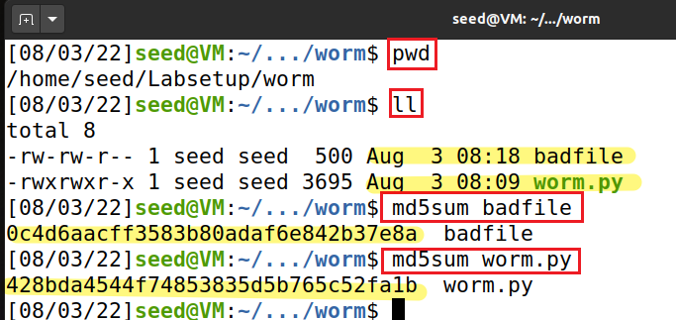
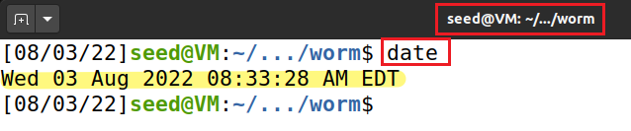
Check attack files hash code
Check time zone
The investigation date/EDT

Slide 11
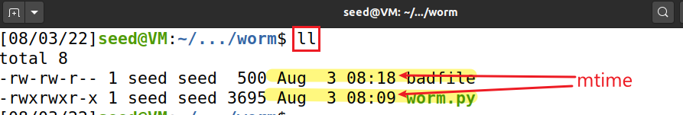
Check time stamps
Changes C
 | File Contents are Modified | Metadata is Modified | File Accessed | Command to Use
mtime | C |  |  | ls -l or stat
ctime |  | C |  | ls -cl or stat
atime |  |  | C | ls -ul or stat
Note that changes of mtime may change ctime and atime as well.

Slide 12
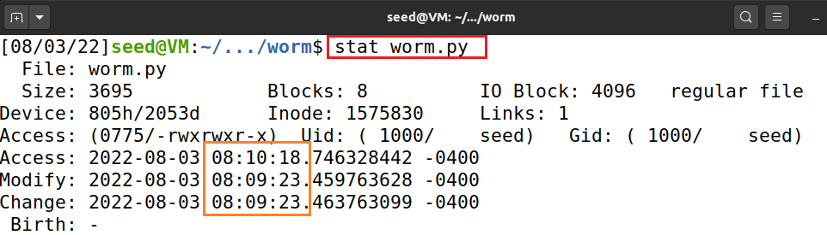
Check time stamps of worm.py
worm.py
A user changed content on 2022-8-3 08:09:23
Accessed on 55 second later (e.g., read file)

Slide 13
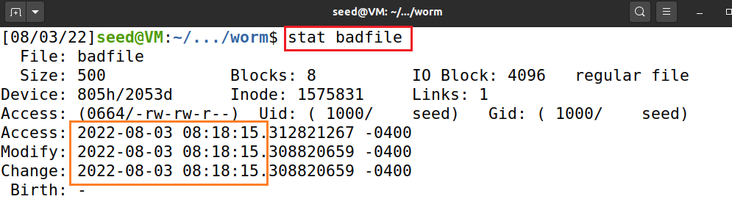
Check time stamps of badfile
badfile
created on 2022-08-03 08:18:15
because badfile was created
worm.py last time modified
worm.py was read
worm.py was executed
2022-8-3 08:09:23
08:10:18AM
08:18:15AM

Slide 14
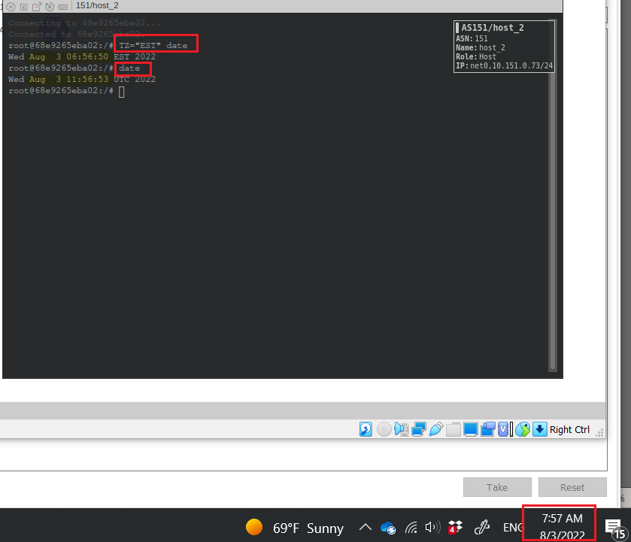
The server time is incorrect! One hour late.
Notes:
5 hours

Slide 15
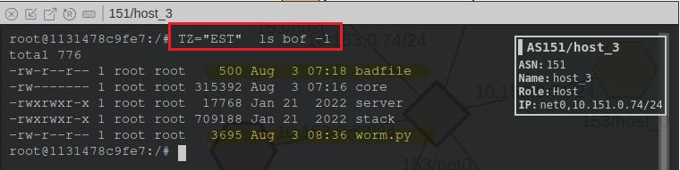
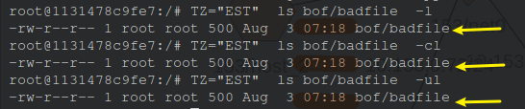
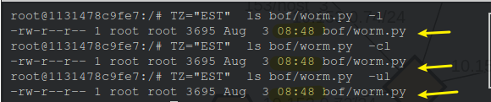
remember +1 hour
Notes:
TZ=“EST” ls bof -l

Slide 16




Attack Machine
Victim Machine
worm.py (the first time) was received/executed
worm.py (again) was received /executed/stopped
worm.py (the last time) was modified
worm.py was read
worm.py was executed
badfile was created
2022-8-3 08:09
08:10AM
09:36AM
~08:18AM
overwrites

Slide 17
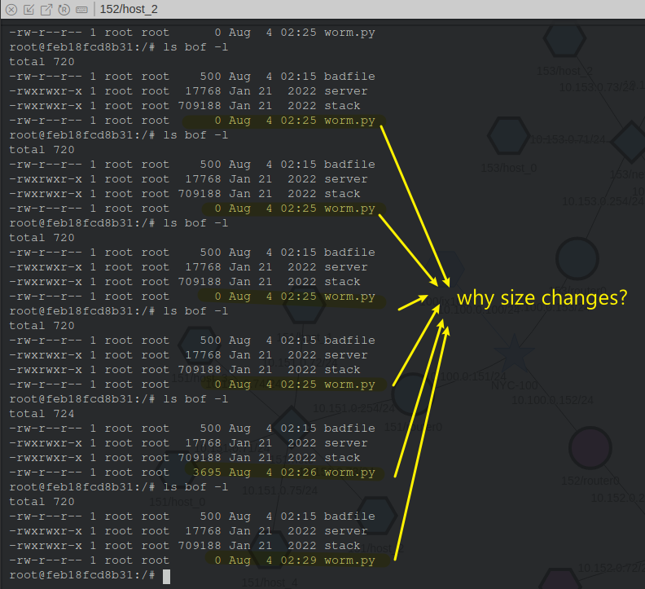
Question

