Slide 1

Setting Up an Initial Lab Environment
Case Image is provided by NIST
Notes:
https://www.cfreds.nist.gov/data_leakage_case/data-leakage-case.html

Slide 2
Overview
Install Kali (Optional)
Get the NIST data leakage case DD image
Exam files in the DD image
Extract registry files from the DD Image
Extract prefetched event log files from the DD Image
Extract security event log files from the DD Image
Install tree, Install RegRipper 3.0, Windows-Prefetch-Parser
Notes:
sudo su

Slide 3
Install Kali

Slide 4
Download and installation instructions
https://github.com/frankwxu/digital-forensics-lab
Read Tool installation section

Slide 5

Get the NIST data leakage case image

Slide 6
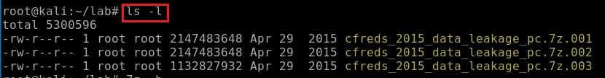
How to download the DD image?
Download DD images. See notes if the link expired
Repeat wget command to download .002 and .003
https://cfreds-archive.nist.gov/data_leakage_case/images/pc/cfreds_2015_data_leakage_pc.7z.001
https://cfreds-archive.nist.gov/data_leakage_case/images/pc/cfreds_2015_data_leakage_pc.7z.002
https://cfreds-archive.nist.gov/data_leakage_case/images/pc/cfreds_2015_data_leakage_pc.7z.003
Verify three zipped files
Notes:
Backup links
https://www.dropbox.com/s/u4axlx8eomgwfdc/cfreds_2015_data_leakage_pc.7z.001
https://www.dropbox.com/s/pyq50s2cri6yftf/cfreds_2015_data_leakage_pc.7z.002
https://www.dropbox.com/s/cxvzuiupmqc7l99/cfreds_2015_data_leakage_pc.7z.003

Slide 7
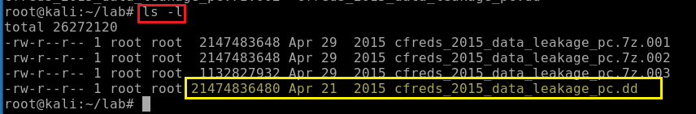
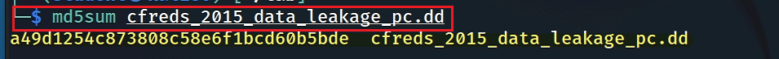
unzipped the DD image
Verify the unzipped DD image
Verify the unzipped DD image with MD5
Notes:
7z e cfreds_2015_data_leakage_pc.7z.001

Slide 8

Exam files in the DD image

Slide 9
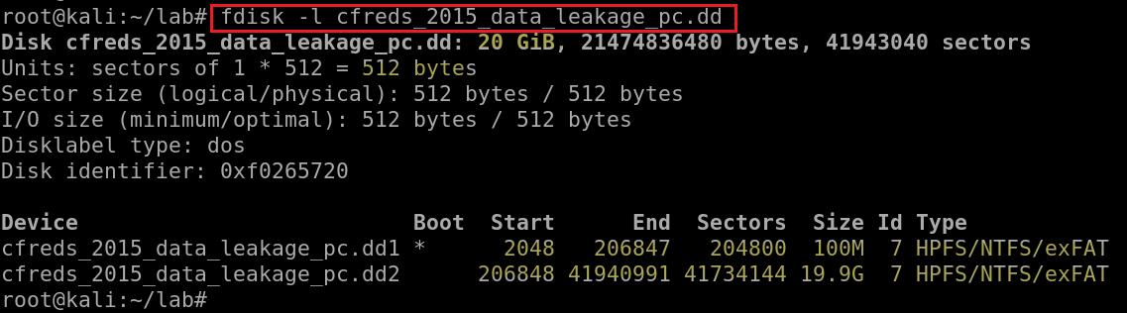
Which partition is the system volume?
Exam partitions of the DD image using fdisk (format disk)
"boot" volume: bootstrap
"system" volume: the remainder of an operating system
Notes:
http://blog.hakzone.info/posts-and-articles/linux/disk-analysis-with-fdisk-mmls-fsstat-and-fls/
Block devices are characterized by random access to data organized in fixed-size blocks. Examples of such devices are hard drives, CD-ROM drives, RAM disks, etc.
fdisk also known as format disk is a dialog-driven command in Linux used for creating and manipulating disk partition table. It is used for the view, create, delete, change, resize, copy and move partitions on a hard drive using the dialog-driven interface.
fdisk -l cfreds_2015_data_leakage_pc.dd

Slide 10
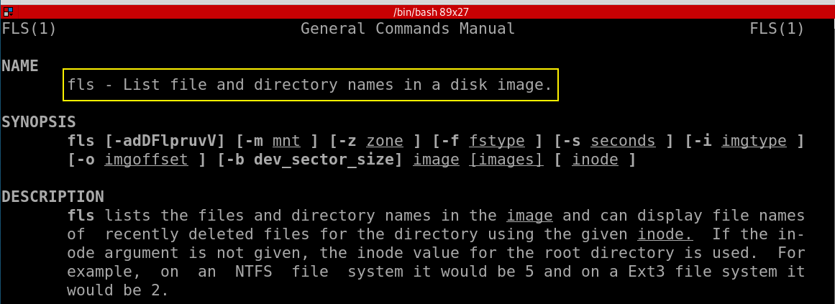
Which command to list file/directory names in a system volume?

Slide 11
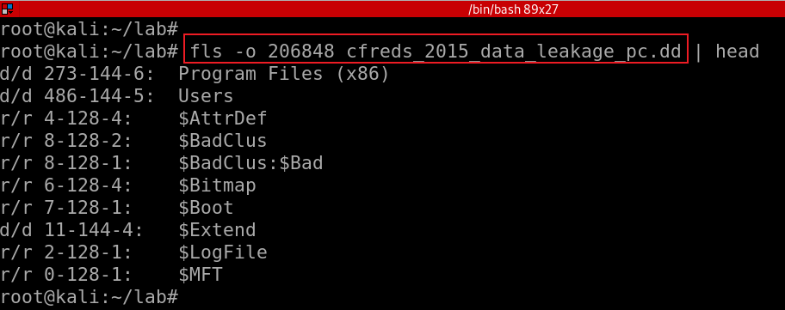
List file/directory names of the system volume
-o: offset
FAT/exFAT: Directory entry (USB)
NTFS: MFT Entry (Win)
UFS: Inode (Digital camera, mobile phone)
ExtX: Inode (Linux)
HFS: Catalog record (Ios)
r/ r
'r': saved in the file's file name structure
'r' : saved in the file's metadata structure.
For allocated files, these should always be equal.
For deleted files, they could be different if one of the structures was reallocated to a different file type.
r: Regular file
d: Directory
273: the entry of metadata address
metadata address: is a term that is used in the sleuth kit (TSK) as a generic term for the addresses of file system-specific data structures
-144-6 (for NTFS), identifies the $Data attribute that this name points to.
Notes:
fls -o 206848 cfreds_2015_data_leadage_pc.dd
https://wiki.sleuthkit.org/index.php?title=Fls

Slide 12

Extract key registry files from a DD image

Slide 13
Overview
What is Windows Registry?
How to access registry files?
How to copy registry files for future forensic analysis?

Slide 14
4.1 What is Windows Registry?
The Windows Registry is a database
Stores low-level settings for the Microsoft Windows operating system
Store setting for applications that opt to use the registry.
It is a hierarchical database
Store forensic information
Components use registry
Kernel,
Device drivers,
Services,
Security Accounts Manager (SAM)
User interface
University
College
CS Dept.
Criminal Justice Dept.
Admin

Slide 15
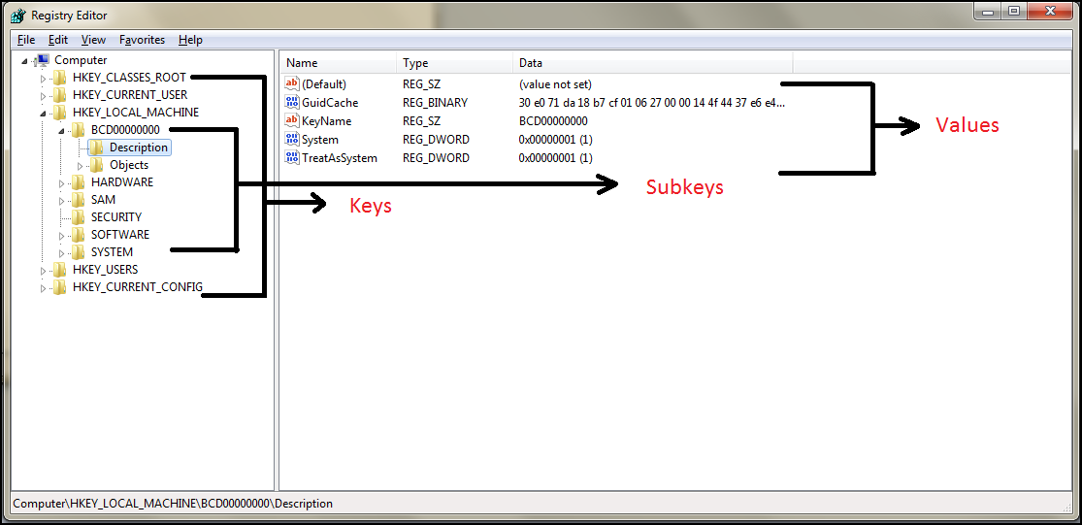
The five main root keys of registry are:
HKEY_CLASSES_ROOT (HKCR)
HKEY_CURRENT_USER (HKCU)
HKEY_LOCAL_MACHINE (HKLM)
HKEY_USERS (HKU)
HKEY_CURRENT_CONFIG (HKCC)

Slide 16
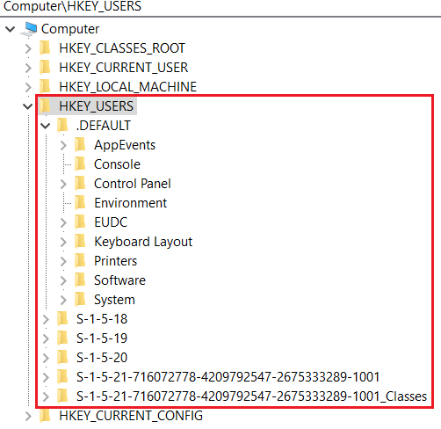
HKEY_USERS (HKU)
Contains information about all the users who logged in to the computer at some point
When log on, the current logged in user profile is linked by HKCU
Saved in each user's profile folder
C:\Users\IEUser\Ntuser.dat
C:\Users\ssh_Server\Ntuser.dat
C:\Users\Default User\Ntuser.dat
contains the base settings for new users when they first logon,

Slide 17
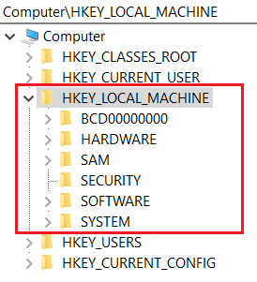
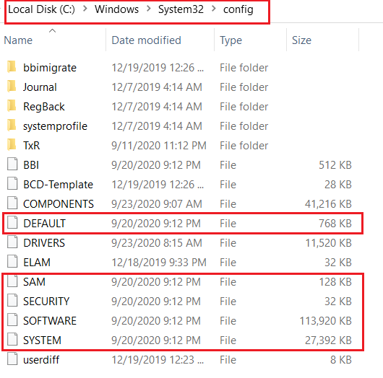
HKEY_LOCAL_MACHINE (HKLM)
Contains computer hardware and software information
Loaded at boot time from
Store Plug-and-Play devices Infor
Created dynamically, not stored in a file
Loaded at boot time from

Slide 18
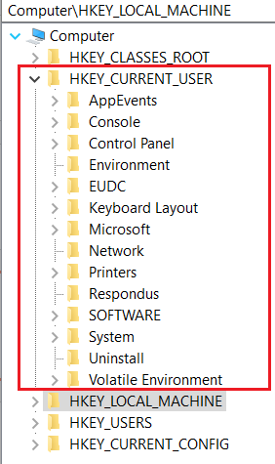
HKEY_CURRENT_USER (HKCU)
Does not contain any data
A link to the subkey of HKEY_USERS
Stores settings for currently logged-in use
Unloaded when the user logs out
If no profile is available, built from default user
Control everything of the current logged user
Environment variables
Desktop settings,
Network connections, printers,
Application preferences.
Keyboard layout
Current logged user information
Treasure for investigators

Slide 19
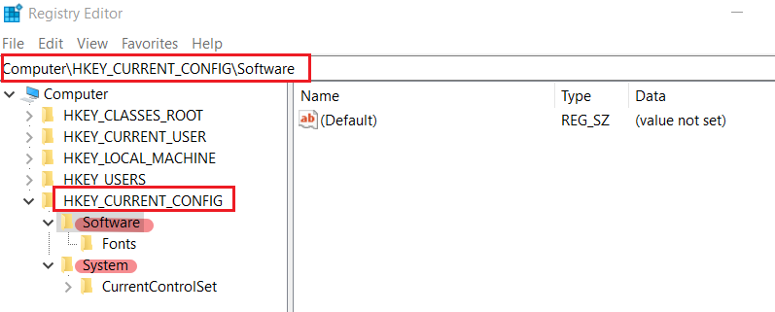
HKEY_CURRENT_CONFIG (HKCC)
It doesn't store any information itself but instead acts as a pointer, or a shortcut, to a registry key
Noting shown here, but points to other registry

Slide 20
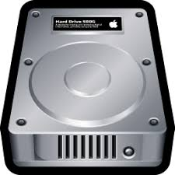

4.2 How to access registry files in dd image ? the easiest way: Mounting
root
bin
cp
mv
home
student1
student2
mnt
chip
step 1: create a virtual device
step 3: attach device
to the access point
/dev/loopN
mount
losetup
loop device
.dd raw
step 2: create a folder
as an access point
(to a device)

Slide 21
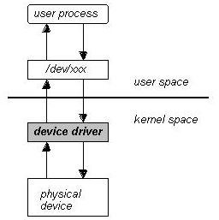
Technical view of Mounting
Mounting ensures that your computer recognizes the media's format
mounting a device/driver
Set up loop device
a pseudo-device that makes a file accessible as a block device
Create a mounting point
drive or folder
Attach the loop device to the mount point
2. folder
3
1

Slide 22
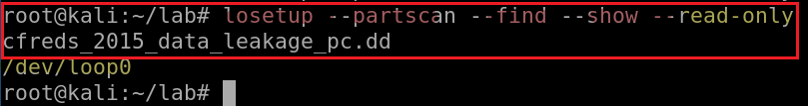

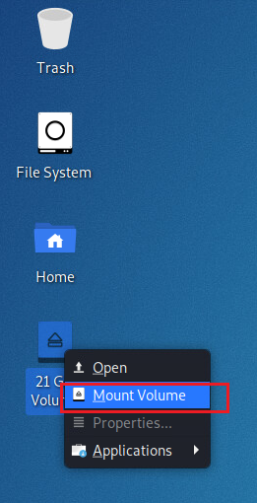
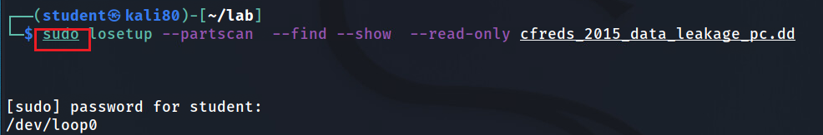
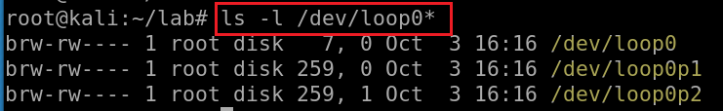
Set up loop device (a pseudo-device that makes a file accessible as a block device)
--partscan: scan the partition table on a newly created loop device
--find: find the first unused loop device.
--show: print device name
--read-only: setup read-only loop device.
Try to add sudo to get admin privilege if above ccmd doesn’t work.
Otherwise, you have to manually mount the image
Show disk (loop0), partition 1 (loop0p1), partition 2 (loop0p2)
Notes:
losetup --partscan --find --show --read-only cfreds_2015_data_leakage_pc.dd
losetup --detach /dev/loop0
losetup --detach-all
them unmount /dev/loop0
use sudo su if you have any troubles

Slide 23
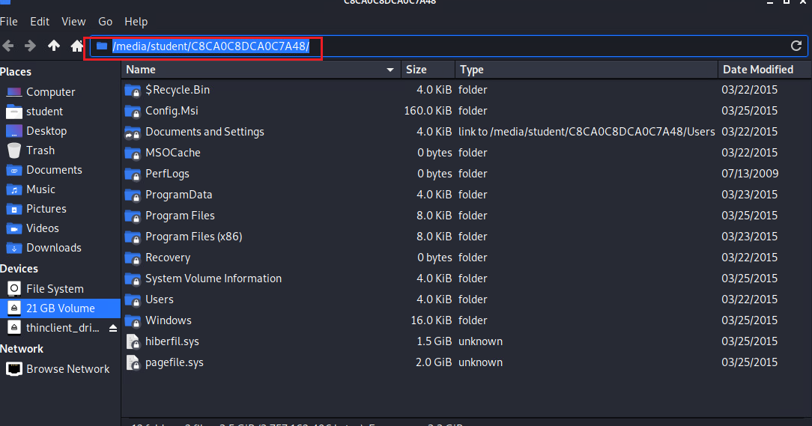
Show mounted image

Slide 24
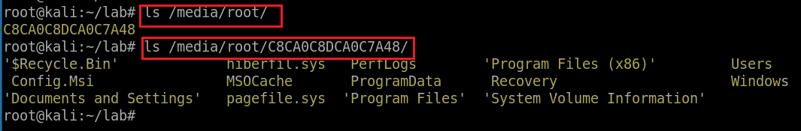
Kali 2020 automatically create the mounting point /media/YOUR_Account/CB…48. The partition 2 is mounted to the mounting point
manually mount the image
Create a folder as the mount point
Mount partition 2 to the mounting point
Unmount command: umount /mnt/nist_dataleak_pc_dd2/
Notes:
mount -o ro,loop,offset=206848 cfreds_2015_data_leakage_pc.dd /mnt/loopdev
umount /mnt/nist_dataleak_pc_dd2/

Slide 25
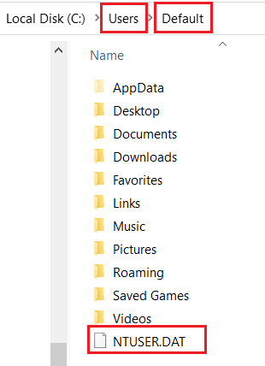
What files contains the registry information?
Contains computer hardware and software information
Contains information about all the users who logged in to the computer at some point

Slide 26
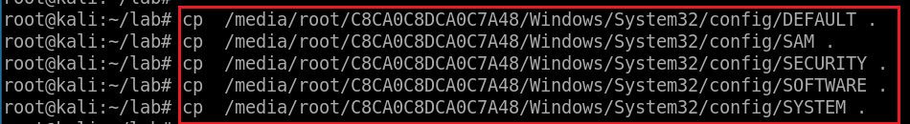
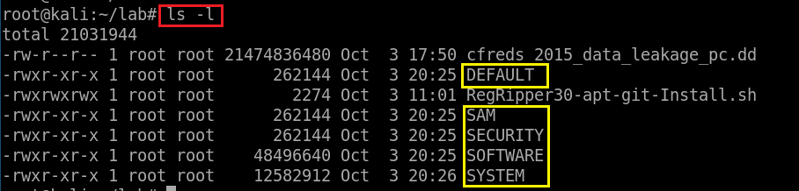
4.3 How to copy registry files for future forensic analysis?
Copy System (five) files to \lab
Verify five files

Slide 27
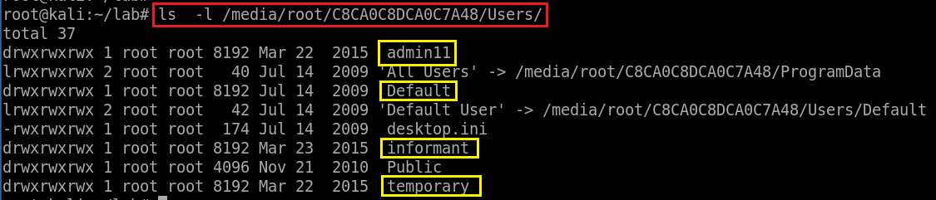
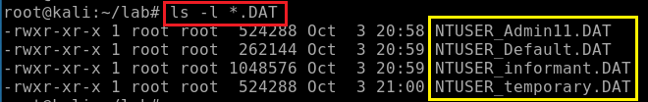
Find users in the PC
Find copy users information to \lab
Verify four files

Slide 28
Extract prefetch event log files from a DD image

Slide 29
Prefetch introduction
What is Cache?
Is type memory that stores data to improve performance
What is Prefetching?
The loading of a resource (instructions, data) to cache before it is required
Which resource are chosen for prefetching?
Chosen based on the user’s daily behavior
E.g., the most used resource
Prefetch log can be used for forensic analysis
E.g., monitoring program execution

Slide 30
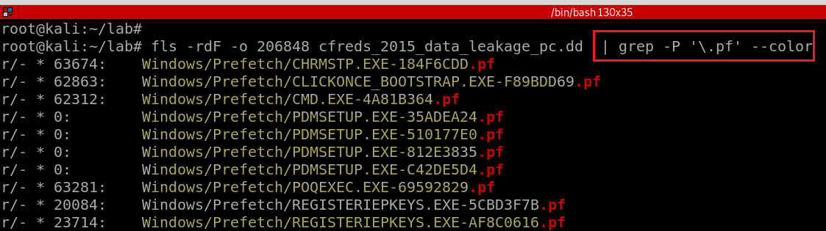
Check .pf files in a DD image
-r: recursively, -F: Display only files, -d: deleted files
-P: PCRE - Perl Compatible Regular Expressions
\: Escapes a special character
note: always enclose the regular expression in single quotes
grep supports three regular expression syntaxes, Basic, Extended, and Perl-compatible.
A regular expression or regex is a pattern that matches a set of strings
https://www.debuggex.com/cheatsheet/regex/pcre
Notes:
https://linuxize.com/post/regular-expressions-in-grep/

Slide 31
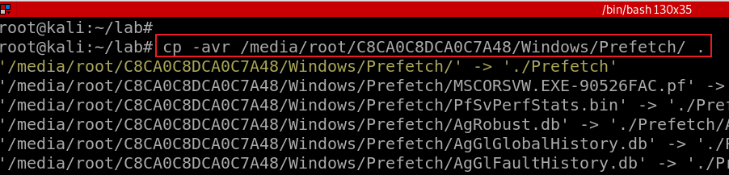
Copy Prefetch folder to current folder
-a : Preserve the specified attributes such as directory a file mode, ownership, timestamps, if possible additional attributes: context, links, xattr, all.
-v : Verbose output.
-r : Copy directories recursively.
Notes:
mkdir Prefetch
cp -avr /media/root/C8CA0C8DCA0C7A48/Windows/Prefetch/ ./Prefetch/

Slide 32
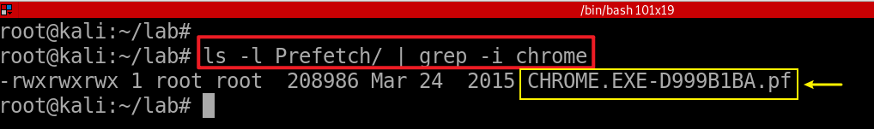
Verify and check .pf of chrom.exe is in ./Prefetch folder

Slide 33

Extract security event log files from the DD Image

Slide 34
Event log files overview
Windows OS records various events for debugging
Created by the Windows 7 Event Viewer (eventvwr.msc)
Event logs has file extension .evtx
Contains a list of events
Saved in a proprietary binary format
Only can be viewed within the Event Viewer

Slide 35
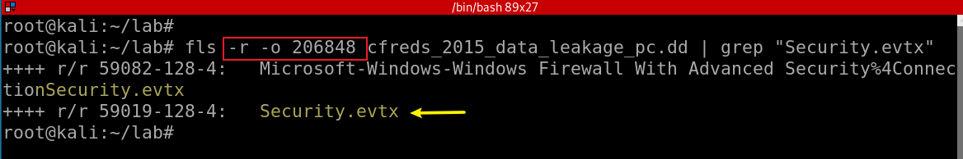
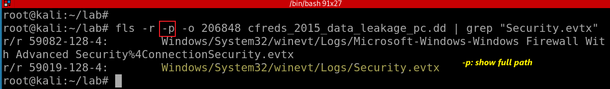
Search for “Security.evtx” from the DD image
-r: Recurse on directory entries
Search for “Security.evtx” from the DD image and show full path
Notes:
fls -r -o 206848 cfreds_2015_data_leakage_pc.dd | grep "Security.evtx"
fls -r -p -o 206848 cfreds_2015_data_leakage_pc.dd | grep "Security.evtx"

Slide 36
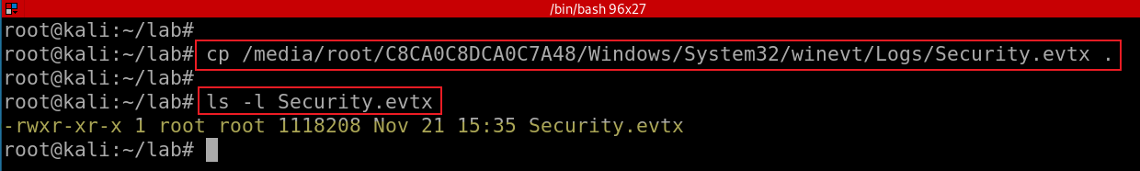
Copy “Security.evtx” from the DD image to the lab directory

Slide 37
Install software
Optional: If you downloaded Kali form https://github.com/frankwxu/digital-forensics-lab, you can skip this section

Slide 38
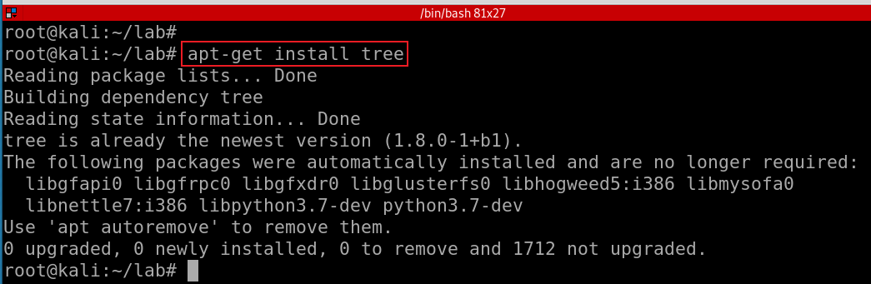
7.1 Install tree

Slide 39
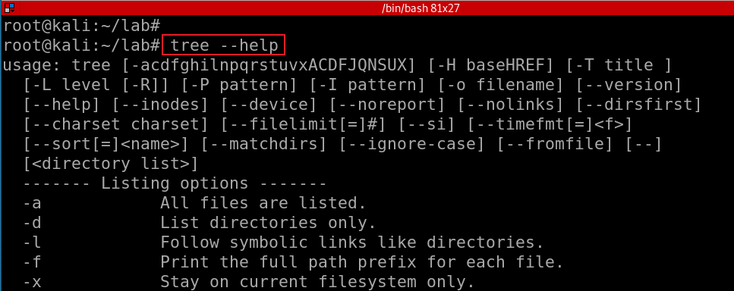
Show tree help menu

Slide 40
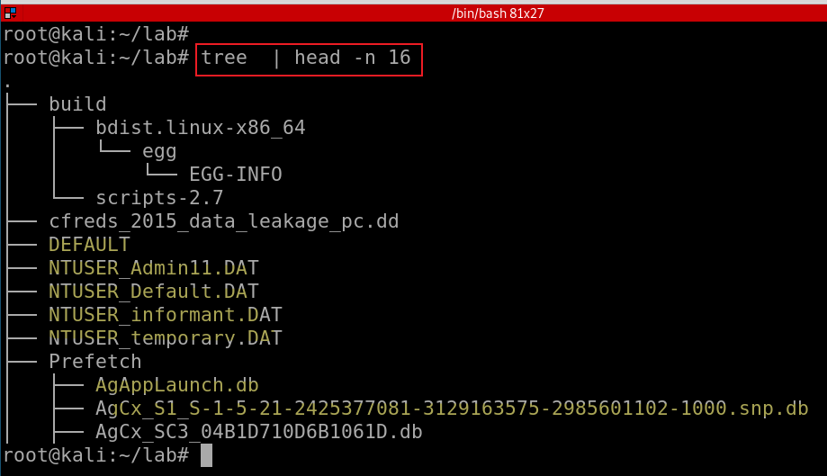
Show files of the current folder in a tree structure
Notes:
sudo apt-get install tree

Slide 41

7.2 Install RegRipper 3.0
RegRipper is a software tool to extract/parse information (keys, values, data) from the Registry
Open-source software (Windows and Linux)
Written in Perl
Consists of a framework that executes plugins
Two basic tools
A command line (CLI) tool called rip
Graphic user interface (GUI)

Slide 42
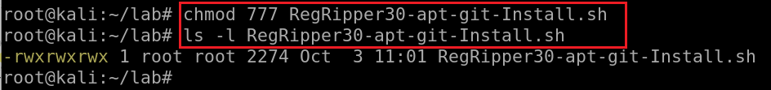
Download RegRipper 3.0 installation script
use the backup link if the original link does not work
Verify the script
Make the script executable
Notes:
wget https://raw.githubusercontent.com/frankwxu/digital-forensics-lab/main/NIST_Data_Leakage_Case/tools/RegRipper30-apt-git-Install.sh
https://medium.com/@stdout_/installing-regripper-v2-8-on-ubuntu-26dc8bc8a2d3
https://github.com/keydet89/RegRipper3.0

Slide 43
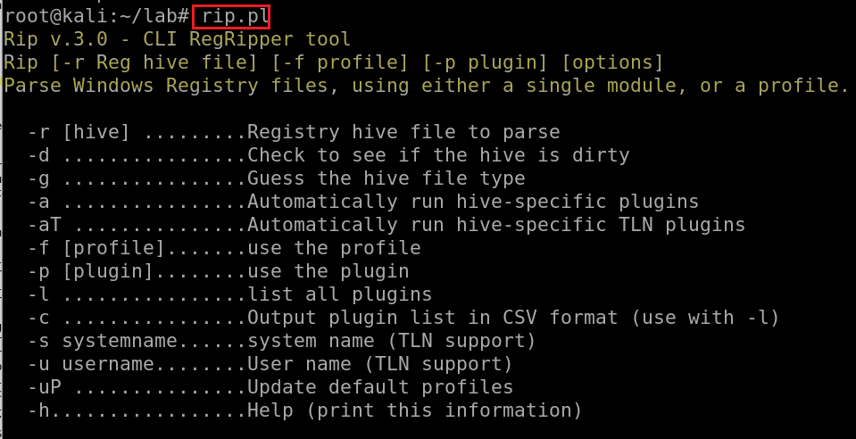
Run the script to install
Test regripper 3.0

Slide 44
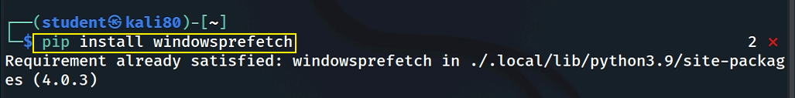
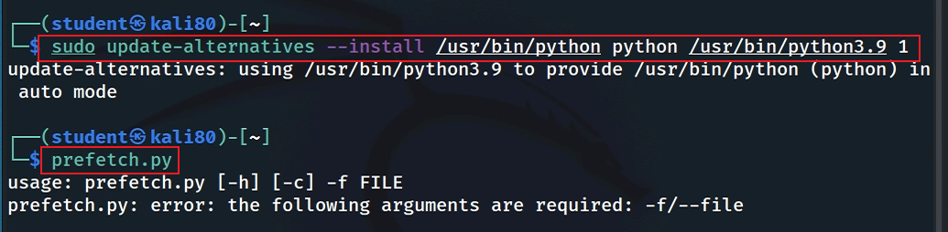
7.3 Install Windows-Prefetch-Parser
Install parser
Test if prefetch tool works (you can skip if your python version is 3.9)
Notes:
https://github.com/PoorBillionaire/Windows-Prefetch-Parser.git
pip install windowsprefetch
sudo update-alternatives --install /usr/bin/python python /usr/bin/python3.9 1
https://medium.com/analytics-vidhya/how-to-install-and-switch-between-different-python-versions-in-ubuntu-16-04-dc1726796b9b

Slide 45
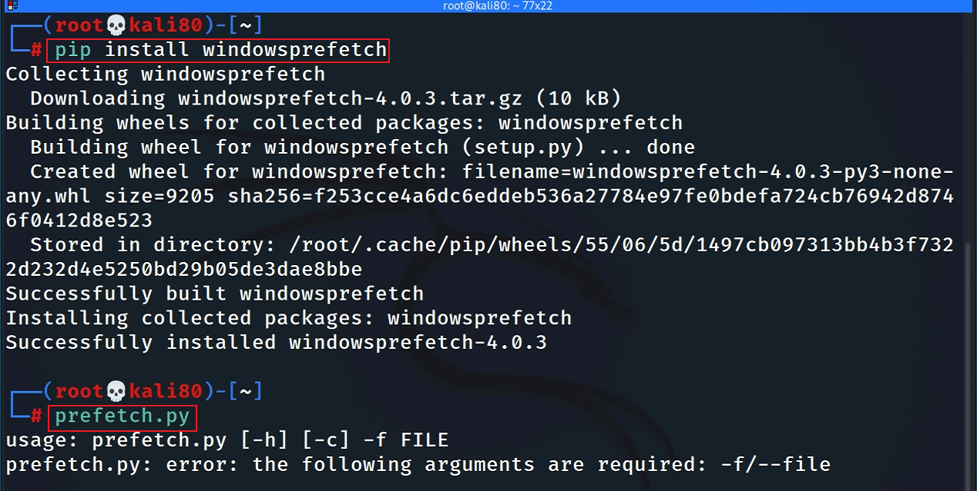
If you are the root

Slide 46
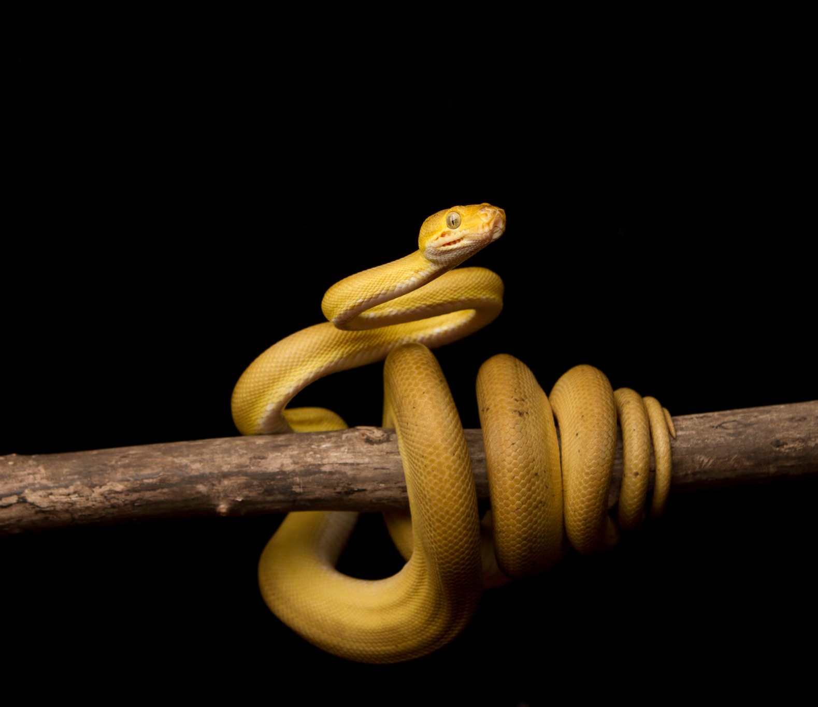
7.4 Install Window event log parser: Python-evtx
A pure Python parser for recent Windows Event Log files
Parse files with ".evtx“
Provides programmatic access to the File and Chunk headers, record templates, and event entries

Slide 47
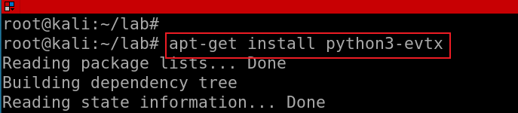
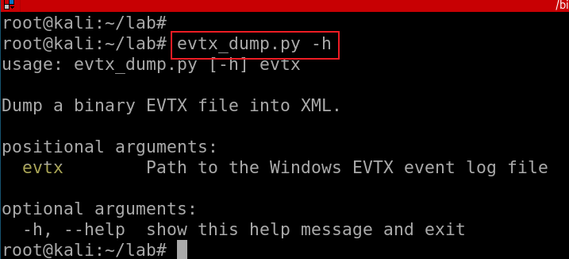
Install via apt
Run apt-get update if there is any error message
Verify installation
Notes:
Apt-get install python3-evtx

