Slide 1

Investigate Data Leakage Case
Keywords: Recycle Bin and Anti-forensics
Notes:
http://xmlstar.sourceforge.net/doc/UG/

Slide 2
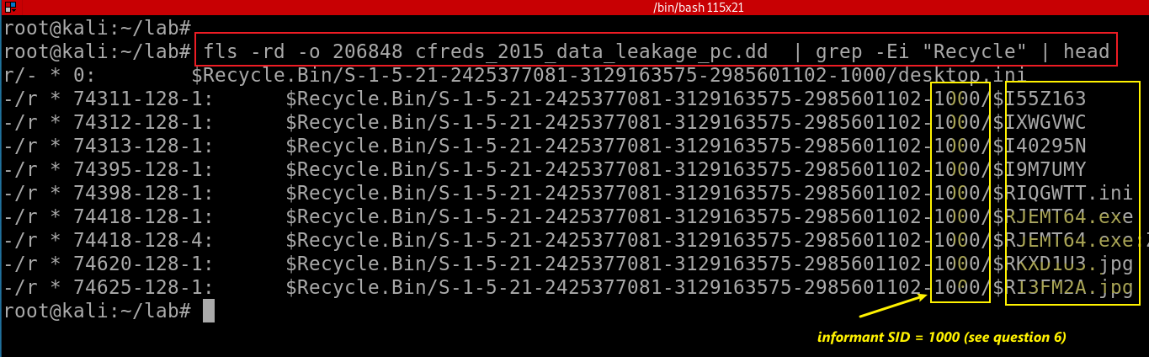
51. Examine ‘Recycle Bin’ data in PC.
Windows 7 Recycle Bin is called $Recyle.bin.
Each deleted file is represented by a pair of files $I[random].extension & $R[random].extension
Notes:
fls -rd -o 206848 cfreds_2015_data_leakage_pc.dd | grep -Ei "Recycle" | head

Slide 3

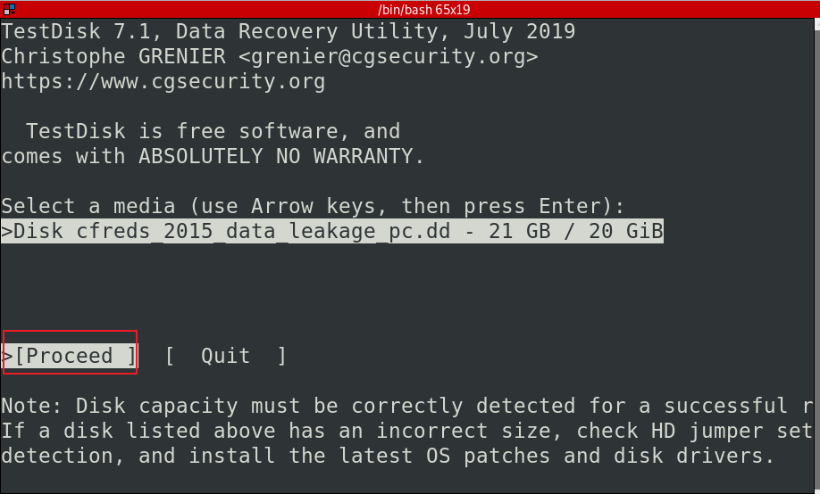
Use testdisk to Recover $Recyle.bin
Recover the image
Recover the image
Notes:
testdisk cfreds_2015_data_leakage_pc.dd

Slide 4
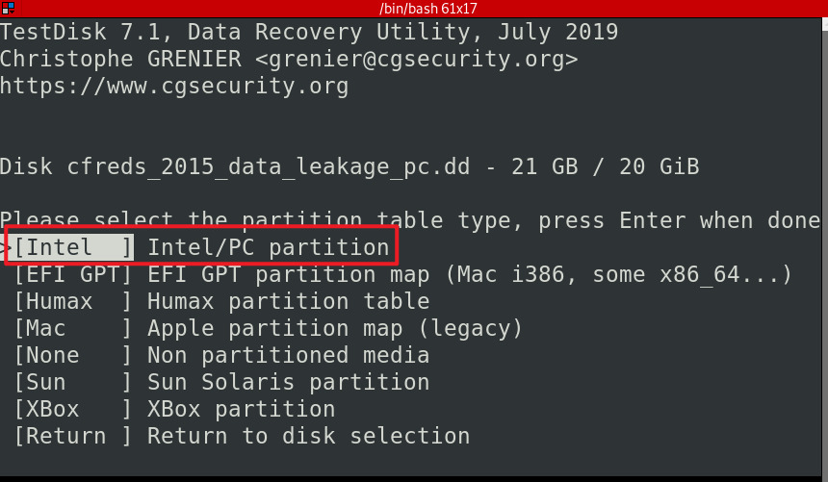
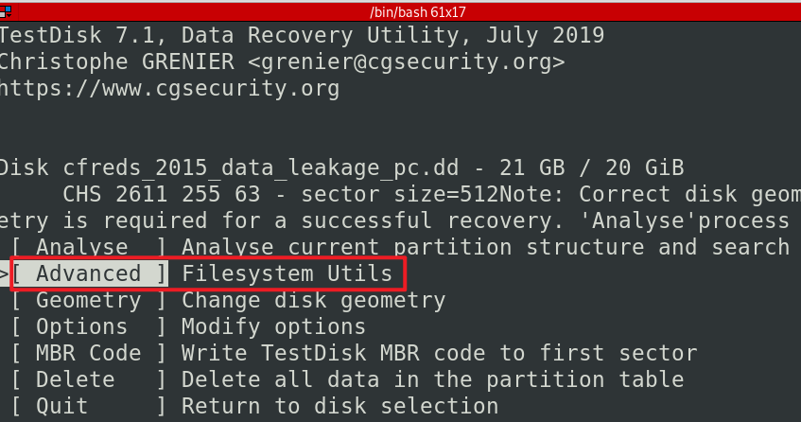

Slide 5
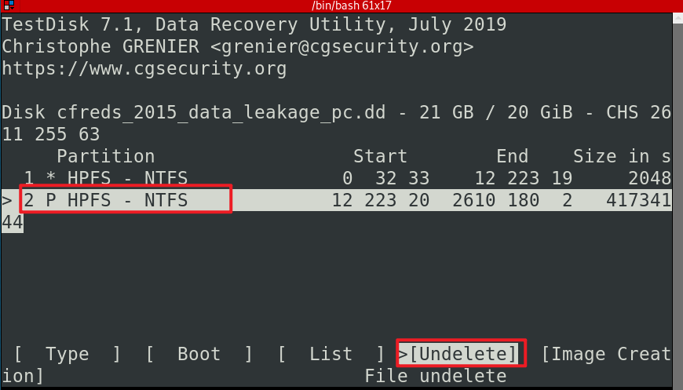

Slide 6
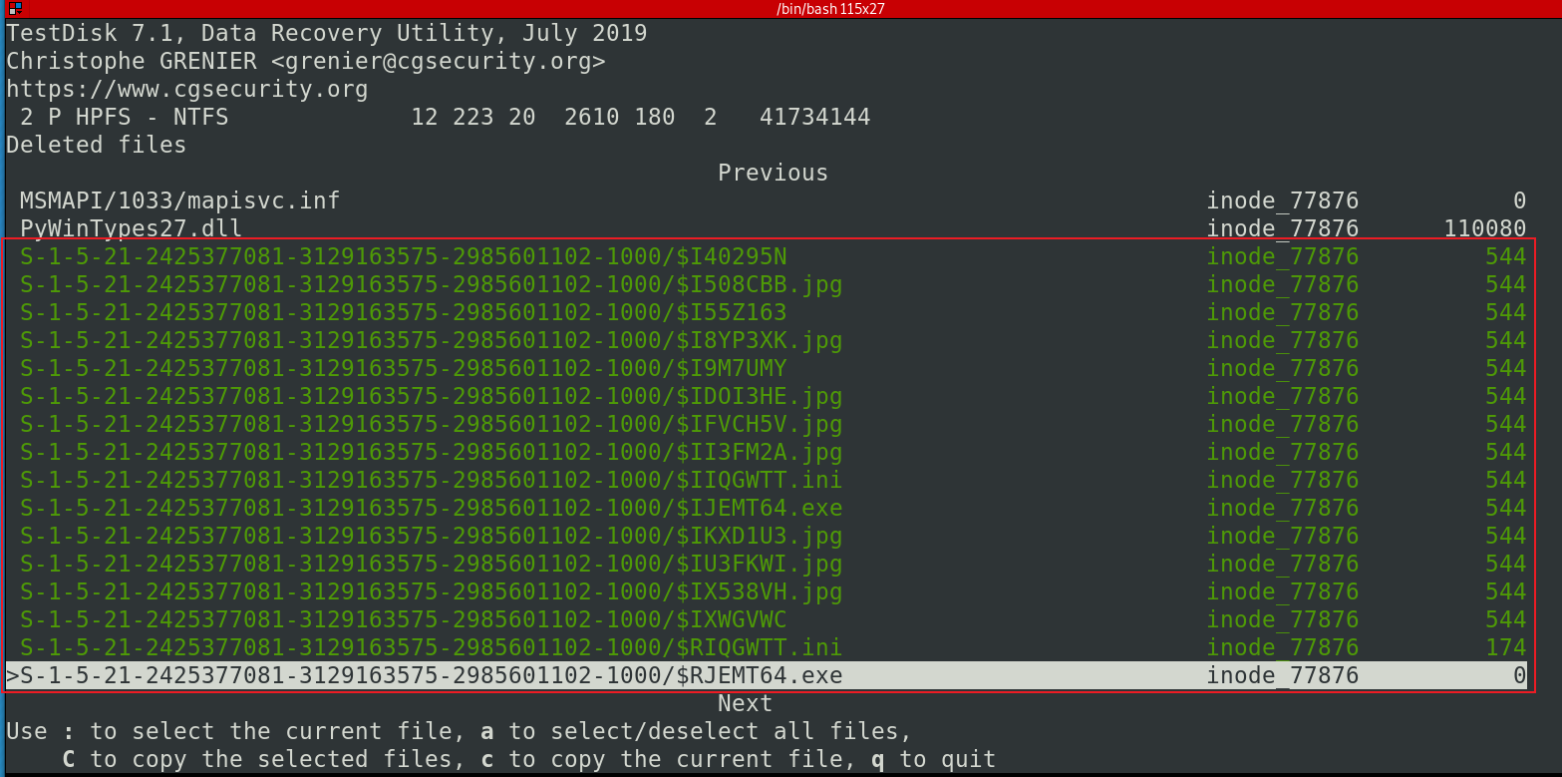
Use testDisk to recover files
: to select the highlighted files
C: to copy

Slide 7
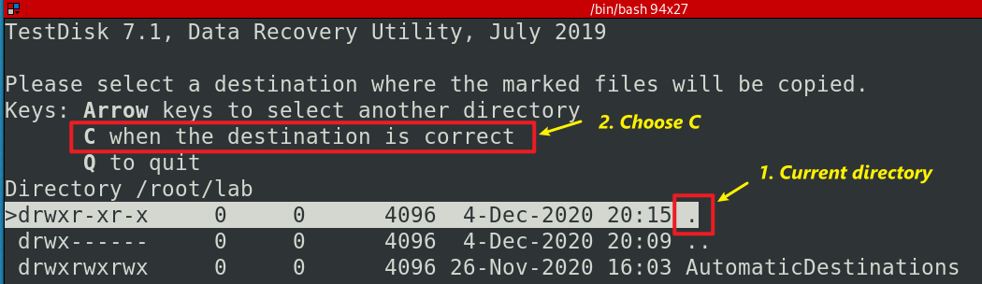
Choose the destination and copy
Quit all

Slide 8
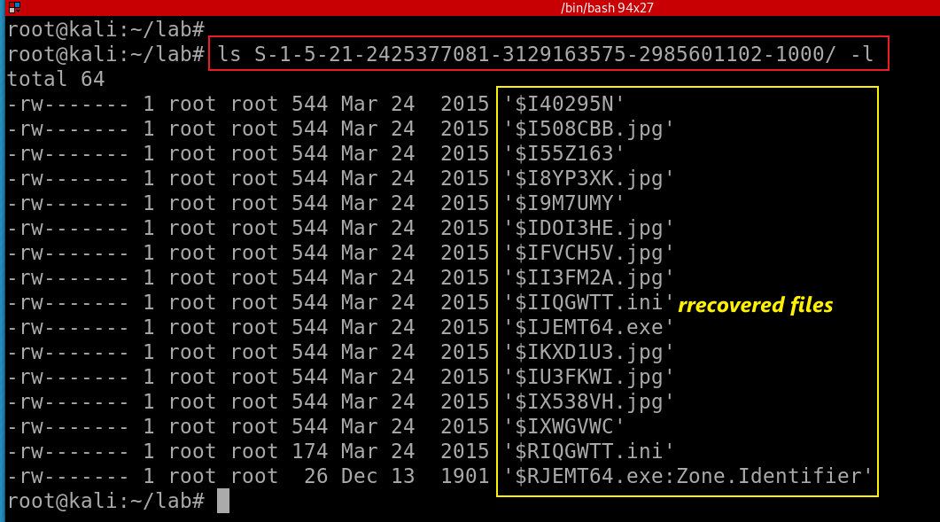
ls S-1-5-21-2425377081-3129163575-2985601102-1000/ -l

Slide 9
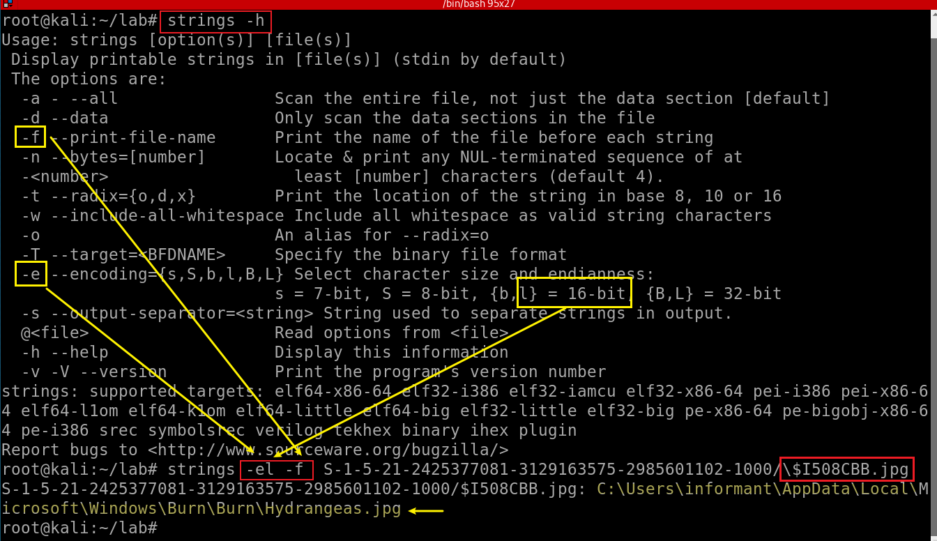
Match random file names with readable file names in the file
Notes:
strings -el -f S-1-5-21-2425377081-3129163575-2985601102-1000/\$I508CBB.jpg

Slide 10
52. What actions were performed for anti-forensics on PC at the last day ‘2015-03-25’?
Anti-forensics activities
Search anti-forensic tools
Download anti-forensic tools
Install anti-forensic tools
Run anti-forensic tools
Delete files [Shift] + [Delete]
Uninstall anti-forensic tools
Disconnecting Google drive account
Delete some e-mails in Outlook
Wiping traces of Eraser in $UsnJrnl
Notes:
http://journeyintoir.blogspot.com/2013/01/re-introducing-usnjrnl.html

Slide 11
52. 1 Search IE anti-forensics using keyword
Anti
Forensics
Hide/Steganography
Delete/erase/wipe/remove/eliminating
Overwrite
Detect
encapsulation
Cover
Trace
Encryption
Evidence
Manipulate
Log
Disable
Destroy/clean

Slide 12
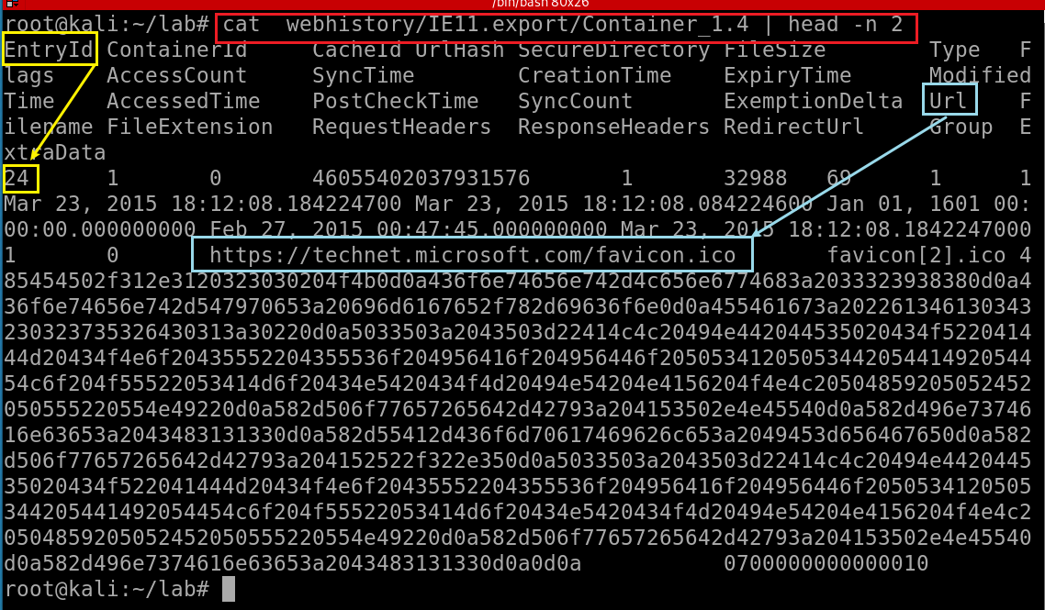
Find IE record information
Notes:
cat webhistory/IE11.export/Container_1.4 | head -n 2

Slide 13
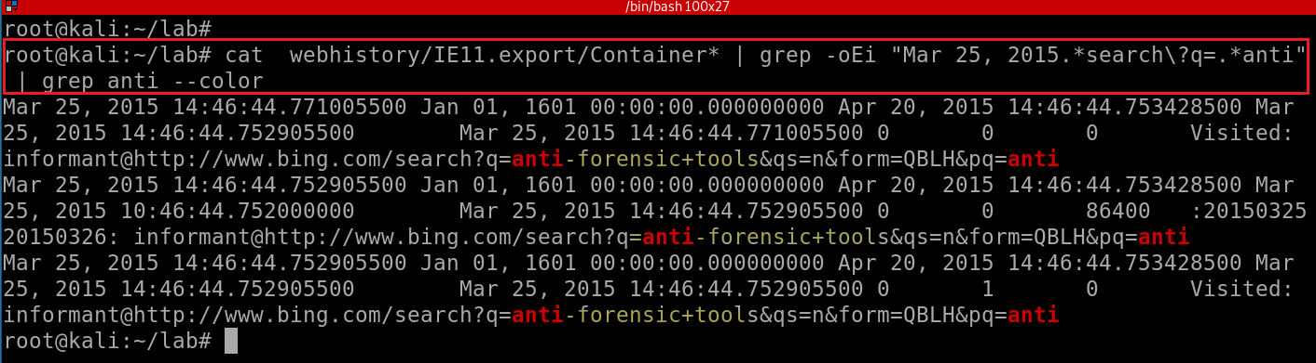
Three tasks:
Show all IE history
Grep date and with key word “anti”
Highlight anti in red
-o: only show match string
Notes:
cat webhistory/IE11.export/Container* | grep -oEi "Mar 25, 2015.*search\?q=.*anti" | grep anti --color

Slide 14
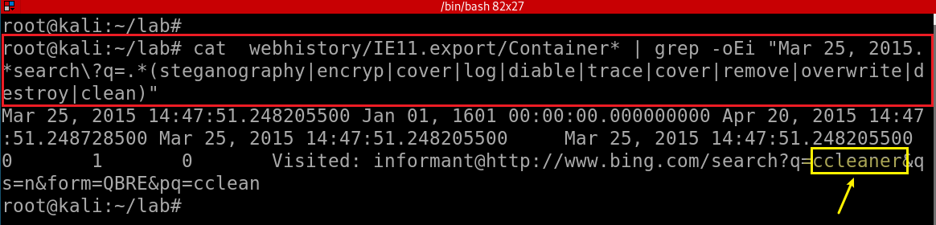
Search a list of anti-forensic keywords
Notes:
cat webhistory/IE11.export/Container* | grep -oEi "Mar 25, 2015.*search\?q=.*(steganography|encryp|cover|log|diable|trace|cover|remove|overwrite|destroy|clean)"

Slide 15
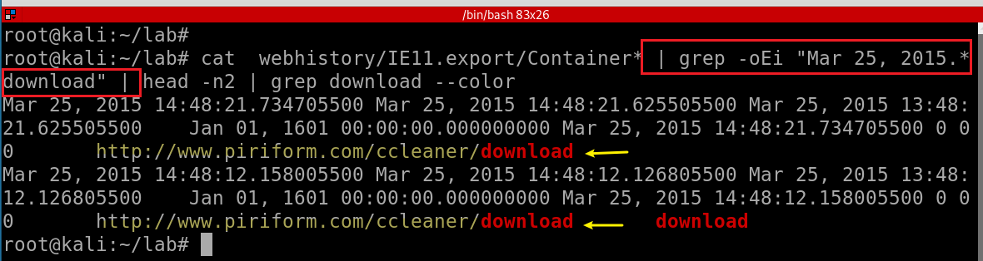
52. 2 Search IE download history
Search key word “download”, only show first two records for the demonstration purpose
Notes:
cat webhistory/IE11.export/Container* | grep -oEi "Mar 25, 2015.*download" | head -n2 | grep download --color

Slide 16
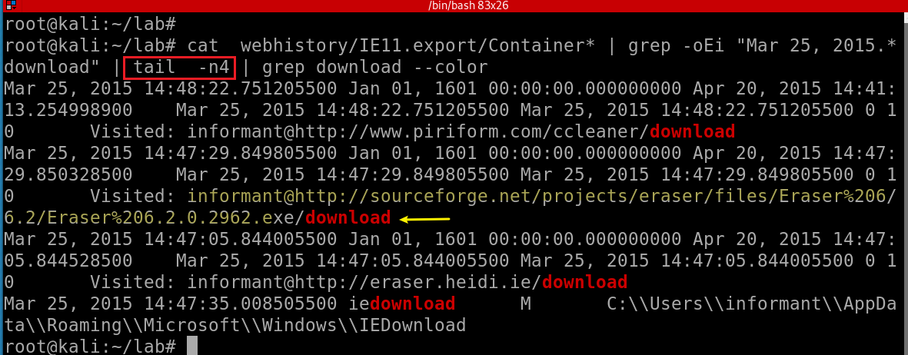
Search key word “download”, only show last four records for the demonstration purpose

Slide 17
Possible two programs are downloaded
ccleaner
eraser

Slide 18
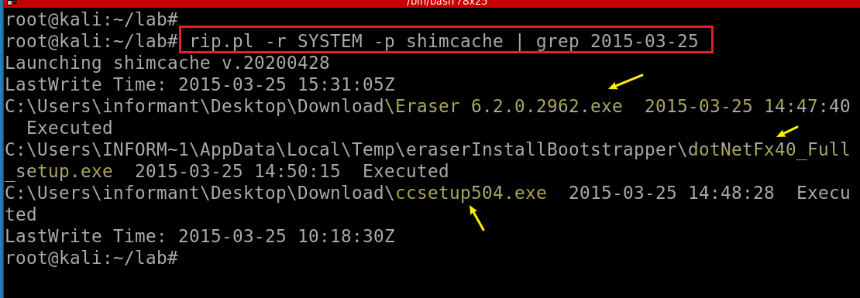
52. 3 Install download programs- shimcache
Cehck shimcache to monitor executed programs
Notes:
rip.pl -r SYSTEM -p shimcache | grep 2015-03-25

Slide 19
52. 4 Check software installation
Windows Installer uses the registry to record information about updates installed for each Windows Installer-based product.
These registry keys help identify the state of each update
registered, applied, superseded, or obsoleted.
Information about installed updates is stored across several registry keys and values.
To allow for the product to be in a serviceable state in which it can be repaired, updated, or uninstalled, it is critical for the data in these registry keys to be synchronized.
Otherwise, maintenance mode operations cannot be performed on the product .msi file.

Slide 20
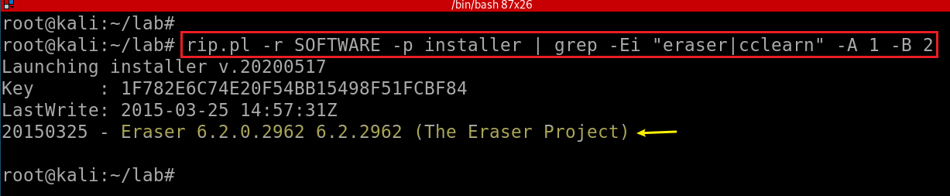
Check software managed by installer
Check if eraser or cclearner is managed by Win installer
Microsoft\Windows\CurrentVersion\Installer\UserData\SID
Notes:
rip.pl -r SOFTWARE -p installer | grep -Ei "eraser|cclearn" -A 1 -B 2

Slide 21
Check uninstall registry
Many applications also add their uninstall entries
HKLM\Software\Microsoft\Windows\CurrentVersion\Uninstall\[app name]
HKLM\Software\\Microsoft\Windows\CurrentVersion\App Paths
Some software doesn't even write to the Registry at all
Chrome, GoToMeeting
Could be misleading
An application was installed once, but then was manually deleted
Need to check the filesystem to see if the application still exists
File location
Software
NTUSER.DAT

Slide 22
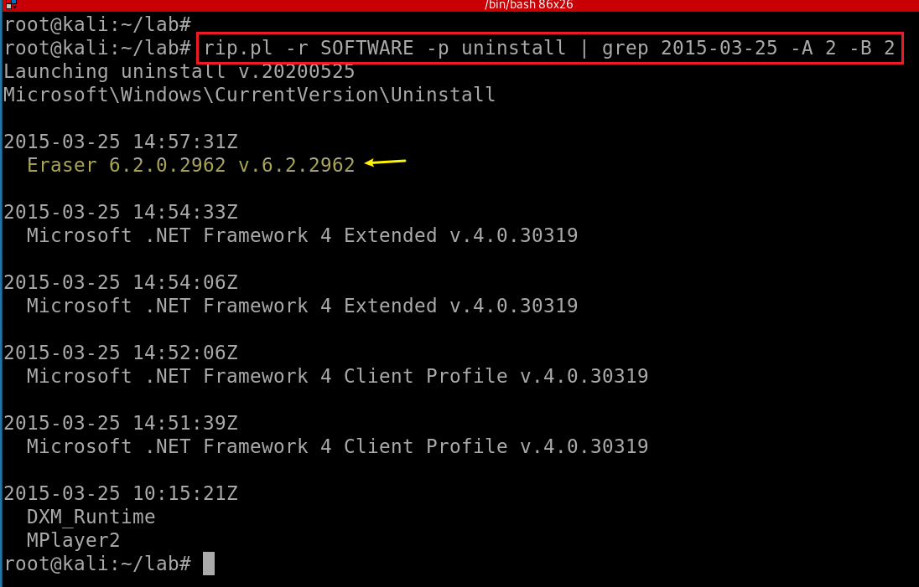
Check Software registry hive
Notes:
rip.pl -r SOFTWARE -p uninstall | grep 2015-03-25 -A 2 -B 2
rip.pl -r NTUSER_informant.DAT -p uninstall | grep 2015-03-25 -A 2 -B 2

Slide 23
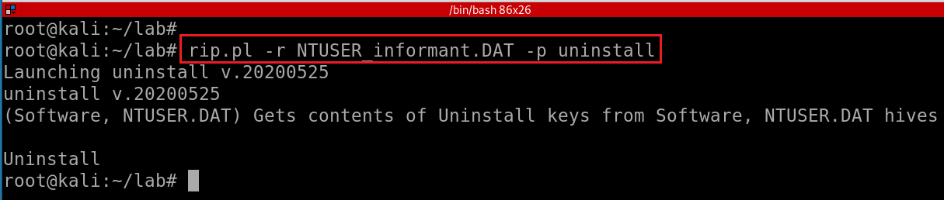
Check NTUSER_informant.DAT registry hive
Nothing found
Notes:
rip.pl -r NTUSER_informant.DAT -p uninstall

Slide 24
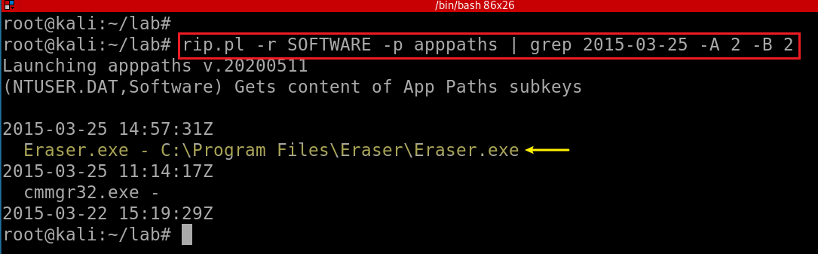
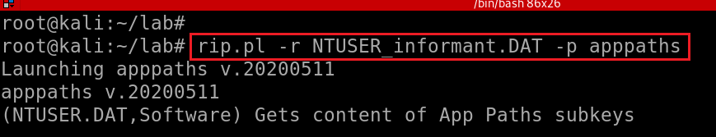
Check app paths registry
Check Software apppaths
Check NTUSER_informant apppaths

Slide 25
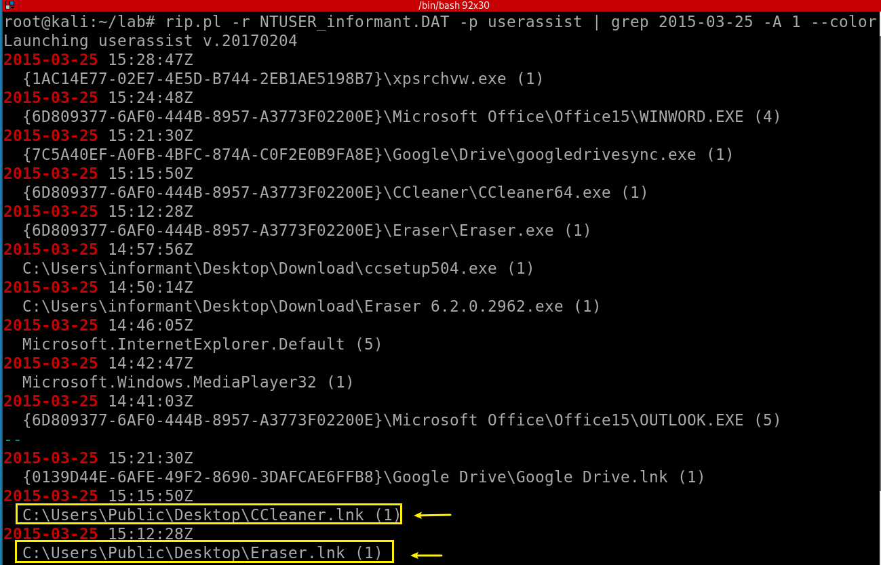
52. 5 Execute two programs : userassist
Notes:
rip.pl -r NTUSER_informant.DAT -p userassist | grep 2015-03-25 -A 1 --color

Slide 26
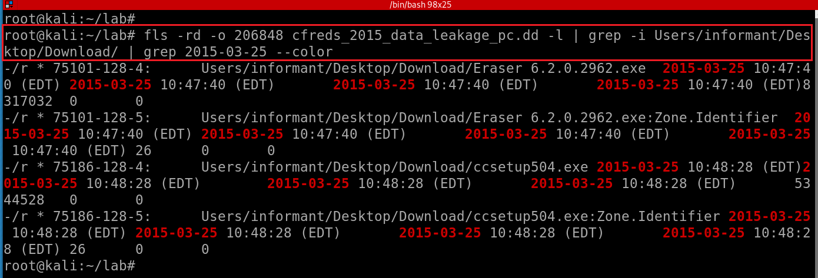
52. 6 Search for deleted .exe files
Only search for 2015-03-25 from Download folder
Notes:
fls -rd -o 206848 cfreds_2015_data_leakage_pc.dd -l | grep -i Users/informant/Desktop/Download/ | grep 2015-03-25 --color

Slide 27
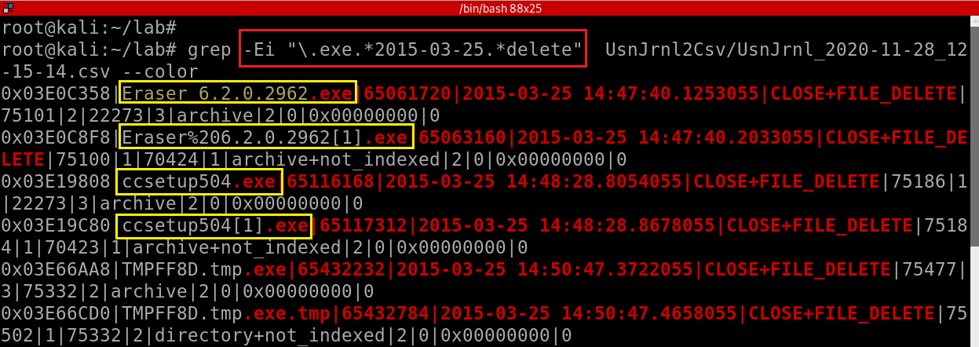
Only search for deleted .exe from $UsnJrnl on 2015-03-25
Notes:
grep -Ei "\.exe.*2015-03-25.*delete" UsnJrnl2Csv/UsnJrnl_2020-11-28_12-15-14.csv --color

Slide 28
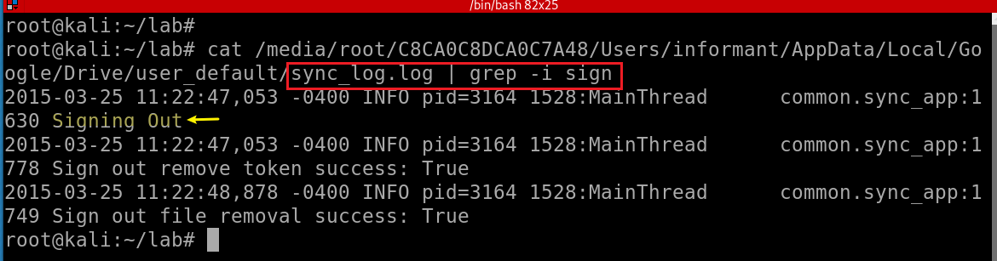
52. 7 Google driver log
Disconnecting Google drive account

Slide 29
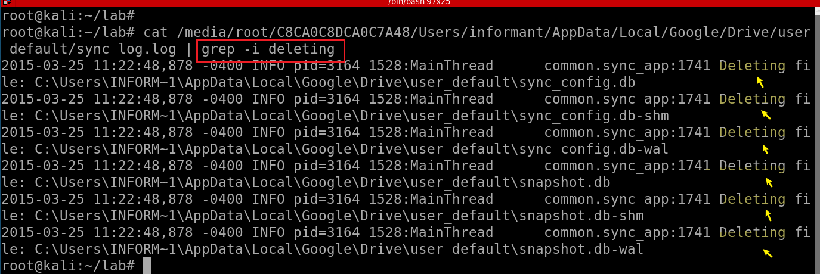
Find deleted files from Google driver
Notes:
cat /media/root/C8CA0C8DCA0C7A48/Users/informant/AppData/Local/Google/Drive/user_default/sync_log.log | grep -i deleting

