Slide 1

Investigate Data Leakage Case
Keywords: Data Recovery, Data Carving
Notes:
http://xmlstar.sourceforge.net/doc/UG/

Slide 2
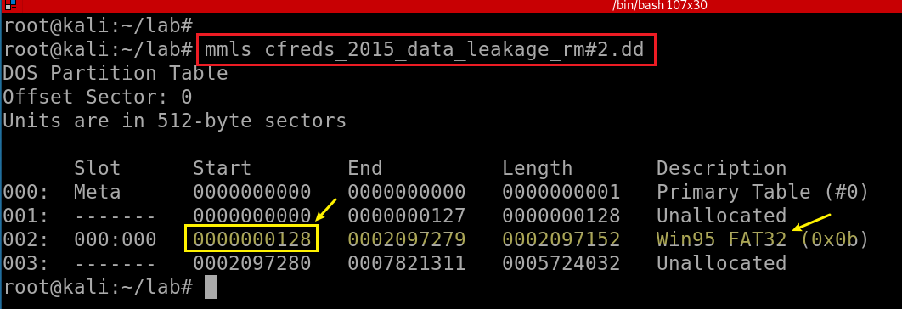
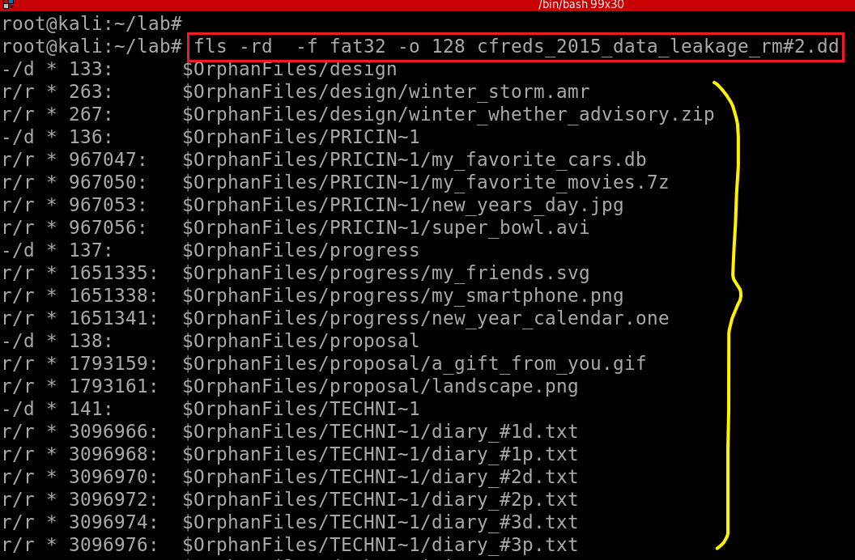
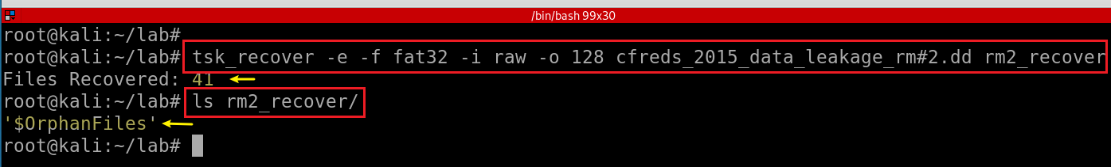
Recover deleted files from USB drive ‘RM#2’.
Displays the layout of a disk, including the unallocated spaces.
Displays the deleted files
Sleuthkit tsk_recover command to recover deleted files
Notes:
mmls cfreds_2015_data_leakage_rm#2.dd

Slide 3
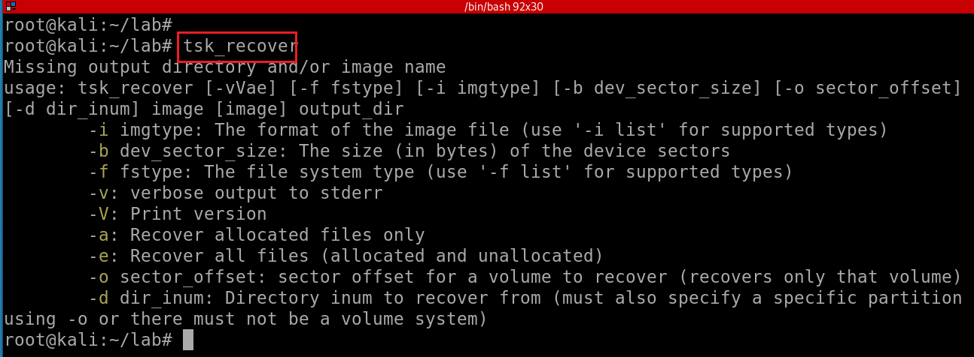
Sleuthkit tsk_recover command in order to recover deleted files
Notes:
tsk_recover

Slide 4
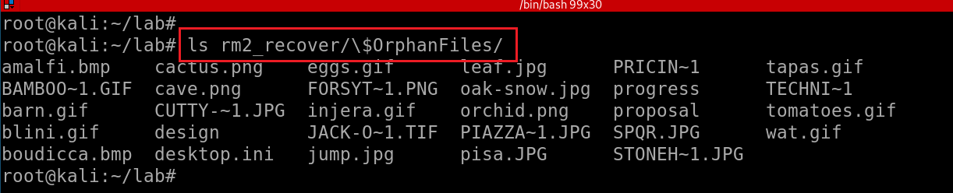
Sleuthkit tsk_recover command to recover deleted files
Verify recovered files
Notes:
tsk_recover -e -f fat32 -i raw -o 128 cfreds_2015_data_leakage_rm#2.dd rm2_recover

Slide 5
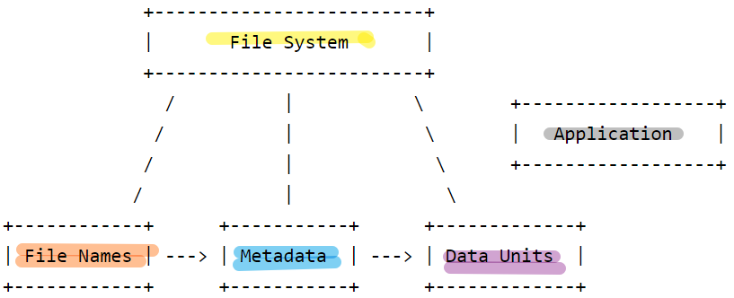
What is $OrphanFiles?
Orphan files are deleted files that still have file metadata in the file system
Cannot be accessed from the root directory
That is why Orphan files have no parent
In most file systems, the file metadata are stored in a different location than the file name.
Metadata includes times and which blocks are allocated to a file
The name points to the metadata location.
It is possible for the name of a deleted file to be erased or reused, but the file metadata still exists.
Orphan files are listed in the $OrphanFiles directory in the root directory.
This directory does not actually exist in the disk image, it is just a virtual way for TSK to provide you with access to the metadata that exists.
Notes:
https://wiki.sleuthkit.org/index.php?title=Orphan_Files

Slide 6
How is $OrphanFiles generated?
Frist, walking the directory tree
enumerating all of the metadata addresses that the file names point to.
Then, it goes through all of the metadata structures
identifies which of the unallocated structures do not have a name pointing to them. These are the orphan files.

Slide 7
54. What actions were performed for anti-forensics on USB drive ‘RM#2’?
What is quick format?
Allows you to overwrite any files on the drive, but it does not fully erase them;
Only marked as unallocated
With the right software, the old files could be recovered.
Inference from data recovery results
Quick format is used for deleting data

Slide 8
55. What files were copied from PC to USB drive ‘RM#2’?
RM#2 has two types of files
Existing file in RM#2
Deleted file in RM#2
$UsnJrnl records all the changes to volume
Approach
search for each file of RM#2 that shown in $UsnJrnl
Notes:
ls -R rm2_recover/

Slide 9
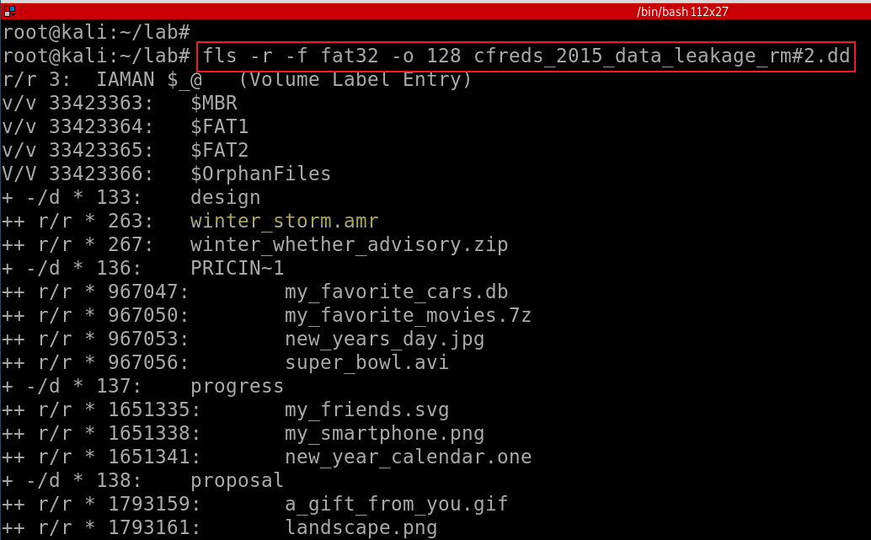
List existing files in RM#2
Notes:
fls -r -f fat32 -o 128 cfreds_2015_data_leakage_rm#2.dd

Slide 10
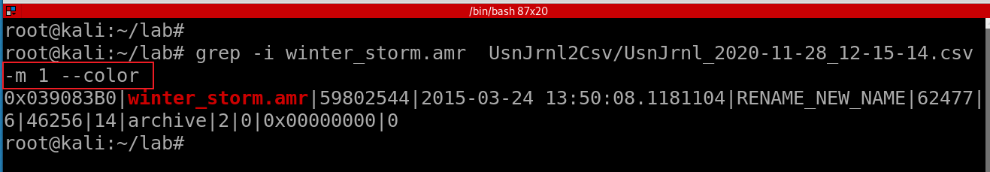
Search one example normal file winter_storm.amr (RM#2) in USN Journal
Notes:
grep -i winter_storm.amr UsnJrnl2Csv/UsnJrnl_2020-11-28_12-15-14.csv -m 1 --color

Slide 11
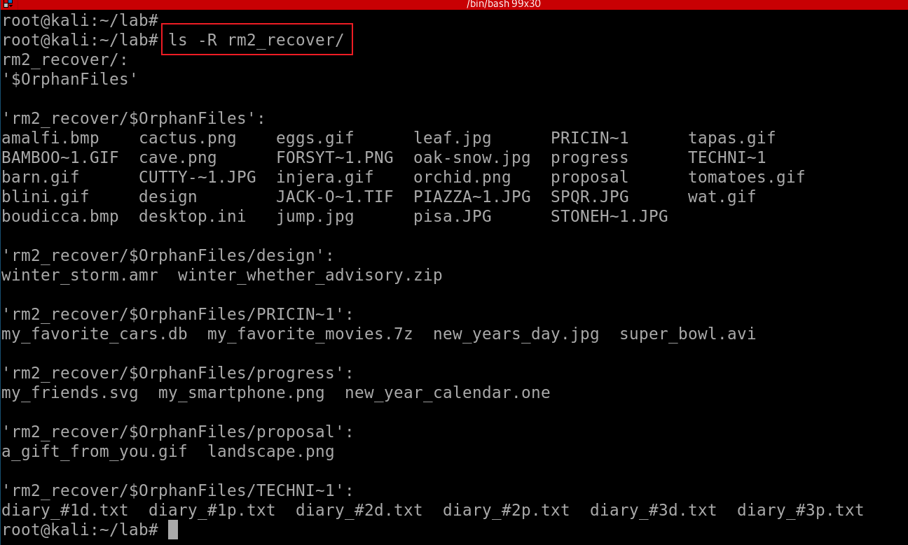
List deleted file in RM#2
Notes:
ls -R rm2_recover/

Slide 12
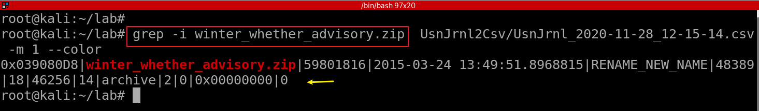
Search one example delete file winter_whether_advisory.zip (RM#2) in USN Journal
Notes:
grep -i winter_whether_advisory.zip UsnJrnl2Csv/UsnJrnl_2020-11-28_12-15-14.csv -m 1 --color

Slide 13
56. Recover hidden files from the CD-R ‘RM#3’.
Get RM#3 dd image
Review files on the image
Search hidden strings
Search hidden hex
Recover the deleted files
Data carving
Notes:
wget -q https://www.cfreds.nist.gov/data_leakage_case/images/rm%233/cfreds_2015_data_leakage_rm%233_type2.7z
ls -l cfreds_2015_data_leakage_rm#3_type2.7z
7z e cfreds_2015_data_leakage_rm#3_type2.7z
md5sum cfreds_2015_data_leakage_rm#3_type2.dd

Slide 14
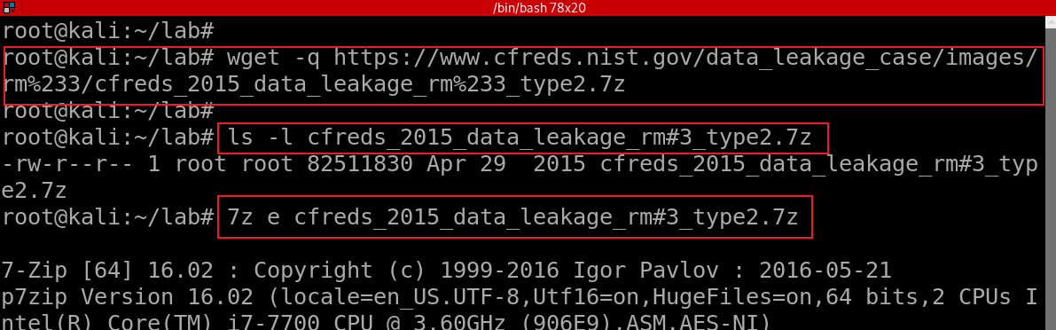
56.1 Get RM#3 dd image
Download RM#3 image
Notes:
wget -q https://www.cfreds.nist.gov/data_leakage_case/images/rm%233/cfreds_2015_data_leakage_rm%233_type2.7z
ls -l cfreds_2015_data_leakage_rm#3_type2.7z
7z e cfreds_2015_data_leakage_rm#3_type2.7z
md5sum cfreds_2015_data_leakage_rm#3_type2.dd

Slide 15
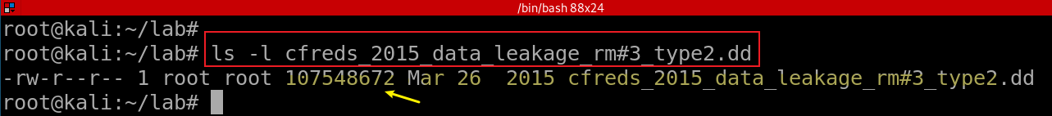
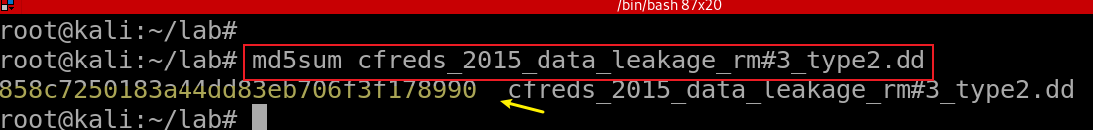
List the RM#3 image
Verify the hash

Slide 16
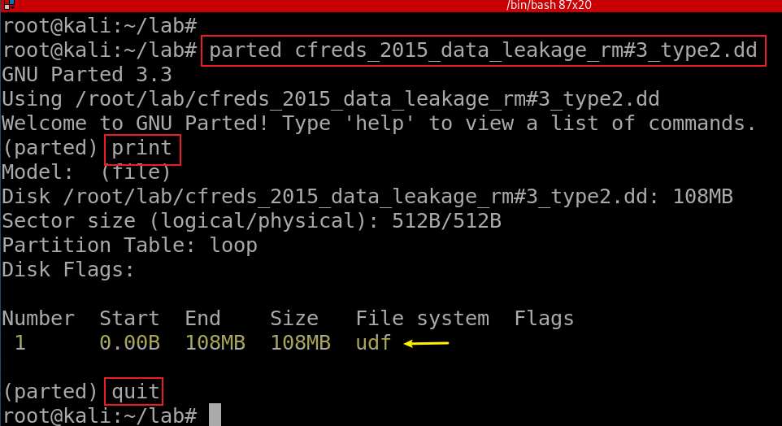
Find the type of DD image
Universal Disk Format (UDF) is an open vendor-neutral file system for computer data storage for a broad range of media., CDs and DVDs.
Notes:
parted cfreds_2015_data_leakage_rm#3_type2.dd

Slide 17
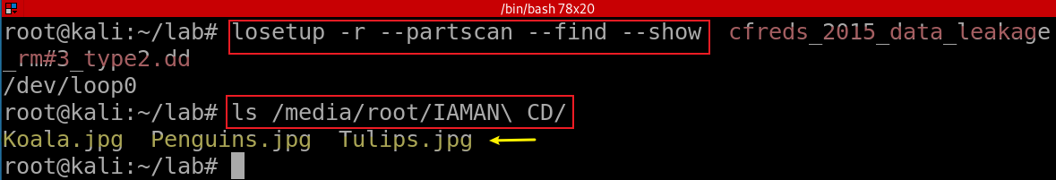
56.2 Review files on RM#3 image
Notes:
losetup -r --partscan --find --show cfreds_2015_data_leakage_rm#3_type2.dd
ls /media/root/IAMAN\ CD/

Slide 18

56.3 Search hidden strings
DD image may contain strings of human-readable text
Strings will search for strings
four characters or longer (default)

Slide 19
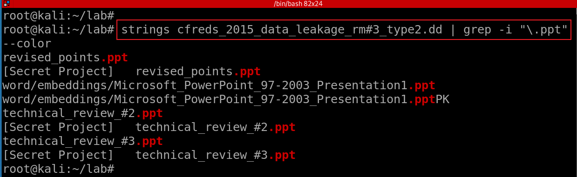
Search for files with extension .ppt
Notes:
strings cfreds_2015_data_leakage_rm#3_type2.dd | grep -i "\.doc" --color

Slide 20
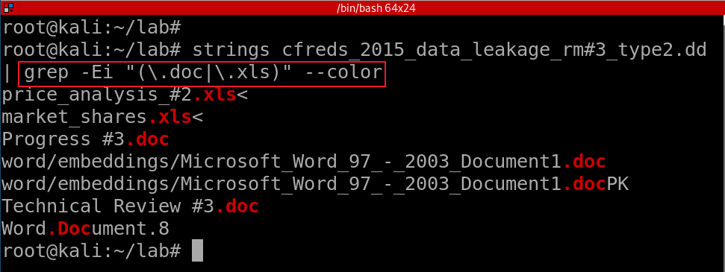
Search for files with extensions .doc or .xls
Notes:
strings cfreds_2015_data_leakage_rm#3_type2.dd | grep -Ei "(\.doc|\.xls)" --color

Slide 21
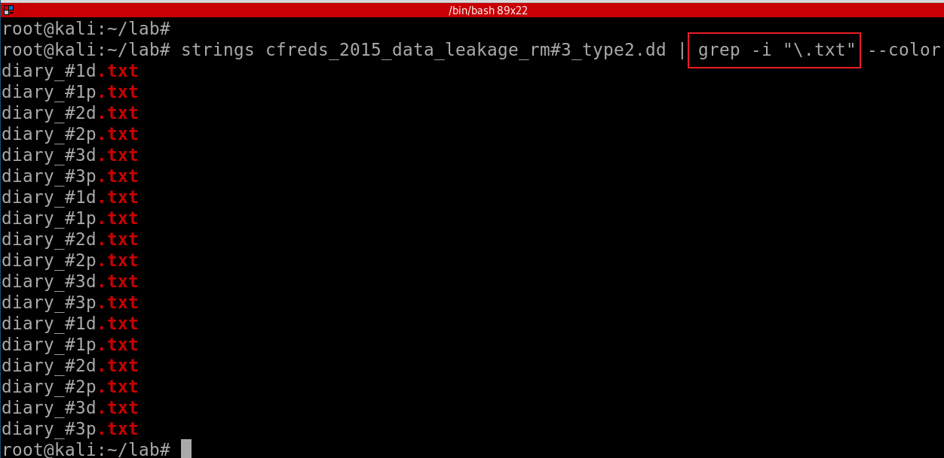
Search for files with extensions .txt
Notes:
strings cfreds_2015_data_leakage_rm#3_type2.dd | grep -i "\.txt" --color

Slide 22
56.4 Search hidden hex
View readable Hex of a file
1
Search readable Hex of file
2
Search unreadable Hex of file
3
JPG File signature
Search unreadable Hex of the DD image
4
All possible signature of files

Slide 23
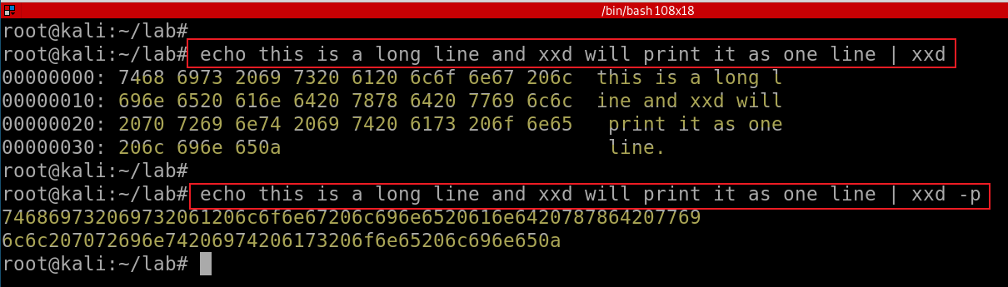
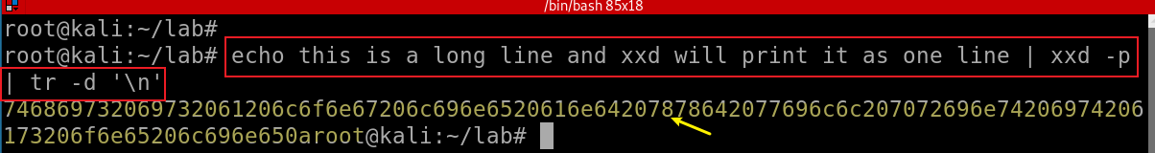
View readable Hex of a file
Demonstrate three different ways of show Hex of a file
-p: plain hexdump
-d: delete new line \n
Notes:
echo this is a long line and xxd will print it as one line | xxd
echo this is a long line and xxd will print it as one line | xxd -p
echo this is a long line and xxd will print it as one line | xxd -p | tr -d '\n'

Slide 24
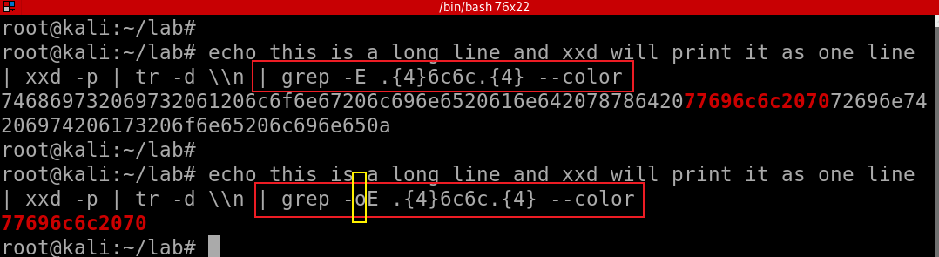
Search readable Hex of file
Search the hex of “ll” (the last two characters of the word “will” ) in the file and compare the output with and without -o
.{4} :Only match two characters before and after ll
Notes:
echo this is a long line and xxd will print it as one line | xxd -p | tr -d \\n | grep -E .{4}6c6c.{4} --color
echo this is a long line and xxd will print it as one line | xxd -p | tr -d \\n | grep -oE .{4}6c6c.{4} --color

Slide 25
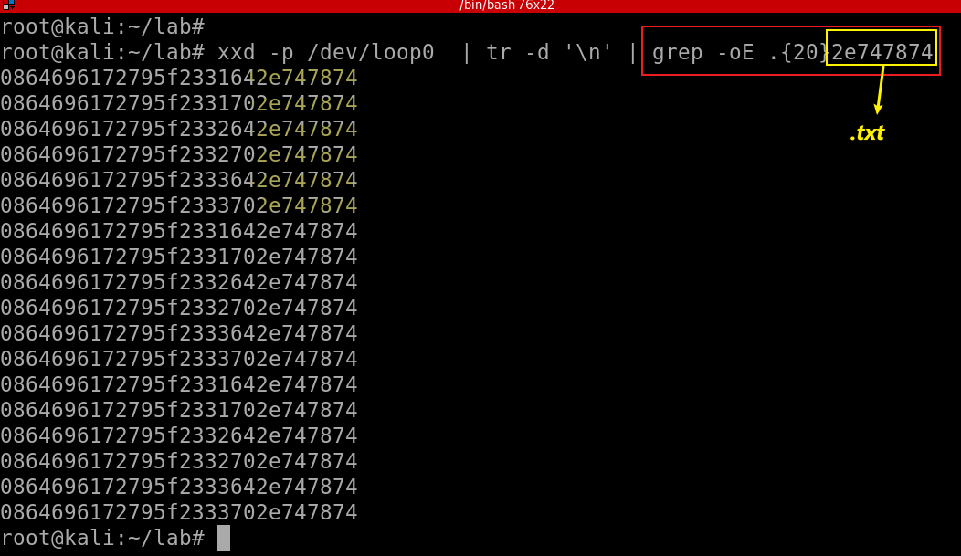
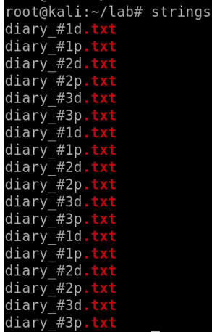
Search for any text string with .txt
Notes:
xxd -p /dev/loop0 | tr -d '\n' | grep -oE .{20}2e747874

Slide 26
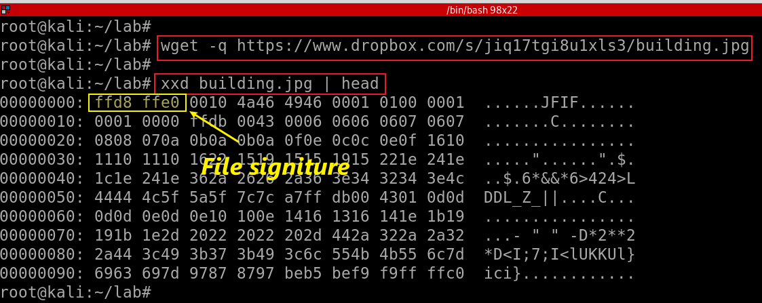
Search unreadable Hex of file:File signature
Show .jpg file signature (ffd8 ffe0)
Notes:
wget -q https://www.dropbox.com/s/jiq17tgi8u1xls3/building.jpg

Slide 27
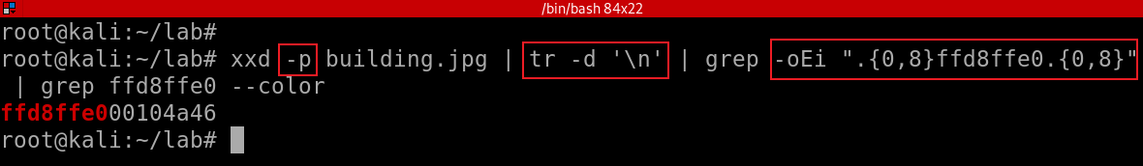
Show .jpg file signature (ffd8 ffe0) and only show 8 hex before and after the signature
Notes:
xxd -p building.jpg | tr -d '\n' | grep -oEi ".{0,8}ffd8ffe0.{0,8}" | grep ffd8ffe0 --color

Slide 28
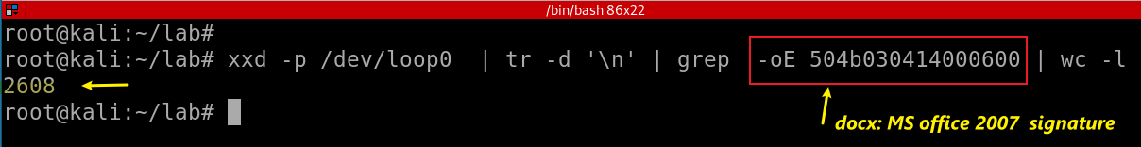
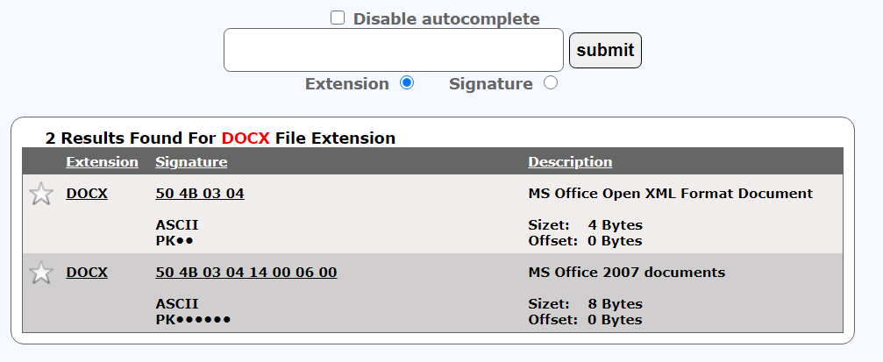
Search unreadable Hex of the DD image
Search for .docx file signature and count the number of signatures
https://www.filesignatures.net/index.php?search=docx&mode=EXT
Notes:
xxd -p /dev/loop0 | tr -d '\n' | grep -oE 504b030414000600 | wc -l

Slide 29
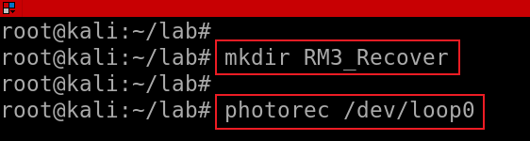
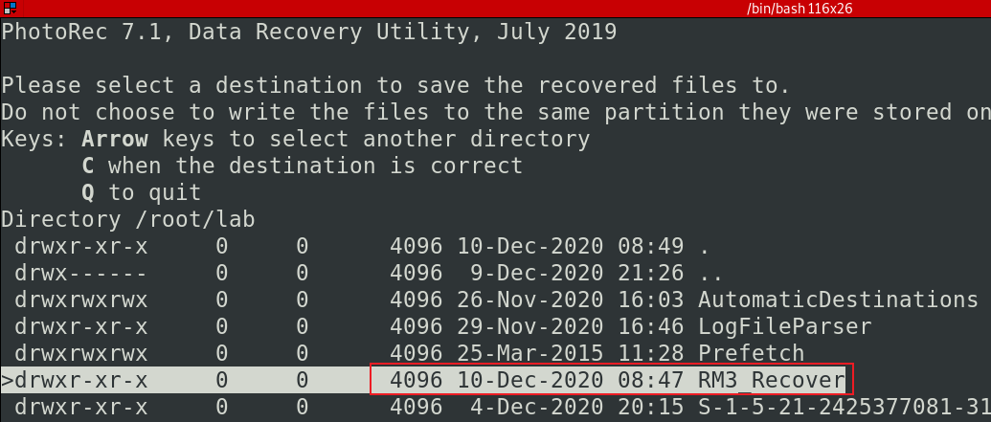
56.5 Recover the deleted files
Extract deleted files to RM3_Recover
Notes:
mkdir RM3_Recover
photorec /dev/loop0

Slide 30
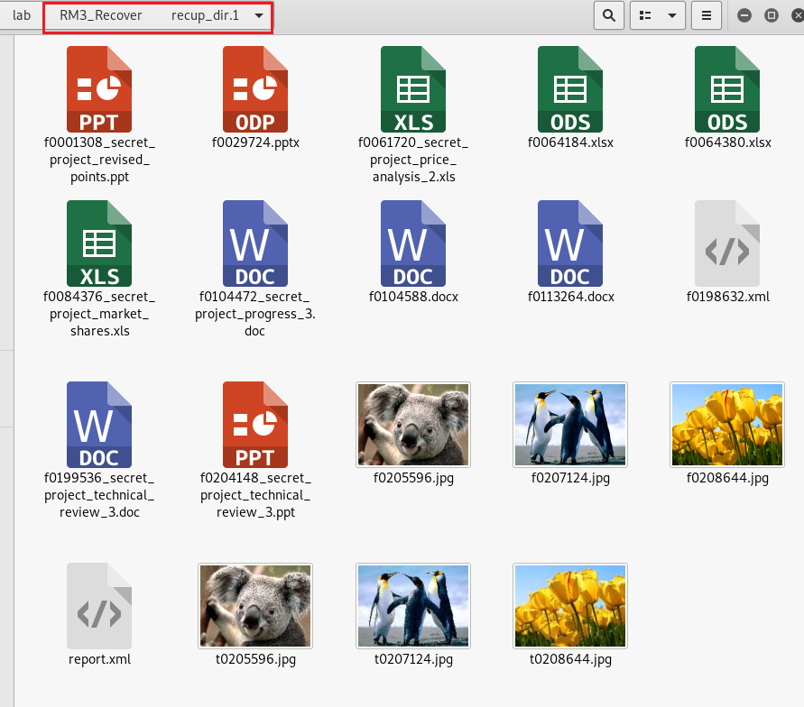

Slide 31
56.6 File carving CD-R
Anti-forensic techniques may apply to the CD-R
Based on strings and Hex search
Files are deleted
We plan to carve CD-R
Extracting structured data out of raw data, based on format specific characteristics present in the structured data.
Without any matching file system meta-data
Used to recover files from the unallocated space in a drive
Two tools
Binwalk, Formost

Slide 32
Binwalk
Binwalk is an open-source firmware extraction tool
Extracts embedded file systems from firmware images.
Created in 2010 by ReFirm Lab’s own Principal Reverse Engineer Craig Heffner
Widely recognized as the leading tool for reverse engineering firmware images.
Including more functions than xxd and grep
When process binary-based file stream
Pre-installed in Kali
apt-get install binwalk
Notes:
https://github.com/ReFirmLabs/binwalk/wiki/Usage

Slide 33
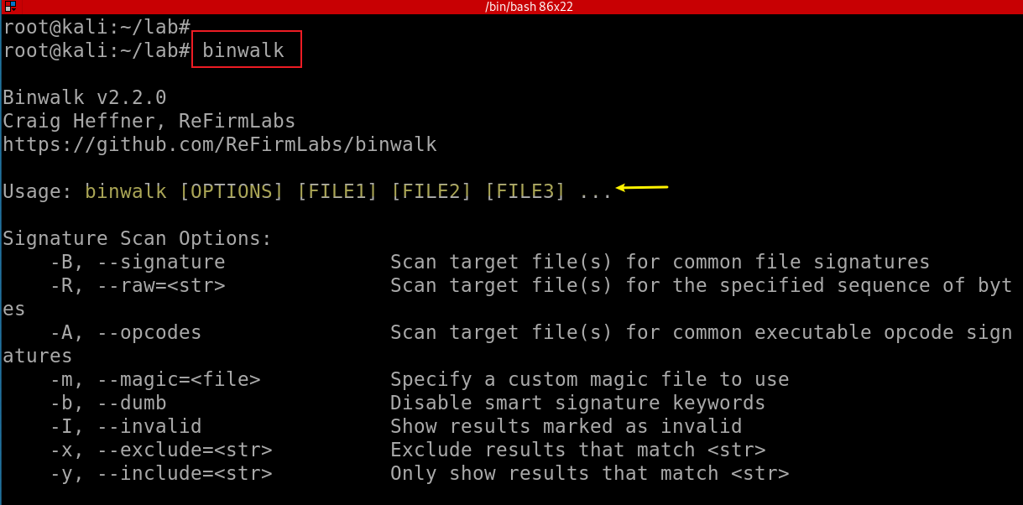

Slide 34
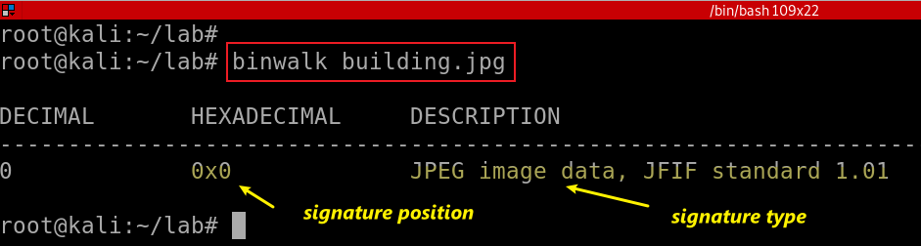
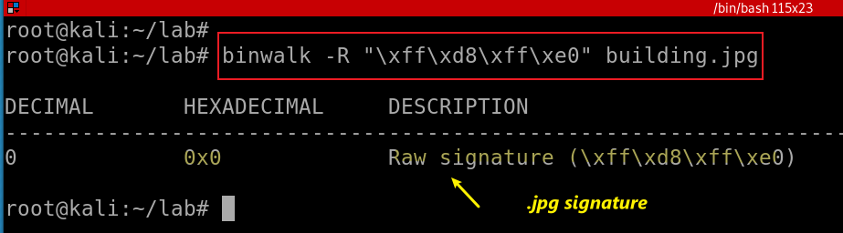
Extract signatures of Koala.jpg
Extract signatures (Hex) of Koala.jpg
Notes:
binwalk building.jpg

Slide 35
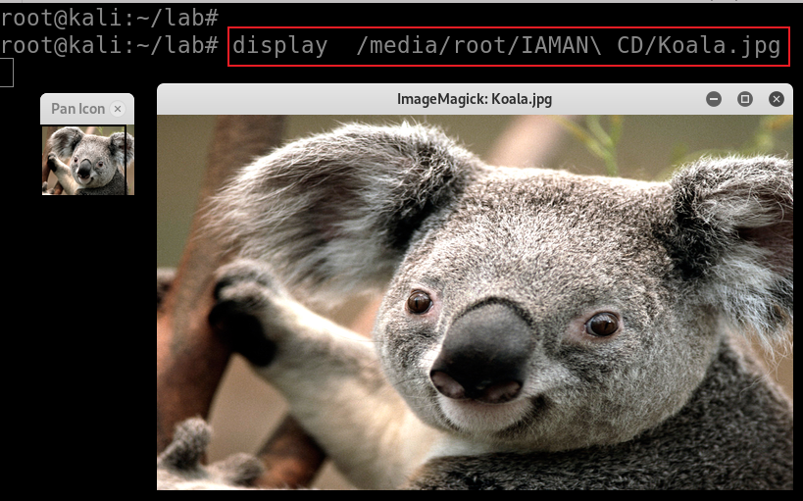
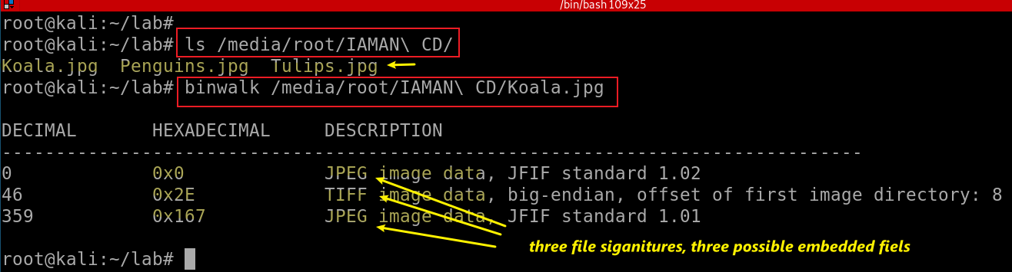
Extract signatures of Koala.jpg
Notes:
ls /media/root/IAMAN\ CD/
binwalk /media/root/IAMAN\ CD/Koala.jpg

Slide 36
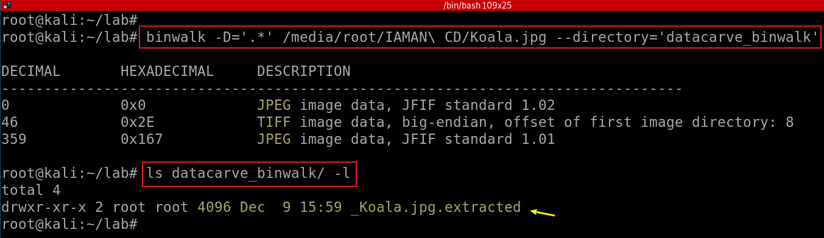
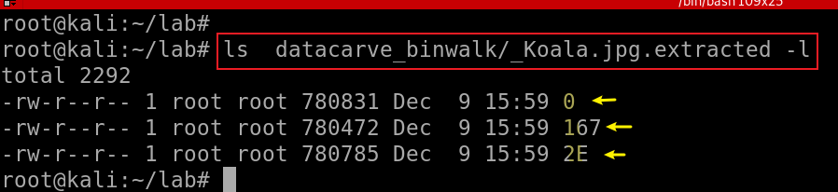
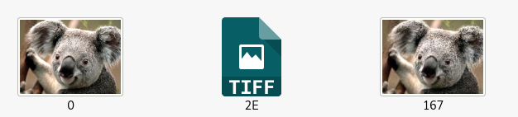
Notes:
binwalk -D='.*' /media/root/IAMAN\ CD/Koala.jpg --directory='datacarve_binwalk'
ls datacarve_binwalk/ -l

Slide 37
How to manually extract the third image using binwalk
Find the third jpg signature address
Find the jpg end address
Compute the size of the jpg
Copy the content to a new jpg

Slide 38
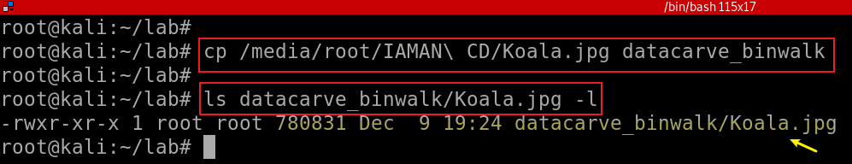
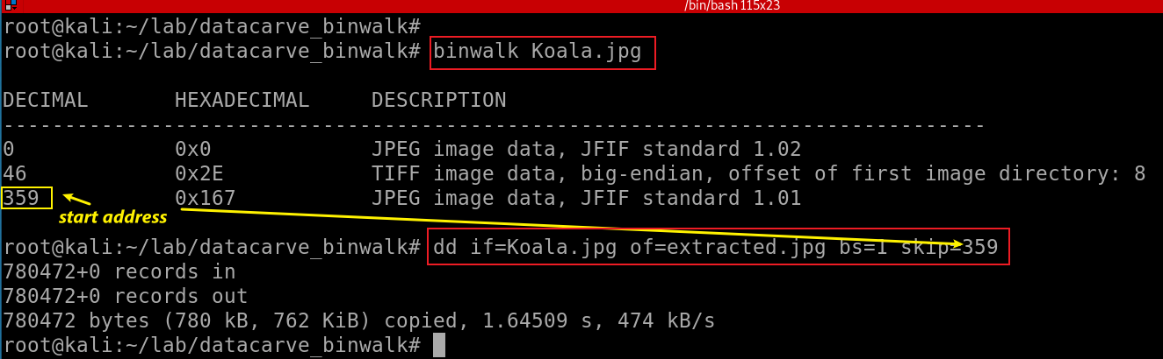
Create a working folder and copy Koala.jpg to the working folder
Extract the third image to a new file extracted.jpg
-bs: one-by-one copy
Notes:
cp /media/root/IAMAN\ CD/Koala.jpg datacarve_binwalk
ls datacarve_binwalk/Koala.jpg -l

Slide 39
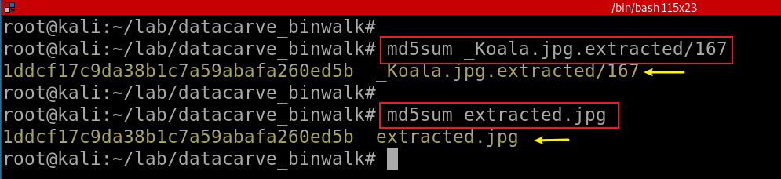
Verify two files (auto. vs manual. )are the same by comparing hash code
Can you extract files from /dev/loop0?
binwalk -D 'JPEG:jpg' /dev/loop0 --directory='CD_carved‘ it not working!
Notes:
md5sum _Koala.jpg.extracted/167
md5sum extracted.jpg

Slide 40
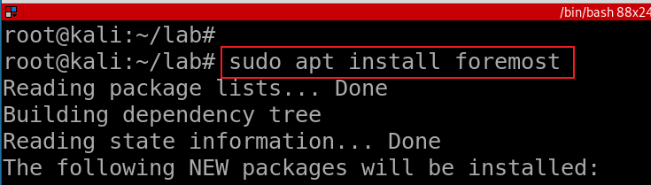
foremost
Data carving
Recover files based on their headers, footers, and internal data structures.
Foremost Support image types
dd, Safeback, Encase, etc, or directly on a drive.

Slide 41
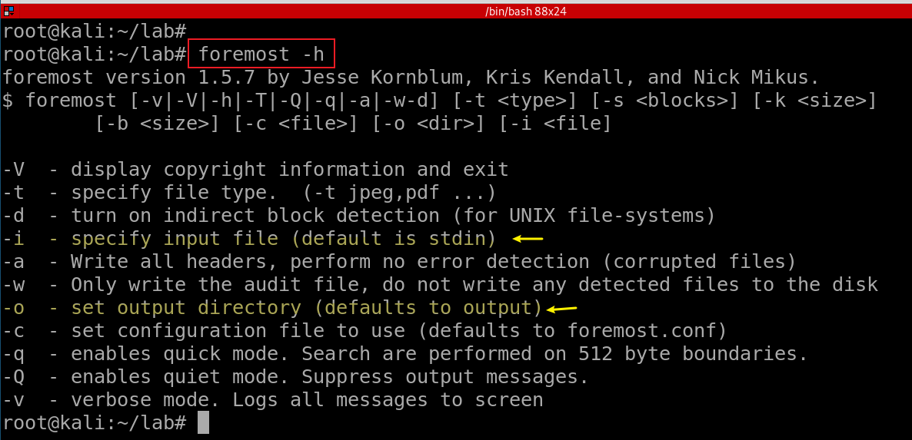
Notes:
Search for jpeg format skipping the first 100 blocks foremost -s 100 -t jpg -i image.dd
Only generate an audit file, and print to the screen (verbose mode) foremost -av image.dd
Search all defined types foremost -t all -i image.dd
Search for gif and pdf’s foremost -t gif,pdf -i image.dd
Search for office documents and jpeg files in a Unix file system in verbose mode. foremost -vd -t ole,jpeg -i image.dd
Run the default case foremost image.dd

Slide 42
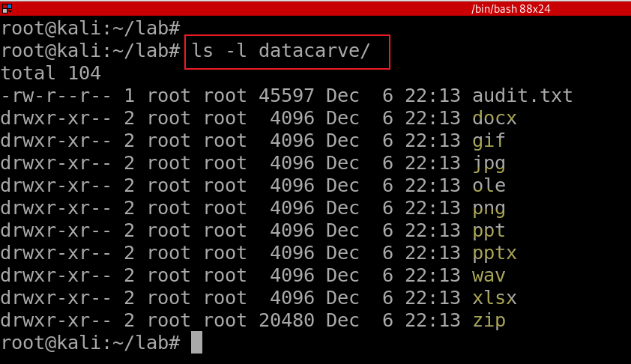
Notes:
foremost -i cfreds_2015_data_leakage_rm#3_type2.dd -o datacarve
ls -l datacarve/

Slide 43
57. What actions were performed for anti-forensics on CD-R ‘RM#3’?
Formatting CD-R (Burning Type 1: Like a USB flash drive)
01
There are only three files on CD-R
But we are able to recover many files (quick format)
Copying confidential files and some meaningless files to CD-R
02
Many file signatures (carving or string search)
Deleting confidential files from CD-R for hiding them
03
File recovering and carving

