Slide 1
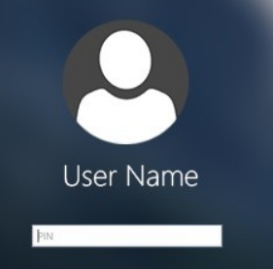
Crack Windows’ Passwords

Slide 2
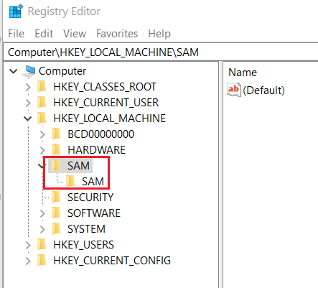
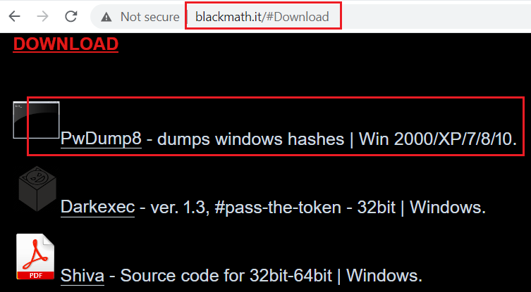
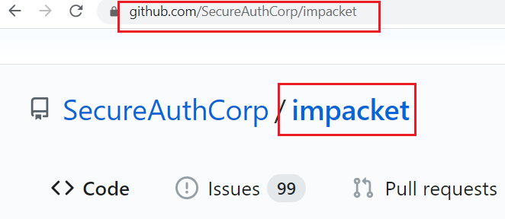
Questions need to be answered
Where Windows’ log on passwords are saved?
Are password saved in plaintext?
How to retrieve saved passwords (hash)?
How to recover these passwords from hashes?
How difficult to crack them?

Slide 3
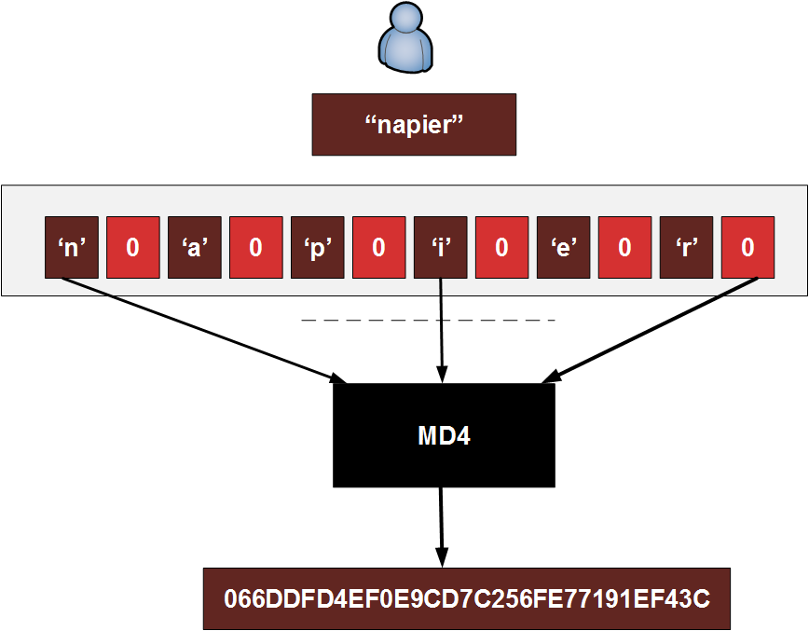
What is NTLM hashes?
New Technology LAN Manager (NTLM)
A Microsoft security protocols
intended to provide authentication, integrity, and confidentiality to users
Implemented with Windows NT , 7, and 10
Notes:
https://asecuritysite.com/encryption/lmhash?sortby=hashme

Slide 4
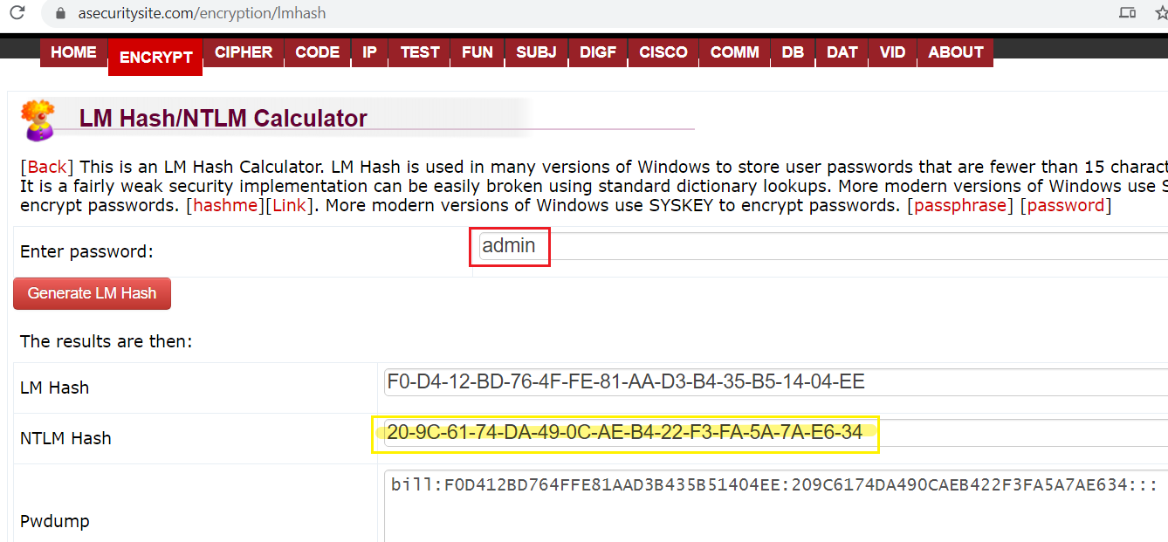
How to generate NTLM?
-f: from
-t: to
Notes:
iconv -f ASCII -t UTF-16LE <(printf "lolwut") | openssl dgst -md4
https://asecuritysite.com/encryption/lmhash
https://blog.atucom.net/2012/10/generate-ntlm-hashes-via-command-line.html

Slide 5
Background
We assume that you have successfully dumped Windows password NTLM hashes from the DD image from https://www.cfreds.nist.gov/data_leakage_case/data-leakage-case.html
For the purpose of the practice, we have provided the dumped password hashes (next slide)

Slide 6
Background
Information about passwords
The length is more than 8 characters
The length is less than 11 characters
Characters consist of all lower case alphabets and numbers
 | Password | NTLM Hash
1 |  | 9E3D31B073E60BFD7B07978D6F914D0A
2 |  | 21759544B2D7EFCCC978449463CF7E63
3 |  | 75ED0CB7676889AB43764A3B7D3E6943
4 |  | 1B3801B608A6BE89D21FD3C5729D30BF
Notes:
NT Hashes and user passwords (it will be useful for practicing Windows password cracking)
(a) 9E3D31B073E60BFD7B07978D6F914D0A → Password: informant#suspect1
(b) 21759544B2D7EFCCC978449463CF7E63 → Password: djemals11
(c) 75ED0CB7676889AB43764A3B7D3E6943 → Password: dkdlxpzmxla
(d) 1B3801B608A6BE89D21FD3C5729D30BF → Password: xpavhfkfl

Slide 7
The Lab Plan
Part 1: Practice crack passwords (up to 5 lower case alphabets, a-z)
01
Generate rainbow tables
Use generated rainbow table
e.g., admin=>209C6174DA490CAEB422F3FA5A7AE634
Part 2: Time Estimation
02
Part 3: Crack real-world passwords show in previous slide
03
Download pre-generated rainbow tables
Use pre-generated rainbow table

Slide 8
Part 1: Practice crack passwords
Assume the password consists of up to 5 lower case alphabets

Slide 9
The goal of the practice
Portend you don’t need know the plaintext password “admin”
(admin)=>209C6174DA490CAEB422F3FA5A7AE634
For the given NTLM
You need to find out what the plaintext password
We use the rainbow table attack
Why not brute-force? Space issue
Rainbow table is precomputed table for reversing cryptographic hash functions
Hash chains are a technique for decreasing this space requirement.

Slide 10
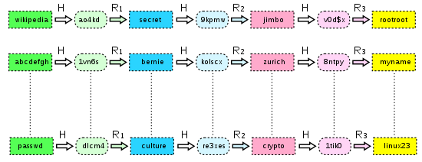
What is rainbow table attack?
R: reduce function: MUST map back to one potential passwords
Plaintexts
R
Hashes
p
H
chain_len
chain_num
Notes:
http://kestas.kuliukas.com/RainbowTables/

Slide 11
How Hash chains decreases the space requirement?
Only begin and end of each chain are saved

Slide 12

Given
yes
Match?
no

Slide 13
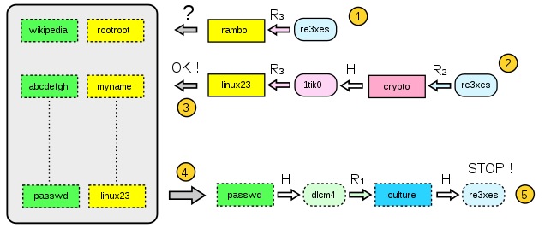

Slide 14
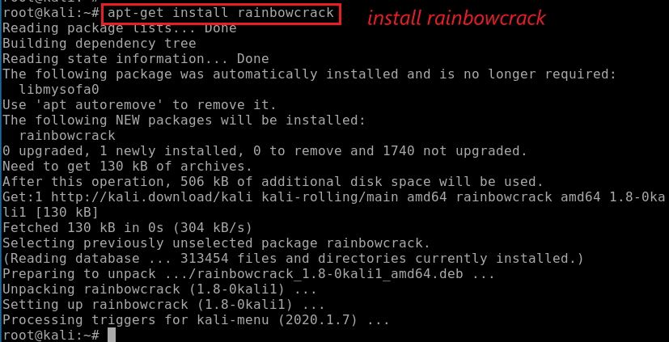
How to install NTLM hash crack tool?
Download and install

Slide 15

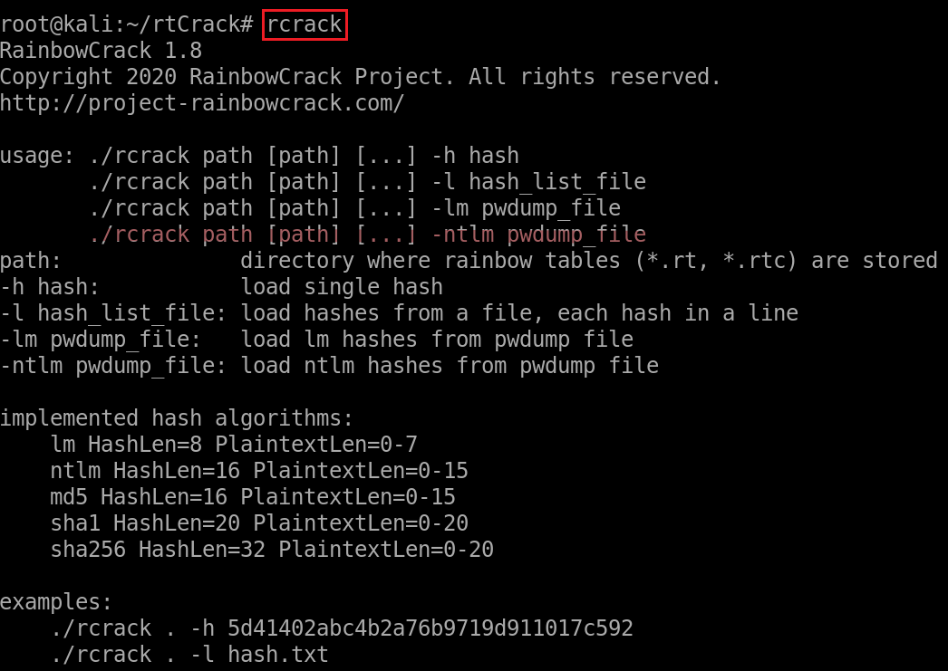
Create a working directory
Verify the installation

Slide 16
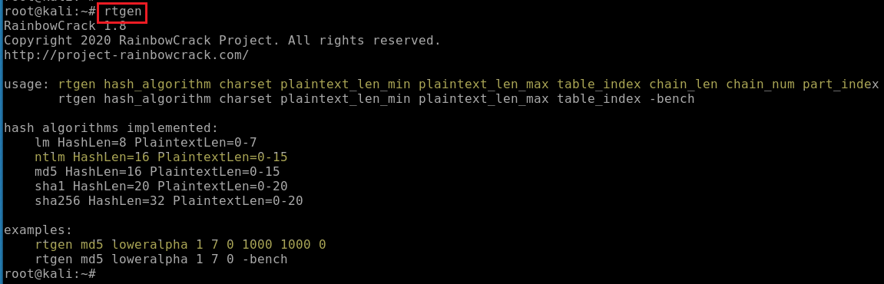
How to generate a password dictionary?
Show command help

Slide 17
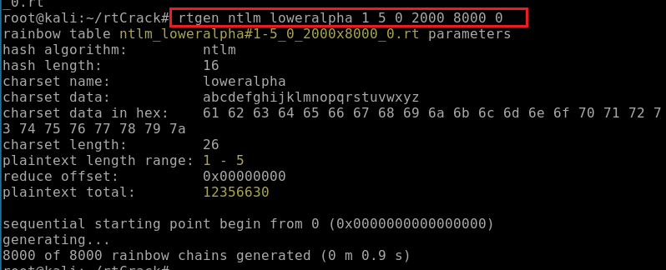
Generate rainbow table with up to 5 lower case letters
0: the reduction function
2000: length of a chain
8000: number of chain
0: belongs to a large table 0 (accept any names for the table sets if you use different R. See an example at next slide)
Need chain_lengh* chain_num > key size
Key size= 36^1 + 26^2 + 26^3 + 26^4 + 26^5 =12,000,000

Slide 18
Example: When using different reduce function (1-8) to generate rainbow tables with password length between 8 and 11.
What is the problem is chain_length and chain_num?
Notes:
Key size is huge
26^8+26^9+26^10+26^11=?
26^11=3.6703445e+15

Slide 19
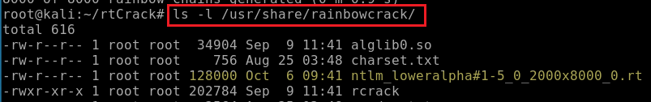
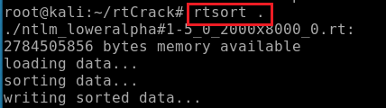
Find the generated file name and location
Sort the rainbow table for a fast search
Rainbow table is an array of rainbow chains. Each rainbow chain has a start point and an end point. The rtsort program sorts the rainbow chains by end point to make binary search possible.

Slide 20
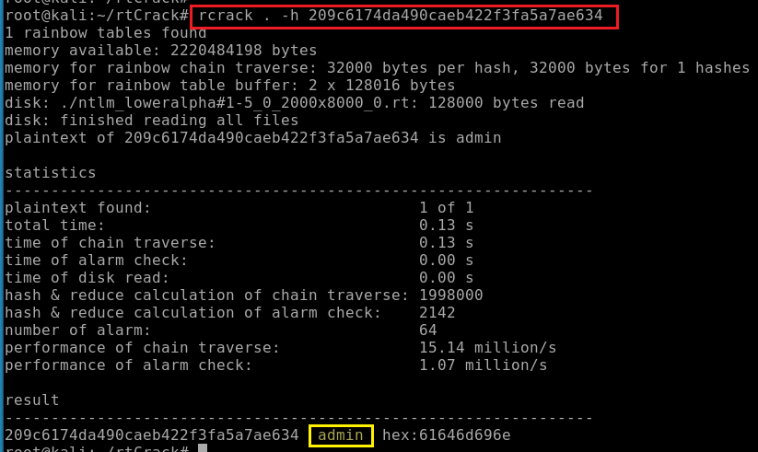
How to use the rainbow state to crack the password?
Notes:
rcrack . –h 209C6174DA490CAEB422F3FA5A7AE634

Slide 21
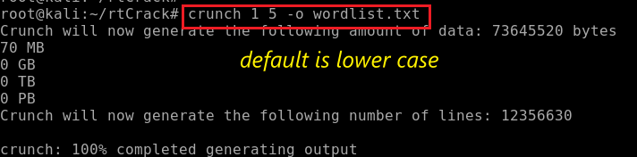
Let’s test Success Rates of rainbow table attack?
Generate a word list with length up to 5 lower case letters
Verify the generated wordlist with 73M

Slide 22
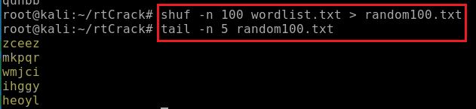
Randomly pick up 100 passwords

Slide 23
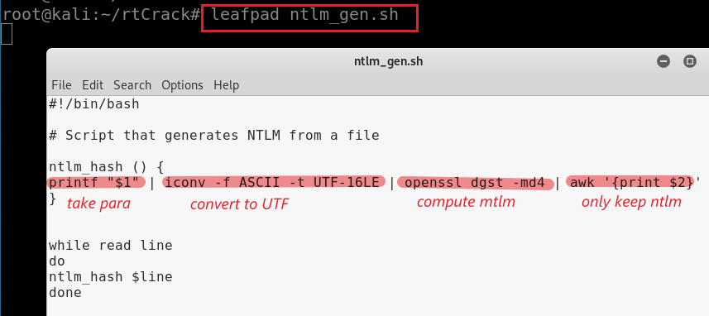
Write a short shell script to read each password and generate NTLM hash
Make the shell script executable
Notes:
#!/bin/bash# Script that generates NTLM from a filentlm_hash () {printf "$1" | iconv -f ASCII -t UTF-16LE | openssl dgst -md4 | awk '{print $2}'}while read linedontlm_hash $linedone

Slide 24

Optional method (if you want to download the shell script)
Make the shell script executable
Verify the script
Remove some special characters in script
Make the shell script executable
Notes:
https://www.dropbox.com/s/sdcj8hhyvk1ubyj/ntlm_gen.sh

Slide 25
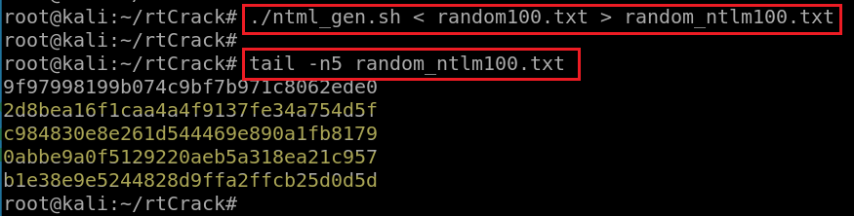
Run the script and generate 100 NTLM

Slide 26
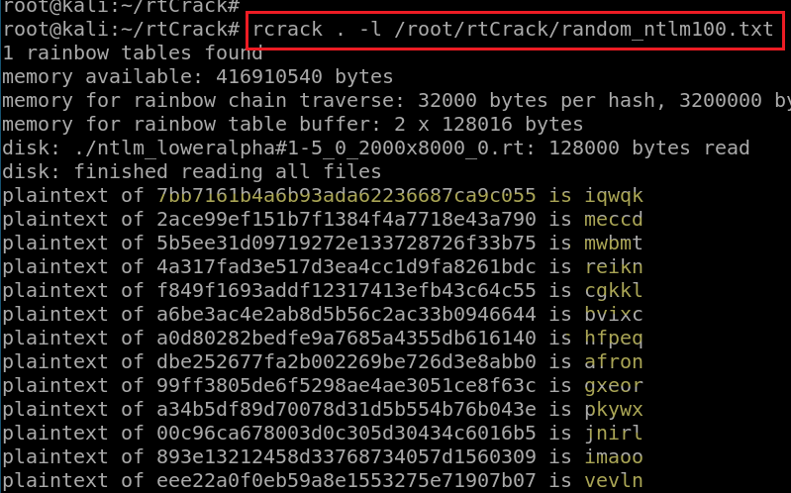
Find the location of 100 NTML
Crack these 100 NTML

Slide 27

Part 2: Time Estimation

Slide 28
Case study
How much time do we need to computer a rainbow table?
alpha-numeric (ABCDEFGHIJKLMNOPQRSTUVWXYZ0123456789)
plaintext length range: 1-7
How much time to crack passwords for given hashes?
LM (similar to NTLM, before Windows 7)
Hardware
Intel® Pentium® 4 3.2 GHz
1GB of RAM
Notes:
http://www.windowsecurity.com/uplarticle/Cryptography/LSO-RainbowCrack.pdf

Slide 29
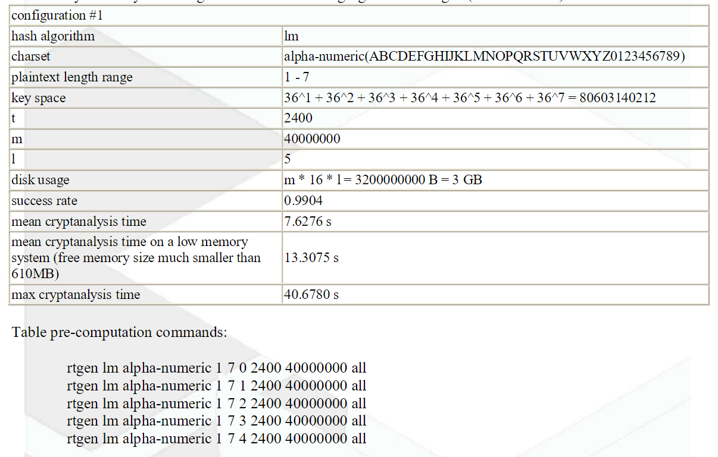
Configuration for generating rainbow table
5 days!

Slide 30
Tools | Algorithm | Time | Success Rates
rcrack | Rainbow table | 233 s | 32 of 41 (78.05%)
Cain | Brute force | 10 hours | 27 of 41
John the Ripper | Default dictionary | 3 minutes | 32 of 48
L0phtcrack | Rainbow table | 11 hours | 26 of 32
L0phtcrack | Brute force | 91 days

Slide 31
Part 3: Crack real-world passwords

Slide 32
