Slide 1
P2P Data Leakage (USN Journal Timeline)
Forensic Science – Cyber Investigations

Slide 2
Previous Presentations
0. Lab Setup
1. Disk Image and Partitions
2. Registry and File Directory
3. MFT Timeline
Note: This is a continuation of answering question #6 from MFT Timeline.

Slide 3
Objectives
Learn about the Update Sequence Number (USN) Journal.
Extract the contents of the USN Journal.
Create a timeline out of the USN Journal’s entries.
Learn how to filter the timeline for specific entries and/or periods of time.
All timestamps will be in the UTC format.

Slide 4
What is the USN Journal?
The USN (Update Sequence Number) Journal keeps a record of changes made to files and folders in a volume.
These changes include when a file or folder was opened, closed, renamed, created, deleted, etc.
The USN Journal is in the $Extend directory. Like the MFT, this folder is hidden and can only be seen by forensic tools.
Some tools that can see the $MFT: fls, ils, hex editors

Slide 5
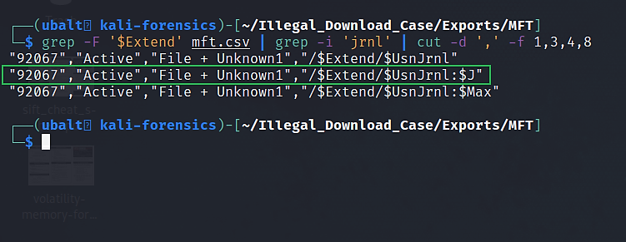
Location of the USN Journal.
There are three entries for the USN Journal. While the file is called $UsnJrnl, the USN Journal is in $UsnJrnl:$J.
$UsnJrnl is an empty file.
$UsnJrnl:$J is an alternate data stream of $UsnJrnl.

Slide 6
What is an alternate data stream (ADS)?
An alternate data stream is hidden data inside of a file on an NTFS volume.
They are not visible in file explorers or through command line tools such as dir and ls.
People can use alternate data streams to hide compromising information and/or malicious executables.

Slide 7
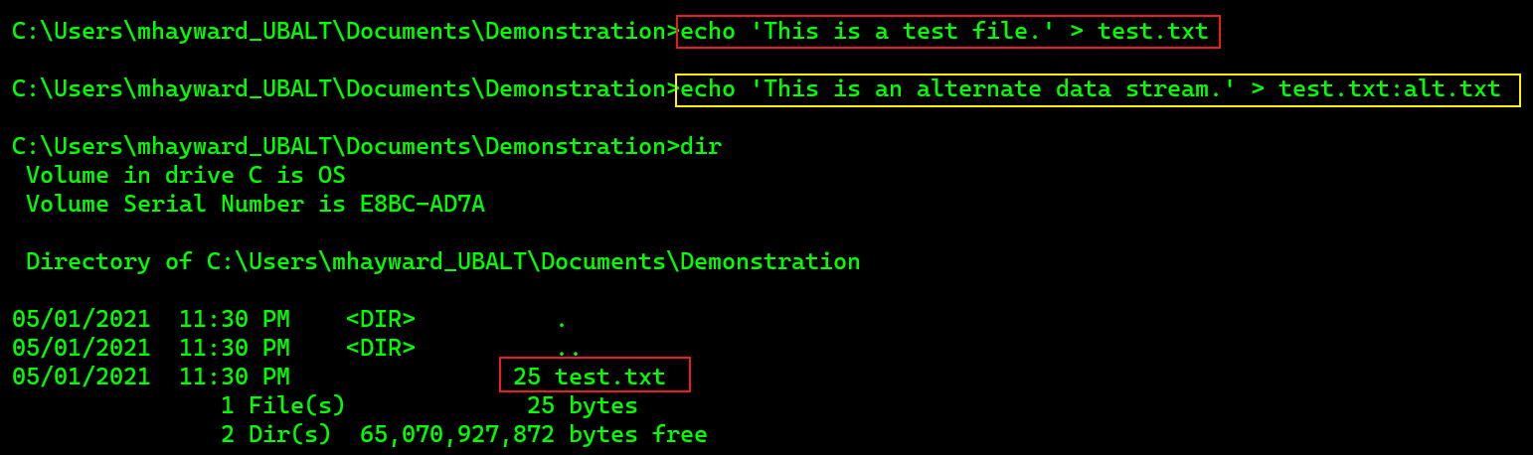
(Optional) How to create an alternate data stream.
In Windows Command Prompt (cmd.exe):
A text file called ‘test.txt’ was created.
‘test.txt:alt.txt’ is the alternate data stream. It is not visible when using the dir command (equivalent to ls on Linux).

Slide 8
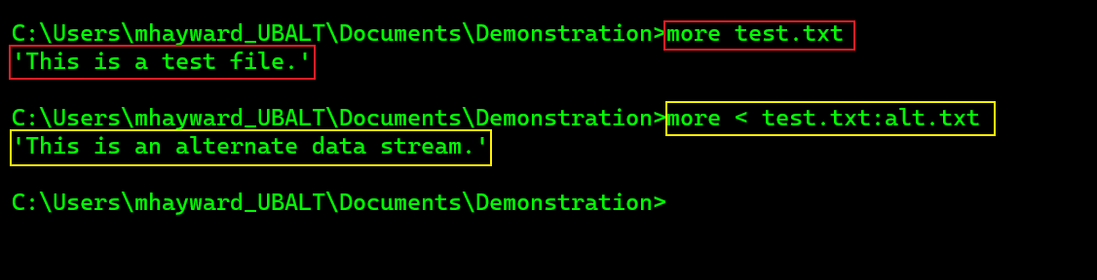
(Optional) How to create an alternate data stream.
In Windows Command Prompt (cmd.exe):
By using more (equivalent to cat on Linux) on test.txt, you only see the text you put on that file. You do not see what was on the alternate data stream.
You could see the contents of the alternate data stream by specifying test.txt:alt.txt.

Slide 9
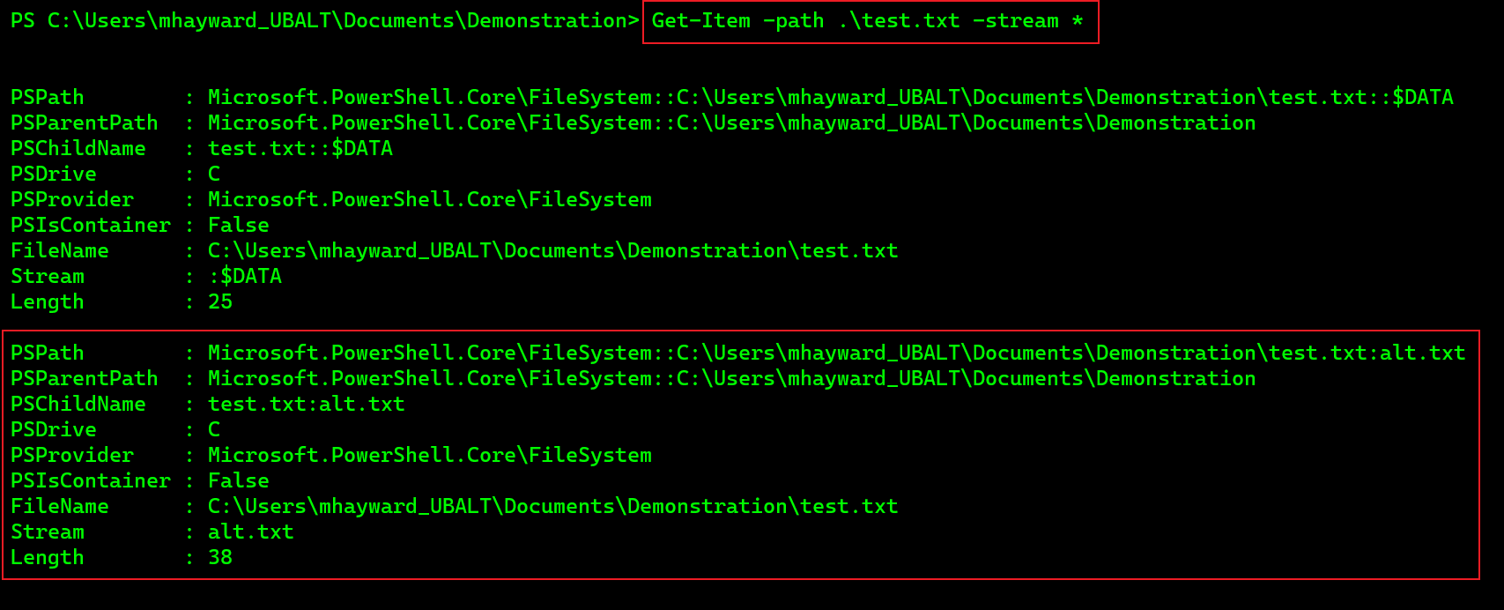
(Optional) Displaying the alternate data stream of our example file.
In Windows Powershell (powershell.exe):

Slide 10
How to use USN Record Carver.
USN Record Carver is a python script that will obtain the USN Journal from a disk image.
To use this tool, type in the ‘-f’ argument and point it to where the disk image is. Then use the ‘-o’ argument to output its contents to a separate file.
Command –
usncarve.py –f <disk image> -o <output file>

Slide 11
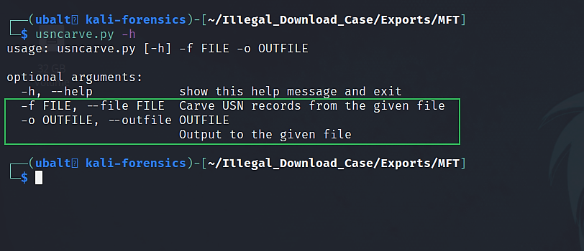
How to get help for USN Record Carver.

Slide 12
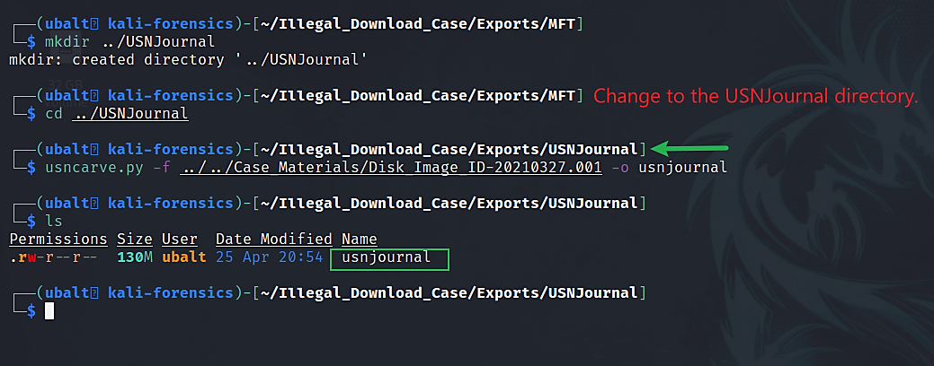
Use USN Record Carver to obtain the USN Journal entries.

Slide 13
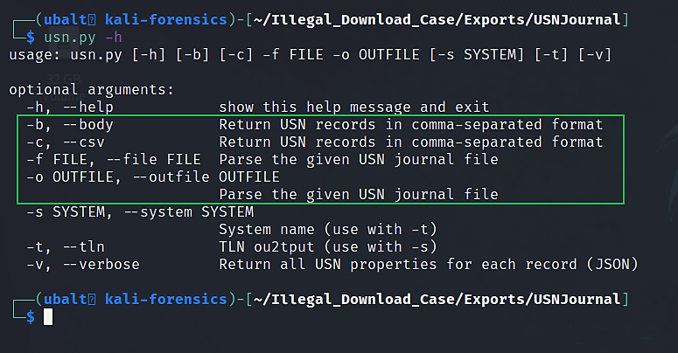
How to get help for USN Journal Parser.

Slide 14
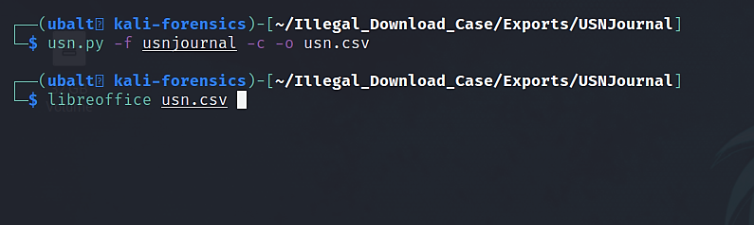
Use USN Journal Parser to parse the USN Journal entries.

Slide 15
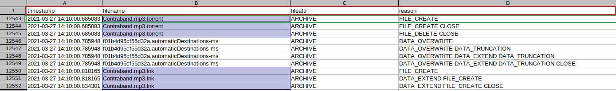
Open usn.csv in LibreOffice Calc.
Tip: Freeze the first row so that you will always see the column labels as you scroll down.

Slide 16
Layout of the USN Journal.
The timestamps are specific to what is shown in the ‘reason’ column.
The ‘reason’ column shows why the entry was recorded.
For example, a reason could be that the file was created. In this case, the reason for the entry would be ‘FILE_CREATE’.

Slide 17
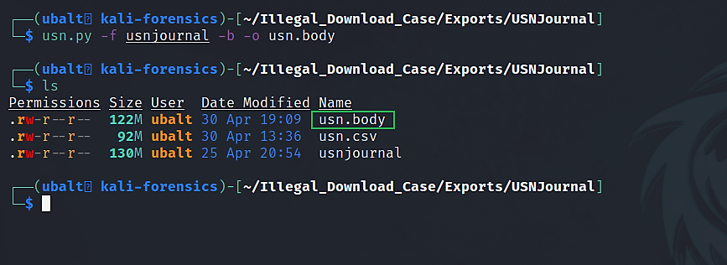
Use usn.py to generate a body file.

Slide 18
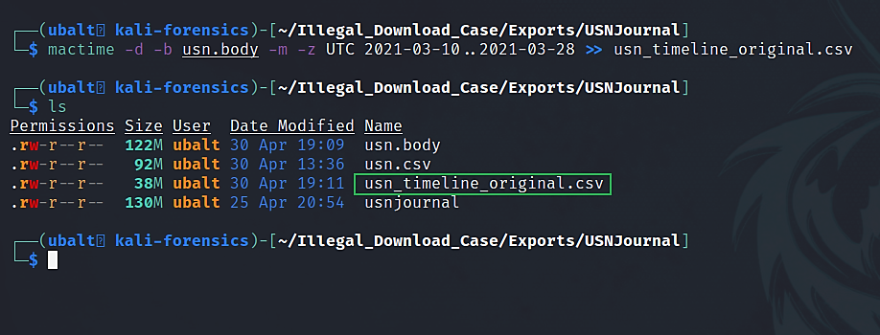
Use mactime to generate a timeline from the USN Journal records.

Slide 19
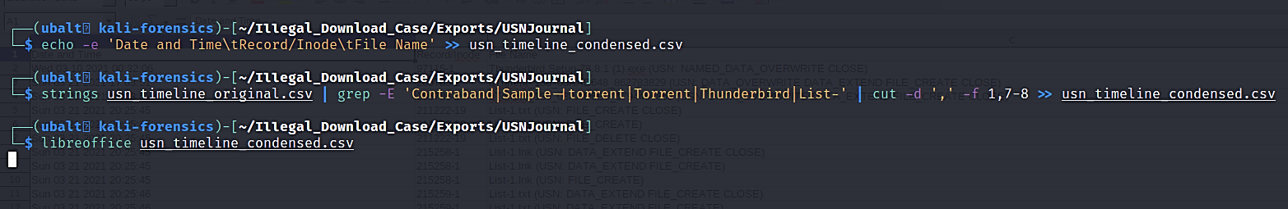
Analyze the timeline for files of interest.

Slide 20
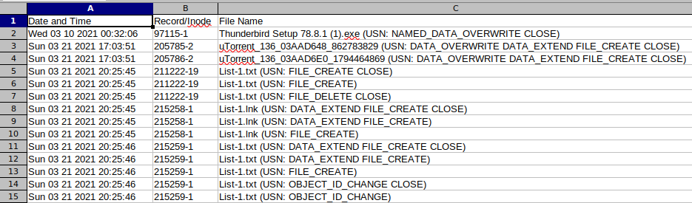
(Option 1) Analyze the timeline for files of interest in LibreOffice Calc or other spreadsheet application.
Note: The timeline lists the earliest dates at the top and the most recent dates at the bottom.

Slide 21
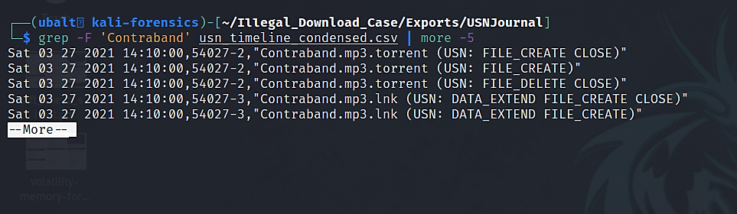
(Option 2) Analyze the timeline for files of interest in the terminal.
This shows Contraband.mp3.torrent being created on 3/27/2021 at 14:10:00. This validates what we found from the MFT timeline.
The timeline also includes the MFT record number. We can use istat to get further information about this file (example), or icat to extract it for further analysis (example).

Slide 22
Explanation
By looking at this timeline, you can see the file activity on the volume.
For example, if you grep for Contraband, you can see every instance of Contraband.mp3 and Contraband.mp3.torrent and the changes that were made to them.
For every file that catches your interest in the investigation, you can reference this timeline and verify what change took place at a given time.

Slide 23
Overview of what the timeline has about files of interest.
File Name | Action | Date/Time Recorded
uTorrent.exe | File Created | 03/21/2021 @ 20:39:07
Sample-1.mp3 | File Created | 03/21/2021 @ 20:40:28
Sample-1.mp3.torrent | File Created | 03/21/2021 @ 20:42:38
Contraband.mp3.torrent | File Created | 03/27/2021 @ 14:10:00
Contraband.mp3 | File Created | 03/27/2021 @ 14:13:44
Note: This is not a complete timeline of the events.
These entries are the first recording of the respective files in the USN Journal. These do not match the first recordings on the MFT timeline.
uTorrent’s entry here coincides with the MFT’s entry of uTorrent.exe being created in /Users/Kamryn/AppData/Roaming/uTorrent. (This may suggest that the torrent app was used at this time.)
Sample-1.mp3’s entry here matches the MFT’s entry of this file in /Users/Kamryn/Documents/Reference/Work. (The Sample-1.mp3 in /Users/Kamryn/Downloads was not recorded in the USN Journal.)
Notes:
You could look at Volume Shadow Copies to check earlier copies of the USN Journal. It is possible you could find the entries there.

Slide 24
What do we gain from this timeline?
Compared to the MFT timeline, the USN timeline gives us specific entries for file activity.
The MFT provides the time certain files were created. With the USN timeline, we get creation times in addition to other important file actions such as deletion or renaming.
If any of the .mp3 files were renamed, the USN timeline would have entries showing what the file was originally called.
Likewise, if the files were deleted, this timeline could prove that the files existed on the system.
In this case, none of the files of interest were deleted or renamed.
You may see identical entries between the MFT and USN timelines.
For Contraband.mp3, the MFT records the file being created on 3/27/2021 at 14:13:44. The USN timeline also says the file was created at this time.
This timeline does not show file paths unlike the MFT timeline. Be aware that while you have specific entries for file activity, you need to know where those files are on the file system. Therefore, comparing these entries with the MFT timeline is recommended.

Slide 25

Alternate Ways of Answering the Question
Log2timeline is a very powerful tool that can parse the USN Journal. However, a new user could be overwhelmed by the number of options it has.

Slide 26
Next Presentation
uTorrent Log File

