Slide 1
iPhone iOS Device Investigations
General Device Information, Account Information, Jailbreak

Slide 2
Overview
iPhone Device information
Account information
Jailbreaking

Slide 3
iPhone Device Information

Slide 4
Overview
Description | Path
Build Version | ~/var/installd/Library/MobileInstallation/LastBuildInfo.plist
iOS Version | ~/var/installd/Library/MobileInstallation/LastBuildInfo.plist
Phone Number | ~/private/var/wireless/Library/Preferences/com.apple.commcenter.plist
Carrier Info | ~/private/var/wireless/Library/Preferences/com.apple.commcenter.plist
Device Serial Number | ~/private/var/logs/AppleSupport/general.log
Device Model Number | ~/private/var/logs/AppleSupport/general.log

Slide 5
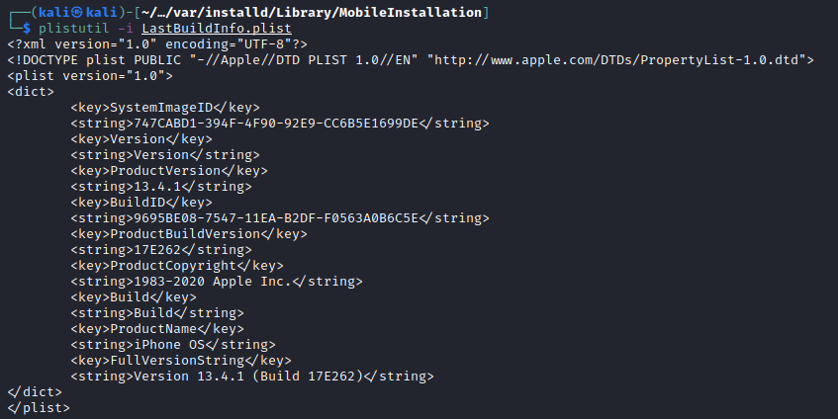
What is the software version information?
iOS Version (Short)
Build Number (Short)
iOS + Build (Full String)
Notes:
Cd into /var/installd/Library/MobileInstallation
Plistutil -i LastBuildInfo.plist

Slide 6
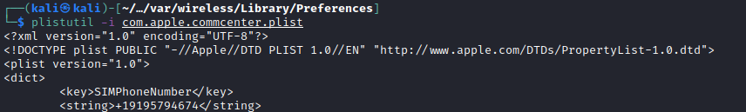
What is the phone number?
Com.apple.commcenter.plist – Found at ~/private/var/wireless/Library/Preferences
Plistutil –I com.apple.commcenter.plist
The phone number registered to the SIM card inside this iPhone is +19195794674
Notes:
~/private/var/wireless/Library/Preferences
Plistutil –I com.apple.commcenter.plist

Slide 7

What is the device’s ICCID?
Integrated Circuit Card Identifier – One of a kind signature that identifies the SIM card.
Com.apple.commcenter.plist – Found at ~/private/var/wireless/Library/Preferences
Plistutil –I com.apple.commcenter.plist
Scroll down until you see this string
ICCID: 8901260971148676693

Slide 8

What is the device’s IMSI?
International Mobile Subscriber Identity – Unique code used to identify mobile networks & users.
IMSI is part of the identification process granting it access.
Com.apple.commcenter.plist – Found at ~/private/var/wireless/Library/Preferences
Scroll down until you see this string
IMSI: 310260974867669

Slide 9
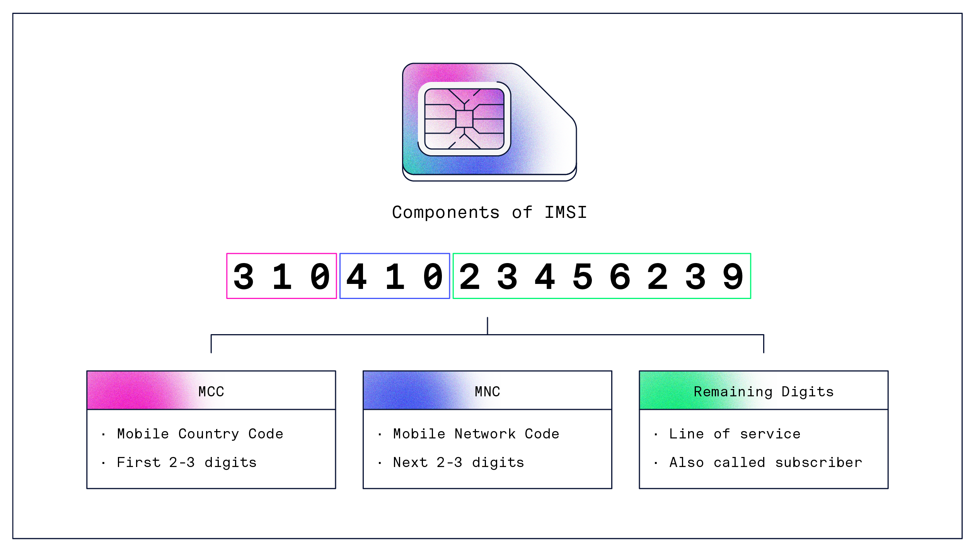
Notes:
https://www.hologram.io/blog/imsi

Slide 10


What are the device’s MCC & MNC codes?
Mobile Country Code (MCC) and Mobile Network Code (MNC) are used to find & identify network providers.
Com.apple.commcenter.plist – Found at ~/private/var/wireless/Library/Preferences
Plistutil –I com.apple.commcenter.plist
MCC: 310 (US)
Scroll down until you see these strings
MNC: 260 (T-Mobile)
Phone user was on the T-Mobile Network
Notes:
https://en.wikipedia.org/wiki/Mobile_network_codes_in_ITU_region_3xx_(North_America)

Slide 11

What is the serial number?
A serial number is a unique, identifying number or group of numbers and letters assigned to an individual piece of hardware or software.
General.log – Found at ~/private/var/logs/AppleSupport
Cat general.log
Serial Number: DX3T126VH2XV

Slide 12
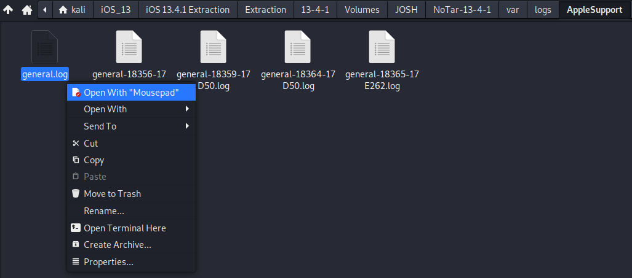
What is the device’s model number?
A model number is a unique number given to each product. Model numbers allow manufactures to keep track of each hardware device.
General.log – Found at ~/private/var/logs/AppleSupport
View with text editor.
Notes:
https://www.theiphonewiki.com/wiki/Models

Slide 13

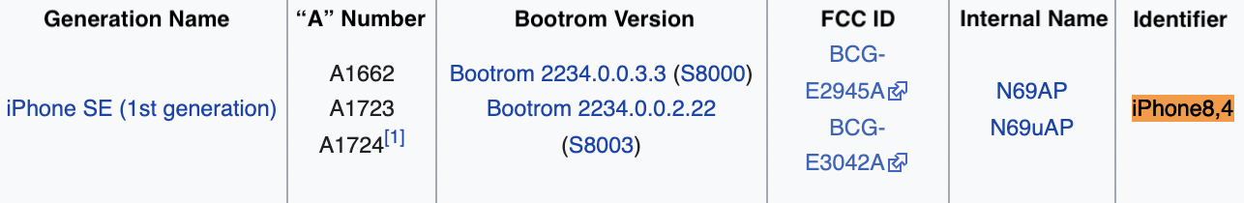
What is the device’s model number (2)
Image came from an iPhone SE (1st Generation)

Slide 14

Account information

Slide 15
Overview
Description | Path
Apple ID | ~/var/mobile/Library/Accounts/Accounts3.sqlite
Last iTunes Backup Date | ~/var/mobile/Library/Preferences/com.apple.mobile.ldbackup.plist
Last iCloud Backup Date | ~/var/mobile/Library/Preferences/com.apple.mobile.ldbackup.plist
Location Services | ~/private/var/mobile/Library/Preferences/Com.apple.locationd.plist

Slide 16
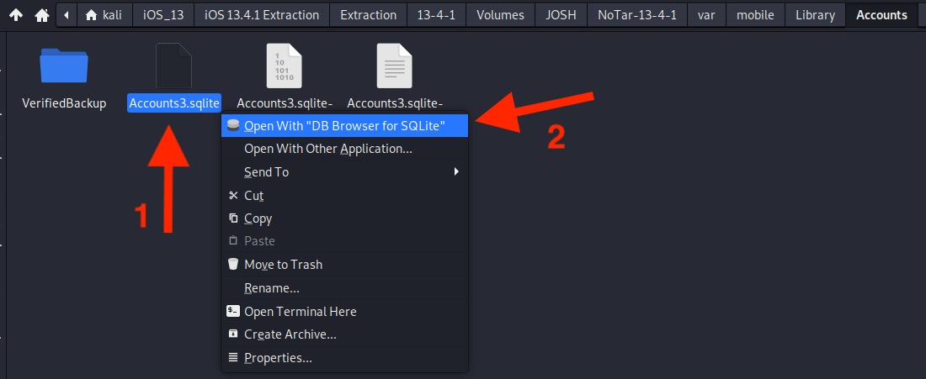
What is the iCloud account present?
Account information in stored in a database file called Accounts3.sqlite.
Found at ~/var/mobile/Library/Accounts/Accounts3.sqlite
Use DB Viewer to view database.

Slide 17
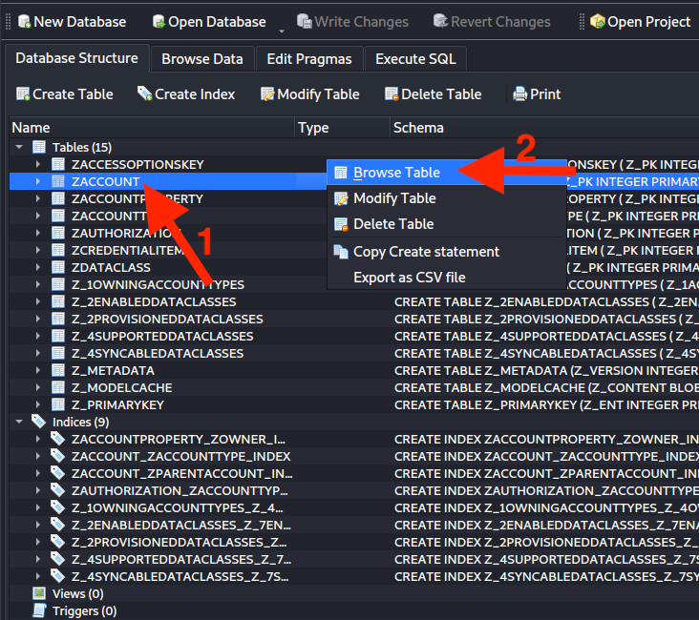
Right click on the ZACCOUNT table and select Browse Table

Slide 18
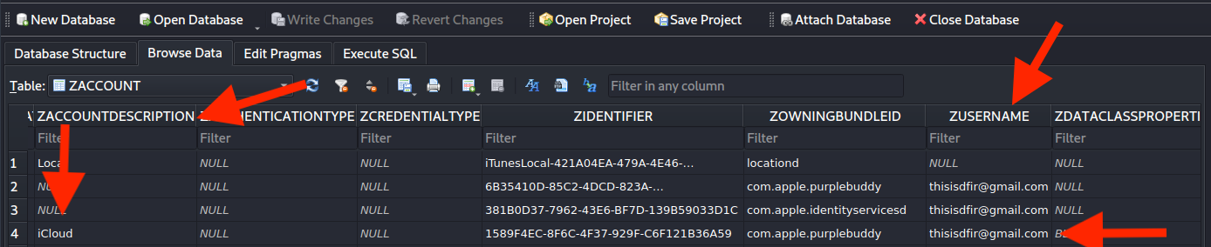
Under the ZACCOUNTDESCRIPTION column look for an “iCloud” field. Directly over is the ZUSERNAME column. Match up the row and that is the iCloud account.
In this case, the iCloud linked to this iPhone is thisisdfir@gmail.com

Slide 19
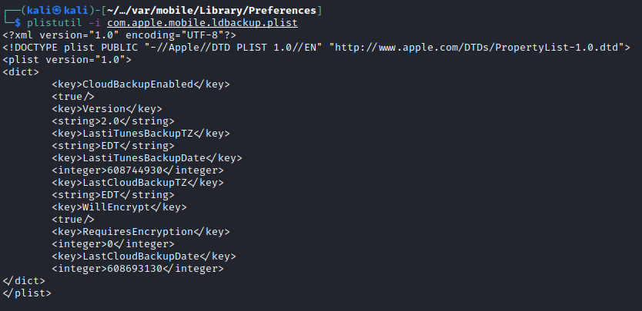
Last iTunes & iCloud Backup date.
Data for the last time an iPhone was synced with iTunes or iCloud can be found here:
~/var/mobile/Library/Preferences/com.apple.mobile.ldbackup.plist
Plistutil -i com.apple.mobile.ldbackup.plist
True means iCloud backups are enabled. False means iCloud backups are disabled
Time zone backup was done in. EDT = Eastern Daylight Time
Backup date stamps, in Apple Cocoa Core Date format

Slide 20
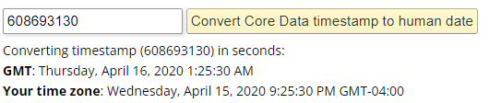
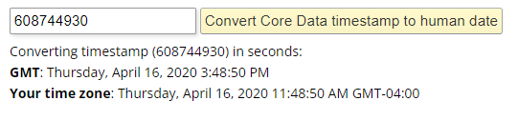
Converting Cocoa Core Date to Human time
The Cocoa Core Data Timestamp is the number of seconds since midnight, January 1, 2001, GMT.
To convert visit: epochconverter.com/coredata
LastCloudBackupDate: 608693130
LastiTunesBackupDate: 608744930
iCloud
iTunes

Slide 21
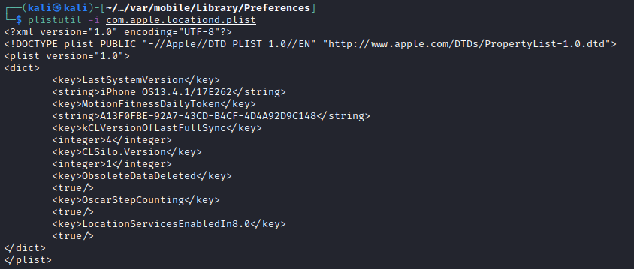
Location Services
Com.apple.locationd.plist - Found at ~/private/var/mobile/Library/Preferences
Contains:
Information if Location services are enables.
Plistutil –I –com.apple.location.plist
True = Location services are enabled, False = Disabled.

Slide 22
Jailbreak

Slide 23
What is Jailbreak - how does it affect iOS.
The term jailbreak is the process by which full execute and write access is obtained on all the partitions of iOS. Modern jailbreaks include patching the kernel to get around code signing and other restrictions.
There are two types of jailbreak semi-tethered and semi-untethered.
When a device begins booting, it loads Apple’s own kernel initially, so a jailbroken device must be exploited and have the kernel patched each time it is booted up
Semi-tethered solutions are the lease popular form of jailbreaking. Every time the user reboots their phones the jailbreak will be removed, meaning they must tether their phone to their computer and run the jailbreak software to keep the jailbroken state on their device.
Semi-untethered is the most popular form of jailbreak which allows users to reboot their phones and resume the jailbreaking features without having to attach to a computer to patch the kernel.

Slide 24
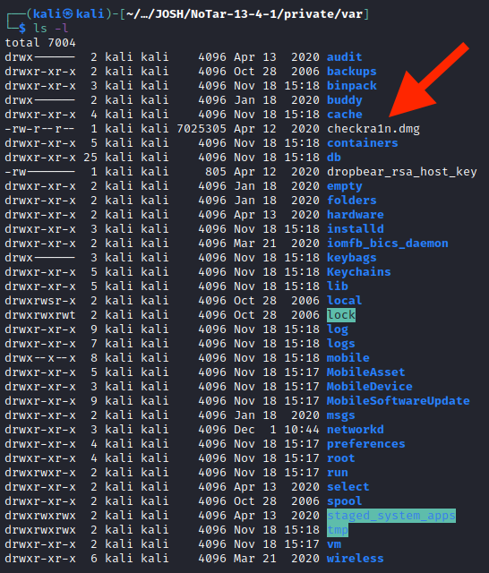
Finding evidence of Jailbreak
Supported jailbreaking software on iOS 13.4.1
Checkra1n
Odyssey
Unc0ver
Discovering Evidence of Jailbreak
In the user's folder located at ~/var you will find a disk image (dmg) of one of the jailbreak Softwares.
Here we can see there is a checkra1n.dmg located at the root of the user’s folder.
Notes:
https://www.theiphonewiki.com/wiki/Jailbreak/13.x
Ls –l

Slide 25
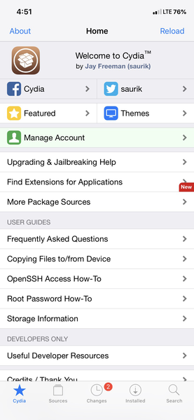
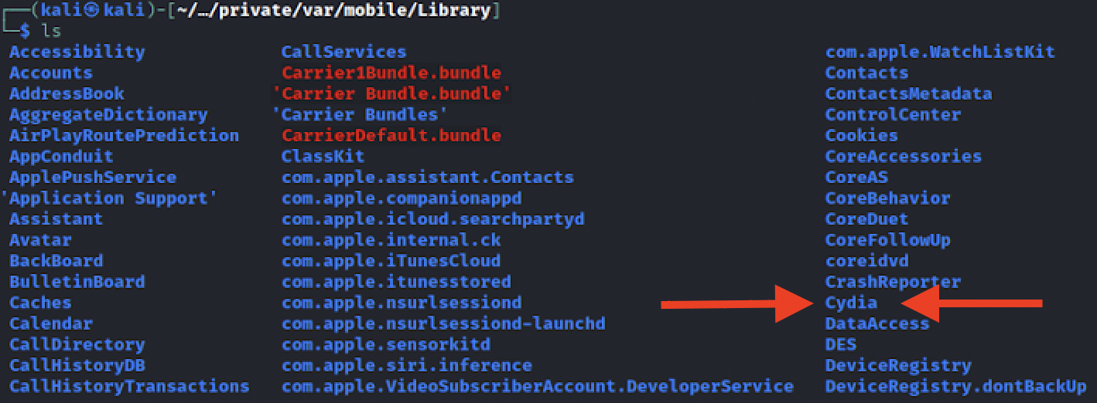
Finding evidence of Jailbreak (cont.)
Another place to check is ~/var/Mobile/Library. Specially looking for a Cydia folder.
Cydia is an open-source software installer that uses the Debian APT system for package management.
Notes:
https://www.theiphonewiki.com/wiki/Cydia.app

