Slide 1
iOS System and App Settings

Slide 2
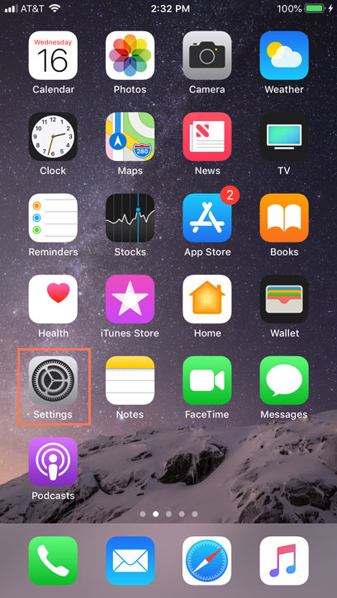
iOS System Settings Overview
The Settings Application on iOS devices controls everything from the way your iPhone works to the data it shares with apps and other devices.
Settings gives you easy access to many different things, including settings for your notifications and privacy.

Slide 3
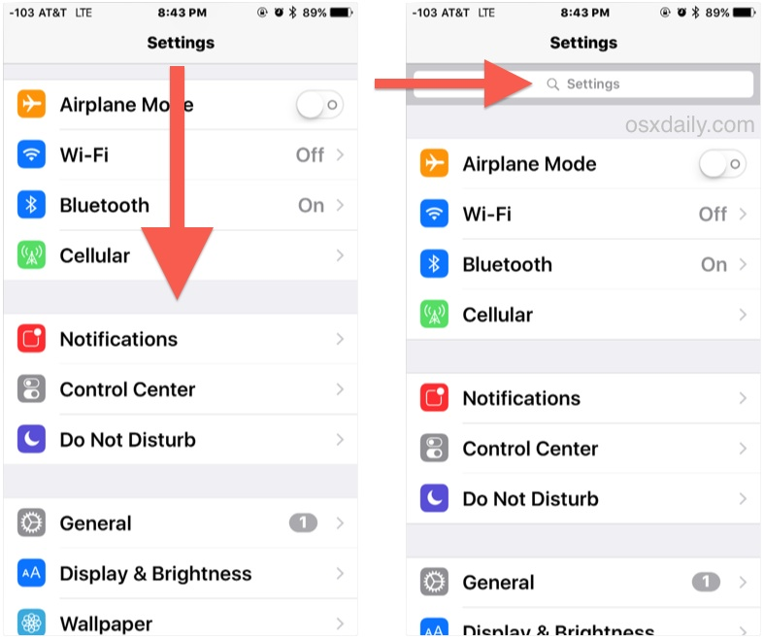
Understanding Application Settings
Applications, both first and third party also have their own settings or preferences. Some may be toggled directly in the app or directly in the Settings app. Usually notification preferences are handled by the Settings app, but settings like display preferences are handled directly by the application itself.

Slide 4
Where are system settings stored on iOS

Slide 5
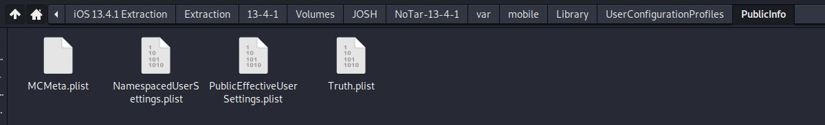
Where are settings stored from the Settings App?
Settings from the Settings Application may be found in plist xml format here: ~/var/mobile/Library/UserConfigurationProfiles/PublicInfo
There are two (2) important plists to mention here. Truth.plist is the default settings for the Settings App. Either when a new iPhone is configured or the User resets settings back to default.
PublicEffectiveUserSettings.plist are what the current settings are set to by the user.
Boolean Values so either True or False. True = enabled, False = Disabled.

Slide 6
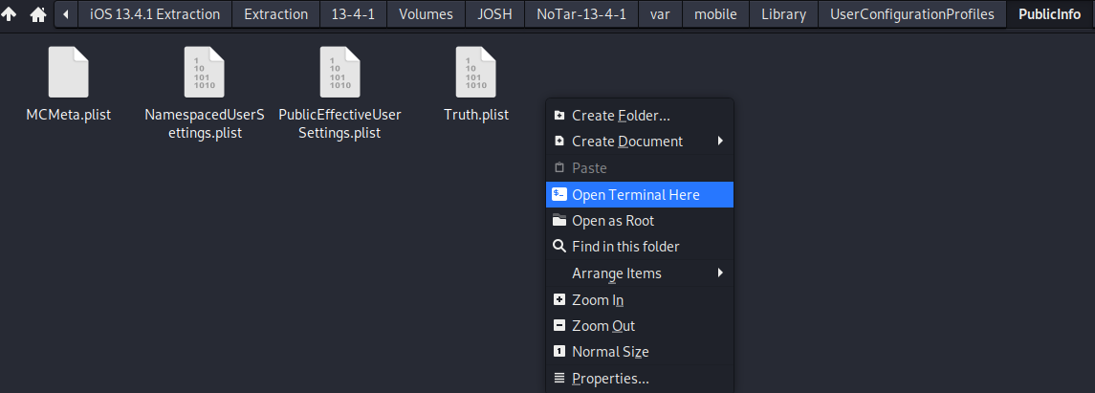
Examining System Settings
Navigate to ~/var/mobile/Library/UserConfigurationProfiles/PublicInfo
Right click in the Public Info folder and open terminal.
Plistutil –I PublicEffectiveUserSettings.plist

Slide 7
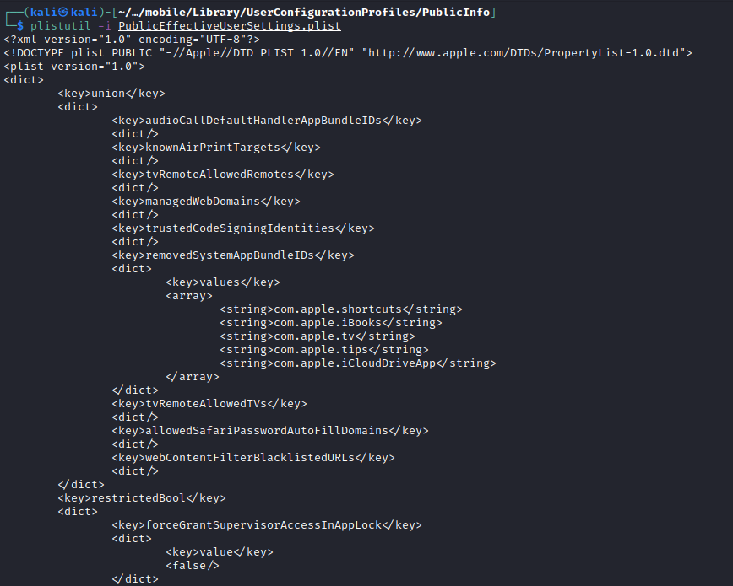
Examining System Settings (2)
Plistutil –I PublicEffectiveUserSettings.plist
Past this chunk of XML is where System Settings exist.

Slide 8
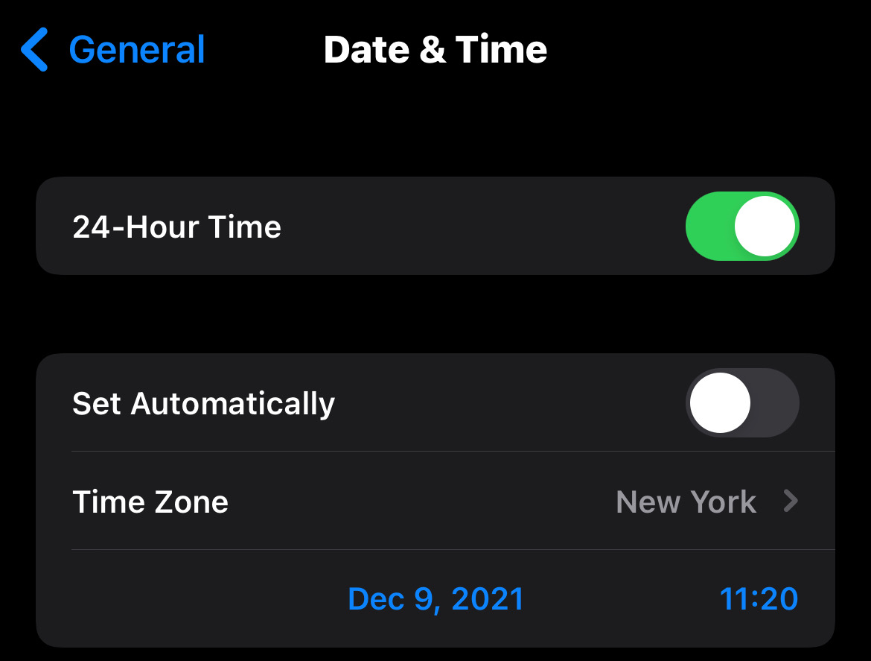

Examples from XML
Is time set to automatic detection?
Scroll down until you see this string.
Phone user did not have their time settings set automatically

Slide 9
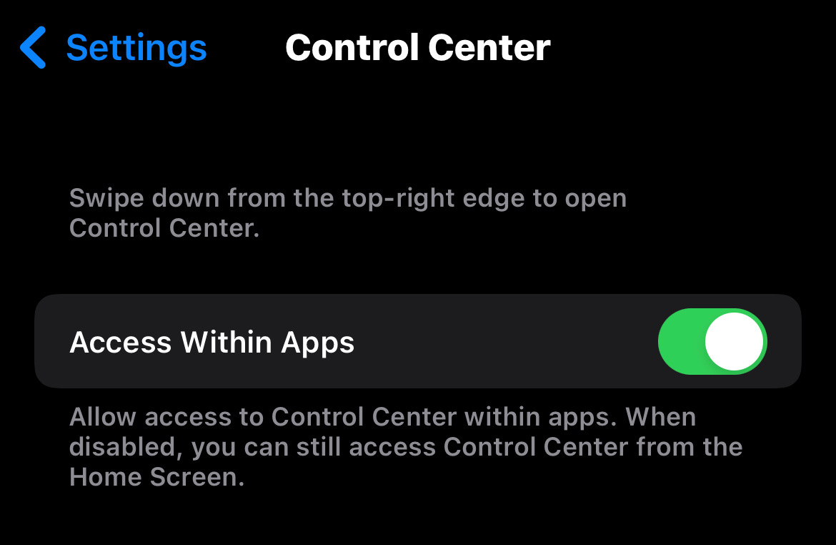

Examples from XML (2)
Is control center allowed in Apps?
Scroll down until you see this string.
Phone user allows the use of Control Center while in Applications.
Notes:
Add control center picture

Slide 10
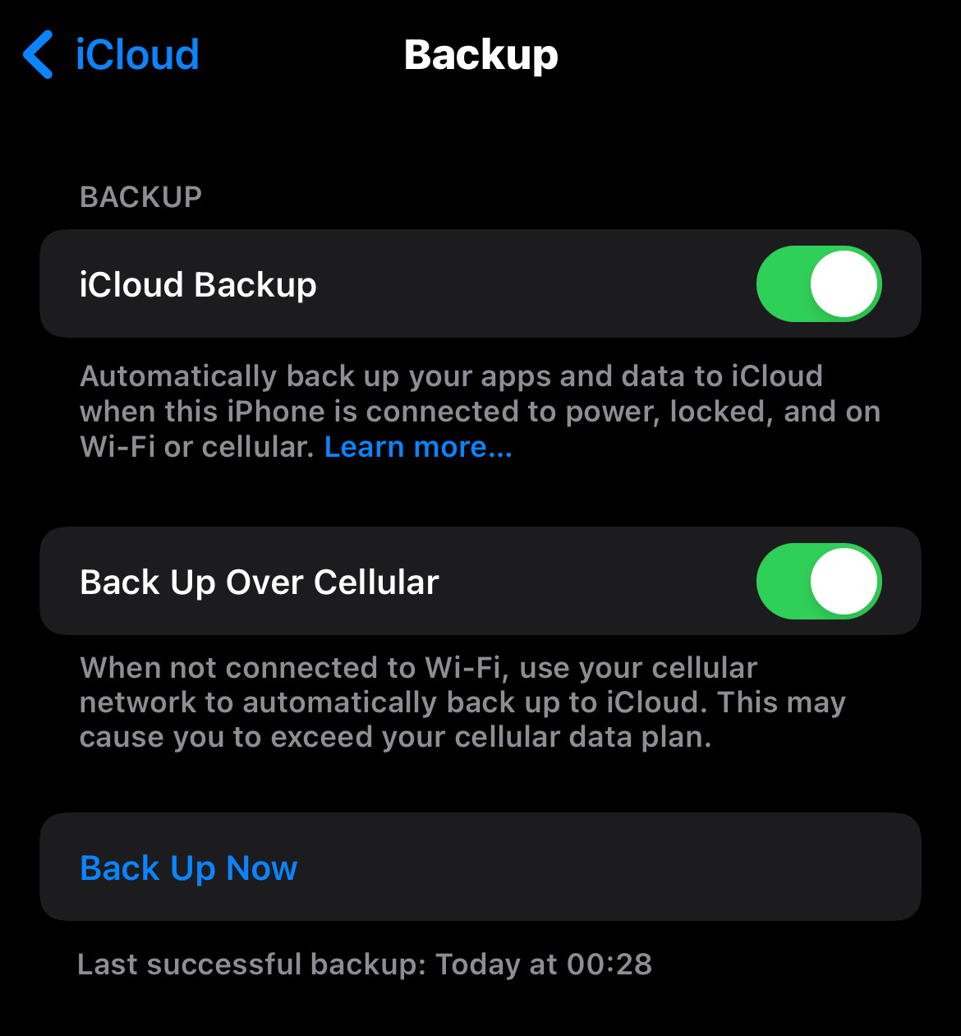

Examples from XML (3)
Are iCloud backups enabled?
Scroll down until you see this string.
Phone user has enabled iCloud backups.

Slide 11
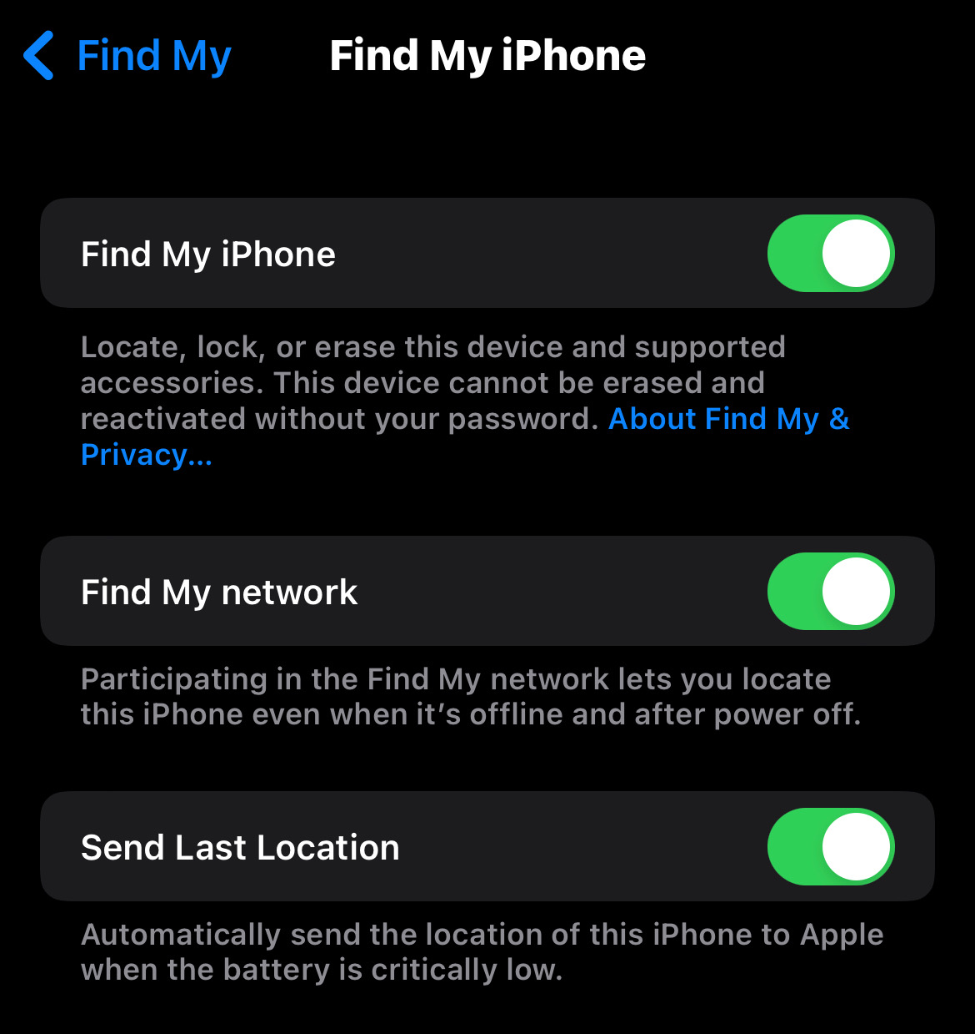

Examples from XML (4)
Is FindMyDevice enabled?
Scroll down until you see this string
Phone user has enabled Find My iPhone.

Slide 12
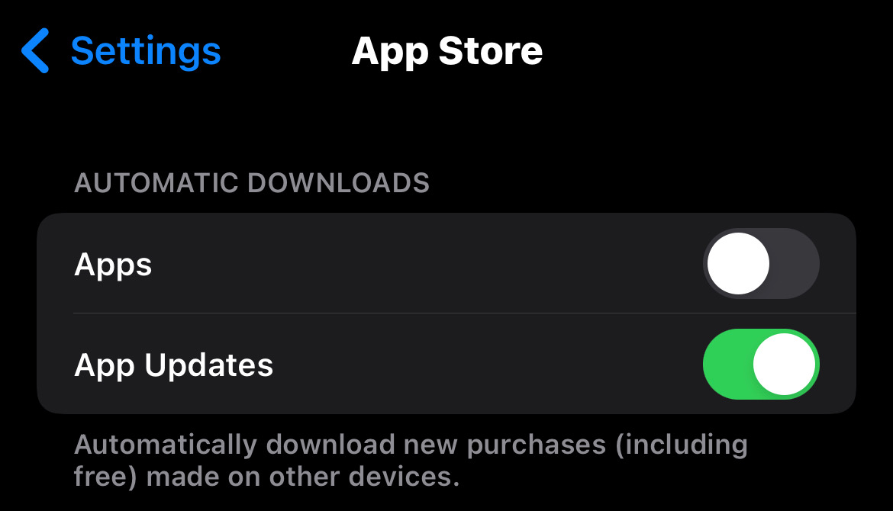

Examples from XML (5)
Are automatic app updates enabled?
Scroll down until you see this string
Phone user has enabled Automatic App Updates

Slide 13
Where are app related settings stored on iOS

Slide 14
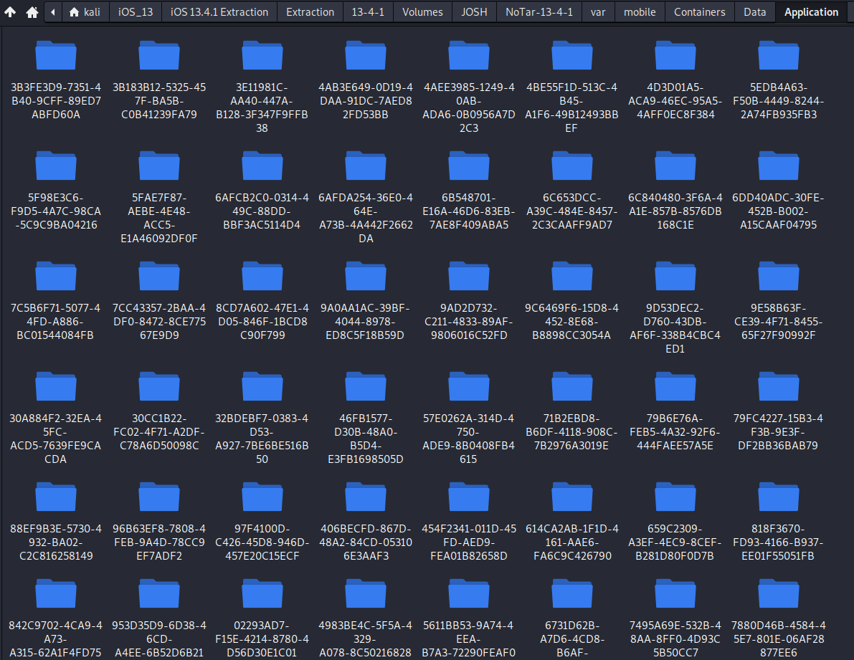
Where are settings stored from the different Apps on iOS?
Settings from the Settings Application may be found in plist xml format here:
~/var/mobile/Containers/Data/Application/<Application ID>/Library/Preferences

Slide 15
Quick word on the Application Sandbox
The folder from the previous slide is what is considered the Application Sandbox.
What is the Application Sandbox?
For security reasons, iOS places each app (including its preferences and data) in a sandbox at install time. A sandbox is a set of fine-grained controls that limit the app’s access to files, preferences, network resources, hardware, and so on. As part of the sandboxing process, the system installs each app in its own sandbox directory, which acts as the home for the app and its data.
The sandbox can minimize the damage that can be done from a potential hacker, but it can't prevent the attack from happening.
When an app is installed on a mobile device, the system creates a unique directory for it.
Sandboxing only prevents the hijacked app from affecting the other apps and other parts of the system.

Slide 16
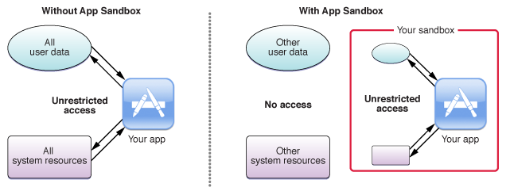
Visualization of the Application Sandbox

Slide 17
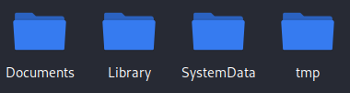
Inside a Sandboxed application
Inside any of the <Application ID> folders is the following folder structure:
Used to store user-generated content.
Folder for temporary files that user creates while using application
This is the top-level directory for any files that are not user data files.
Used to store non-removable files related to application.

Slide 18
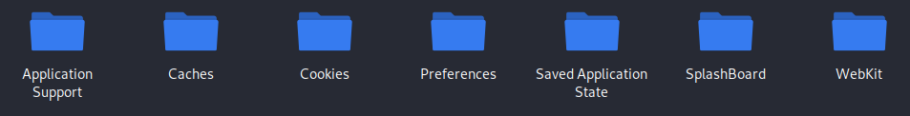
Locating Application Related Settings
Inside any of the <Application ID> folders, enter the Library Folder.
Inside the Library Folder, enter the Preferences Folder.

Slide 19
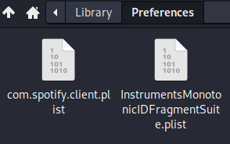
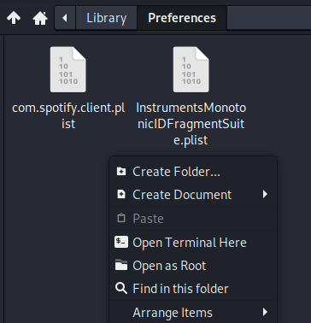
Locating Application Related Settings (2)
Inside the Preferences folder, there will be a plist file usually with a similar name to the application.
In this case, we are in the Spotify Application Folder
To examine, right click and open Terminal Here

Slide 20
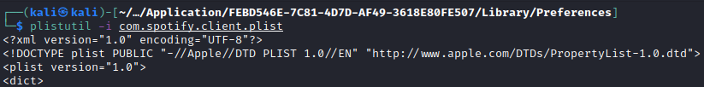

Analysis of Spotify Settings
Plistutil –I com.spotify.client.plist
What is the account name?
Scroll down until you see this string.
Account Name is “Thisisdfir”

Slide 21



Analysis of Instagram Settings
Plistutil –I com.burbn.threads.plist
What is the account name?
Scroll down until you see this string.
Username: “thisisdfir”
When was Instagram Installed?
Scroll down until you see this string.
Install date: 04-13-2020 19:30:04 UTC

