Slide 1
iOS Messages Investigation

Slide 2
Overview
Introduction to Messages App
Investigating Messaging Database

Slide 3
Introduction to iOS Messaging
SMS/MMS

Slide 4

Why it's important to investigate Messages
Messages are one of the most popular forms of communication
People use Messaging apps to share information
Messages may give the information about
Who sent it
Who received it
Timestamps
Message content

Slide 5
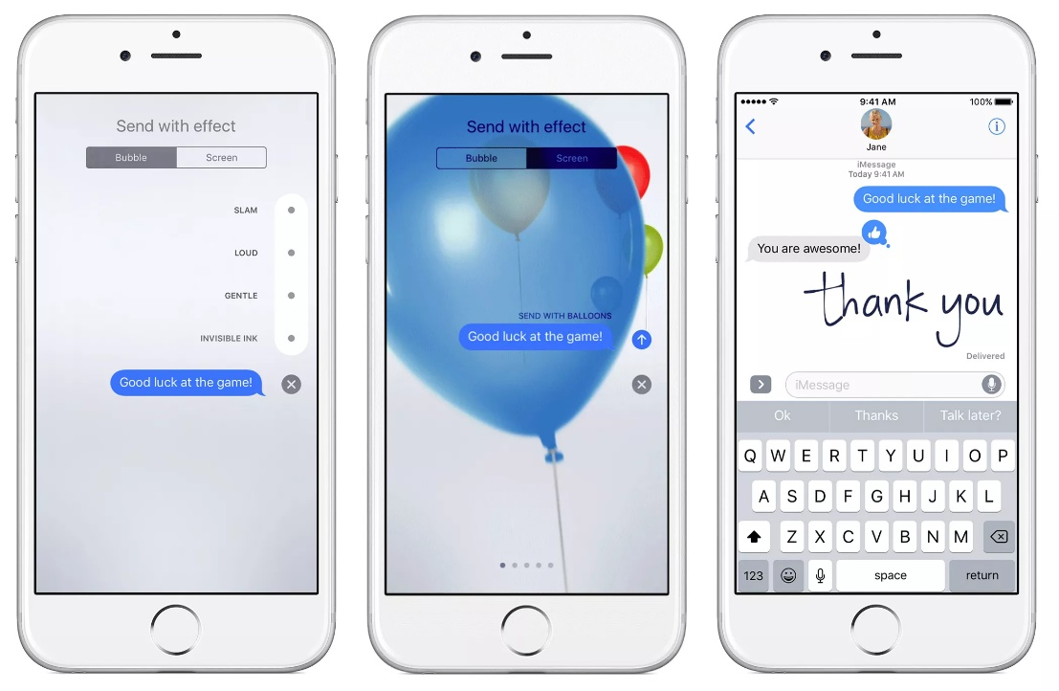
What is a messaging service?
SMS (short message service)
a text messaging service component of most telephone, Internet, and mobile device systems
MMS (Multimedia Message Service)
send multimedia content—pictures, video, and audio—in addition to text

Slide 6
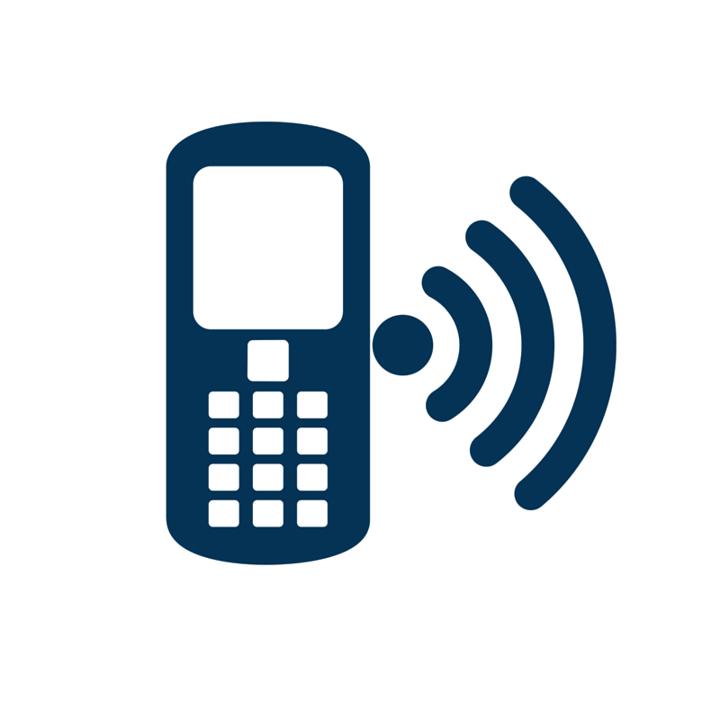

How Messages are sent/received
Message is routed through Cell Tower Network
Sending Device
Receiving Device

Slide 7
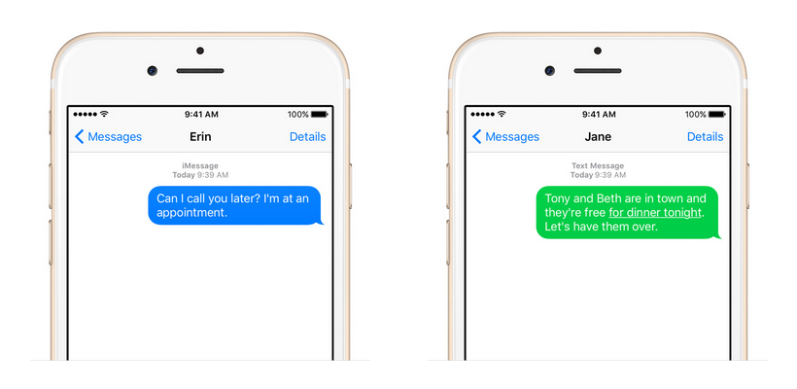

What is iMessage?
Messages is the default texting app for iOS on any iPhone, iPod touch, and iPad. It lets you do all the basic things you'd expect: Send texts, photos, emojis, and all the other standard texting stuff.
On the other hand, iMessage is an Apple-specific set of features and tools that are built on top of Messages. The advanced features used in Messages come from iMessage. You can use other apps to send texts from your iPhone, but if you want to use all of iMessage's features, your only option is to use the Messages app.

Slide 8
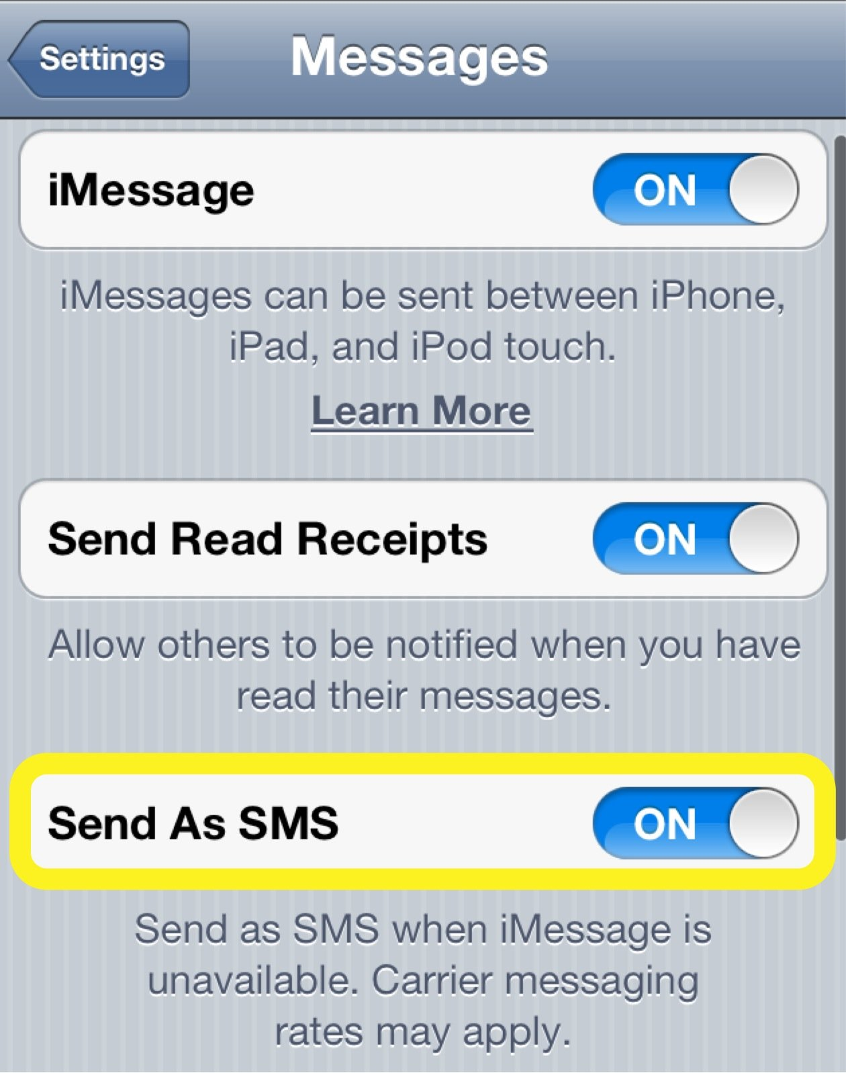
What is iMessage? (2)
The iMessage service works on all devices that run iOS 5 and higher, including the iPod touch and iPad. It's also built into the Messages app that comes with all Macs running Mac OS X 10.7 and later.
The Messages app lets you text anyone whose device can receive standard text messages, including people using Android and other phones. If those people don't have iMessage, though, they won't be able to use any of iMessage's features. Any iMessage-specific things you send, like animations, won't work on their devices.

Slide 9
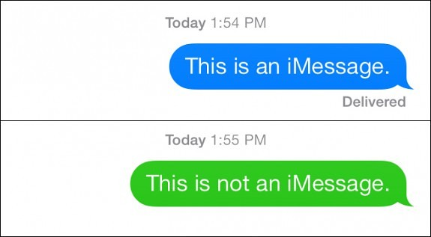
Differences between iMessage and SMS
iMessage
SMS
Your word balloons are blue.
The Send button is blue.
The text-entry box reads iMessage before you've typed in it.
Depending on the recipient's read-receipt settings, some iMessage's will also say Delivered beneath them.
Green word balloons.
A green Send button.
The text-entry box reads Text Message before you've typed in it.

Slide 10

Investigating Messages Database
SMS/MMS

Slide 11
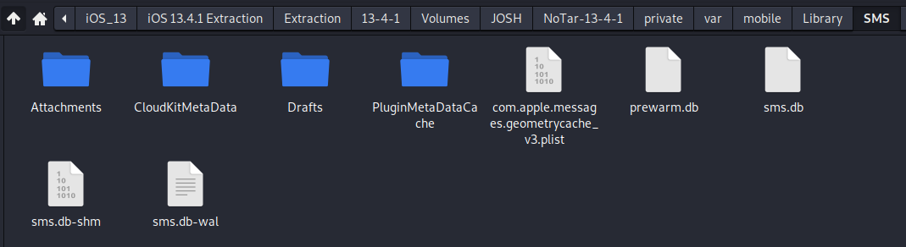
How iOS stores Messages from Messages App
iOS stores Messages in an SQLite database file located here ~/private/var/mobile/Library/SMS/sms.db
Attachments as well as Drafts (typed out but unsent) messages also are stored here.

Slide 12
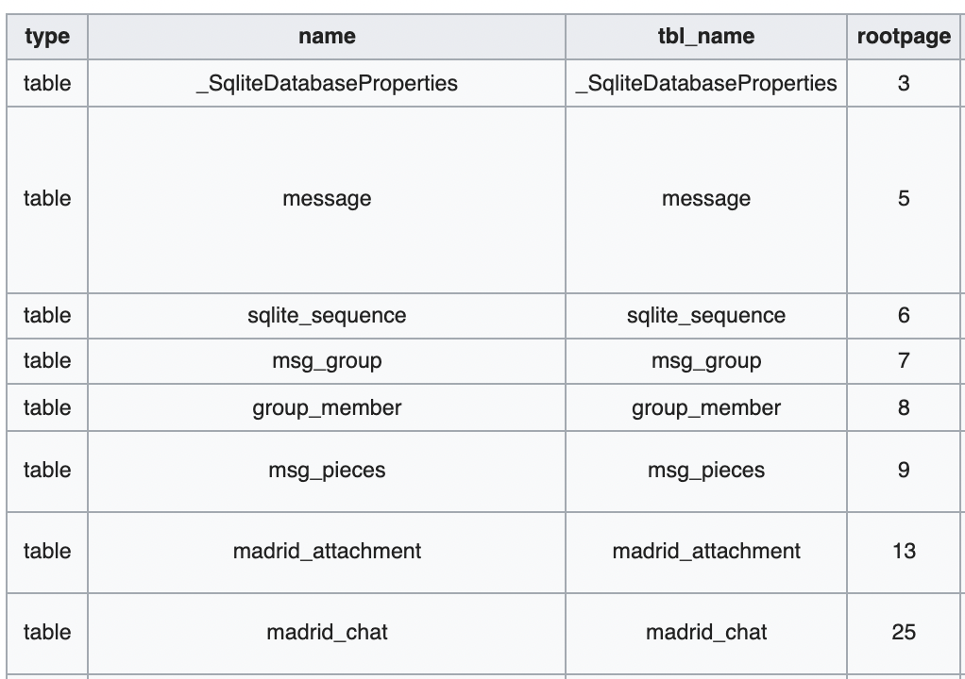
Database Structure
sqlite_sequence
_SqliteDatabaseProperties
msg_group
group_member
message
msg_pieces
madrid_attachment
madrid_chat

Slide 13
Important Tables
message | This is the main table where all messages are stored.
msg_group | This defines a chat (SMS/text/message) conversation group.
group_member | This defines the member of the chat (SMS/text/message) conversation group. As you currently cannot define groups, there is always only one member in each group, so the group_id and ROWID values match.
msg_pieces | This table contains information about MMS objects.

Slide 14
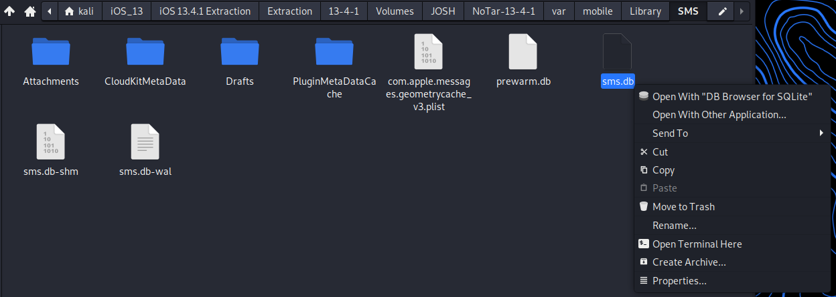
Viewing sms.db
Right click on sms.db and open with DB Browser for SQLite

Slide 15
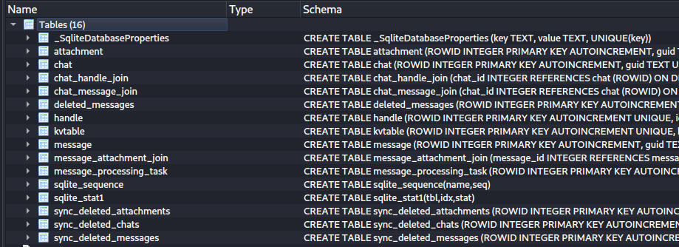
Viewing sms.db (2)
Once in the SQLite Browser, we can see all the data tables. To view a table right click on it and select “View Table”

Slide 16
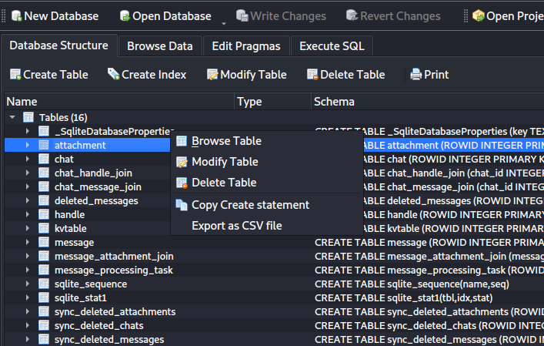
Viewing sms.db (3)
Select the attachment table, right click and select browse table.
The attachment table shows a list of all attachments sent via the native Messages app.

Slide 17
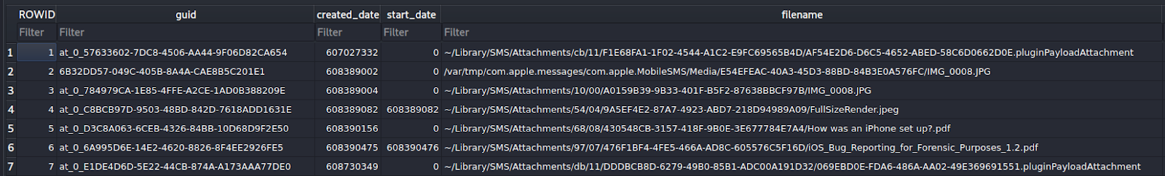
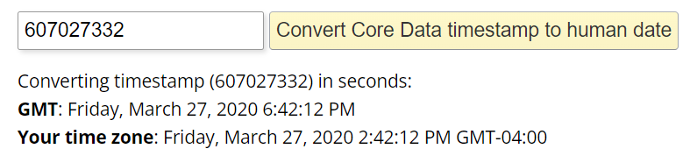
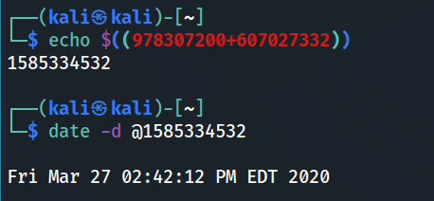
Attachment Table
Created Date, in Apple Cocoa Core Date.
File name + Path stored on phone.
978307200=Core Date 2001/01/01 – epoch date 1970/01/01
Notes:
echo $((978307200+607027332))
date -d @1585334532
https://www.epochconverter.com/coredata

Slide 18
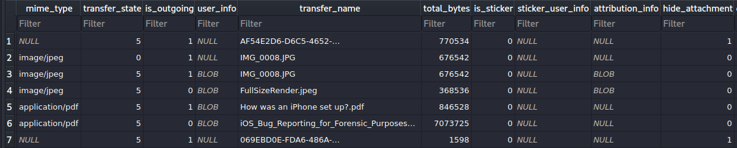
Attachment Table (2)
Was sent by user = 1
Was received by user = 0
Was deleted = 1
Not deleted = 0
Image extension type
Attachment Name
File size (in bytes)

Slide 19
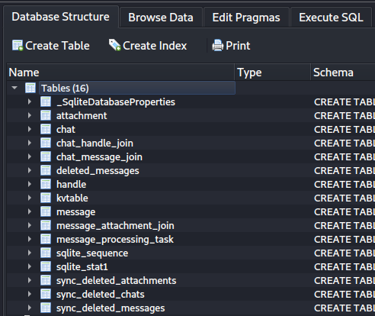
Chat Table
Move back to Database Structure tab by clicking on the Database Structure tab.
Select and right click Browse table on the chat table.
The chat table shows conversation by threads.
Conversation threading is how messages are organized on iOS.
This method of sorting allows for all messages exchanged by a sender and receiver to be stored in 1 place.

Slide 20
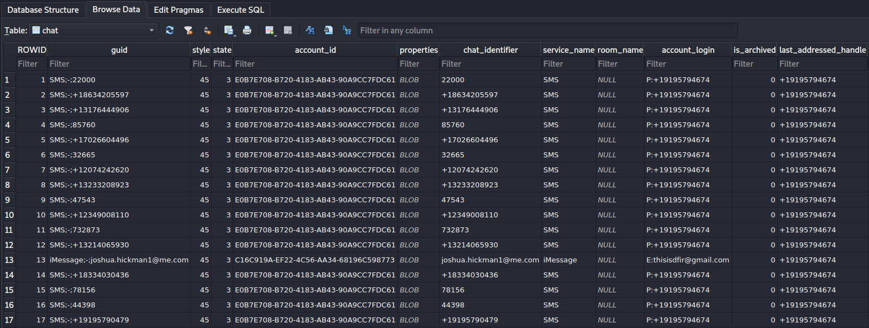
Chat Table (2)
Chat name (Usually shows contact name if saved)
Recipient
Service type SMS or iMessage
Sender Phone # or email

Slide 21
Message Table
Move back to Database Structure tab by clicking on the Database Structure tab.
Select and right click Browse table on the message table.

Slide 22
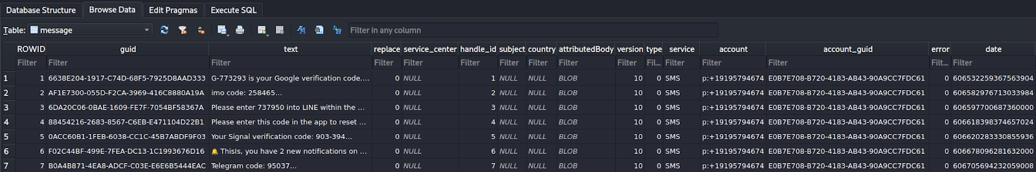
Message Table (2)
Receiving timestamp Apple Core Cocoa Date
Sender ID, reference chat table ROW ID column
Message content
Receiving account

