Slide 1

Investigating Contacts, Voicemails, and Call Logs
iOS 13

Slide 2
Overview
Background
Investigating Contacts
Investigating Call logs
Investigating Voicemails

Slide 3
Why it's important to investigate contacts, call logs & voicemails?
Contacts: Understanding who the device owner communicates with.
Contact profile
Groups information
Call logs: Understanding owner’s call history
Who made the call
Was it received or not
Duration of the call
Voicemails: Know who contacted the owners and left a message.
Who left the message
Content of the message can be recovered and/or transcribed.

Slide 4

Investigating Contacts Information

Slide 5
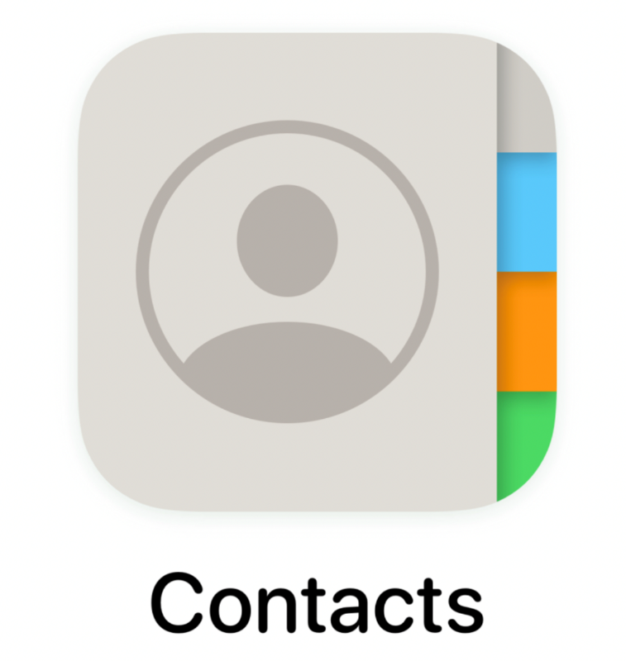
What is Contacts?
Keeps your contacts organized and up to date
View your contacts by account (e.g., work vs. personal)
Easily add contacts and edit information like phone numbers, emails, and photos
Get suggestions for adding new contacts.
Back up your contacts and sync them across all your devices
Safely back up the contacts on your device to the cloud
Access the contacts in your iCloud account from any device
Evidence types
Contact info such as name, emails, phone numbers, etc.…

Slide 6
What information does a contact consist of?
Phone number,
Mobile & Work phone
Display name
Nickname
Company
department, title, Website, etc.
Email
Email type (home, work, mobile, other)
Instant message
Messenger, Teams, Facebook, Etc.
Address
address type ( home, work, other)
Photo
Website
url, website type
Notes

Slide 7
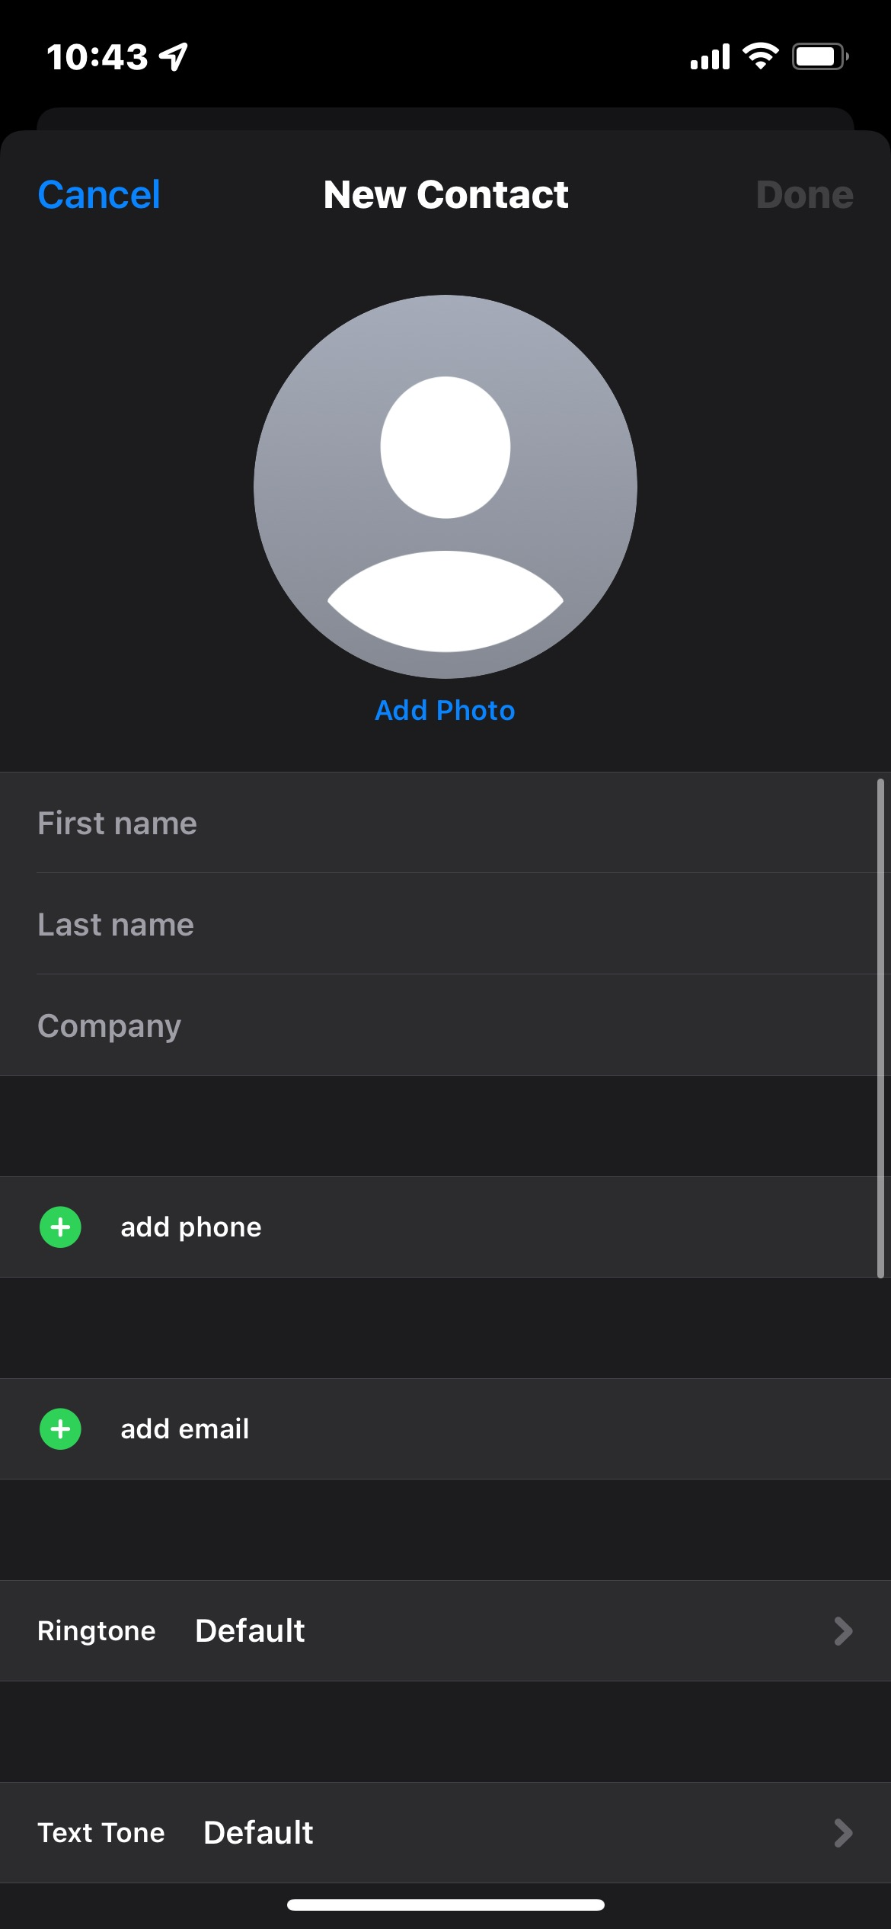
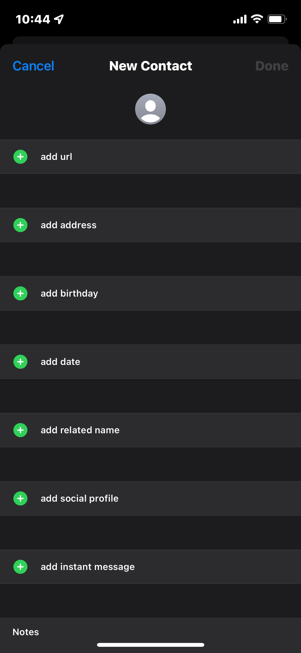
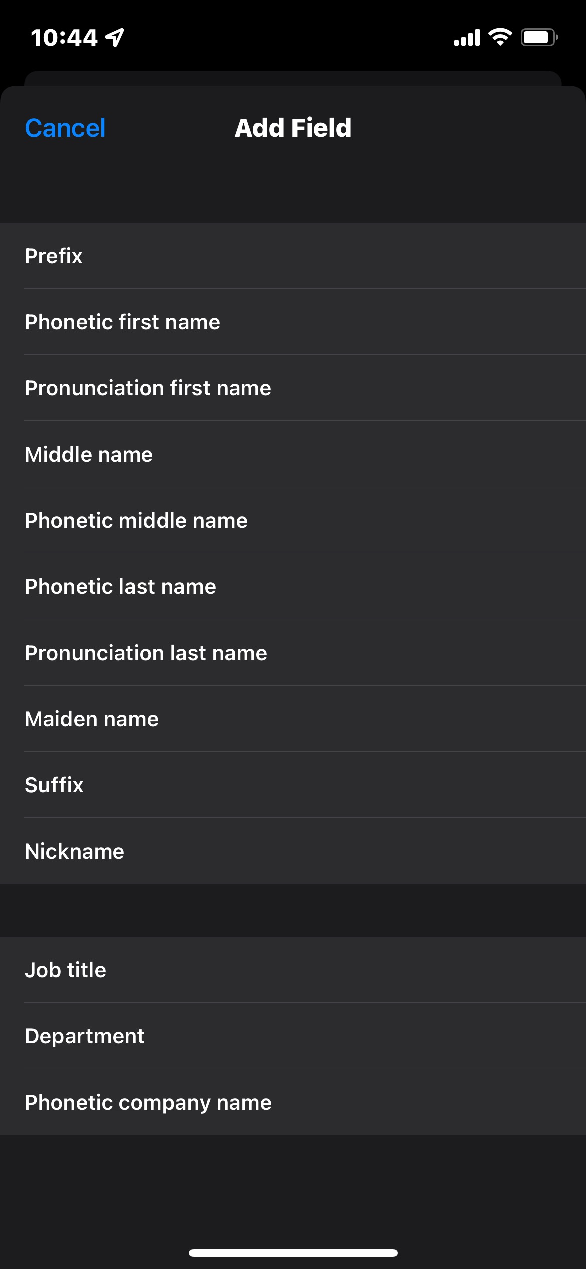

Slide 8
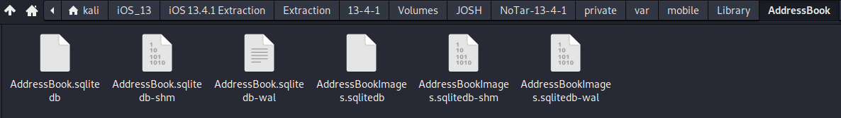
Understanding the Contacts database and tables
Located at ~/var/mobile/Library/AddressBook
Right click on AddressBook.sqlitedb and open with DB Browser for SQLite
The address book will contain all personal contact information of the user, except for those from a third-party application.
Notes:
Cmd: sqlitebrowser 'Pixel 3/data/data/com.android.providers.contacts/databases/contacts2.db’
https://www.dev2qa.com/android-contacts-database-structure/

Slide 9
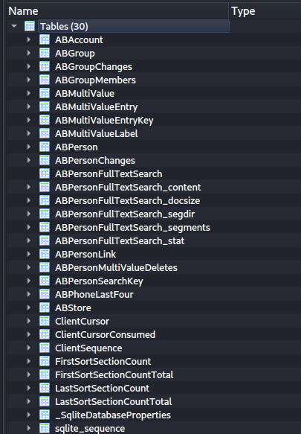
Stores account identifying information.
Stores group information.
Stores the extended information from the ABPerson table like email address, phone numbers, website URL etc. The ABMultiValue tables uses a file named record_id that is linked with the row_id file of the ABPerson table.
Stores details like name, notes, and organization.
Stores contacts based on last 4 digits of phone number

Slide 10
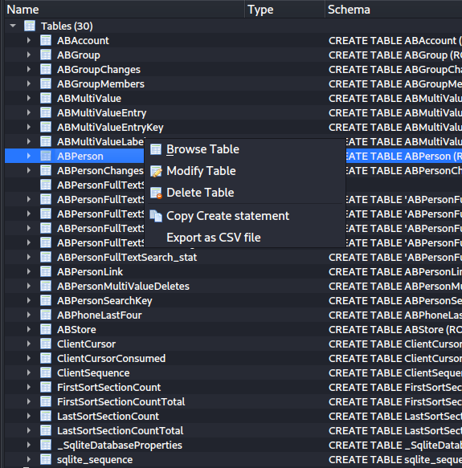
Examining the ABPerson table
Select the ABPerson table, right click and select Browse Table.
The table stores details like name, notes, and organization. The row_id # is linked to the ABMultiValue table’s record_id

Slide 11
Examining the ABPerson table (2)
Modified Date (Apple Cocoa Core) Timestamp
First & Last Name of Contact
Additional descriptive fields but blank
Creation Date (Apple Cocoa Core) Timestamp
Row_ID

Slide 12
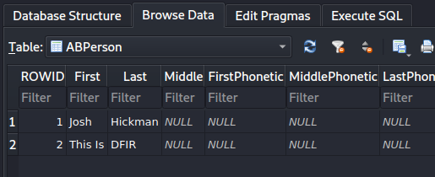
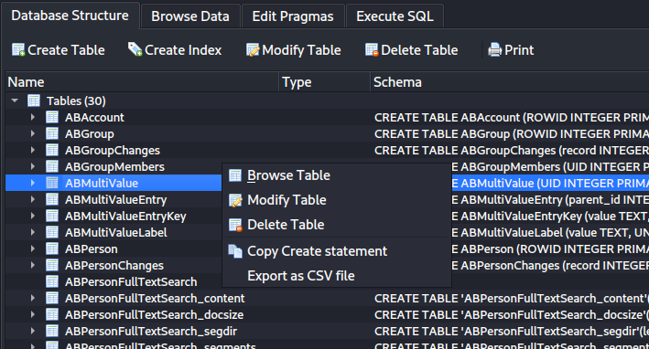
Examining the ABMultivalue Table
Return back to the Database Structure tab by clicking on it
Select ABMultiValue table and right click Browse Table.

Slide 13
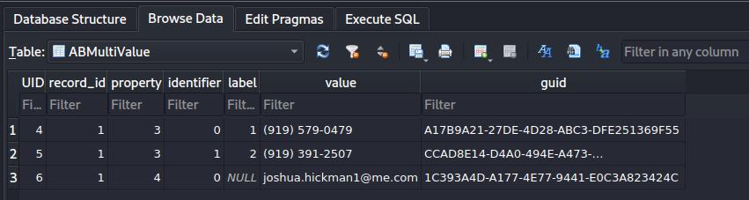
Examining the ABMultivalue Table (2)
Record_ID that references Row_ID in ABPerson Table.
Value, either Phone Number or Email

Slide 14
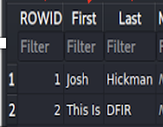
Comparison Between Tables
We can see the the row_id from the ABPerson table and record_id from the ABMultivalue table match.
Therefore, all of the values on the ABMultivalue table belong to Josh Hickman.

Slide 15

Investigating Call History Information

Slide 16
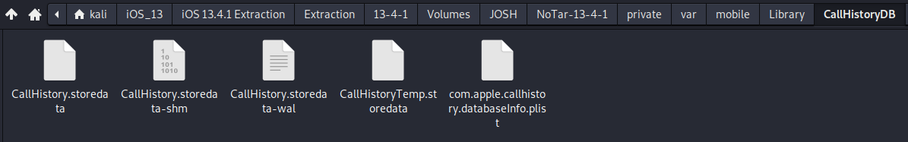
Understanding the call history database and tables
Located at ~/var/mobile/Library/CallHistoryDB
Received, dialed, or missed call details of the user’s iPhone gets saved into this SQLite database along with the metadata like date, time, call duration, etc.
Right click on CallHistory.storedata and open with DB viewer for SQLite

Slide 17
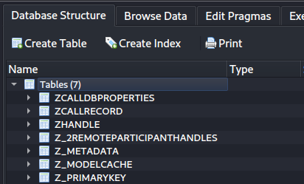
Call History Database Structure
Record of total minutes spent on phone calls, incoming and outgoing.
Main table where call history and metadata is stored.

Slide 18
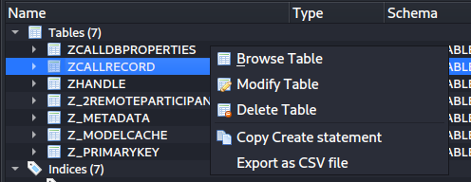
Examining ZCALLRECORD Table
Select the ZCALLRECORD table, right click and select Browse Table.
In this table, only the details of 100 of the latest calls will be stored. Older entries will be removed from the record.

Slide 19
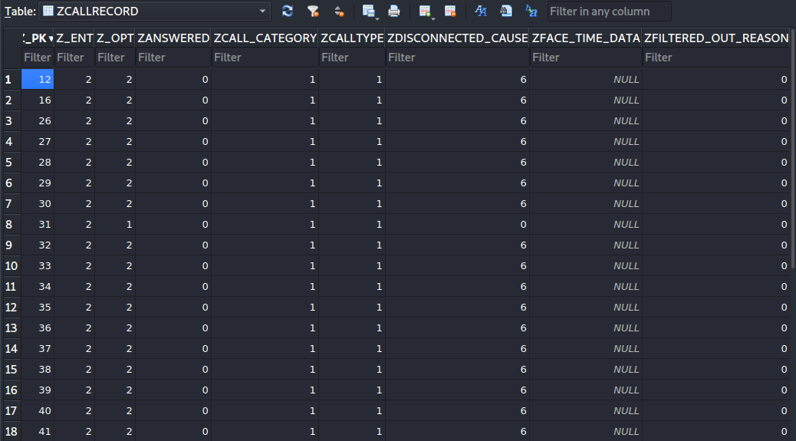
Examining ZCALLRECORD Table (2)
Was the call answered? 0=False
1=True
Call Type; 1 = Regular Call
8 = Facetime
Category; 1 = Regular Phone Call
2= Facetime

Slide 20
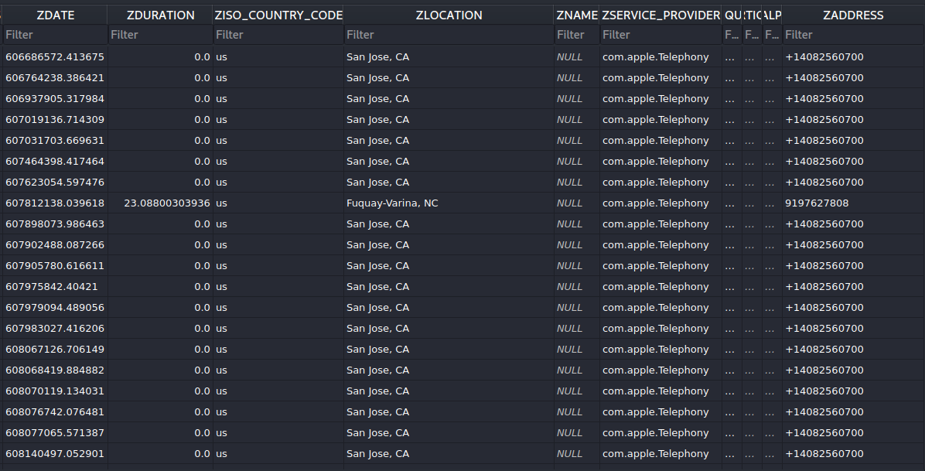
Examining ZCALLRECORD Table (3)
Bundle ID of “Phone” app, Facetime = com.apple.Facetime
Timestamp of call, Apple Cocoa Core Timestamp
Call Duration, in seconds, milliseconds
Country code of incoming/outgoing call
Area Code Location
Name, always blank
Phone number of Incoming/Outgoing

Slide 21

Investigating Voicemails

Slide 22
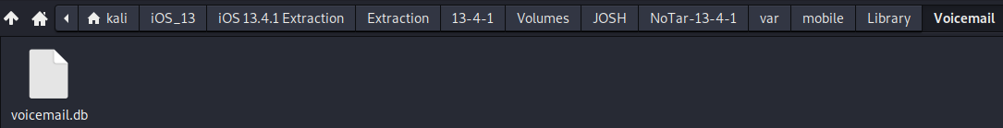
Understanding the Voicemail database and tables
Located at ~/var/mobile/Library/Voicemail
Missed incoming calls who leave messages will be stored here, information like date/time, callback number, duration of message are stored here.
Right click on voicemail.db and select open with DB viewer for SQLite.

Slide 23
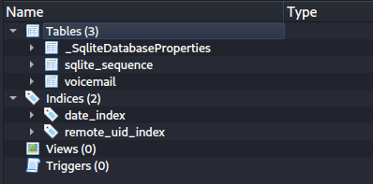
Investigating voicemail table
Voicemail data is stored in the voicemail table
Right click on the voicemail table and select Browse Table.

Slide 24
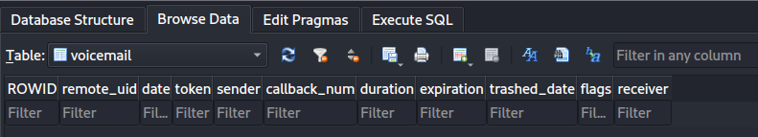
Investigating voicemail table (2)
Phone user has no voicemails
Received date (Apple Cocoa Core Timestamp)
Duration of Voicemail, in Seconds, Milliseconds
Caller’s Number

