Slide 1

Calendar Investigation
iOS 13

Slide 2

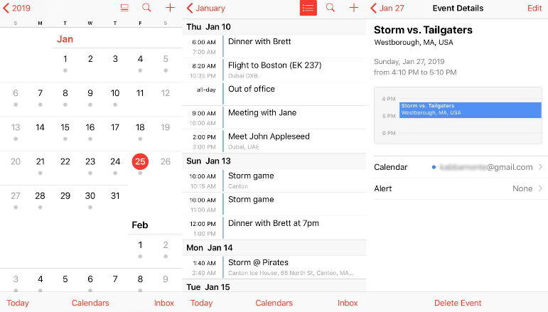
What is the Calendar application
Calendar is a tool to keep track of:
Appointments
Events
Birthdays
Evidence types include:
Events
Reminders

Slide 3
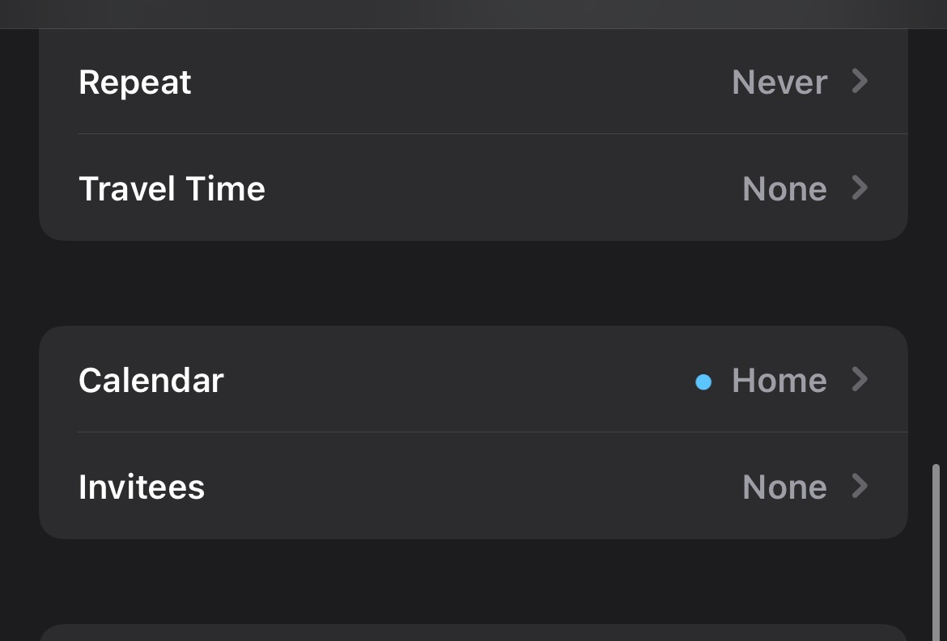
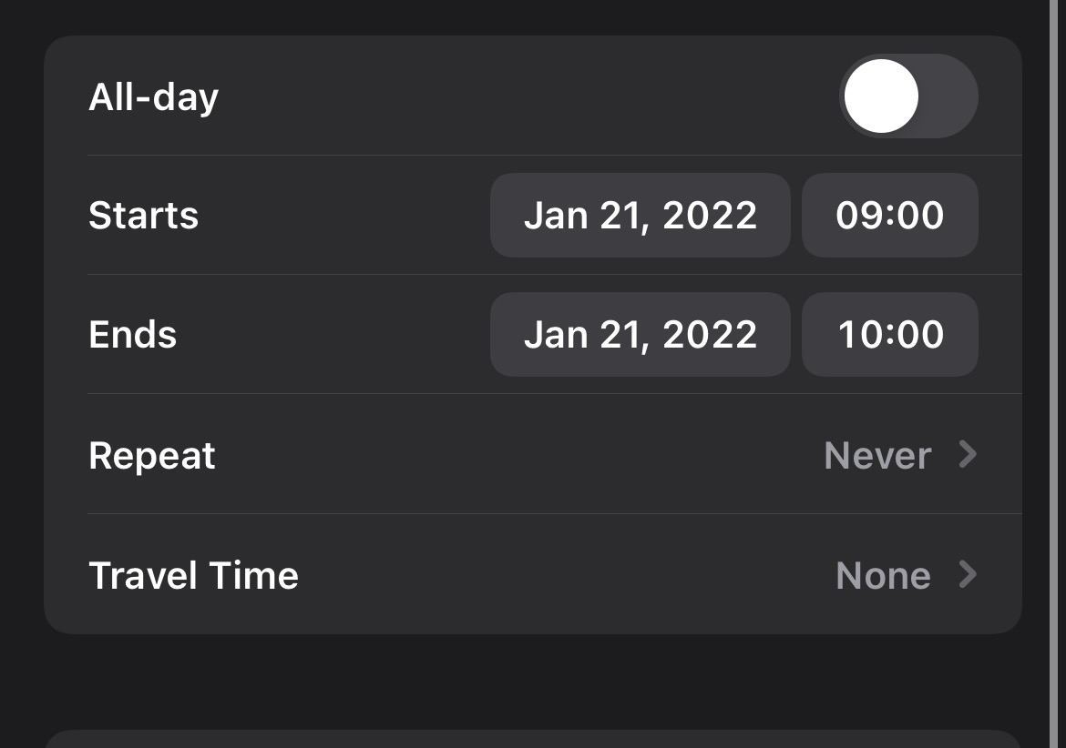
Calendar Fields

Slide 4
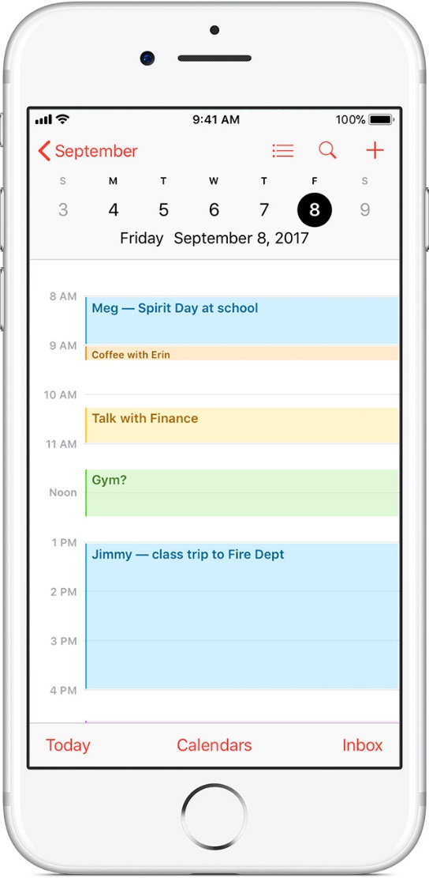
Why is it important to investigate calendar evidence?
Calendar saves the information about the appointments, events etc.
It can give the information about:
Date/time of appointments
Place of appointment
Events created
Attendees

Slide 5
Note
Calendar app can be very useful in an investigation but in this example, there is not a lot data to look at in any of the tables.
In the future, you may use this approach to look through the suspect's calendar data.

Slide 6

Calendar scenario
Assume that suspect added an event along with the attendees for any date and added a reminder about that event
Questions
What is the date of the scheduled event?
Who are the attendees?
For which date is the reminder set?
Are there any other events saved by the suspect?

Slide 7
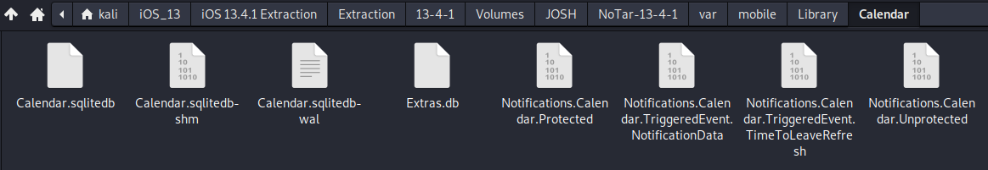
Step 1: Find the location of the evidence
Located at ~/var/mobile/Library/Calendar
This database holds information related to events available in Calendar.
This database holds information like calendar settings or details related to particular calender events.
Notes:
Cmd: tree 'Pixel 3/data/data/com.android.providers.calendar' -L 1

Slide 8
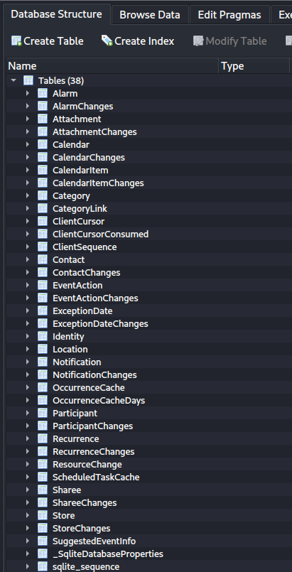
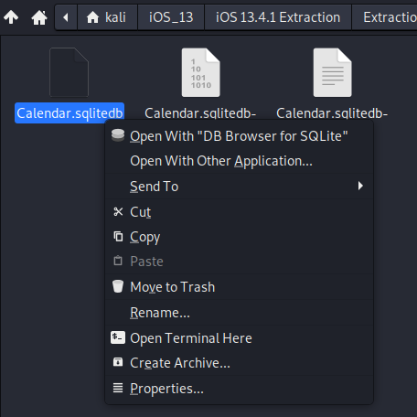
Step 2: Examine the Calendar database
Right click on Calendar.sqlitedb and open with DB Browser for SQlite
Tables to focus: Attachment, Calendar, CalenderItem Location, Participant.
In this case there isn't any data to look at in any of the tables.

Slide 9
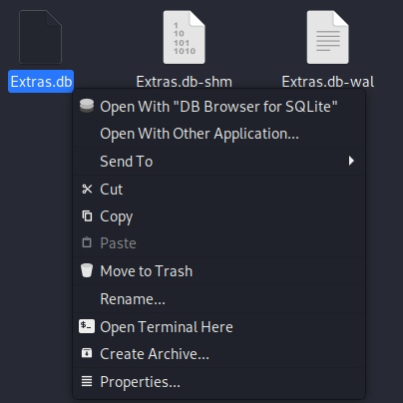
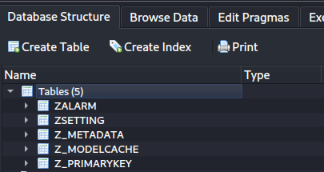
Step 3: Examine the Extras database
Right click on Extras.db and open with DB Browser for SQlite
In this case there isn't any data to look at in any of the tables.
But typically, this database holds extra Data for the main Calendar database

Slide 10

Solutions
What is the date of the scheduled event?
CalendarItem table
Who are the attendees ?
Participant table
For which date is the reminder set?
CalendarItem table
Are there any other events saved by the suspect?
Calendar table

Slide 11

To summarize
Understand the application
Locate the Calendar directory
Examine the Calendar databases
Open calendar.sqlitedb and Extras.db
Explore these tables: Attachment, Calendar, CalendarItem, Location, and Participant.

