Slide 1
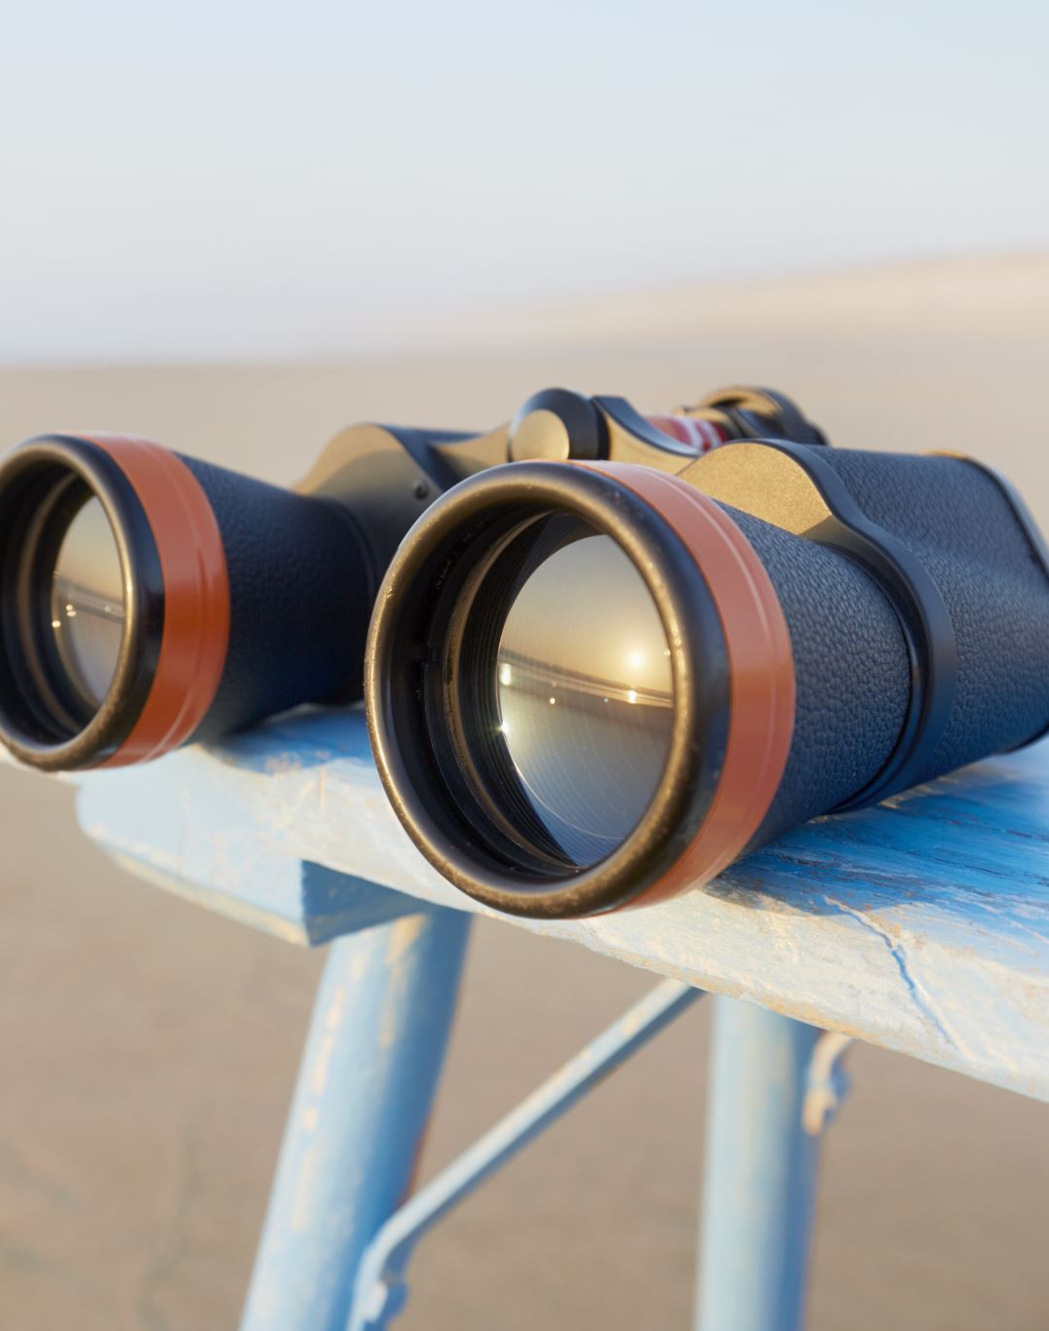
Safari Investigation
iOS 13

Slide 2
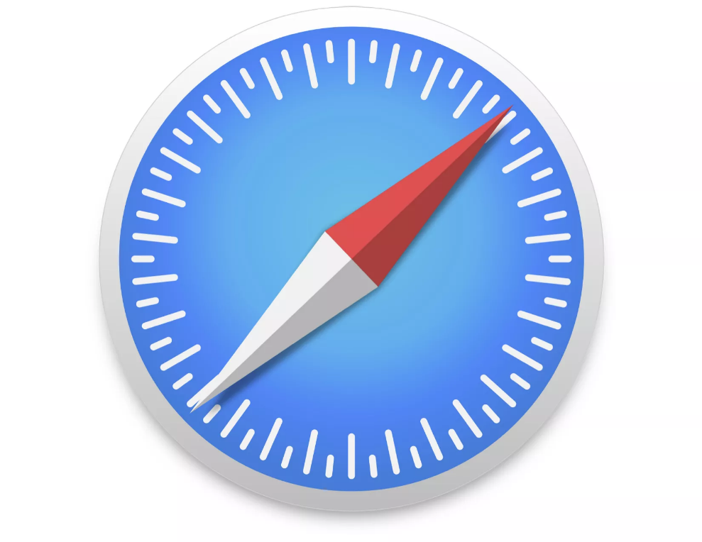
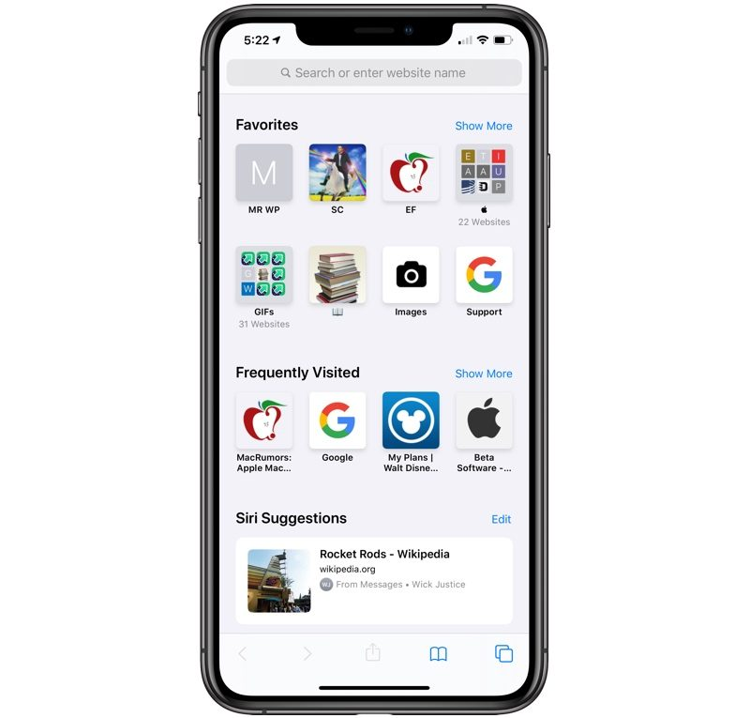
What is Safari?
The Safari web browser is the default web browser for the iPhone, iPad, and macOS, first released by Apple in 2003.
The popularity of the Safari browser exploded with the iPhone and the iPad, and currently has about a 54% market share of mobile browser usage in the United States.

Slide 3
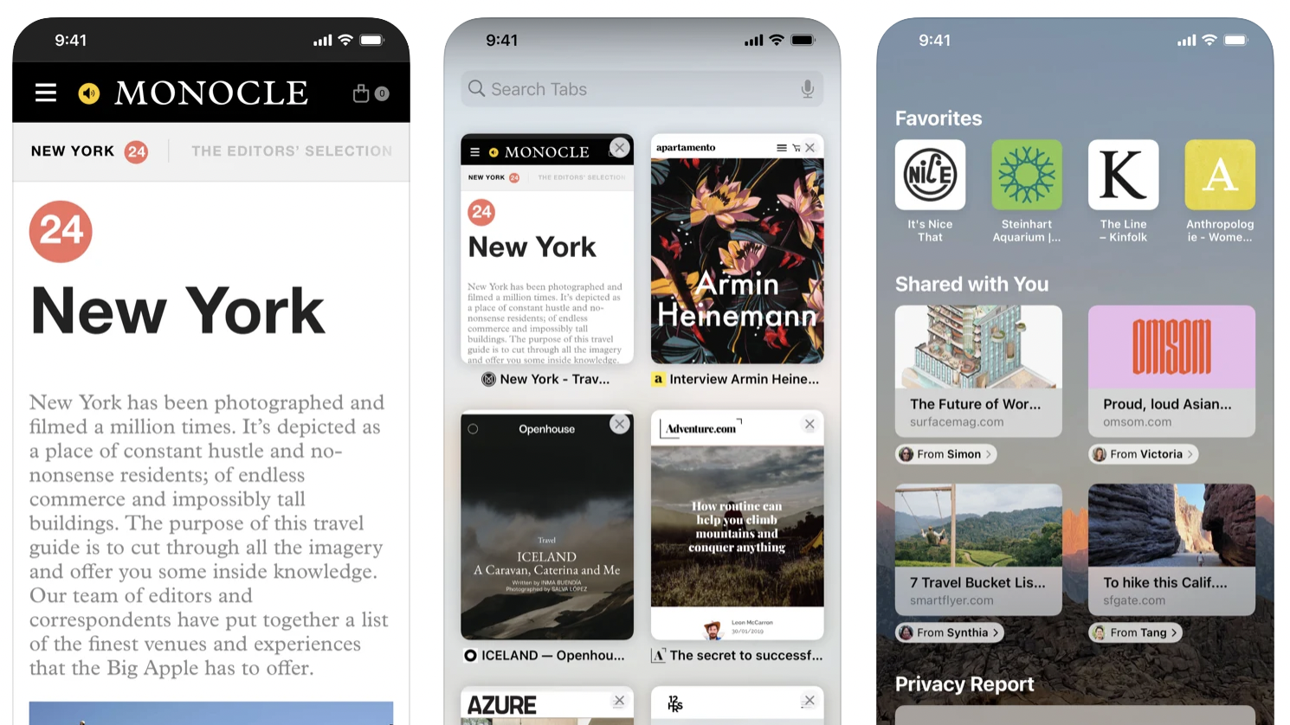
Notes:
https://apps.apple.com/us/app/safari/id1146562112

Slide 4
Where does evidence come from?
Generated by Safari
Bookmarks
Browser State
Browser History
Search History

Slide 5
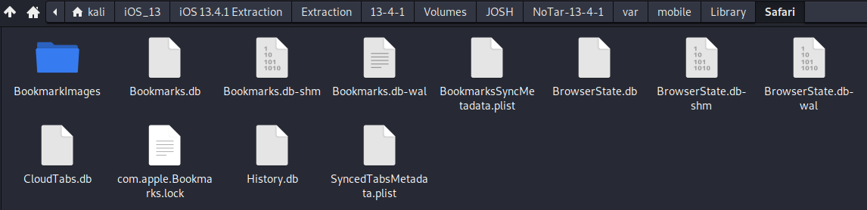
How to find evidence generated by Safari?
Located in an SQLite Database format at ~/var/mobile/Library/Safari

Slide 6
Breakdown of important databases
Bookmarks.db – Safari bookmarks, i.e., saved URLS.
Browserstate.db – Stores active browser tabs in the order they were opened
Cloudtabs.db – Stores browser tabs to be carried onto another apple device.
For context - This feature automatically syncs open tabs across devices with the same iCloud account. For example, you can view a list of all tabs open on your MacBook while using Safari on the iPhone or iPad.
History.db – Stores browser history, can be cleared if user clears history.

Slide 7
Safari Scenario
Assuming that the suspect does not clear history on their phone.
What did the suspect search on google?
At what time did the suspect execute those searches?

Slide 8
Scenario Step by Step
Step 1: Find the database where browser history is stored
Step 2: Find the table contains the browser history data
Step 3: Find the column contains the search data
Step 4: Find the timestamp data in the nearby cell and convert

Slide 9
Step 1: Find the database where browser history is stored
Right click, open with DB Browser for SQLite on History.db

Slide 10
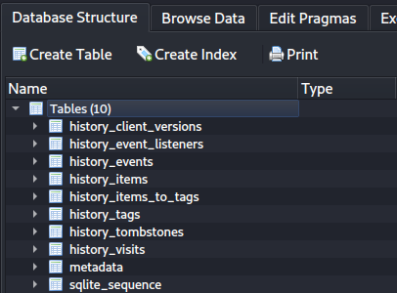
Step 2: Find the table that contains browser history with timestamps
Table contains browser history
Right click, Browse table on history_visits

Slide 11
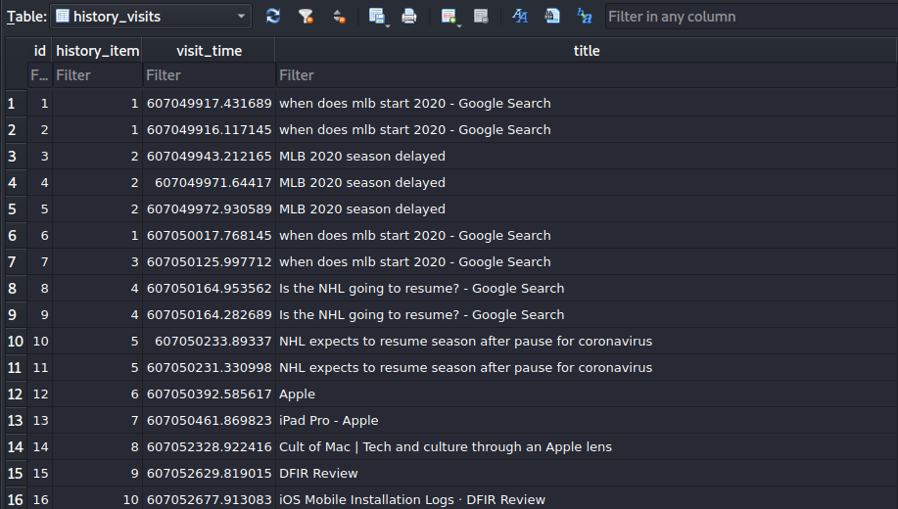
Step 3: Find the column that contains browser history along with the timestamp
Visit timestamp
Webpage title
Google Searches, searches are marked with –Google Search

Slide 12
Step 4: Compile and convert
Google Search | Timestamp | Converted Timestamp
When does MLB start 2020 | 607049916.117145 | GMT: Saturday, March 28, 2020 12:58:36 AM
When does MLB start 2020 | 607049917.431689 | GMT: Saturday, March 28, 2020 12:58:37 AM
When does MLB start 2020 | 607050017.768145 | GMT: Saturday, March 28, 2020 1:00:17 AM
When does MLB start 2020 | 607050125.99771 | GMT: Saturday, March 28, 2020 1:02:05 AM
Is the NHL going to resume? | 607050164.953562 | GMT: Saturday, March 28, 2020 1:02:44 AM
Is the NHL going to resume? | 607050164.282689 | GMT: Saturday, March 28, 2020 1:02:44 AM
https://www.epochconverter.com/coredata

Slide 13
Scenario conclusion
We can determine that the phone user searched two strings, When does MLB start 2020 & Is the NHL going to resume? Between 12:58am and 1:02am 3/28/2020 GMT.

Slide 14
Investigating Bookmarks.db
Right click, open with DB Browser for SQLite on Bookmarks.db

Slide 15
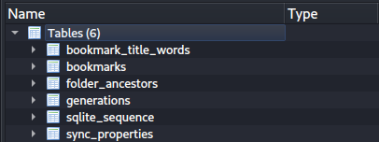
Find the table that contains Bookmarks
Table contains bookmarks
Right click, Browse table on bookmarks

Slide 16
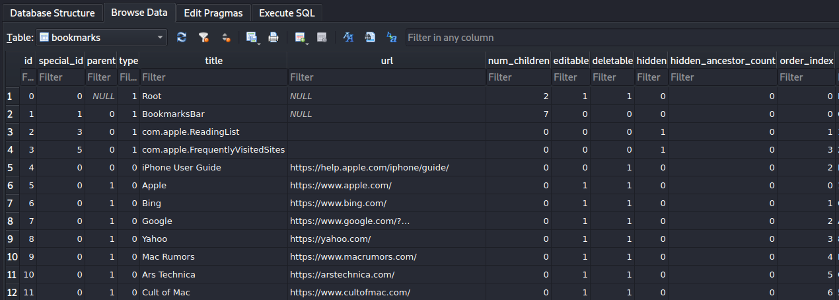
Examining Bookmark Table
Type; System related = 1
Not System related = 0
Bookmark Name
URL attached to Bookmark
Deletable = 1
Not Deletable = 0
Hidden from user = 1
Not hidden from user =0

Slide 17
Investigating BrowserState.db
Right click, open with DB Browser for SQLite on BrowserState.db

Slide 18
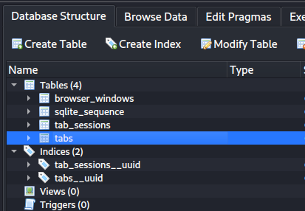
Find the table that contains Browser Tab Info
Table contains information on Browser Tabs
Right click, Browse table on tabs

Slide 19
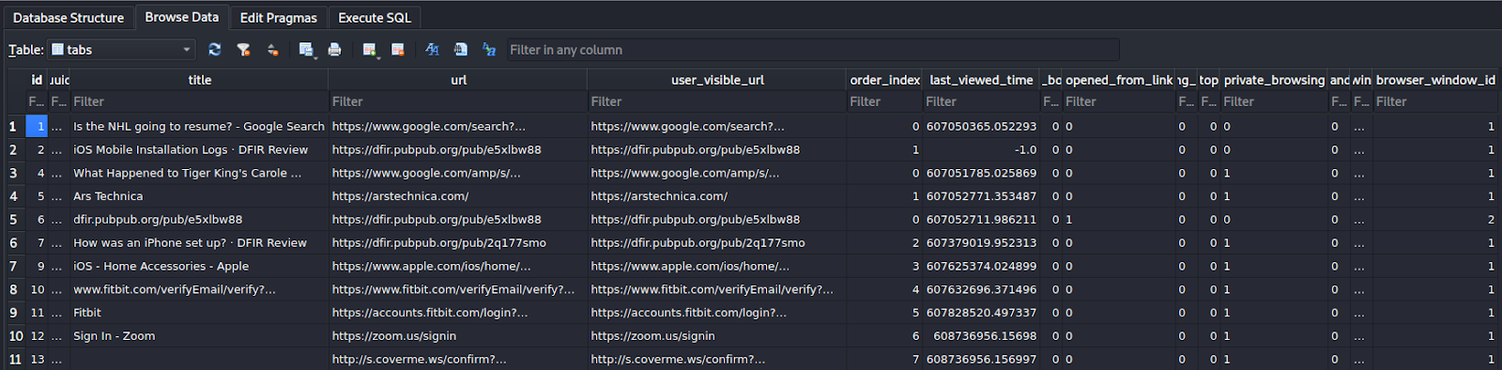
Examining Browser Tabs Table
Viewed in Private browser/ No saved history
Timestamp of last visit
Opened from Link/re-direct
Webpage Title
Website URL
URL user sees

Slide 20
Investigating Cloud Tabs
Right click, open with DB Browser for SQLite on CloudTabs.db

Slide 21
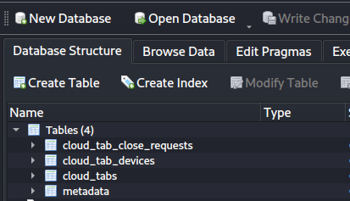
Find the table that contains Cloud Tab Info
Table contains information on Cloud Tabs
Right click, Browse table on cloud_tabs

Slide 22
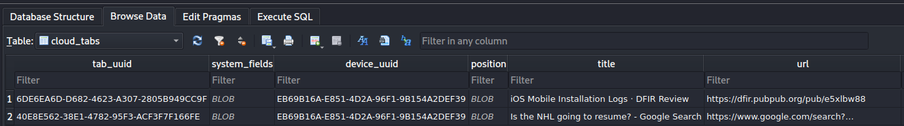
Examining Cloud Tabs Table
Originating Device UUID
Webpage Title
Webpage URL

